Slide 1
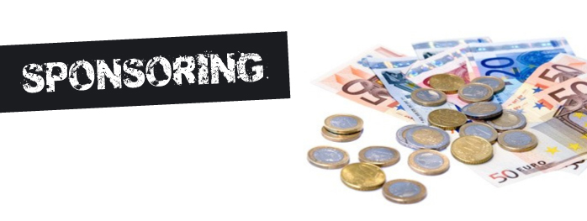
Lecture 4
Strategic Management and Advance Marketing for sports organizations
Summer School
SPORT EVENT MANAGEMENT
Lionel Maltese
Maitre de Conférences Aix Marseille University – CERGAM IAE Aix-en-Provence
Associate Professor Sport Event Management Kedge Business School
Assets Manager ATP – WTA Events and consulting
Member of the Executive Committee FFT – Roland Garros – Economic Development
Twitter : @lionelmaltese

Slide 2
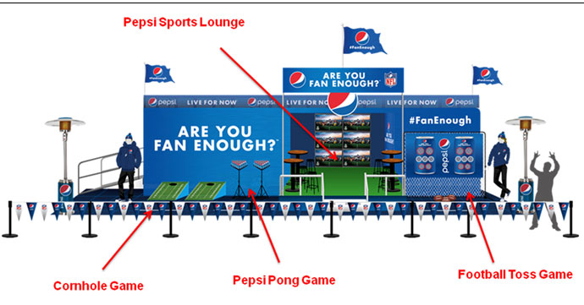

Slide 3
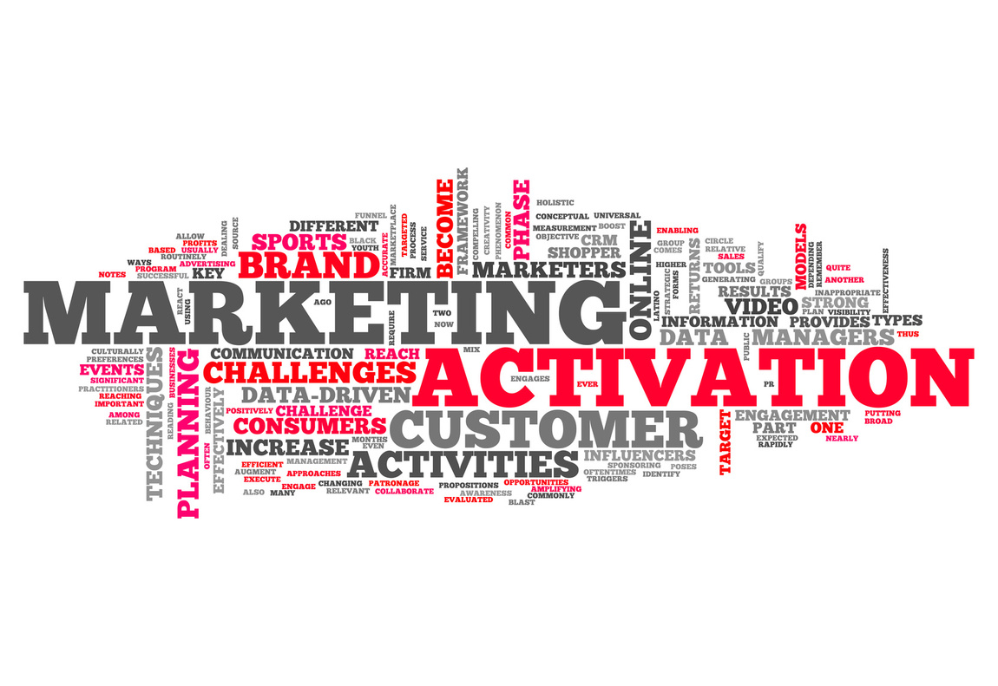
Our goals
As event or club manager : analysing and producing a sponsorship activation program
Operational approach :
  How to prospect for a new sponsor ?
  How to customize your sponsorsorship offer ?

Slide 4
Sponsors goals
WHY ?
HOW ?
Top of mind (notoriety), image, reputation !
Increase sales / product ou service placement
CRM, Prospection
Internal communication
Connect the fans to the brands
Media – Social Media – PR
On site marketing operations
PR (BtB & BtC)
PR
Activations

Slide 5
Definition
Provision of assistance either financial or in kind to an activity by a commercial organization for the purpose of achieving commercial objective (Meenaghan, 1983)
Sponsorship involves two main activities (Cornwell and Maignan, 1998) :
  Exchange between a sponsor and a sponsoree whereby the latter receives a remuneration (cash or in-kind contribution) and the former obtains the right to associate itself with the activity sponsored
  Marketing of the association by the sponsor

Slide 6
Sponsor support : financial or not
SPONSOR
Firm, non profit organization, institution…
SPONSORED
Entity : individual, group, oragnization, event…
Area : sports, arts, environment..
Benefits for the sponsor : achieve communication objectives
Media
Sponsor
target
Sponsored
Target
PUBLIC

Slide 7
Sponsorship strategic approaches
Passion : executive passion for sport (« President dancer ») : RLD, Kampf, Weber, Lagardere…
Opportunism : business project using sponsorphip potential : Sodexo, Veolia, Vinci, Eiffage, Bouygues, Thomson & PSG…
Strategic : sponsorshsip integration into a global brand strategy : We all speak football, We are tennis…

Slide 8
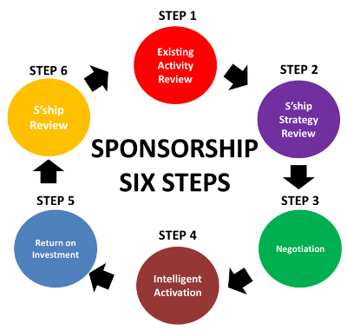

Slide 9

In the real world
→ 75 % : Executive meeting and individual introducing
2 personalities
Actor games
Serendipity capability
→ 25 % strategic process / brand strategic management

Slide 10



Slide 11
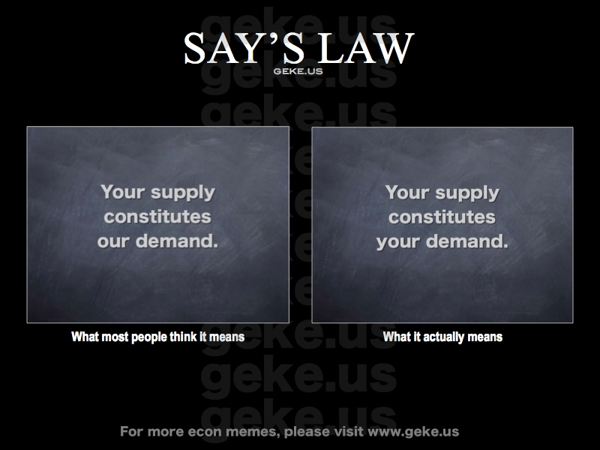

Slide 12

Mega event & the rest
Demand > Supply
Best clubs and events
Sponsor selection
Financial optimization
Open call - closing
Demand < Supply
Others clubs and events
Customization
Prospect
Introducing + closing

Slide 13







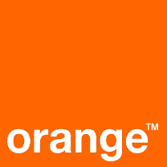



Make the difference
Competitive advantage
Not only visibility !
Reputation !
Visibility
+
Sensemaking activation to create a difference

Slide 14
The Place to leverage and activate
Sponsorship leverage can be defined as “the act of using collateral marketing communications to exploit the commercial potential of the association between a sponsee and sponsor.”
Activational communications (or activation) can be described as “communications that promote the engagement, involvement, or participation of the sponsorship audience with the sponsor”
(Weeks, Cornwell & Drennan, Psychology & Marketing, 2008)

Slide 15
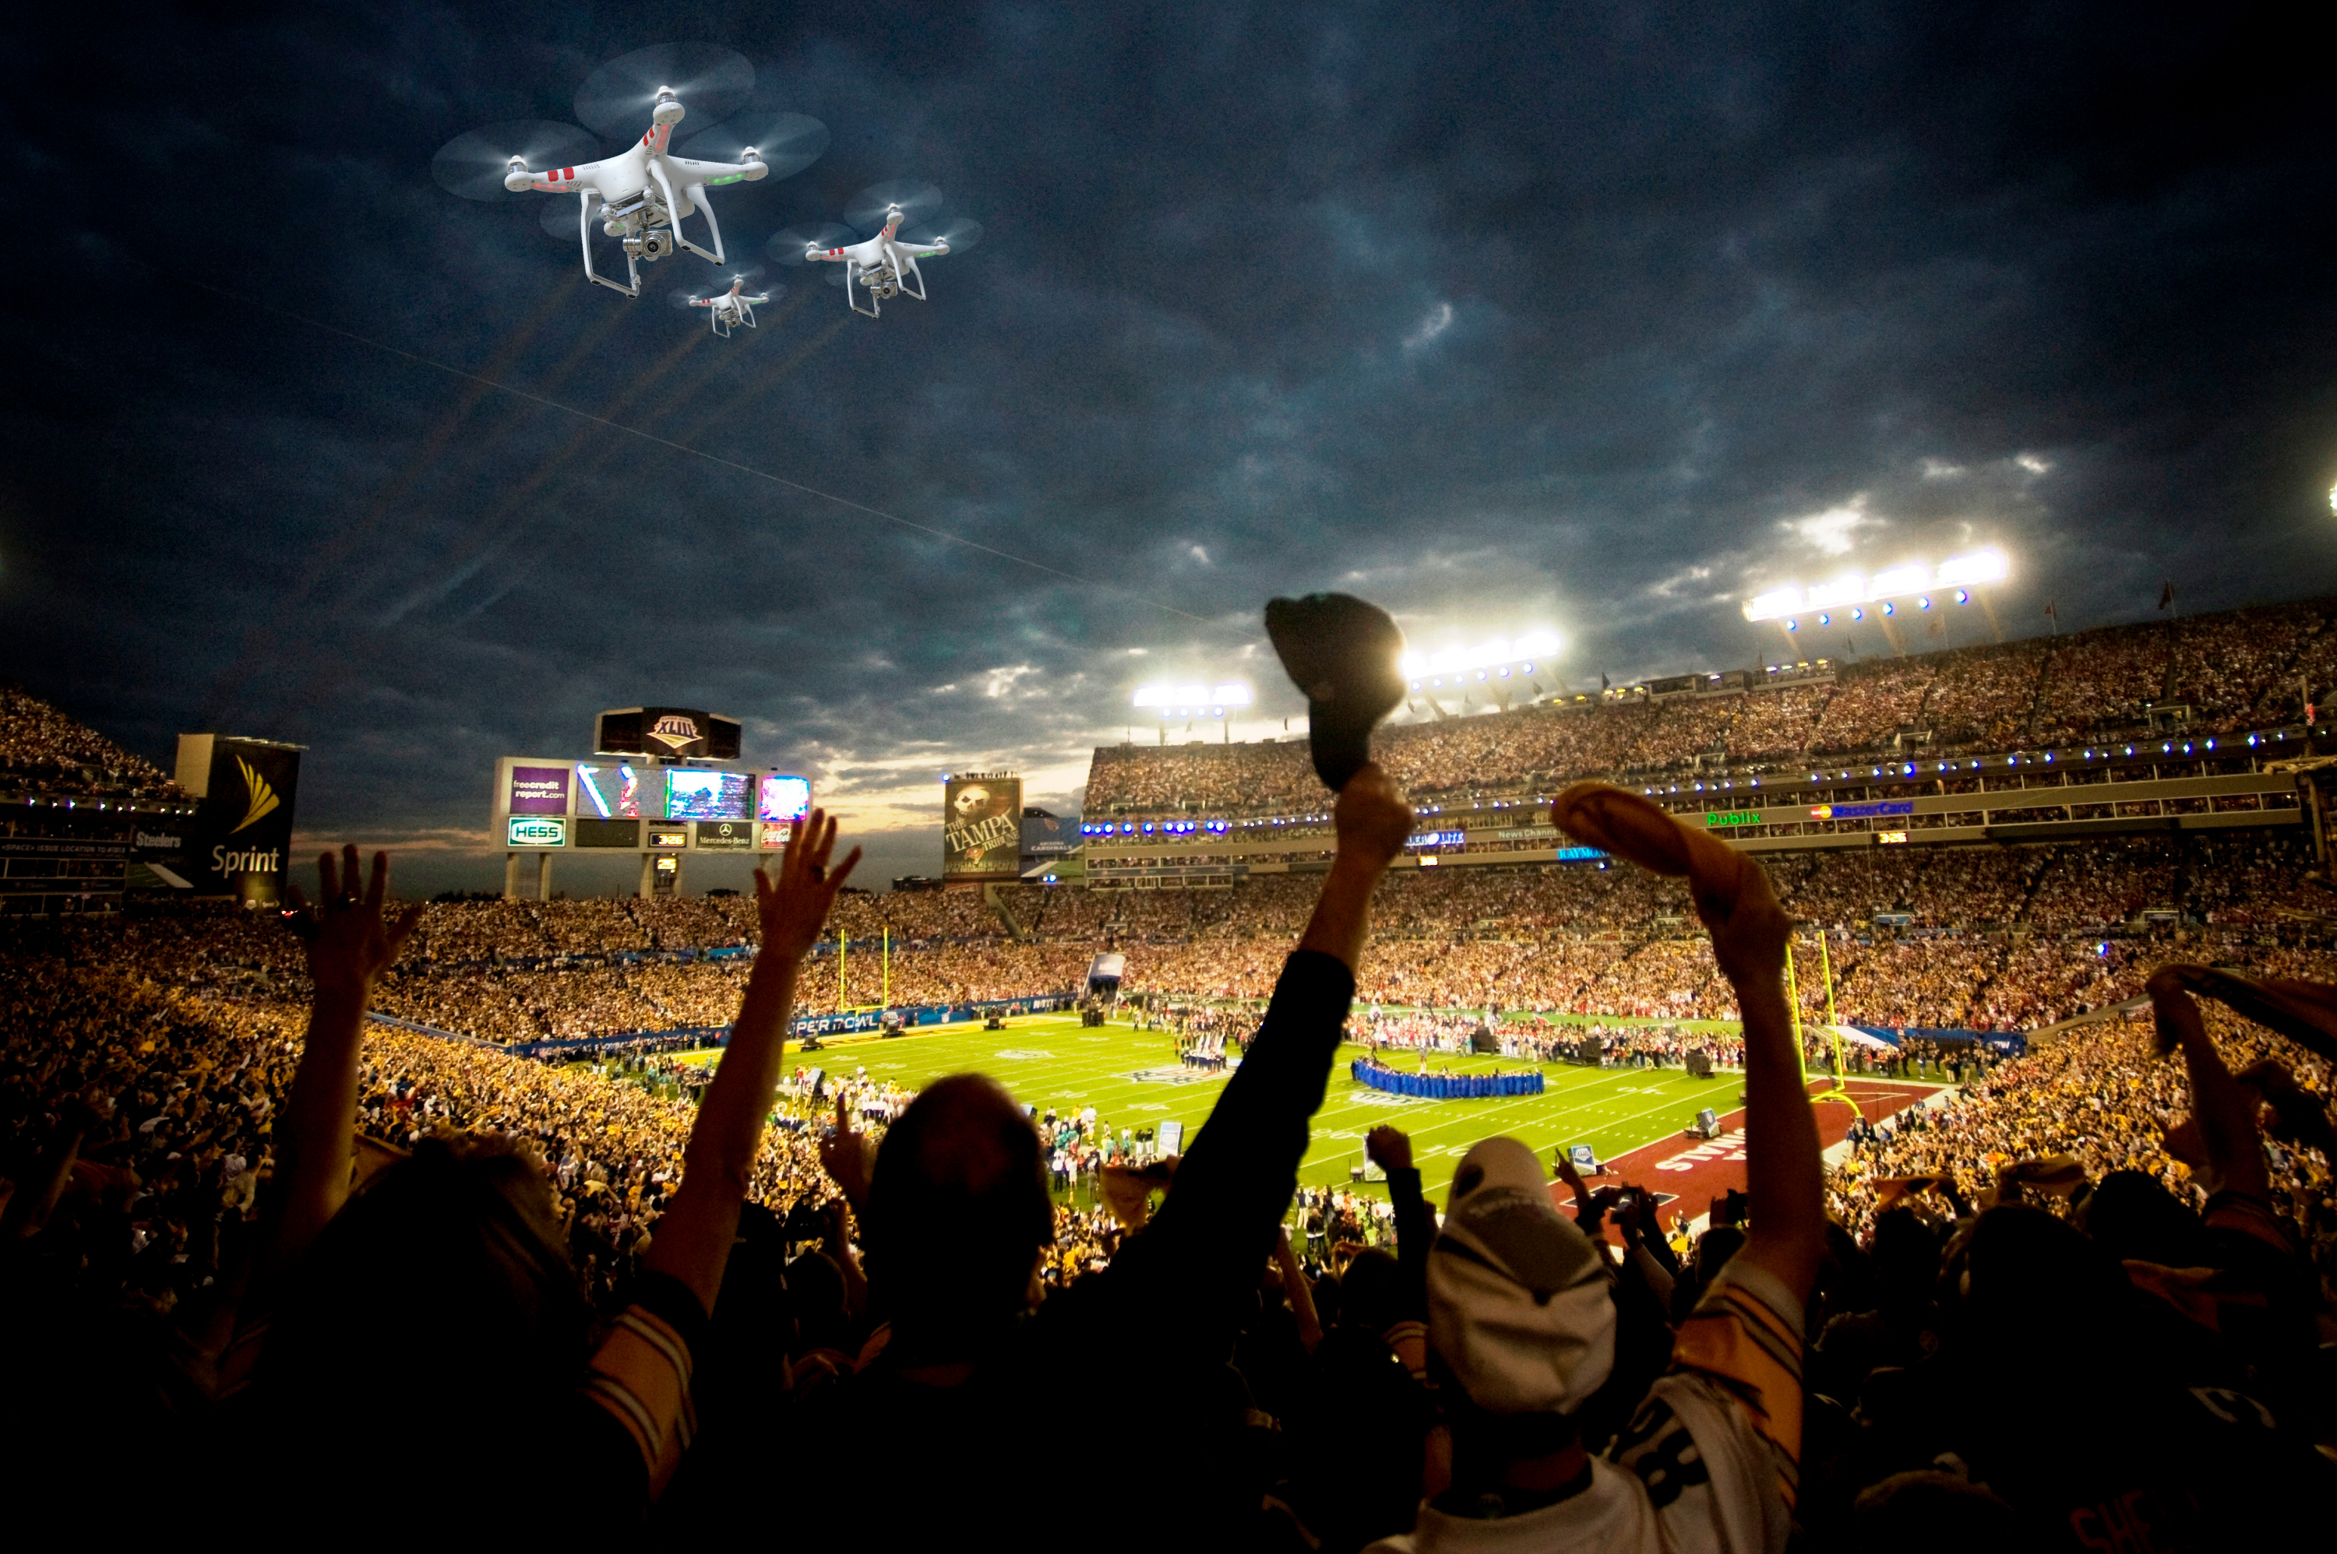
ACTIVATION
« Connect the fans to the brands »

Slide 16
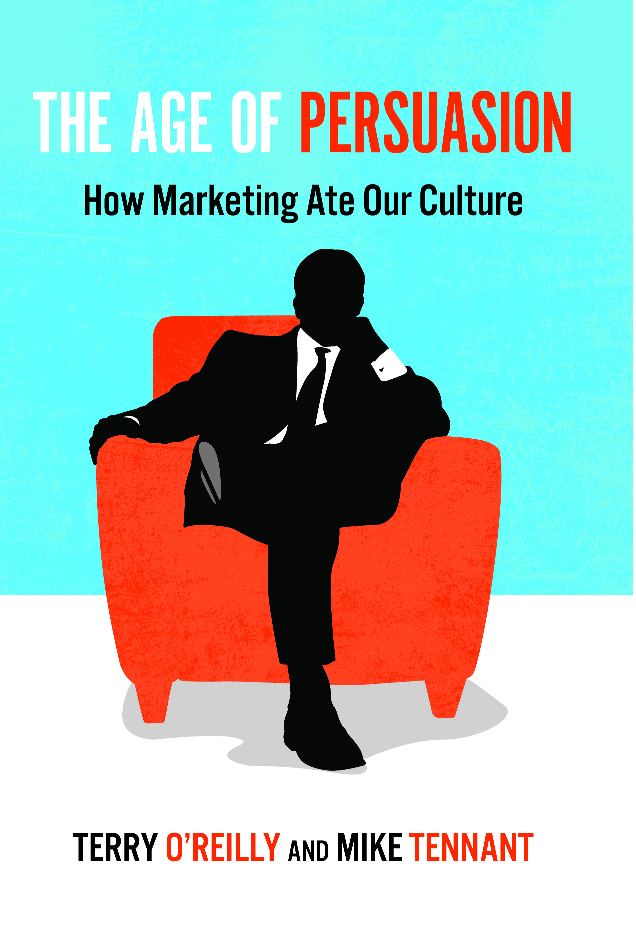
Promotional strategy
Any form of communication used to inform, persuade or remind about company products and services (Keller)

Slide 17
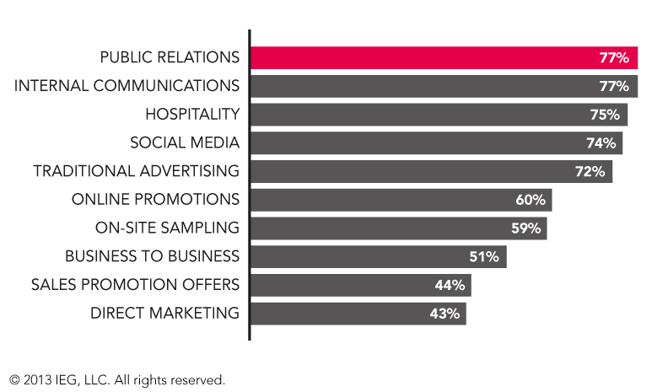
Which of the following marketing communications channels do you use to leverage your sponsorship programs ?

Slide 18
Activation axis
Sponsorship –
Event Communication
Visibility
Relational
Hospitality
Entertainment
Experiential
classical
CRM
Services Marketing
Experiential Marketing
innovationt

Slide 19
Activation tools
Billboards
Printed
supports
Cause Related
Marketing
Scoring
Referees
PR
Media
Supports
Web Marketing
Web 2.0
Fans
Objects
Special Events
Human
Supports
Mobile
Maketing
Stands
Naming
Seminars
Conferences
Games
Official
Supplier
Branding
Visibility
Relations
Participation
Involvement

Slide 20
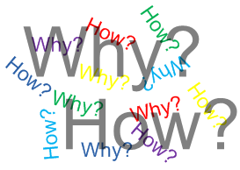
So what ? How to Implement ?
Back to the basics :
WHY ? : targets, visibility, value, internal communication,… [needs + sponsors goals]
HOW ? : activation tools panel [answer needs + objectifs]
= your JOB !

Slide 21
Agencies… or not !
Sport Marketing
Agencies
Club / Event
Sponsors
Need
For
Competencies
Commercial
Sponsorship
Direction

Slide 22
Activation program process
4. Evaluation ROO or ROI
3. Activation - Action
You are on the field
5. Evolution –
Dynamic program
Loyalty
2. Customaze your offer
Sensemaking proporsals
You are not a prof !
Using 3 packs (light – medium – gold)
1. Prospecting – Analyzing - Spying
For a new sponsor
Special individual access and information
by your top management or owner

Slide 23
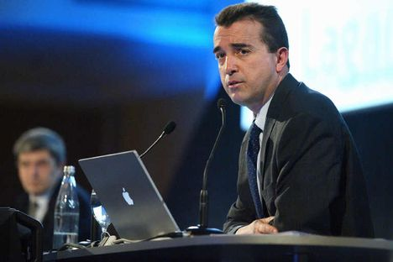




CEO personnality « passion » activation

Slide 24

Basketball competition and free practice
Open area for a general public
Elite championship 5*5
8 cities in Europe : Lyon, Paris, Cologne, Munich, Madrid, Barcelona, Milan, Roma

Slide 25

Visibility activations :
  Street marketing , flyers, printed supports, TS staff.
  Staff + presents for players
  Court: 16 m billboards, wall ITW, tents.
Sensemaking activations »:
  Champion of the Court : 1 vs 1 (300 - 350 players per day)
  2 targets : elite – teens (streetware)

Slide 26

Visibility activations :
  Printed supports logo
  Staff with Nike (shoes) – Winners (shoes)
  Court : 10 m billboards
Sensemaking activations »:
  Nike – 3 point shootout
  Stand for shoes
  Jordan Camps recruitment : buzz

Slide 27

Visibility activations :
  Printed supports logo
  Referees / Foot Locker clothes
  Court : 10 m billboards
Sensemaking activations :
  Flyers + website NBA jam 06 : Foot Locker shop to get your ticket to play
  Game « Foot Locker 10 000€ » : shot from the center of the court.
  Promotional coupons for players and winners

Slide 28

Visibility activations:
  Printed supports logo
  EA Sports Lounge area
  Court n°2 : EA Sports 10 m billboards
Sensemaking activations
  NBA Live 07 video game promotion with stands
  Virtual tournament : European finals (finalists : match Suns / Sixers – Winners : All star Game invitation in Las Vegas 07)

Slide 29

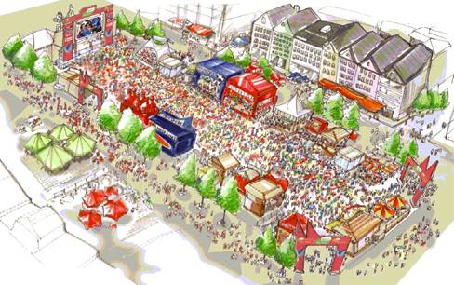
Fan Fest

Slide 30

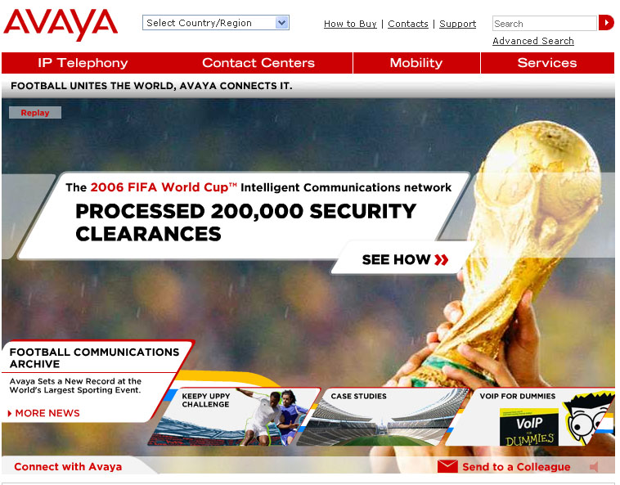
Communication services supplier
Visibility activation:
  Field : 2-4 billboards 8*6.50 m
Sensemaking actiovations
  Website : official facts – news – products
  Promotion services Voice over IP : press, media…

Slide 31

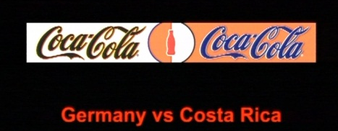
Powerade official supplier ‘energy drink’
Bonaqa official supplier « water »
« We all speak Football » campaign
Visibility activations :
  2 à 4 billboards
  Visibility using teams colors
Sensemaking activations
  FIFA World Cup ™ Trophy Tour :
  Official balls
  Coca-Cola Football Camp
  Panini Virtual Football Stickers
  Children / 6 villages SOS FIFA

Slide 32
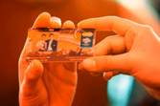

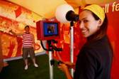
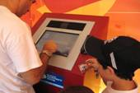
+ 20 years with FIFA → Brand Visibility / N1 International soccer / Relations users + banks
Visibility activations :
  2 – 4 billboards
  90 min TV broadcas : 10-13 min brand visibility
Sensemaking activations
  Hospitality
  Master Card « Priceless Photo » : (Pelé – Klinsmann) / credi card souvenir
  Cities soccer championship by Master Card

Slide 33
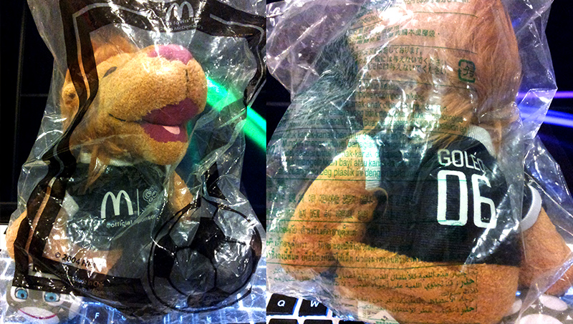
Visibility activation :
  2 – 4 billboards
Sensemaking activations »:
  McDonald’s Player Escort Program : 1048 children (6-10 years)
  Special promotions :
    Germany : Goleo / Celebrity endorsment / Tickets
    Brazil : Countries Burgers
    China : TV adverstersinng and goodies
    USA : Limited goodies FIFA World Cup
    India : coccer table games Mcdonald’s
    Japan : Mini balls and mino Goleo
    Mexico : packaging
    UK : mobile games« A tex to Win » with Georges Hurst (CDM 1966)
  Exclusivity : FIFA Fantasy football
  Salads, fruits… McCofee…
SALES PROMOTION + SOCCER ENGAGEMENT

Slide 34
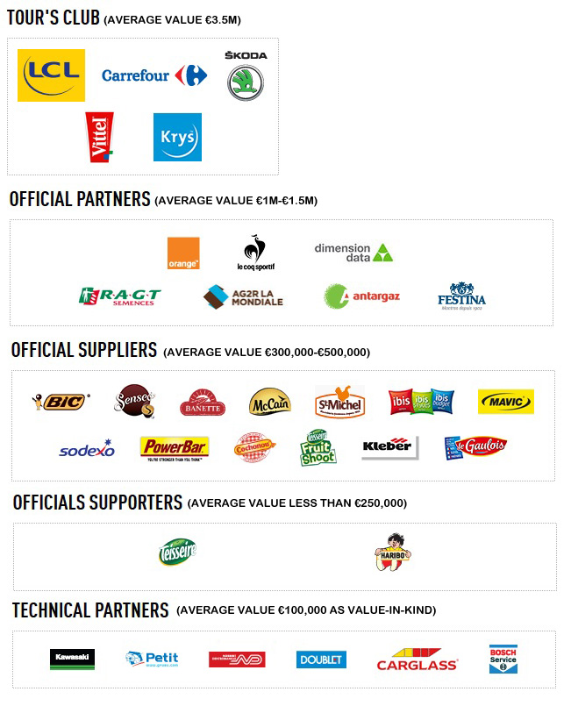


Slide 35

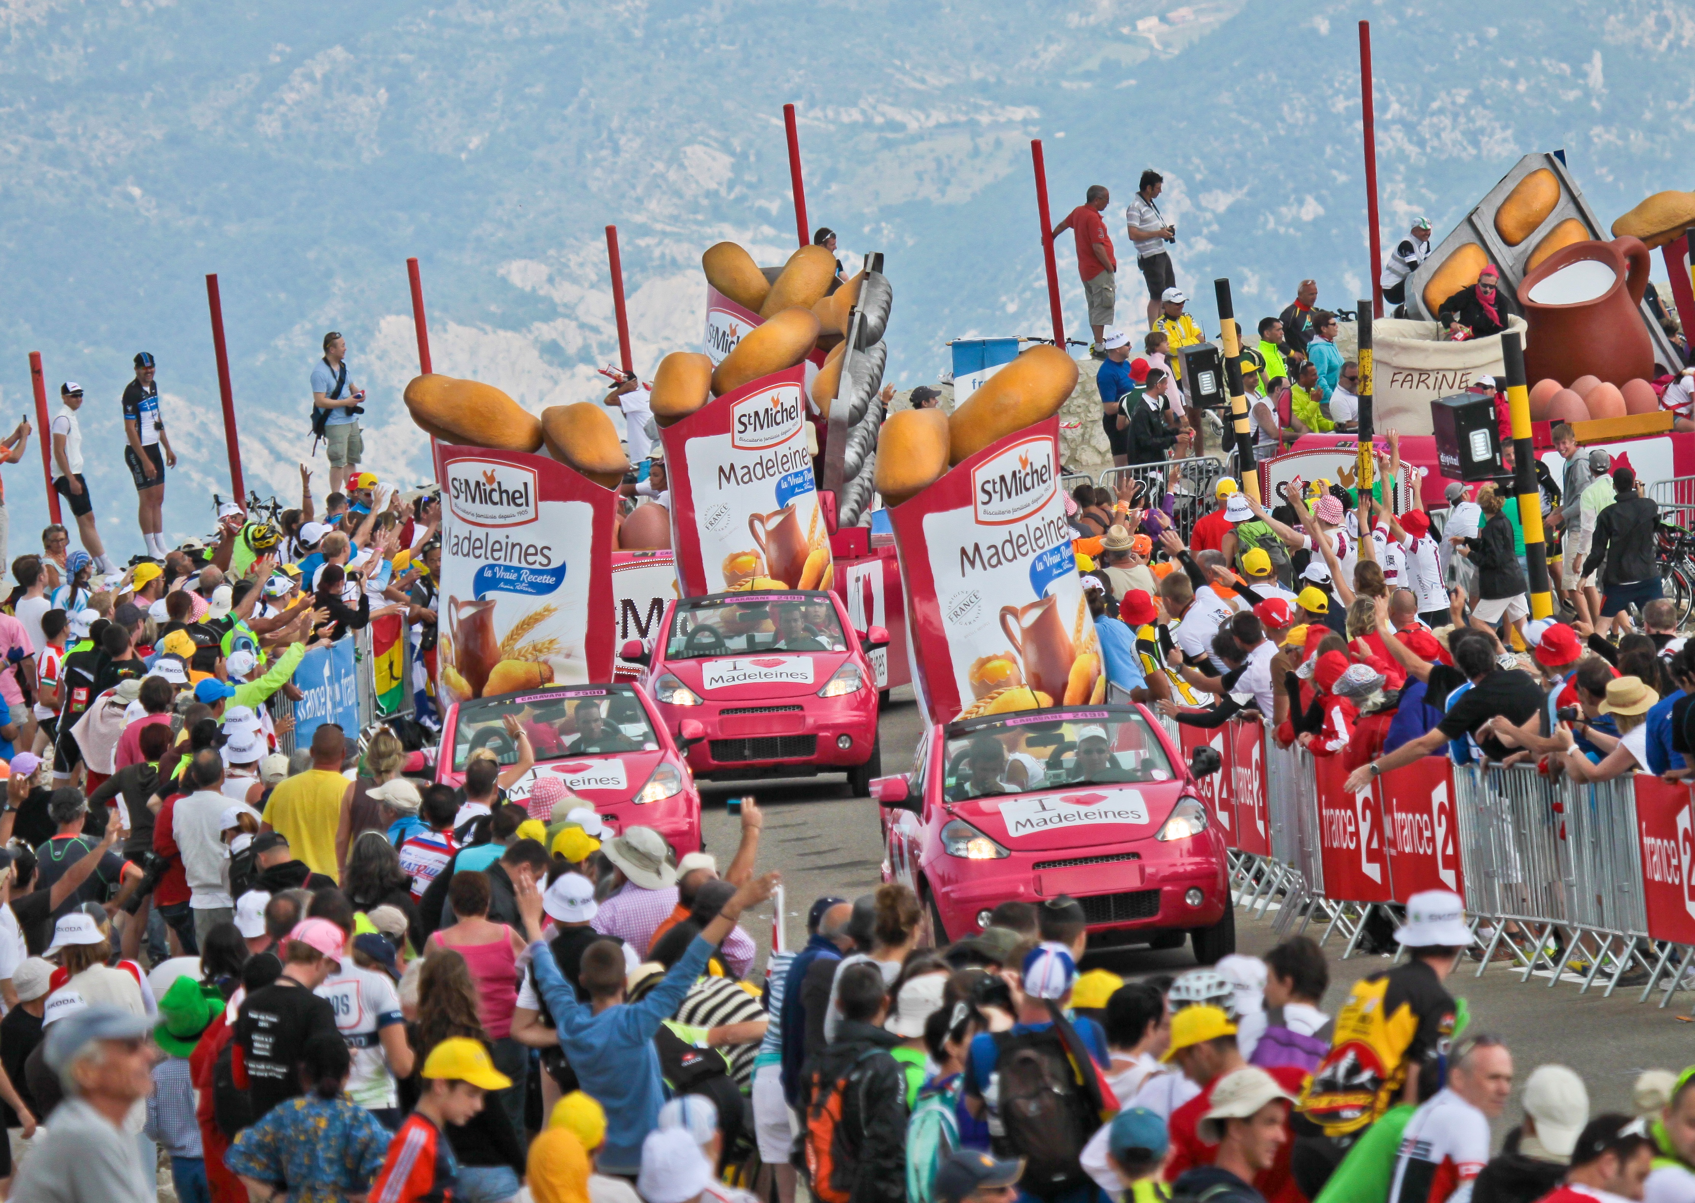

Slide 36

Françoise Bresson (Sponsorsing Director Nestlé Waters - Vittel) : « Link with the public with « La caravane », TDF platform is complete and we can meet our consumers… »
Program
  14 cars et 500 000 producs for the spectators
  Eauficiel : 30 000 for free for spectators
  PR
  Sales activation with 3 Millions (Packs TDF)
  Last 25 km Vittel Red « arches »
  Focus on Vittel origign (les Vosges) with the vacation

Slide 37

Antoine Willaume (Communication & Marketing Director Antargaz) : « Our customers are in rural areas. TDF is a perfect way to meet them ».
Program : Village, caravane, inter-station & VIP
  PR & Hospitality inter-station 50 Km from the arrival (exclusivity : 200 m²)
  Trophy « Flamme Gaz Naturel » with the Major of the City
  Mascot
  200 000 Tap tap & 250 000 magnets

Slide 38

Eric Marchyllie (Sponsoring Director Carrefour) : « Our partnership with TDF and the soccer is focused on proximity. We want to promote our product and our diffrence with our quality made in France and explain our positionning ».
Dispositif :
  Games in shops
  Website : C-letour.fr with practicers and fans
  Cars & Caravane
  Jersey for the best climber

Slide 39
Key points to analyse your future sponsor
Target : identity, image, brand strategy
Goals : Direction : strategy, competitive advantage, needs anticipation
Communication channels
Financial potential : Turnover, assets…
Sponsorship existing actions
Who is the BOSS inside the company :
  Access
  Working on his personnality and the link the your sport (fan, practice, networks…)

Slide 40
Presentation : key steps to connect the fans with brand
Your Brand = your assets to make the difference !
Sponsor Brand : how to be THE answer!
Activations program : make strategic choices to fit with the target needs
Try to propose packs and financial offer

Slide 41


Personnal examples

Slide 42
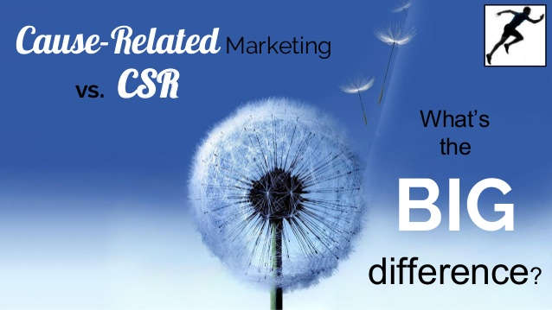
EMOTION ²

Slide 43
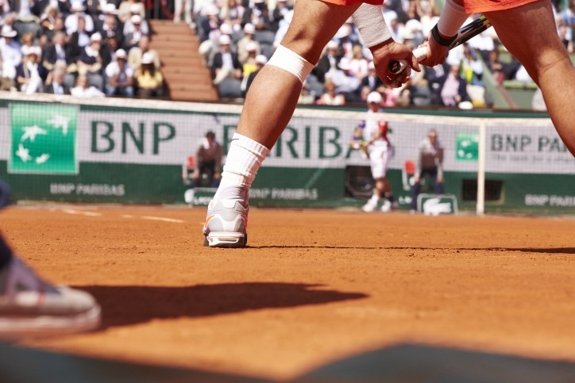
Sponsorship 3.0 : BNP Paribas

Slide 44
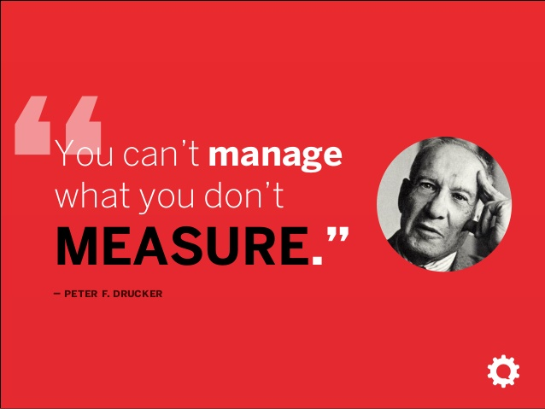

Slide 45



Slide 46


Slide 47
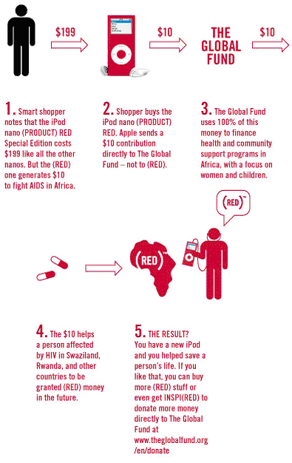
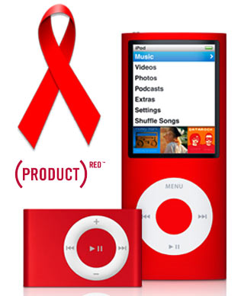
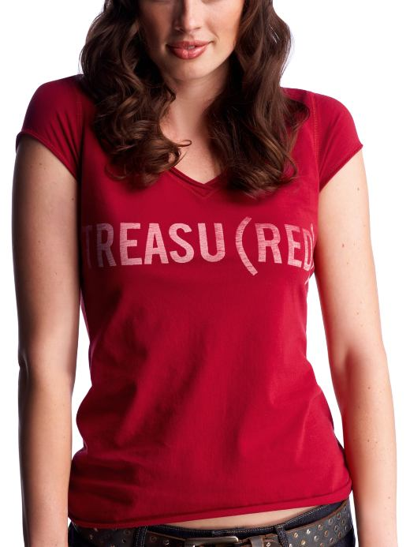
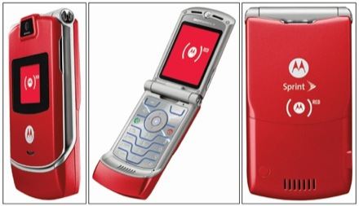
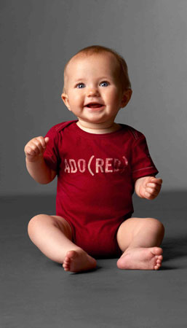
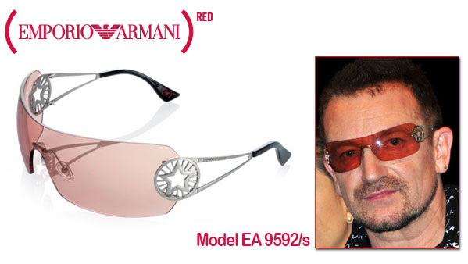

Slide 52
Opportunism or
Pragmatism ?

Slide 53


Slide 54
CAUSE RELATED MARKETING
Cause marketing or cause-related marketing refers to a type of marketing involving the cooperative efforts of a "for profit" business and a non-profit organization for mutual benefit. The term is sometimes used more broadly and generally to refer to any type of marketing effort for social and other charitable causes, including in-house marketing efforts by non-profit organizations.
Cause marketing differs from corporate giving (philanthropy) as the latter generally involves a specific donation that is tax deductible, while cause marketing is a marketing relationship not necessarily based on a donation.

Slide 55

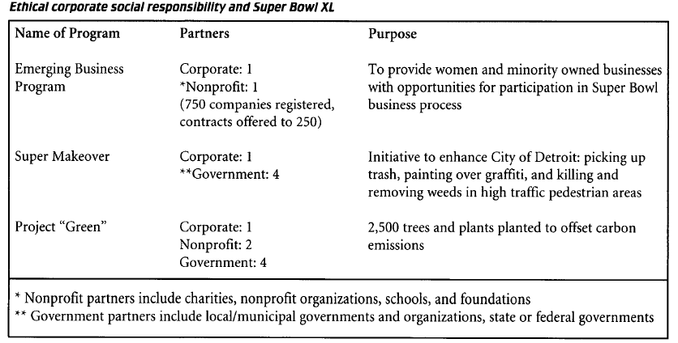
Ethical Corporate Responsibility (Babiak & Wolfe, 2006)

Slide 56
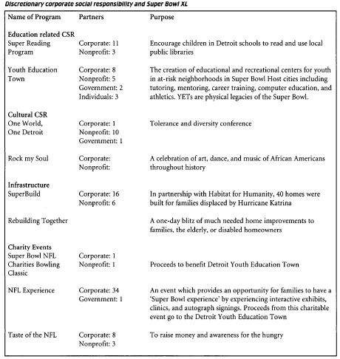
Discretionary Corporate Responsibility (Babiak & Wolfe, 2006)

Slide 57
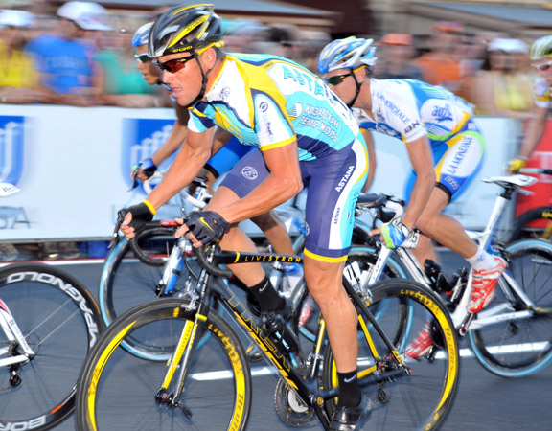



Slide 58


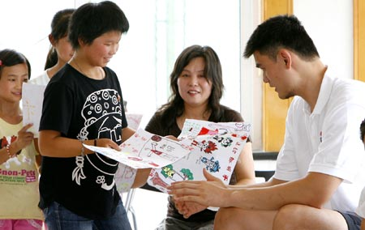

Slide 59
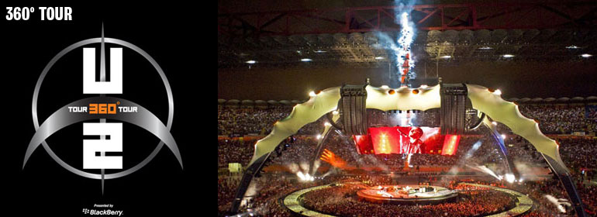


Slide 60


Slide 61
Event Stakeholders
Communication platform
Stakeholders with legitimacy
OGN - Association
Financial
Stakeholders Private or plublic organizations
Classical
Commercial
Sponsorship
Donation
CAUSE
Donation

Slide 62
Process
Cause identification : local aspects, fit with your main sponsors or cities…
Legitimacy with your OGN or association
Activation program
ROI or ROO for :
  Sponsors
  ONG
  Event

Slide 63
The core objective : create sponsors network = cross partnership
HOW ?

Slide 64
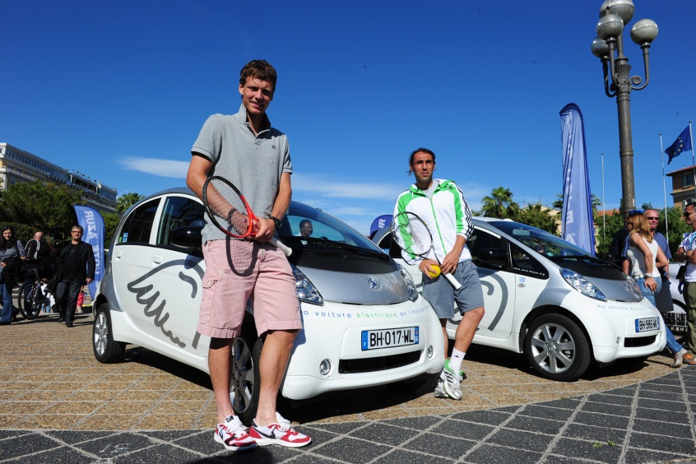
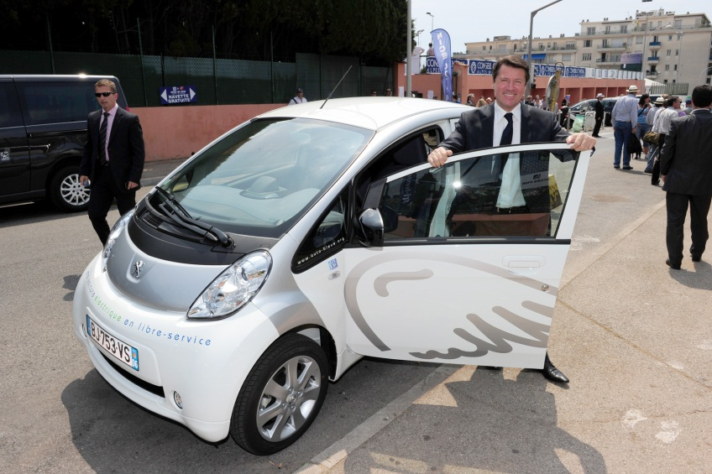
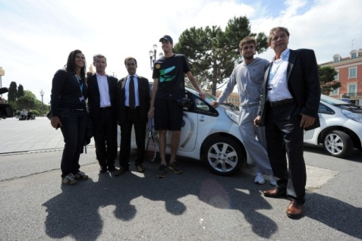
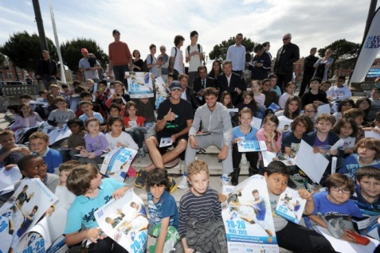




CSR : ressources arrangement and synergies

Slide 65
Solutions :
Corporate Social Responsability and Cause marketing
Cross businesses (not easy…) using public – private networks…
Danger : impossible to put the offer or attractiveness on your website or business presentations…
Destination marketing : public sponsorship strategy

Slide 66
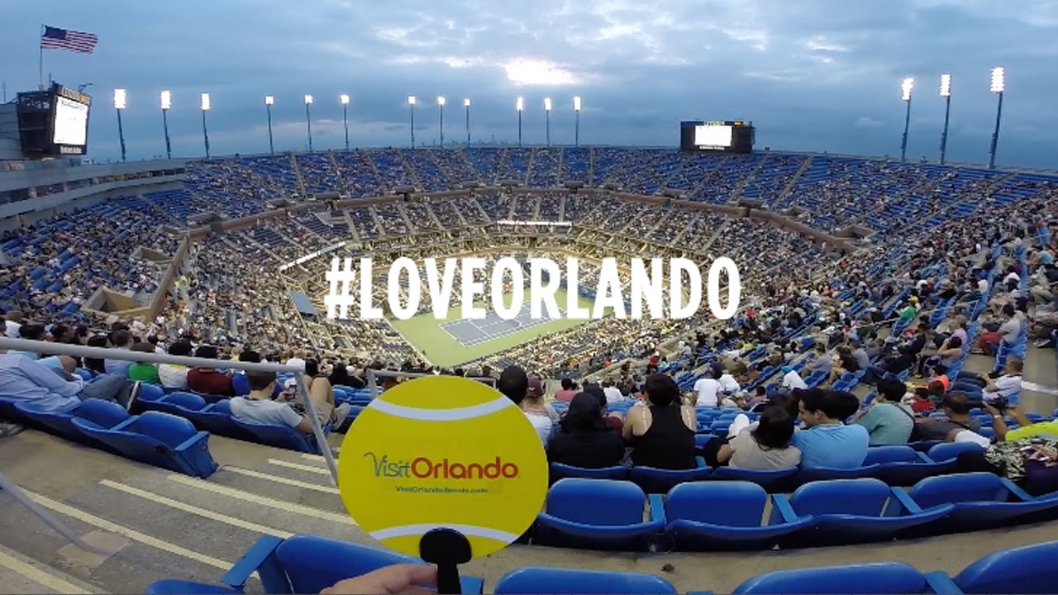




Slide 67
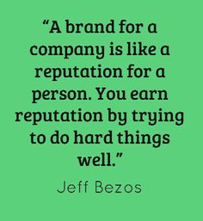


Slide 68
