Slide 1
Lecture 5
Strategic Management and Advance Marketing for sports organizations
Summer School
SPORT EVENT MANAGEMENT
Lionel Maltese
Maitre de Conférences Aix Marseille University – CERGAM IAE Aix-en-Provence
Associate Professor Sport Event Management Kedge Business School
Assets Manager ATP – WTA Events and consulting
Member of the Executive Committee FFT – Roland Garros – Economic Development
Twitter : @lionelmaltese

Slide 2
Assets strategic management
Capabilities : Explore – Exploit - Combine
Resources
Partnerships
Relational
Physical
Reputation
« The Place to express your brand »
« The Place to leverage and activate »
The Place to Be
« The Place to show the show »
Event (game day)
Brand
Sponsors
Brands
Network
Brand
Stadium
Brand

Slide 3
Understanding the Meaning of Performance ?
Athletes
Performance
Shareholders performance
Brand
Exploitation ?
Event
Internal Measure
P.A.P.E.R
Test
Event
Reputation
⇨
Performance
PR Efficiency
(Partners)
Sponsoring
Efficiency
(Partners)
Institutional
Performance
Media
Performance
Stakeholders Performance

Slide 4
Reputational Business Model
Activation
CRM
SPONSORSHIP
7
Sport
Management
Offer attractivity
Media Rights
Ticketing
Sponsorship
  Visibility
  PR
  CSR
Commercial
Brand
2
FACILITIES
STADIUM
ARENA
REPUTATION
BRAND
1
6
5
4
3
Ticketing
Entertainment
Brand
Management
SOCIAL
CAPITAL
8
Negociation
Hospitality
resources
competencies

Slide 5
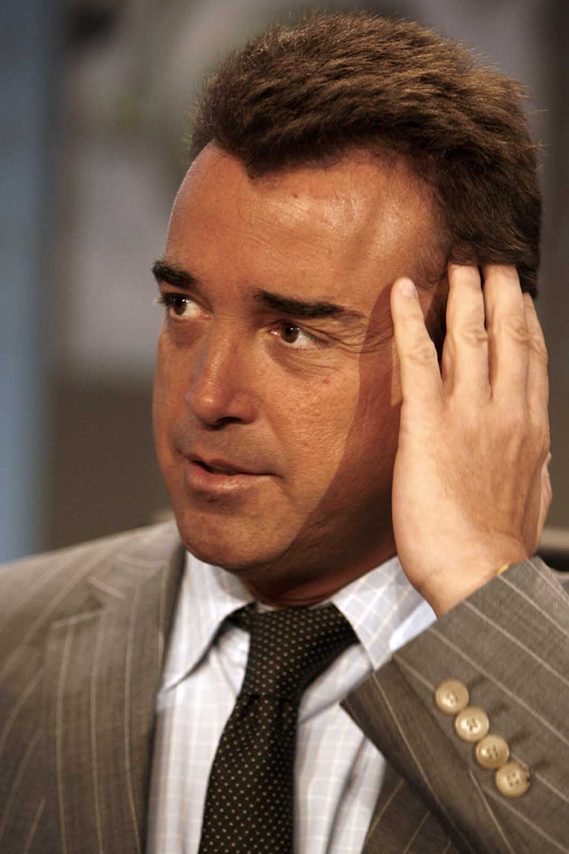
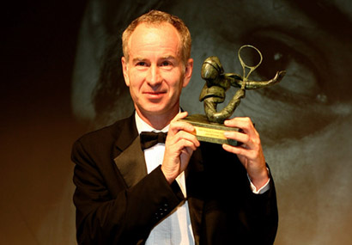
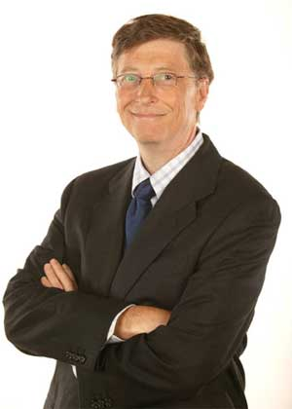
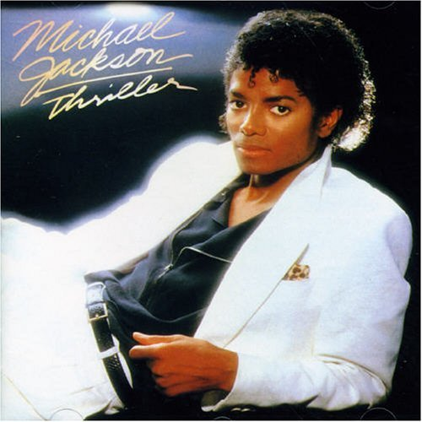
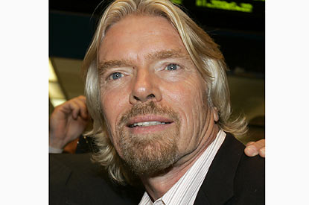
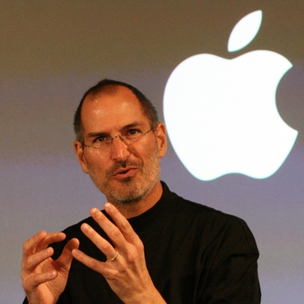



Réputation ?

Slide 6
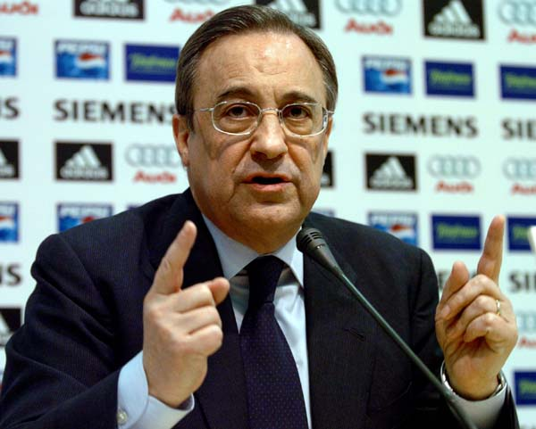
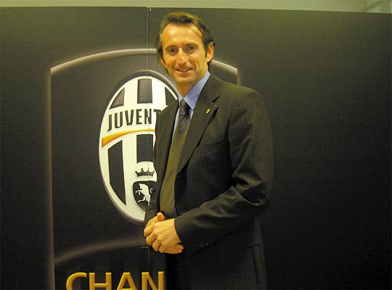
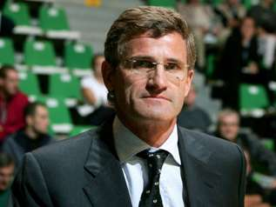
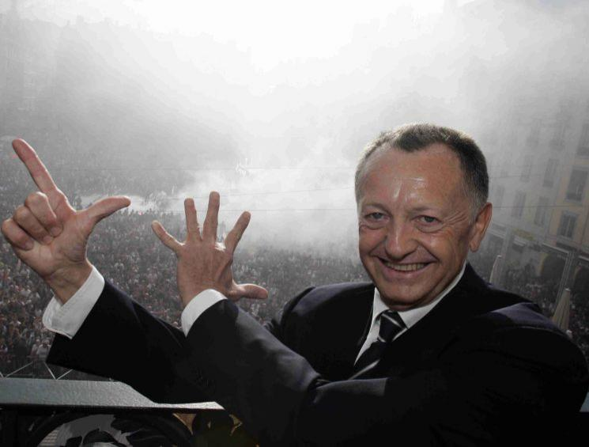
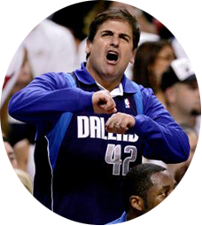
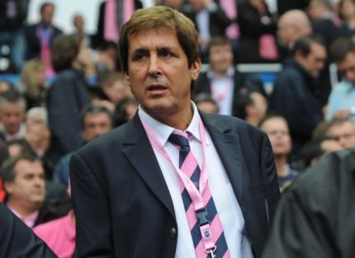
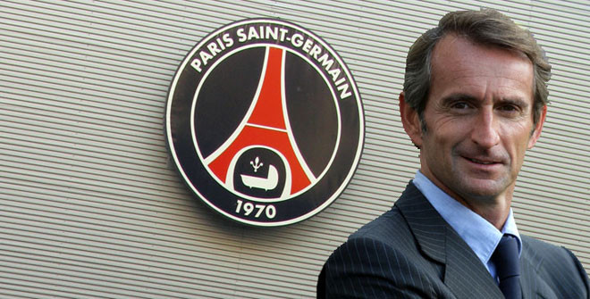
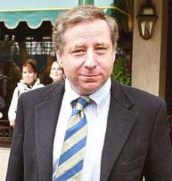

Slide 7
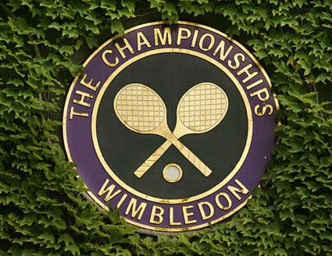
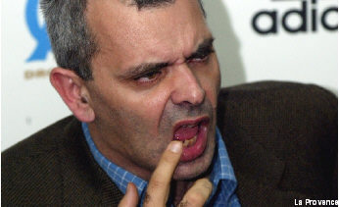
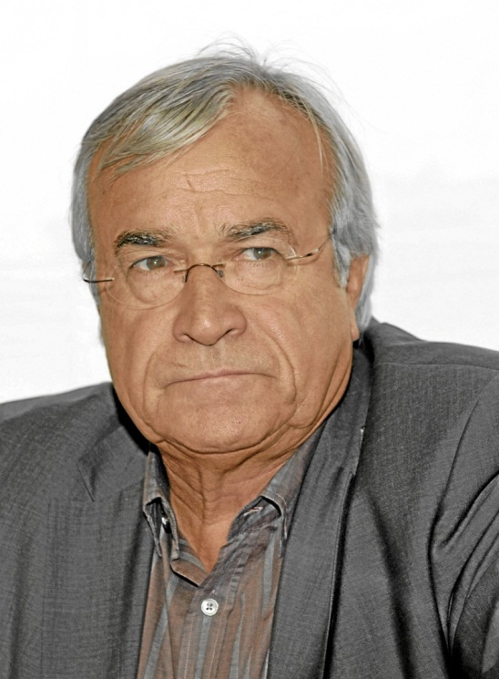



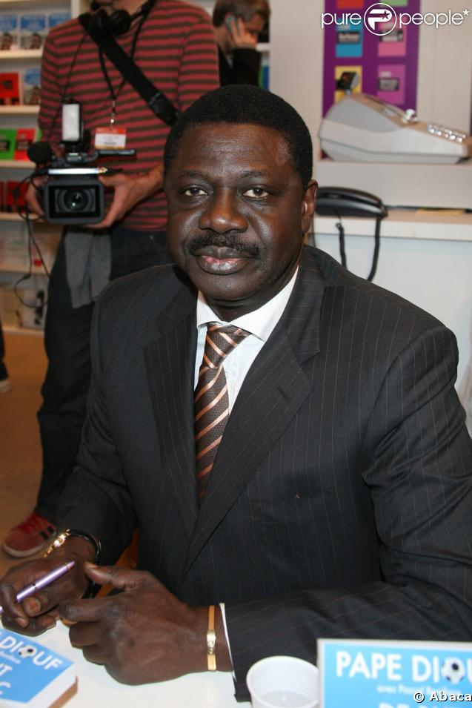
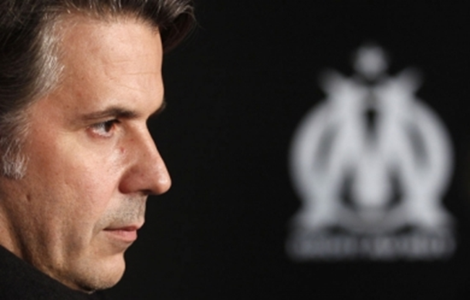

Slide 8

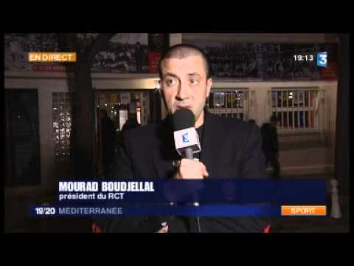
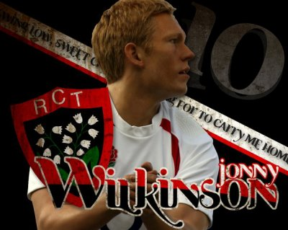

Slide 9
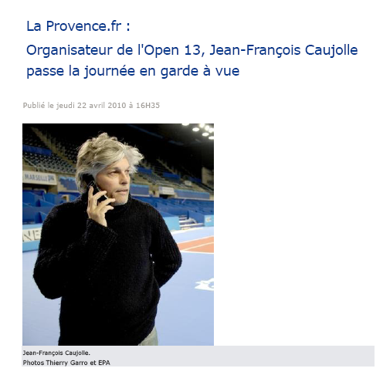

Slide 10
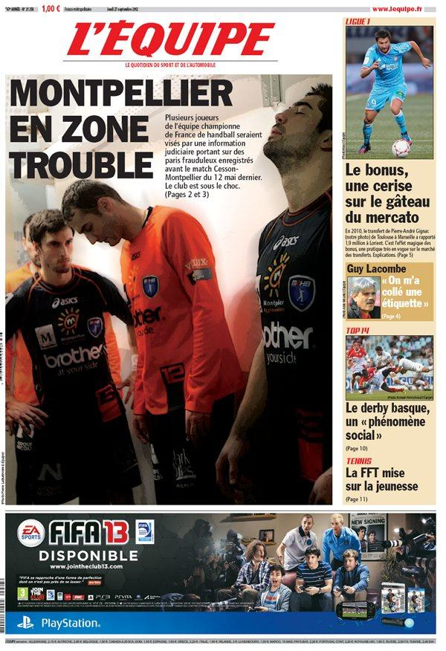
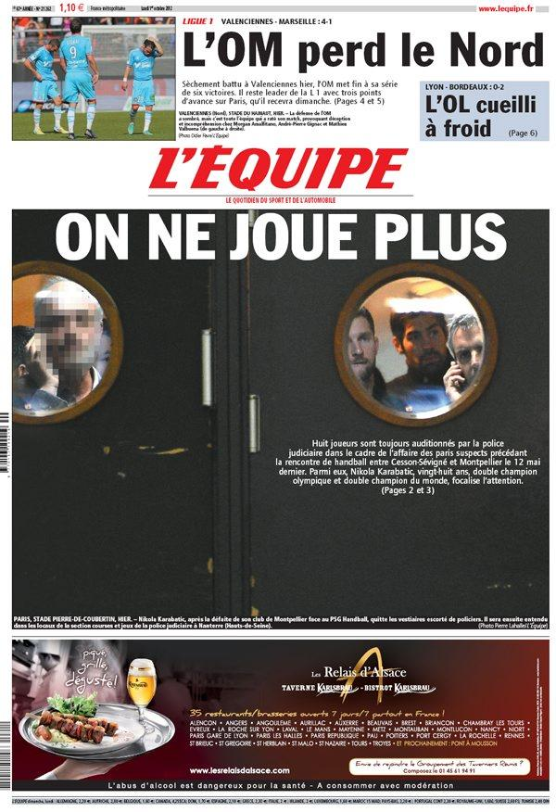

Slide 11
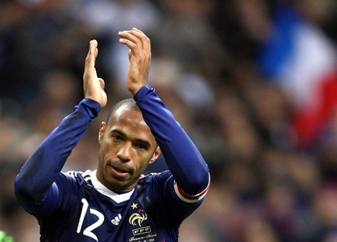
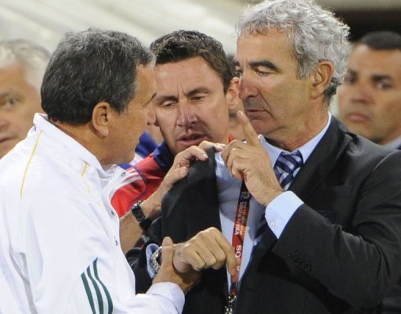
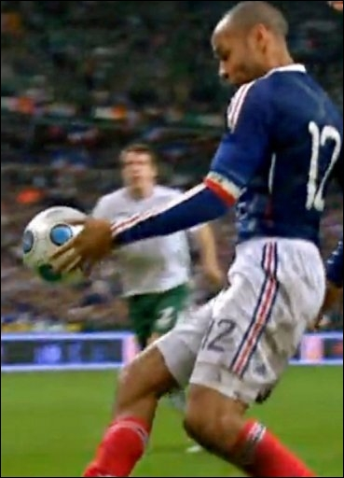
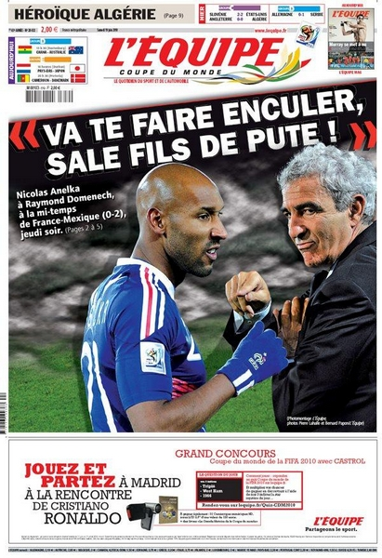
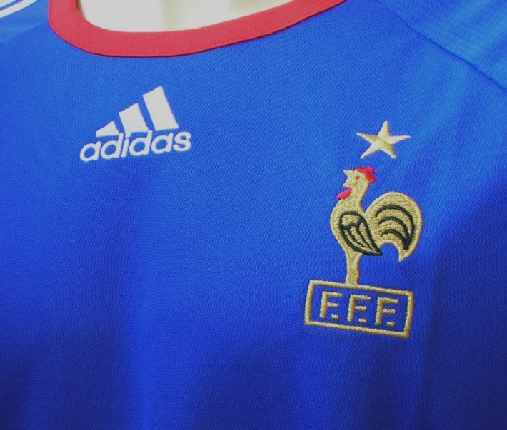
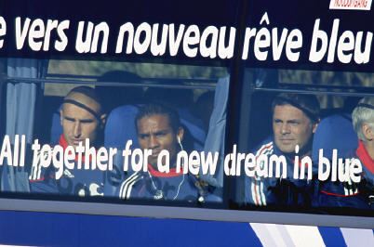
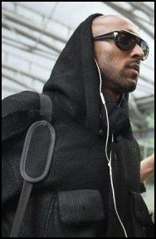


Slide 12
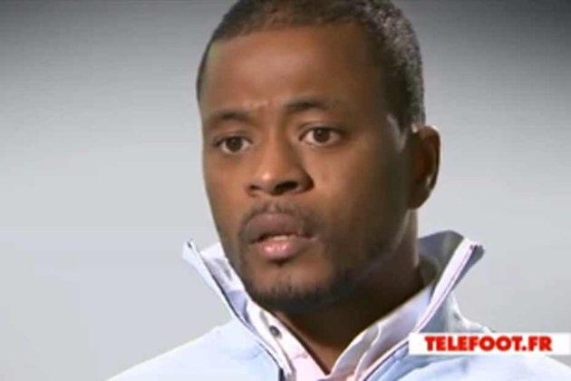

Slide 13
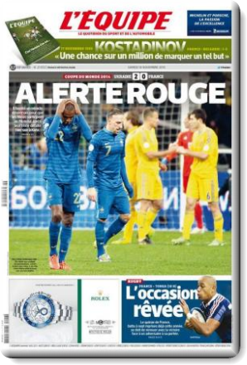
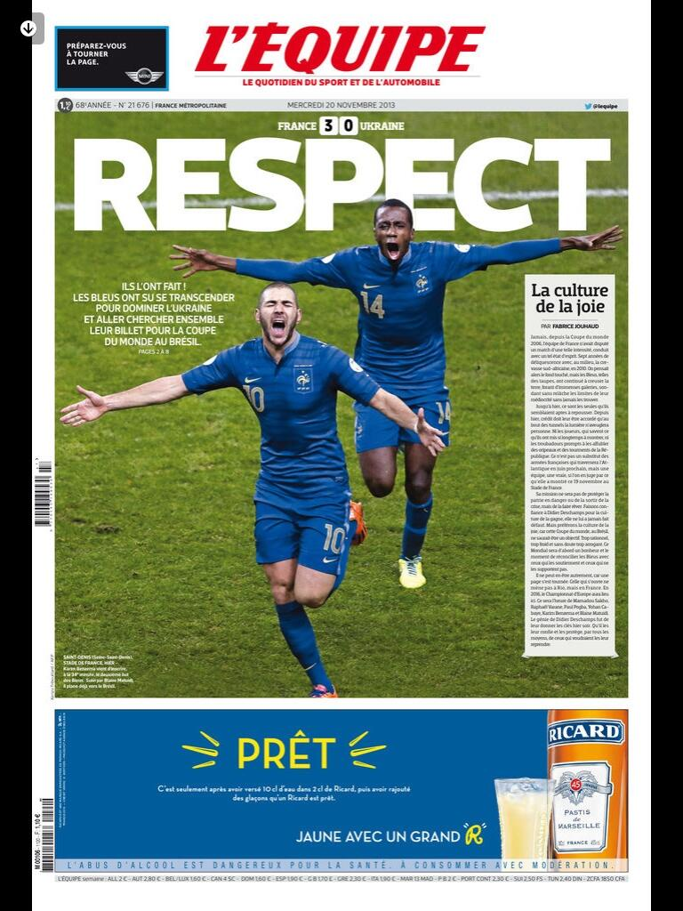

Slide 14
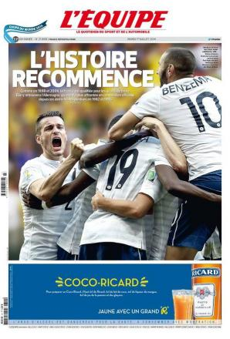

Slide 15
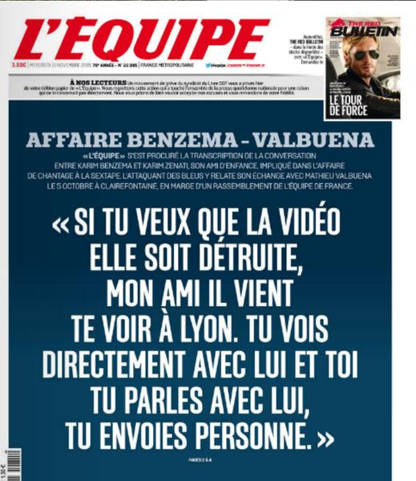

Slide 16
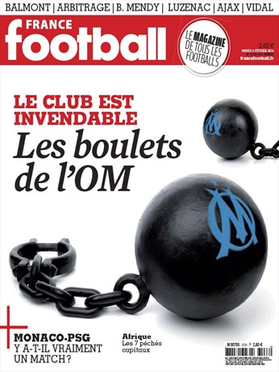
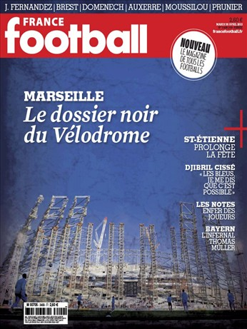
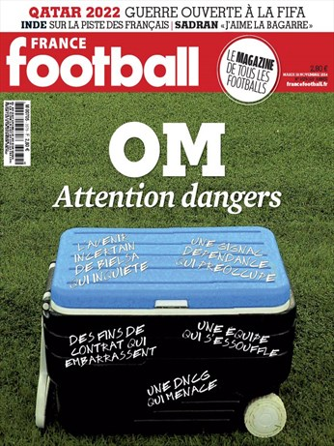
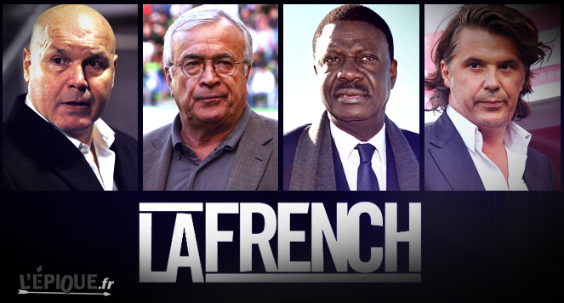
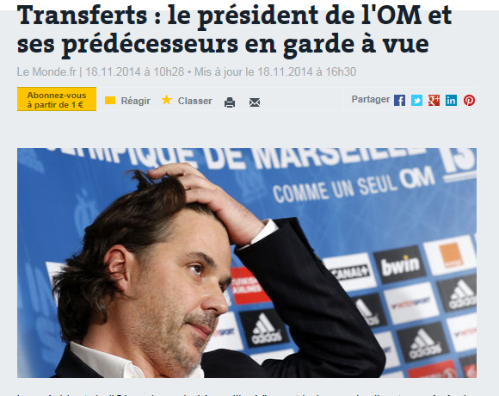

Slide 17
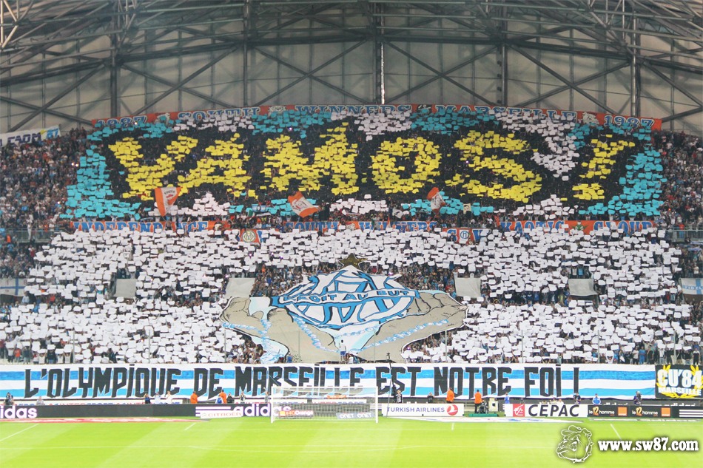
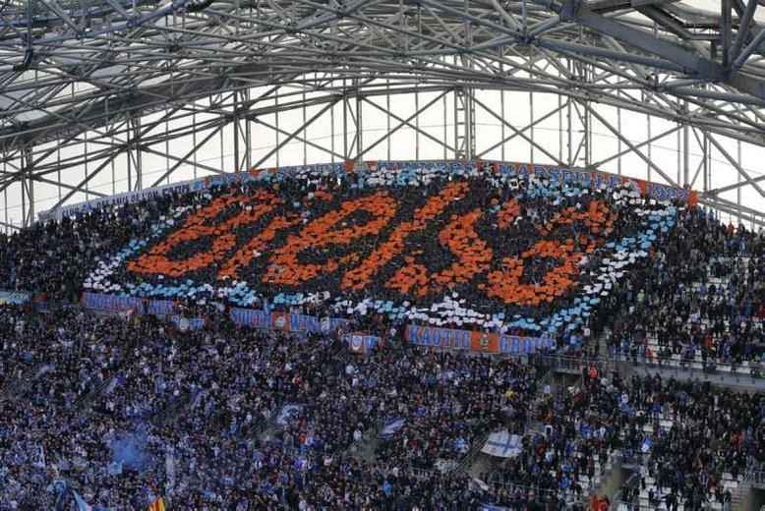
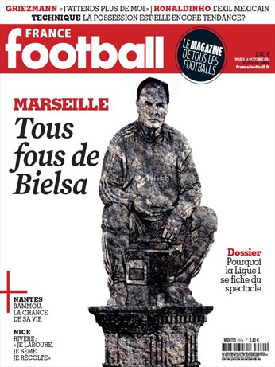
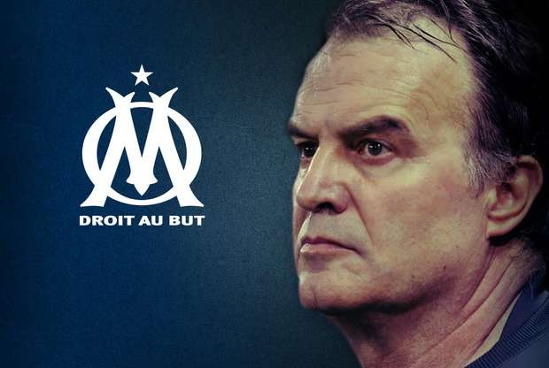

Slide 18
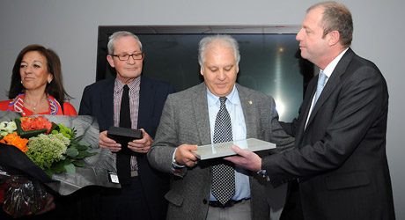
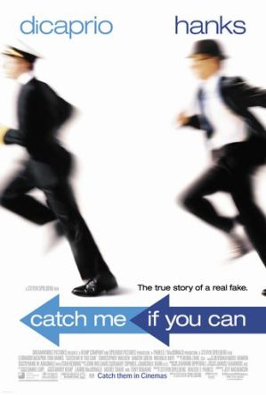
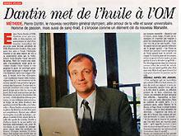

Slide 19
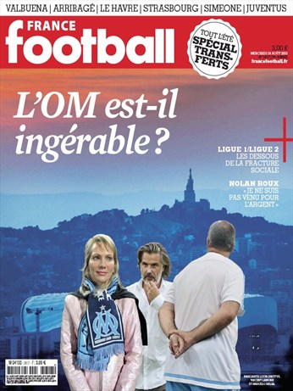

Slide 20
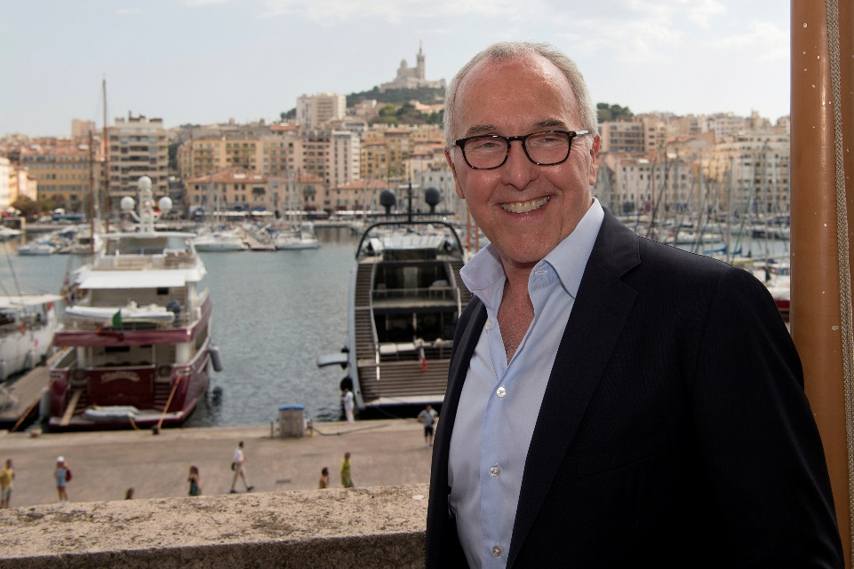




Slide 21



Slide 22


Slide 23
From the March 21, 2011 issue

Slide 24
Most Admired

Slide 29
Reputation = key resource ?
Value
Rareness
REPUTATION =>
Sustained Competitive
Advantage
Organization
Inimitability
Non-Substitutability

Slide 30
Reputation = key asset but difficult to control
Media exposition
Being Good or Being Known (Business School cases !)
Notoriety / Reputation
Actors Reputation (athletes, coach, Managers) : differences between local & major / hallmark & mega events

Slide 31
Expressive organizations ?
Services
Hospitality : B to C – B to B
In the context of Entertainment and sport : organizations (clubs & events) are expressive
Sports organizations compete based on their ability to express who they are and what they stand for.
Emotional and symbolic expressiveness is becoming part of the experience of doing business…
Expressiveness : strategy must serve all stakeholders and that means employees as well as customers, shareholders, creditors, suppliers, local or special communities, and the media.
Product
Sport competition
Experience
Entertainment
Expressiveness implementation :
Very difficult !

Slide 32
Linking Identity, Reputation and Expressive Organization (club or event) Brand

Slide 33
Identity (Fombrun, 1996)
Corporate identity describes the set of values and principles employees (and players) managers associate with a company.
Corporate identity derives from a company’s experiences since its founding, its cumulative record of successes and failures : very important for sports organizations !

Slide 34
Corporate image (Fombrun, 1996)
A corporate image accurately mirrors the company’s identity
The image is often distorted :
  i) as the company tries to manipulate its public through advertising and other forms of self-presentation
or
  ii) rumors develop from the unofficial statements of employees to peers, analysts, and reporters.

Slide 35
Reputation (Fombrun, 1996)
“Reputation” is the general estimation in which one is held by the public (American Heritage Dictionary’s)
A corporate reputation represents the “net” affective or emotional reaction – good or bad, weak or strong – of customers, investors, employees, and the general public to the company’s name.

Slide 37
What’s in a name ?
Sports organizations names are very strategic :
  Cities
  Objects, animals, groups, symbols, features : Colts – Bulls – Celtics – Patriots - Indians…
  Sponsors : BNP Paribas, H Cup , Evian Masters, Andros Trophy…
Moreover : in a market society like ours, it’s clear that names – and the reputations we associate with them – have economic value :
  Michael Jordan : continued to bring in top endorsement income from companies like Nike, Hanes, General Mills and Quaker Oaks (estimated $ 13 million a year)
  Jack Nicklaus, Arnold palmer (golf), Joe Montana, Wayne Gretzky, Andre Agassi, Zinedine Zidane…

Slide 38
Reputation and media
Difficulty to control inside de Communication Mix (TV, Radio, Internet, Press, posting) !
For sports organizations : you can develop your own information for the public : official website (very important !) and sometimes own press (production) or TV

Slide 39
Linking Identity – Name – Image – Reputation (Fombrun, 1996)
Corporate Identity
Names
Self-Presentations
Customer
Image
Community
Image
Investor
Image
Employee
Image
Corporate Reputation

Slide 40
Branding !
A brand is a name, term, sign, symbol, or design or combination of them which is intended to identify the goods and services of one seller or group of sellers and to differentiate them from those of competitors (Kotler, 1991).
Branding ⇨ Differentiation
But for a sport organization :
  Intangible good (except the ticket)
  Athlete brand VS team or event brand = your product is difficult to control in the long term !
  Identity ?
  Tangible element = stadium !

Slide 41
6 classical elements to define a Brand
Attributes : proper characteristics linking to the brand (seller promises…)
  Mercedes : solidity, expensive, durability… “Unlike any other Mercedes-Benz. The Future of the Automobile
  Engineered to move the human spirit”
  Difficult for a club or an event !
Customers benefits : emotional, functional advantages associated to the brand.
  Mercedes : durability (I can use my car for a long time) – Solidity (I am in safety in my car)
  Difficult for a club or an event !

Slide 42
6 classical elements to define a Brand
Values : the brand express the firm culture and its history.
  Mercedes : performance, prestige, tradition…
  OK for a club or an event
Culture : the brand express a cultural linkage
  Mercedes is German (as Bosh, Miel…) Fiat from Italia, Renault from France…
  OK for a club or an event

Slide 43
6 classical elements to define a Brand
Personality : A brand is a person ? An animal (Mascot role in US) ? An object (stadium, trophy (Stanley cup) ?)
  Mercedes is more a CEO, a lion or a prestigious palace…
  It’s possible to construct that for a club or an event (US franchises marketing strategy)
Core targets
  Mercedes : CEO (50 years)
  Difficult but tribal or fans segmentation are useful…

Slide 44
Brand image
Brand image is defined as perceptions about a brand as reflected by the brand associations held in consumer memory (Keller, 1993)
In marketing domain : reputation ⬄ brand image
But club or event = brand ?

Slide 45
Brand construction and control in a very expressive organization…
Place, City, Country
Club or Event
Brand
Public, Fans, Communities
Athletes brand
Sponsors brand

Slide 46

What are 'reputations'?
Reputations are perceptions people have of an individual or organization, be it a company, a city, or a country. These perceptions form as a result of the personal experiences that people have, the messaging they see and hear, and the third party conversations they are exposed to.

Slide 47
What's the difference between 'brand' and 'reputation'?
A brand is a promise. Making a relevant and distinctive promise helps to build a brand.
A corporate reputation is built by fulfilling that promise to stakeholders. A company therefore owns its brand, but stakeholders own its reputation.

Slide 48
Brand construction is difficult in this context…
But :
Reputation construction and control can stimulate and develop your commercial brand !

Slide 49
Rethinking your communication !
COMMUNICATION
STRATEGY
REPUTATION
BRAND
WHY ?
HOW ?

Slide 50
Corporate Reputations can be measured and managed
Reputation management
The Reputation Quotient

Slide 51
Reputation management
(Fombrun, 1996)
Visibility
REPUTATION
Authenticity
Transparency
Consistency
Distinctiveness

Slide 52
Communicates Appropriately with Everyone…
Carries out Visible Stakeholder Initiatives…
Participates in Worthy Social Initiatives…
Visible
Is Recognizably Different...
Makes a Distinctive Promise…
Stands out…
Distinctive
Walks the Talk…
Is Identifiable in its Communications…
Conveys a Consistent Message…
Expressiveness
Quotient
Consistent
States Its Beliefs Openly…
Discloses Information in a Timely Fashion…
Shows Responsiveness to all Stakeholders…
Transparent
Is Credible and Sincere in Its Communications…
Is Honest…
Is Appealing to deal with…
Authentic
The expressiveness quotient (Fombrun and Van Riel, 2004)

Slide 53
Reputation management in action !
You have to
  Create
  Protect
  Repair
your reputation
Indeed bad reputation can affect brand development… (OM)

Slide 54

But don’t forget your resources reputation !
Sponsors Brand
PR and CEO celebrity
Local or cultural identity
Hospitality (stadium)
Your history !
“Being Known” => not always “Being Good”
(Stade Français or NY Knicks cases…)

Slide 55
Reputations are magnets : they help a company attract resources
(Fombrun and Van Riel, 2004)
Employees
Make jobs more attractive
& motivate hard work
Customers
Encourages repeat purchase
& builds market share
REPUTATION
Investors
Lowers capital costs
& attracts next investment
Media Journalists
Generates more favorable
Press coverage
Financial Analysts
Affects content of coverage
And recommendations

Slide 56
Measure : reputation Quotient (6 dimensions and 20 attributes)
(Fombrun and Van Riel, 2004)
7-pt scale
7 = describes very well
1=oes not describe well
Social Responsibility
Supports Good Causes
Environmental Responsibility
Community Responsibility
Emotional Appeal
Feel good about
Admire and Respect
Trust
Vision & Leadership
Market Opportunities
Excellent Leadership
Clear Vision for the future
Products & Services
High Quality
Innovative
Value for money
Stands Behind
REPUTATION
Financial Performance
Record of profitability
Low Risk investment
Growth Prospects
Outperforms Competitors
Workplace Environment
Good Place to work
Good employees
Rewards Employees Fairly

Slide 60
Transfer in the context of sports organizations
7-pt scale
7 = describes very well
1=oes not describe well
Social Responsibility
Supports Good Causes (Ethic)
Environmental Responsibility
Community Responsibility
(fans)
Emotional Appeal
Admire and Respect sport
& athletes
Passion & hedonism
Comsumer
experience
Vision & Leadership
Market Opportunities
Excellent Leadership
Clear Vision for the future
CEO celebrity
Products & Services
High Quality of sport show
& experience
Innovative
Value for money (tickets)
Hospitality
REPUTATION
Financial Performance
Record of profitability
Low Risk investment
Growth Prospects
Outperforms Competitors
Media returns - affluence Stakeholders performance
Workplace Environment
Good Place to work
Good employees
Volunteers management

Slide 61






Slide 62


Slide 63



Slide 64



Slide 65


Slide 66


Slide 67


Slide 68
Remarks…
Communication : fit with the actuality ?
Merchandising and memory ?
Identity and Reputation : places – french inheritance
The athlete is known because of the event
Difficulty to target : popular event
“Caravane” : sponsoring unicity
Event director : charisma and celebrity : Jean-Marie Leblanc → Christian Prudhomme

Slide 69
Questions ?
How do you manage an exceptional (mega) event ?
Development ? Innovation ?
Culture ?
Answers ?
You have to maintain your level !
Reputation management (creation – protection (doping) – repair) : pivotal resource !
If you can : transform your event reputation into a brand
+
External control (sponsors – media – institutions – communities…)

Slide 70





Slide 71





Reputation ⇨ Brand
Roland Garros

Slide 72



Slide 73



Slide 74



Slide 75



Slide 76


Slide 77
5 principles Reputation Management | For Roland Garros
Be visible | Media choice (F2-3) Stadium evolution
Be authentic | Traditional identity History respect (museum)
Etre consistent | Sport advantage Sponsors control (colors on the court)
Etre distinctive | Sport exception : Grand Slam Clay courts Physical impacts
Etre transparent | Communication (ex players) FFT is an association (now difficulty with Christian Bîmes)

Slide 78
Physical
Resources
Partner
Resources
Relational
Resources
Corporate
Reputation
Reputational
Resources
Sport
Reputation
Protection
Exploitation
Learning
Forecasting
Organisational
Capabilities

Slide 79

Cascade of assets
Reputational
Resources
« axes »
Learning
Organizational
Capabilities
Partnership
Resources
Physical
Resources
Relational
Resources
Stock of resources
Dynamic Capabilities
« Bricolage »

Slide 80
Jean-Claude Blanc : resources management strategist…
TV Rights
€32 million
Public Relations
€31 million
Sponoring
€25.5 million
Ticketing
€21 million
Equilibrium « Resource-Based » (2001-2006)
No Resources Dependency
+
External control of the environment
= rents optimization (most important in France)

Slide 81

Roland Garros Turnover : 175,2 M€
80 000 VIP
Hospitality box :
55 000€ - 70 000€
New stadium :
340 M€
Audience :
2,1 Milliards

Slide 82



And Now ?

Slide 83
Reputational business model and external control of your stakeholders sharing resources
Connexion with Fans = medias
Private Sponsors
Public sponors
Sports Institutions
Reputation
Club / event
Organization
Athletes
Management
Reputational Business Model
Suppliers
Fans
Media
Services for fans
Media plat-form = Entertainement

Slide 84
Reputational → Cultural FRM Business Model
CRM
Activation
B to B
Athletes
Management
Parnerships
Reputation
BRAND
Physical Resources (Stadium)
FANS
Entertainment Production
Ticketing & CRM
Social Capital
PR infrastructure development
Resources Basis
Direct impact
Deployment
Indirect impact
Core Competences

Slide 86
How to protect their reputation ?
With reputation of top management affected !

Slide 87
Sustaibable Assets strategic management
Capabilities : Explore – Exploit - Combine
Resources
Partnerships
BRAND
Relational
Reputational
Physical
« The Place to express your brand »
« The Place to leverage and activate »
The Place to Be
« The Place to show the show »
Event (game day)
Brand
Sponsors
Brands
Network
Brand
Stadium
Brand

Slide 88
Cultural (Fan Relationship Management) Business Model : Modern Stadium
Activation
CRM
SPONSORSHIP
Sport
Management
7
Ticketing
Servicing
Offer attractivity
Ticketing & Services
Sponsorship
  CSR
  PR
  Visibility
Media Rights
Commercial brand
3
REPUTATION
FALICITIES
Stadium/Arena
BRAND
2
6
5
1
4
Brand
Management
Fan Relationship
Management
SOCIAL
CAPITAL
8
Hospitality
Negociation
resources
+
= ASSETS
competencies

