Slide 1
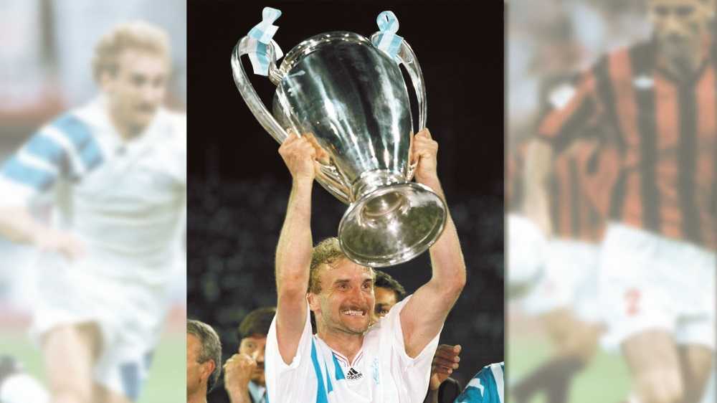
Commercial Business Strategies in Sport Organisations lionelmaltese.fr
@lionelmaltese
Lecture 1
Lionel Maltese
Maitre de Conférences Aix Marseille University – CERGAM IAE Aix-en-Provence
Associate Professor Sport BUSINESS Management Kedge Business School
Assets Manager ATP – WTA Events and consulting
Member of the Executive Committee FFT – Roland Garros – BUSINESS STRATEGY

Slide 2
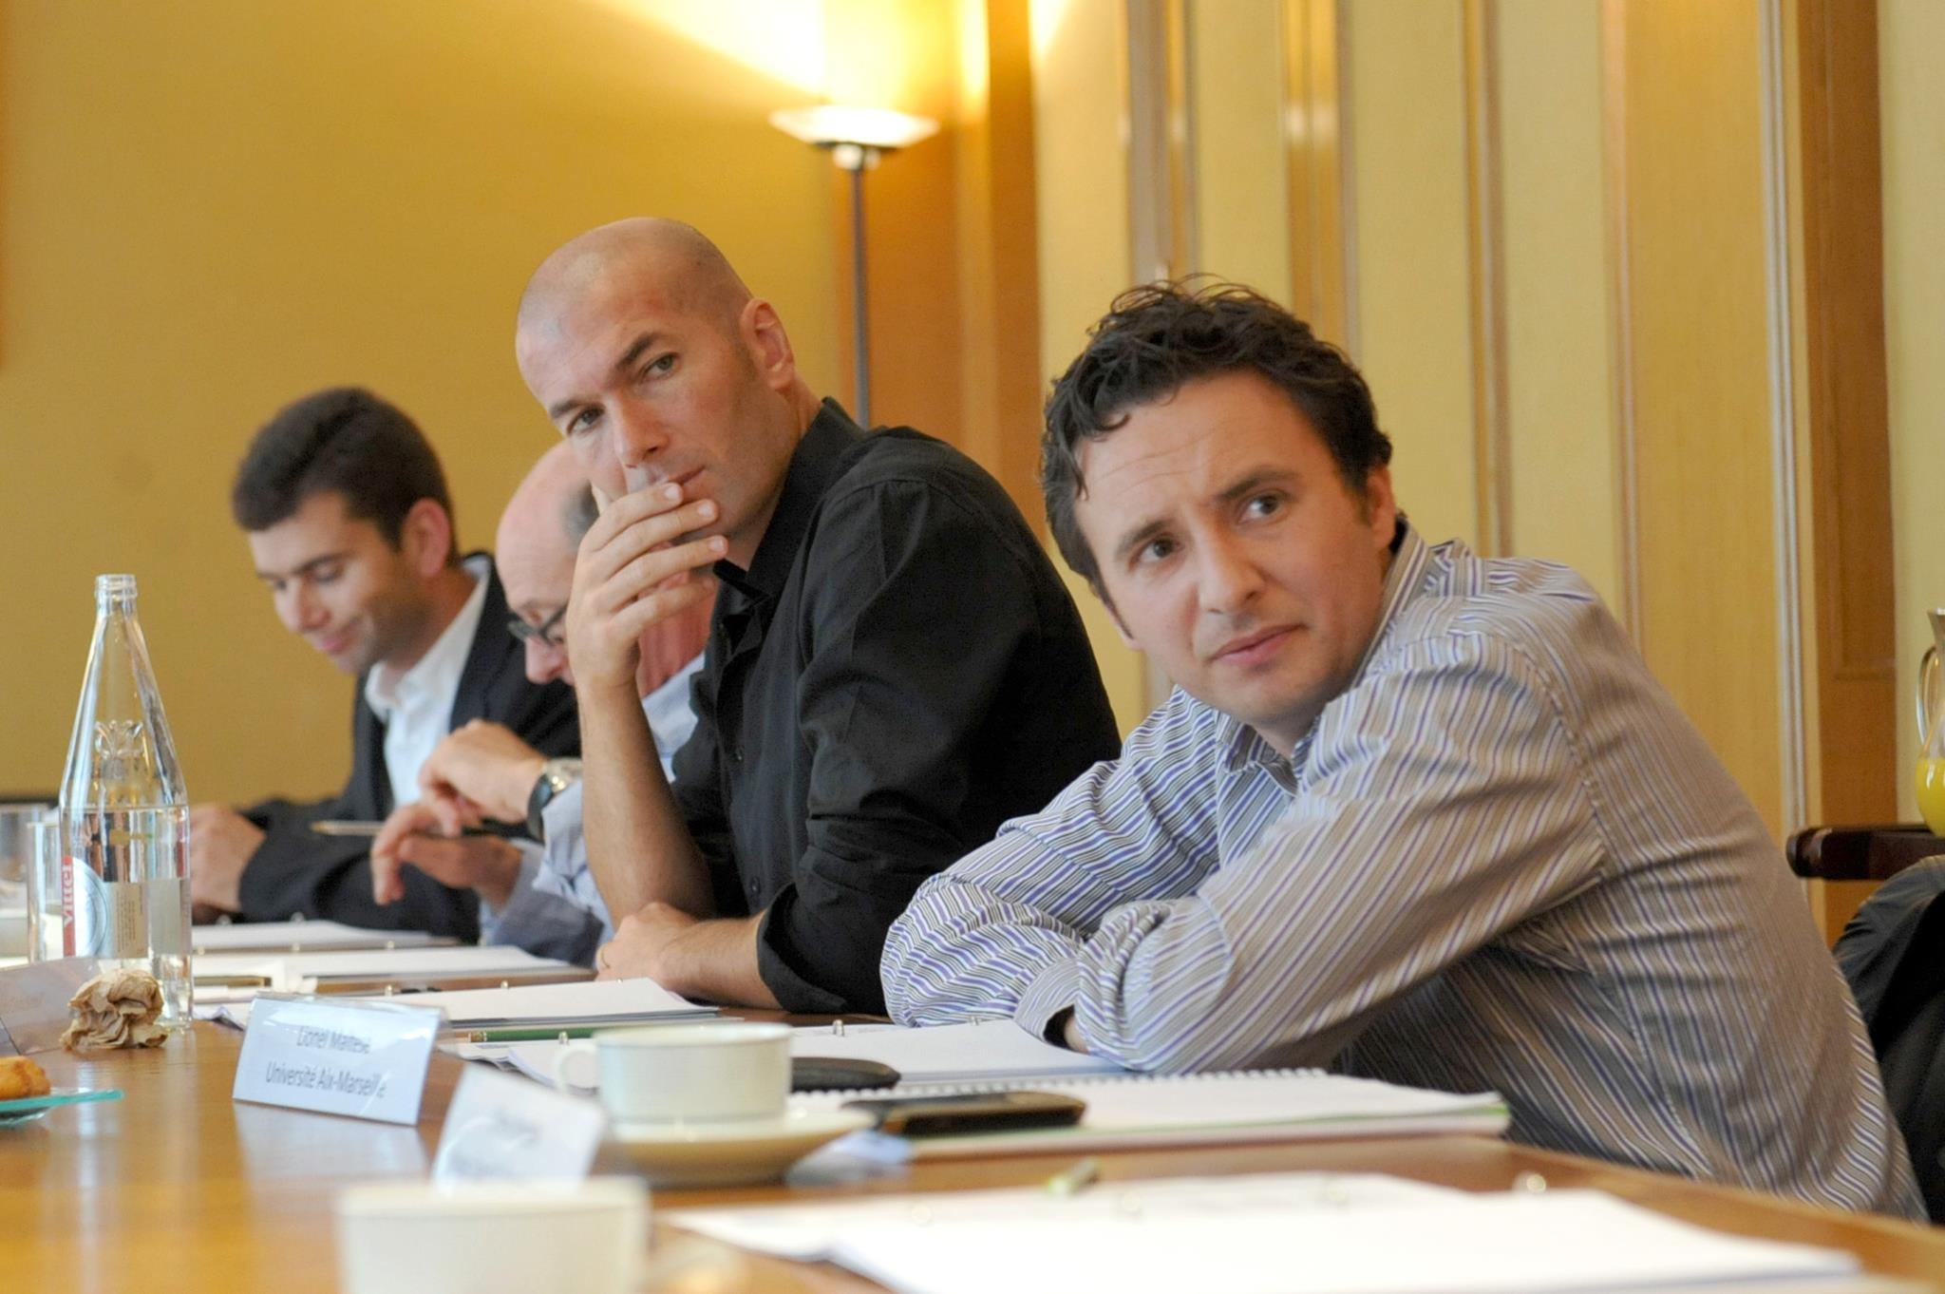
You are, you have…
Last diploma : Phd Business Management IAE Aix en Provence 2004 – Econometrics Engineer Aix Marseille University 2001
Last sport experience (this summer) :
OM Business Assets Consulting Mission & PSG Fan Marketing Mission
Roland Garros Hospitality & Public Relation Business Strategy with Jo Tsonga
ATP World Tour : Nice to Lyon transfert and business creation (JFC, TP, JWT) ,
FFT – Roland Garros Executive Comitee / Executive competencies help for recruitment
….
Sport Practice Fan… :
Tennis, Basket, Soccer, Rugby Seven, Paddle board… and anterior cruciate ligament (ACL) …
OM, Celtics, Juve, Warriors, Canadiens, Seahawks, Fed, Stan, Jo, Liza, Ray Allen, Curry, Voller, ZZ, Slater, Bird, Wilko….

Slide 3
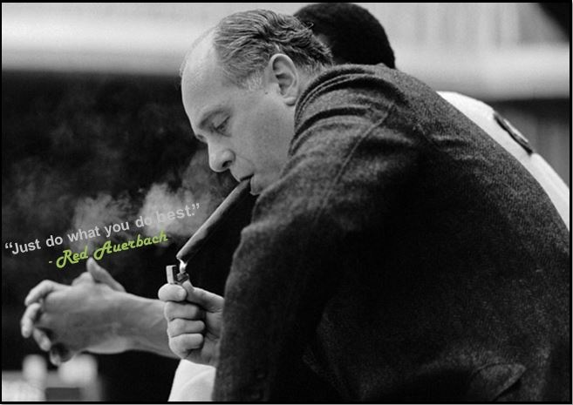
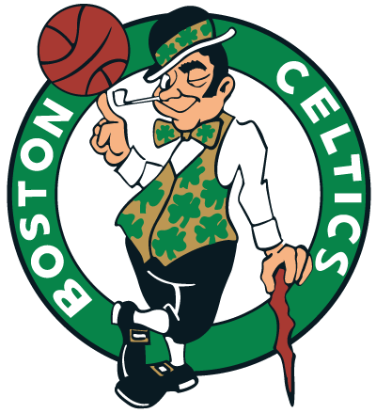

Slide 4


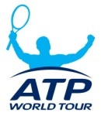



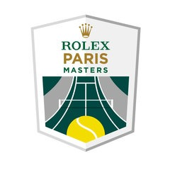












Since 2005
Maitre de Conférences
Aix Marseille University
Strategy & Communication
Associate Professor Kedge Business School
Sport
Business Management
Since 1999
Professional
ATP & WTA
Events management
Manager
Since 2001
Research
Aix Marseille University
Laboratory
Member of the Executive Committee
Economic Development – Business Strategy
Head of R&D Department
Consulting
Sport Business Strategy & Marketing

Slide 5
















R&D Department FFT / Roland Garros
Fan & Practicers experience & engagement
Sponsorship activations
CSR
Strategic management
Digital marketing
Sport law
…

Slide 6


Slide 7
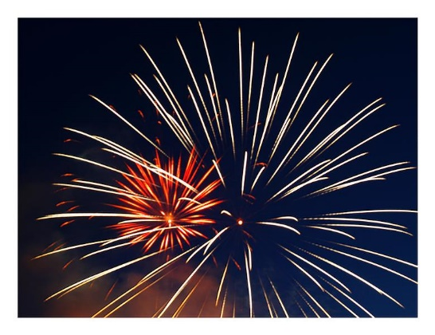

Msc ISEM / Kedge BS ?

Slide 8
Kedge Business School and Sport Expertise : Inputs & Outputs ?
Research
N1 Europe
Ms ISEM
(N1 France
Top 10 World)
Msc Marketing
Summer School
PGE (ESC)
5 profs
LM
JPD
FP
JMM
FR
+
Alumni
Networks
Alumni
Companies
Institutions
Academic
(Project)
Communication
Media
N1 (School)

Slide 9
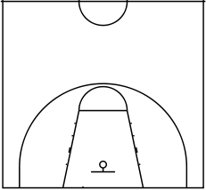
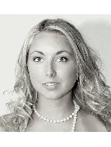
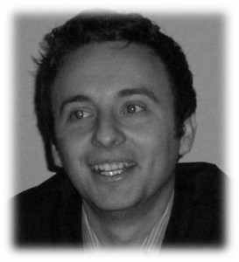
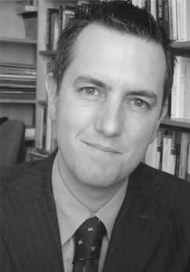
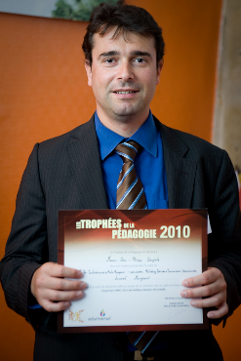
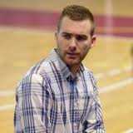
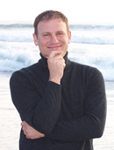
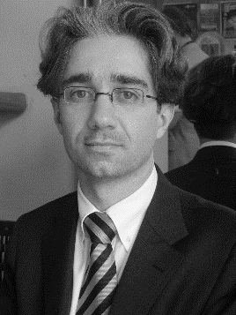
Lionel
Maltese
Jean-Michel Marmayou
Jean-Philippe Danglade
Aurélie Fersing
Alejandro Requena Ramón
Frank
Pons
Fabrice Rizzo

Slide 10
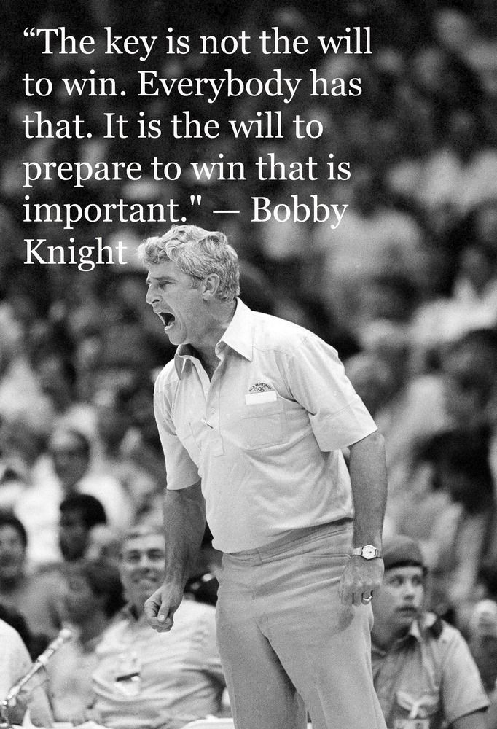
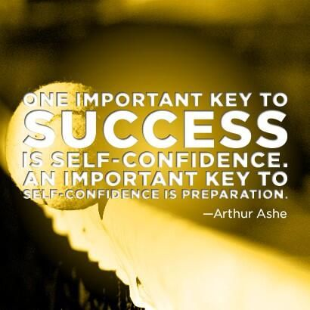

Slide 11
YOUR PROGRAM
Sport Business Conferences :
NBA-FFT-UBISOFT, Kantar, OM-ADIDAS-PUMA…
SEMESTER 1
Commercial business strategies in sport organisations |  | BOUVRANDE Thomas 6H / WEISZ Michael 9H / MALTESE Lionel 15H
Commercial Sponsorship and Operational Activations |  | CARILLAT François 15H / GUILLET Marie-Amélie
Sport Media Consulting and Event Communication Strategy |  | FERSING Aurélie (15H) / ROGER David (15H)
Event, Experiential, Social and Cultural Marketing for sport |  | PACE Stefano 15H / RINALLO Diego 15H
Sport Career Services and labor market opportunities |  | INNOCENTI Damien (30H)
Droit des compétitions Sportives et de ses acteurs |  | RIZZO Fabrice 30H
SEMESTER 2
Strategic Management and sales & Digital marketing in Sports Organizations |  | MALTESE Lionel 15H / LADIK Daniel 15H
Economie du sport spectacle |  | DURAND Christophe 30H
Fan Experience and Stadium Strategic Management |  | THIODET Anthony 18H/ LEPRON Julien 12H
Brand Management in sports organizations |  | PONS Franck 30H
Sport RSE & Destination Marketing |  | FRANCOIS Aurélien 15H / DANGLADE Jean-Philippe 15H
Organisation contractuelle du spectacle sportif |  | MARMAYOU Jean-Michel 30H

Slide 12
My job for you
Be reputational to promote you ! Professional & academic publications – business – networks - alumni
Attract experts both academics and professionals to tranfert knowledge and competencies (my role)
Students help for selection
I am not your Director and not an administrative people (no time for that and not possible legally)

Slide 13
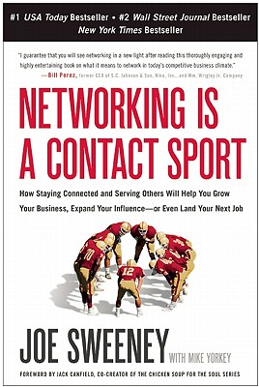


Slide 14
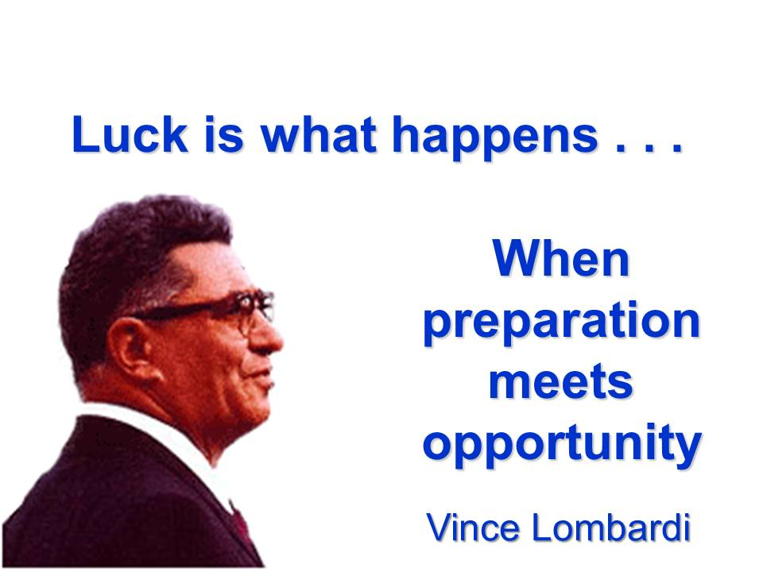
Vince Lombardi

Slide 15
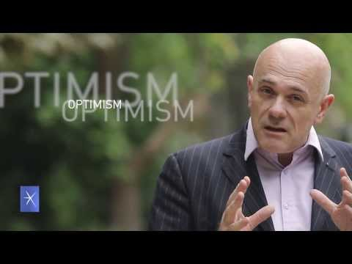

Slide 16
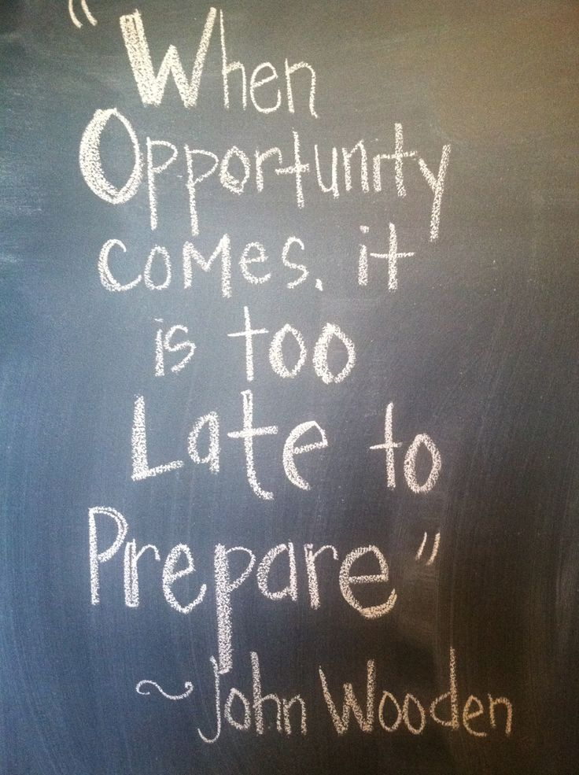

Slide 17
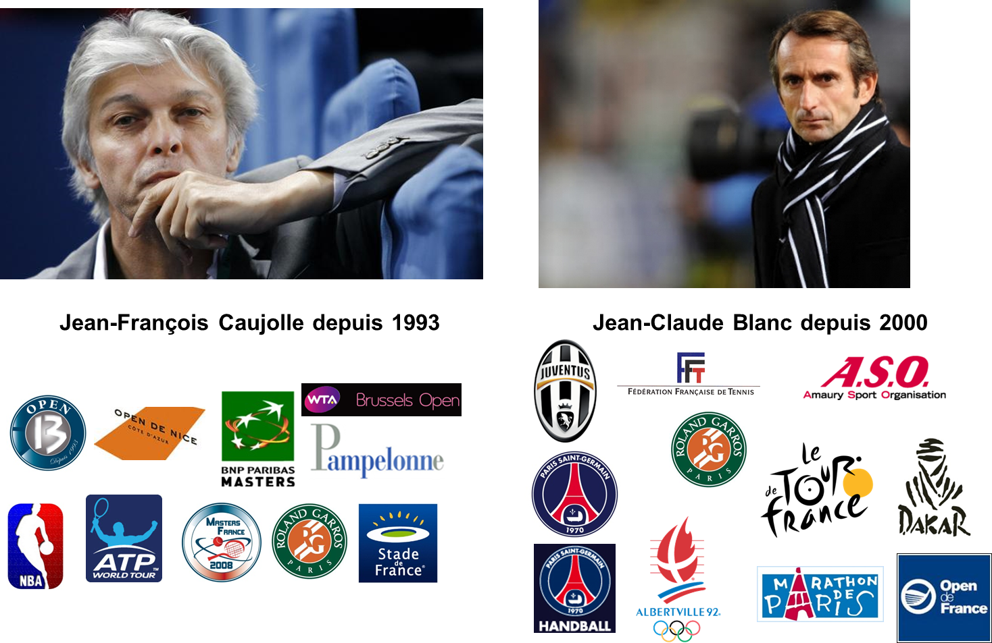
Jean-François Caujolle since 1993
Jean-Claude Blanc since 2000

Slide 18
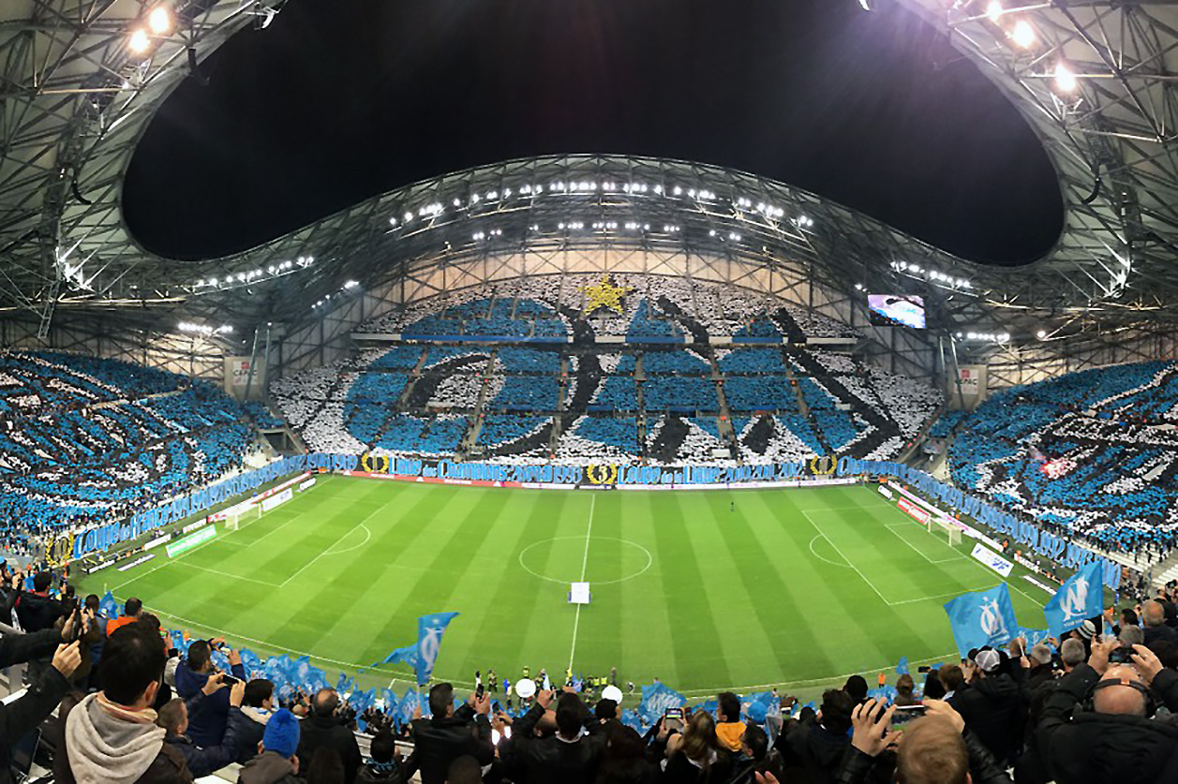

Slide 19
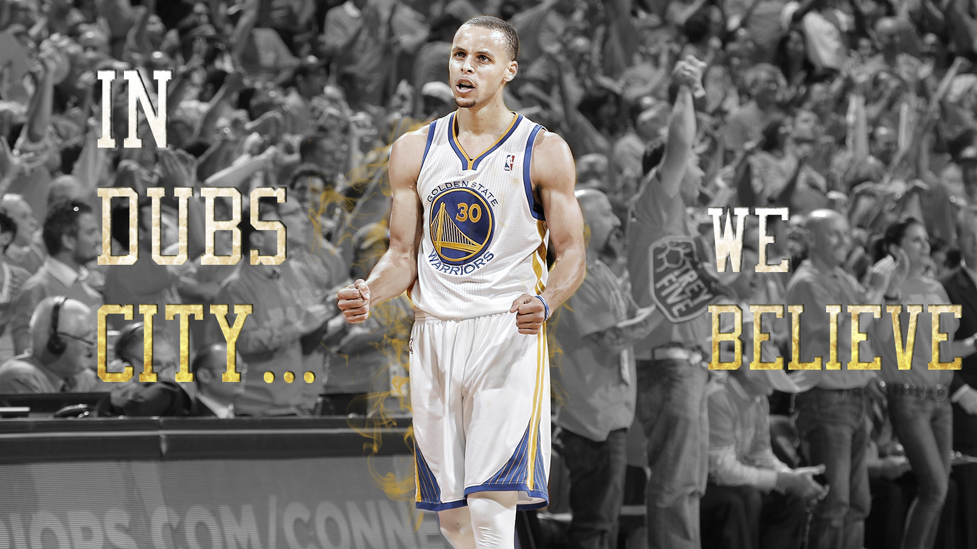

Slide 20
SPORTAIMENT BUSINESS
PLACE
&
MOMENT
FOR
FANS

Slide 21
Marshall Glickman
CEO G2 Strategic, former president of the NBA’s Portland Trail Blazers
Over the last four decades, sports in North America has evolved from pure competition to business…from game to entertainment. Although the quality of competition has remained the centerpiece, North American sports culture is primarily motivated by money.
In France, as in most European countries, the sports culture has historically been driven by the competitions themselves, so consumption trends are not comparable. That said, there is no question that economic reality is driving French sports organizations to become more professional and oriented to business and profits.
From the perspective of an American who has extensive experience working with European and French sports organizations, finding the right balance between economics and culture is precisely the right recipe for success.

Slide 22
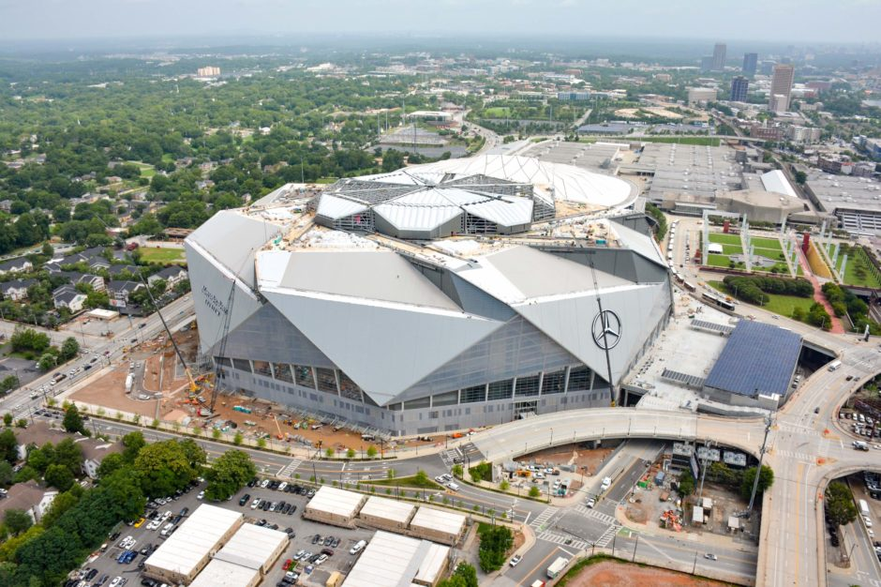
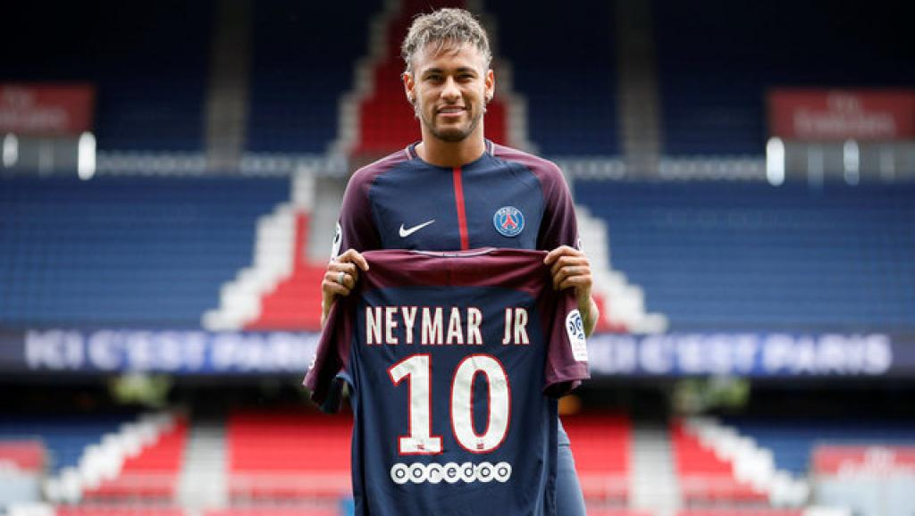
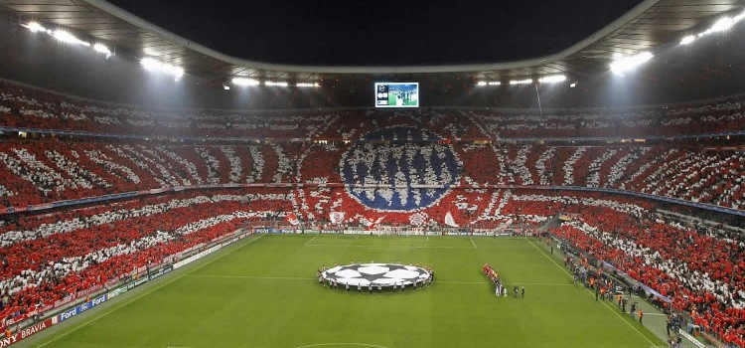
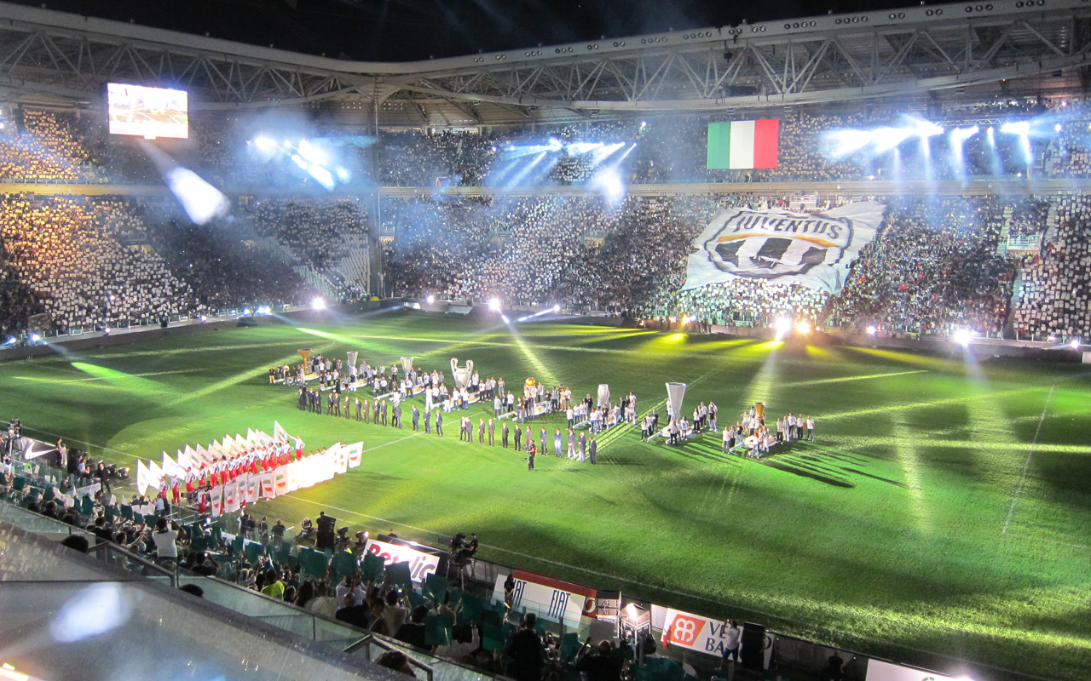
New sport Business model ?

Slide 23
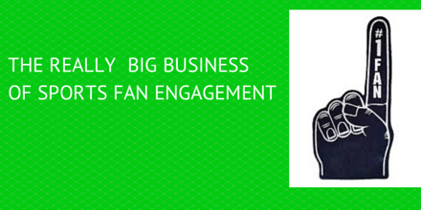
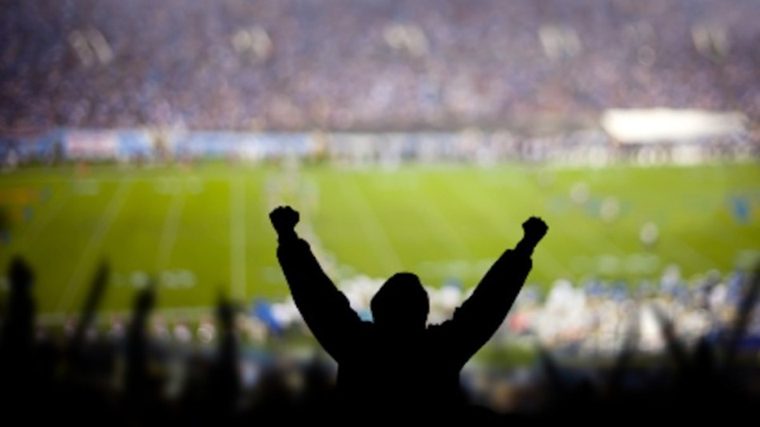

Slide 24

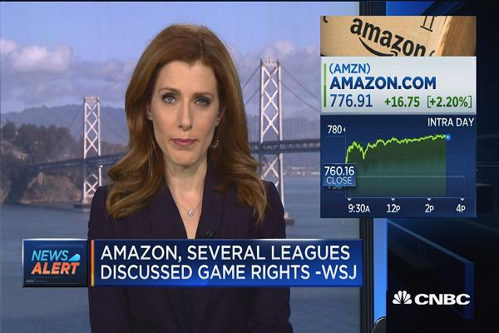

Slide 25

Sport Marketing Digest : Communication - Networks – Experiences – Brand
Relational Marketing
CRM – Ticketing – RP – Social Capital
« The Place to be »
Experiential Marketing
Entertainment BtC BtB CtC
« The Place to show the show »
Brand Management
Merchandising – branding
« The Place to express your brand »
Event Communication – Commercial Sponsorship
« The Place to leverage and activate »

Slide 26
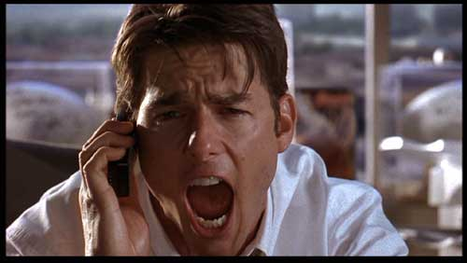
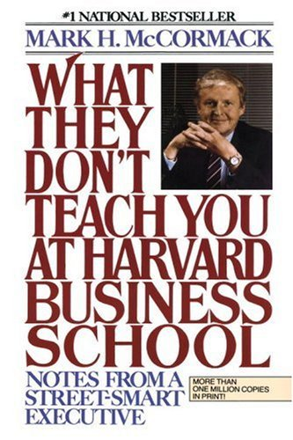
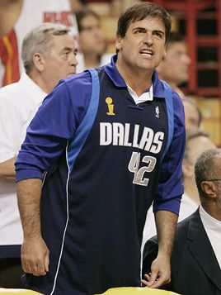
To be a value-added in sport business
Or american dream !
Business Marketing capabilities !

Slide 27
Competencie ?
Success comes from knowing that you did your best to become the best that you are capable of becoming. John Wooden
EXPERIENCE
Knowledge
EXPERTISE
Know-How
TEAM
Being
(know how to be)

Slide 28
Sport business market competencies
SALES : Ticketing, PR, Activations, Rights, Sponsorship, Negociation, Merchandising, Licencing, CRM (FRM), Place Management…
COMMUNICATON : Branding, Digital, Medias, PR
EVENT MANAGEMENT : Coordination, Project management, Suppliers management, Recruitment, Human organisation…

Slide 29
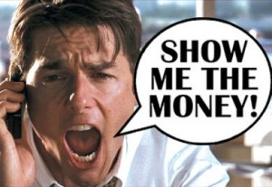
Course goal !

Slide 30
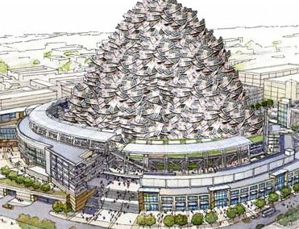
Exams
SPONSORSHIP ACTIVATION MANAGER
FAN RELATIONSHIP
MANAGER
BTB
SPONSORSHIP ACTIVATION
BTC
TICKETING / FAN RELATIOSHIP MANEMENT
3-4 Groups :
Activation for OM (Top Sponsors) : in RLD Center or Orange Velodromewith the direction !
50 %
Group our individual :
Ticketing and global Tennis Fans Strategy in Lyon (New ATP Event with Jo Tsonga and ASVEL (TP) End of October
50 %

Slide 31
Program : 15H and More !
Sport Business Markets and Case Studies
Sponsorship Activation
Ticketing and FRM Strategy
Workshop / Coaching : Activation for OM
Group Presentation

Slide 32

CASE STUDY 1
2006 - 2011
2011 - 2016
FUTURE ?

Slide 33
TICKETING
100 000
spectators
REPUTATION
SPORTAINMENT
FAN EXPERIENCE
GOALS
N1
INDOOR TOURNAMENT

Slide 34
Positioning
Servicing
Hospitality
General Public
Product*
Best Draw / Players
Experience
Entertainment
Fan Experience

Slide 35
ACTION
Tennis – Indoor
Number and games
time
Attraction
Stars
&
Show
“VOLUME”
Journey session
“DIFFERENCIATION”
Night session
Danger* !

Slide 36
Rentability
100K€ → 125K€
Innovation
Sportainment reference
Goals 2011-2016
Sponsorship ACTIVATIONS

Slide 37
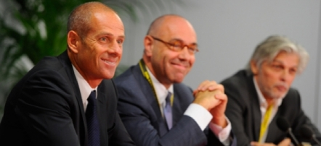
Competencies…

Slide 38

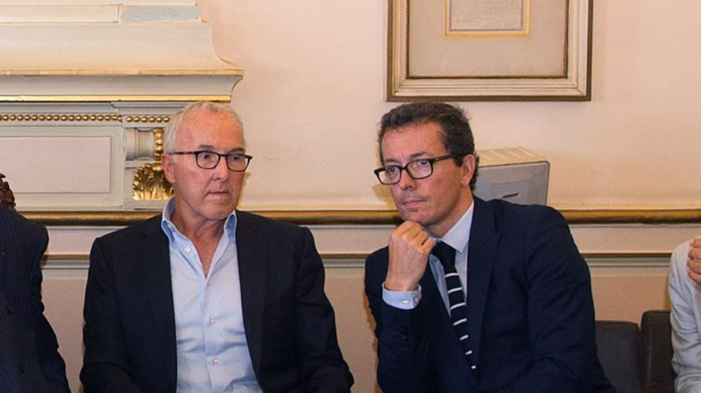
OM « Champion Project »
Top Sponsors renew :
2017 : Intersport, Caisse d’Epargne, Mutuelle du Soleil, Winamax, Boulanger, Coca-Cola, EA Sport, Onet
2018 : Adidas, Citroën, Quick
2026 : Orange
New owner from US (F. McCourt and Staff, JE Eyraud)

Slide 39
Business & Marketing Organisation
TICKETING
MS
FAN
GMS
BRAND
SV
SPONSORSHIP
HOSPITALITY
BK
BTB
SERVICING
AM
$
Tickets – Match Day Revenue
$
Sponsorship
Hospitality Events
$
Merchandising
Products

Slide 41
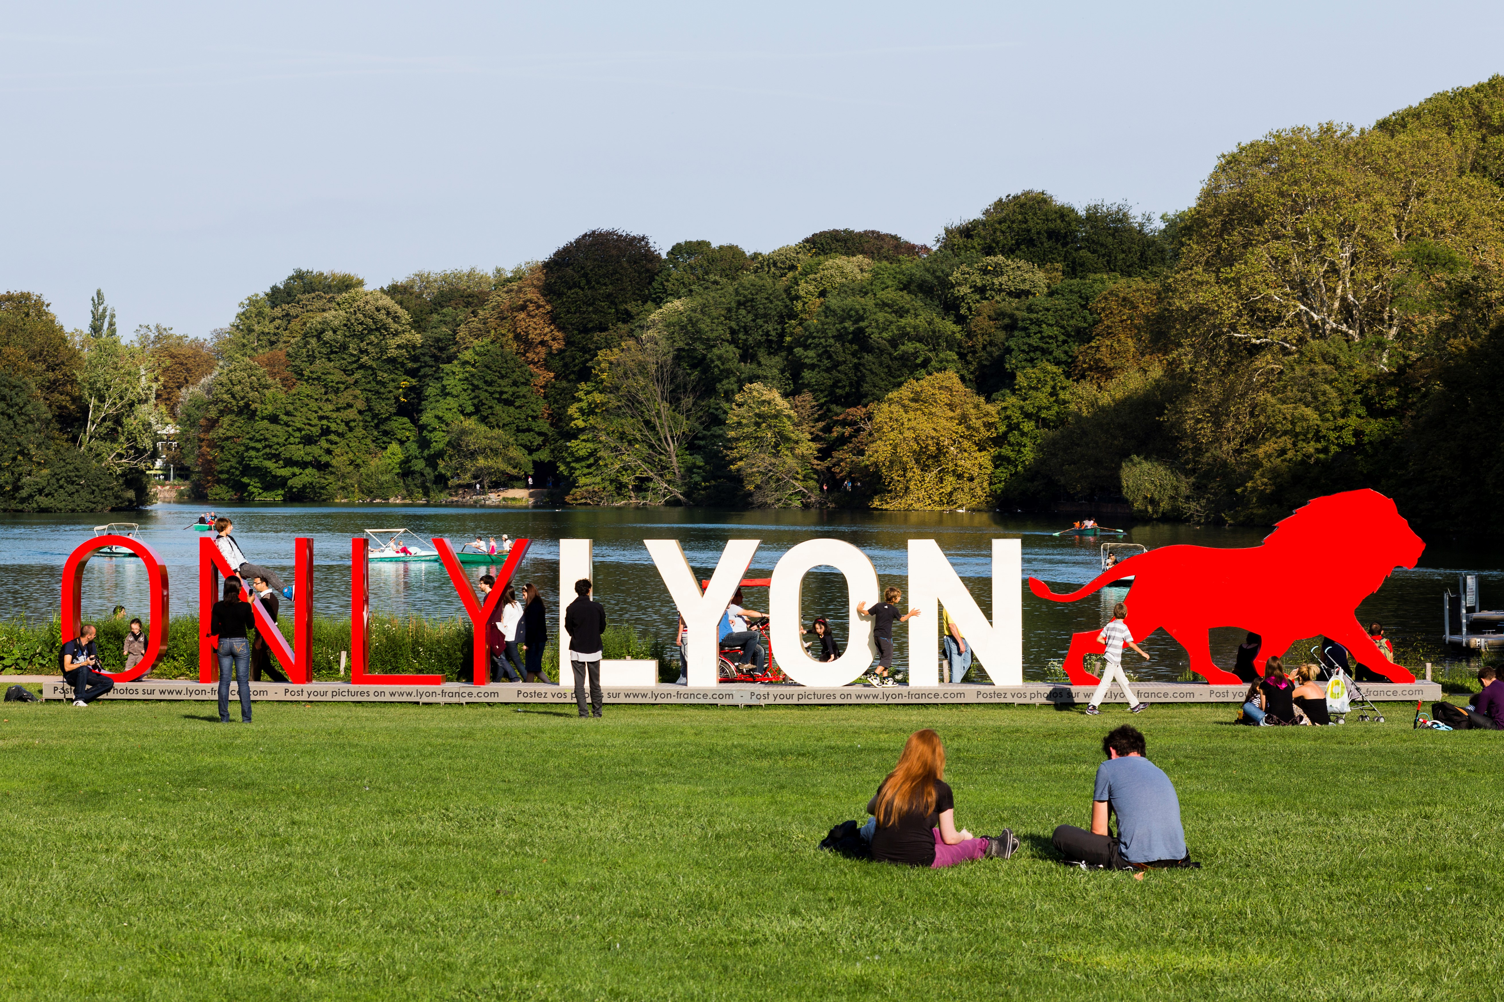


ATP250 LYON

Slide 42
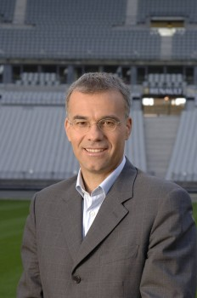
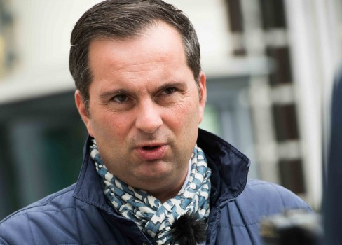

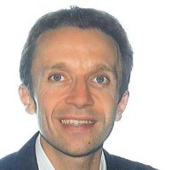
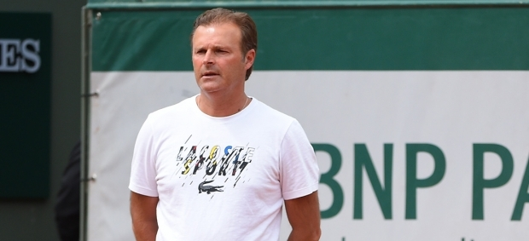

Slide 43

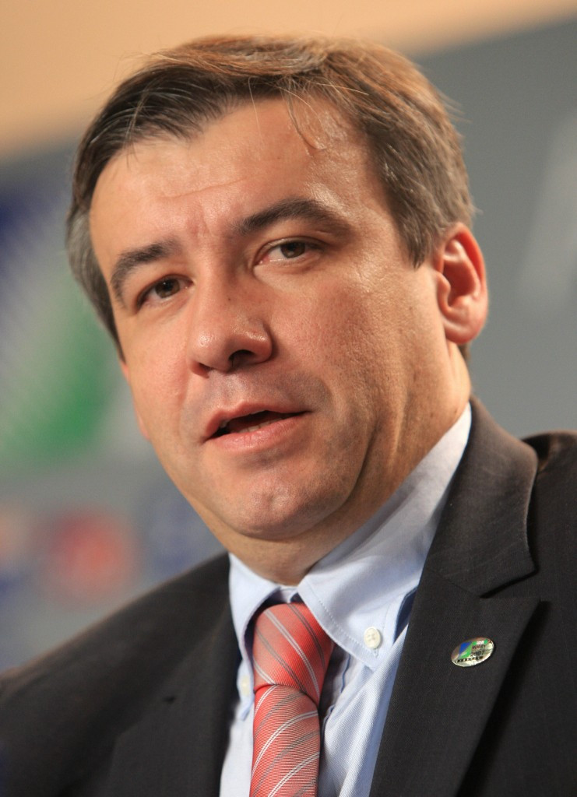
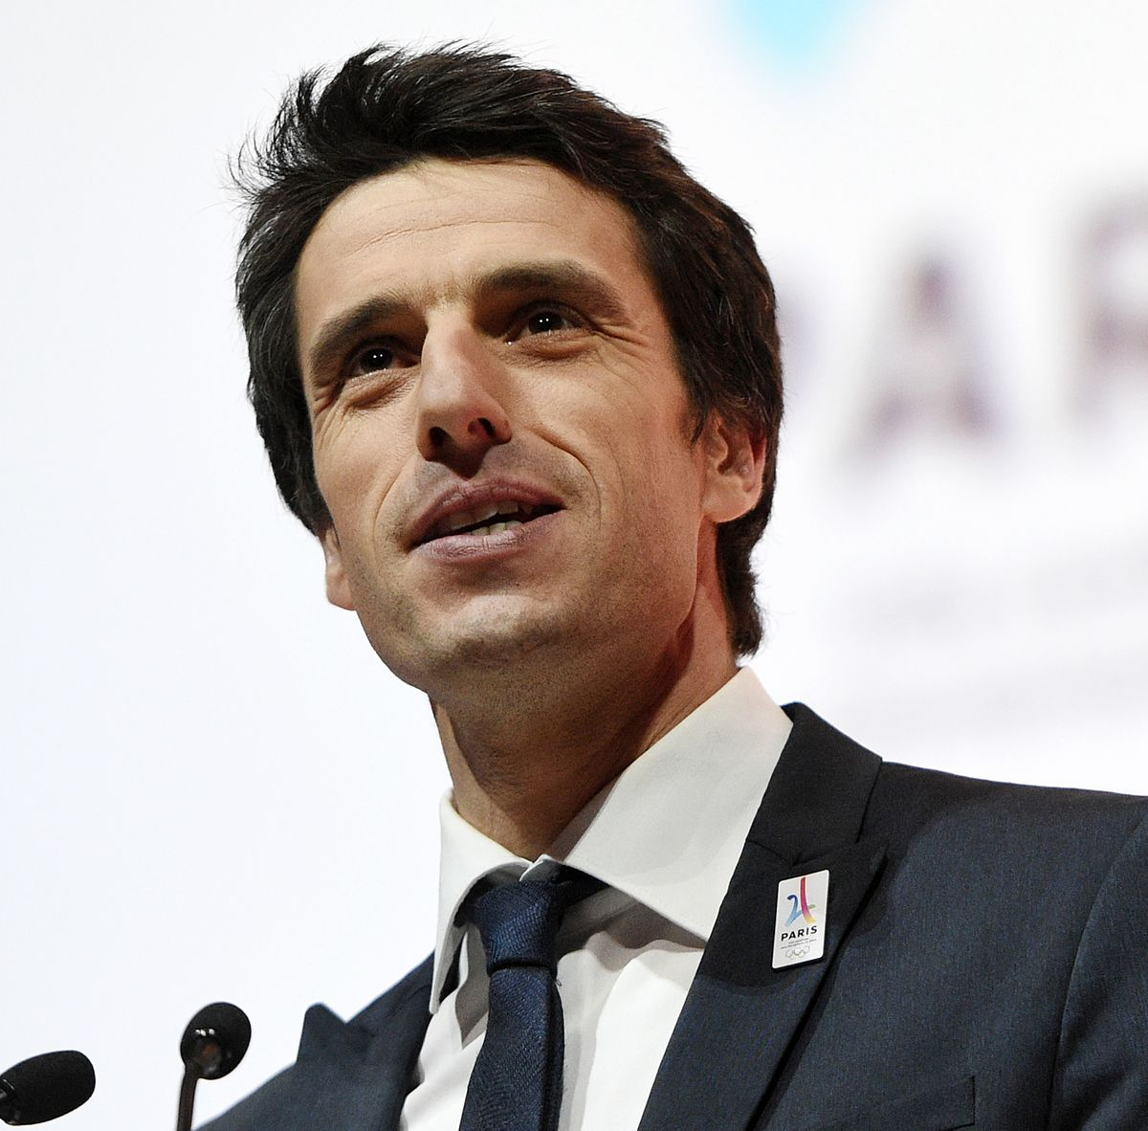
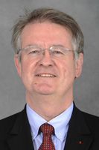

Slide 44

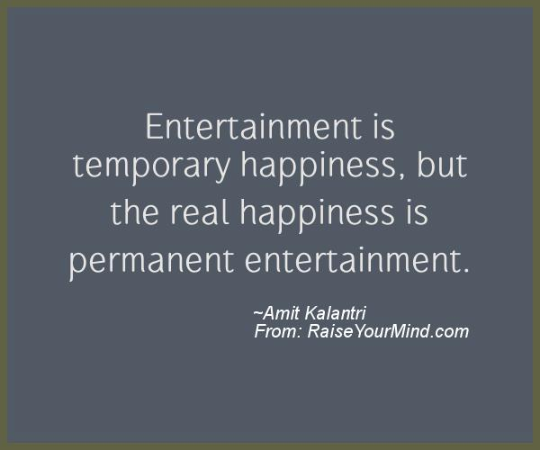

Slide 45
HOW DOES SPORT COMPARE TO OTHER INTERESTS?
– % of those ‘Passionate’ for each interest
% with Passionate in interests

