Slide 1
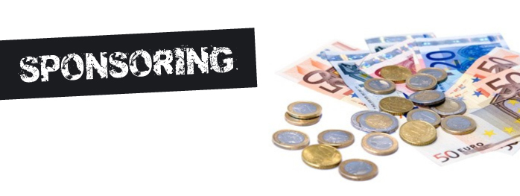
Services Marketing & Sports Management lionelmaltese.fr
@lionelmaltese
Lecture 1
Lionel Maltese
Maitre de Conférences Aix Marseille University – CERGAM IAE Aix-en-Provence
Associate Professor Sport BUSINESS Management Kedge Business School
Assets Manager ATP – WTA Events and consulting
Member of the Executive Committee FFT – Roland Garros – BUSINESS STRATEGY

Slide 2
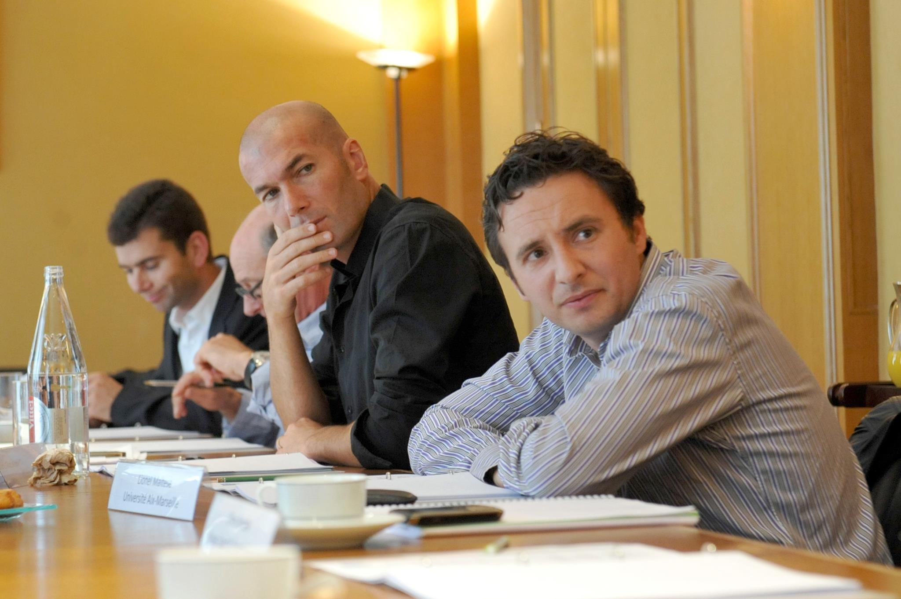
You are, you have…
Last diploma : Phd Business Management IAE Aix en Provence 2004 – Econometrics Engineer Aix Marseille University 2001
Last sport experience (this summer) :
OM Business Assets Consulting Mission & PSG Fan Marketing Mission
Roland Garros Hospitality & Public Relation Business Strategy with Jo Tsonga
ATP World Tour : Nice to Lyon transfert and business creation (JFC, TP, JWT) ,
FFT – Roland Garros Executive Comitee / Executive competencies help for recruitment
….
Sport Practice Fan… :
Tennis, Basket, Soccer, Rugby Seven, Paddle board… and anterior cruciate ligament (ACL) …
OM, Celtics, Juve, Warriors, Canadiens, Seahawks, Fed, Stan, Jo, Liza, Ray Allen, Curry, Voller, ZZ, Slater, Bird, Wilko….

Slide 3



















Since 2005
Maitre de Conférences
Aix Marseille University
Strategy & Communication
Associate Professor Kedge Business School
Sport
Business Management
Since 1999
Professional
ATP & WTA
Events management
Manager
Since 2001
Research
Aix Marseille University
Laboratory
Member of the Executive Committee
Economic Development – Business Strategy
Head of R&D Department
Consulting
Sport Business Strategy & Marketing

Slide 4
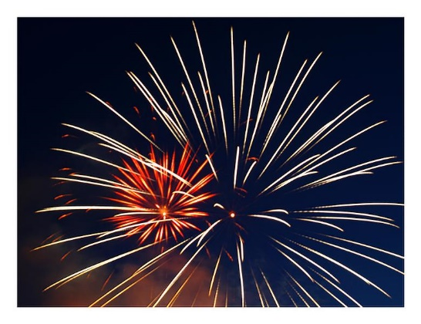

Msc ISEM / Kedge BS ?

Slide 5
Kedge Business School and Sport Expertise : Inputs & Outputs ?
Research
N1 Europe
Ms ISEM
(N1 France
Top 10 World)
Msc Marketing
Summer School
PGE (ESC)
5 profs
LM
JPD
FP
JMM
FR
+
Alumni
Networks
Alumni
Companies
Institutions
Academic
(Project)
Communication
Media
N1 (School)

Slide 6
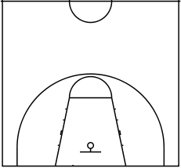
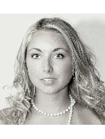
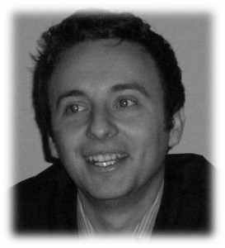
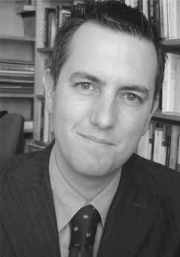
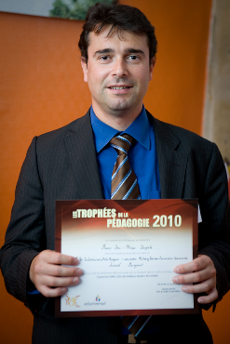
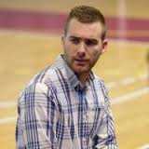
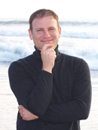
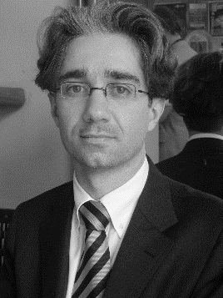
Lionel
Maltese
Jean-Michel Marmayou
Jean-Philippe Danglade
Aurélie Fersing
Alejandro Requena Ramón
Frank
Pons
Fabrice Rizzo

Slide 7
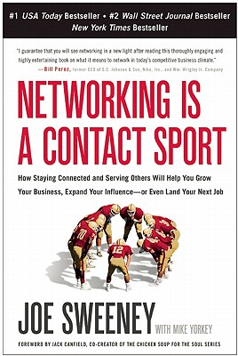


Slide 8
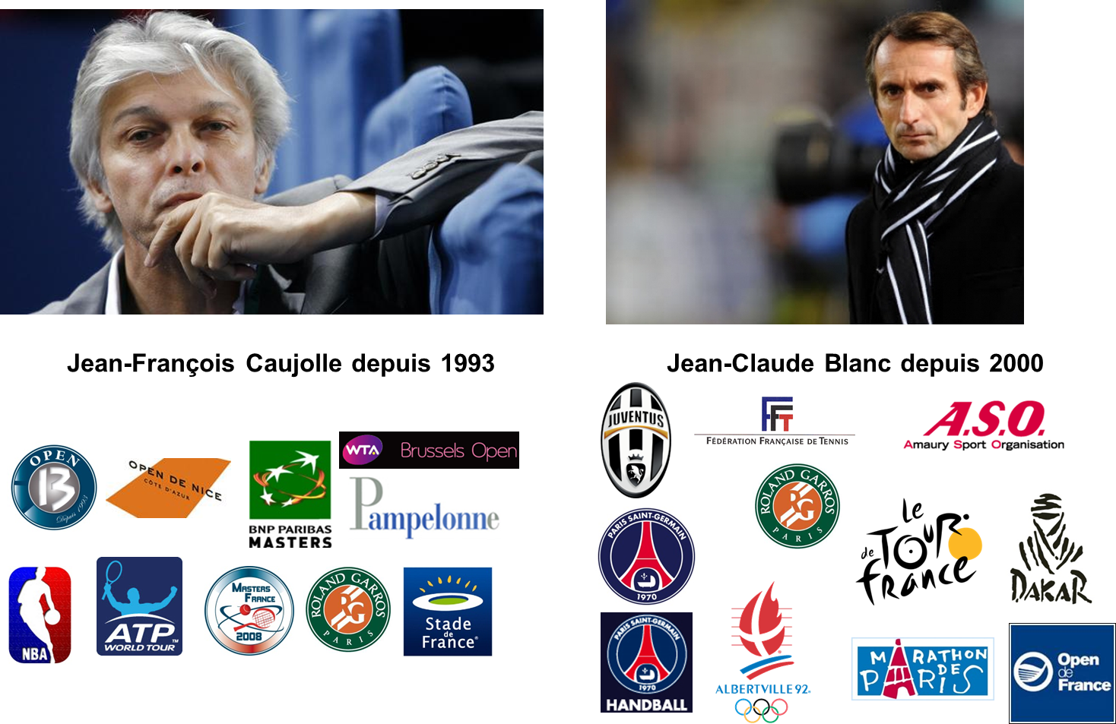
Jean-François Caujolle since 1993
Jean-Claude Blanc since 2000

Slide 9
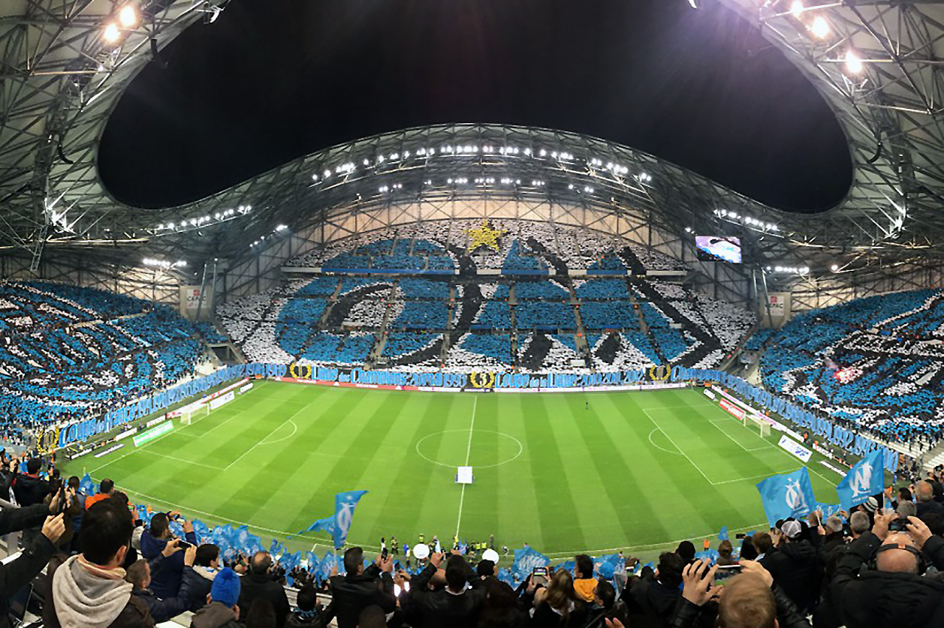

Slide 10
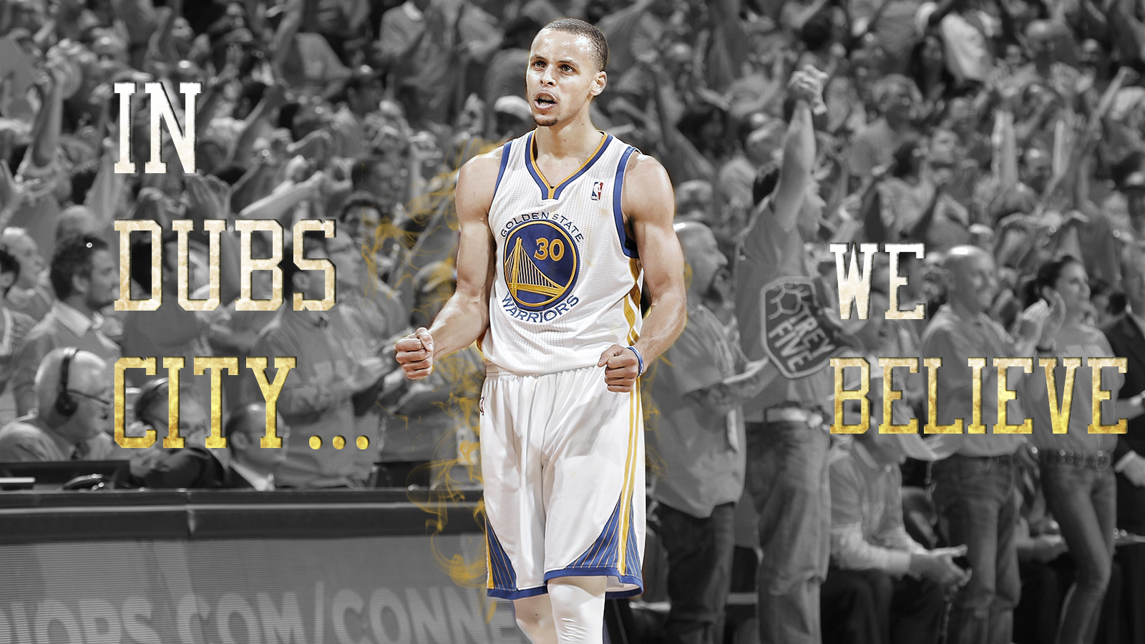

Slide 11
SPORTAIMENT BUSINESS
PLACE
&
MOMENT
FOR
FANS

Slide 12
Marshall Glickman
CEO G2 Strategic, former president of the NBA’s Portland Trail Blazers
Over the last four decades, sports in North America has evolved from pure competition to business…from game to entertainment. Although the quality of competition has remained the centerpiece, North American sports culture is primarily motivated by money.
In France, as in most European countries, the sports culture has historically been driven by the competitions themselves, so consumption trends are not comparable. That said, there is no question that economic reality is driving French sports organizations to become more professional and oriented to business and profits.
From the perspective of an American who has extensive experience working with European and French sports organizations, finding the right balance between economics and culture is precisely the right recipe for success.

Slide 13
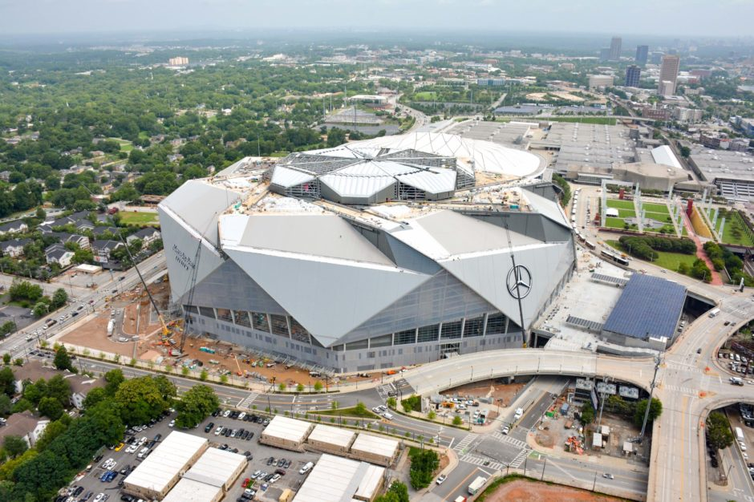
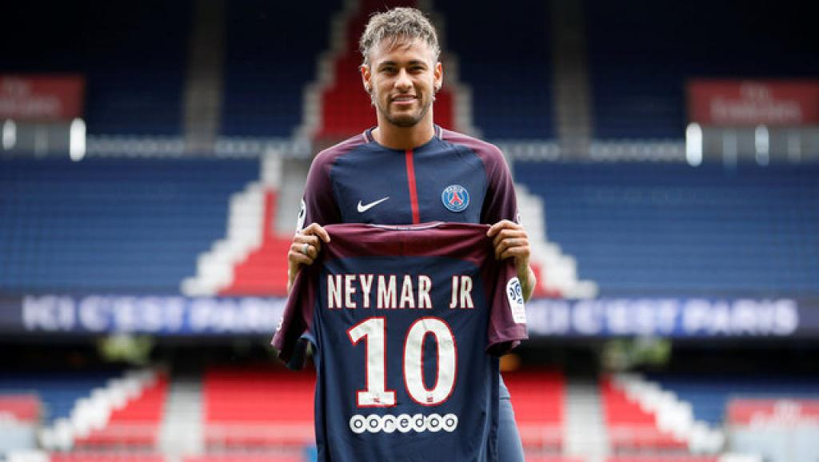
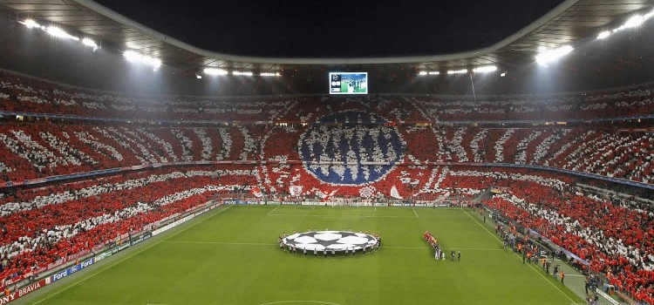
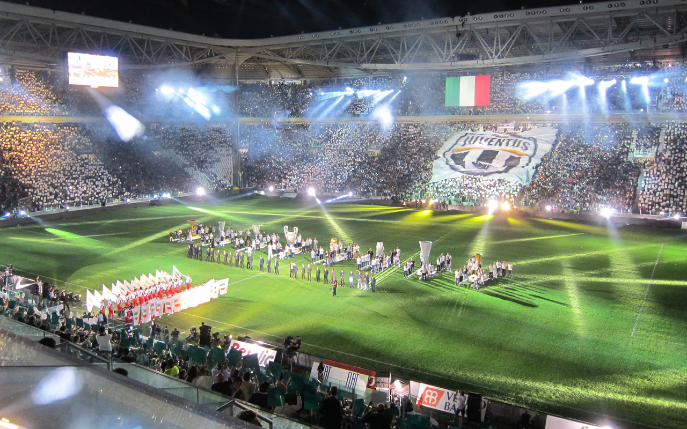
New sport Business model ?

Slide 14
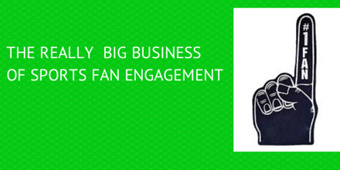


Slide 15
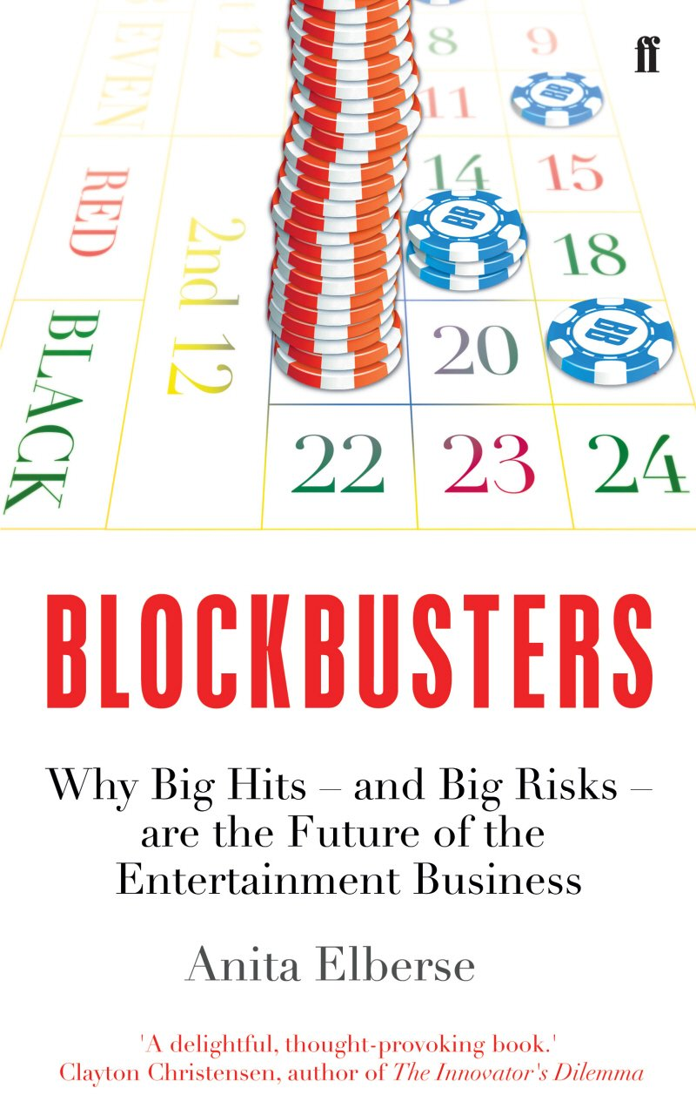
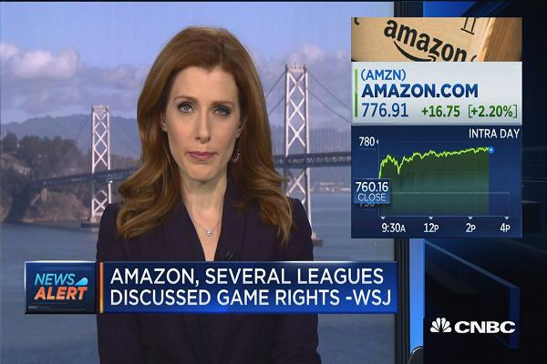

Slide 16

Sport Marketing Digest : Communication - Networks – Experiences – Brand
Relational Marketing
CRM – Ticketing – RP – Social Capital
« The Place to be »
Experiential Marketing
Entertainment BtC BtB CtC
« The Place to show the show »
Brand Management
Merchandising – branding
« The Place to express your brand »
Event Communication – Commercial Sponsorship
« The Place to leverage and activate »

Slide 17
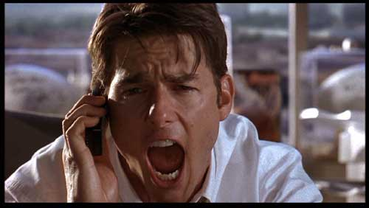
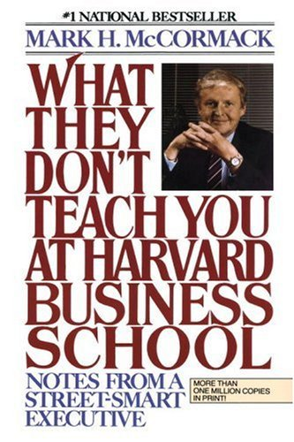
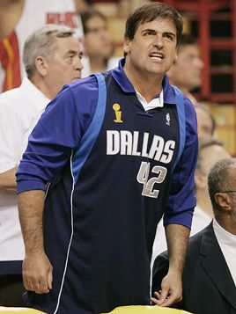
To be a value-added in sport business
Or american dream !
Business Marketing capabilities !

Slide 18
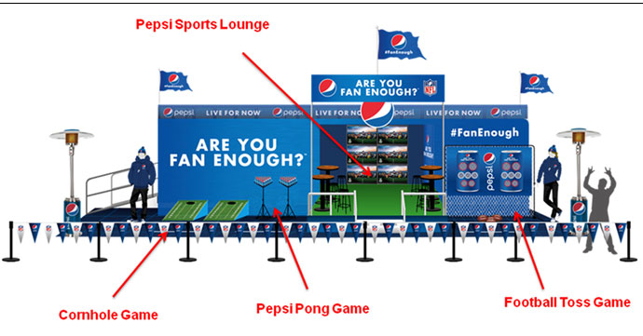

Slide 19
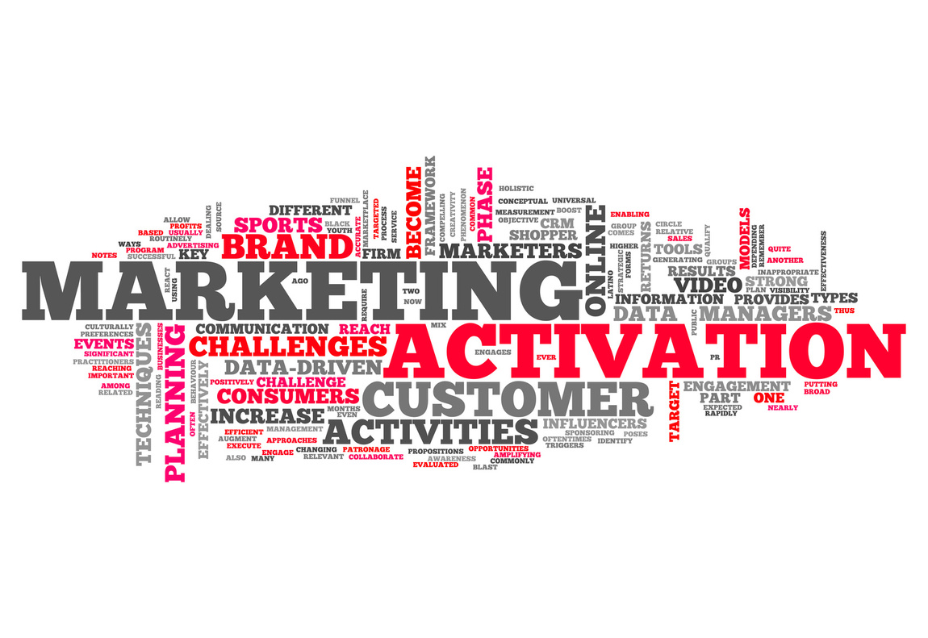
Our goals
As event or club manager : analysing and producing a sponsorship activation program
Operational approach :
  How to prospect for a new sponsor ?
  How to customize your sponsorsorship offer ?

Slide 20

NOW TRENDING IN THE SPONSORSHIP WORLD
1
THE MARKETPLACE (AND RIGHTS FEES) CONTINUE TO GROW
2
SPONSORS HAVE A BIGGER VOICE (AND RESPONSIBILITY?) THAN EVER
3
BRANDS REQUIRE PROOF OF IMPACT – BEYOND EXPOSURE
4
COMMUNITY / ACTIVATION / ENGAGEMENT PLAY A CRITICAL ROLE
5
DIGITAL HAS CHANGED THE GAME
6
E-SPORTS AND OTHERS ARE CHANGING IT FURTHER
7
SPONSORSHIP IS MORE STRATEGIC THAN EVER
… BUT YOU ALREADY KNEW THAT

Slide 21















GLOBAL DEDICATED CUMULATIVE TV AUDIENCE
Select Events - Year-end 2016
FIFA WORLD CUP BRAZIL 2014
OLYMPIC GAMES RIO 2016
ICC CWC 2015
FORMULA ONE
(ALL RACES)
ATP TENNIS FINALS, 1000S, 500S & 250s
(62 EVENTS)
WTA TENNIS PREMIER & INTERNATIONALS
(56 EVENTS)
RUGBY WORLD CUP 2015
THE EMIRATES
FA CUP
AFC CHAMPIONS LEAGUE 2015
China Super League
306m
367.8m
408m
499m
580m
937.7m
1.32bn
1.56bn
1.9bn
3.6bn

Slide 22
THE FUTURE OF DIGITAL SPORTS CONSUMPTION
– % of sports content via PC/Laptop or Mobile/Tablet

Slide 23

GLOBAL SPORTS SPONSORSHIP SPEND
– US$ Billions
Based on projected figure for 2016

Slide 24
SPONSORSHIP SALES
– Sector stabilisation returns
1
FINANCIAL SERVICES most volatile, but stabilising
2
BEVERAGE SECTOR on the rise
3
AUTOMOTIVES slight decline, still top 3
4
TELECOMS steady decline since crisis
Trend analysis by sector

Slide 25
Sponsors goals
WHY ?
HOW ?
Top of mind (notoriety), image, reputation !
Increase sales / product ou service placement
CRM, Prospection
Internal communication
Connect the fans to the brands
Media – Social Media – PR
On site marketing operations
PR (BtB & BtC)
PR
Activations

Slide 26
Definition
Provision of assistance either financial or in kind to an activity by a commercial organization for the purpose of achieving commercial objective (Meenaghan, 1983)
Sponsorship involves two main activities (Cornwell and Maignan, 1998) :
  Exchange between a sponsor and a sponsoree whereby the latter receives a remuneration (cash or in-kind contribution) and the former obtains the right to associate itself with the activity sponsored
  Marketing of the association by the sponsor

Slide 27
Sponsor support : financial or not
SPONSOR
Firm, non profit organization, institution…
SPONSORED
Entity : individual, group, oragnization, event…
Area : sports, arts, environment..
Benefits for the sponsor : achieve communication objectives
Media
Sponsor
target
Sponsored
Target
PUBLIC

Slide 28
Sponsorship strategic approaches
Passion : executive passion for sport (« President dancer ») : RLD, Kampf, Weber, Lagardere…
Opportunism : business project using sponsorphip potential : Sodexo, Veolia, Vinci, Eiffage, Bouygues, Thomson & PSG…
Strategic : sponsorshsip integration into a global brand strategy : We all speak football, We are tennis…

Slide 29
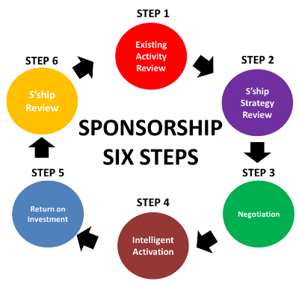

Slide 30

In the real world
→ 75 % : Executive meeting and individual introducing
2 personalities
Actor games
Serendipity capability
→ 25 % strategic process / brand strategic management

Slide 31

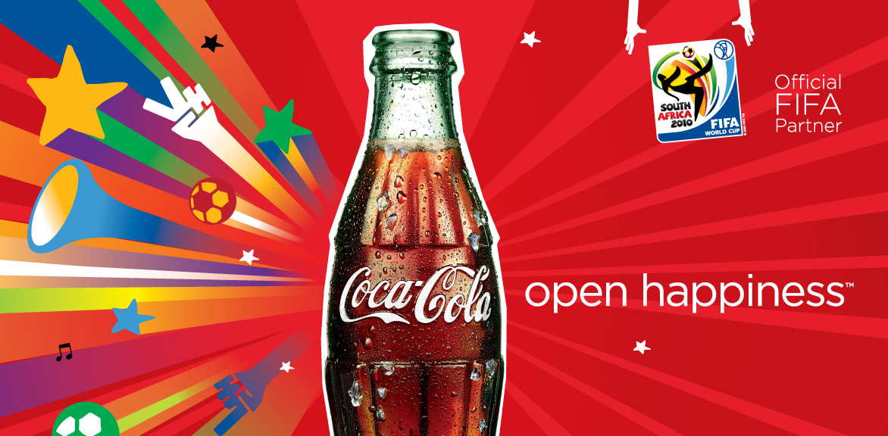

Slide 32
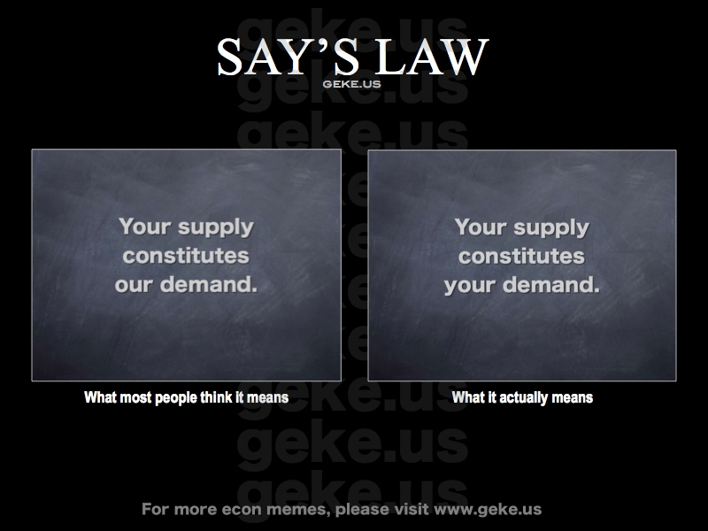

Slide 33

Mega event & the rest
Demand > Supply
Best clubs and events
Sponsor selection
Financial optimization
Open call - closing
Demand < Supply
Others clubs and events
Customization
Prospect
Introducing + closing

Slide 34











Make the difference
Competitive advantage
Not only visibility !
Reputation !
Visibility
+
Sensemaking activation to create a difference

Slide 35
The Place to leverage and activate
Sponsorship leverage can be defined as “the act of using collateral marketing communications to exploit the commercial potential of the association between a sponsee and sponsor.”
Activational communications (or activation) can be described as “communications that promote the engagement, involvement, or participation of the sponsorship audience with the sponsor”
(Weeks, Cornwell & Drennan, Psychology & Marketing, 2008)

Slide 36
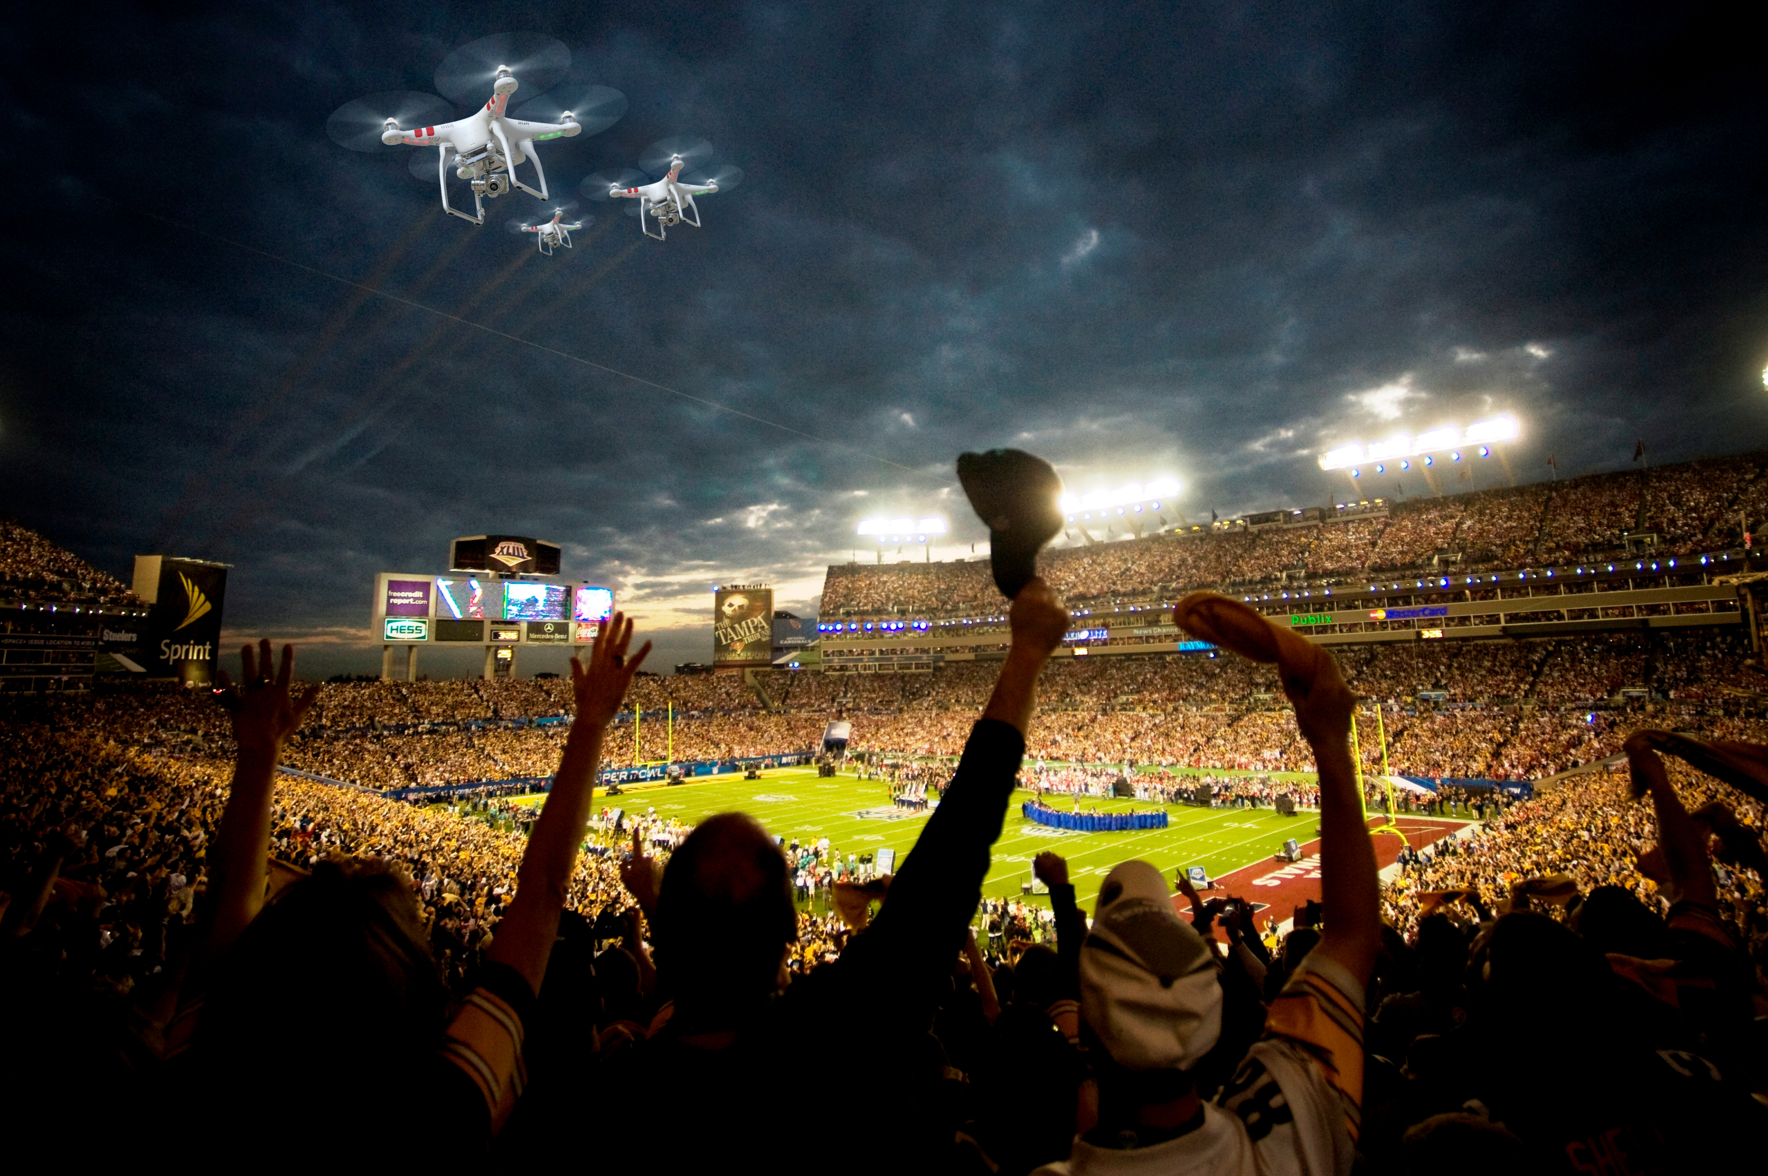
ACTIVATION
« Connect the fans to the brands »

Slide 37
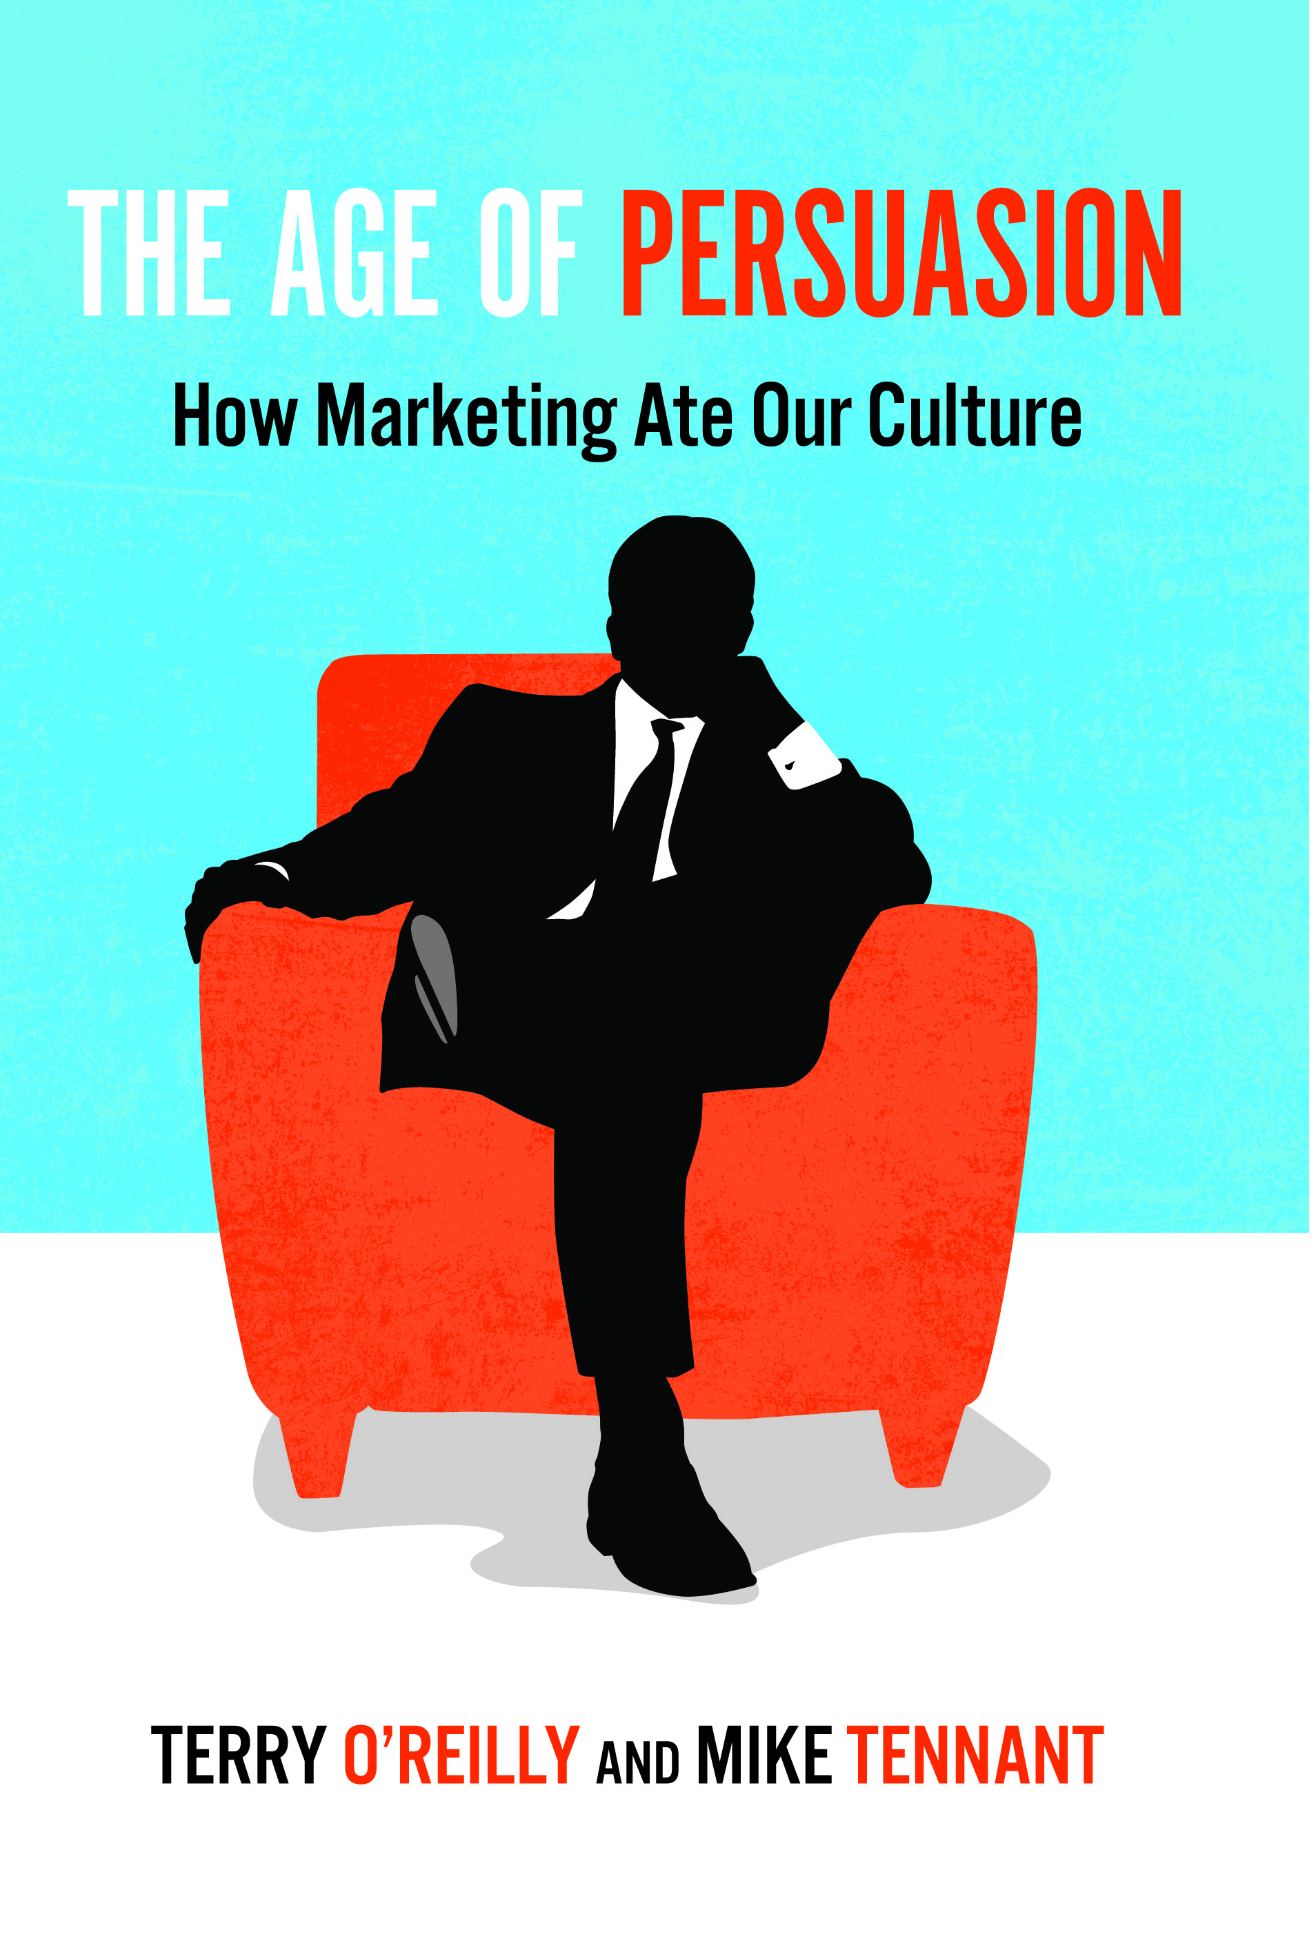
Promotional strategy
Any form of communication used to inform, persuade or remind about company products and services (Keller)

Slide 38
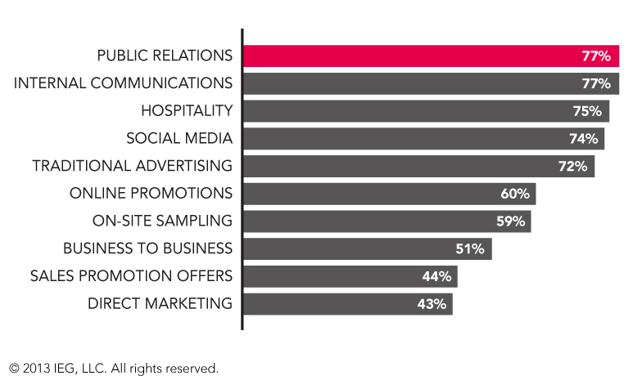
Which of the following marketing communications channels do you use to leverage your sponsorship programs ?

Slide 39
Activation axis
Sponsorship –
Event Communication
Visibility
Relational
Hospitality
Entertainment
Experiential
classical
CRM
Services Marketing
Experiential Marketing
innovationt

Slide 40
Activation tools
Billboards
Printed
supports
Cause Related
Marketing
Scoring
Referees
PR
Media
Supports
Web Marketing
Web 2.0
Fans
Objects
Special Events
Human
Supports
Mobile
Maketing
Stands
Naming
Seminars
Conferences
Games
Official
Supplier
Branding
Visibility
Relations
Participation
Involvement

Slide 41
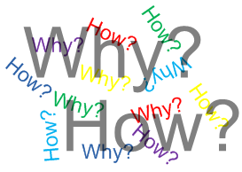
So what ? How to Implement ?
Back to the basics :
WHY ? : targets, visibility, value, internal communication,… [needs + sponsors goals]
HOW ? : activation tools panel [answer needs + objectifs]
= your JOB !

Slide 42
Agencies… or not !
Sport Marketing
Agencies
Club / Event
Sponsors
Need
For
Competencies
Commercial
Sponsorship
Direction

Slide 43
Activation program process
4. Evaluation ROO or ROI
3. Activation - Action
You are on the field
5. Evolution –
Dynamic program
Loyalty
2. Customaze your offer
Sensemaking proporsals
You are not a prof !
Using 3 packs (light – medium – gold)
1. Prospecting – Analyzing - Spying
For a new sponsor
Special individual access and information
by your top management or owner

Slide 44
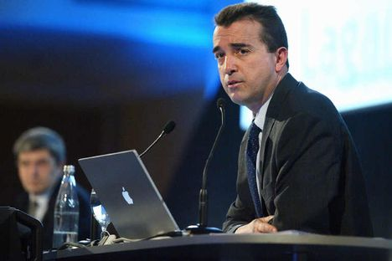

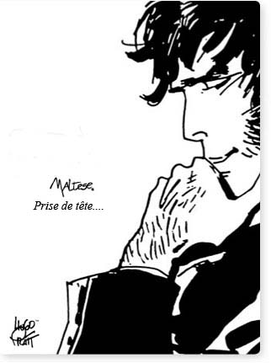


CEO personnality « passion » activation

Slide 45

Basketball competition and free practice
Open area for a general public
Elite championship 5*5
8 cities in Europe : Lyon, Paris, Cologne, Munich, Madrid, Barcelona, Milan, Roma

Slide 46

Visibility activations :
  Street marketing , flyers, printed supports, TS staff.
  Staff + presents for players
  Court: 16 m billboards, wall ITW, tents.
Sensemaking activations »:
  Champion of the Court : 1 vs 1 (300 - 350 players per day)
  2 targets : elite – teens (streetware)

Slide 47

Visibility activations :
  Printed supports logo
  Staff with Nike (shoes) – Winners (shoes)
  Court : 10 m billboards
Sensemaking activations »:
  Nike – 3 point shootout
  Stand for shoes
  Jordan Camps recruitment : buzz

Slide 48

Visibility activations :
  Printed supports logo
  Referees / Foot Locker clothes
  Court : 10 m billboards
Sensemaking activations :
  Flyers + website NBA jam 06 : Foot Locker shop to get your ticket to play
  Game « Foot Locker 10 000€ » : shot from the center of the court.
  Promotional coupons for players and winners

Slide 49

Visibility activations:
  Printed supports logo
  EA Sports Lounge area
  Court n°2 : EA Sports 10 m billboards
Sensemaking activations
  NBA Live 07 video game promotion with stands
  Virtual tournament : European finals (finalists : match Suns / Sixers – Winners : All star Game invitation in Las Vegas 07)

Slide 50

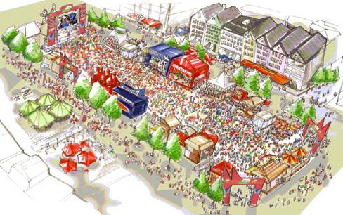
Fan Fest

Slide 51

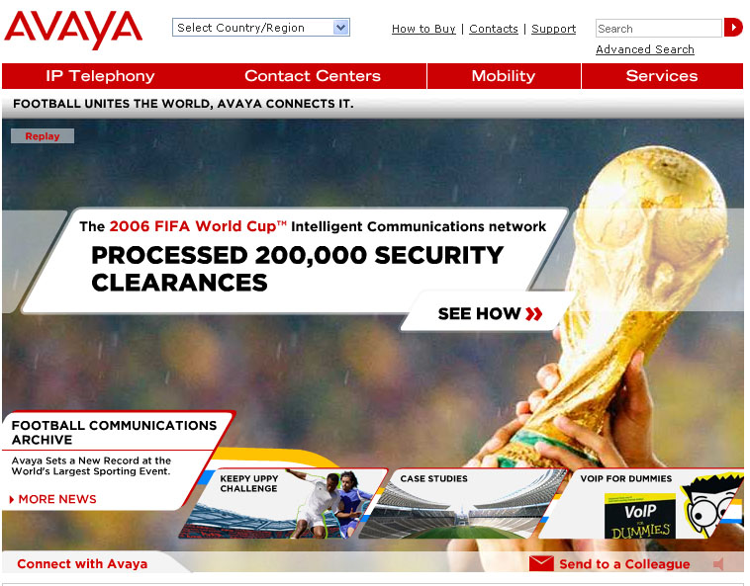
Communication services supplier
Visibility activation:
  Field : 2-4 billboards 8*6.50 m
Sensemaking actiovations
  Website : official facts – news – products
  Promotion services Voice over IP : press, media…

Slide 52

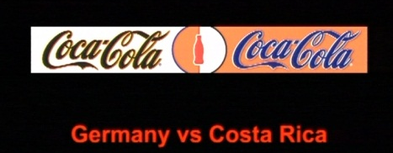
Powerade official supplier ‘energy drink’
Bonaqa official supplier « water »
« We all speak Football » campaign
Visibility activations :
  2 à 4 billboards
  Visibility using teams colors
Sensemaking activations
  FIFA World Cup ™ Trophy Tour :
  Official balls
  Coca-Cola Football Camp
  Panini Virtual Football Stickers
  Children / 6 villages SOS FIFA

Slide 53
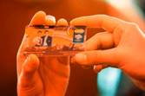

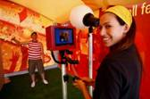
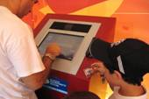
+ 20 years with FIFA → Brand Visibility / N1 International soccer / Relations users + banks
Visibility activations :
  2 – 4 billboards
  90 min TV broadcas : 10-13 min brand visibility
Sensemaking activations
  Hospitality
  Master Card « Priceless Photo » : (Pelé – Klinsmann) / credi card souvenir
  Cities soccer championship by Master Card

Slide 54
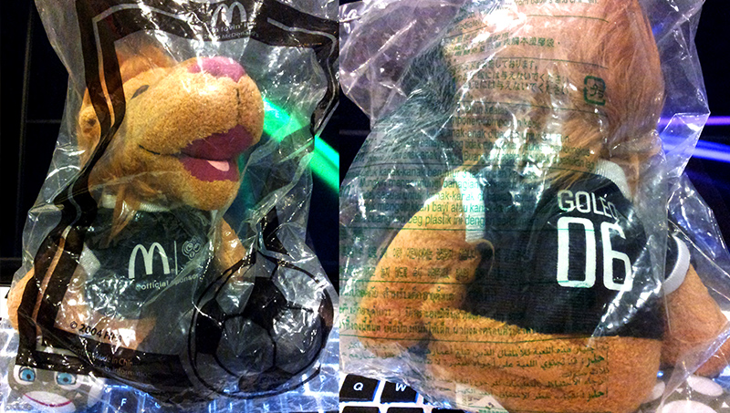
Visibility activation :
  2 – 4 billboards
Sensemaking activations »:
  McDonald’s Player Escort Program : 1048 children (6-10 years)
  Special promotions :
    Germany : Goleo / Celebrity endorsment / Tickets
    Brazil : Countries Burgers
    China : TV adverstersinng and goodies
    USA : Limited goodies FIFA World Cup
    India : coccer table games Mcdonald’s
    Japan : Mini balls and mino Goleo
    Mexico : packaging
    UK : mobile games« A tex to Win » with Georges Hurst (CDM 1966)
  Exclusivity : FIFA Fantasy football
  Salads, fruits… McCofee…
SALES PROMOTION + SOCCER ENGAGEMENT

Slide 55
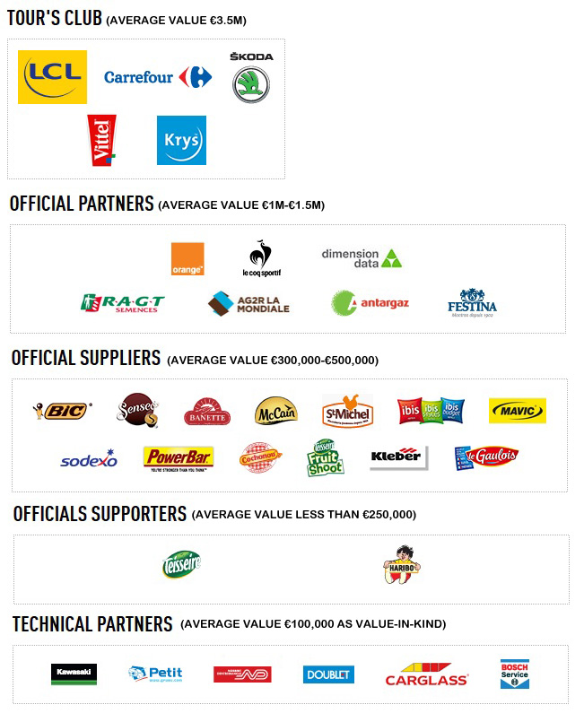


Slide 56
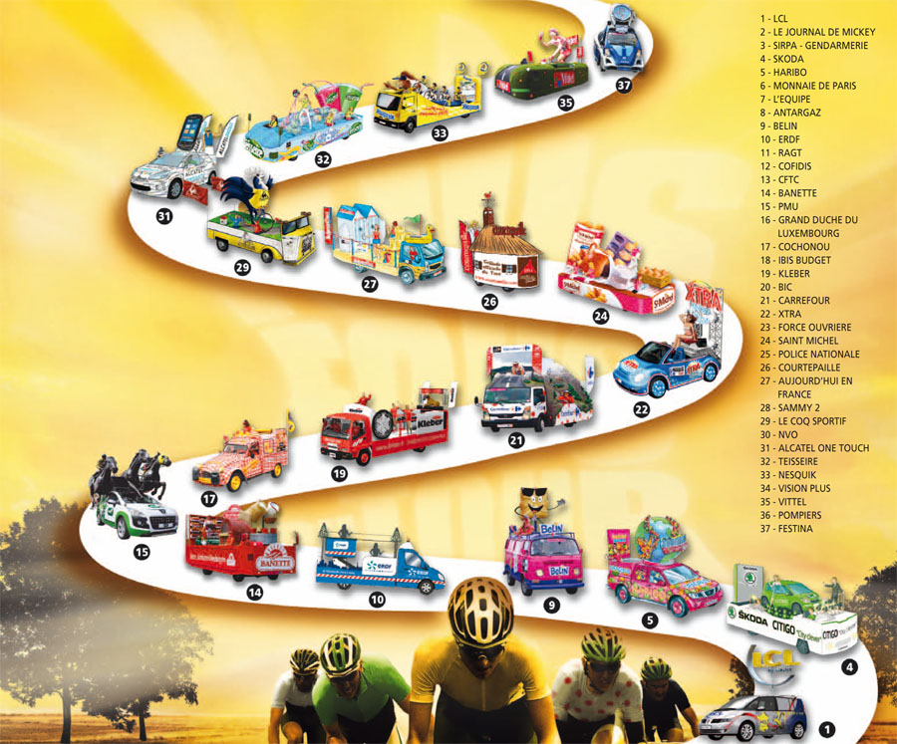
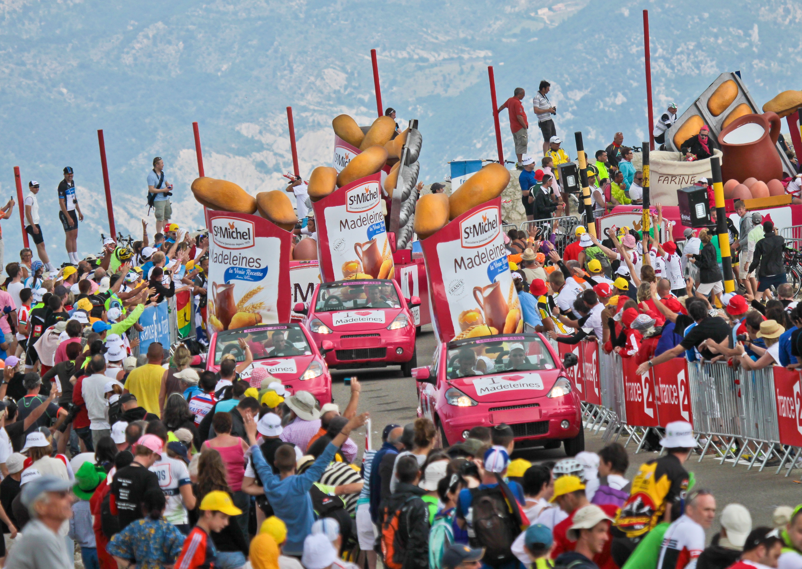

Slide 57

Françoise Bresson (Sponsorsing Director Nestlé Waters - Vittel) : « Link with the public with « La caravane », TDF platform is complete and we can meet our consumers… »
Program
  14 cars et 500 000 producs for the spectators
  Eauficiel : 30 000 for free for spectators
  PR
  Sales activation with 3 Millions (Packs TDF)
  Last 25 km Vittel Red « arches »
  Focus on Vittel origign (les Vosges) with the vacation

Slide 58

Antoine Willaume (Communication & Marketing Director Antargaz) : « Our customers are in rural areas. TDF is a perfect way to meet them ».
Program : Village, caravane, inter-station & VIP
  PR & Hospitality inter-station 50 Km from the arrival (exclusivity : 200 m²)
  Trophy « Flamme Gaz Naturel » with the Major of the City
  Mascot
  200 000 Tap tap & 250 000 magnets

Slide 59

Eric Marchyllie (Sponsoring Director Carrefour) : « Our partnership with TDF and the soccer is focused on proximity. We want to promote our product and our diffrence with our quality made in France and explain our positionning ».
Dispositif :
  Games in shops
  Website : C-letour.fr with practicers and fans
  Cars & Caravane
  Jersey for the best climber

Slide 60
Key points to analyse your future sponsor
Target : identity, image, brand strategy
Goals : Direction : strategy, competitive advantage, needs anticipation
Communication channels
Financial potential : Turnover, assets…
Sponsorship existing actions
Who is the BOSS inside the company :
  Access
  Working on his personnality and the link the your sport (fan, practice, networks…)

Slide 61
Presentation : key steps to connect the fans with brand
Your Brand = your assets to make the difference !
Sponsor Brand : how to be THE answer!
Activations program : make strategic choices to fit with the target needs
Try to propose packs and financial offer

Slide 62
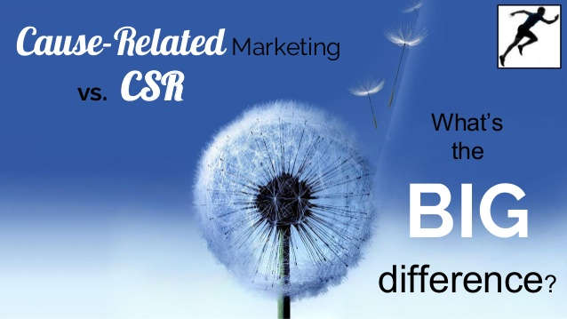
EMOTION ²

Slide 63
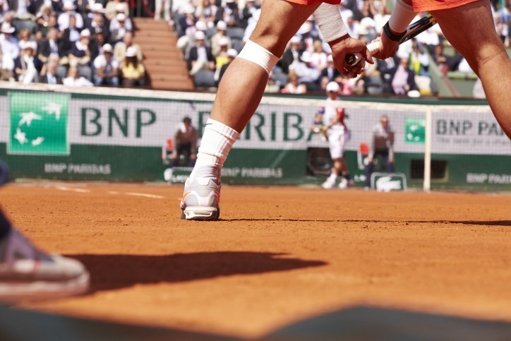
Sponsorship 3.0 : BNP Paribas

Slide 64
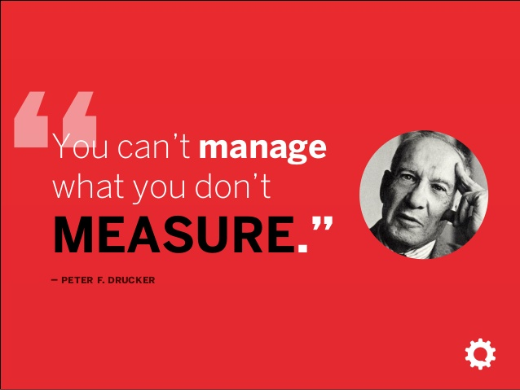

Slide 65



Slide 66


Slide 67
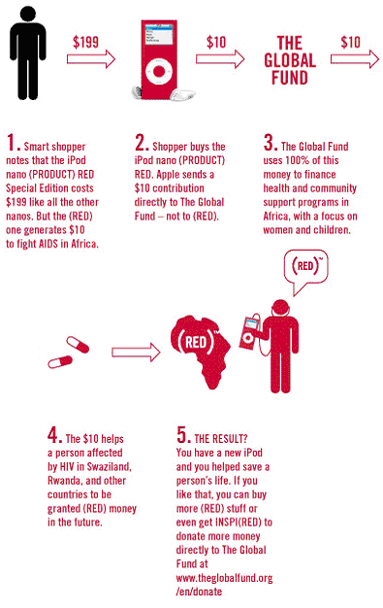






Slide 72
Opportunism or
Pragmatism ?

Slide 73


Slide 74
CAUSE RELATED MARKETING
Cause marketing or cause-related marketing refers to a type of marketing involving the cooperative efforts of a "for profit" business and a non-profit organization for mutual benefit. The term is sometimes used more broadly and generally to refer to any type of marketing effort for social and other charitable causes, including in-house marketing efforts by non-profit organizations.
Cause marketing differs from corporate giving (philanthropy) as the latter generally involves a specific donation that is tax deductible, while cause marketing is a marketing relationship not necessarily based on a donation.

Slide 75


Ethical Corporate Responsibility (Babiak & Wolfe, 2006)

Slide 76

Discretionary Corporate Responsibility (Babiak & Wolfe, 2006)

Slide 77




Slide 78




Slide 79



Slide 80


Slide 81
Event Stakeholders
Communication platform
Stakeholders with legitimacy
OGN - Association
Financial
Stakeholders Private or plublic organizations
Classical
Commercial
Sponsorship
Donation
CAUSE
Donation

Slide 82
Process
Cause identification : local aspects, fit with your main sponsors or cities…
Legitimacy with your OGN or association
Activation program
ROI or ROO for :
  Sponsors
  ONG
  Event

Slide 83
The core objective : create sponsors network = cross partnership
HOW ?

Slide 84








CSR : ressources arrangement and synergies

Slide 85
Solutions :
Corporate Social Responsability and Cause marketing
Cross businesses (not easy…) using public – private networks…
Danger : impossible to put the offer or attractiveness on your website or business presentations…
Destination marketing : public sponsorship strategy

Slide 86





Slide 87



Slide 88


