Slide 1
Lecture 1
Strategic Management and sales & digital marketing in sports organizations
Msc ISEM
lionelmaltese.fr
Lionel Maltese
Maitre de Conférences Aix Marseille University – CERGAM IAE Aix-en-Provence
Associate Professor Sport BUSINESS Management Kedge Business School
Assets Manager ATP – WTA Events and consulting
Member of the Executive Committee FFT – Roland Garros – BUSINESS STRATEGY

Slide 2
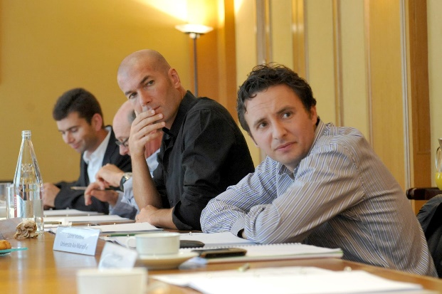
You are, you have…
Last diploma : Phd Business Management IAE Aix en Provence 2004 – Econometrics Engineer Aix Marseille University 2001
Last sport experience (this summer) :
OM Business Assets Consulting Mission & PSG Fan Marketing Mission
Roland Garros Hospitality & Public Relation Business Strategy with Jo Tsonga
ATP World Tour : Nice to Lyon transfert and business creation (JFC, TP, JWT) ,
FFT – Roland Garros Executive Comitee / Executive competencies help for recruitment
….
Sport Practice Fan… :
Tennis, Basket, Soccer, Rugby Seven, Paddle board… and anterior cruciate ligament (ACL) …
OM, Celtics, Juve, Warriors, Canadiens, Seahawks, Fed, Stan, Jo, Liza, Ray Allen, Curry, Voller, ZZ, Slater, Bird, Wilko….

Slide 3
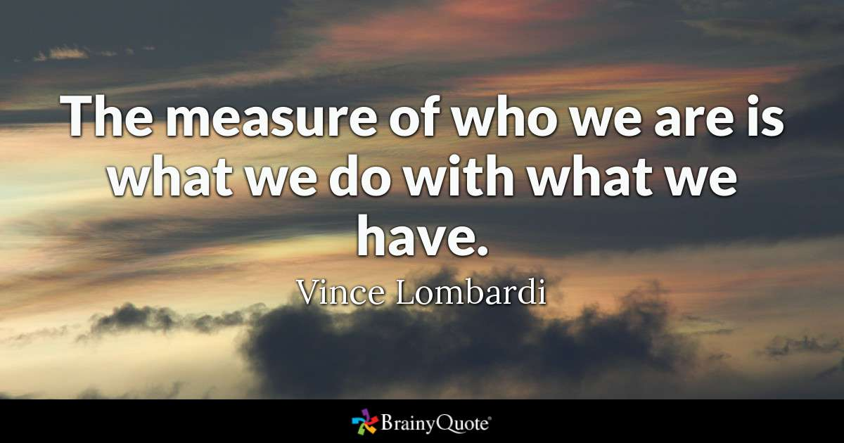

Slide 4
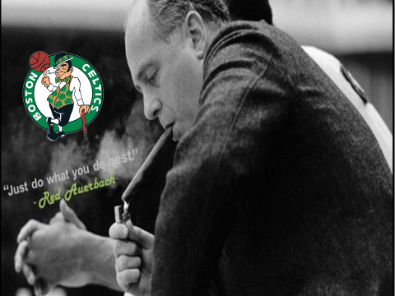

Slide 5






















Since 2005
Maitre de Conférences
Aix Marseille University
Strategy & Communication
Associate Professor Kedge Business School
Sport
Business Management
Since 1999
Professional
ATP & WTA
Events management
Manager
Since 2001
Research
Aix Marseille University
Laboratory
Member of the Executive Committee
Economic Development – Business Strategy
Head of R&D Department
Consulting
Sport Business Strategy & Marketing

Slide 6














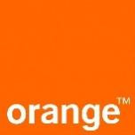


R&D Department FFT / Roland Garros
Fan & Practicers experience & engagement
Sponsorship activations
CSR
Strategic management
Digital marketing
Sport law
…

Slide 7


Slide 8
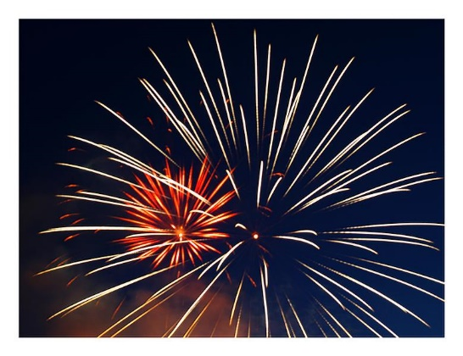

Msc ISEM / Kedge BS ?

Slide 9
Kedge Business School and Sport Expertise : Inputs & Outputs ?
5 profs
LM
JPD
FP
JMM
FR
+
Alumni
Ms ISEM
(N1 France
Top 10 World)
Msc Marketing
Summer School
PGE (ESC)
Research
N1 Europe
Networks
Alumni
Companies
Institutions
Academic
(Project)
Communication
Media
N1 (School)

Slide 10
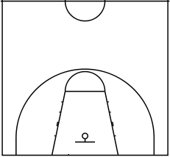
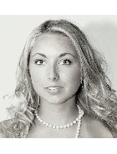
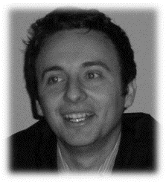
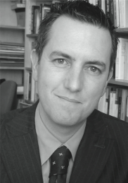
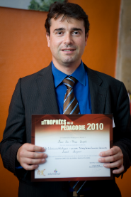
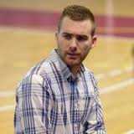
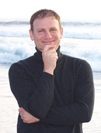
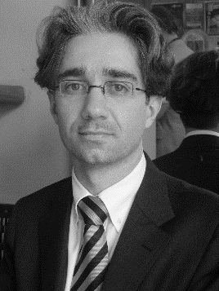
Lionel
Maltese
Jean-Michel Marmayou
Jean-Philippe Danglade
Aurélie Fersing
Alejandro Requena Ramón
Frank
Pons
Fabrice Rizzo

Slide 11
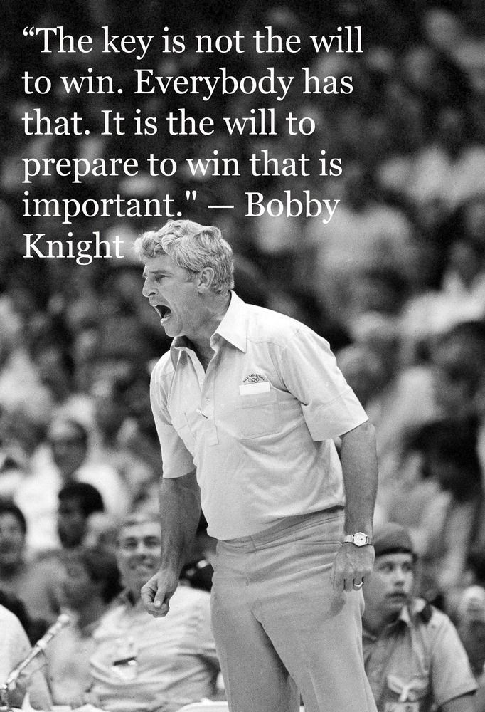


Slide 12
YOUR PROGRAM
Sport Business Conferences :
NBA-FFT-UBISOFT, Kantar, OM-ADIDAS-PUMA…
SEMESTER 1
Commercial business strategies in sport organisations |  | BOUVRANDE Thomas 6H / WEISZ Michael 9H / MALTESE Lionel 15H
Commercial Sponsorship and Operational Activations |  | BERENGER Julien 15H / WEIBENBORN Lena 15H
Sport Media Consulting and Event Communication Strategy |  | FERSING Aurélie 15H / ROGER David 15H
Event, Experiential, Social and Cultural Marketing for sport |  | PACE Stefano 15H / RINALLO Diego 15H
Sport Career Services and labor market opportunities |  | INNOCENTI Damien 30H
International Sport Business Projects & E-Gaming |  | MALTESE Lionel 15H / SADOSKI Sébastien 15H
SEMESTER 2
Strategic Management and sales & Digital marketing in Sports Organizations |  | MALTESE Lionel 15H / LADIK Daniel 15H
Economics and Finance of professional teal sports |  | SIMMONS Robert 30H
Fan Experience and Stadium Strategic Management |  | THIODET Anthony 18H/ LEPRON Julien 12H
Brand Management in sports organizations |  | PONS Franck 30H
CSR in sports and Destinantion Marketing |  | BEE Colleen 15H / FUNK Dan 15H
Talent Marketing management |  | DANGLADE Jean-Philippe 12H / GEOFFROY Kevin 9H / LAYNAT Laurent 9H

Slide 13
Sport Business Conferences :
NBA-FFT-UBISOFT, Kantar, OM-ADIDAS-PUMA…
YOUR PROGRAM
SEMESTER 1
Commercial business strategies in sport organisations |  | BOUVRANDE Thomas 6H / WEISZ Michael 9H / MALTESE Lionel 15H
Commercial Sponsorship and Operational Activations |  | CARILLAT François 15H / GUILLET Marie-Amélie
Sport Media Consulting and Event Communication Strategy |  | FERSING Aurélie (15H) / ROGER David (15H)
Event, Experiential, Social and Cultural Marketing for sport |  | PACE Stefano 15H / RINALLO Diego 15H
Sport Career Services and labor market opportunities |  | GHIBAUDO Alain(30H)
Droit des compétitions Sportives et de ses acteurs |  | RIZZO Fabrice 30H
SEMESTER 2
Strategic Management and sales & Digital marketing in Sports Organizations |  | MALTESE Lionel 15H / LADIK Daniel 15H
Economie du sport spectacle |  | DURAND Christophe 30H
Fan Experience and Stadium Strategic Management |  | THIODET Anthony 18H/ LEPRON Julien 12H
Brand Management in sports organizations |  | PONS Franck 30H
Sport RSE & Destination Marketing |  | FRANCOIS Aurélien 15H / DANGLADE Jean-Philippe 15H
Organisation contractuelle du spectacle sportif |  | MARMAYOU Jean-Michel 30H

Slide 14
My job for you
Be reputational to promote you ! Professional & academic publications – business – networks - alumni
Attract experts both academics and professionals to tranfert knowledge and competencies (my role)
Students help for selection
I am not your Director and not an administrative people (no time for that and not possible legally)

Slide 15
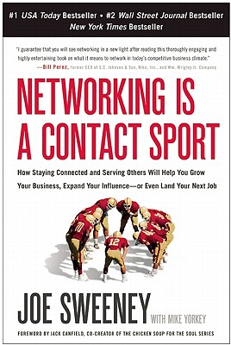


Slide 16
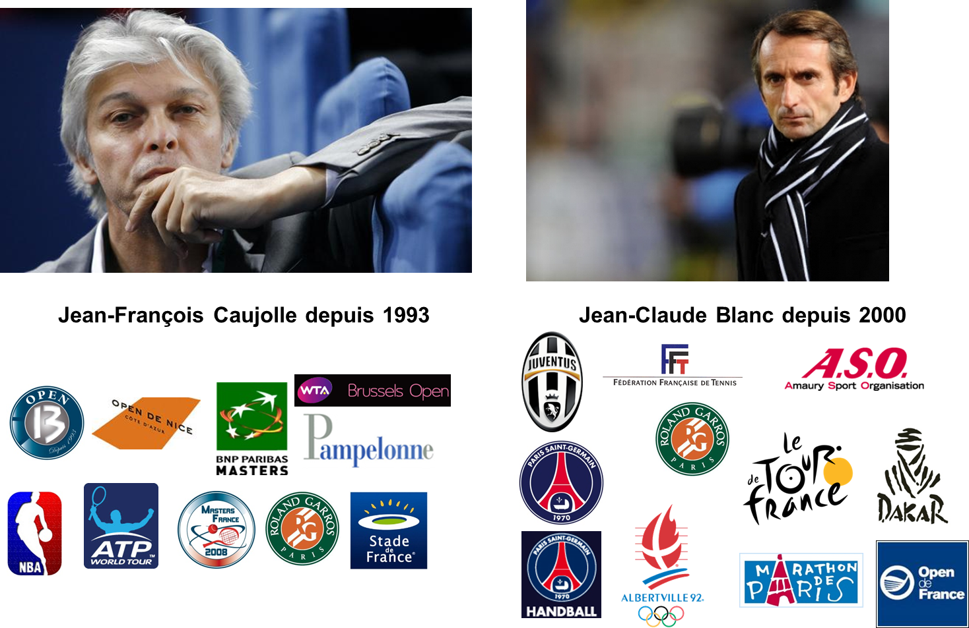
Jean-Claude Blanc since 2000
Jean-François Caujolle since 1993

Slide 17
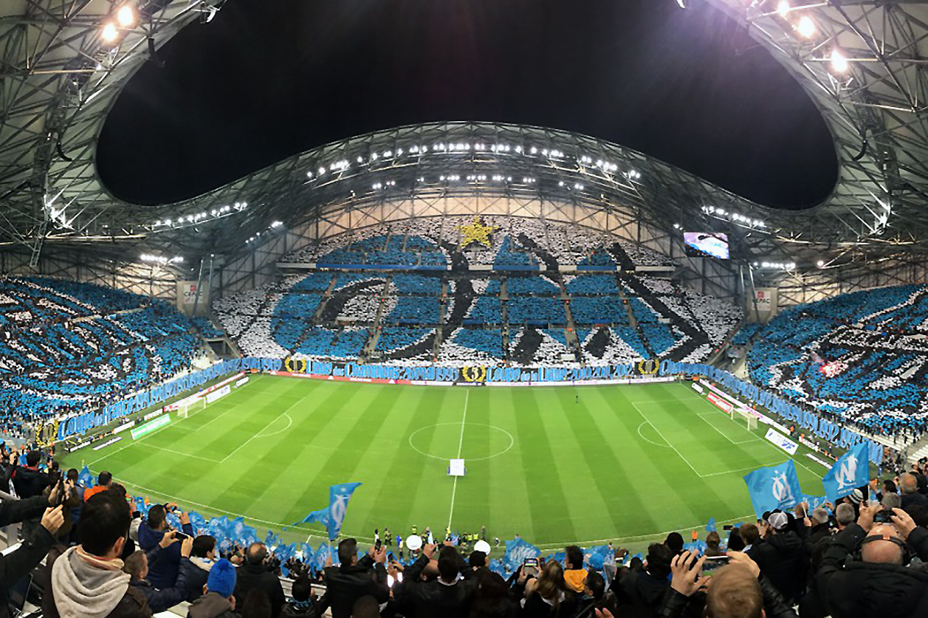

Slide 18
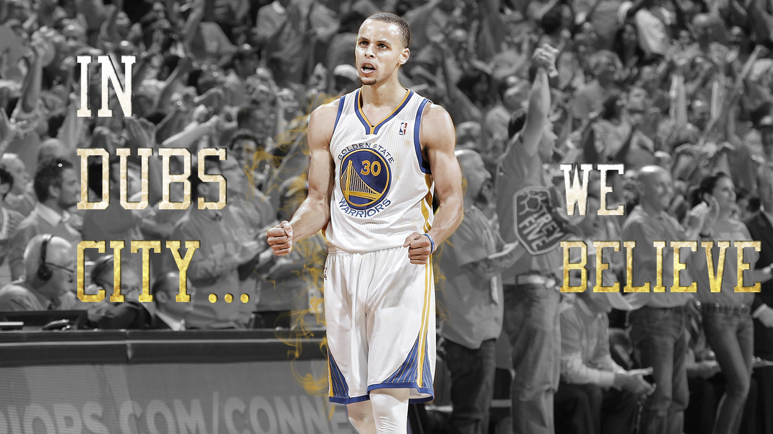

Slide 19
SPORTAIMENT BUSINESS
PLACE
&
MOMENT
FOR
FANS

Slide 20
Marshall Glickman
CEO G2 Strategic, former president of the NBA’s Portland Trail Blazers
Over the last four decades, sports in North America has evolved from pure competition to business…from game to entertainment. Although the quality of competition has remained the centerpiece, North American sports culture is primarily motivated by money.
In France, as in most European countries, the sports culture has historically been driven by the competitions themselves, so consumption trends are not comparable. That said, there is no question that economic reality is driving French sports organizations to become more professional and oriented to business and profits.
From the perspective of an American who has extensive experience working with European and French sports organizations, finding the right balance between economics and culture is precisely the right recipe for success.

Slide 21
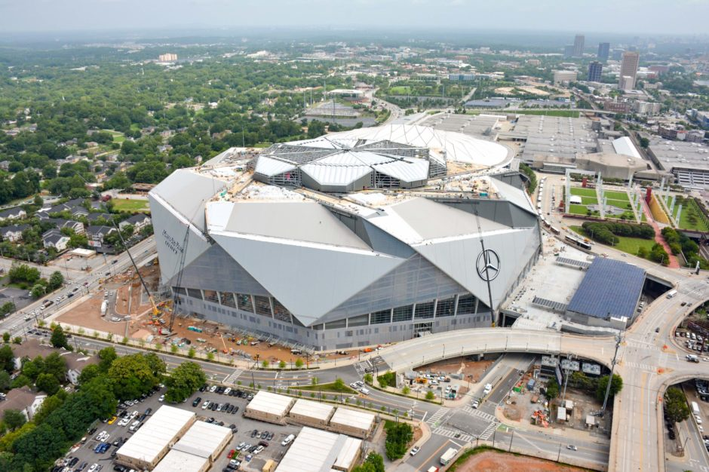
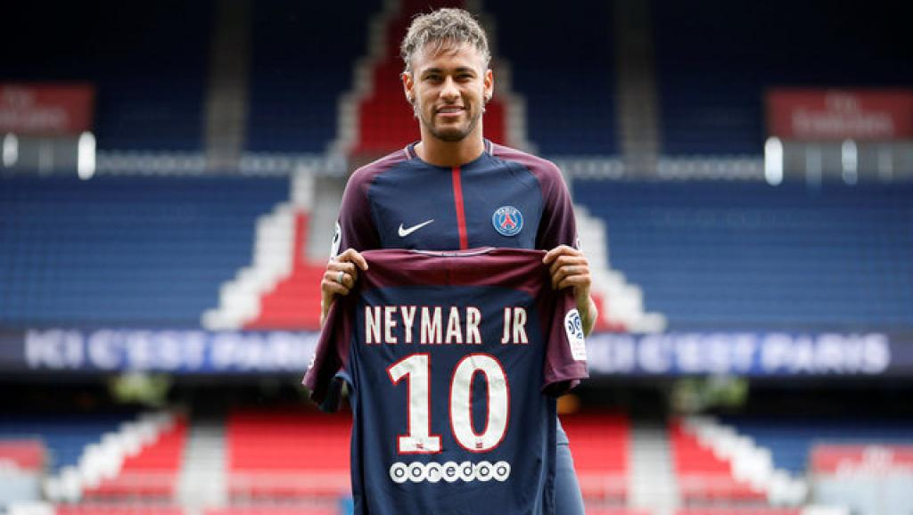
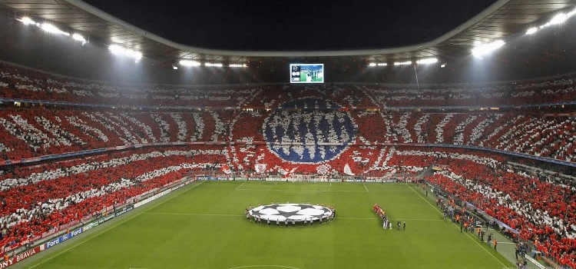
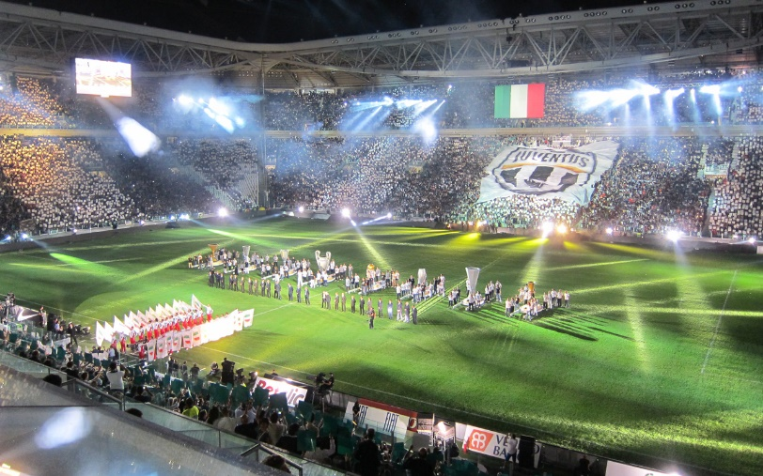
New sport Business model ?

Slide 22
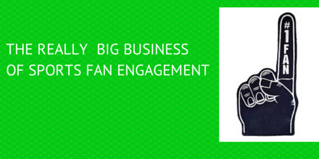


Slide 23
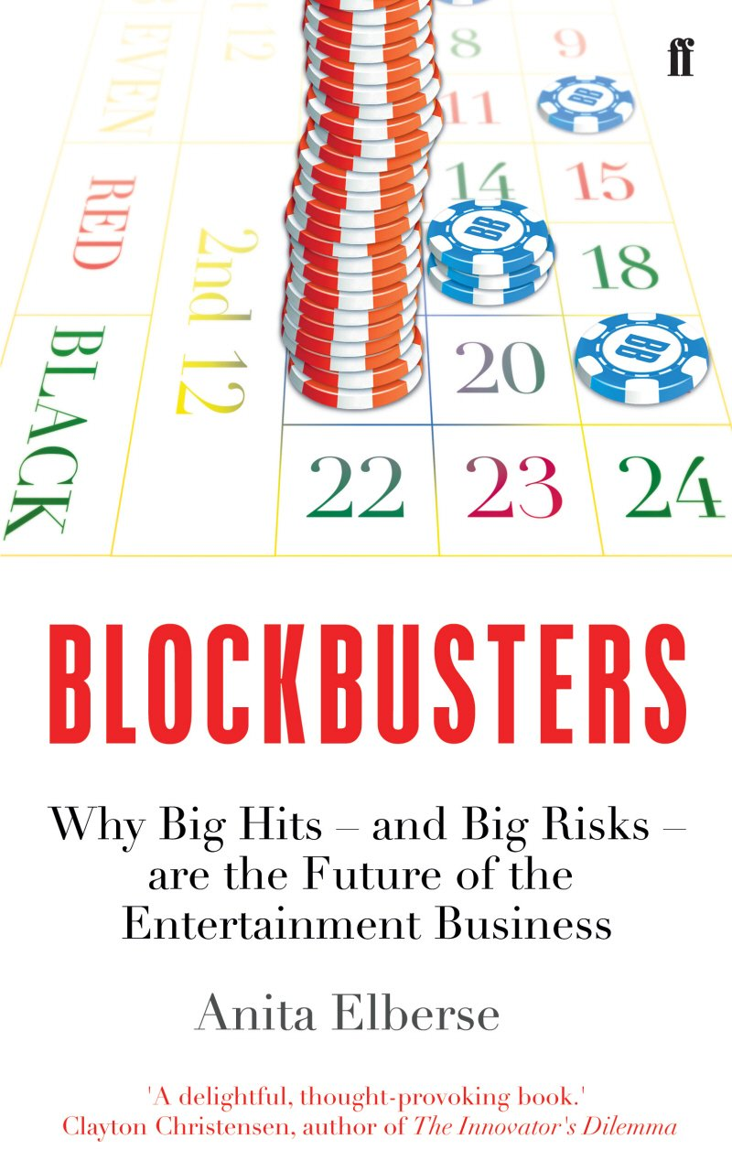
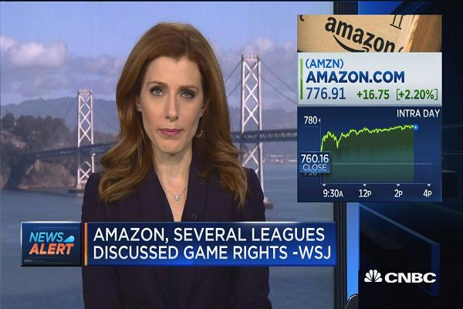

Slide 24

Sport Marketing Digest : Communication - Networks – Experiences – Brand
Relational Marketing
CRM – Ticketing – RP – Social Capital
« The Place to be »
Experiential Marketing
Entertainment BtC BtB CtC
« The Place to show the show »
Brand Management
Merchandising – branding
« The Place to express your brand »
Event Communication – Commercial Sponsorship
« The Place to leverage and activate »

Slide 25
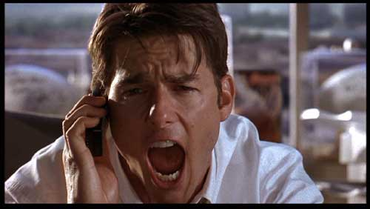
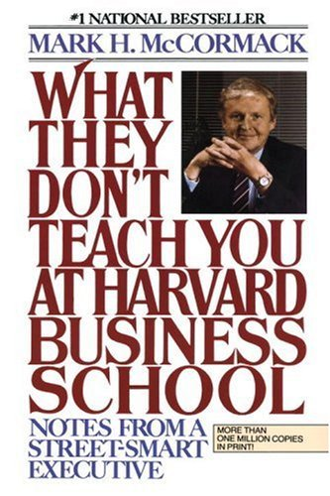
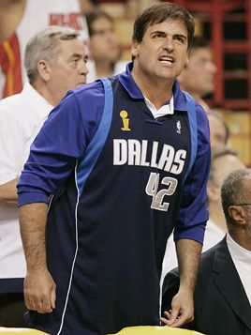
To be a value-added in sport business
Or american dream !
Business Marketing capabilities !

Slide 26
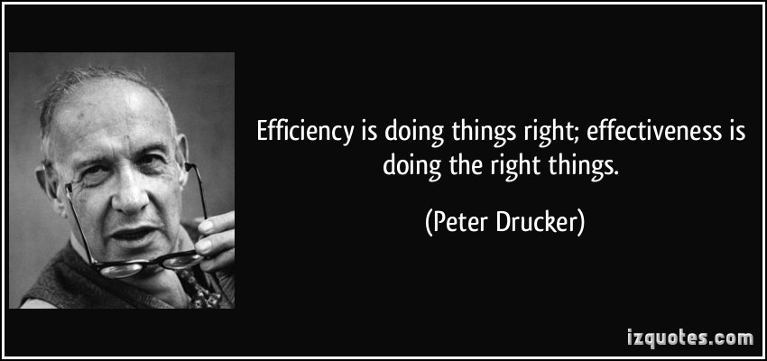
Assets Manager : the « road » for EFFICIENCY ?

Slide 27
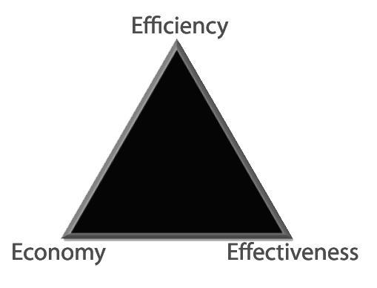
The right effort allocation
Reducing costs of inputs
To achieve the goals

Slide 28


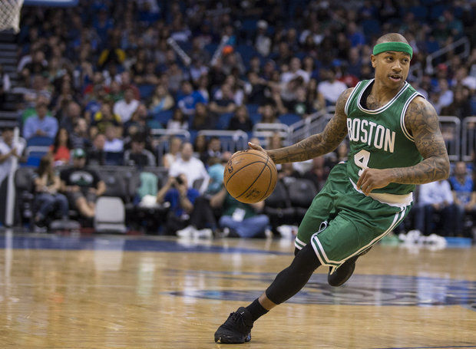
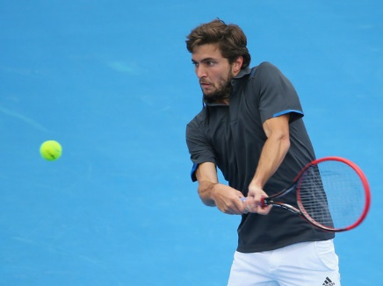

Slide 29
Competencie ?
Success comes from knowing that you did your best to become the best that you are capable of becoming. John Wooden
EXPERIENCE
Knowledge
EXPERTISE
Know-How
TEAM
Being
(know how to be)

Slide 30


Slide 31
My strategy : creating my ecosystem !
Teaching
Media
Communication
Students
Alumni
Customers
Applied Research
Business
Consulting

Slide 32
What is strategy ?
"Strategy is the direction and scope of an organisation over the long-term: which achieves advantage for the organisation through its configuration of resources within a challenging environment, to meet the needs of markets and to fulfil stakeholder expectations".

Slide 33
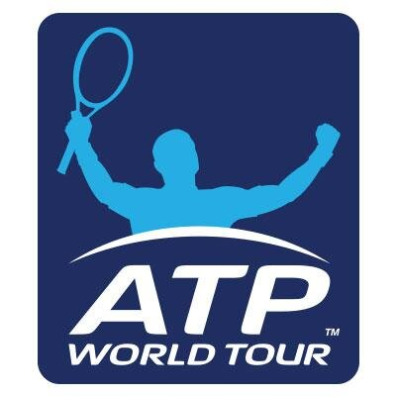


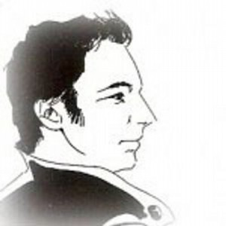


Business and Fans studies : « Sport Business Marketing R&D Institute »
Servicing / Expérience / Hospitality / Strategic management & Business Models
Possibilities for your memory ?

Slide 34
Key words
Strategy
Sport
Events / Clubs
Ecosystem
Assets
Business Model
Efficiency
Relations
Reputation
Culture

Slide 35
Personal reflexions…
Sport Business = SME Market
Business comes from Media for mega event and championships
Stock of resources are often important but competencies not…
Sport = unique communication platform but we can define it as a moment and a place
Unicity in sports = Emotion as a marketing tool to attract customers and stakeholders
Your Job : understand the offer and help to sell or market sport event products then be a sport manager

Slide 36
Business Ecosystem (Moore, 1993)
“An economic community supported by a foundation of interacting organizations and individuals—the organisms of the business world. The economic community produces goods and services of value to customers, who are themselves members of the ecosystem. The member organisms also include suppliers, lead producers, competitors, and other stakeholders. Over time, they coevolve their capabilities and roles, and tend to align themselves with the directions set by one or more central companies”.

Slide 37
Sports Organizations Ecosystem ?
Media
Broadcast
Sports goods
& Equipments
Production
Sponsors
Suppliers
Events
Clubs
Franchises
Institutions
Federations
Actors
Consulting
Agencies
Athletes &
agents
Council

Slide 38
Club (or franchise) VS sport event
Professional athletes management and control
Clubs and Franchises :
Contracts : transactions and salary
Motivation : training, selection, financial premiums
→ Athlete = “asset” for the managers
Events :
Fees (ATP, PGA for instance)
No control of sport performance by the managers
→ Dependency of the athletes (calendar for instance) and their professional associations (ATP, PGA, UCI…)

Slide 39
Main “goals” for this seminar !
Sports organizations [professional Events & Clubs] = management “stake” ?
Proposition of a new Strategic Management and Business Model for these organizations !
Understand & manage key factors of success (or failure) : sponsoring, public relations, reputation, physical (stadium) & local factors, managerial skills…
Develop your professional skills on : strategic analysis & formulate Sport Organizations Business Plan (Development Plan) : STRATEGIC PLANNER for sport organizations
PROJECT → PLAN

Slide 40
Focus on “Event Concept”
In sports context, “event” is everywhere :
National Championships (every week ! : NBA, MLB, NFL, NHL, LNF, Top 14, Premier League…)
National and International Competitions (JO, World Cups…)
One shot events (every year) : Roland Garros, Tour de France, ATP, PGA, Superbowl, Formula 1… exhibitions…
…

Slide 41
For consumers : Entertainment & Event = “experiential service”
Key questions
Strategic Marketing :
How to show the show ?
How to sell, communicate, package this “experiential service” ?
Who are our consumers : B to B, B to C, C to C… : working on communities (fans : difficult for an event !)
Strategy :
To perform and to develop sustainable performances on : sports measures, financial ratios, affluence – audience…

Slide 42
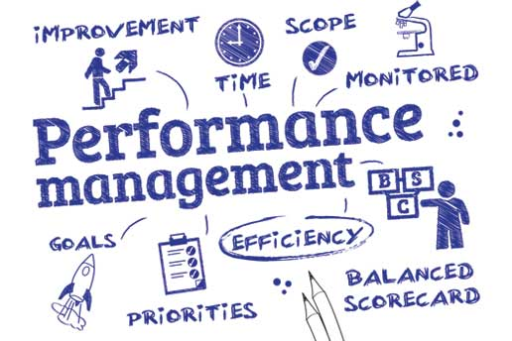

Slide 43
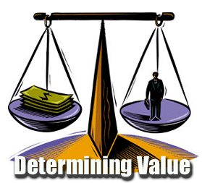

Slide 44
But… we need definitions (Covell an al., 2007)
Organization : « Any group of people working together to achieve a common pupose or goals thant could not be attained by individuals working separately »
Management :
  The coordination of human, material, technological, and financial resources needed for the organization ti achieve its goals.
  Responsibility for performance

Slide 45
But : what is performance for sports organizations ?
Performance indicators (Pis) give us an evaluation process that can provide objective and meaningful performance feedback to aid future decision making.
The methods of evaluation are both quantitative and qualitative but all the final results depend upon one or more manager’ interpretation (judgement)
The key for sport organizations : your stakeholders analysis.

Slide 46
Sports Event
&
Wedding Event

Slide 47
Your judgement of what is performance for :
A restaurant ?
A concert ?
A movie ?
A student ?
A Professor ?
Your Master ?
Kedge Business School ?

Slide 48
Sport organizations – performance and stakeholders
You can evaluate returns for :
Média
Athletes
Sponsors
Institutions
Spectators
Cities
Suppliers
Owner
….
→ Various PIs for different objectives and muliple stakeholders…

Slide 49
Managing a club / event ?
Learning by Doing : “operational organization” → Self Made Men : (Jean-Marie Leblanc, Jean-François Caujolle, Gilles Moretton…) without academic formation (tacit knowledge and not explicit : see Julien & Vincent presentation…)
Distinction between :
  Operational activities : press, ticketing, sports aspects, technical (stage manager) direction, volunteers or vacations management…
  Development (you !) : experts in : Marketing, Strategy, Finances, RH… THE FUTURE IN SPORTS ORGANIZATIONS (Jean-Michel Aulas, Jean-Claude Blanc, Patrice Clerc, Christian Prudhomme…)
  The twice but without sleeping…

Slide 50
Event : definition
An organized occasion such as a meeting, convention, exhibition, special events, gala, dinner, etc. An event is often composed of several different yet related functions (Getz, 2005)
Principles applying to all events :
  Temporary (project)
  Unique combination of co-production factors (this aspect is, in fact, the “background” of my courses)

Slide 51
Categorization of events
Scale of impacts (attendance, media, profile, infrastructure, costs, benefits)
High
Low
LOCAL
MAJOR
HALLMARK
MEGA-EVENT
Category of event

Slide 52
Categorization of events
Local or community events : Local consumers (Beach events, Corrida, Snowboard & Surf contest, ATP International Series Tournaments, National Events…)
Major events : Media interest (coverage & benefits) and capability of attracting significant visitor numbers (Formula 1, Master Series ATP, PGA…)

Slide 53
Categorization of events
Hallmark events : identified with the spirit or ethos of a town, city or region (synonymous with the name of the place) & very traditional (Wimbledon is the best example, 24H du Man, Paris Dakar, Masters Evian…)
Mega events : so large that they affect whole economics and reverberate in the global media (Olympic Games, FIFA World Cup, IAAF World Championships, Superbowl, March Madness, NBA, MLB, NHL Finals…)

Slide 54
Managing stakeholders into sport organizations ecosystem
Private sponsors
Public sponsors
Sport institutions
Event / Club
Organisation
Athletes
Suppliers
Spectators
Media

Slide 55
How to control external environment (stakeholders) and how to be independent to perform, to develop and maintain ?
So sport organizations are in the “eye” of important actors “stakeholders” :
Our strategic problematic is :
Now before studying strategic analytic tools :
What is Strategy ?
What are the more “sensemaking” approaches to analyze a sports organizations and their stakeholders ?

Slide 56
Michael Porter : Competitive Advantage
Competitive strategy is "about being different. It means deliberately choosing a different set of activities to deliver a unique mix of value."
Strategy is about competitive position, about differentiating yourself in the eyes of the customer, about adding value through a mix of activities different from those used by competitors.
His formal definition : "a combination of the ends (goals) for which the firm is striving and the means (policies) by which it is seeking to get there."

Slide 57
Henry Mintzberg : 5 “P”
Plan, a "how," a means of getting from here to there.
Ploy, really just a specific manoeuvre intended to outwit an opponent or competitor.
Pattern in actions over time ; for example, a company that regularly markets very expensive products is using a "high end" strategy.
Position; that is, it reflects decisions to offer particular products or services in particular markets.
Perspective, that is, vision and direction.

Slide 58
Main Strategic Approaches
(Saias & Métais, 2001)
POSITIONING
MOVEMENT
S.W.O.T
5 Forces
Resource-Based View RBV
Permanent Transformation
Competitive
Advantage
STRATEGIC « FIT »
STRATEGIC
« INTENT »
Michael Porter & Co
Gary Hamel and C. K Prahalad & Co

Slide 59
FIT
What business are we in ?
S-C-P : Structure Conduct Performance
  The structure of the industry will dictate the conduct of firms and thereby their performance (most popular : SWOT or “five-forces” model (Porter, 1979)).
The big illustration is the 5 Forces Model (Porter, 1979).

Slide 60
Porter’s Five Forces (Industry)
Barriers to Entry
Bargaining Power of Suppliers
Bargaining Power of Customers
Competitors
Substitutes

Slide 61
Porter’s Five Forces (Industry)
The bargaining power of customers :
  Buyer concentration, volume, relative costs, information availability, price sensitivity…
The bargaining power of suppliers :
  Relative costs, supplier concentration, threat of forward integration, cost of inputs relative to selling price of the product

Slide 62
Porter’s Five Forces (Industry)
The threat of new entrants :
  Existence of barriers to entry, brand equity, switching costs and absolute cost advantage, access to distribution, learning experience…
The threat of substitute products (services) :
  Relative price performance of substitutes, buyer switching costs, perceived level of product differentiation
The intensity of competitive rivalry :
  Number of competitors and diversity, rate of industry growth, exit barriers, brand equity, level of advertising expense, informational complexity and asymmetry…

Slide 63
INTENT
What are we able to make with what we have ?
RBV (Resource-Based-View, Wernerfelt, 1984, Barney, 1991, Grant, 1991) : certain assets (resources and capabilities) with certain characteristics will lead to sustainable competitive advantage.
Strategy dictated by unique resources and capabilities of the firm (what can the firm do best?)

Slide 64
Concepts definitions
Resources : stocks of available factors that are owned or controlled by the firm (Amit and Schoemaker, 1993)
Capabilities : a firm’s capacity to deploy resources, usually in combination, using organizational processes, to effect a desired end” (Amit and Schoemaker, 1993)
Dynamic capabilities : capacity of the organization to renew competences to be in line with the changing business environment (Teece and al., 1997).
Asset = resource + capability

Slide 65
Resource Based-View : VRIO model (Barney, 1991)
Value
Rareness
Resources & capacities
Lead to
Sustained Competitive
Advantage
Organization
Inimitability
Non-Substitutability

Slide 66
VRIO Properties
Is the resource or capability…
Valuable
Rare
Difficult to imitate
Difficult to substitute
Organizational
Implications
Neutralize threats and exploit opportunities
Not many firms possess
Physically unique
Path dependency
Causal ambiguity
Social complexity
No equivalent strategic resources or capabilities
Productive exploitation by the organization

Slide 67
Criteria for Sustainable Competitive Advantage and Strategic Implications
Is a resource or capability…
Valuable Rare Difficult Without Implications
to Imitate Substance for Competitiveness
No No No No Competitive disadvantage
Yes No No No Competitive parity
Yes Yes No No Temporary competitive
advantage
Yes Yes Yes Yes Sustainable competitive
advantage

Slide 68
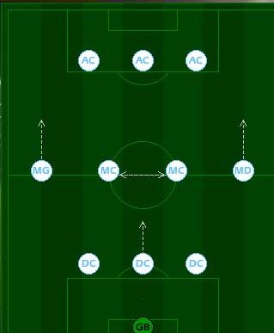
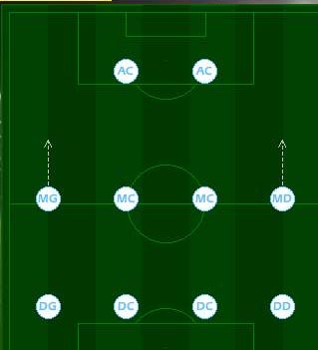
FIT : Soccer metaphor
The strategy (tactical) is a function of the external environment (rival teams : opportunities - threats).
The trainer has a tactic adapted to the adversary and the players (resources) adapt to this positioning (diagram of play).

Slide 69
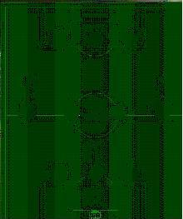
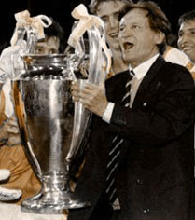
Intent : Soccer metaphor
The head coach "visionary" (or manager) has resources (players) and sets up a strategy (tactical) starting from these forces and weaknesses (resources), in order to face to certain opportunities or threats of the environment (air play, speed, physical engagement)


Slide 70
So What ?
How can we “implement” that ? It’s very theoretical !
Your and my job : to be able to construct a business plan (development) with a “specific RBV analysis” (your “sensemaking background”), and furthermore :
  Persuade and control our stakeholders
  Maintain our performance
  To be “ready” for new opportunities and threats because of very instable sports environment…
Managing resources & capabilities = core competency of a “modern” CEO in sport organizations (Jean-Claude Blanc…and you !)

Slide 71
Categorizing resources
Barney (1991) : 3
  Physical capital : technology, plants, equipment, geographical localization…
  Human capital : formation, experience, networks - relationships…
  Organizational capital : formal structure, control, routines, process, coordination systems…
Grant (1991) : 6
  financial, physical, human, technological, organizational, reputation.
Wernerfelt (1989) : 3
  Fixed assets : plants, equipment…
  “Blueprints” : patent, brand, reputation
  Teamwork “effects” : routines, habits, experience…

Slide 72
Sport events & clubs : assets identification
Sport Event & Clubs
Financial resources « Profit centres » | Ticketting
 | Contracts (sponsoring, Public Relations) & Players (clubs only)
 | TV rights
 | Merchandising
 | Institutions (public subsidies)
Renown | History
 | Sport performance
 | Affluence, audience
Assets
Players & coach (clubs only) Partnership (sponsoring, partners) Reputation (event, sport, players) Relational (Social capital, relational networks, Public Relations) Physical (infrastructures, stadium, territory) Organizational Capabilities (Core competences, event driven know how, project management))

Slide 73
Partnership (sponsorship) resources
Sponsoring : brand image, image transfer, notoriety, visibility, target specificity, TV…
  Examples : BNP Paribas, Louis Vuitton, Rollex, Peugeot, Indesit, Adidas, Nike, Fedex, Coca-Cola, Philips, Renault, Mercedes…
Leverage and activate !
$ = Commercial Sponsorship Contracts

Slide 74
Relational Resources
Event Manager’s Social Capital (Christian Bîmes & Jean-Claude Blanc, Patrice Clerc & Jean-Marie Leblanc …)
Relational and business networks !
$ = Public Relations

Slide 75
Reputational Resources
Event legend and history : JO, America’s Cup, Le Tour de France, Roland Garros, Wimbledon…
Corporate Reputation : FFT, Amaury, IMG, Octagon…
$ = Media Rights & commercial brands

Slide 76
Physical (territorial) Resources
Stadium : Wimbledon, Roland Garros, Madison Quare Garden…
Territory : Tour de France, F1, Rally & Tennis (Monte Carlo), 24 H du Man, Stade Toulousain, Pau-Orthez, Derby de la Meije…
Infrastructures : training camps and conditions…
$ = Ticketing and merchandising

Slide 77
Dynamic Capabilities and Organization
Dynamic Capabilities : “processes to integrate, reconfigure, gain and release resources – to match and even create market change”
  Examples : Stade Français (Rugby) with Max Guazzini or Roland Garros Brand and co-branding (Adidas, Peugeot, Lancel…)
Organizational capabilities : Project Management
  Most “organizational event” : Tour de France !

Slide 78
Concepts
RBV first model for a sport organization
Partnership Resources
Reputational
Resources
Resources
portfolio
PROPERTIES
?
Players
Coach (club only)
Relational Resources
Physical Resources
Core
Competencies,
Capabilities
Organizational team,
Managers
Performance, Sucess
Sport Success
Financial Sucess
Public Sucess
Long Term

Slide 79
From strategy to event marketing
Strategic Intent
→ Formalize → Business Model → Business Plan (development)
Exploration – exploitation – Managing assets
Resource dependency - stakeholders → External control of the organization
Implementation
Services & Experiential Marketing
Segmentation B to C & B to C
Packaging « hedonic & emotional » experience (services)
Creation and development of communities : fostering of customer (fans) loyalty

Slide 80
Athletes as suppliers for the « show content »
Key synergistic resources « Heart »
Deployment resources « Lung »
Market-based resources
❹
❶
❷
❸
Partnership –
Sponsorship
Privates - Public – Media
Sport
Management
Communication
Hospitality
management
CRM
Activation
CRM
Negociation
Sport
Performances
Reputation
Stadium
Ticketing
Commercial Brand
Merchandising
Hedonism
Brand
Management
Co-branding
Social networks &
capital
Public Relations
Resources
Intangible Resources « Event expressiveness »
CRM
BtoB Networks
Competencies
Commercial resources linked to products & services and profit centers

Slide 81
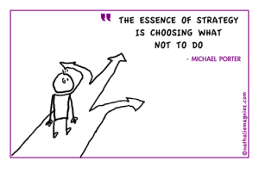

Slide 82
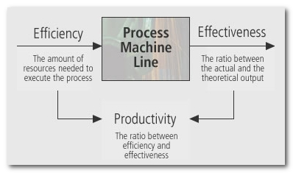

Slide 83
Seminar Program
Lecture 1 : Sport Business Ecosystem
Lecture 2 : Sport Business Models
Lecture 3 : Relational Business Model
Lecture 4 : Reputational Business Model
Lecture 5 : FRM - Cultural BM & Group Project Workshop

