Slide 1
Manager sa réputation Lionel Maltese CNE Samedi 20 octobre 2018

Slide 2
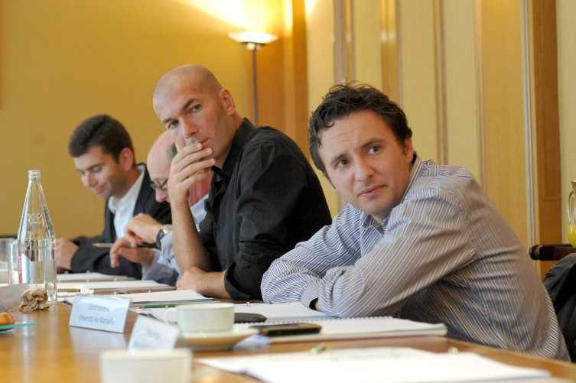
Lionel Maltese
Enseignant - chercheur - entrepreneur
FFT ?
Membre élu Comité Exécutif
Développement Economique
Enseignement
Maître de Conférences
Aix Marseille Université
Professeur Grande Ecole
de Commerce (Kedge Business School)
Entrepreneur
Manager Tournois ATP/WTA (46)
Marseille – Lyon – Nice – Bruxelles Paris - Toulouse
Consultant :
OM – PSG - BNPP
Recherche
Economie – Management et Marketing sportif
Tennis Club du Bocage (Ligue PACA)
Fan : OM / Celtics / Eagles / Juve / Duke – ZZ / Liza / Wilko / Rudi Völler / Ray Allen / Grant Hill / Pat Rafter / Stefan Edberg / RF / Jo / Irving / Tatum…
Passionné

Slide 3
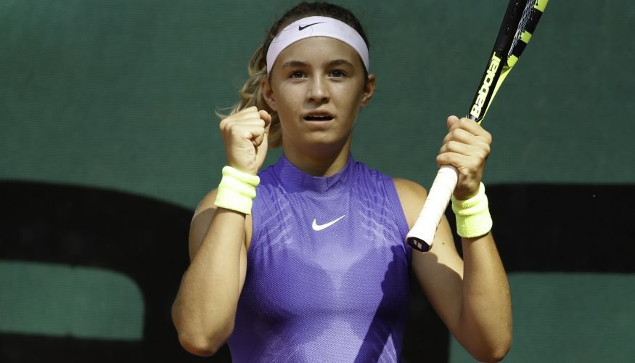
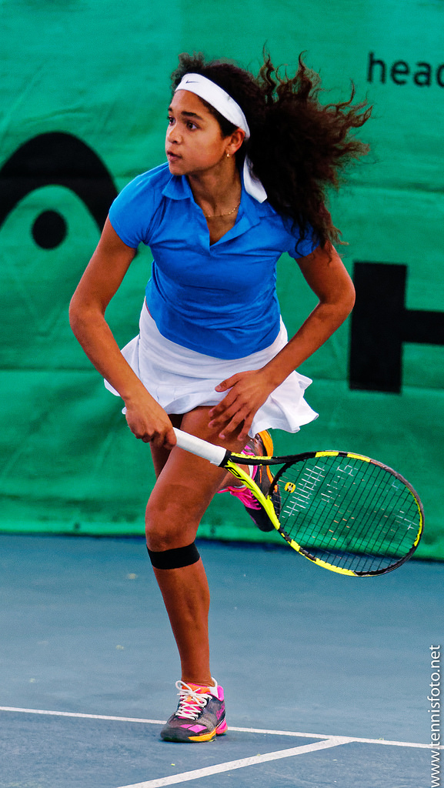
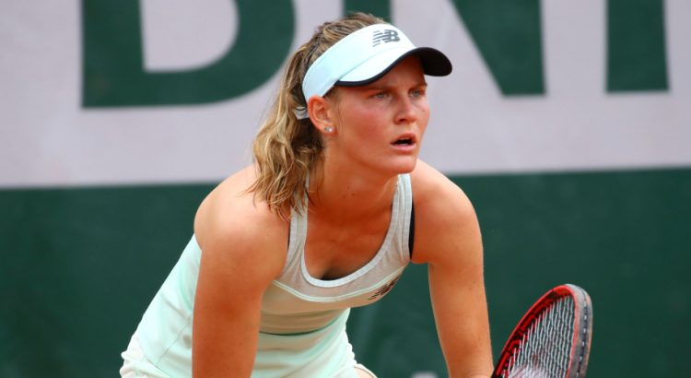
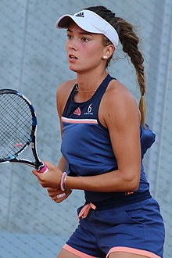
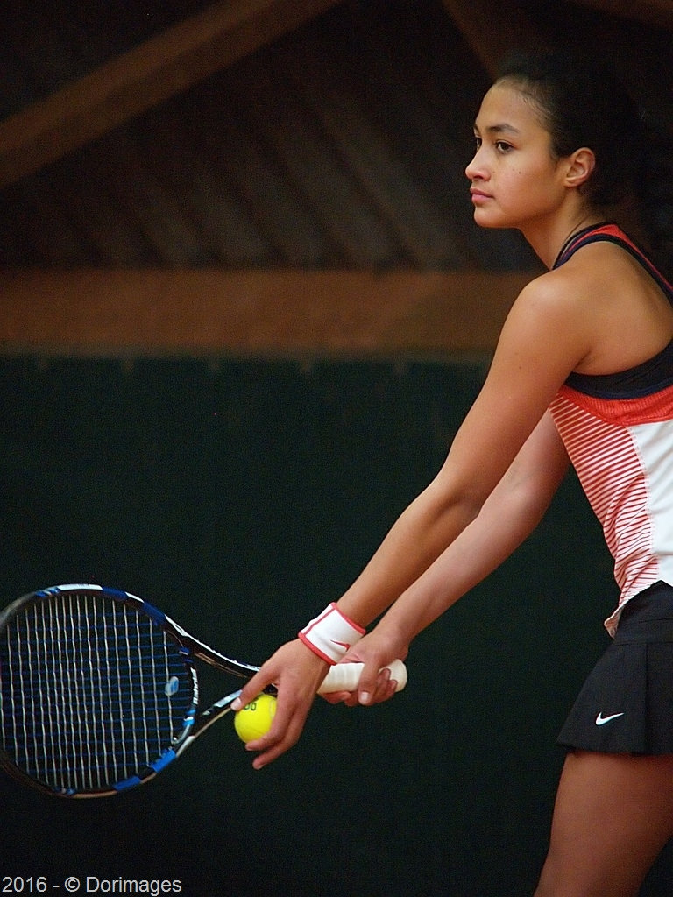
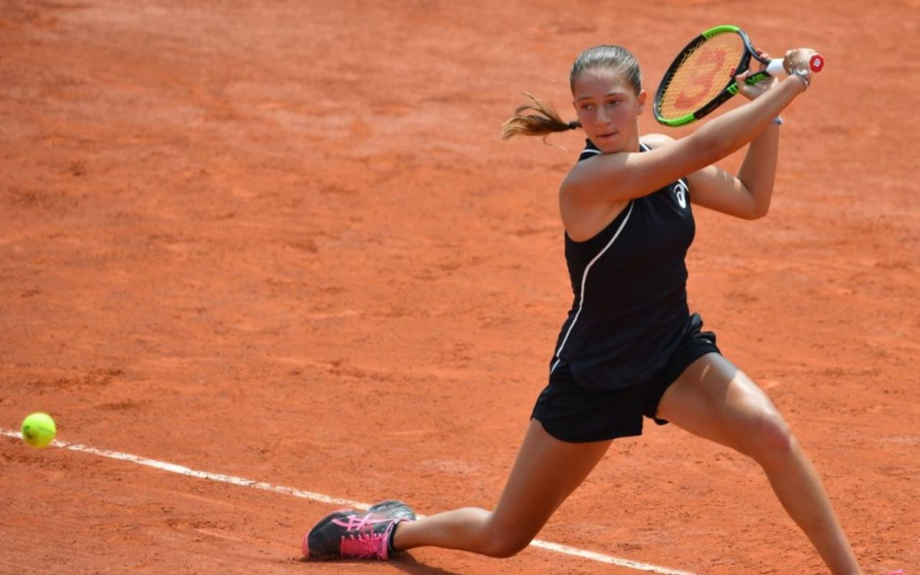
About you ?
Club Origine ? Fan de ? One word to describe you ?
Flavie Brugnone
Fiona Ferro
Anaelle Leclercq
Sara Cakarevic
Mylene Halemai
Diane Parry

Slide 4
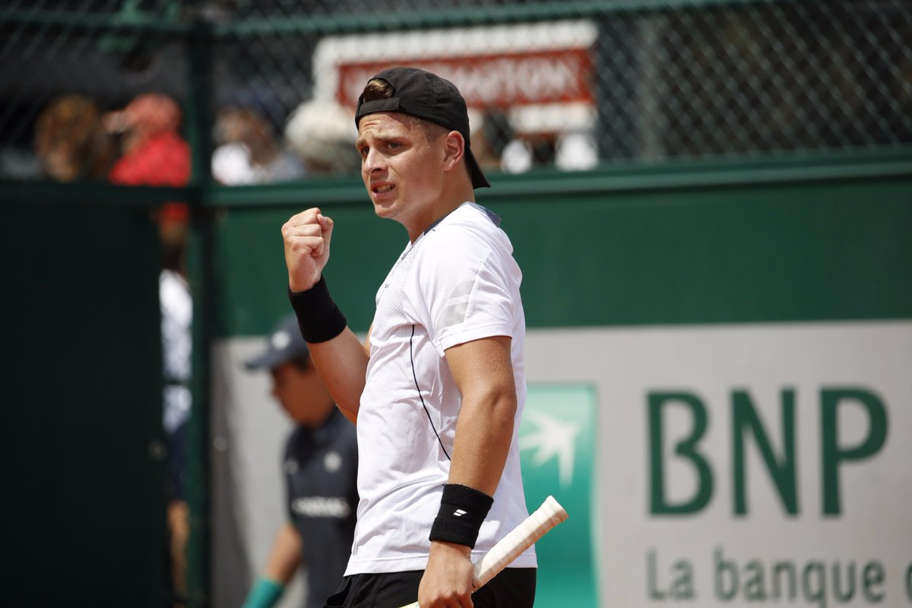
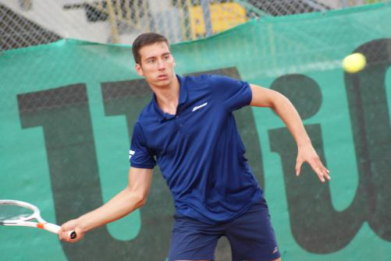
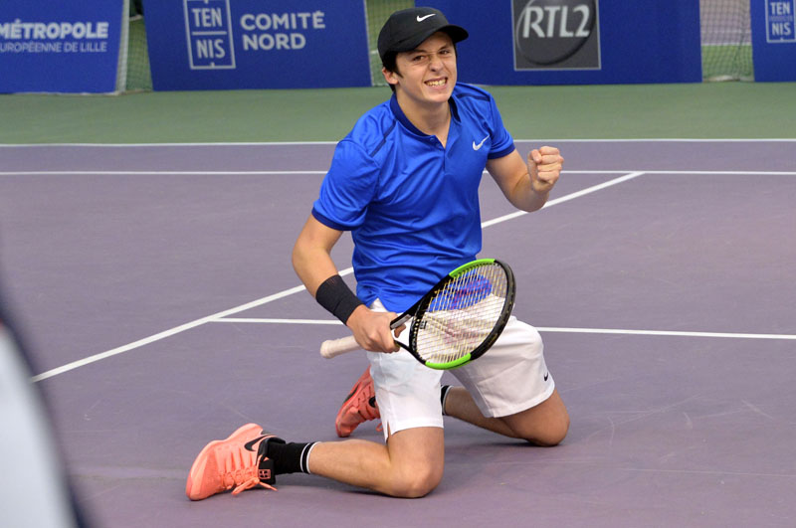
About you ?
Club Origine ? Fan de ? One word to describe you ?
Sean Cuénin
Clément Tabur
Luka Pavlovic
Harold Mayot

Slide 5
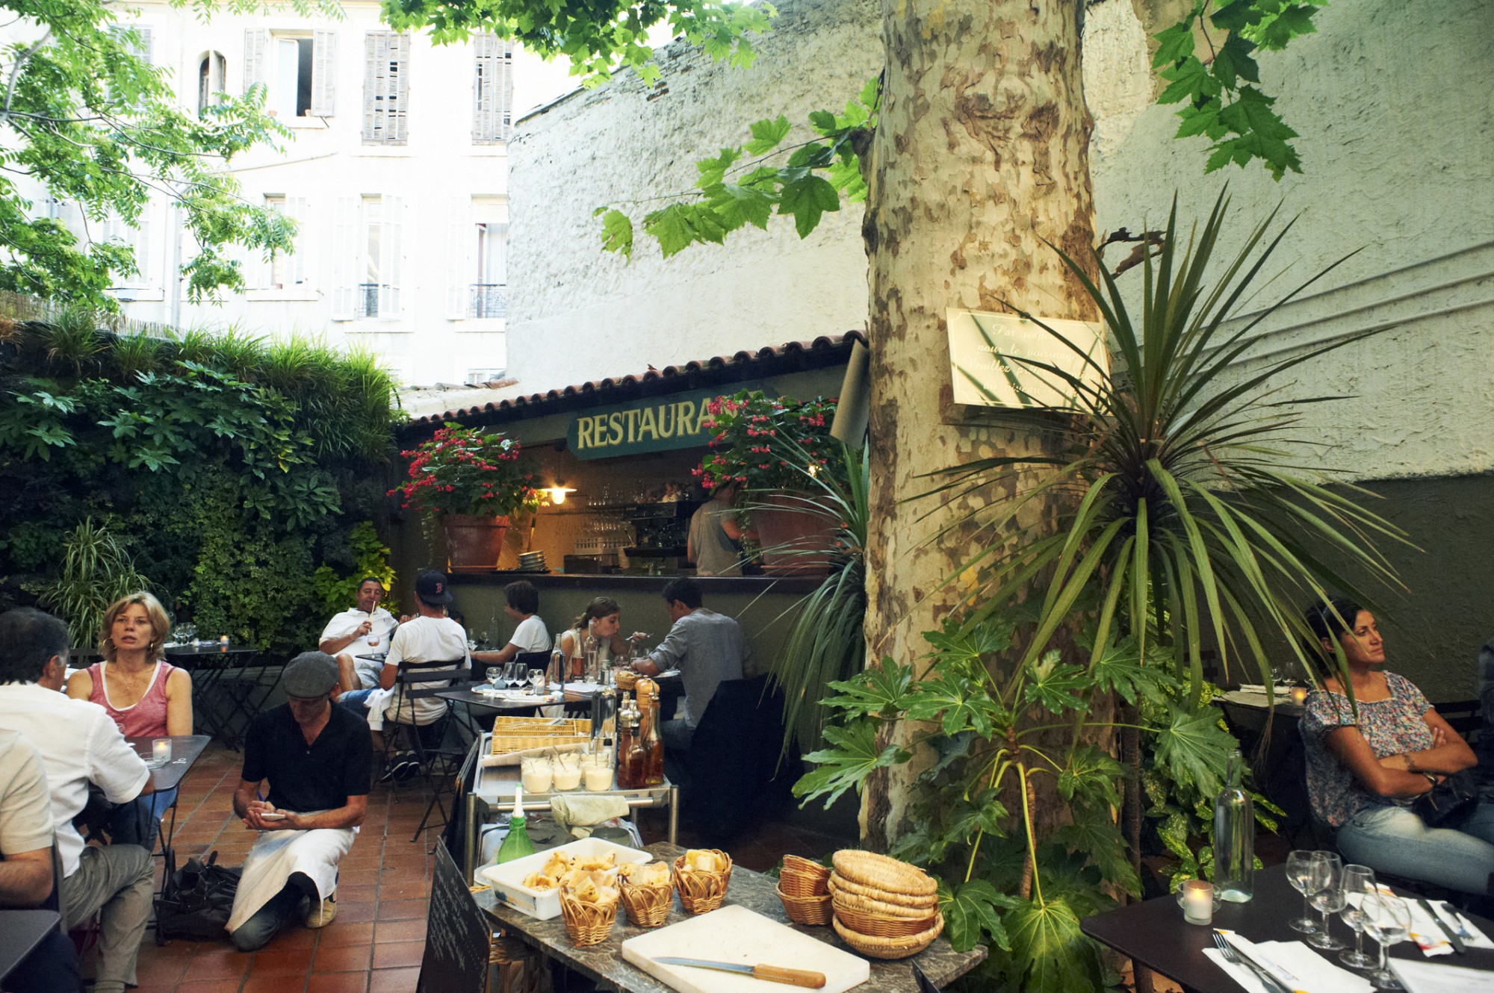
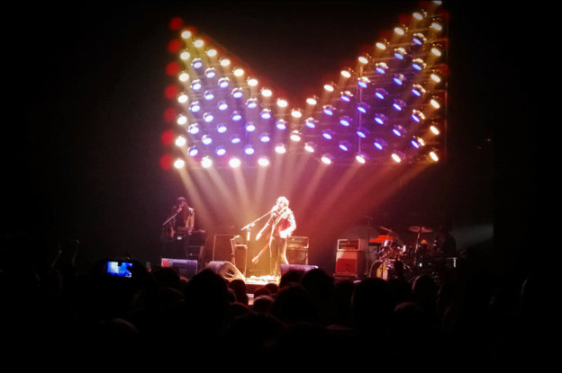
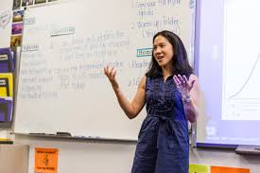
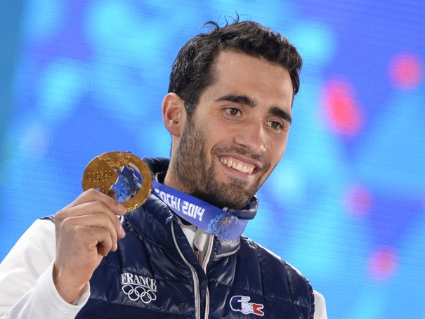
?

Slide 6
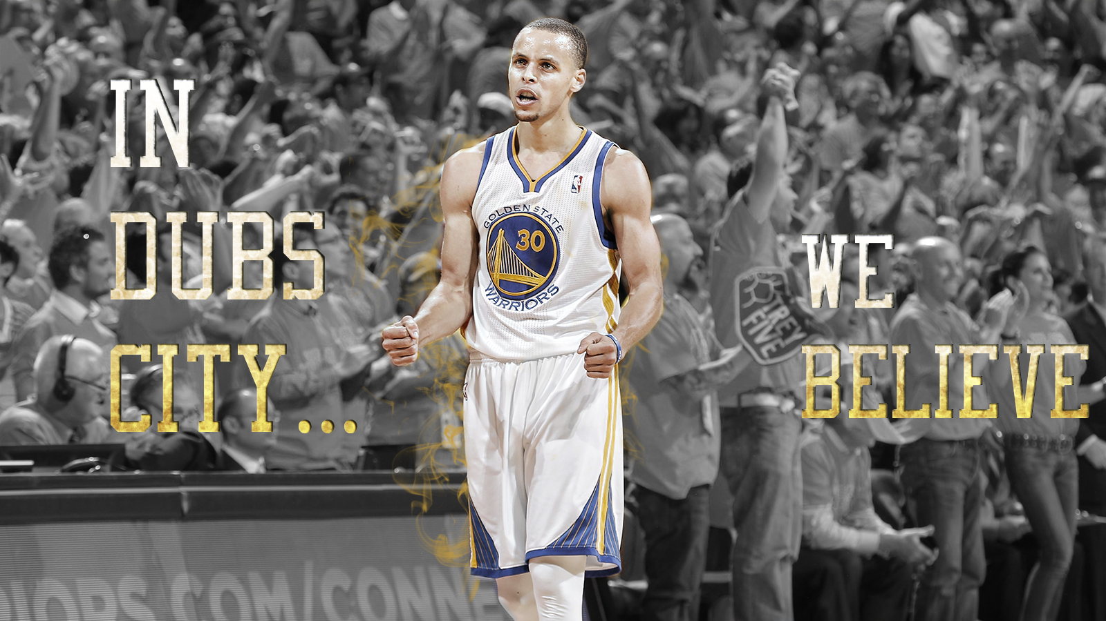

Slide 8
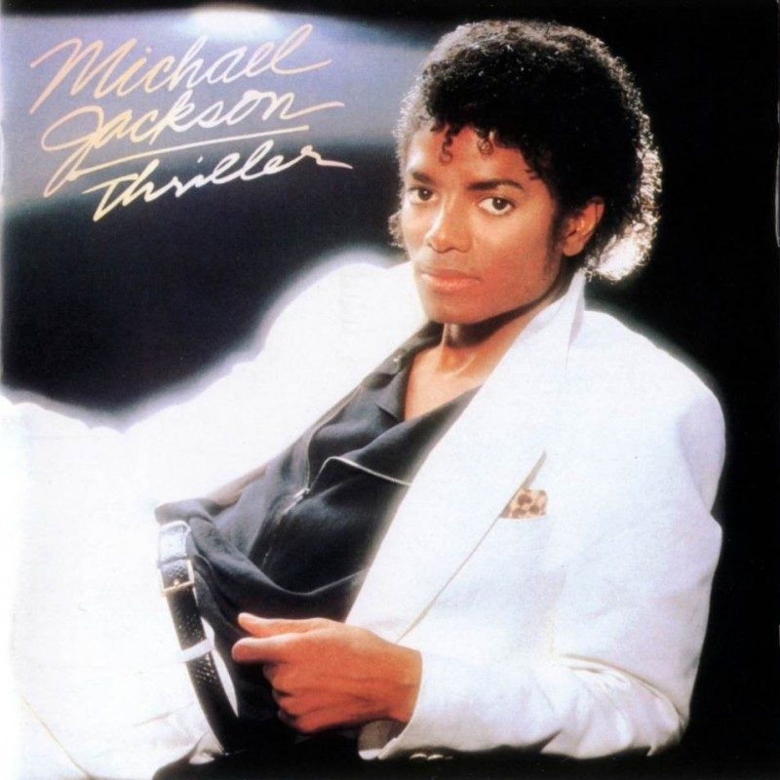
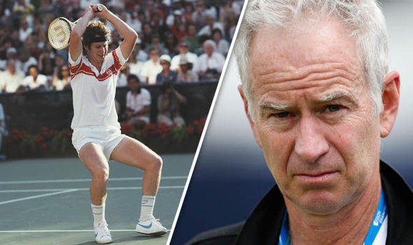
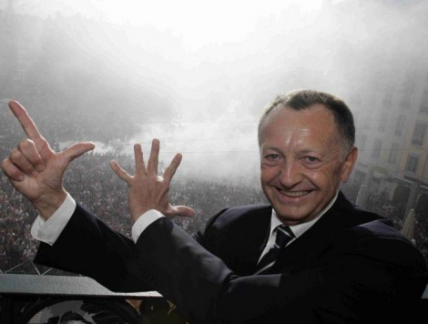
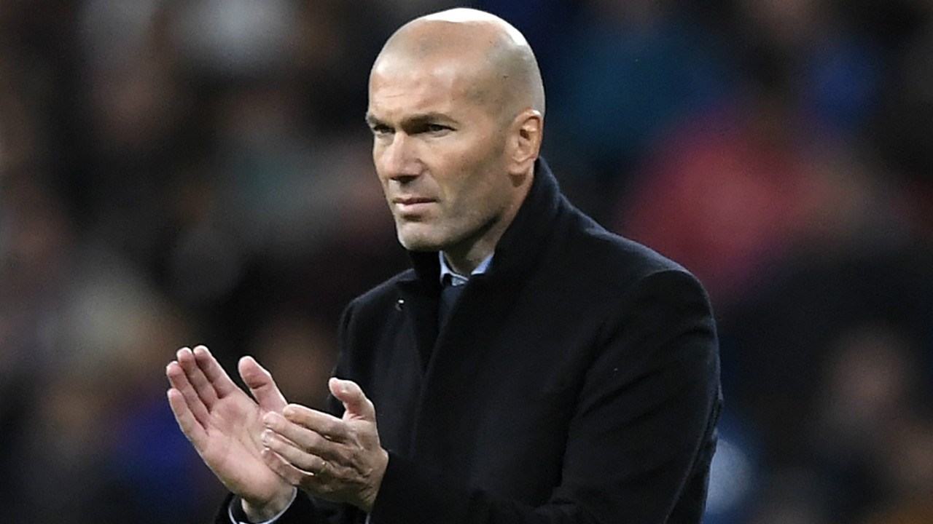
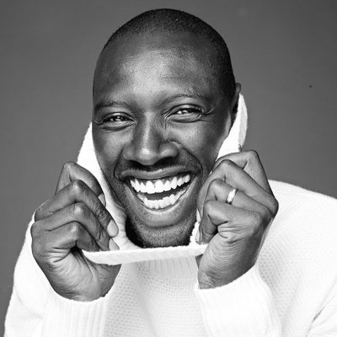
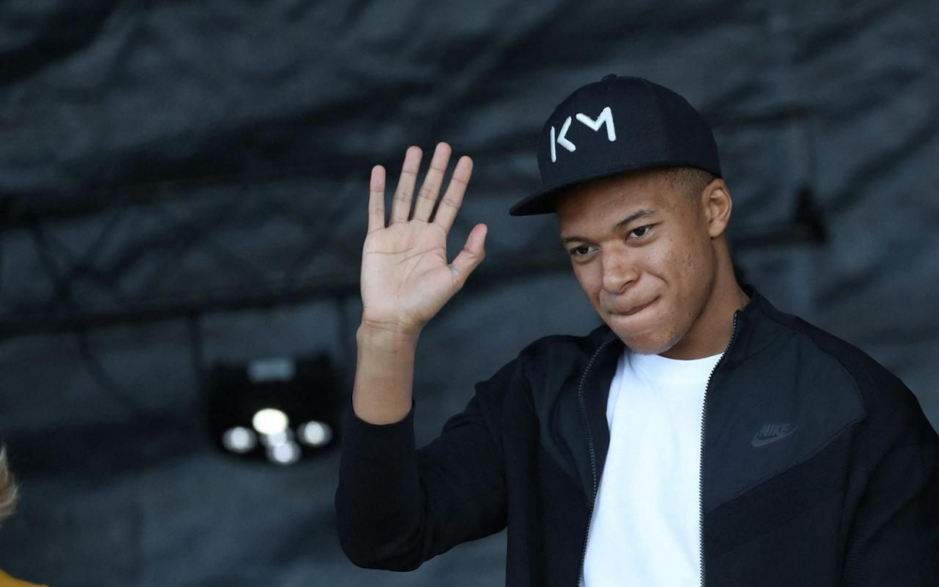
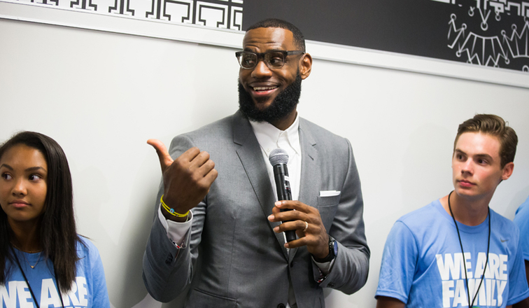
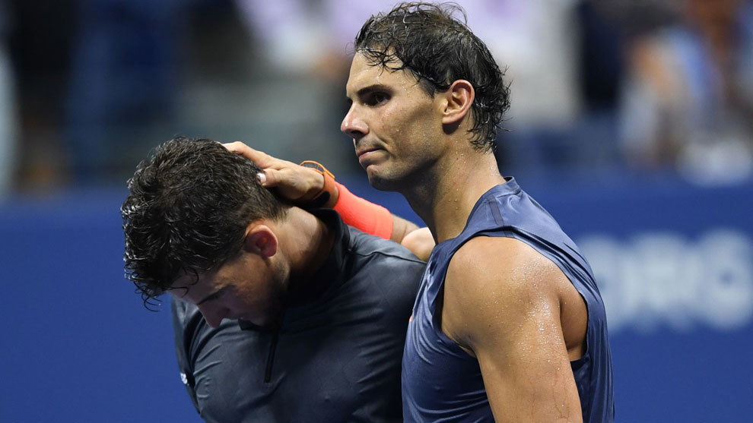
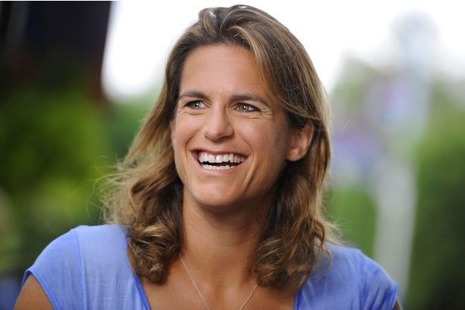

Slide 9
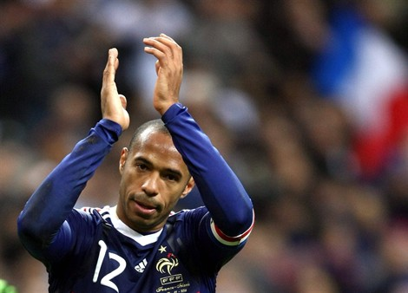
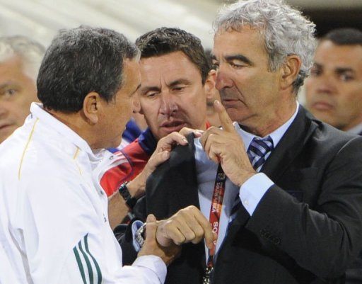
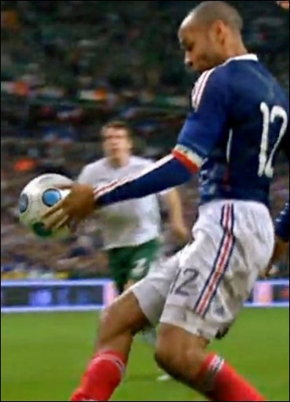
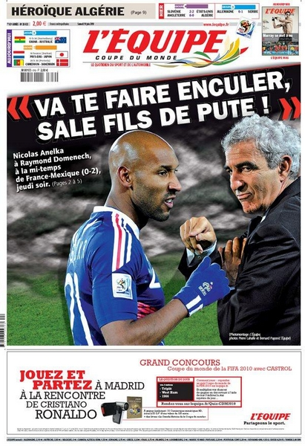
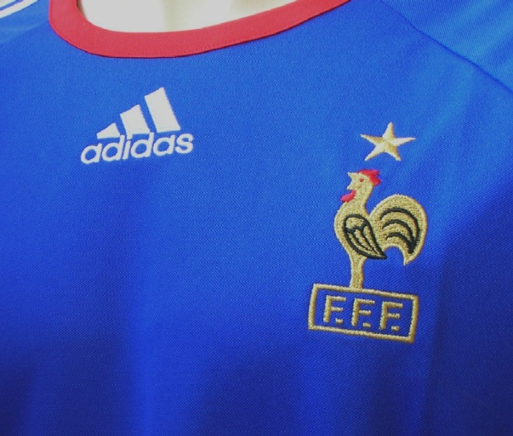
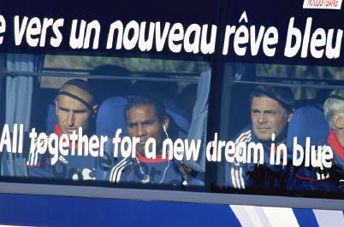
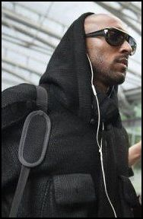

Slide 11
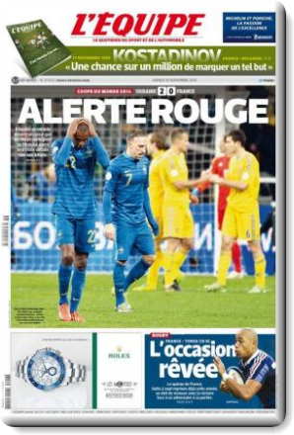
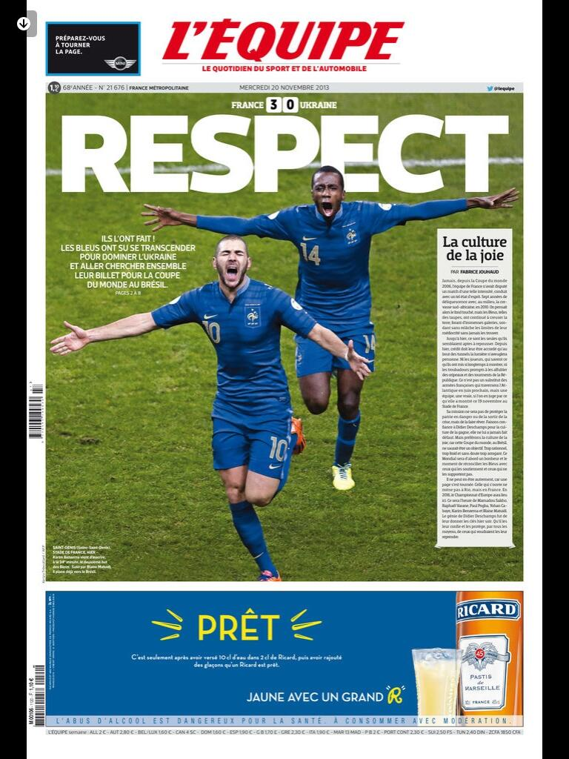

Slide 12
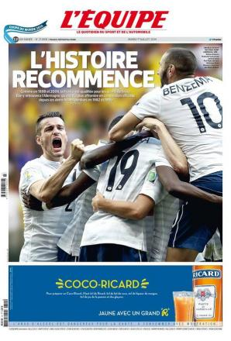

Slide 13
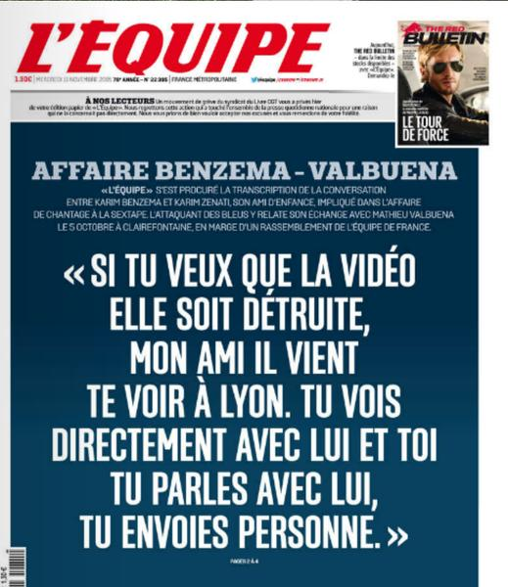

Slide 14
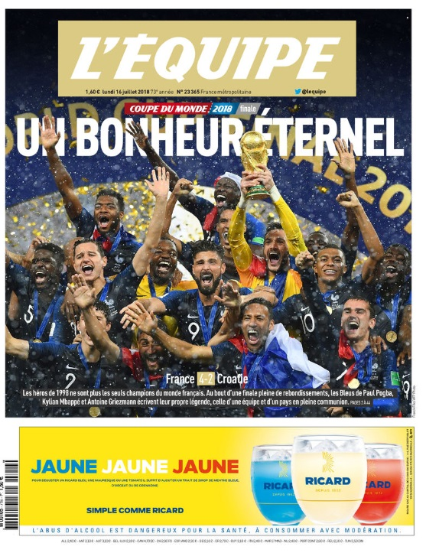

Slide 15
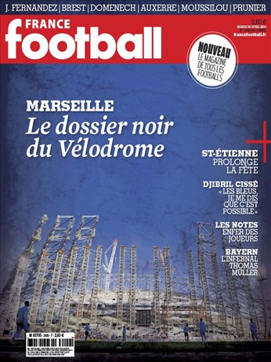
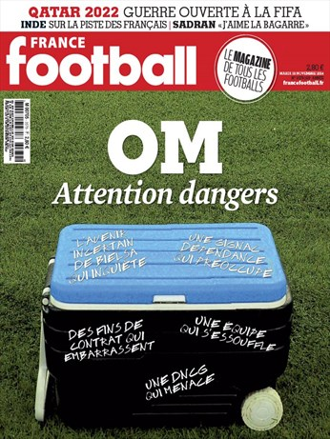
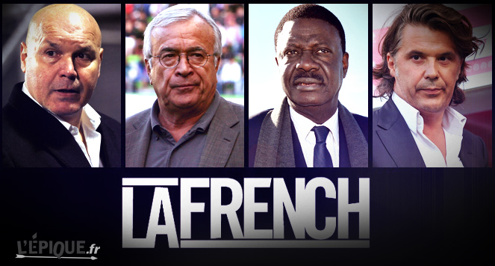

Slide 16
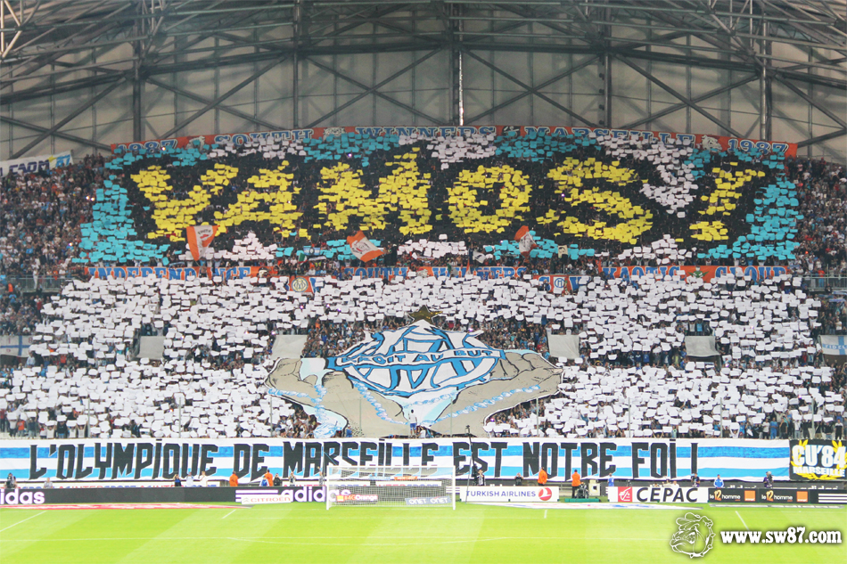
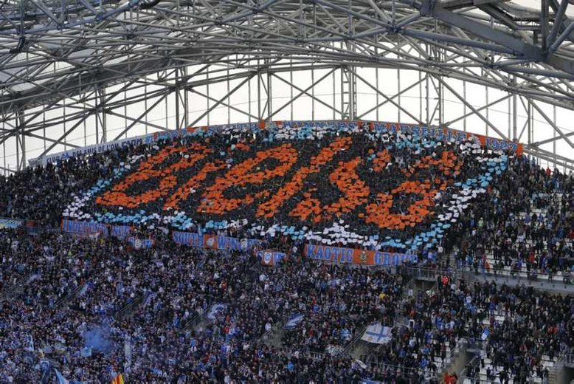
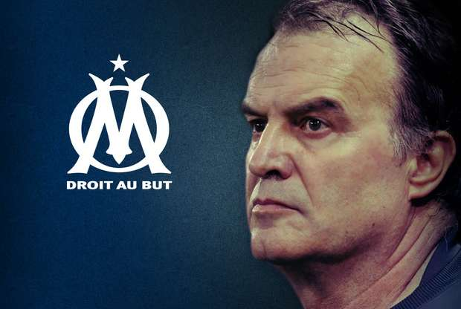

Slide 18
What are 'reputations'?
Reputations are perceptions people have of an individual or organization, be it a company, a city, or a country. These perceptions form as a result of the personal experiences that people have, the messaging they see and hear, and the third party conversations they are exposed to.

Slide 19
What's the difference between 'brand' and 'reputation'?
A brand is a promise. Making a relevant and distinctive promise helps to build a brand.
A corporate reputation is built by fulfilling that promise to stakeholders. A company therefore owns its brand, but stakeholders own its reputation.

Slide 20
Manager sa réputation : comment ?
Visible
Authentique
Transparente
REPUTATION
Cohérente
Distincte

Slide 21
Vos parties prenantes
Famille & proches
WTA/ATP/ITF
Joueuses / Joueurs / Tournois
Médias
Staff
Entraîneurs – préparateurs physiques – kiné - ostéopathes agents…
Partenaires
FFT
Fans

Slide 22
