Slide 1
Strategic Management and sales & digital marketing in sports organizations
Msc ISEM
Lecture 2
lionelmaltese.fr
Lionel Maltese
Maitre de Conférences Aix Marseille University – CERGAM IAE Aix-en-Provence
Associate Professor Sport BUSINESS Management Kedge Business School
Assets Manager ATP – WTA Events and consulting
Member of the Executive Committee FFT – Roland Garros – BUSINESS STRATEGY

Slide 2
Strategic management of Stakeholders in sport organizations ecosystem
Private sponsors
Public sponsors
Sport institutions
Event / Club
Organisation
Athletes
Suppliers
Spectators
Media

Slide 3
Identifying key stakeholders (Mitchell et al., 1997)
LEGITIMACY
POWER
Discretionary
Dormant
Dominant
Definitive
Dangerous
Dépendent
Demanding
Non stakeholder
URGENCY

Slide 4
Sport events & clubs : assets identification
Sport Event & Clubs
Financial resources « Profit centres » | Ticketting
 | Contracts (sponsoring, Public Relations) & Players (clubs only)
 | TV rights
 | Merchandising
 | Institutions (public subsidies)
Renown | History
 | Sport performance
 | Affluence, audience
Assets
Players & coach (clubs only) Partnership (sponsoring, partners) Reputation (event, sport, players) Relational (Social capital, relational networks, Public Relations) Physical (infrastructures, stadium, territory) Organizational Capabilities (Core competences, event driven know how, project management))

Slide 5
Concepts
RBV first model for a sport organization
Partnership Resources
Reputational
Resources
Resources
portfolio
PROPERTIES
?
Players
Coach (club only)
Relational Resources
Physical Resources
Core
Competencies,
Capabilities
Organizational team,
Managers
Performance, Sucess
Sport Success
Financial Sucess
Public Sucess
Long Term

Slide 6
Learning by failures on resources
Sectoral factors understood
Handicap of Inexperience
Survival = Capacity to develop new assets because of « ossification » of the starting ones
Organizational Rents
Strategic assets lead to development
B
C
R & C
High Value
R & C
Low Value
Low probability of survival without important starting assets to support learning about sectoral factors and the acquisition of valuable R & C
Handicap of Ignorance
A
D
The risk of failure increases because of the gap and its evolution between R & C and the competitive requirements of the environment
Handicap of obsolescence
Sector factors not understood

Slide 7
Failure Case Study
ATP Tennis Tournament
Philips Open of Nice (1995)
“Honeymoon illusion”

Slide 8
History : Philips Open of Nice
Date : April – Outdoor (clay)
Tournament direction : ex ATP french players (Pascal Portes and Dominique Bedel)
Ambush with Monte Carlo Tournament (TMS) : important sport success (Sampras, Courrier, Bruguera…)
Creation of this event for Philips
Resources allocations → Focus on Philips demand
Long term Vision ?

Slide 9
Understanding the failure
Philipe Open of Nice
Handicap of inexperience
« Honeymoon illusion » with Philips
Handicap of obsolescence :
Resources isolation
Failure of « axes » resources
&
Capabilties on survival sectors
Weakening of the stock of resources
&
Dynamism (mechanism) broken
Event failure

Slide 10

Partnership Resources
« Axes »
Learning
Organizational
Capabilities
Survival
Relational
Resources
Reputational
Resources
Survival
Physical
Resources
Dynamic capabilties
Stock of resources

Slide 11

Open Nice Côte d’Azur - Positioning
Historical tournament and club of the french sporting inheritance
Favorable site towards player / fan proximity
High quality Public Relations
Customization of the offers and flexibility of the organization
Roland Garros ambushing
Last preparation for the French Open in the heat of the clay season
Last stop before a Grand Slam which entails broad international media coverage
Jean-François Caujolle, co-director
Melting pot between top french players and top 15 members of the ATP world tour

Slide 12










Dangers
TITLE SPONOR
No stadium
No TV Rigths
Public sponsors dependency
Relational Model = short term?
OFFICIAL SPONSORS
SPONSORS

Slide 13
How to be sustainable ?
With a relational model !

Slide 14

One solution for this case !
Creative Artists Agency (CAA) is a prominent entertainment and sports agency headquartered in Los Angeles. CAA represents A-list and emerging stars in movies, television, music, and sports. It is often cited as the leading talent agency and its clients include Meryl Streep, Brad Pitt, George Clooney, Sandra Bullock, Oprah Winfrey, Julia Roberts, Steven Spielberg, and David Letterman.
CAA Sports represents more than 650 of the world's best athletes in baseball, football, hockey, basketball, soccer, tennis, and golf,
Licensing, endorsements, speaking, philanthropy, video games, and the Internet.
broadcast rights, corporate marketing initiatives, and sports properties for sales/sponsorship opportunities.

Slide 15
CAA Football : Drew Brees, Peyton Manning, Eli Manning, Tony Romo, LaDainian Tomlinson, and Adrian Peterson, among many others.
• CAA Basketball LeBron James, Chris Bosh, and Dwyane Wade, plus Carmelo Anthony, Tony Parker, Chris Paul, and many other stars.
• CAA Baseball negotiated $400 million in new guaranteed contracts within the past year ($135 million more than the next closest agency), including three of the six largest contracts in the league (based on an average annual value.) Clients include Derek Jeter, Ryan Howard, Roy Halladay, Ryan Braun, and Ryan Zimmerman.
• CAA Hockey Sidney Crosby, Henrik Sedin, Evgeni Malkin, Jonathan Toews, Daniel Briere, Patrick Kane, John Tavares, and Daniel Sedin, among many others.
• CAA Tennis 3 Novak Djokovic and #4 Andy Murray, plus tennis legends Andre Agassi and Stefanie Graf.
• Cristiano Ronaldo, renowned manager of Real Madrid José Mourinho, Chelsea FC’s Deco, Manchester United stars Nani and Anderson, and along with CAA client Simon Fuller, represents David Beckham, for whom it orchestrated the landmark deal that brought him to Major League Soccer’s Los Angeles Galaxy.
• In 2009, CAA was the organizer of the World Football Challenge, a six-city round robin tournament which brought Chelsea FC, AC Milan, FC Internazionale Milano, and Club America to compete in the United States, and became the most watched international soccer exhibition matches to air on Spanish-language cable all year.
• CAA Golf represents Sports Illustrated’s “Individual Male Athlete of the Century” Jack Nicklaus and legendary champion Greg Norman, who spent seven years atop the world rankings and now heads a global enterprise.
• The agency represents such superstar athletes as action sports icons Tony Hawk and Shaun White and four-time reigning NASCAR champion Jimmie Johnson.
• CAA Sports won the highly-coveted assignments to sell major corporate partnerships for the new Yankee Stadium and the soon-to-be renovated Madison Square Garden, and has since closed nearly 20 deals.
• Corporate clients also include FC Barcelona, Chelsea FC, Juventus FC, and StubHub, among many others.

Slide 16
Assets Construction !
Be efficient !

Slide 17
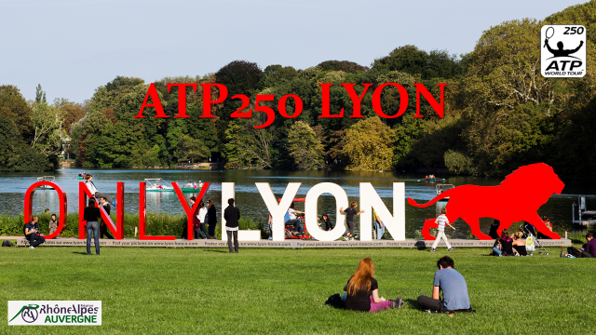

Slide 18
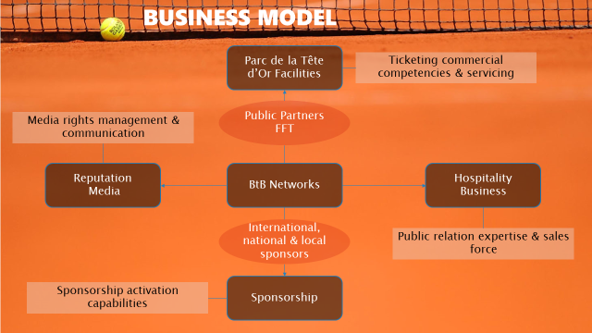

Slide 19
Business Plan & Model
From theory to practice !

Slide 20
Business Plan
A Business Plan is a document that summarizes the operational and financial objectives of a business and contains the detailed plans and budgets showing how the objectives are to be realized.
A Business Plan includes :
  Strategy formulation and complete description
  Financial aspects linking to the project
  Core Model (Business Model) to resume the link between strategy and financial returns

Slide 21
Business Plan of what ?
For sport organizations :
  New partnership activation ?
  Develop new profit centers ? Stadium ?
  Ticketing strategy : new technologies ? CRM ?
  Merchandising ?
  Branding strategy ? Co-branding ?
  Diversification ?
  Training ?
  Recruitment ?
  Quotation ?
  …

Slide 22
Business Plan approach
For sport organizations → specific “hybrid” approach : RBV development at first and environment analysis as a kind support in a generic (classical) “background”
3 levels :
  Evaluation
  Organization
  Restitution

Slide 23
Evaluation step
1. Assets (resources & capabilities) identification linking to the main profit centers and key stakeholders
2. Potential and rent evaluation of each asset (V.R.I.O)
3. Description of the main characteristics of the “macro” environment :
  Economical
  Political
  Sociological & cultural
  Legal aspects

Slide 24
Evaluation step
4. Description of the main characteristic of the “micro” environment ( “5 forces model”) :
  Identification of your stakeholders linking to resources access and sharing : analyze your control and negotiating power !
  Customers (marketing segmentation) : analyze your control and negotiating power !
  Competitors (direct - substitutes – new entrants) analyze the threats
5. First summary :
  Financial needs : budget necessary to implement
  Human needs : competencies ? Recruitment ? Formation ? Placements ? Consulting agencies ?
  Global profitability of the development project
  First prices fixation : ticketing – Public Relations – Communication supports - Merchandising…

Slide 25
Organizational step
1. Articulation and orchestration of resources with your capabilities : exploration and exploitation to optimize the whole potential of assets portfolio ?
2.Interactions between resources : analyze the links and the creation of a system ?
3.Renew or reject your assets ?

Slide 26
Resume
“BUSINESS MODEL”
Definition : a sort of diagram which explain how you can generate profits (more precisely your turnover)

Slide 27
Business Model ?
« The essence of the idea is ‘how you get paid’, or ‘how you make money’ with a taxonomy of alternative mechanisms ». (Chesbrough et Rosembloom, 2002)
« Business model refers to the core architecture of a firm, specifically how it deploys all relevant resources ». (Tapscott, 2001)

Slide 28
5 “keys” to explain for your Business Model
Trade ?
Business
Model
Positioning ?
Singularity ?
Core human compenetencies ?
Description of the demand in your market?

Slide 29
Example of Business Model : ZARA case
Creation (imitation in fact !), production (plants), distribution (ZARA shops) of fashion products with a large diffusion
Positioning in selling fashion products with relative low prices
Singularity : imitation of fashion actuality (most creative dressmakers) & new models in the shops every week !
Core competencies : control of all the process of the supply chain management (creation – production – logistic) → a just in time strategy very difficult to implement in this industry !
The demand is very high for this kind of “fashion” products with relative low prices…

Slide 30


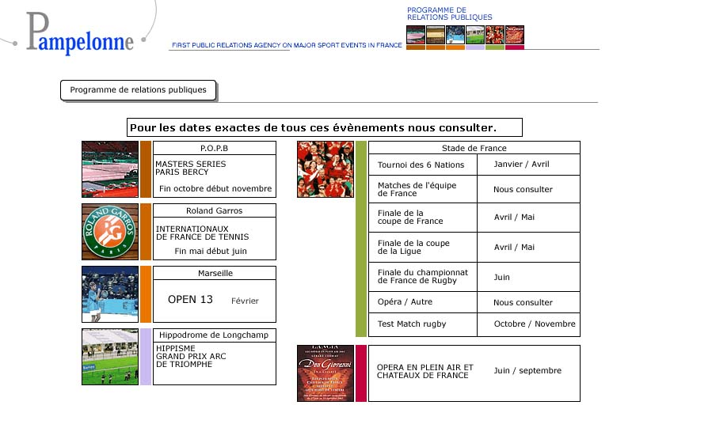
Example :
www.pampelonne.com

Slide 31
Pampelonne Business Model
Trade : Public Relations expert → implementation & activation
Positioning : High level services coupling to rare sport experiences with the most prestigious events
Core competences : relational networks exploitation – anticipation due to personal informations and “special” access to key actors…
Singularity : contracts & agreement (Roland Garros – Stade de France…) – possession of an event (Open13) and direction of BNP Paribas Masters in Paris.
The demand ? : Large firms communication (Public Relations) strategy (Total, Sodexho, BNP Paribas…) and important demand due to exceptional event (Rugby World Cup for instance…)

Slide 32
Understanding your Business Model
Adapted from Gary Hamel : Leading the Revolution (2002)
Customer Benefits
Configuration
Company Boundary
Customer Interface
Fulfillment & Support
Information & Insight
Relationship Dynamics
Princing Structure
Core Strategy
Business Mission
Product / Market Scope
Basis for
Differenciation
Strategic Resources
Core Competencies
Strategic Assets
Core Processes
Value Network
Suppliers
Partners
Coaltions

Slide 33
Restitution step
Business and marketing actions :
  Stadia / Arena management (“Model based on Fans”) :
    hospitality
    CRM (Ticketing)
    Merge sport and Entertainment
  Sponsorship Activations
  CSR Strategy
  Reputation and Brand Management
  Sport area development : training – coaches – scout… : sport performance !

Slide 34
Final Restitution step
  Proposition of development axes and Marketing activities :
  Public Relations – Social Capital
  Partnership - Sponsorship Activation
  Communication
  Brand Management
  Merchandising
  Ticketing – CRM
  Stadia Management :
    Experiential View B to B
    Experiential View B to C
  …

Slide 35
Be careful !
Be sensemaking in linking your final propositions (development axes and marketing activities) to your strategic analysis (evaluation + organization)

Slide 36
+ You have to be “sensemaking” and on the implementation of :
Characterisation of interconnections between resources (and not only VRIO) and their interaction with the environment indicates that the managerial aptitudes to manipulate assets within a single system are essential !
The objective is to create an unique combination of assets to exploit opportunities, face to threats and to develop sustainable performance.

Slide 37

Success case
Open13 1993---2017
www.open13.org
“Familial professional “bricolage” from Marseille”

Slide 38

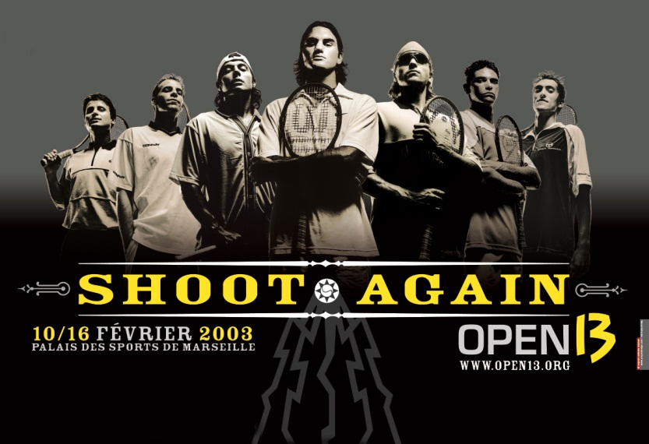
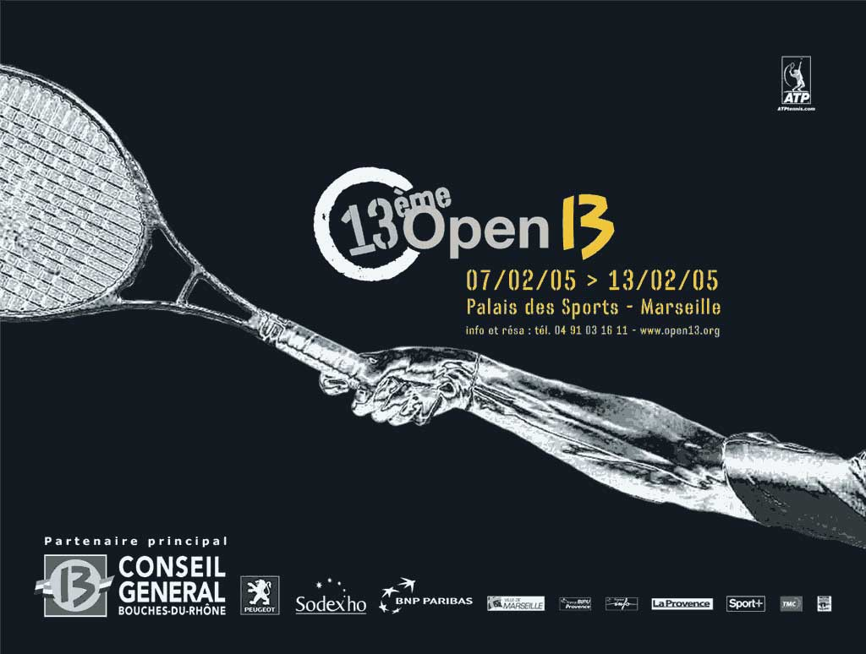
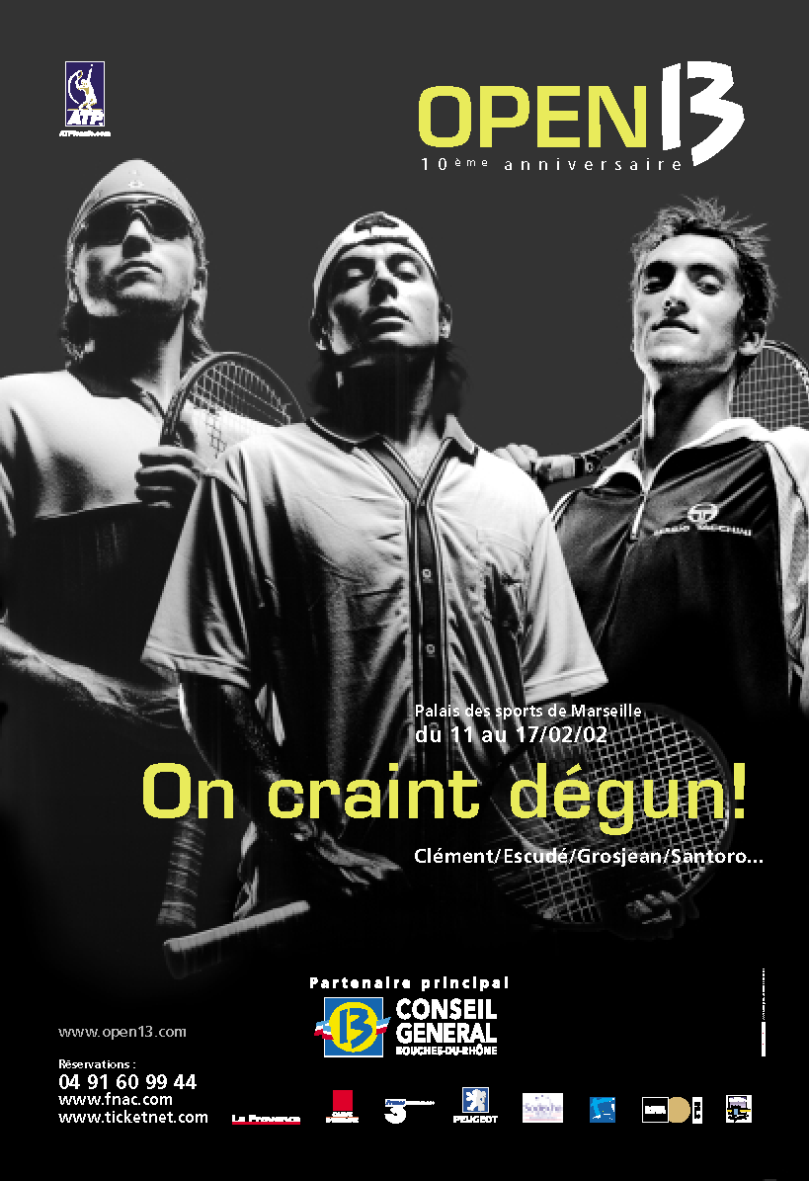

Slide 39

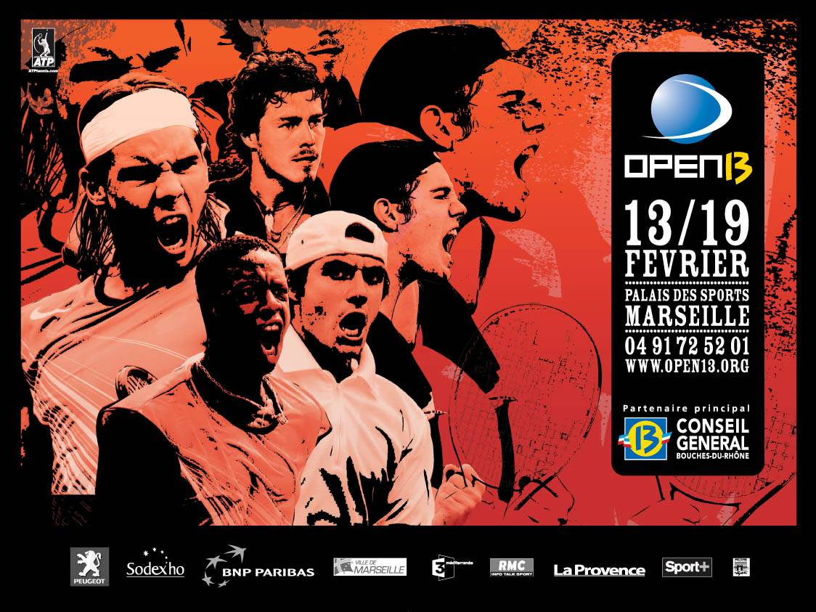

Slide 40
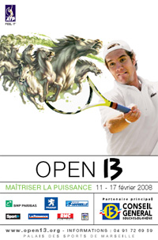
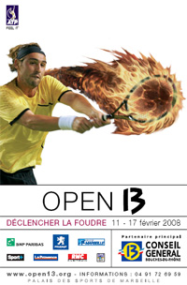
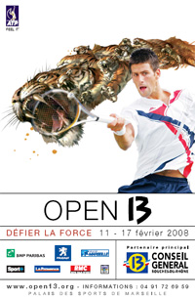
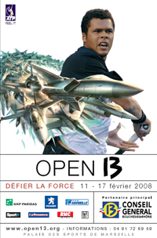

Slide 41
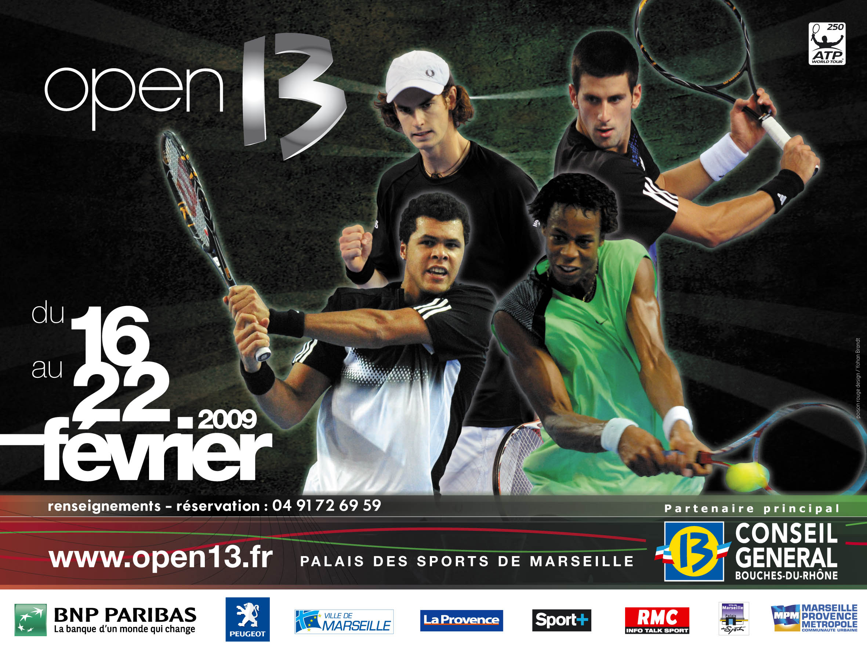

Slide 42
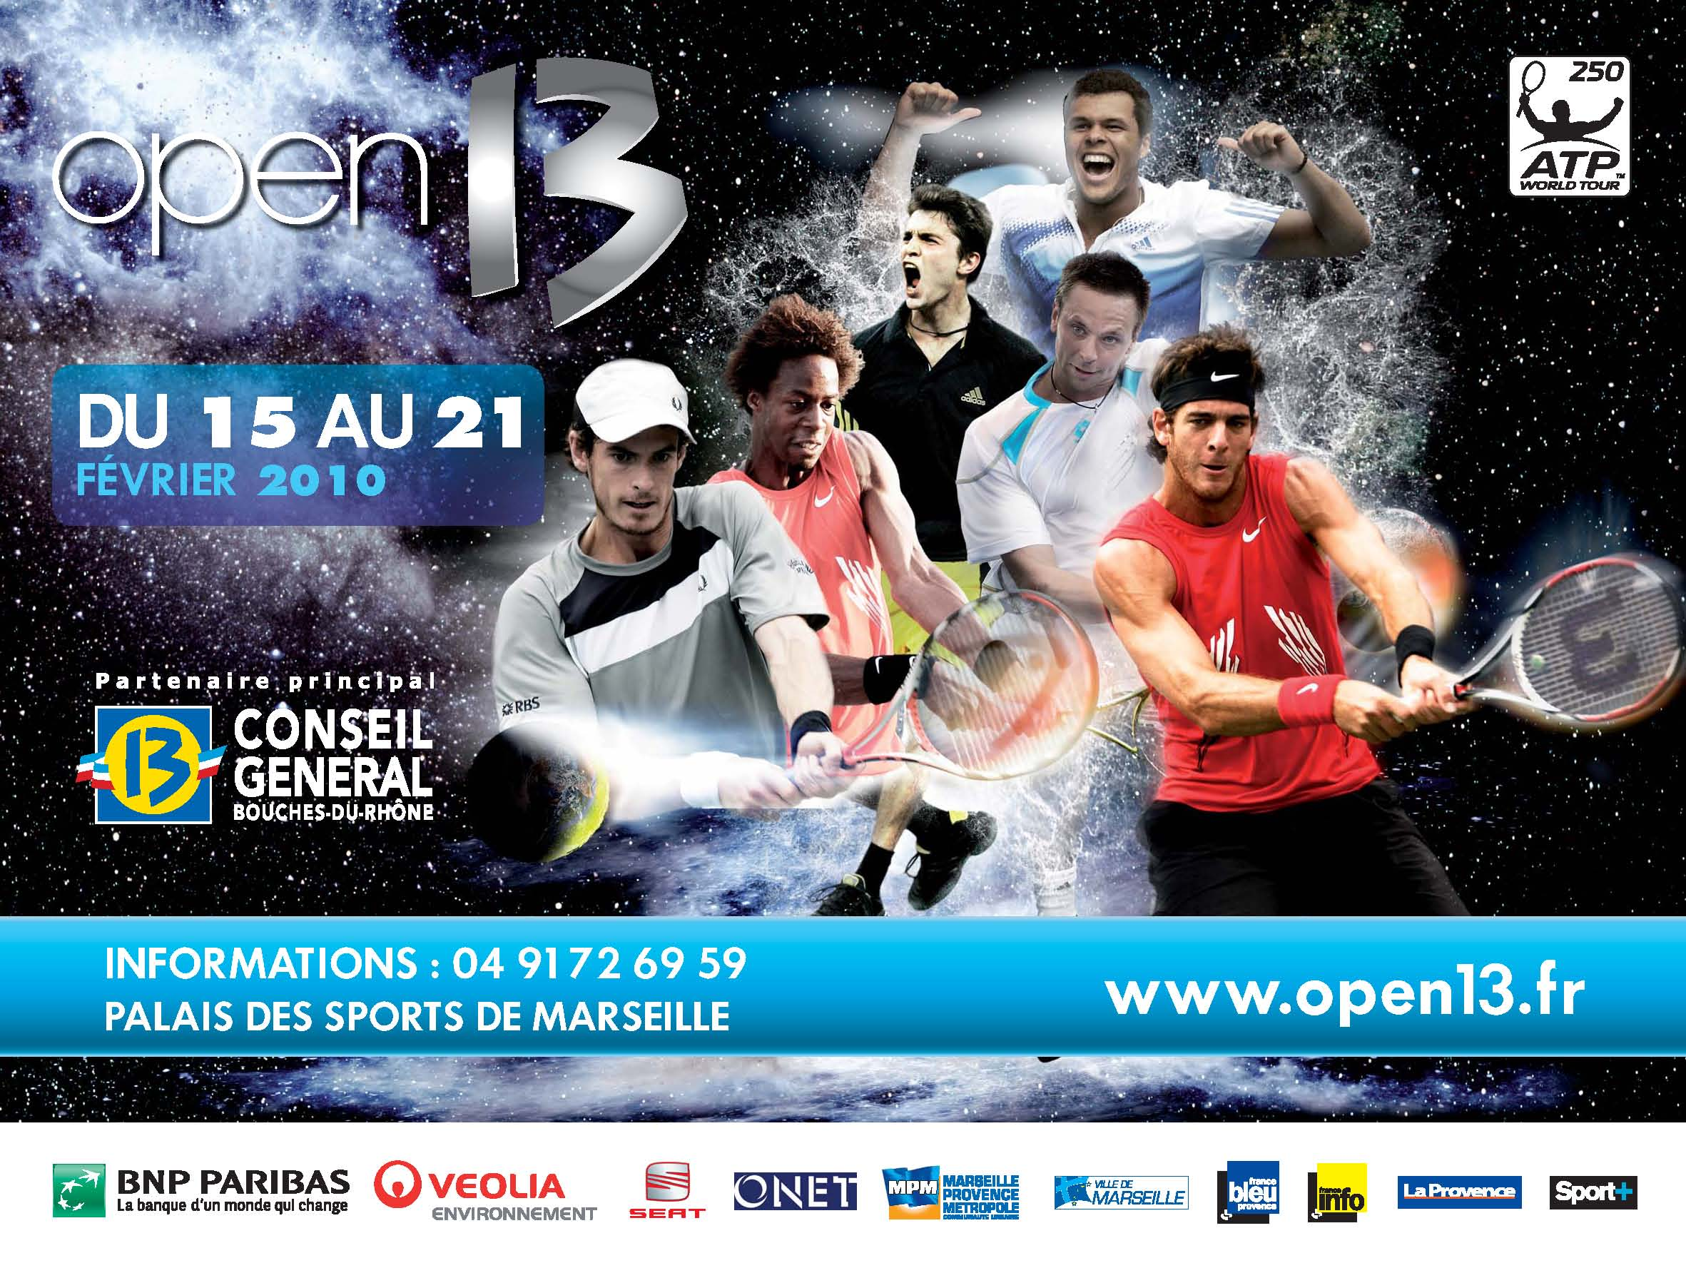

Slide 44


Slide 46


Slide 56
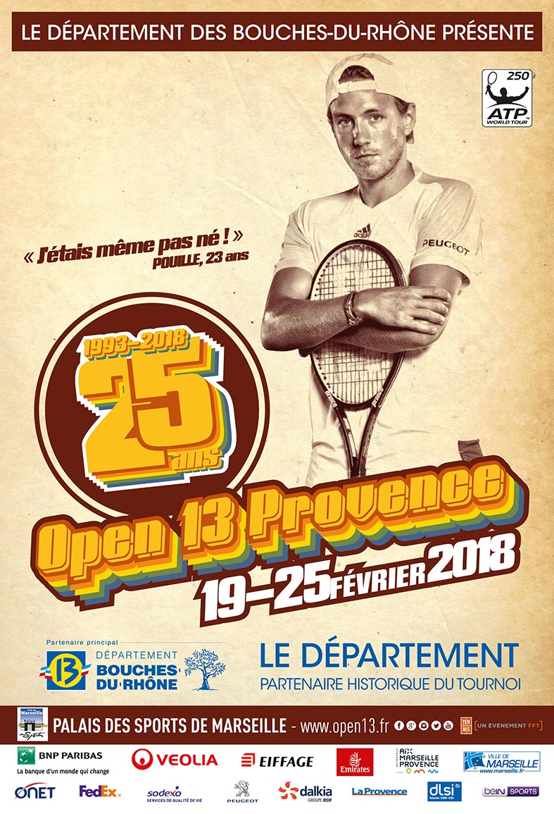
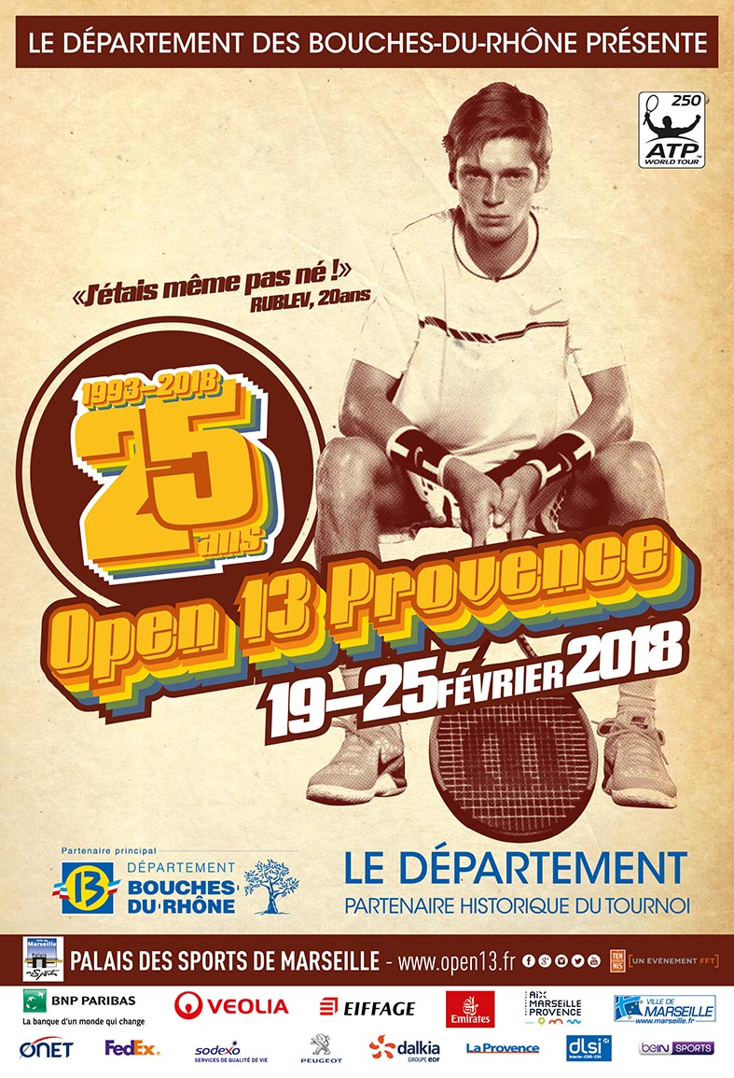

Slide 57
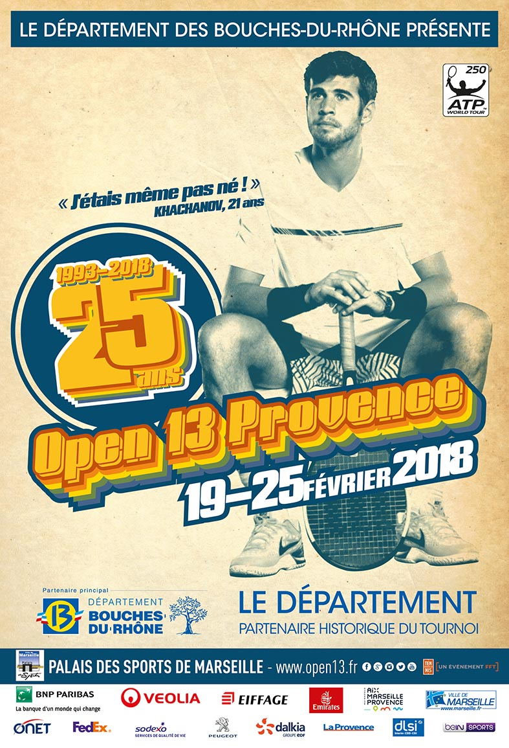
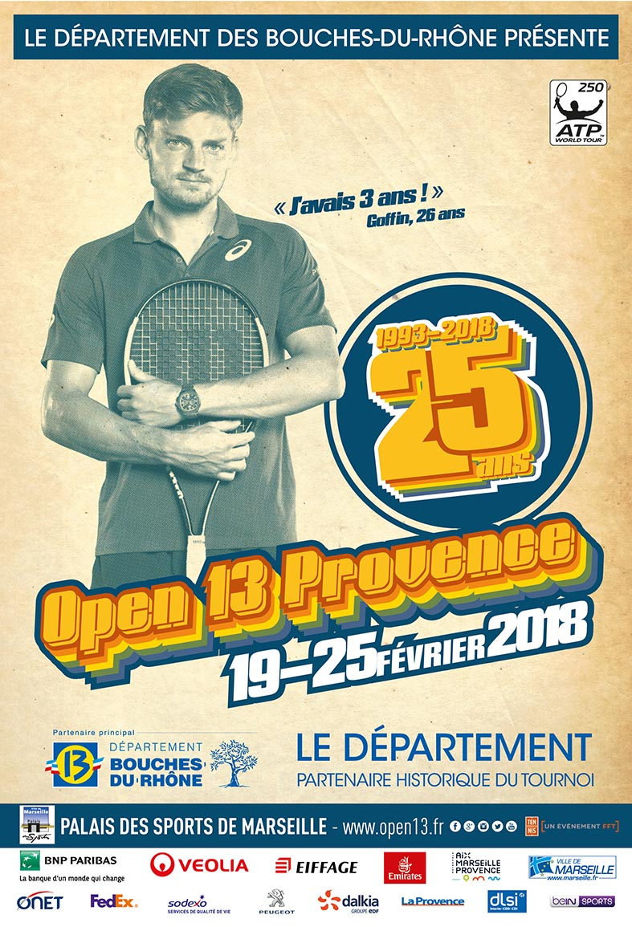

Slide 58
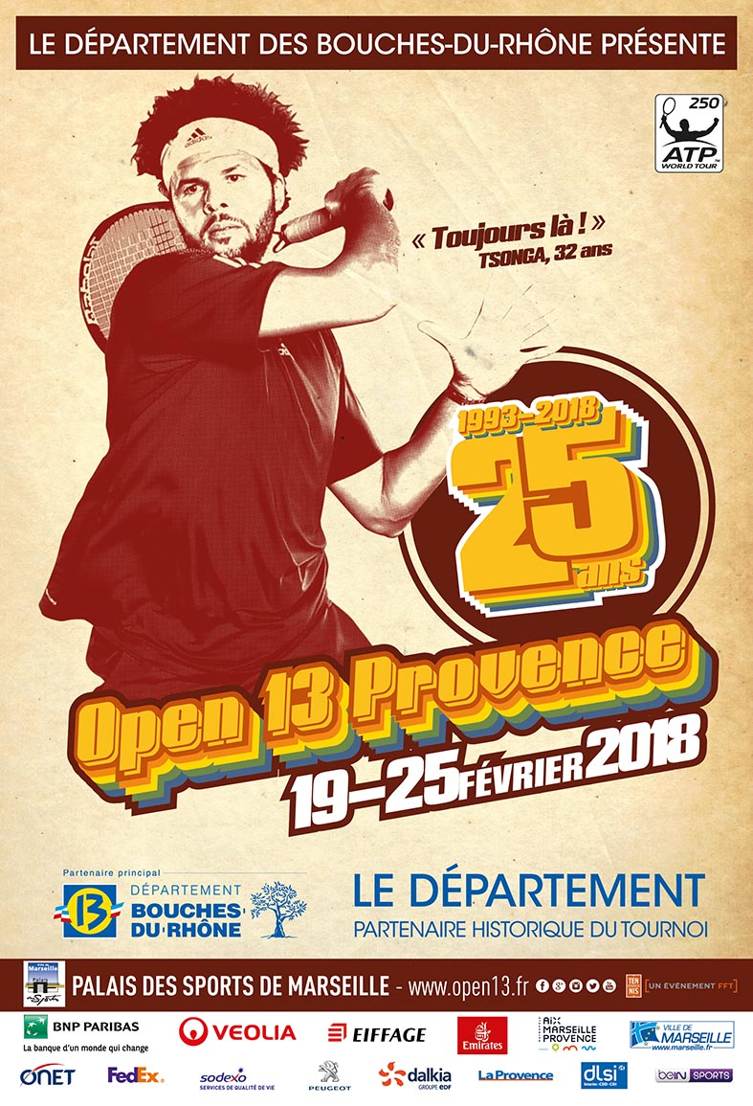


Slide 59
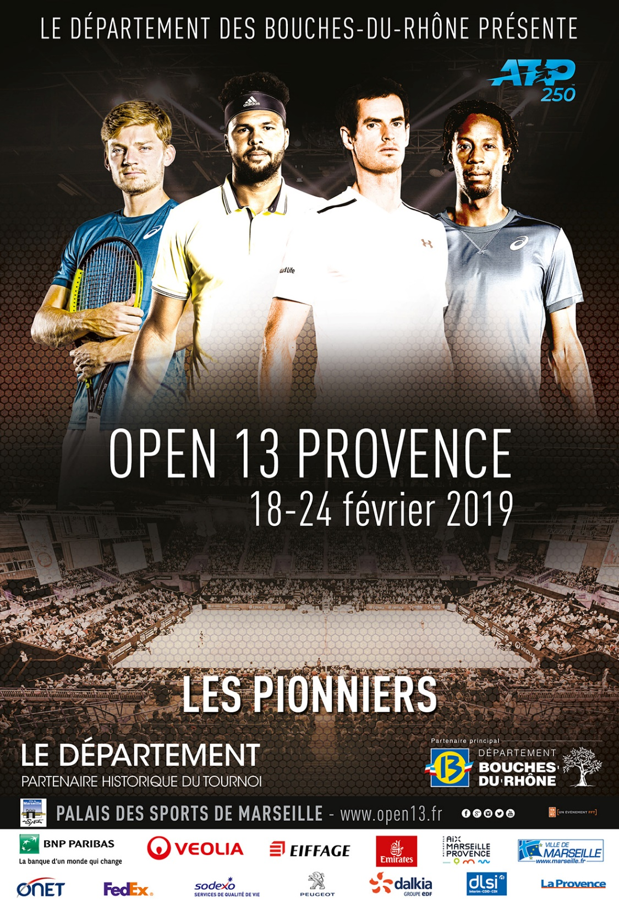
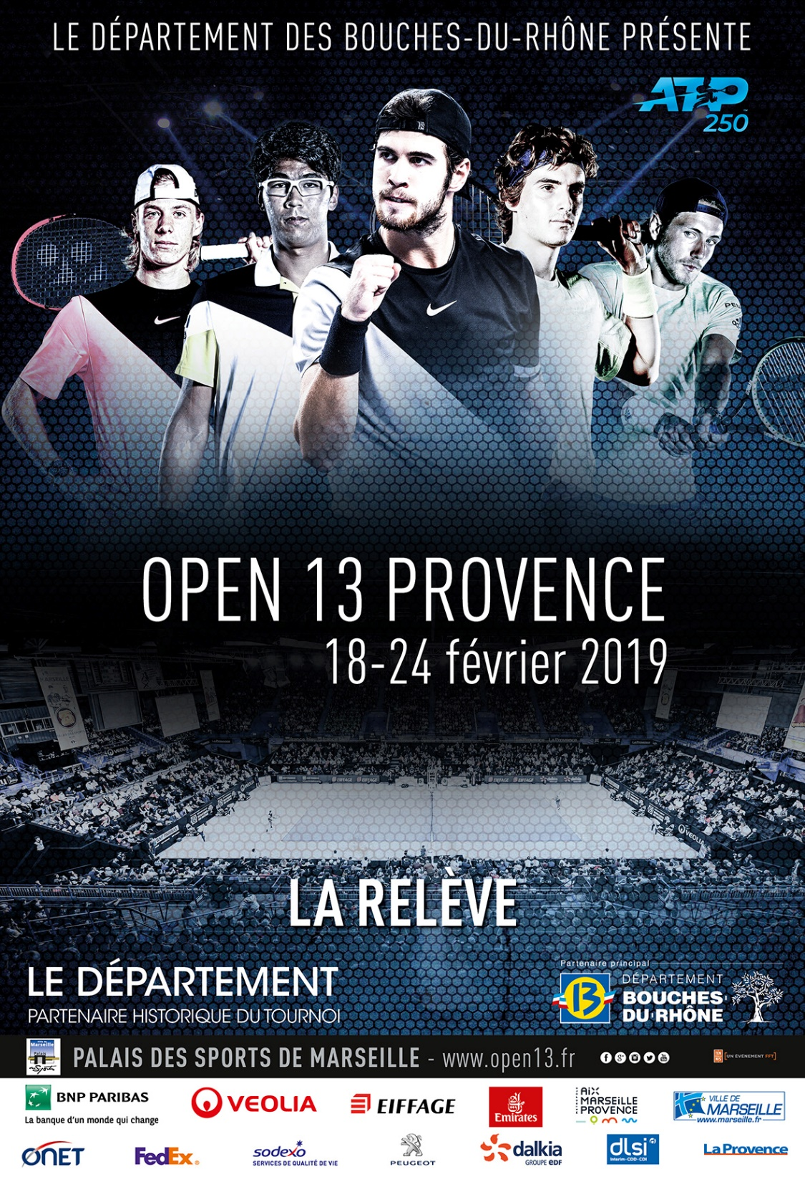

Slide 60
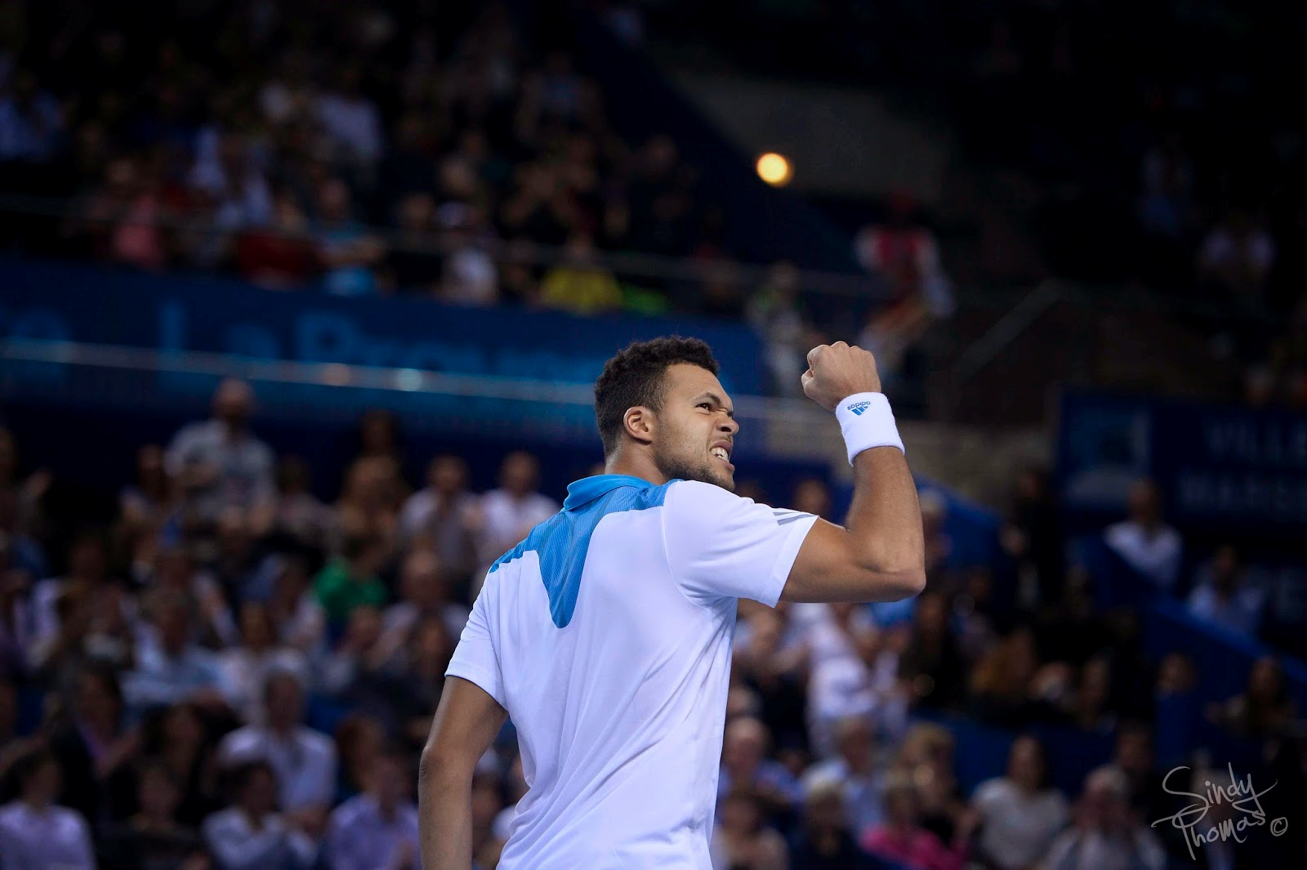
ARE YOU OPEN ?

Slide 61
N°1
Sport Ranking
ATP 250
N°2-3
ATP 500
Public Relations
Reference
Place to Be
South of France
Mix Public / Private Sponsor
Hight Loyalty
Cost Efficiency
Operational Organization

Slide 62
Cascade of assets
Relational
Resources
« Axes »
Learning
Organizational
Capabilities
Partnership
Resources
Reputational
Resources
Physical resources
Stock of resources
Dynamic Capabilities
« Bricolage »

Slide 63
Business Model / RBV Open13
CRM
Activation
B to B
Partnerships
Reputation
Social Capital
Social
Networking
Physical Resources (stadium)
PR infrastructure development
Resources Basis
Direct impact
Deployment
Indirect impact
Core Competences

Slide 64
New investor from India…

Slide 65
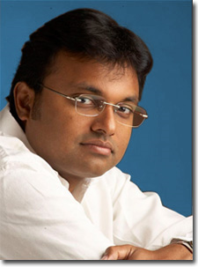
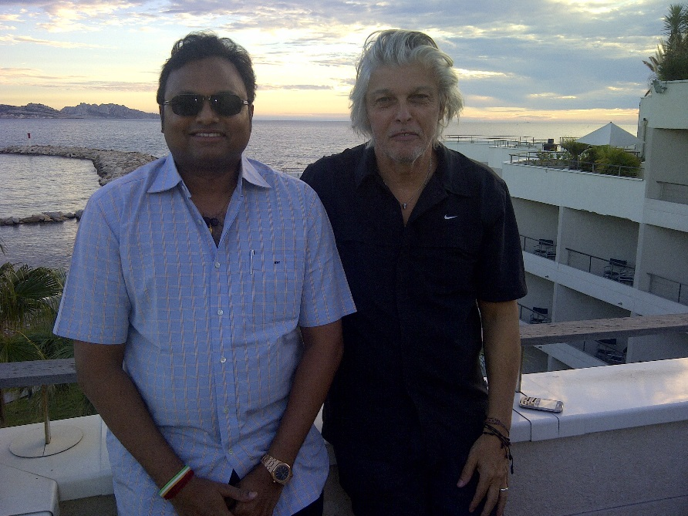


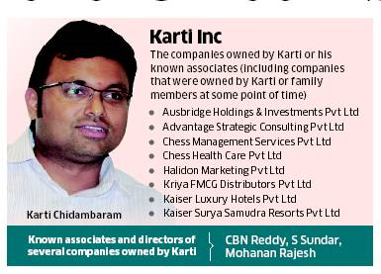
Futur ?

Slide 66
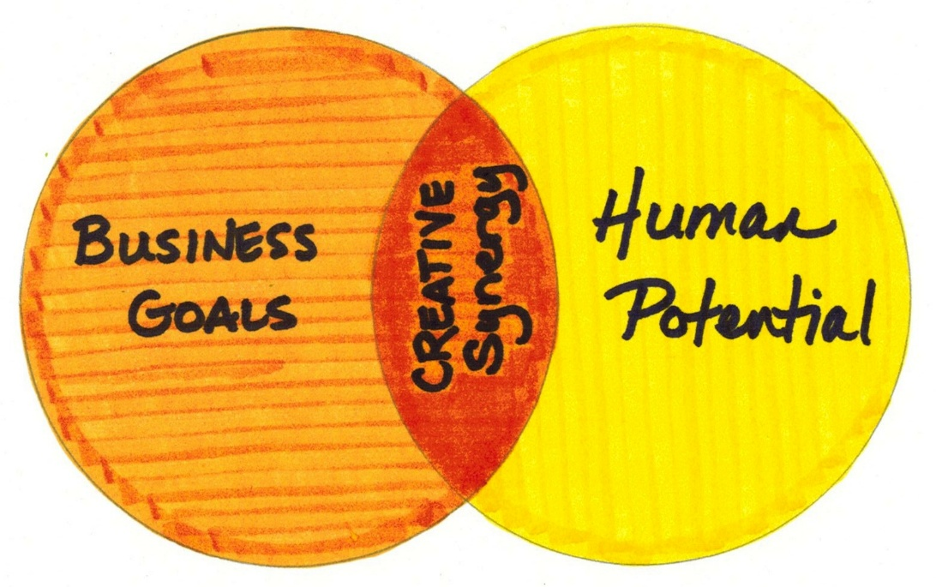
T.T.T Strategy
"Human beings are the new form of currency and valuation in companies.“ (C.K. Prahalad)
How to create synergies between Tournaments, Talents and Team forging an unique tennis ecosystem ?

Slide 67
Strategic vision for an unique tennis ecosystem
Sport business companies are not industrial, we have to create a new « crafting human strategy »
Sport performance is the first goal : we have to create and maintain sport reliability and credibility
Strategic assets combination and synergy will create a powerfull brand with a singular value chain for our future tennis factory.

Slide 68
Each asset (Tournament – Talent – Team) will help each other for their sustainable development in sharing resources and competencies such as political, institutional, business, tennis networks and knowledge.
Team
Assets | Description
Tournaments | Marseille, Nice, Chennai, Vienna, Geneva, Taipei…
Talents | Agents pooling with Ivan Ljubicic and Naor Amit (Raonic, Berdych, Gulbis, Thiem…)
Team | 4 Slam Tennis Academy Barcelona managing by Galo Blanco, Fernando Vincente and Jairo Velasco
Talents
Tournaments

Slide 69
Theoretical Assets Relations | Practical Assets Relations
Tournaments → Talents | Wild Cards – Marketing and Media Promotion - Personal Branding and Endorsment by potential tournaments’ sponsors
Talents → Tournaments | Security of top players – Public Relations - Activation of « marketing » sponsors using the double brand impact Player/Tournament
Tournaments → Team | Wild Card – Promoting the next generation – Team branding and promotion during the events to attract new young players by individual networking
Team → Tournaments | Young talents discovering – Education Program for local young players with the Team contribution
Talents → Team | Young players emulation – Permanent tennis performance learning
Team → Talents | Talent maker factory – Marketing storytelling

Slide 70
90 % of sports organizations
Relational Business Model because :
With a large part of the turnover linking to public and private sponsors
Without huge TV Rights
Without Stadium or Arena to implement a strong brand strategy based on fans consuming

Slide 71
Strategic vision ?
?
Relational
BM
Reputational
BM
Cultural
BM

Slide 72

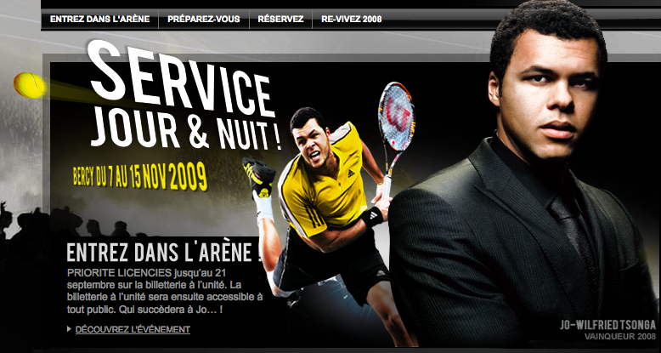

Slide 73
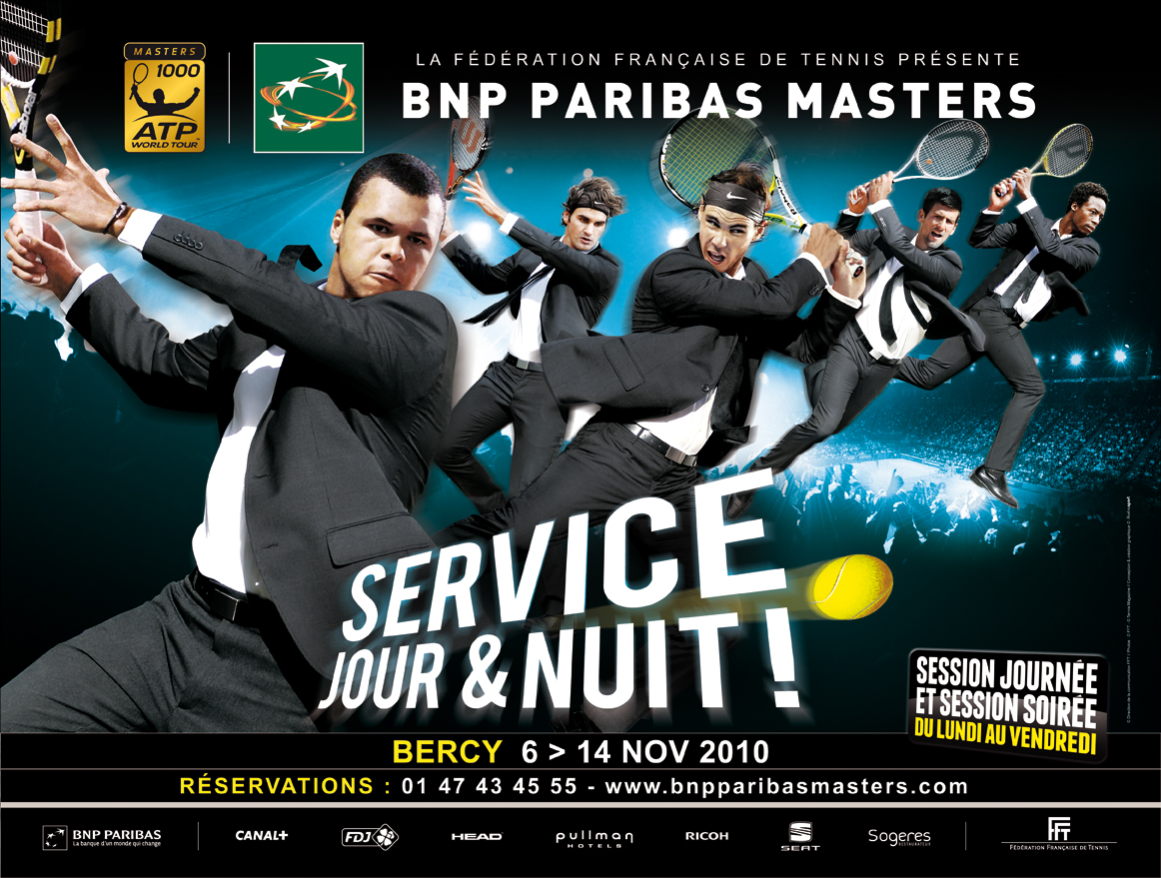
© Illustrasport – juin 2010

Slide 74
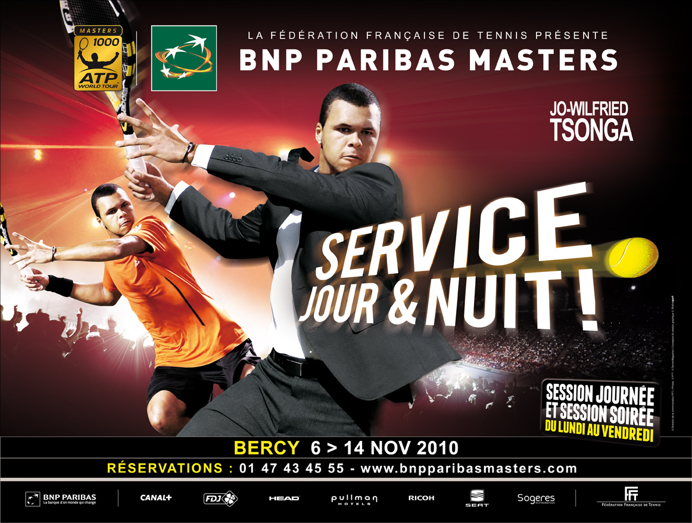

Slide 75
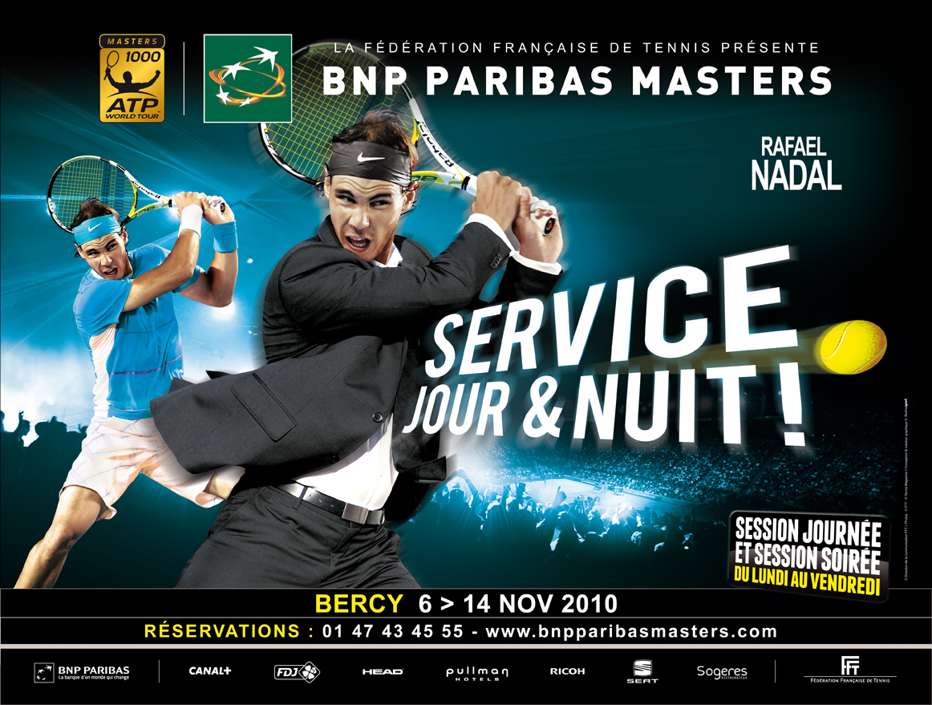

Slide 76
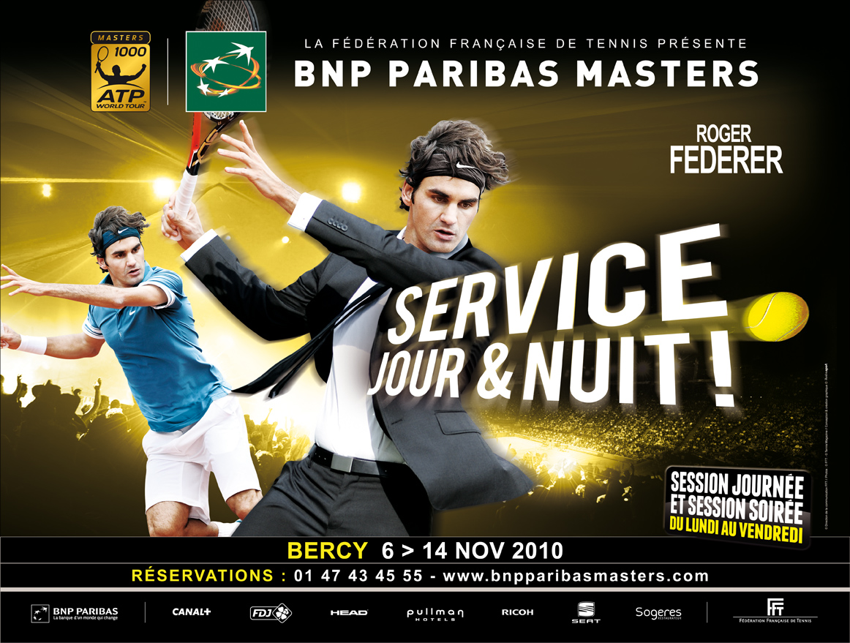

Slide 77
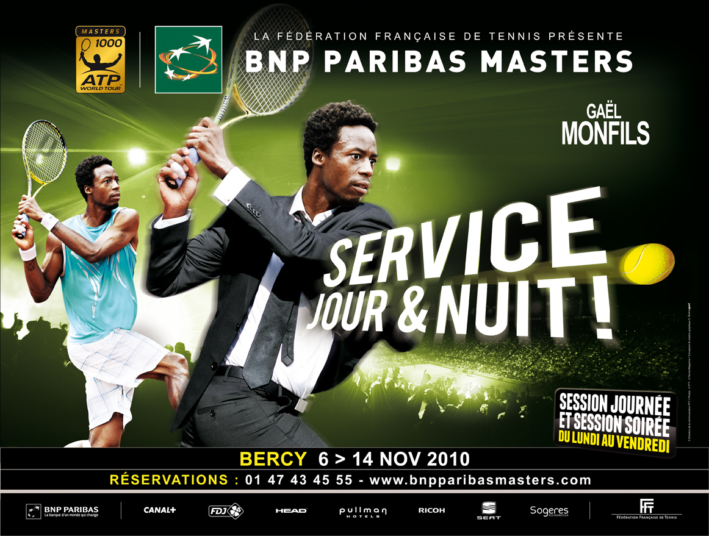

Slide 78
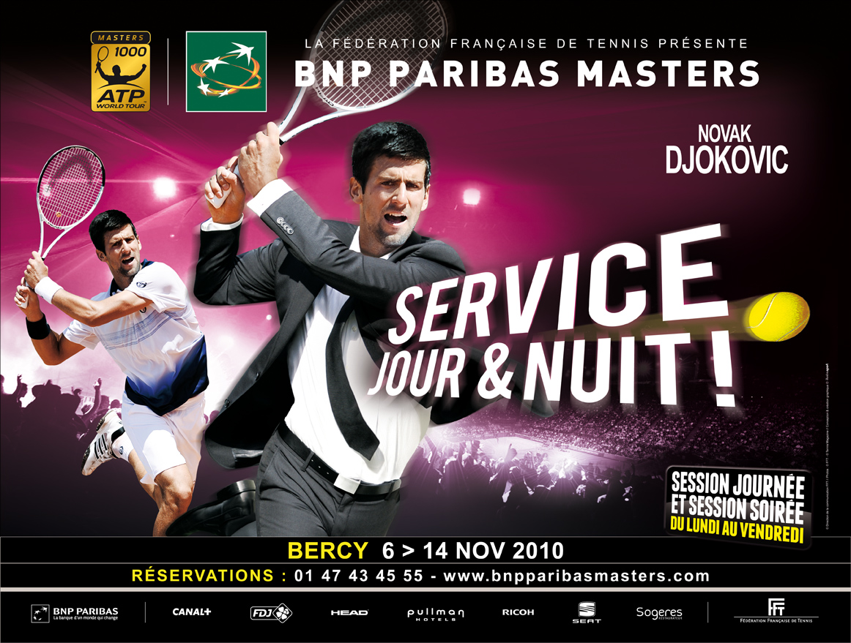

Slide 79
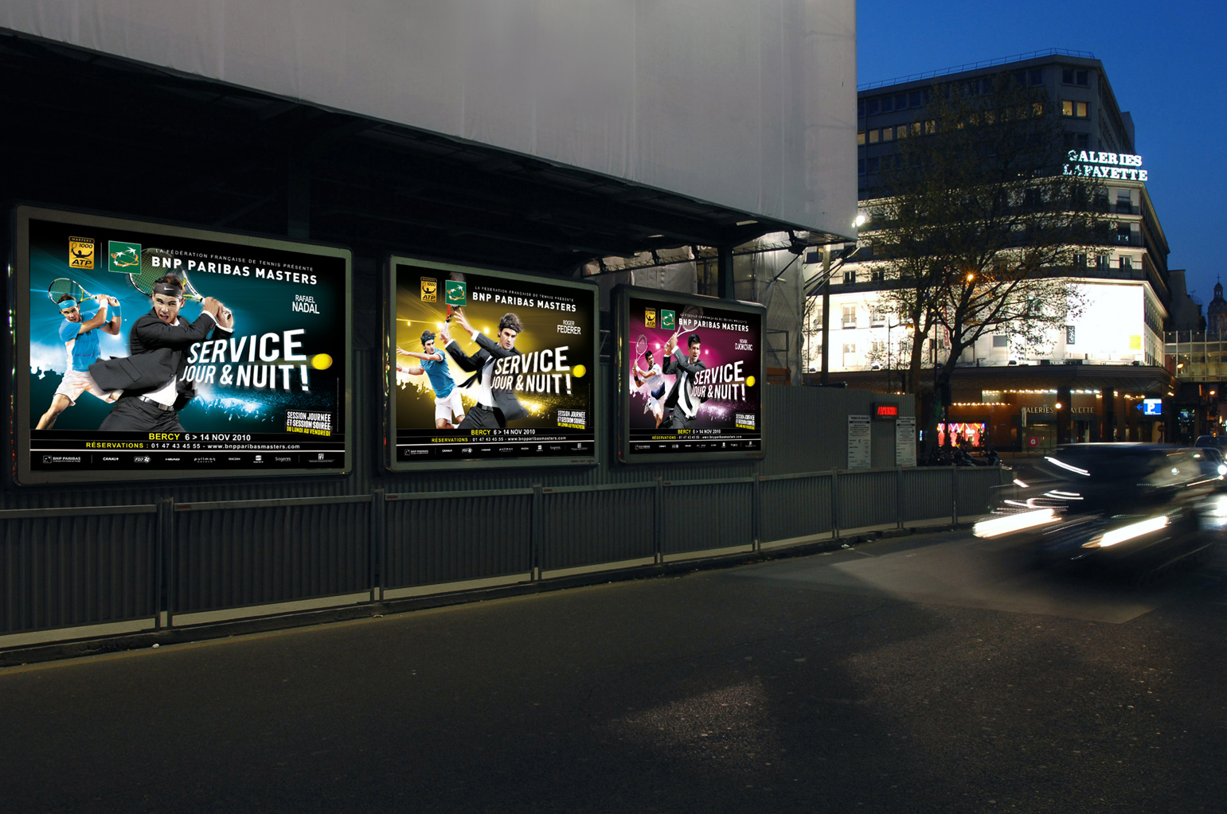

Slide 81
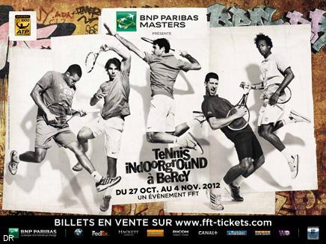

Slide 82
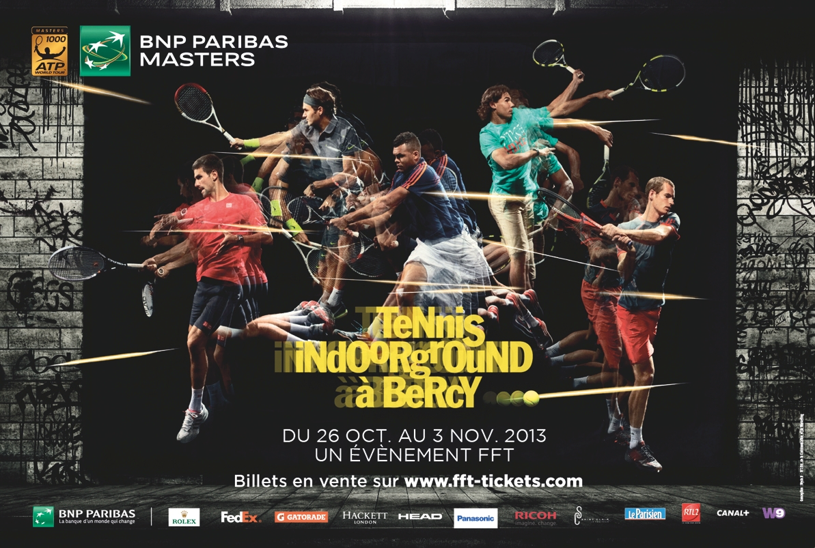

Slide 83
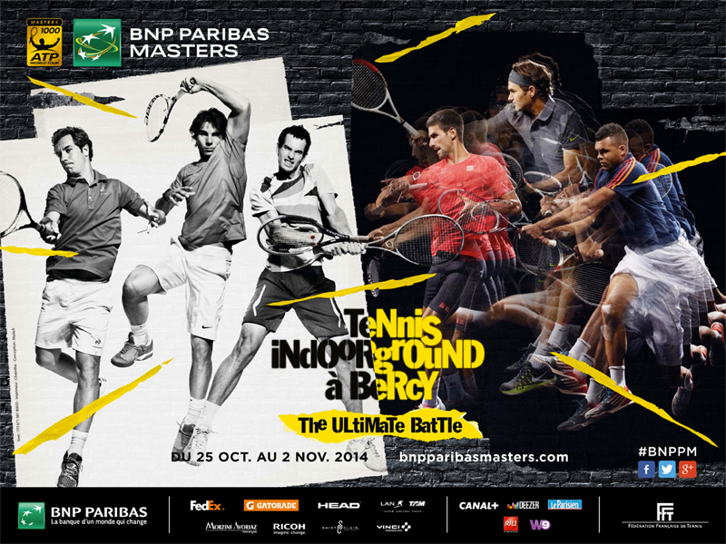

Slide 84
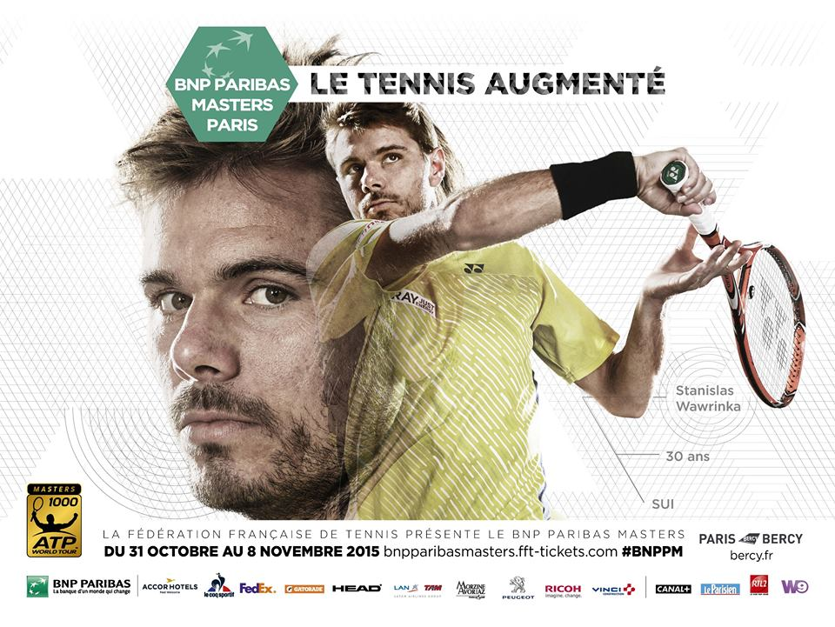

Slide 85
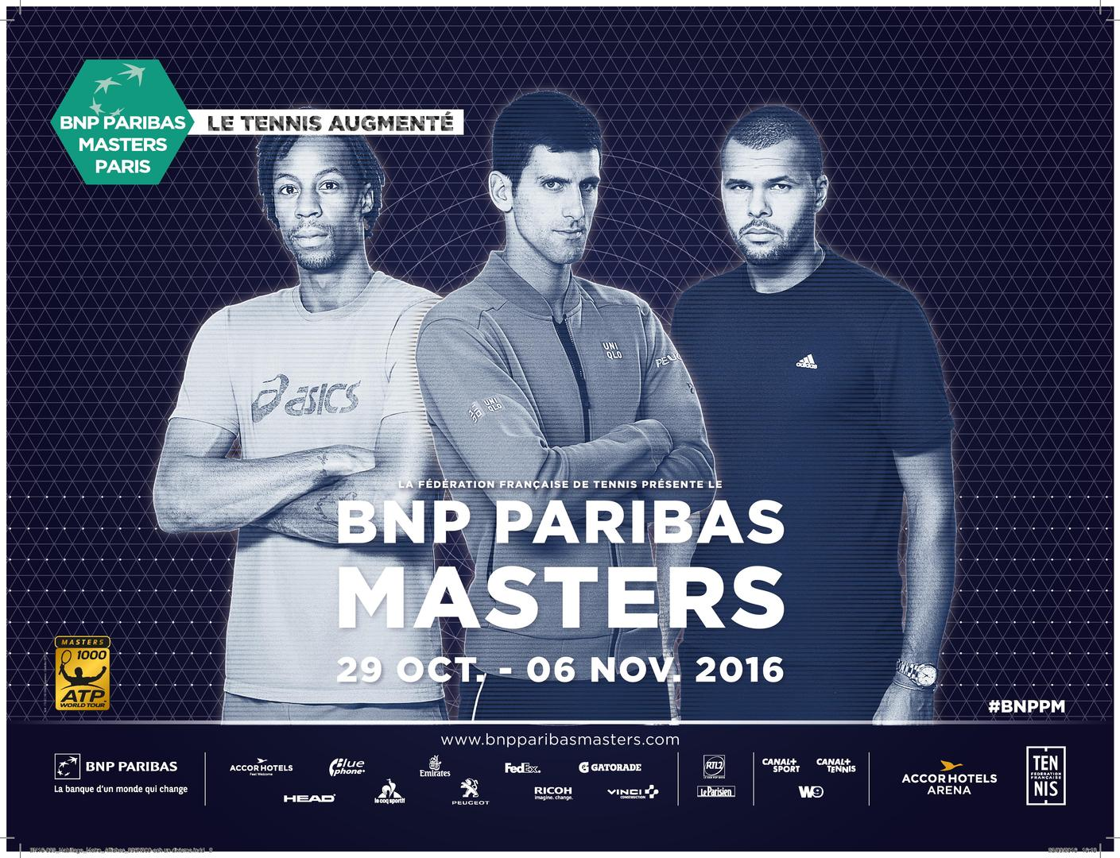

Slide 86
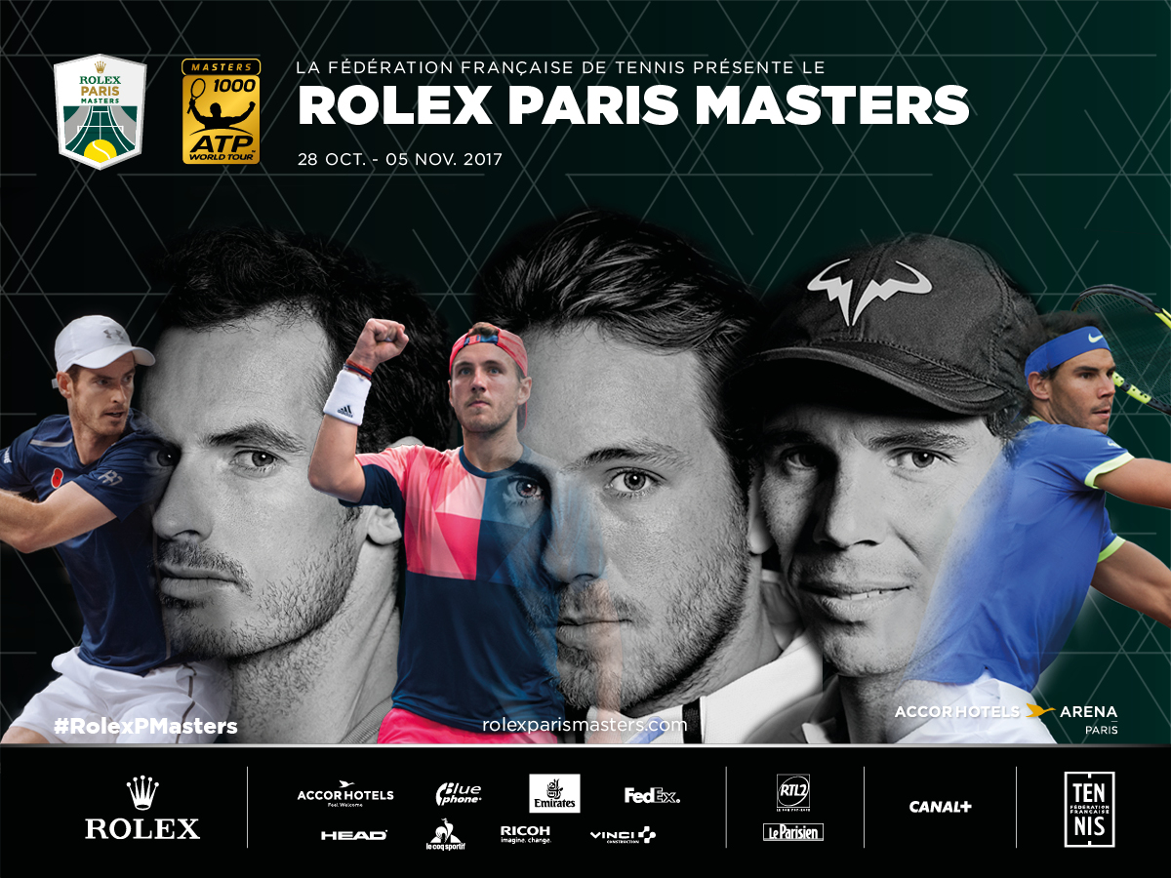

Slide 87
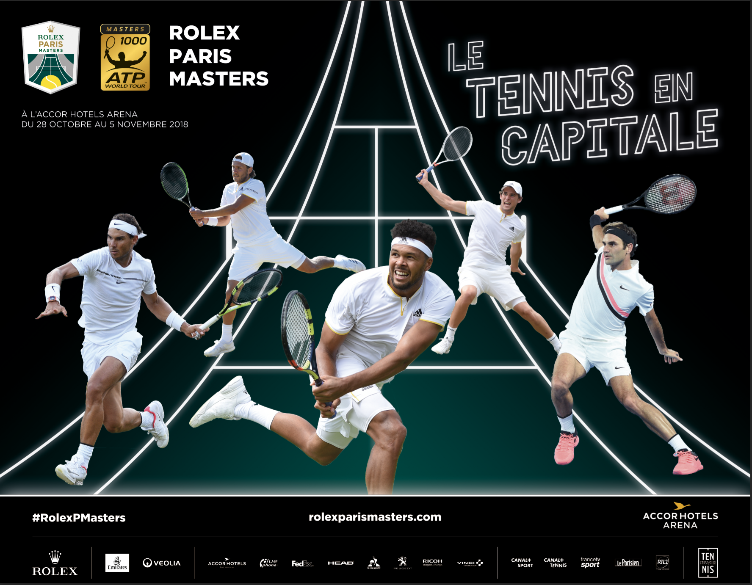

Slide 88
Business Model / RBV BNPPM
CRM
Activation
B to B
Athletes
Management
Parnerships
Reputation
Physical Resources (Stadium)
Entertainment Production
Ticketing & CRM
Social Capital
PR infrastructure development
Resources Basis
Direct impact
Deployment
Indirect impact
Core Competences

Slide 89
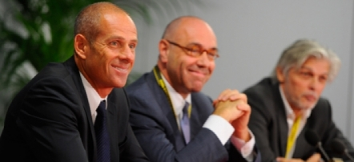
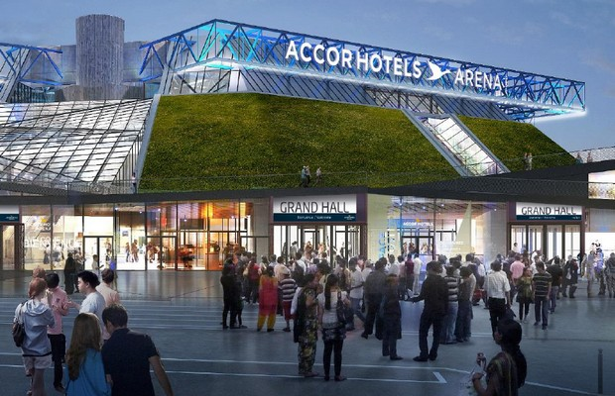
Futur ?

Slide 90
10 % of sports organizations
Reputational business model based on brand management and where fans are the HEART of the entire Model
With a modern stadium or arena
With TV Rights
With a better control of key assets : reputation-brand and stadium-arena

Slide 91
3 Business Models in sport Business area
Hospitality / PR
Relational
Club or Event BRAND
Cultural
Reputational
Media / WOM
Communication
FRM
Brand Management

