Slide 1
Lecture 4
Strategic Management and Advanced for sports organizations
Summer School
SPORT EVENT MANAGEMENT
lionelmaltese.fr
Lionel Maltese
Maitre de Conférences Aix Marseille University – CERGAM IAE Aix-en-Provence Associate Professor Sport BUSINESS Management Kedge Business School Assets Manager ATP – WTA Events and consulting Member of the Executive Committee FFT – Roland Garros – BUSINESS STRATEGY

Slide 2
Athletes as suppliers for the « show content »
Key synergistic resources « Heart »
Deployment resources « Lung »
Market-based resources
❹
❶
❷
❸
Partnership –
Sponsorship
Privates - Public – Media
Sport
Management
Communication
Hospitality
management
CRM
Activation
CRM
Negociation
Sport
Performances
Reputation
Stadium
Ticketing
Commercial Brand
Merchandising
Hedonism
Brand
Management
Co-branding
Social networks &
capital
Public Relations
Resources
Intangible Resources « Event expressiveness »
CRM
BtoB Networks
Competencies
Commercial resources linked to products & services and profit centers

Slide 3
Focus on Relational Business Models
How to implement ?
How to involve ?
How to maintain ?
How to create dependency and control the external environment ?

Slide 4
Relational (« Meetic ») Business Model
CRM
Negociation
SPONSORSHIP
2
Offer attractivity
SPONSORSHIP
PR
Visibility
CSR
Media rights
Ticketing
1
REPUTATION
SOCIAL
CAPITAL
BRAND
4
7
8
5
3
Sport
Management
Interpersonnal
Networking
PHYSICAL
SUPPORT
6
Hospitality
Management
resources
competencies

Slide 6
Concepts
RBV first model for a sport organization
Partnership Resources
Reputational
Resources
Resources
portfolio
PROPERTIES
?
Relational Resources
Player
Coach (club only)
Physical Resources
Core
Competencies,
Capabilities
Organizational team,
Managers
Performance, Sucess
Sport Success
Financial Sucess
Public Sucess
Long Term

Slide 7
Relational resources as pivotal
To generate profit with Public Relations & Hospitality
With the support of Social capital & Networking core compencies
With the understanding of sports events organizations as « THE PLACE TO BE » !
BtB markets and relationships

Slide 8
Focus on Relational ressources and the offer
Public Relations

Slide 9
SKODA TOUR DE FRANCE VIP PROGRAM

Slide 10
Your CONTENT (Brand Equity)
The relation =
Your social capital
Your individual relationships
Your support (place) = hospitality = way of life (french touch for instance)
Your optimization = sport as emotional moment and place to generate extrabusinesses

Slide 11
Public Relations (PR) ?
Public Relations is a management function which tabulates public attitudes, defines the policies, procedures and interest of an organization followed by executing a program of action to earn public understanding and acceptance. " (Edward Bernays)
According to Michel Crozier (1957) : Public Relations is a set of processes used by managers to gain external publics’ sympathy and goodwill.

Slide 12
Public Relations activities
Public relations involves:
Evaluation of public attitudes and opinions.
Formulation and implementation of an organization's procedures and policy regarding communication with its publics.
Coordination of communications programs.
Developing rapport and goodwill through a communication process.
Fostering a positive relationship between an organization and its public constituents.

Slide 13
PR = Marketing asset
A very « large » communication tool : financial communication, lobbying, media, Sponsorship…
More than 200 definitions… for us : It’s a marketing activity implemented by a firm, a public or private organization, a person or a group, to create, establish, maintain or improve, on the one hand loyalty, understanding and sympathy, and on the other hand, the relationships with the public inside and outside the institution, at the origign of its development (Kotler and Dubois, 2004).

Slide 14
PR for events managers
Press-relations : control & development
Events creation during your event
Political PR
« People » exploitation (dedicated person in your organization)
Construction and management of relational networks inside and outside your event
Forging an « iron cage » for your event network : be carefull about the balance between quantitative and qualitative interpersonal relationships

Slide 15
« Celebrity utility » : people and ex professional athletes
« Open the doors »…
Personal relationships with important CEO
Adress book
Relationships with the athletes
« Special » information access

Slide 16
The example of China : the importance of interpersonal relationship (GUANXI - 关系 ) in Business
The Chinese word « guanxi » (关系) refers to the concept of drawing on connections in order to secure favors in personal relations (Luo, 2000).
Key characteristics :
Implicit mutual obligations, assurances and understanding
Attitudes toward long term social and business relationships
More than a friendship or a simple interpersonal relationship : it includes reciprocal oblogations to respond to requests for assistance.
So Guanxi means interpersonal linkages with the implication of continued exchange of favors ⬄ in my experience in a PR agency we can tranfer this phenomemon in sports events context !

Slide 17
pr
LOBBYING

Slide 18
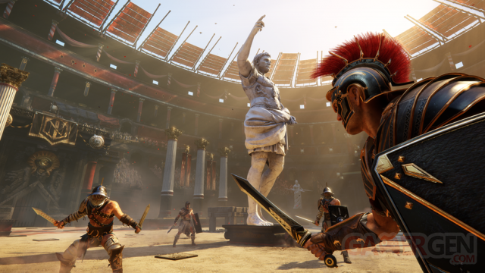

Slide 19
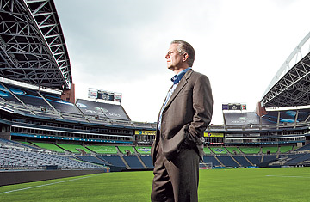
CEO are also key FANS !!!!!!!!!!!!!!!!!!!!!!!

Slide 20
PR consuming reasons
Happiness & passion : individual « happiness therapy »
Demontration : be visible for their guests
Strategic : CRM and collecting information about guests to anticipating their needs

Slide 21
PR segmentation
Cibles | Marketing Goals
Prospect | Improving prospects RDV
Current customer | Loyalty & CRM
Lost customer | Understanding of company errors
Ambassadors | Lobbying, viral marketing
Employee | Internal communication and human relation management

Slide 22
PR & Press Relations
Do not reduce PR with press relations
Generally, PR are using to (Occurrence Agency Study, 2003) :
Brands and products communication (70 %)
Institutional communication
Press relations (53 %)
But on the fiels, the tools are :
Press relations (97 %)
Institutional communication (91 %)
Internal communication (89 %)

Slide 23
Interpersonal “ties” efficiency (Granovetter, 1973)
“The Strength of Weak Ties”, 4 criteria :
Relation duration
Emotional intensity
Intimacy
Services reciprocity between stakeholders

Slide 24
PR evaluation from customers perspective
Setting measurable PR objectives (BNPP current challenge !)
Launching :
Example : Using press and event to ensure better returns on special targets.
The event facilitates the access to media.

Slide 25
Remarks…
Can we separate the PR impact for advertising ones ?
Analyse and try to evaluate the ties between the target members more than the target itself ! Very difficult to measure : a thesis ?

Slide 26
Main objective of a PR strategy ?
Gathering your network thanks to an event (partner club, community…) and make it Valuable – Rare – Non Imitable (or Substituable) - Organizational

Slide 27
Dangers !
Too much ties to manage ? Strength or Weak Ties ?
Dependency ?
Be careful to the rumors inside the networks…

Slide 28
Product –Service - Experience
PRODUCT
Hospitality
Servicing
PR
Players
VIP People

Slide 29
Occade example Now Canal Plus Event…
Grand Slam of Tennis of Lyon
GPTL

Slide 30
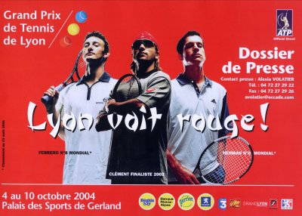

Slide 33
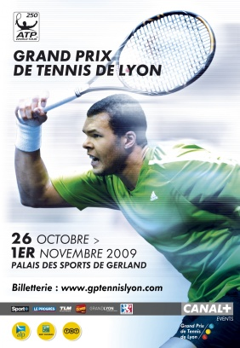
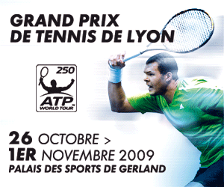

Slide 34
Partnership Strategy (GPTL)
SFR 2003
ARKEMA 2006
Banque Rhône Alpes 2006
« 5 balls »
Strategy
Historique
Beghin Say 2005
PERRIER 2004

Slide 35
GPTL
Corporate
Reputation
Sport
Reputation
Reputational
Resources
Partnership
Resources
Relational
Resources
Physical Resources
Relational competencies
CEO celebrity
Opportunism
Learning
Organizational capabilities

Slide 36
Cascade of assets
Relational
Resources
« Axes »
Learning
Organizational
Capabilities
Partnership
Resources
Physical resources
Reputational
Resources
Stock of resources
Dynamic Capabilities
« Bricolage »

Slide 37
Relational Business Model
CRM
Activation
B to B
Partnerships
Reputation
Social Capital
Individual networking
Physical Resources (stadium)
PR infrastructure development
Resources Basis
Direct impact
Deployment
Indirect impact
Core Competences

Slide 38
Event development ?
Balance between PR / Public event or Sport / Business ?
Question : sponsors turnover and control ?
PR rarity ? Overflowing ?

Slide 39
?

Slide 40
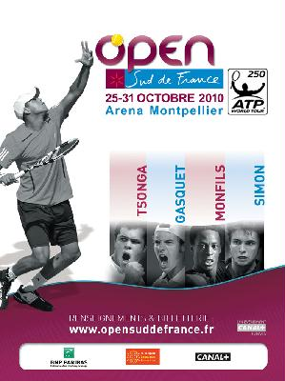

Slide 41
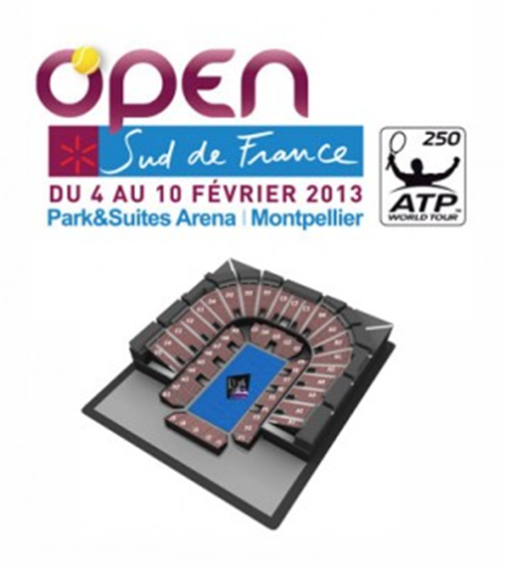
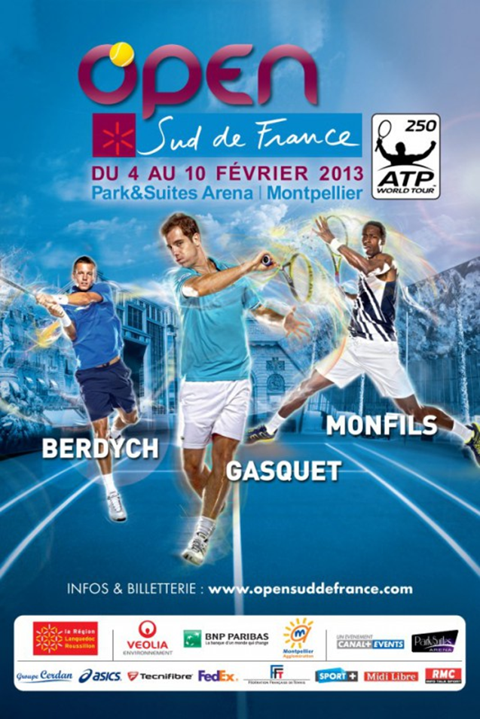
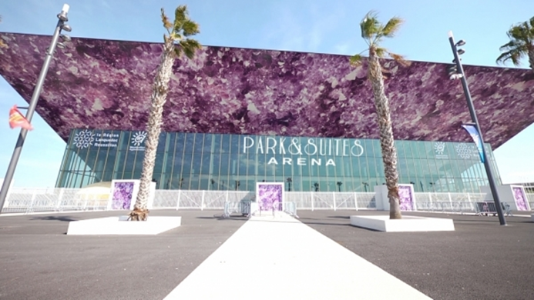

Slide 42
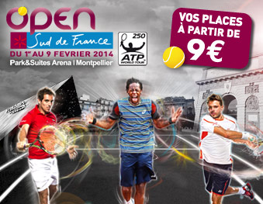

Slide 44
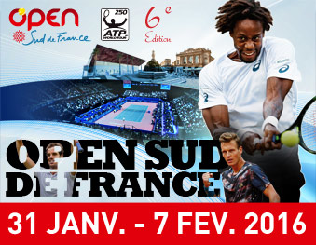

Slide 45
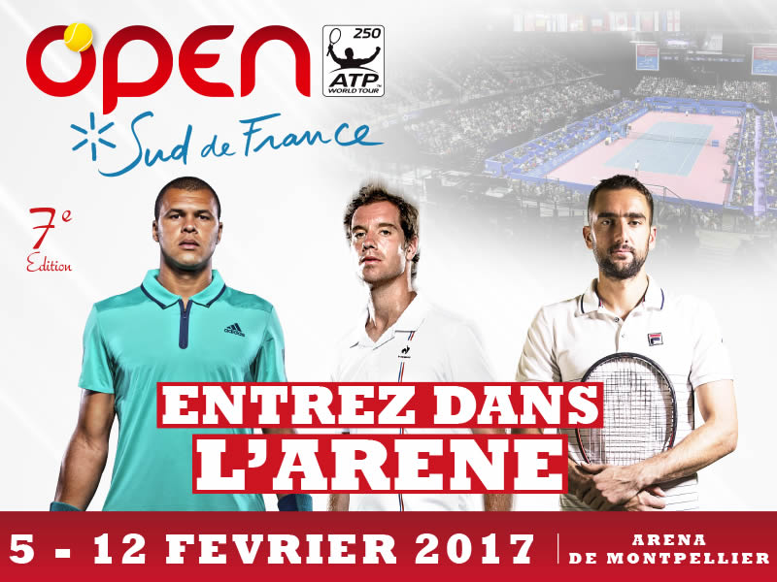

Slide 46
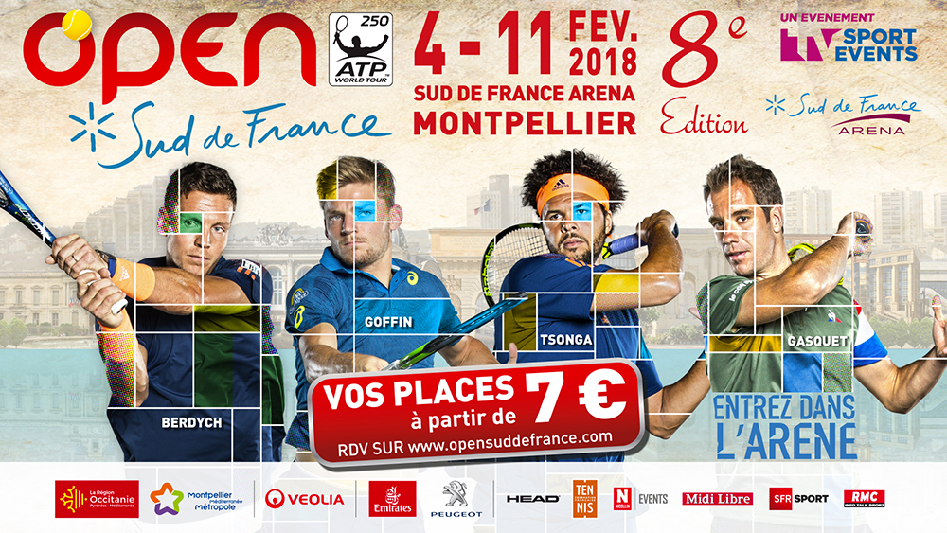

Slide 47
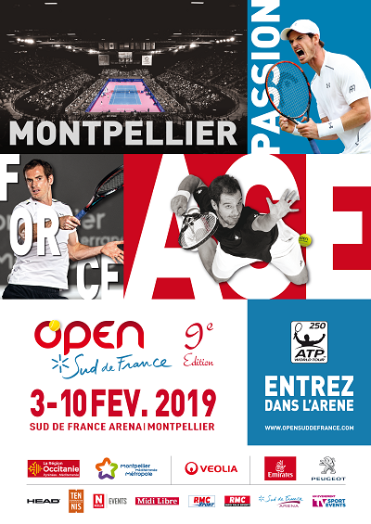

Slide 48
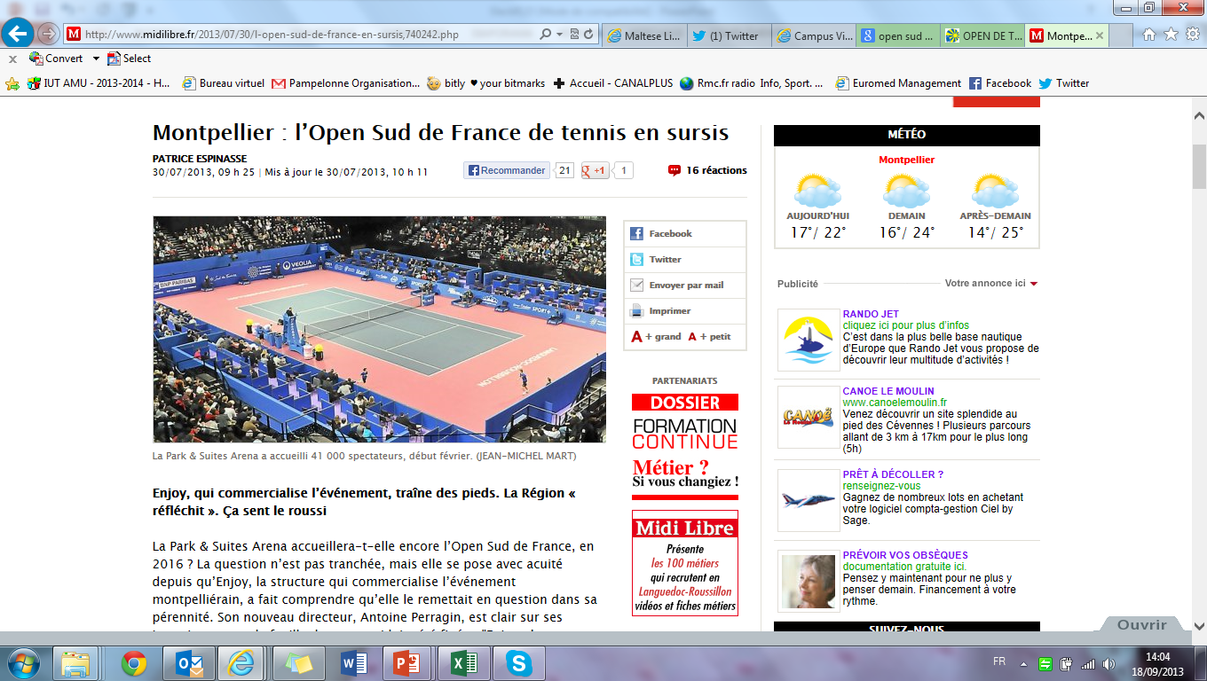

Slide 49
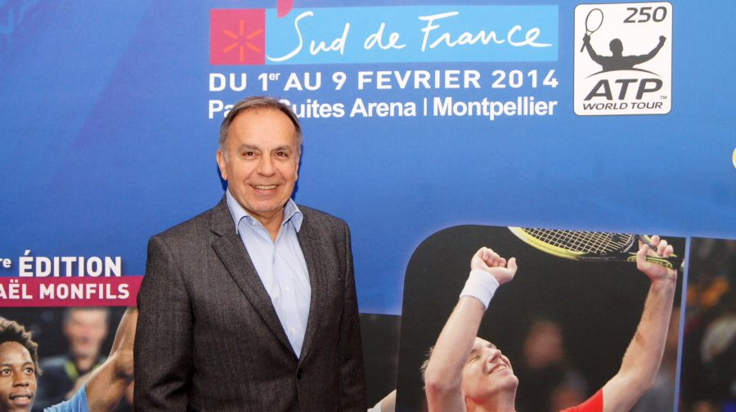
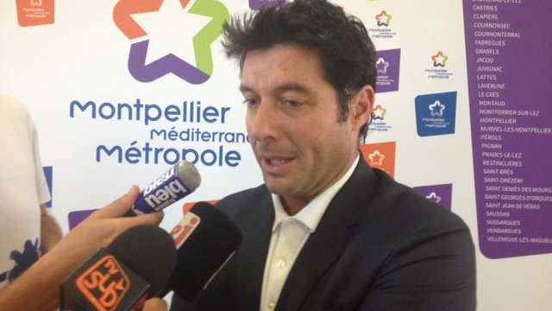
Business Model Evolution & Innovation ?

Slide 50
Future ?
New place (stadium) and new business model ?
Competencies ?
Reputation – relation Construction ?
To pay the players (the central offer) you need money !
Coopetition / Resource-Supplier ?

Slide 51
Your difficulties
The business of Public Relations
Entertainment = people !
ROI for your customer…
PR Brand = VIP Event, is it possible ?

