Slide 1
ECON 321 SPORTS ECONOMICS
WEEK 2
Introduction
First Generation Studies
Second Generation Studies
Assessment of Economic Factors
Assessment of Sporting Quality Factors

Slide 2
Introduction
Understanding demand is of crucial importance to decision-
makers. Team owners will, at the very least, want to increase
revenue. Therefore team owners will be interested in knowing:
- how ticket prices affect attendance
- how stadium location and quality affect attendance
- how television broadcasts affect attendance
- whether attendances are affected by measures of outcome
uncertainty
- how attendance is affected by the quality of the contest

Slide 3
Nature of the Product
Last week we noted that the product in
professional sport was the game. More specifically:
“the core product is defined as the game itself, that is whatever takes
place on the field of play including the manner in which the contest is
conducted, the style and strategy employed and the interpretation of
understood laws, rules, regulations and historical precedents”
(Sutton and Parrett, 1992. Quoted in Borland (2003))
Therefore the demand for the game (contest) is due to “fan
interest”. BUT it is not the only demand….

Slide 4
Nature of the Product
“Direct” Demands versus “derived” demands
Direct Demand
Consumer derives utility from the sporting contest:
- live attendance at the venue
- watching the event on pay-per-view
Derived Demand
Contest is used as an input in production of another good or
service
- Firms selling merchandising
- Firms involved in sports marketing / sponsorship/ betting
- Government seeking inputs to promote economic activity
- Broadcasters seeking inputs to programme production

Slide 5
Determinants of Demand
Standard consumer-theory model
Representative, rational consumer who chooses a
Consumption bundle subject to a budget constraint
Categories of determinants:
Economic
Tastes and Preferences
Quality of Contest

Slide 6
Determinants of Demand
1. Economic
Price
- opportunity cost of attendance (-ve relationship)
(admission price, travel costs, match programmes, food and drink)
Income
- disposable income
(+ve related to demand if “normal” good)
Market Size
population / catchment area
(+ve relationship)
availability of substitutes (direct – e.g. television transmissions or
Indirect – e.g. other sporting contests)
Market Conditions
- unemployment
(+ve? – improves economic well-being / happiness?)

Slide 7
Determinants of Attendance Demand
2. Consumer Tastes and Preferences
Habit Persistence
- team loyalty / allegiance
Veblen Effect
- conspicuous consumption (e.g. executive seating)
Bandwagon Effects
- increase in consumption by one or more individuals
leads to an increase in consumption by other consumers
who wish to emulate them

Slide 8
3.3 Determinants of Demand
3. Quality of Contest
Lancaster’s Characteristics Model (1966)
- Consumers derive utility from the characteristics of goods
Absolute quality of the individuals involved
The appeal of “superstars”
Relative quality of the individuals involved
- Uncertainty of Outcome (closeness of competition)

Slide 10
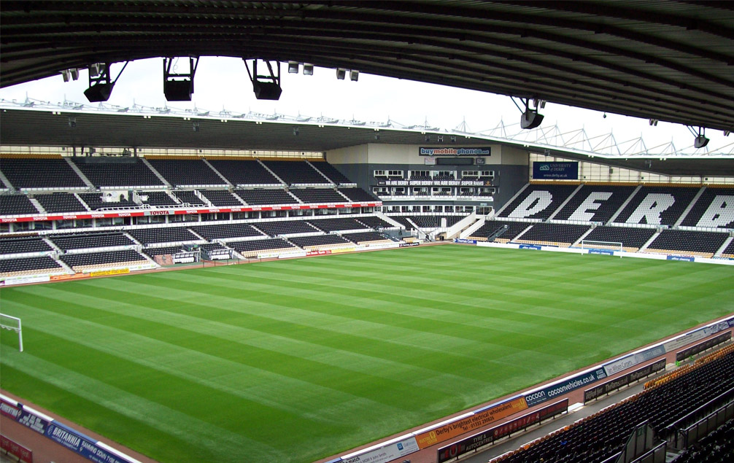

Slide 11
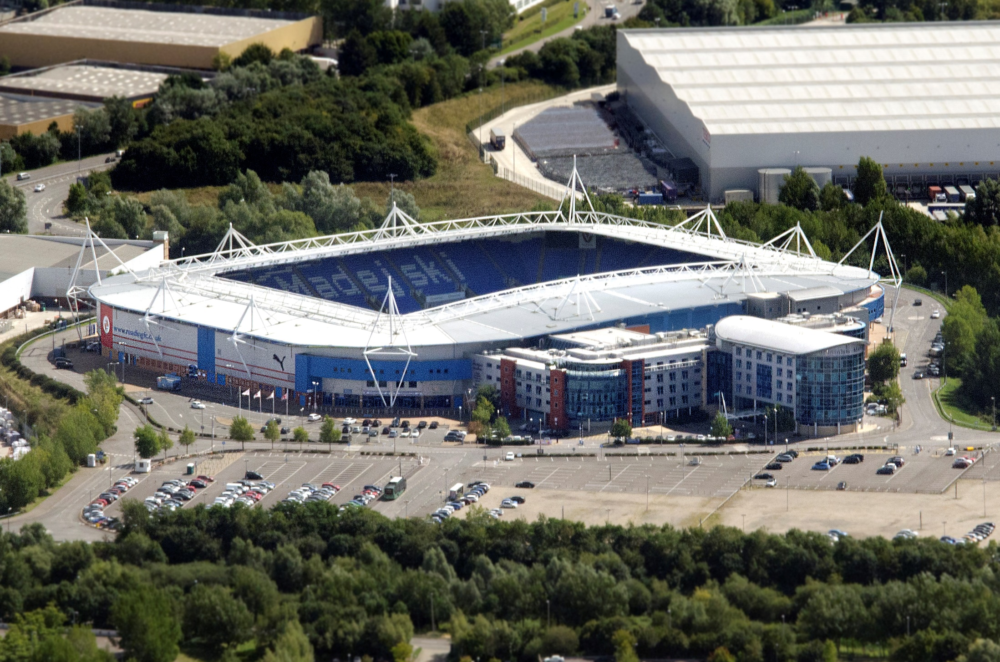

Slide 12
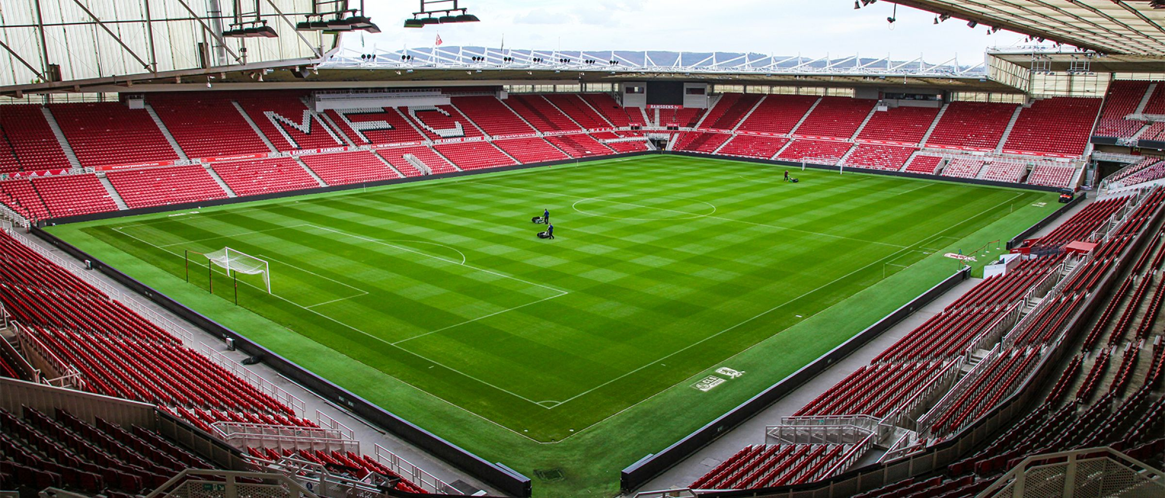

Slide 14
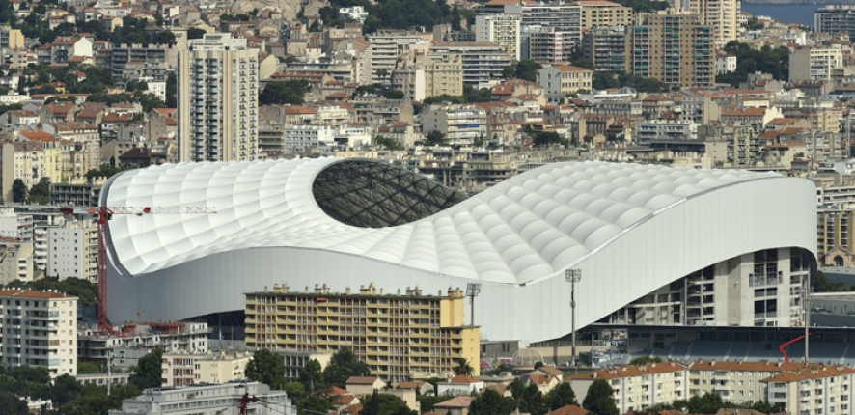

Slide 15
Attendance Demand:
Methodological Issues
Measuring Quantity
- distinction between standing and seated accommodation
- capacity constraints
- demand for sport on TV – how / should it be included?
Measuring Price and Income
price (match ticket and other ancilliary costs)
measuring average income
Incorporating the appropriate mix of quality characteristics
- indexing absolute team quality
- measuring uncertainty of outcome

Slide 16
Ticket prices
Average seat price? Representative price?
Gate revenues/attendance = average revenue
If we include ticket price then it may be wrongly measured and also might be endogenous
Ignore price altogether and package under ‘unobservables’ using team fixed effects

Slide 17
Uncertainty of Outcome
Uncertainty of match outcome (short-run uncertainty)
- Predictability of the individual match
- p(1-p) where p = probability of the home team winning.
Therefore maximised when p = 0.5.
-Consider measures derived from the betting market
Uncertainty of seasonal outcome (medium-run uncertainty)
- Uncertainty over the eventual champions
- Number of teams in contention
Absence of long-run domination (long-run uncertainty)
- Supporters of less successful clubs will lose interest
- Supporters of successful clubs will lose interest

Slide 18
Second Generation Studies
The first generation studies can be characterised as follows:
Cross-sectional, pooled (e.g. Jennett)
or time-series (Bird, 1982)
Primary determinants: economic and uncertainty of outcome
Since 1990 a second generation of studies has developed:
Wider range of explanatory variables;
greater use of panel data;
greater focus on econometric issues.

Slide 19
Second Generation Studies
Example 1: Wider Range of Explanatory Variables
Baimbridge et al. (1996) – C/S match attendance, English
Premier League football 1993/94. As well as the usual economic
factors, the study also includes variables relating to:
- Uncertainty of match outcome
- Uncertainty of seasonal outcome
- Absolute quality of home (away) team
- Weather
- Impact of televised broadcasts
- Scheduling of contests

Slide 20
Second Generation Studies
Example 2: Greater use of Panel Data
By observing the same teams over time enables the analyst to account for team-specific factors (something which cannot be controlled for in either cross-sectional or time-series studies). In the econometric literature this is referred to as heterogeneity.
A good example of this is provided in Simmons (1996). He finds considerable variation in the elasticity of demand with respect to (admission) price. For example over the period of analysis, the estimated price elasticity for Manchester United is -0.12 whereas for Aston Villa it was -1.21.

Slide 21
Second Generation Studies
Example 3: More sophisticated econometric approaches
What modelling issues arise with respect to capacity constraints?
- Accounting for games were there are sell-outs.
What is the direction of causation between team performance and
attendance?
- Does causality run from variations in team performance to
variation in attendance? Based on causality tests, Davies et al. (1995) find that, in the case of rugby league, causation runs from attendance to team performance.
Simultaneity bias between price and attendance?
Suppose attendance depends on price, but clubs adjust price
in view of last season’s attendance. Can lead to biased
estimation.

Slide 22
Assessment of Economic Factors
Measurement of Demand
Attendances are the main source for the dependent variable in demand studies. But, problems in interpreting attendances as a “true” measure of demand.
Attendance made up of season ticket holders (who pay for an entire season in advance) and ticket-holders for individual matches (who commit some time in advance, or turn up on the day). Most attendance data does not distinguish between the two groups (Simmons, 1996, is one of the few exceptions).
Issue of stadium capacity. In the past this was considered not to be a problem as ground capacities were higher and demand lower. Nowadays most of the top clubs sell out regularly. In such cases the capacity constraint becomes binding and we are unable to know the “true” level of demand for the contest.

Slide 23
Generic Model
Dependent variable
Log of match day attendance
Determinants
Log of mean home team attendance in previous season
Log of mean away team attendance in previous season
Home team’s current form
Derby
Midweek game
Certain visiting teams
Month of game
Seasonal trend
Television effects
Other unobservable factors
But not prices (use of Fan Cost Index in baseball studies)

Slide 24
Assessment of Economic Factors
Price
Price variable in general has been insignificant, or at best inelastic. Does this mean attendance is unresponsive to price changes?
Source: Cairns, Jennett and Sloane (1986)

Slide 25
Assessment of Economic Factors
Price
Not necessarily because of the conceptual problems in
measuring price:
Admission price does not fully reflect opportunity cost
More sophisticated pricing policies
(per match, season-tickets, price discrimination)
Inter-relationships between demand for match tickets and
demand for related products and services.
. Introducing travel cost into price results in larger price elasticities
(Forrest, Simmons & Feehan 2002)

Slide 26
The price elasticity puzzle (1)
If clubs want to maximize revenues then price elasticity of demand = -1
If this is right then clubs are behaving irrationally
One resolution is to consider concessionary goods – beer, soft drinks, burgers etc.

Slide 27
A Theory That Produces Pricing in the Inelastic Region
Monopoly Pricing Model for Tickets=Q(P,q,m), P=Price, q=quality, m=market conditions
Pricing is cognizant of a second good; Concessions=C(R,P,q), R=concession price
Total profit from both Tickets+Concessions
Ticket Price might be low to draw people to the concessions.
Cinemas are a prime example- low ticket price, high concessions prices (popcorn, soft drinks)
Works for North American sports, see Berri & Krautmann, JSE 2007
Lots of catering outlets, high levels of consumption- long games!
But does it work for European sports?

Slide 28
Ticket price elasticity below 1
Profit function is π = PQ(P) + C(Q(P)) – mQ
Concessions demand depends on attendance demand which depends on ticket price
Concessions and attendance are complements
Maximise to get P = m – Q/Q′ - C′
Rearrange (P – m)/P =1/|e| - C′/P
LHS is Lerner Index of monopoly power or mark-up on marginal cost
Let m = 0. Then |e| = P/(P + C′) < 1
If C′ is close to 0 then price elasticity is close to 1
If C′ is high (strong complementarity) then price elasticity deviates substantially from 1

Slide 29
Price elasticity puzzle (1)
Empirical evidence for European football suggests that price elasticity > -1, say -0.2 or -0.3
To reconcile these values with the concessions theory requires a sufficiently large component of concession spending in total spending- and that is unlikely e.g. €15 out of €30 is still not enough

Slide 30
The price elasticity puzzle (2)
Forrest, Simmons and Feehan (2002)
See chapter by Forrest on Moodle
Bring travel costs into generalised cost measure
Travel costs are substantial and vary more than ticket prices, also travel cost > ticket price for many (most?) fans
Used Fan Survey data for 1995/6 EPL
Elasticities move closer to -1 when travel cost is allowed for, 8 clubs had elasticity < -1, elastic demand, highest elasticities for clubs that sold out. Lowest elasticities for clubs located close to each other (London)

Slide 31
Assessment of Economic Factors
Income
Similar findings have been noted with respect to the income variable. However, this applies mainly to cross-sectional (short horizon) studies.
For time-series studies (e.g. Bird, 1982) there is evidence to suggest that demand is income inelastic (in fact Bird finds a negative effect which is indicative of football being an inferior good).
Again we need to be careful because most studies use a proxy for income. We also need to consider the time-period in which the study was conducted. Since Bird’s study, incomes and attendances increased…
Income of fans may not be same as income of local population (often used as a proxy)

Slide 32
Did recent recession adversely affect attendance demand?
Hong, Mondello, Coates, International Journal of Sport Finance 2013
22/30 MLB clubs had declining attendances in 2008 and 2009 compared to 2007; total MLB attendance down by 6.7% over this period
Use monthly Federal Reserve Bank of Philadelphia coincident indicator to measure state of the economy
This measure has a highly significant coefficient; explains 6.5% out of 6.8% decline in MLB attendance
So MLB was badly affected by the economic crisis. What about other sports e.g. European football? Seems English football attendances held up well through 2008 and 2009. But note recent concerns about high ticket prices in EPL.

Slide 33
Assessment of Economic Factors
Market Size
Link between size of catchment area and attendance seems obvious.
But empirically catchment areas are hard to define:
Municipal boundaries used to compile local population statistics are
arbitrary and subject to change
Need to adjust in cases where there are two or more clubs in the
same city.
Over time, geographical segmentation of supporters has fallen.
Despite this, the variables offers the most consistency in terms of sign and significance: most cross-sectional studies find this variable to be an important determinant of attendance.

Slide 34
Assessment of Sporting Quality Factors
Team Quality
Similarly the absolute quality of the teams involved has a significantly positive impact on attendance demand. Typically this is analysed indirectly through the measurement of team success, examples include:
- League positions of home and away teams.
- Winning percentage during the current / previous seasons.
- Goals / points per game in previous matches.
Some studies however have looked at the quality dimension more directly:
Number of international and overseas players in each team (Baimbridge et al. 1996; Paton and Cooke, 2005).

Slide 35
Assessment of Sporting Quality Factors
Uncertainty of Outcome
Uncertainty of Match Outcome
Two main approaches have been used:
Difference in winning percentage or difference in league ranking
of teams (e.g. Baimbridge et al., 1996)
Measure of the probability that a team will win derived from betting
odds (Peel and Thomas, 1988, 1992; Forrest and Simmons, 2002).
This is considered an improvement over the other approach
because, “…bookmaker odds might be expected to take into
account the whole myriad of factors that are likely to
influence the outcome of matches (including special factors such
as suspensions of players or injuries) and are therefore a source of
information on how closely fought potential spectators may expect
the match to be” (Forrest and Simmons, 2002: 233). These authors
propose a U-shaped attendance-OU relationship

Slide 36
Assessment of Sporting Quality Factors
Uncertainty of Outcome
Uncertainty of Match Outcome
Coates et al (2014): only 4/24 studies reported supported role for UO in attendance demand.
Many recent studies are showing evidence contradicting conventional view of OU affecting fan demand
OU has zero or ‘perverse’ effect on attendance demand in several studies
Why?

Slide 37
A study that finds conventional OU effects on attendance demand
Sacheti, Paton and Gregory-Smith, Economic Record, 2016
One day international cricket matches in England and Australia 1981-2015
OU measure is absolute difference in ODI rankings between teams and its square

Slide 38
Regression results for ODIs: log attendance
Variable | Australia FE | England Tobit | England FE | England and Australia Tobit
Ratings certainty | -0.001 | -0.013*** | -0.009*** | -0.005**
Ratings certainty² | 0.00004 | 0.00012*** | 0.00009*** | 0.00002
Home strength | 0.003 | -0.003* | -0.003** | -0.004
Opponent strength | 0.003 | 0.003* | 0.003*** | 0.002*
Real income | -0.003*** | 0.002*** | 0.001** | -0.0003
Day/night | 0.191*** | 0.017 | 0.037 | 0.150***
R² | 340 | 202 | 202 | 542
N | 0.17 |  | 0.36

Slide 39
Match-day Attendances in Primera Liga: Buraimo & Simmons
Seasons 2003-05 to 2005-06 inclusive
Match-day attendance
Mean: 28,970
Standard deviation: 18,190
Range: 2,500 to 98,200

Slide 40
Match-day Attendance Model
Explanatory Variables Coefficient T Statistic
Previous home attendance 0.852 37.26
Previous away attendance 0.038 3.20
Home points per game 0.025 1.46
Away points per game 0.046 3.45
Derby 0.129 6.80
Barcelona away 0.150 4.93
Real Madrid away 0.143 4.84
Valencia away 0.016 0.68
Public TV weekday -0.189 -4.09
Public TV weekend -0.032 -1.84
Subscription TV weekday -0.079 -1.47
Subscription TV weekend -0.020 -1.18
Weekday not televised -0.073 -4.00
Probability home win -0.008 -0.07
OUTCOME UNCERTAINTY 0.134 2.81
Constant 1.044 4.49
Panel Home team
Month dummies Yes
Season dummies Yes
Autocorrelation parameter 0.437
R-squared 0.928
N 1469

Slide 41
Outcome Uncertainty in other European Leagues
Similar results in other European leagues
Spectators do not value outcome uncertainty
Spectators seem to prefer less outcome uncertainty not more
England’s FAPL
Tobit model
Coefficient and t statistic: 0.141 and 4.91
Germany’s Bundesliga
Prais-Winsten
Coefficient and t statistic: 0.117 and 2.80
Italy’s Serie A
Prais-Winsten
Coefficient and t statistic: 0.470 and 9.66

Slide 42
Outcome uncertainty in NHL
Coates & Humphreys, Journal of Sports Economics 2012
Attendance demand 2005 to 2009, 5 seasons
NHL fans turn out in large numbers when the home team is expected to win
They don’t turn out in large numbers for close games where home team might lose (probability of home win held constant)
Loss aversion by fans? Expected losses have greater weight than expected gains

Slide 43
Attendance decision under uncertainty
Notes:
Amended utility of winning is weighted by p. Amended utility of losing is weighted by 1-p. Attendance is positively related to E(U).

Slide 44
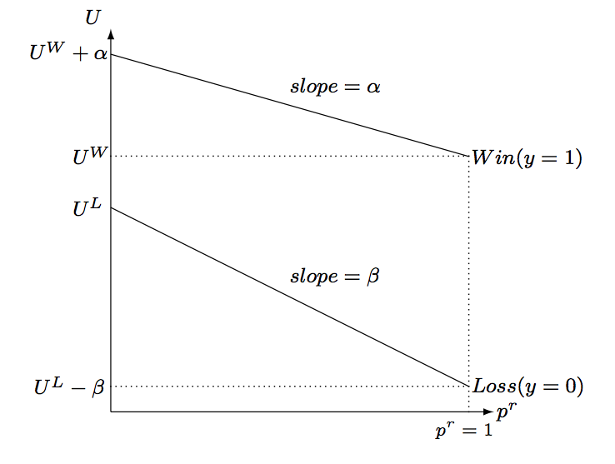
Game Outcomes, Reference Points, and Utility
Notes:
Bigger effect of p on utility of losing compared to utility of winning.

Slide 45
Structural Model and Hypotheses
Loss aversion dominates fan preference for uncertain outcomes (γ > 0)
Home win preference (γ + θ > 0)
UOH (γ < 0; θ > 0; 0 < θ + γ < - γ )
If γ < 0 then fans’ loss aversion dominates preference for uncertain outcomes

Slide 46
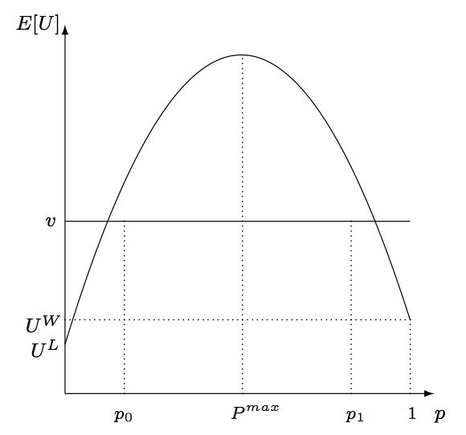
The UOH, Expected Utility, and Attendance

Slide 47
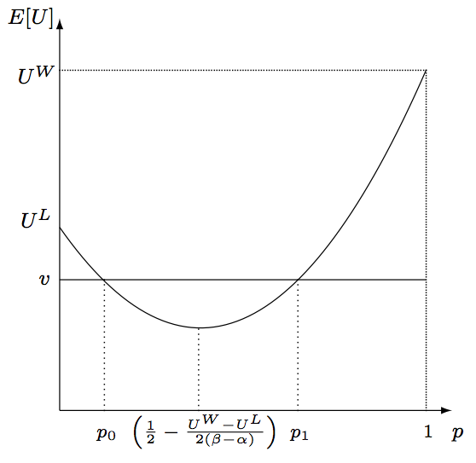
Loss Aversion, Expected Utility, and Attendance

Slide 48
Coates et al. 2014, MLB 2005-10
 | Coefficient | p value
Home win prob | -1.10 | 0.004
Home win prob squared | 1.09 | 0.002
Home avg runs scored | 0.009 | 0.424
Visitor avg runs scored | 0.013 | 0.026
Home avg runs allowed | -0.024 | 0.016
Visitor avg runs allowed | 0.016 | 0.109
Home team win % | 0.556 | 0.001
Visiting team win % | 0.235 | 0.000
N | 11961

Slide 49
A study that finds contrary OU effects on log attendance demand
Miguel Martins & Cro, Journal of Sports Economics, 2018, Portuguese football 2010/11- 14/15, N = 898
3 dominant teams: Benfica, Sporting Lisbon, Porto
Theil measure of OU using bookmaker probabilities of home, draw and away win outcomes. Sum of plog(1/p) over the 3 outcomes.
Larger value means game is expected to be close and more uncertain. Find a significant and negative coefficient on Theil measure. Similar to Buraimo & Simmons, 2008 for EPL
Dummy variable for home team as favourite, coefficient is significant and positive [mixes OU with home advantage]
Home probability and square included as for Coates et al.
Home prob coefficient = -4.09 and coefficient on squared term = 5.86 so ‘almost equal’. Buraimo & Simmons, 2008 found positive sum of coefficients- supported ‘home win preference’ argument

Slide 50
Martins & Cro
Variable | With price | With price and travel cost
Log habit H | 0.940*** | 0.927***
Log habit A | 0.422*** | 0.401***
Log cost |  | -0.165***
Log price | -0.106*
Form H | 0.025*** | 0.026***
Form A | 0.018*** | 0.020***
Away team Big 3 | 0.578*** | 0.579***
Derby | 0.212** | 0.214**
OU CL qualification H | 0.004*** | 0.004***
Prob home win | -4.362*** | -4.085***
Prob home win squared | 6.135*** | 5.863***

Slide 51
Wallrafen et al (2019) German 4th division
Local: 1st or 2nd division game within radius of 50km on same day
Reserve: upper division game on same day as the reserve team game
TVBL: concurrent first division game Saturday 3.30
TVCL: concurrent CL game with a German club at 8.45

Slide 52
Wallrafen et al (2019)
Variable | Coefficient
Local | -0.100***
Reserve | -0.209***
TVBL | -0.173***
TVCL | -0.132**
Local*TV | 0.109**
Monday | 0.115*
Tuesday | -0.099**
Wednesday | -0.105***

