Slide 1
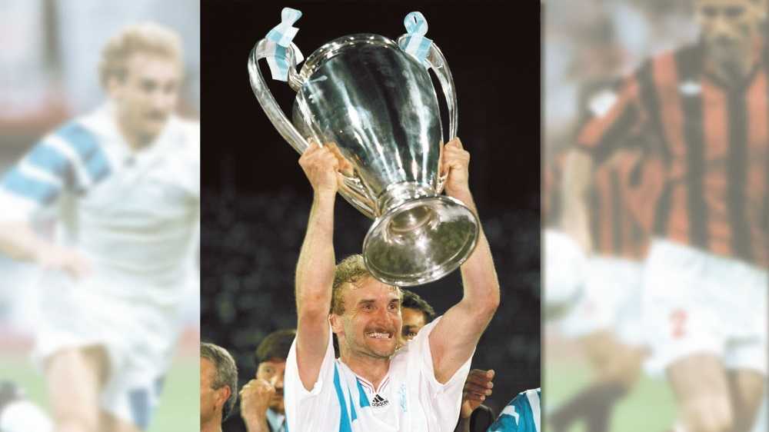
Sport Marketing & Communication
Summer School
SPORT EVENT MANAGEMENT lionelmaltese.fr
@lionelmaltese
Lecture 1
Lionel Maltese
Maitre de Conférences Aix Marseille University – CERGAM IAE Aix-en-Provence
Associate Professor Sport BUSINESS Management Kedge Business School
Manager ATP – WTA Events and Sport Business Management consulting
Member of the Executive Committee FFT – Roland Garros – BUSINESS STRATEGY

Slide 2
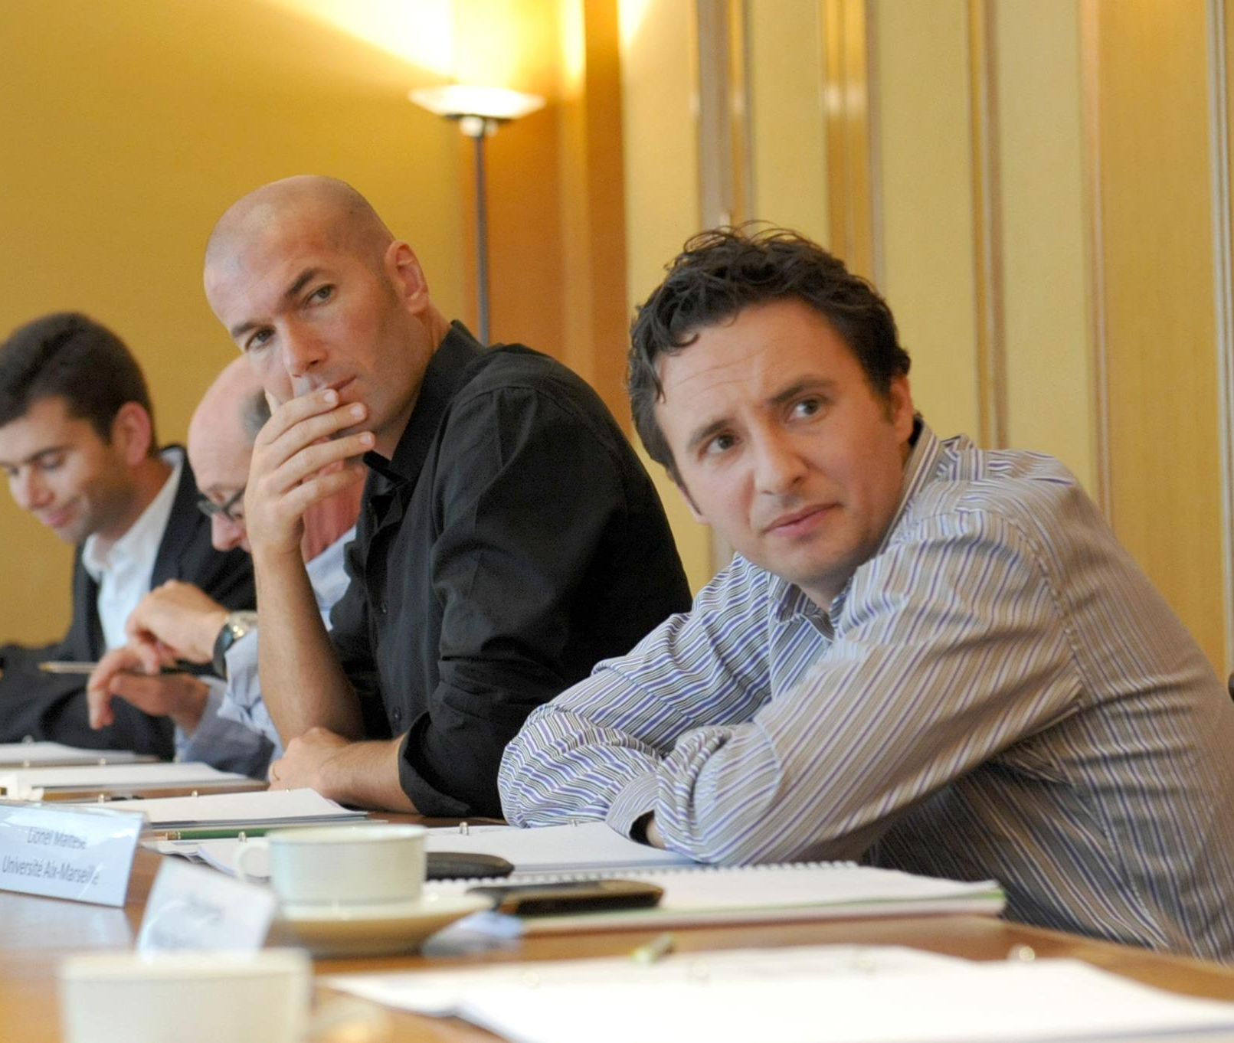
Information is key : you & me
Last diploma :
Phd Business Management IAE Aix en Provence 2004 - Econometrics Engineer Aix Marseille University 2001
Last sport experience :
  Talent Agency Creation & E-Learning for athletes
  Sport Business Efficiency FFT/Roland Garros/Rolex Paris Masters
  ATP Marseille & Lyon Business Strategy
Sport Practice Fan… :
  Tennis, Basket, Soccer, Rugby Seven, Paddle board…
  OM, Celtics, Juve, Warriors, Canadiens, Eagles, Seahawks, Fed, Stan, Jo, Liza, Ray Allen, Curry, Voller, ZZ, Slater, Bird, Wilko….

Slide 3
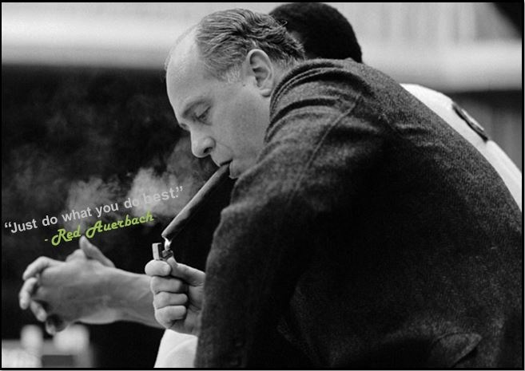
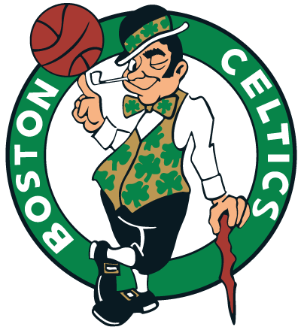

Slide 4


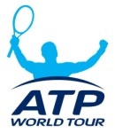



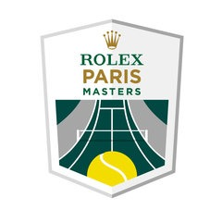












Since 2005
Maître de Conférences
Aix Marseille University
Strategy & Communication
Associate Professor Kedge Business School
Sport
Business Management
Since 1999
Professional
ATP & WTA
Events management
Manager
Since 2001
Research
Aix Marseille University
Laboratory
Member of the Executive Committee
Economic Development – Business Strategy
Assets management
Consulting
Sport Business Strategy & Marketing

Slide 5


Slide 6
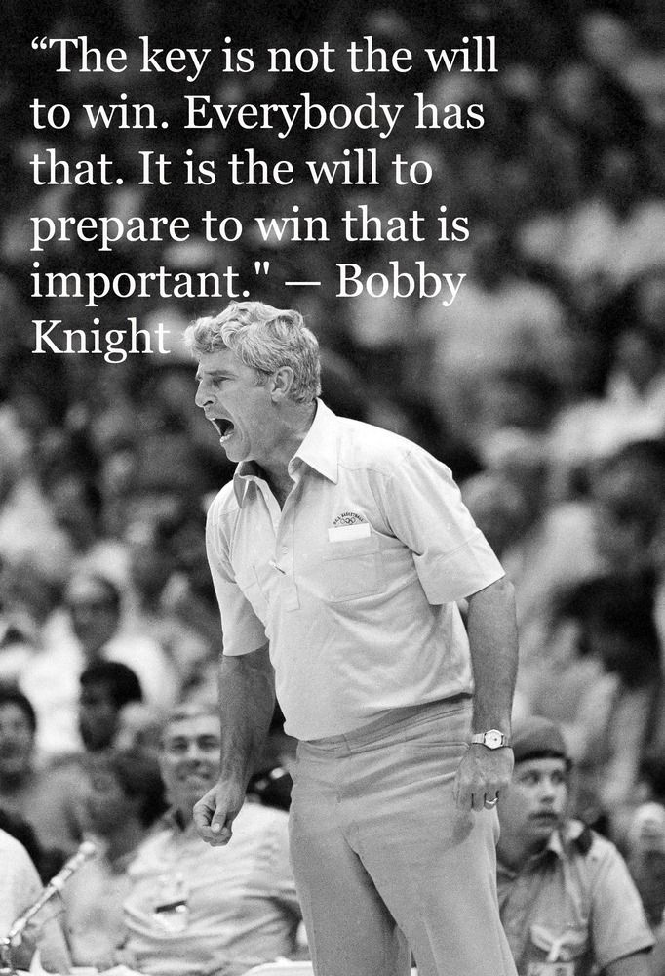
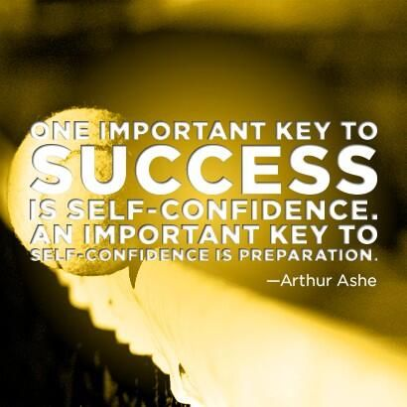

Slide 7
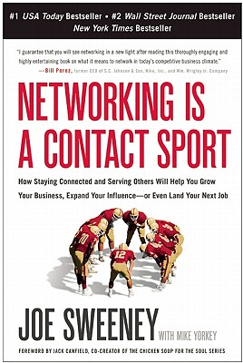


Slide 8
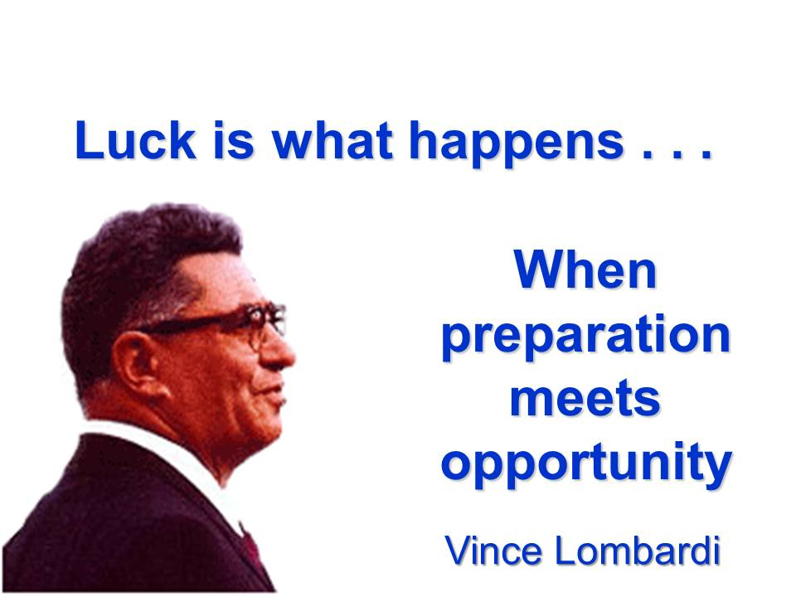
Vince Lombardi

Slide 9
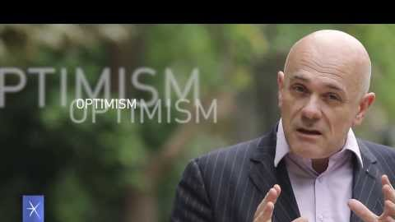

Slide 10
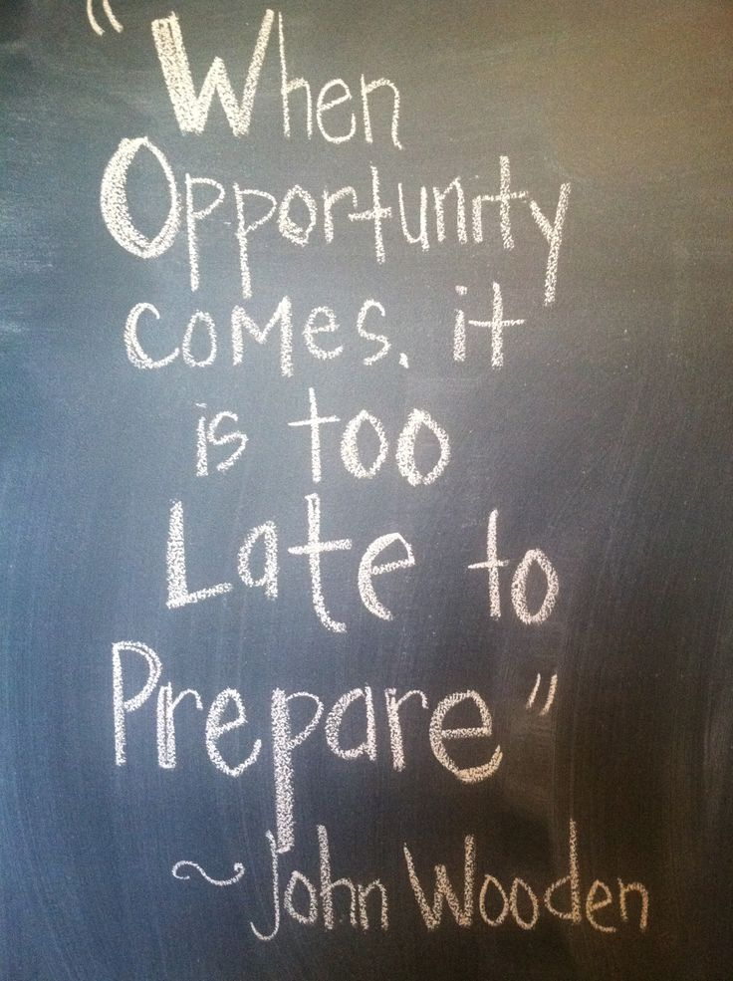

Slide 11
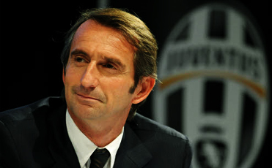
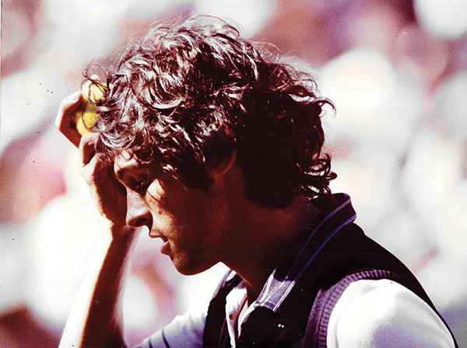
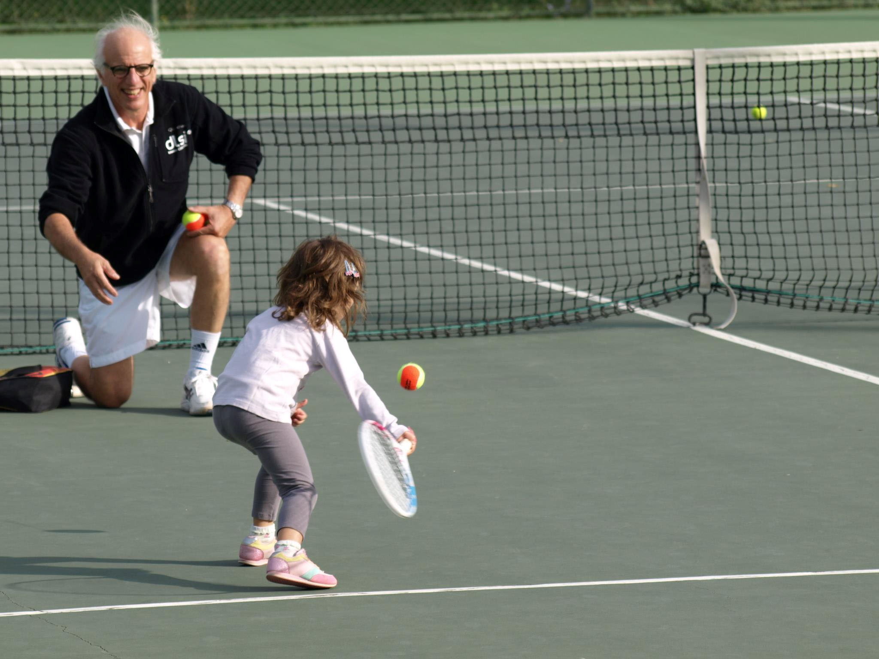
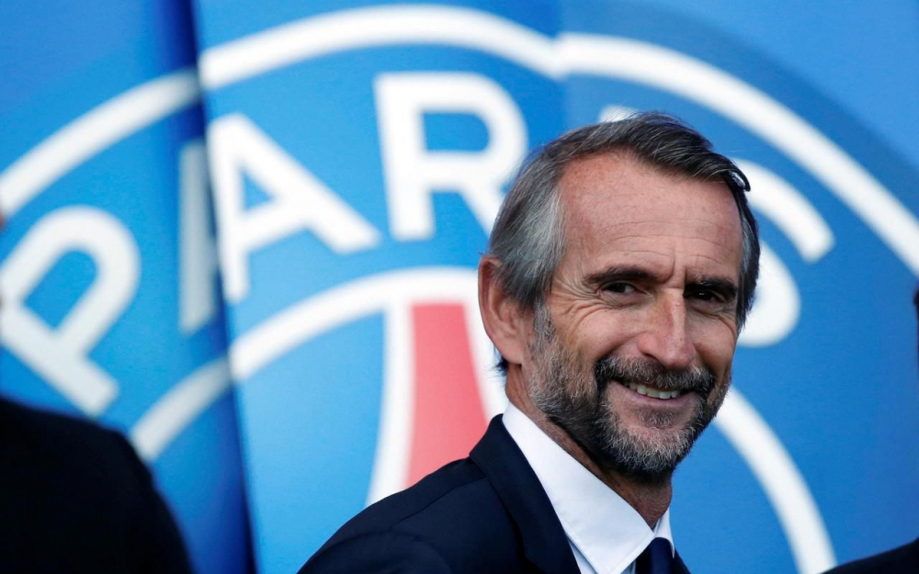
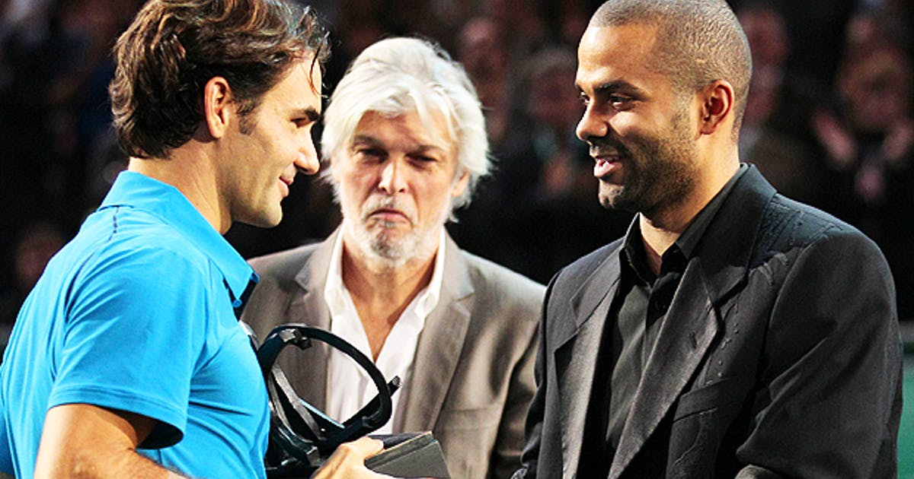
Jean-François Caujolle since 1993
Pierre Maltese since 1978
Jean-Claude Blanc since 2000

Slide 12
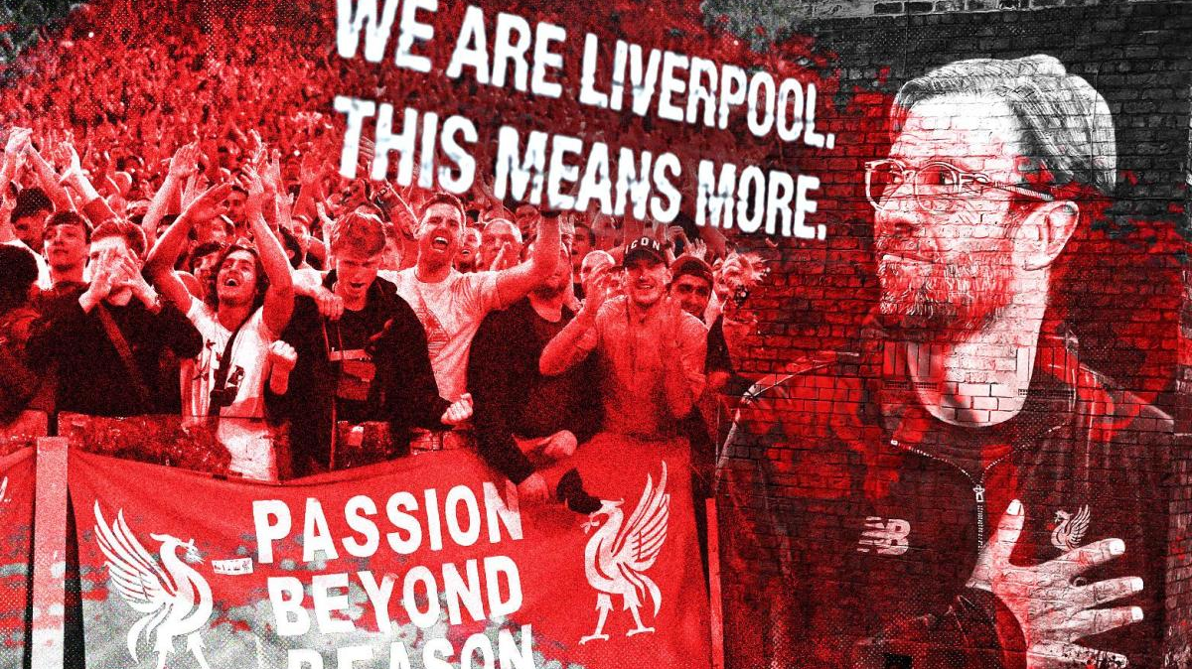

Slide 13
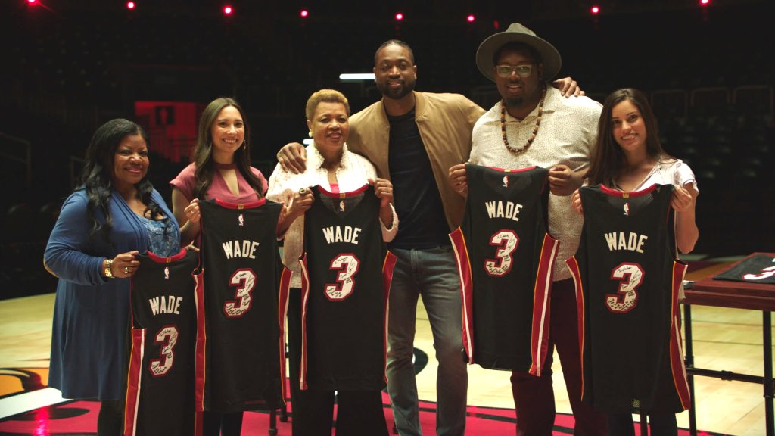

Slide 14
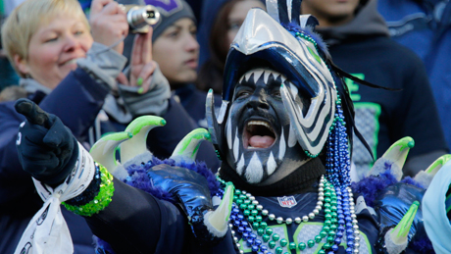
SPORTAIMENT BUSINESS
PLACE
&
MOMENT
For
FANS

Slide 15
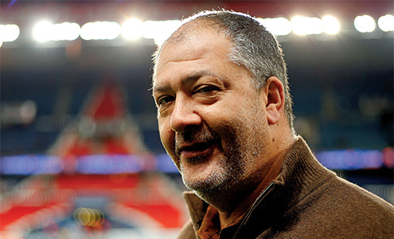
Marshall Glickman
CEO G2 Strategic, former president of the NBA’s Portland Trail Blazers
Over the last four decades, sports in North America has evolved from pure competition to business…from game to entertainment. Although the quality of competition has remained the centerpiece, North American sports culture is primarily motivated by money.
In France, as in most European countries, the sports culture has historically been driven by the competitions themselves, so consumption trends are not comparable. That said, there is no question that economic reality is driving French sports organizations to become more professional and oriented to business and profits.
From the perspective of an American who has extensive experience working with European and French sports organizations, finding the right balance between economics and culture is precisely the right recipe for success.

Slide 16
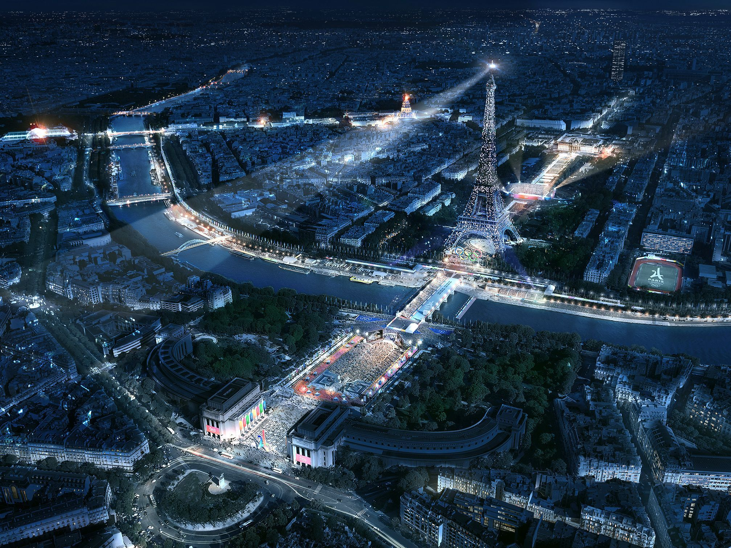



Slide 17
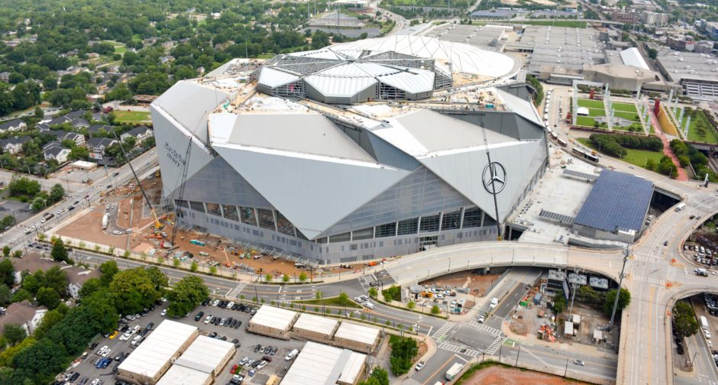

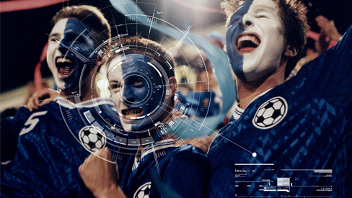
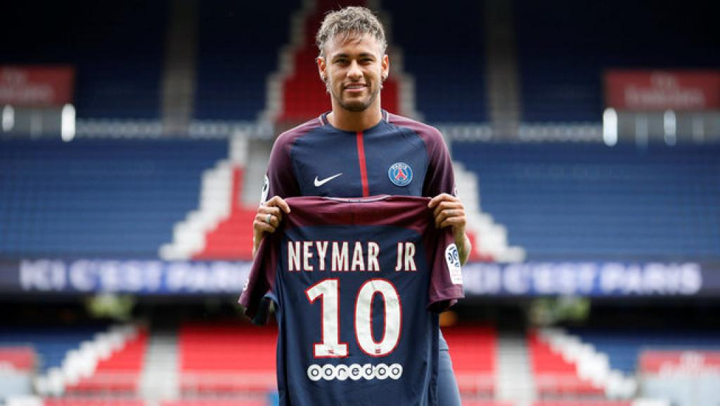

Slide 18
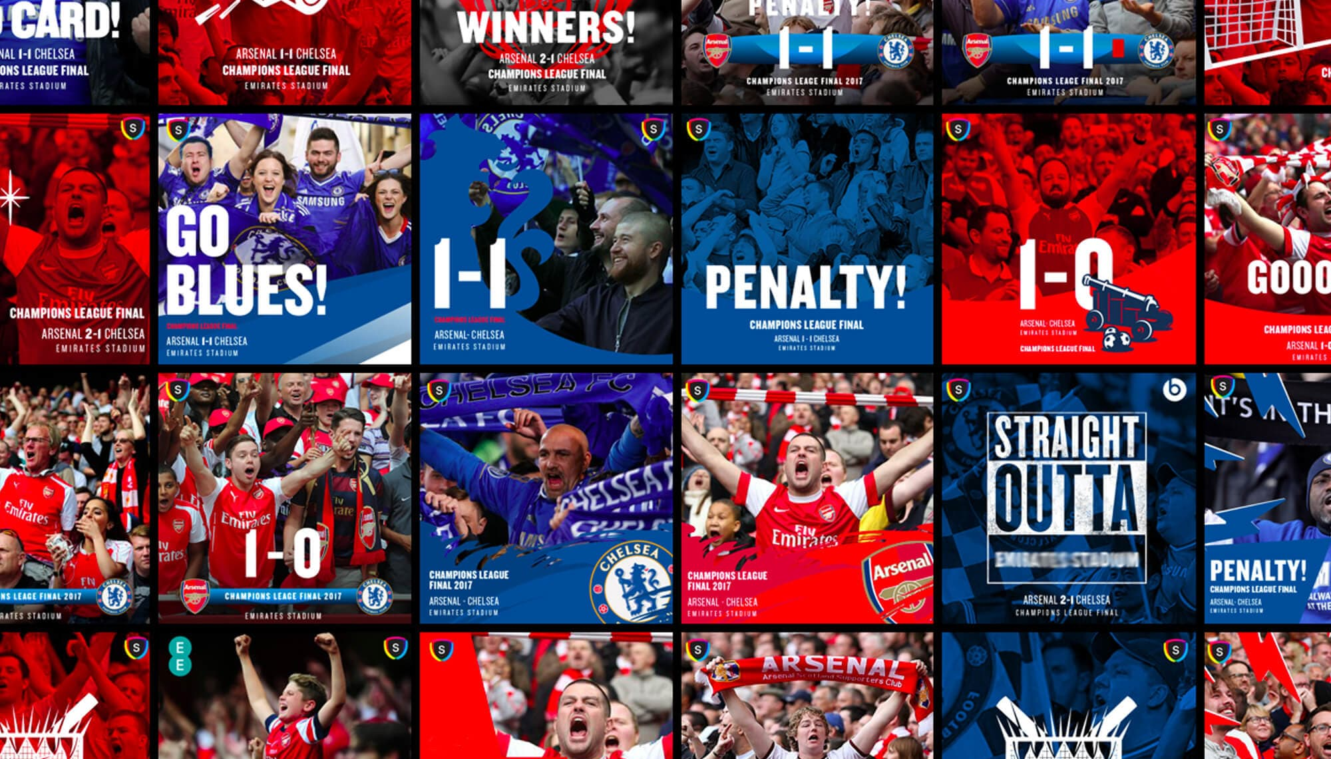
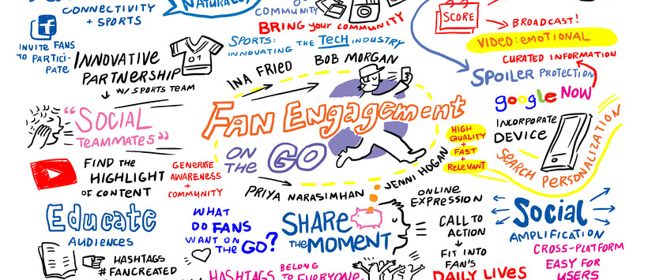
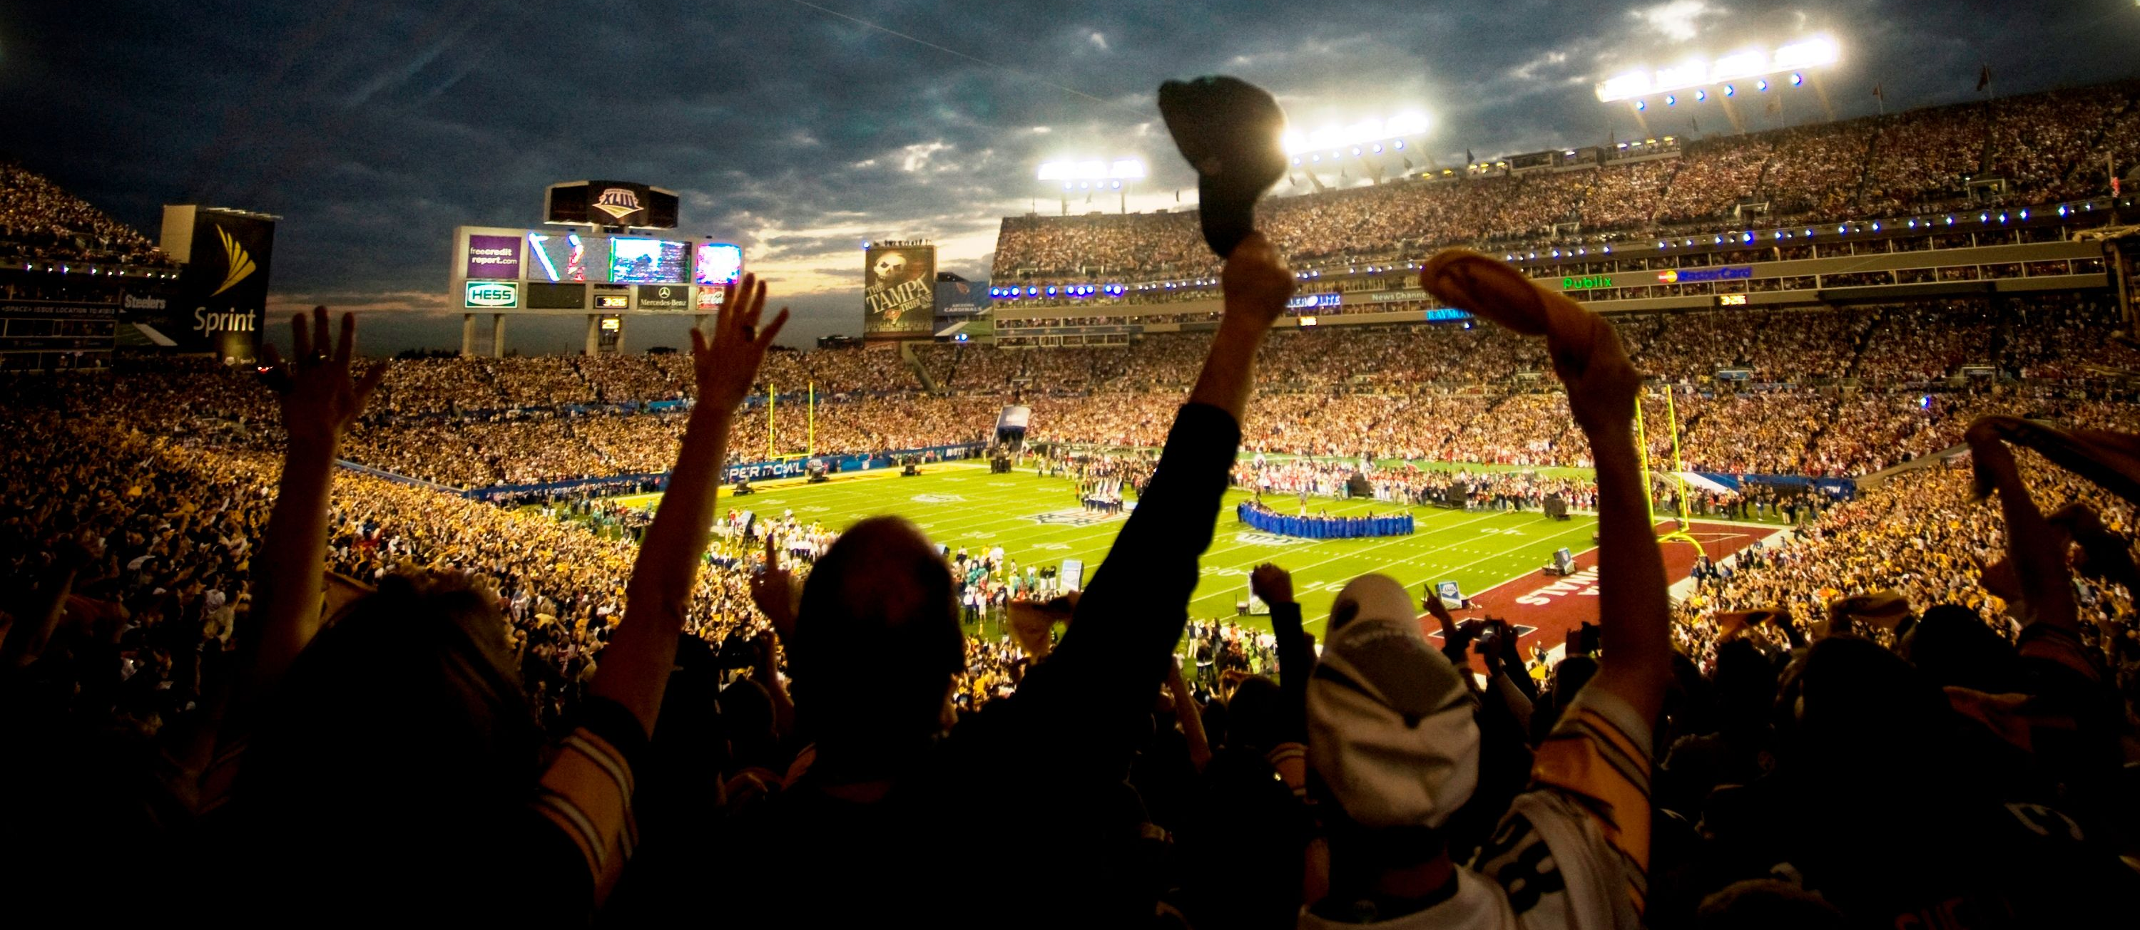
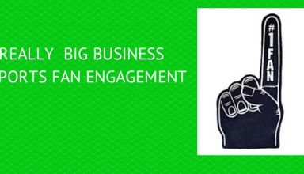

Slide 19
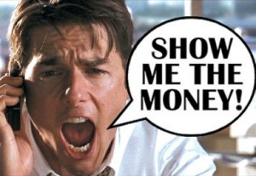
Course goal !

Slide 20

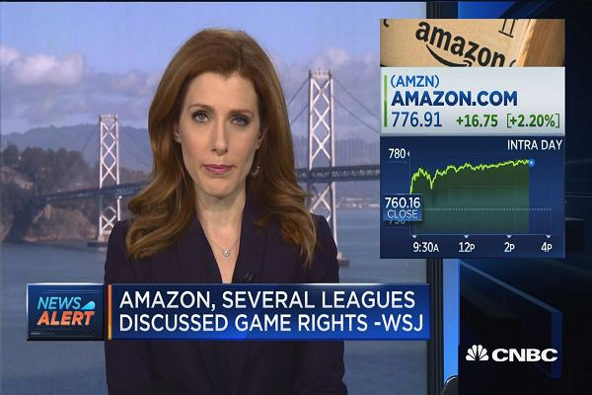

Slide 21
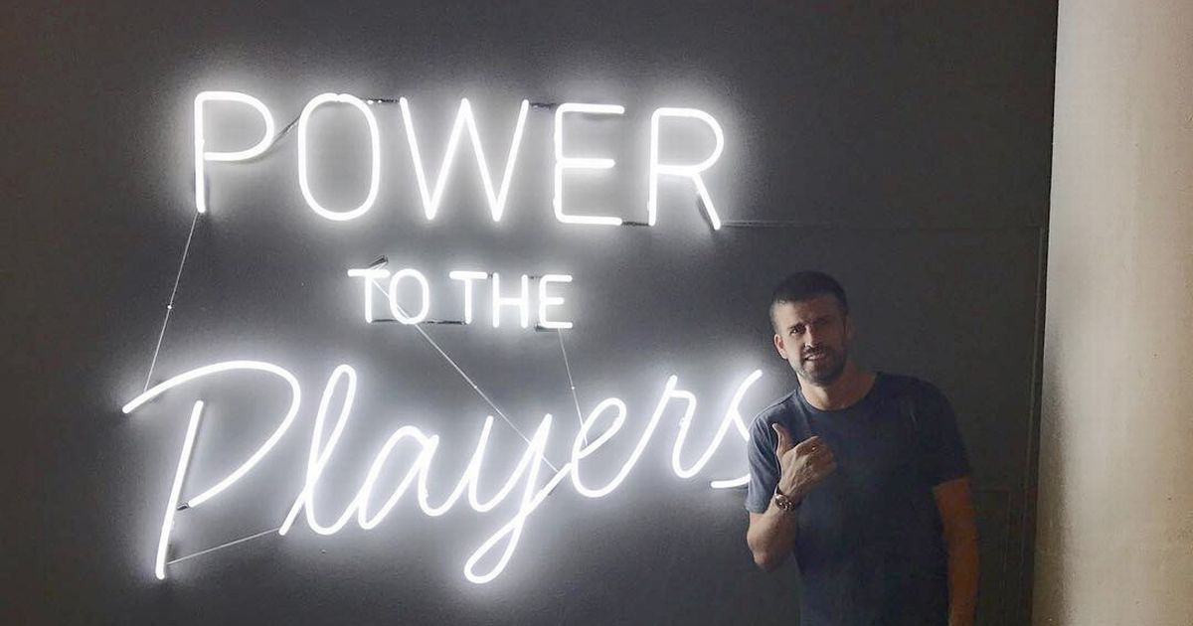

Slide 22
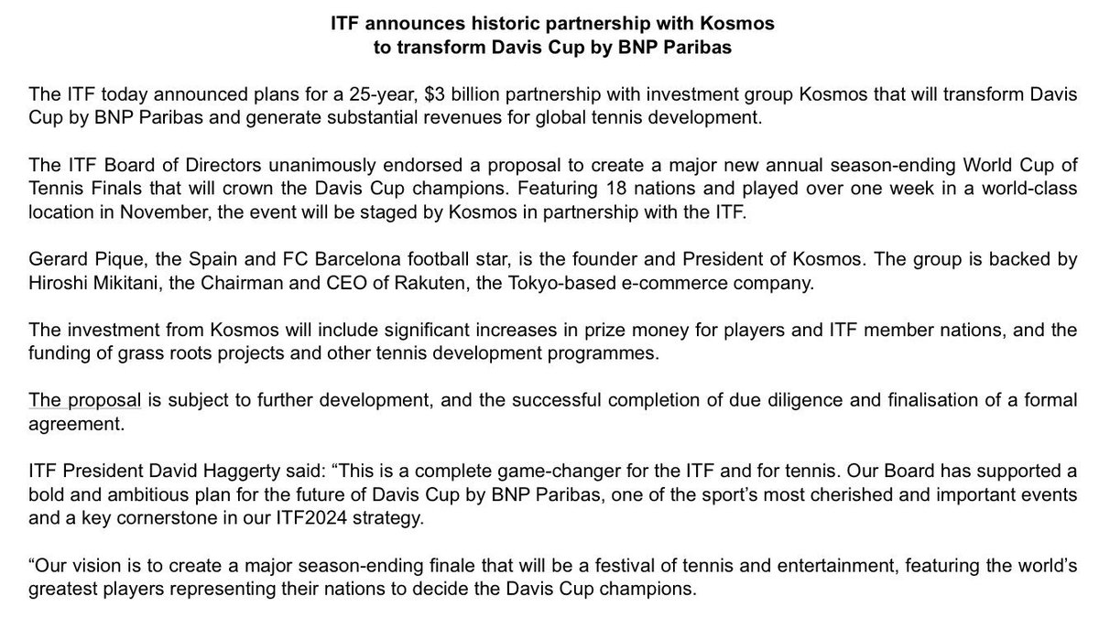

Slide 23

Sport Marketing Digest : Communication - Networks – Experiences – Brand
Relational Marketing
CRM – Ticketing – RP – Social Capital
« The Place to be »
Experiential Marketing
Entertainment BtC BtB CtC
« The Place to show the show »
Brand Management
Merchandising – branding
« The Place to express your brand »
Event Communication – Commercial Sponsorship
« The Place to leverage and activate »

Slide 24
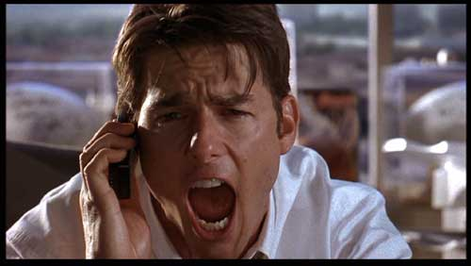
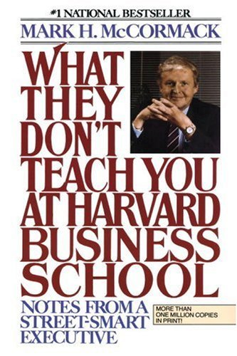
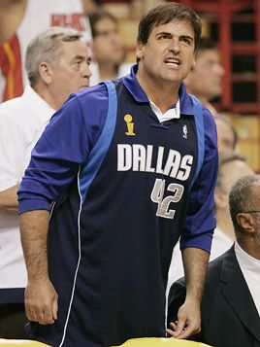
To be a value-added in sport business
Or american dream !
Business Marketing capabilities !

Slide 25
Competencie ?
Success comes from knowing that you did your best to become the best that you are capable of becoming. John Wooden
EXPERIENCE
Knowledge
EXPERTISE
Know-How
TEAM
Being
(know how to be)

Slide 26
Sport business market competencies
SALES : Ticketing, PR, Activations, Rights, Sponsorship, Negociation, Merchandising, Licencing, CRM (FRM), Place Management…
COMMUNICATON : Branding, Digital, Medias, PR
EVENT MANAGEMENT : Coordination, Project management, Suppliers management, Recruitment, Human organisation…

Slide 27
Program : 15H and More !
/
Sport Business Markets and Case Studies
1
Sponsorship Activation 1.0
2
Sponsorship Activation 2.0
3
Workshop / Coaching : Activation for your exam
4
Group Presentation
5

Slide 28

CASE STUDY 1
2006 - 2011
2011 - 2016
FUTURE ?

Slide 29
TICKETING
100 000
spectators
REPUTATION
SPORTAINMENT
FAN EXPERIENCE
GOALS
N1
INDOOR TOURNAMENT

Slide 30
Positioning
Servicing
Hospitality
General Public
Product*
Best Draw / Players
Experience
Entertainment
Fan Experience

Slide 31
ACTION
Tennis – Indoor
Number and games
time
Attraction
Stars
&
Show
“VOLUME”
Journey session
“DIFFERENCIATION”
Night session
Danger* !

Slide 32
Rentability
100K€ → 125K€
Innovation
Sportainment reference
Goals 2011-2016
Sponsorship ACTIVATIONS

Slide 33
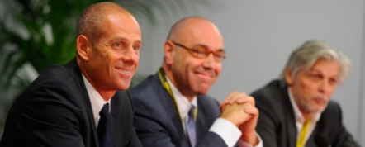
Competencies…

Slide 34
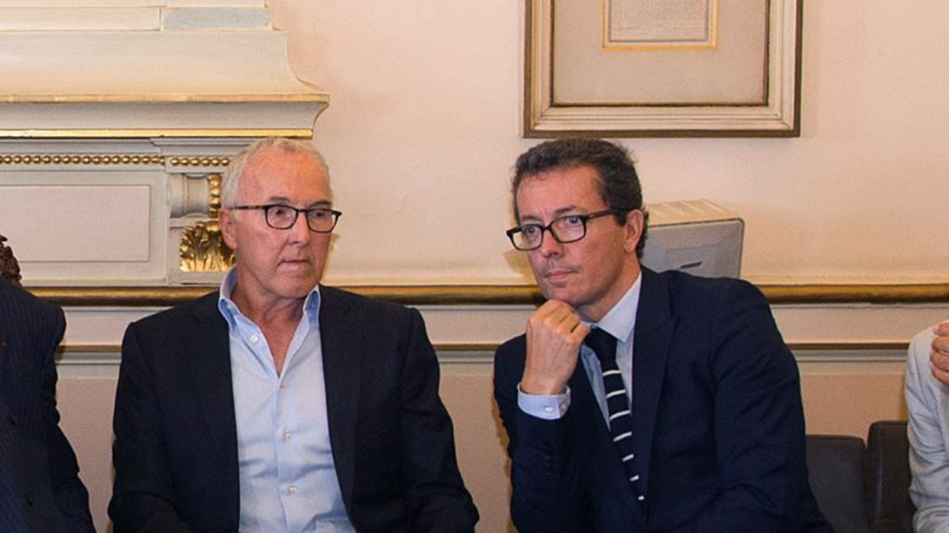

OM « Champion Project »
Top Sponsors renew :
2017 : Intersport, Caisse d’Epargne, Mutuelle du Soleil, Winamax, Boulanger, Coca-Cola, EA Sport, Onet
2018 : Adidas, Citroën, Quick
2026 : Orange
New owner from US (F. McCourt and Staff, JE Eyraud)

Slide 35
Business & Marketing Organisation
TICKETING
MS
FAN
GMS
BRAND
SV
SPONSORSHIP
HOSPITALITY
BK
BTB
SERVICING
AM
$
Tickets – Match Day Revenue
$
Sponsorship
Hospitality Events
$
Merchandising
Products

Slide 37
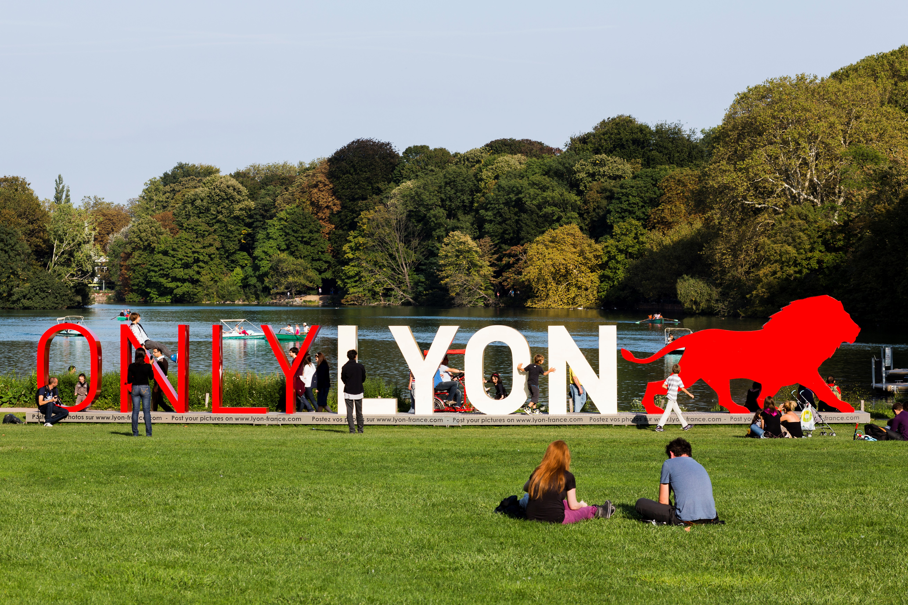


ATP250 LYON

Slide 38

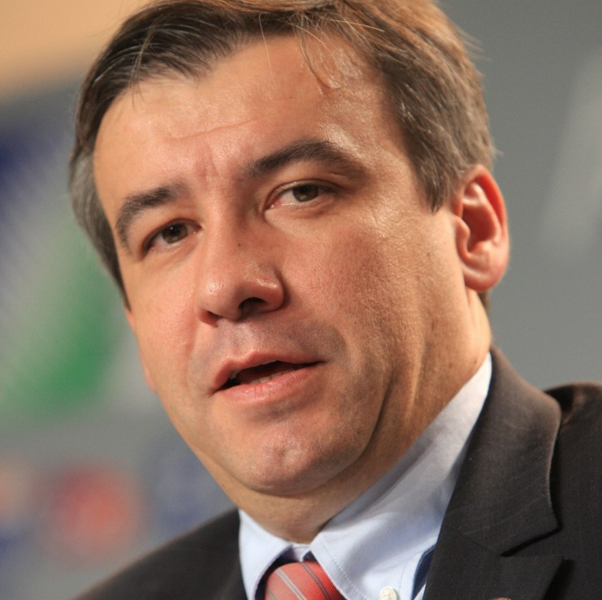
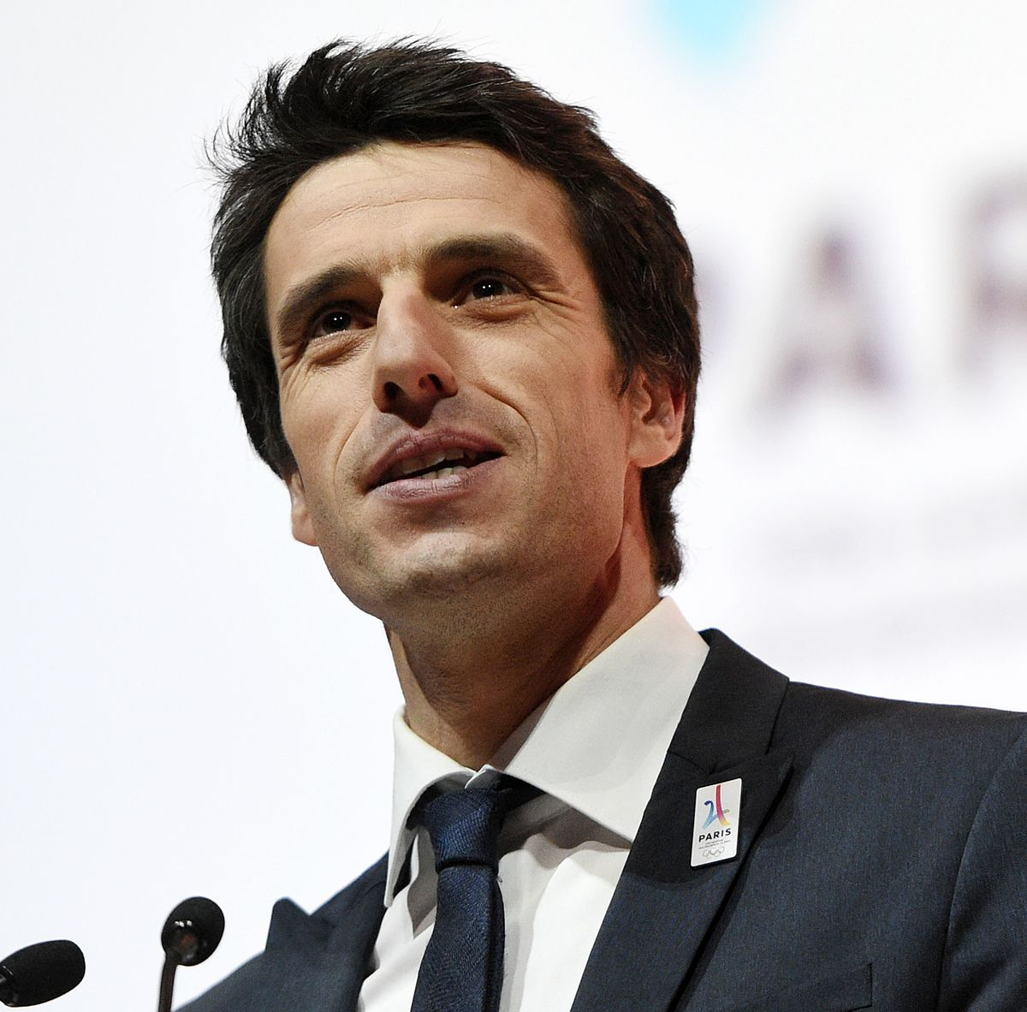
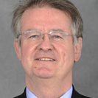

Slide 39

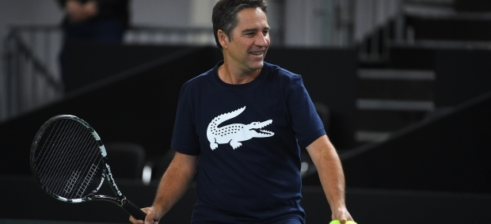
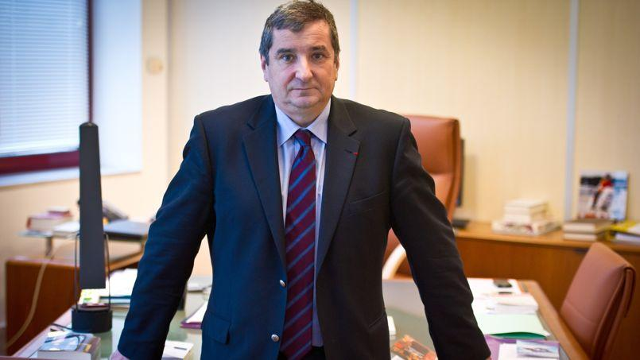
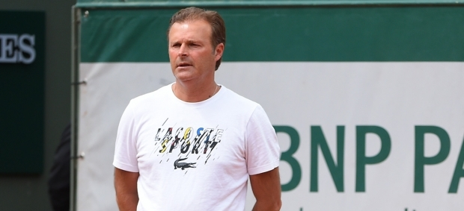
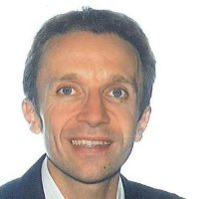
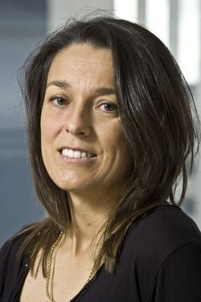
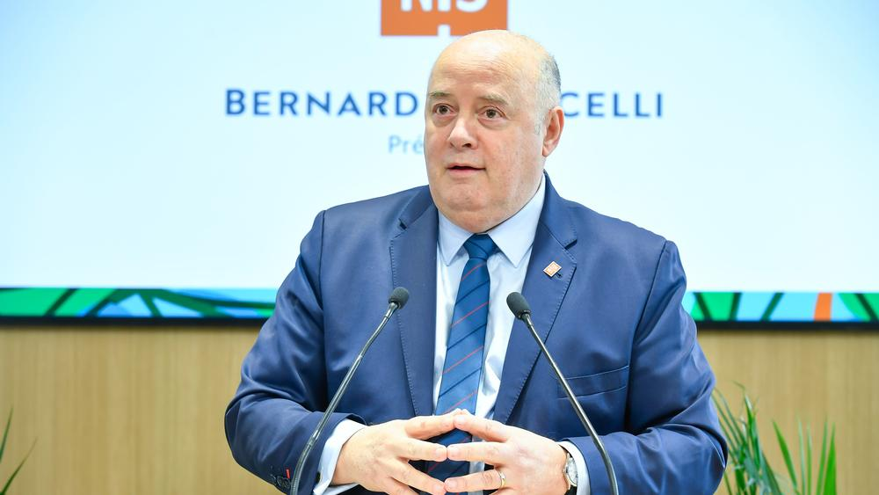

Slide 40

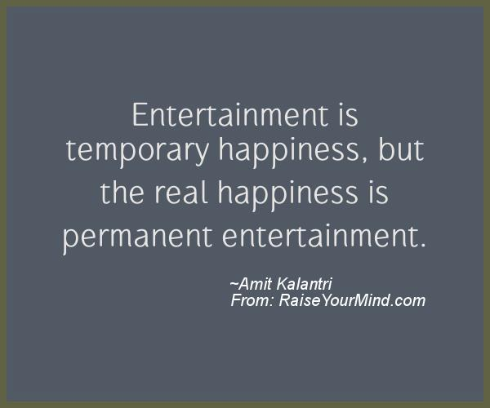

Slide 41
HOW DOES SPORT COMPARE TO OTHER INTERESTS?
– % of those ‘Passionate’ for each interest
% with Passionate in interests

Slide 42
Challenge
Introduction
Activation
Closing
Less « sponsorship as adverstising » and more « sponsorship-linked marketing » as authentic engagement
(Bettina Cornwell, 2019).
One of the key changes in the evolution of sponsorship has been the transition from “badging” (by sponsors) to “building”
(brand engagement and relationships) as the raison d’etre for sponsorship involvement
(Tony Meenaghan, Damien McLoughlin, and Alan McCormack, 2013).

