Slide 1
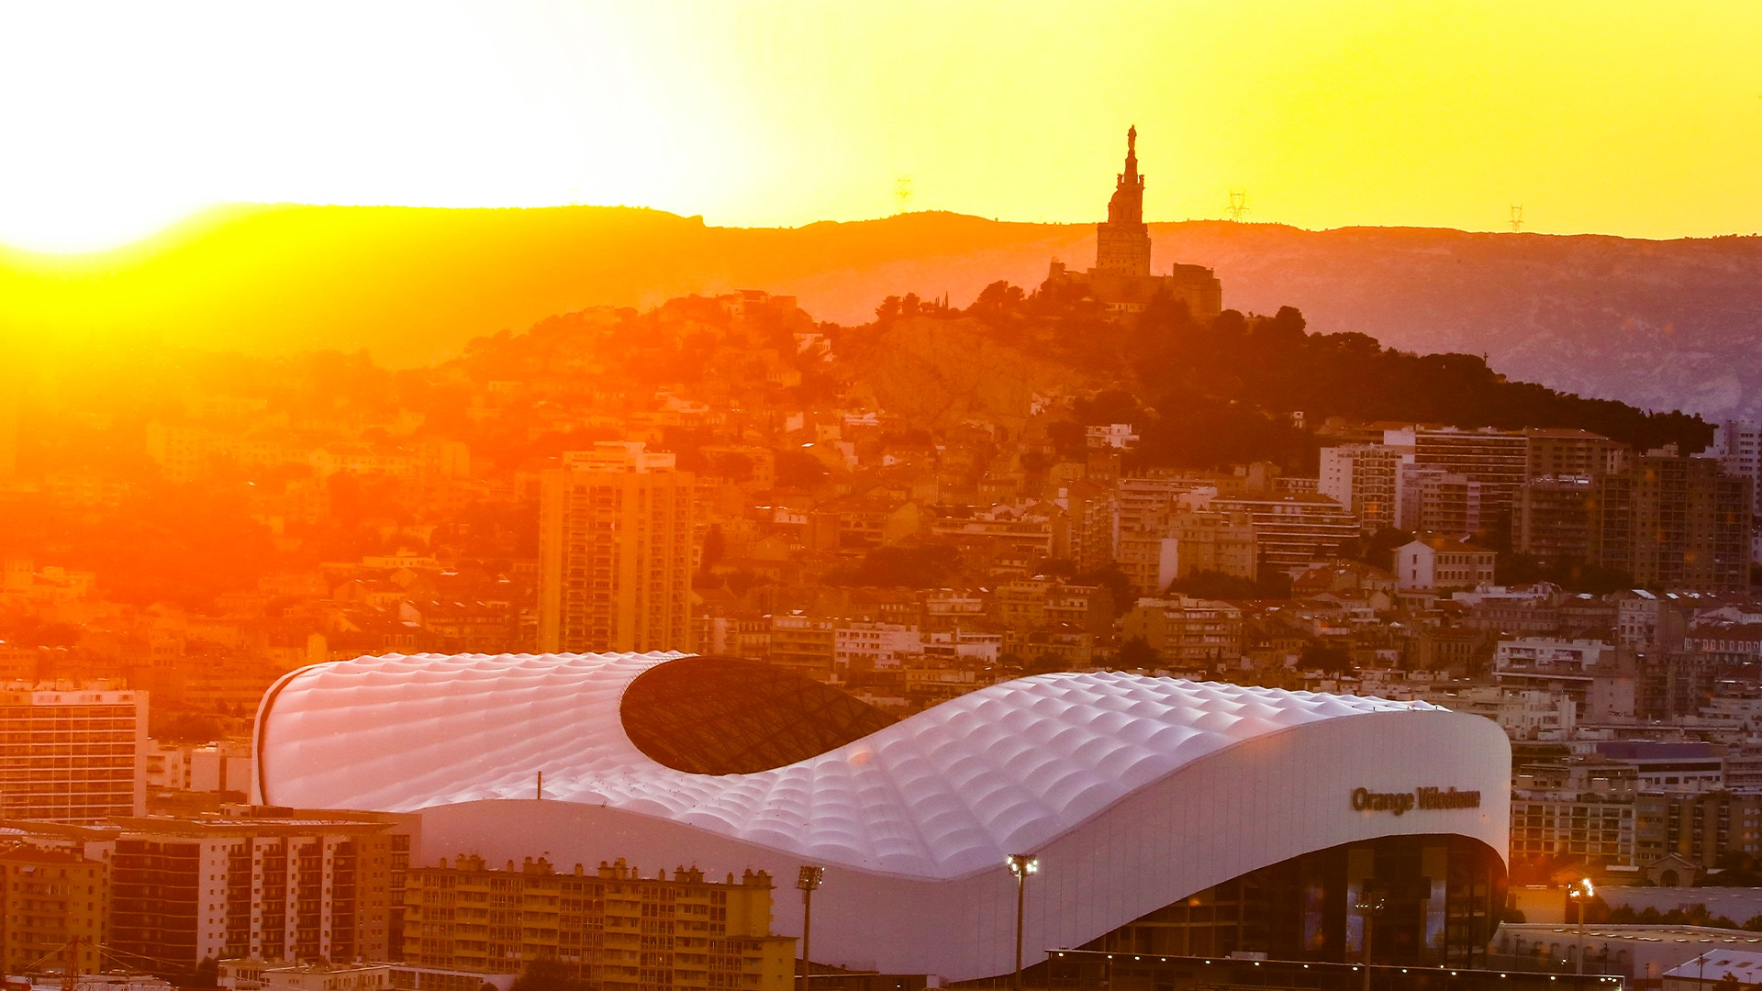
Lionel Maltese
Maître de Conférences Aix Marseille University – CERGAM IAE Aix-en-Provence - #OIMS Laval University Canada
Associate Professor Sport Business Management Kedge Business School
Delegate Manager Marseille – Lyon ATP250 - Senior consulting sport business management
Twitter : @lionelmaltese
Msc International Sport & Event Management
2021-2022 - Season N°30 !!! [1993-2021]

Slide 2


WELCOME & FIRST « WEAK TIES DAY » & INTERACTIONS WITH YOU !

Slide 3
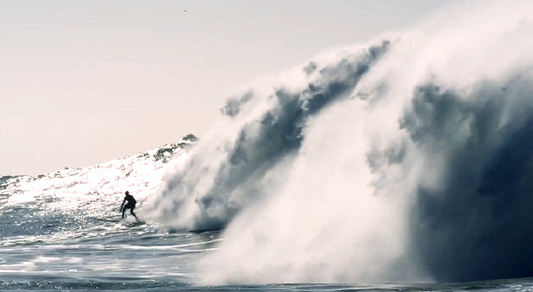
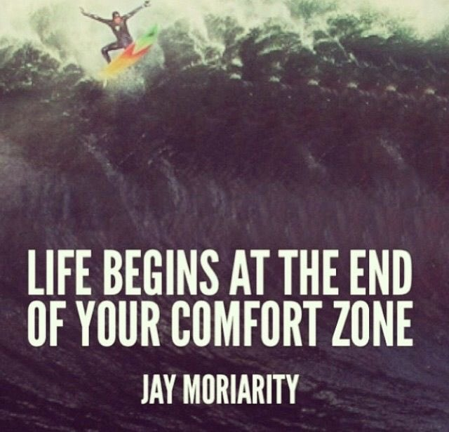
Learn – Prepare & Manage your « grit » and your « weak ties »
This is ISEM !

Slide 4
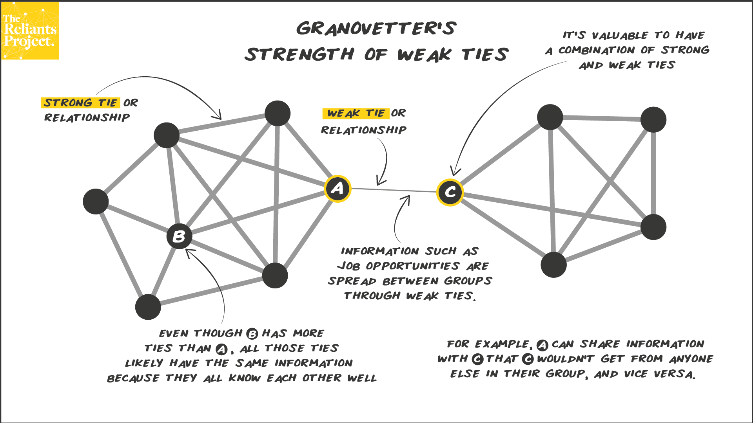

Slide 5
ISEM “TRAINING” TEAM
 | SEMINARS | FULL INTERNATIONAL | MIX INTERNATIONAL FRENCH
S1 | Commercial business strategy in sport organisations | BOUVRANDE Thomas 6H / WEISZ Michael 9H / MALTESE Lionel 15H | BOUVRANDE Thomas 6H / WEISZ Michael 9H / MALTESE Lionel 15H
 | Commercial & social Sponsorship and Operational Activations | DANGLADE Jean-Philippe15H / AL NIMER Mohammad15H | CARILLAT François 15H / GUILLET Marie-Amélie 9HH / CHANTREAU Alizée (6H)
 | Sport Media Consulting and Event Communication Operational Strategy | ROUGER David / FERSING Aurélie 15H | ROUGER David (15H) / FERSING Aurélie 15H
 | Event, Experiential, Social and Cultural Marketing for sport & e-port | VACHIER Sylvain & Romain SOMBRET 15H / FUSCHILLO Gregorio 15H | VACHIER Sylvain & Romain SOMBRET 15H / FUSCHILLO Gregorio 15H
 | Sport Career Services and labor market opportunities | Damien INNOCENTI 30H | GHIBAUDO Alain 30H
 | Sport business consulting projects | MALTESE Lionel 15 / DANCYGER Sammy 15H
 | Droit des compétitions Sportives et de ses acteurs |  | RIZZO Fabrice 30H
S2 | Strategic Management and sales & Digital marketing in Sports Organizations | MALTESE Lionel 15H / LADIK Daniel 15H | MALTESE Lionel 15H / LADIK Daniel 15H
 | Economics and Finance of professional team sports | SIMMONS Rob 30H | DURAND Christophe 30H
 | Fan experience & stadium strategic management | WALRAEVENS Alexandre 9H/ KUDAWOO Joakim 9H /LEPRON Julien 12H | Alexandre WALRAEVENS 9H/ KUDAWOO Joakim /LEPRON Julien 12H
 | Brand Management in sports organizations | PONS Franck 30H | PONS Franck 30H
 | Corporate social responsibility in sports and Destination Marketing | KUNKEL Thilo 15H / BEE Colleen 15H | FRANCOIS Aurélien 15H / Julien BERENGER 9H / LLORENS Emilie 6H
 | Celebrity & Talent Marketing Management | DANGLADE Jean-Philippe 18H / GEOFFROY Kevin 12H
 | Organisation contractuelle du spectacle sportif |  | MARMAYOU Jean-Michel 30H
Conferences : Sport Consulting / Sport Business Skills / Press – Media Challenges / Deltare Challenge / NBA Challenge

Slide 6
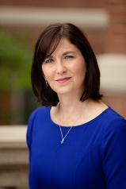
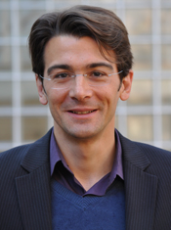
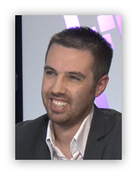
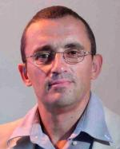
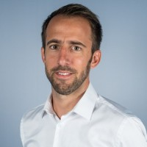
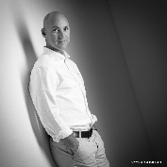
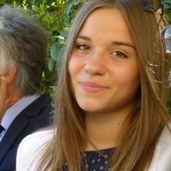
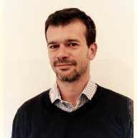
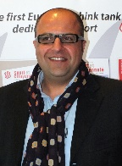
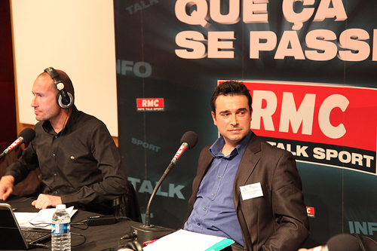
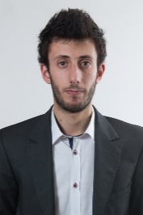
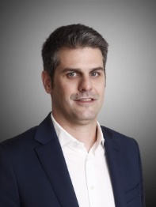
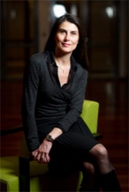
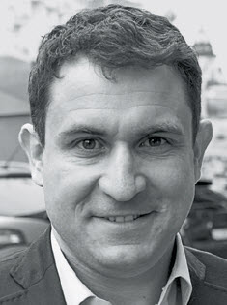
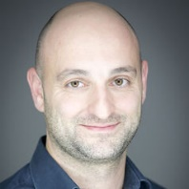
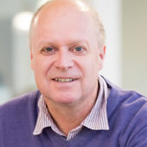
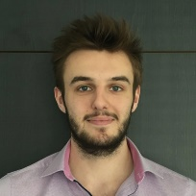
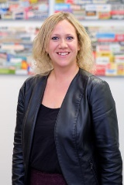
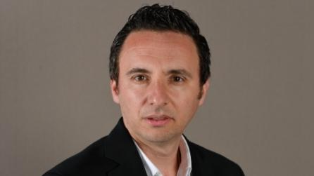
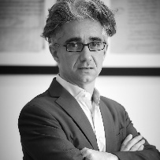
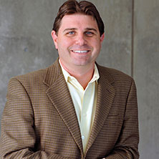
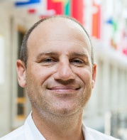
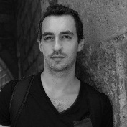
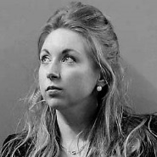
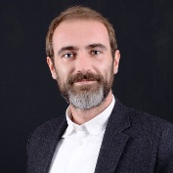
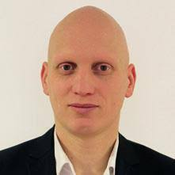
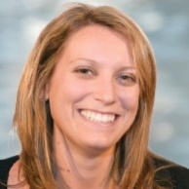
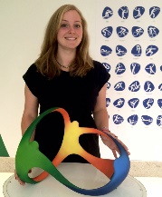
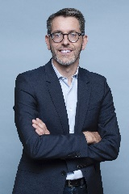
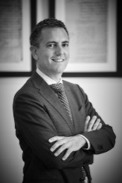
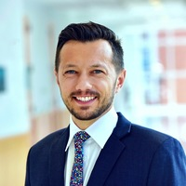
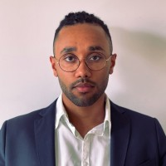
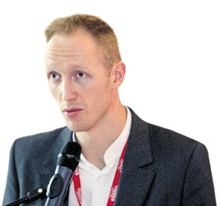
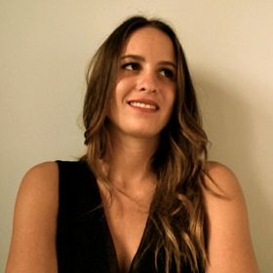
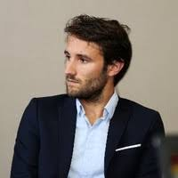
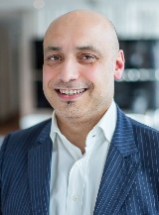
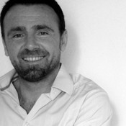
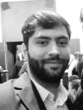
Academics
Professionals
Academic + Professional + Alumni
Sylvain
Vachier
Thomas Bouvande
Marie-Amélie Guillet
David Rouger
Alain
Ghibaudo
Colleen
Bee
François Carillat
Aurélien
François
Christophe Durand
Jean-Philippe Danglade
Gregorio Fuschillo*
Robert
Simmons
Werner Boucher*
Maryline Giroux*
Thibault
Podtevin
Academic + professional (consulting+executive)
Sammy
Dancyger
Julien Berenger
Nathalie
Zimmermann
Academics + Professionals (consulting)
Professionals + Alumni
Fabrice
Rizzo
Daniel
Ladik
Frank
Pons
Michael Weisz
Aurélie Fersing
Damien Innocenti
Alexandre
Walraevens
Lionel Maltese
Emilie
Llorens
Amélie
Bouan
Benjamine Causse
37 weak ties
Thilo
Kunkel
Joakim
Kudawoo*
Julien
Lepron
Alizée
Chantreau
Kevin
Geoffroy
Vincent Chaudel
Romain Sombret
Jean-Michel
Marmayou
Mohammad
Al Nimer

Slide 7
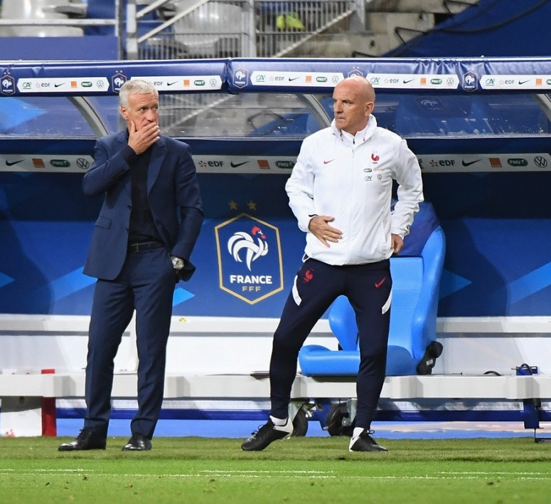
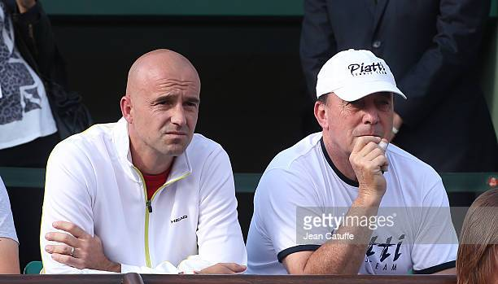
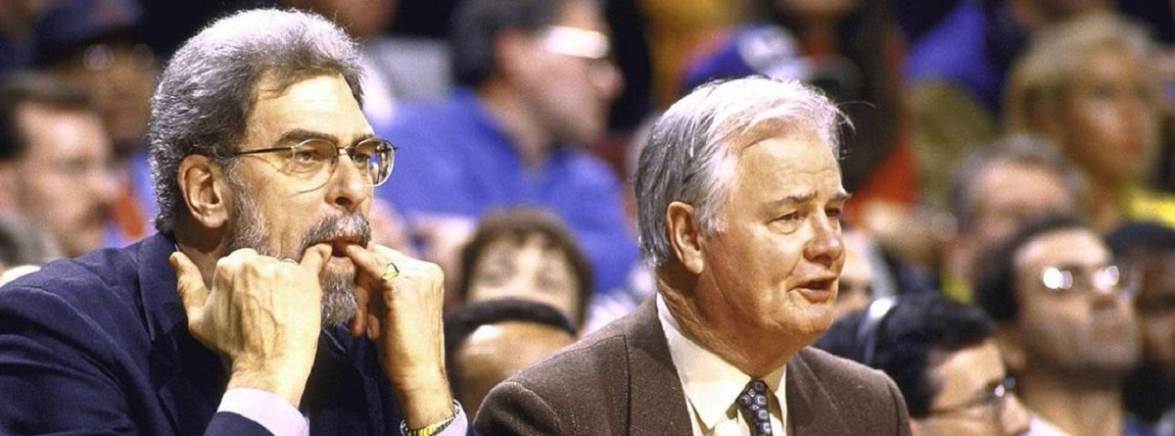

Slide 8
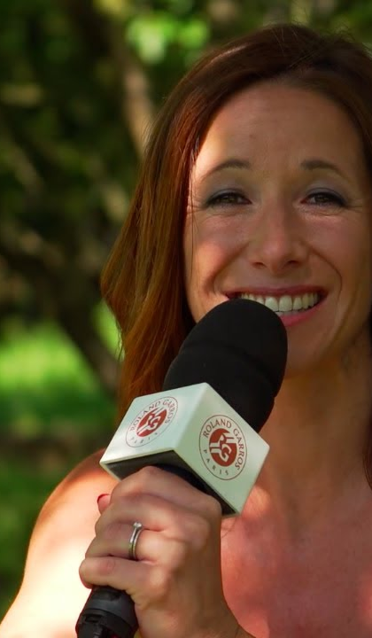
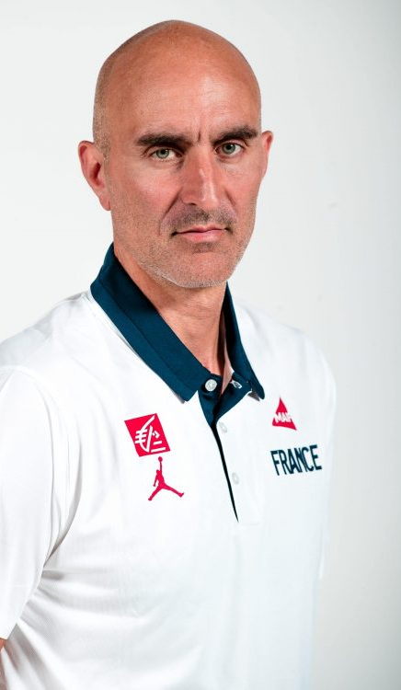
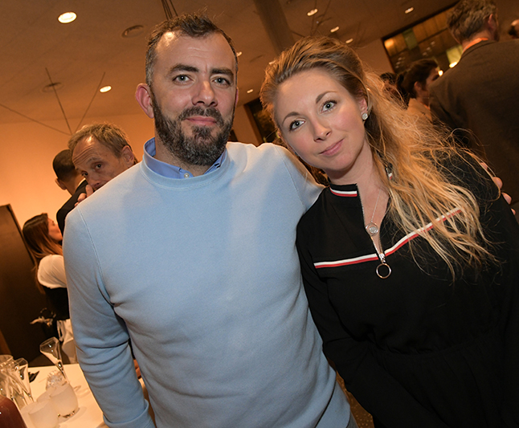
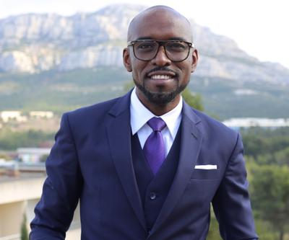

Slide 9
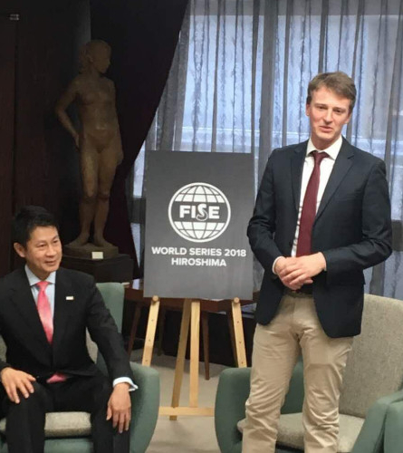



We teach what we are doing in sport business

Slide 10



Slide 11



We are « hardworkers »

Slide 12



We will try to make « grit students » to become « grit & great » sport business women and men

Slide 13


Slide 14






Slide 15







Slide 16



PASSION
WEAK TIES MANAGEMENT

