Slide 1
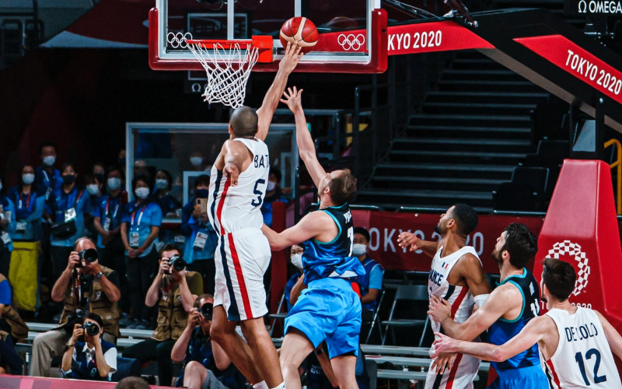
Sport Marketing
&
Communication
Summer School
SPORT EVENT MANAGEMENT
Lecture 1
Lionel Maltese
Maître de Conférences Aix Marseille University – CERGAM IAE Aix-en-Provence - #OIMS Laval University Canada
Associate Professor Sport Business Management Kedge Business School
Delegate Manager Marseille – Lyon ATP250 - Senior consulting sport business management
Twitter : @lionelmaltese

Slide 2
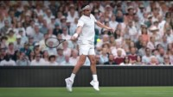

Slide 3
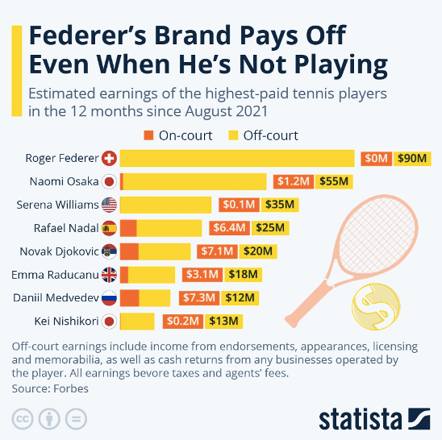

Slide 4

PEDAGOGY
From Sport Business Knowledge TO Sport Business Competencies :
DISCOVER
  Key practical goals using students participation (wooclap)
DECODE
  Methods
  Models
  Best practice
DO
  Students Challenge
  Live Case Student

Slide 5
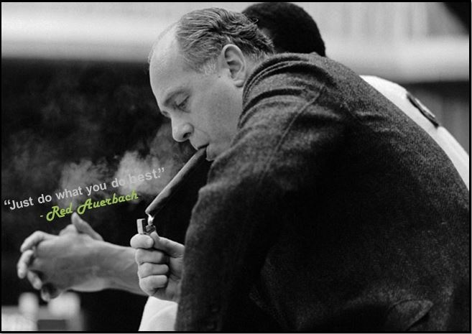


Slide 6
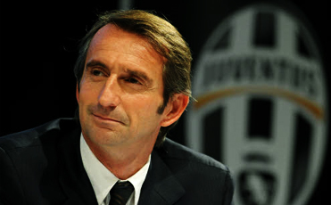
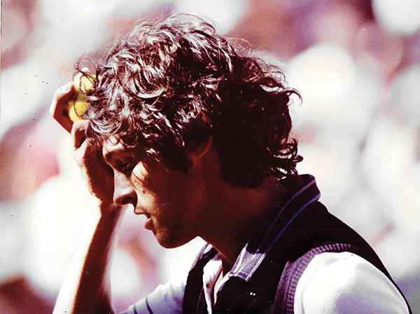
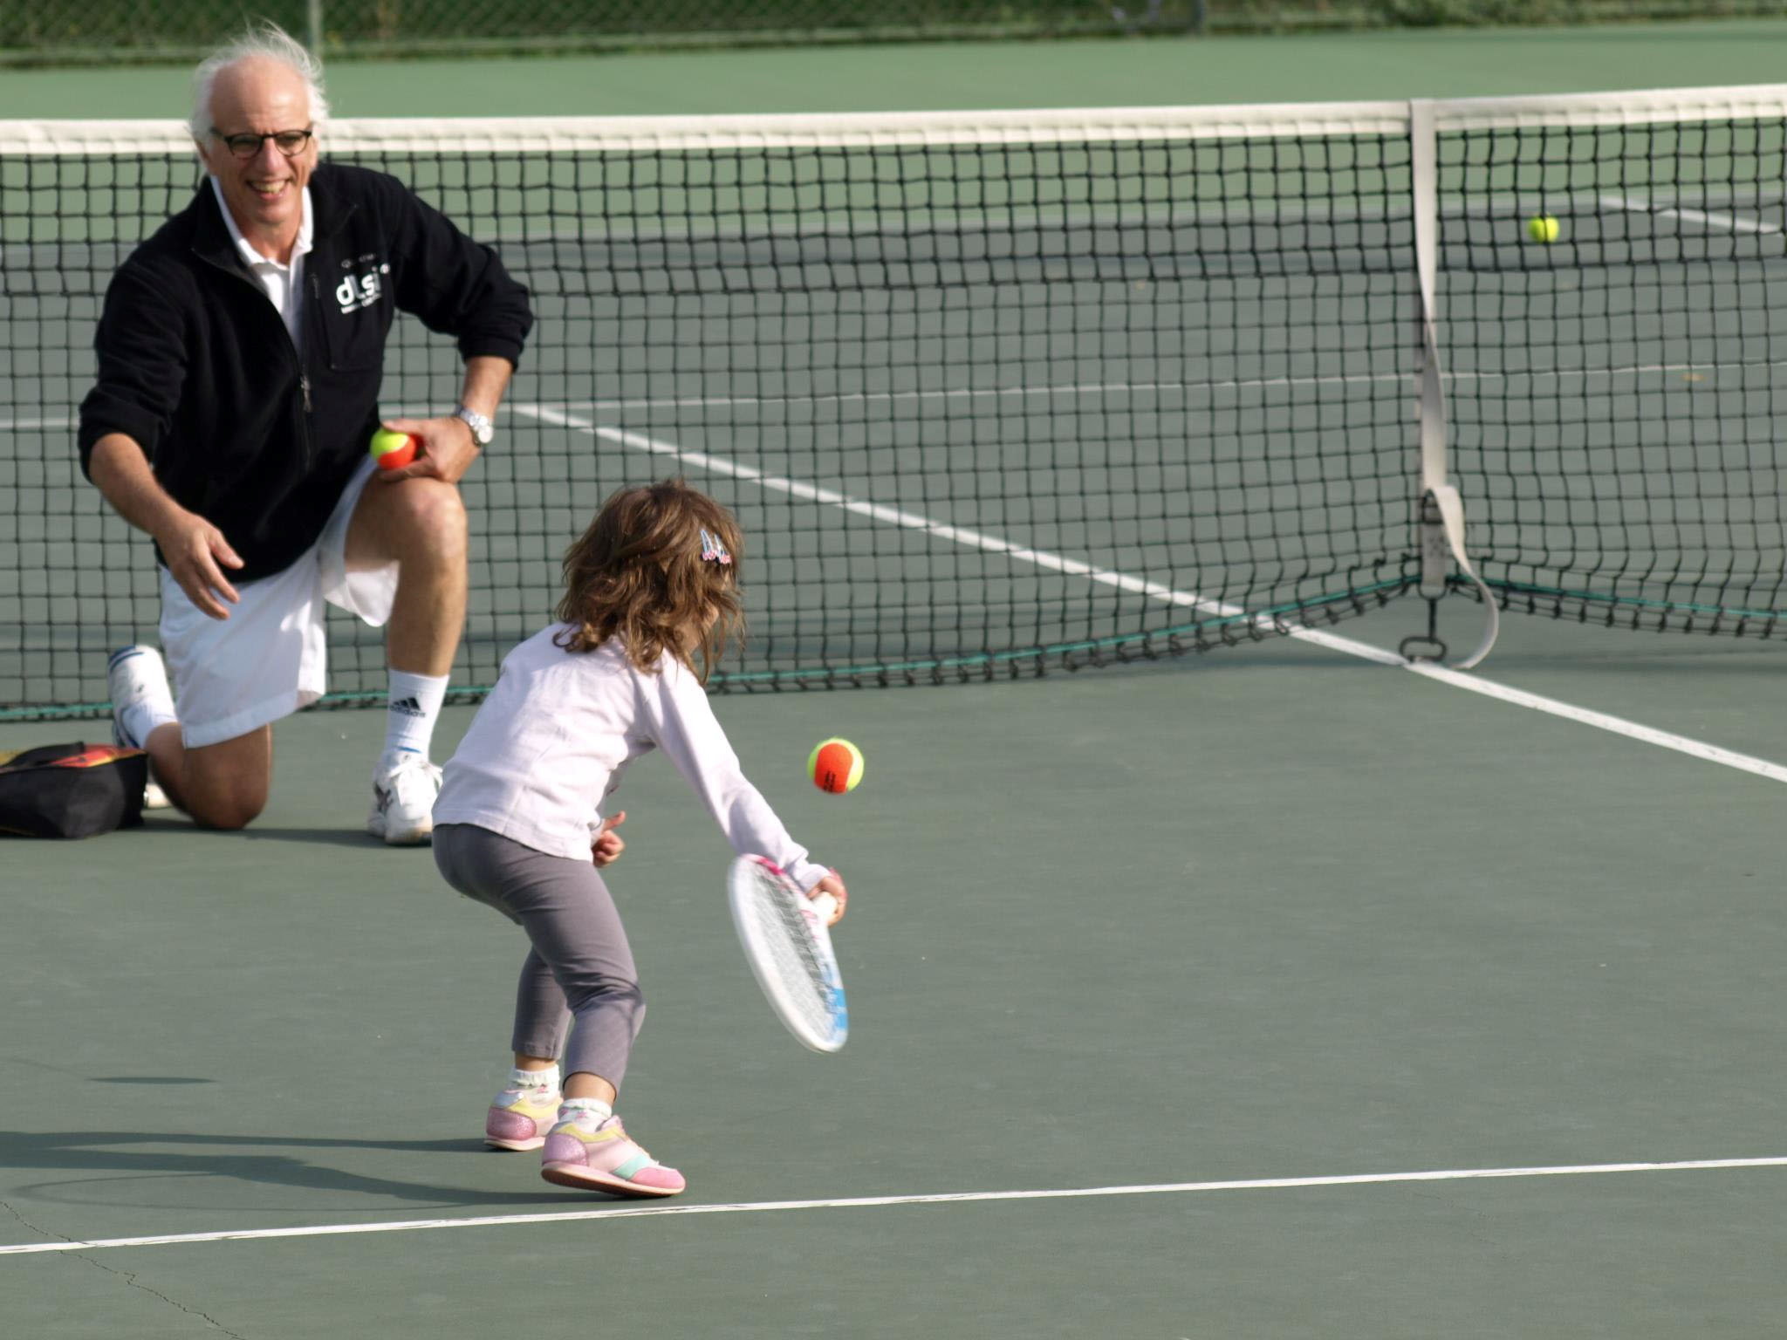
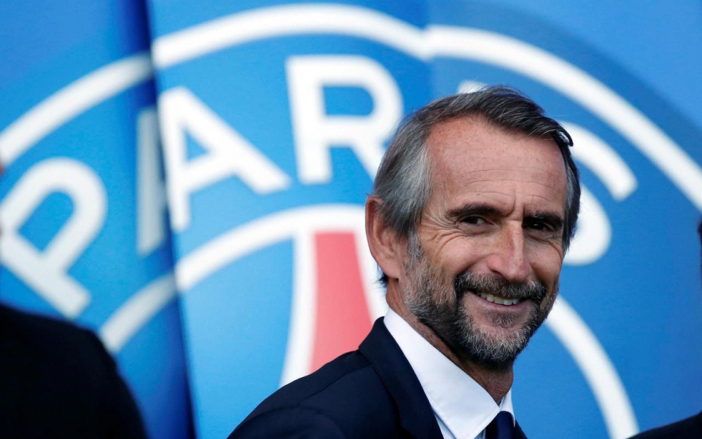
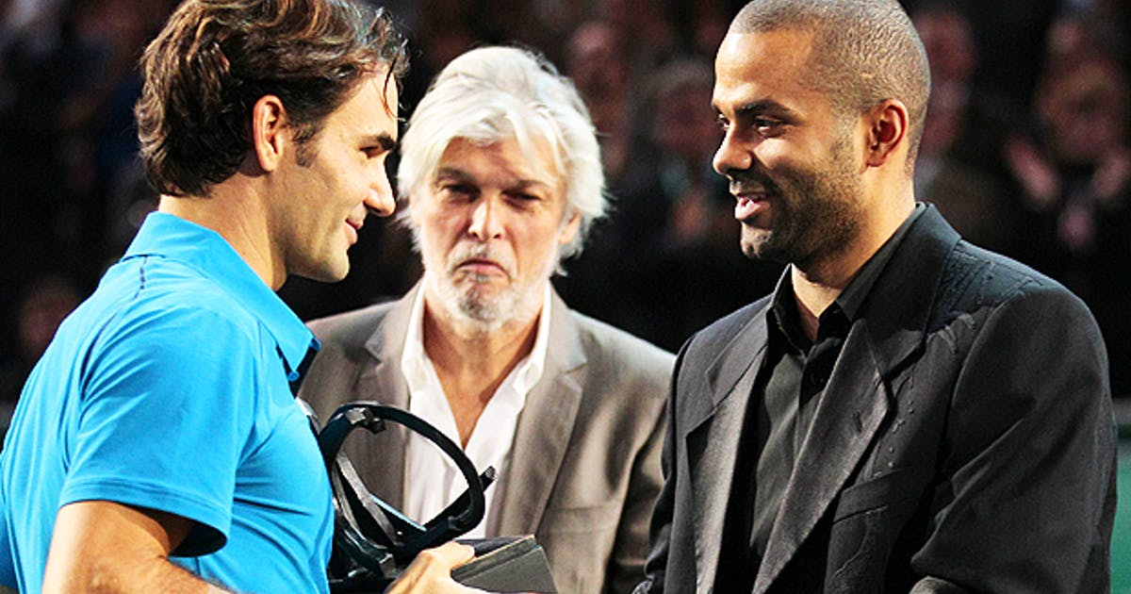
Jean-François Caujolle since 1993
Pierre Maltese since 1978
Jean-Claude Blanc since 2000

Slide 7






















Since 2005
Maître de Conférences
Aix Marseille University
Strategy & entrepreneurship
Since 2006
Associate Professor Kedge Business School
Business Management
Since 1999
Professional
ATP & WTA
Events management
Manager
Since 2001
Research
Member of the Executive Committee 2017-20
Economic Development – Circular Economy – Education
Consulting
Sport Business Strategy & Marketing

Slide 8


Slide 9
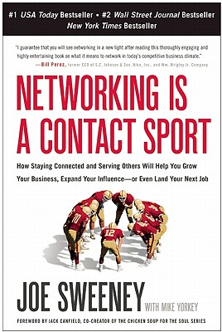


Slide 10
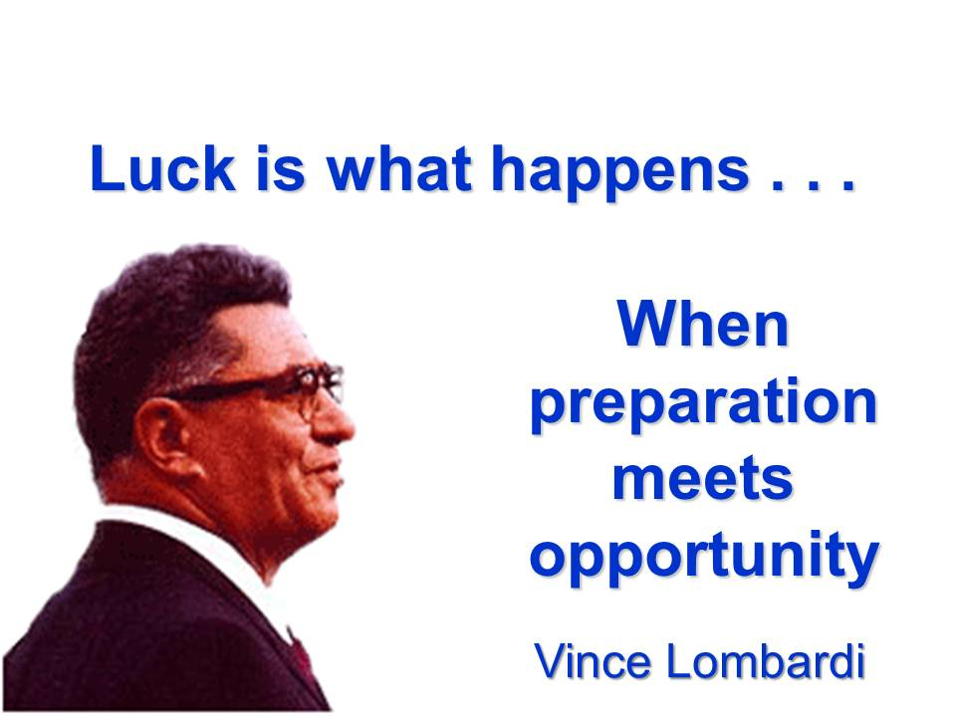
Vince Lombardi

Slide 11
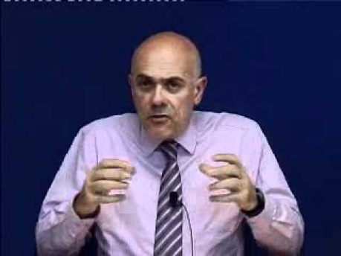

Slide 12
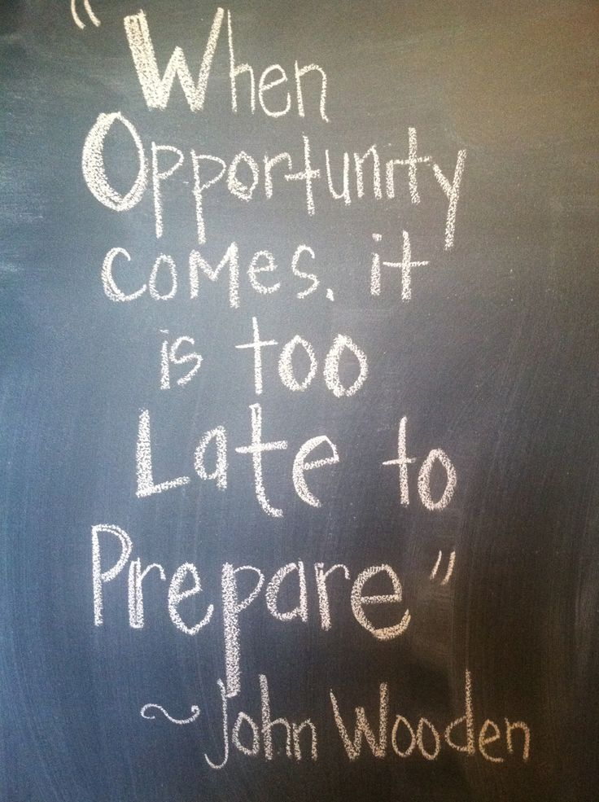

Slide 13
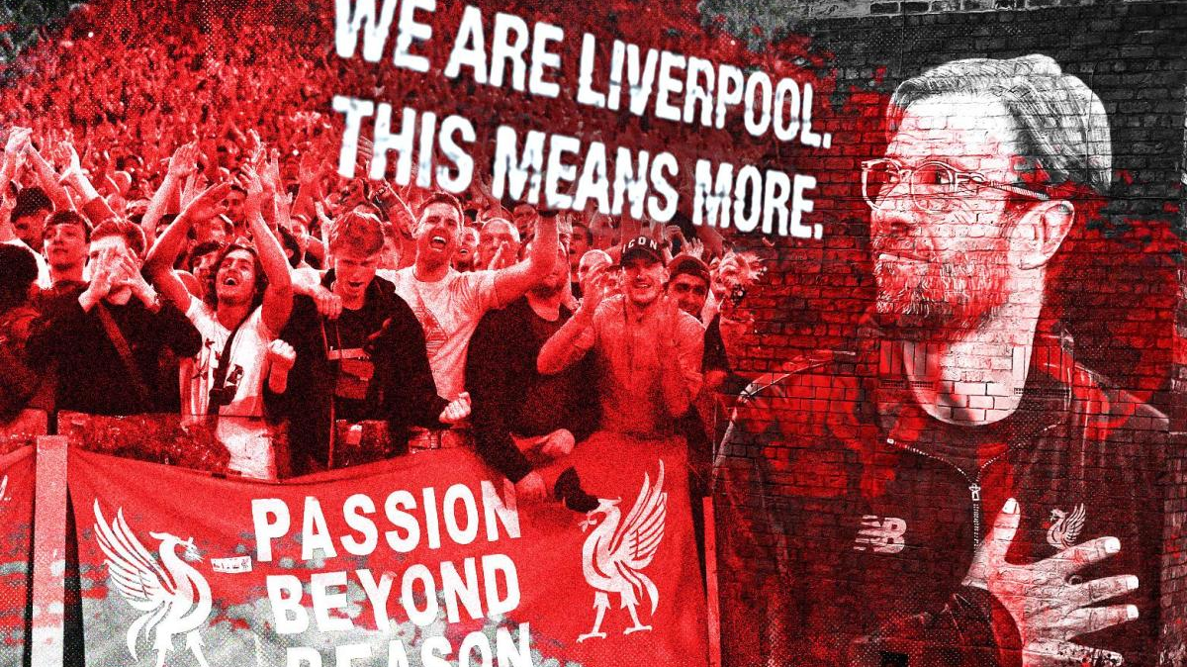

Slide 14
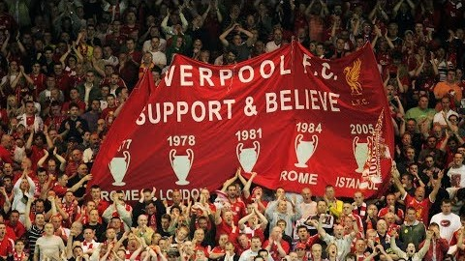

Slide 15
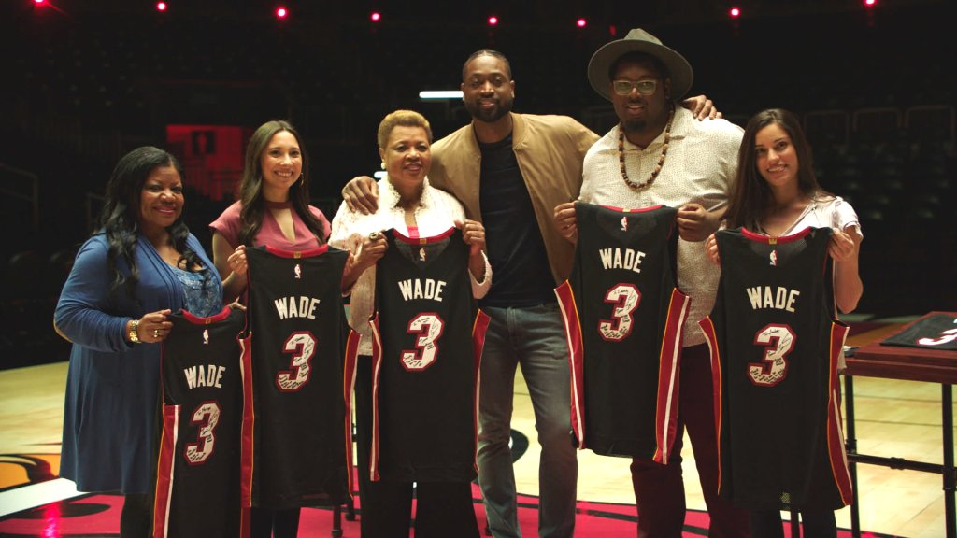

Slide 16
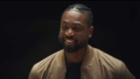

Slide 17
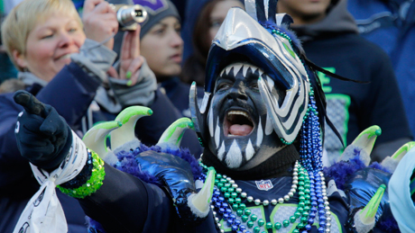
SPORTAIMENT BUSINESS
PLACE
&
MOMENT
For
FANS

Slide 18
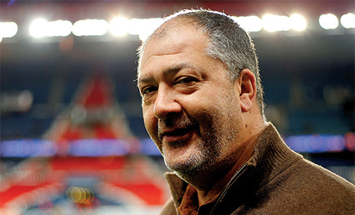
Marshall Glickman
CEO G2 Strategic, former president of the NBA’s Portland Trail Blazers
Over the last four decades, sports in North America has evolved from pure competition to business…from game to entertainment. Although the quality of competition has remained the centerpiece, North American sports culture is primarily motivated by money.
In France, as in most European countries, the sports culture has historically been driven by the competitions themselves, so consumption trends are not comparable. That said, there is no question that economic reality is driving French sports organizations to become more professional and oriented to business and profits.
From the perspective of an American who has extensive experience working with European and French sports organizations, finding the right balance between economics and culture is precisely the right recipe for success.

Slide 19
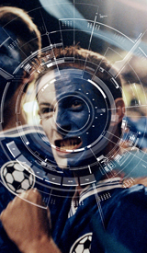

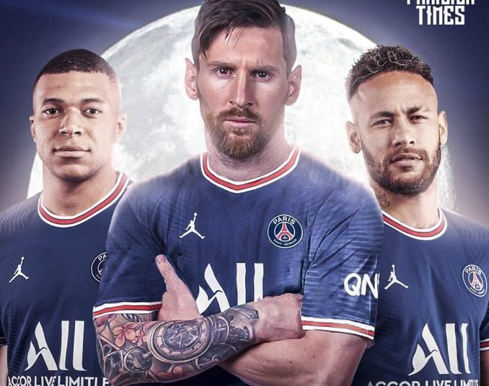
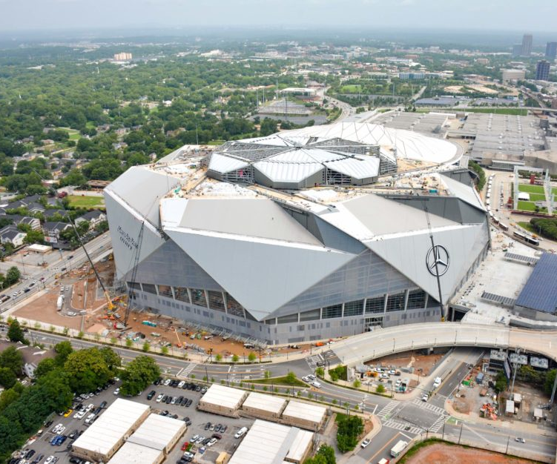

Slide 20
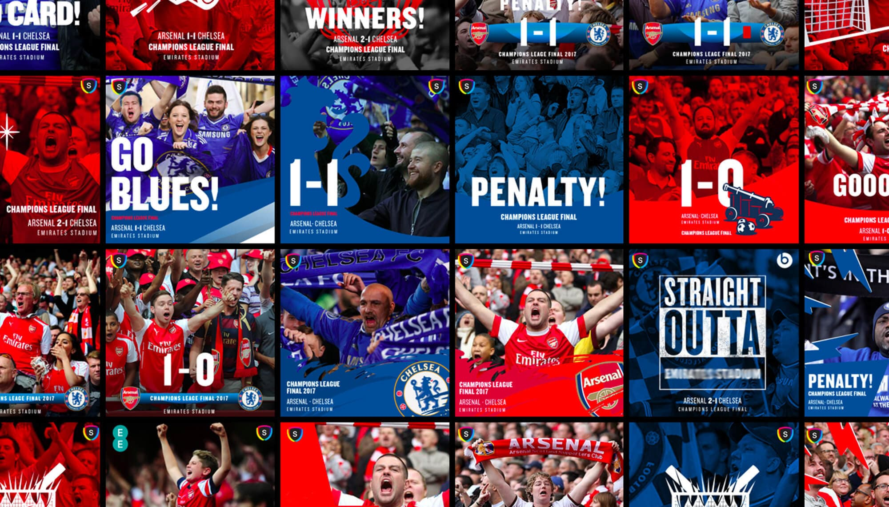
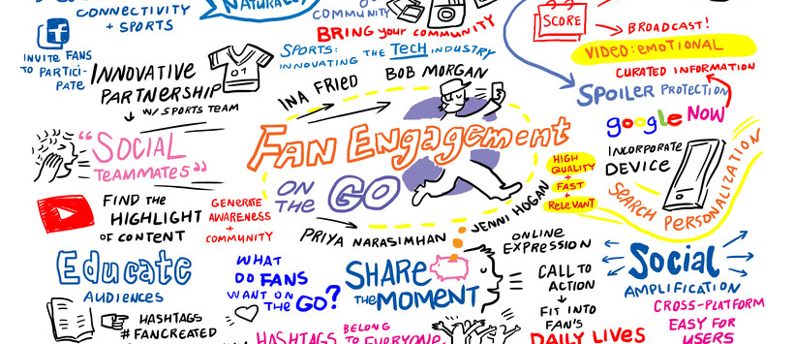
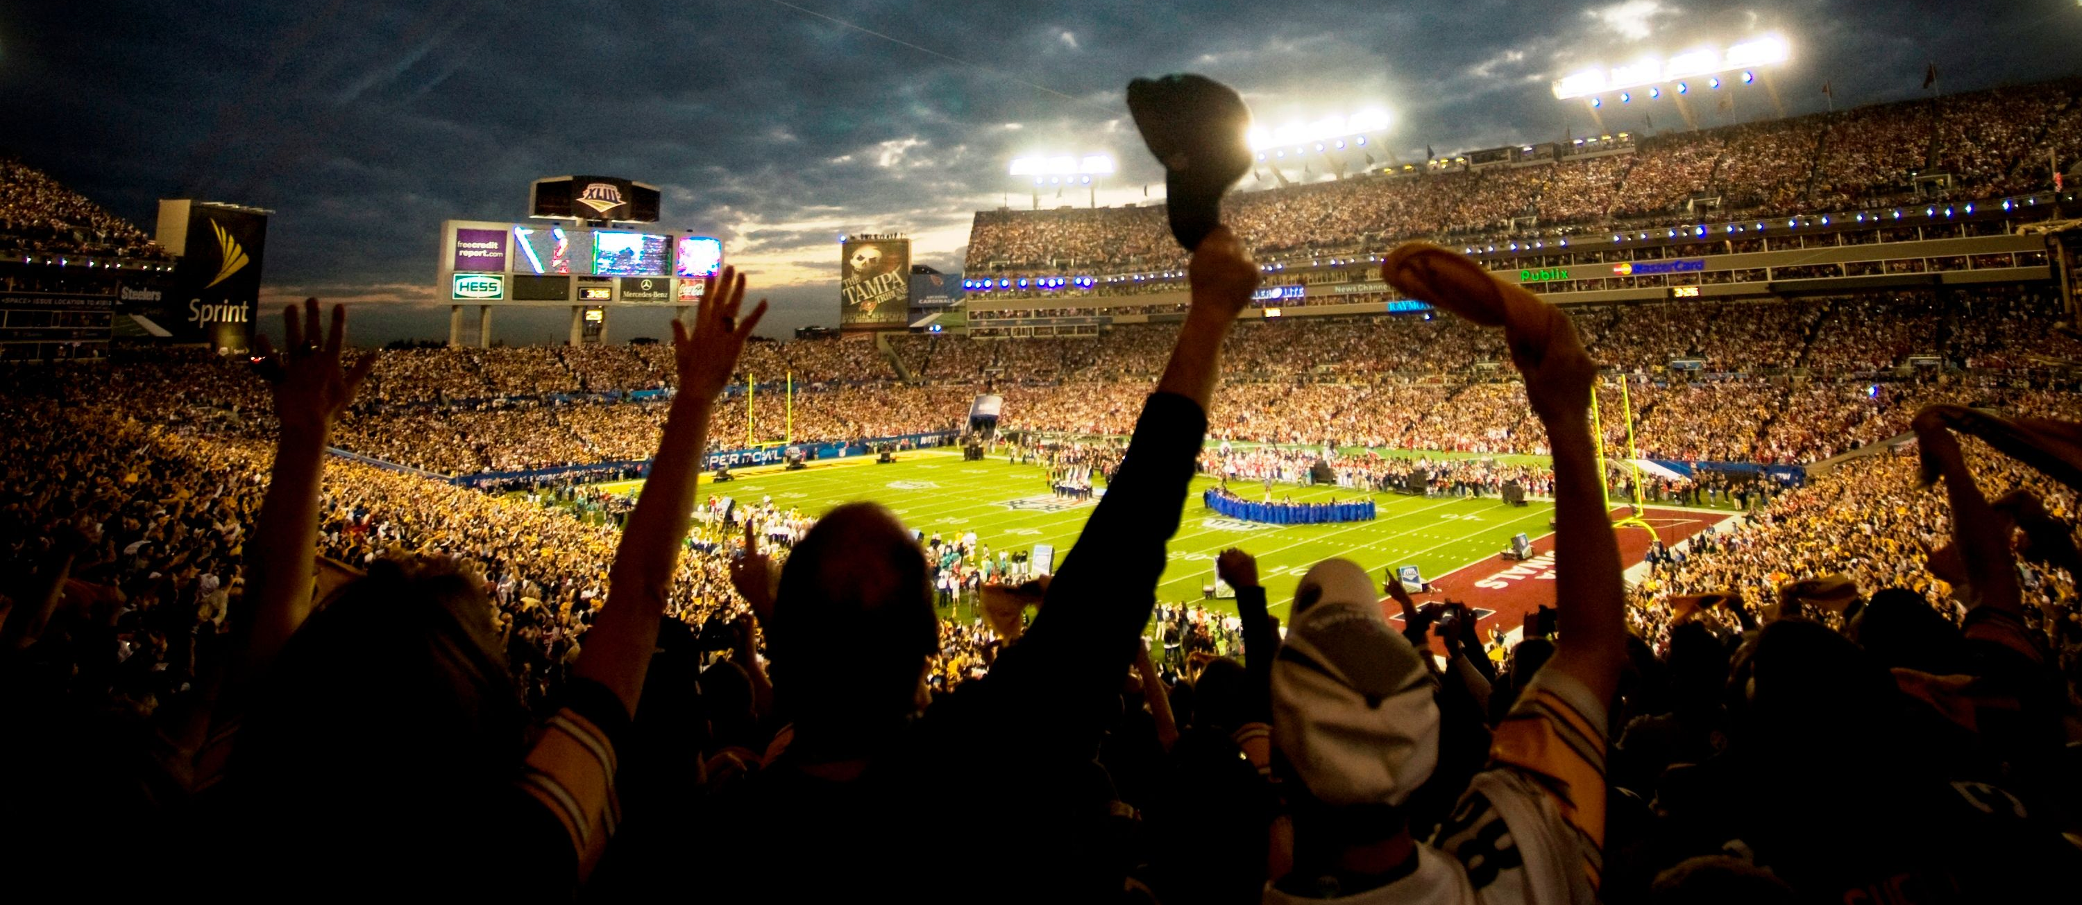
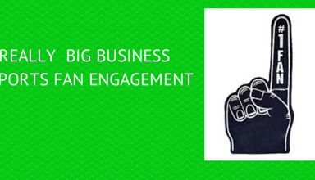

Slide 21
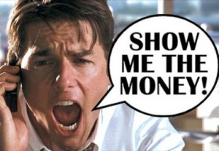
Course goal !

Slide 22

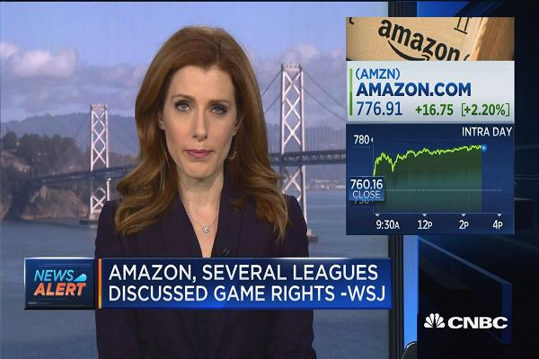

Slide 23
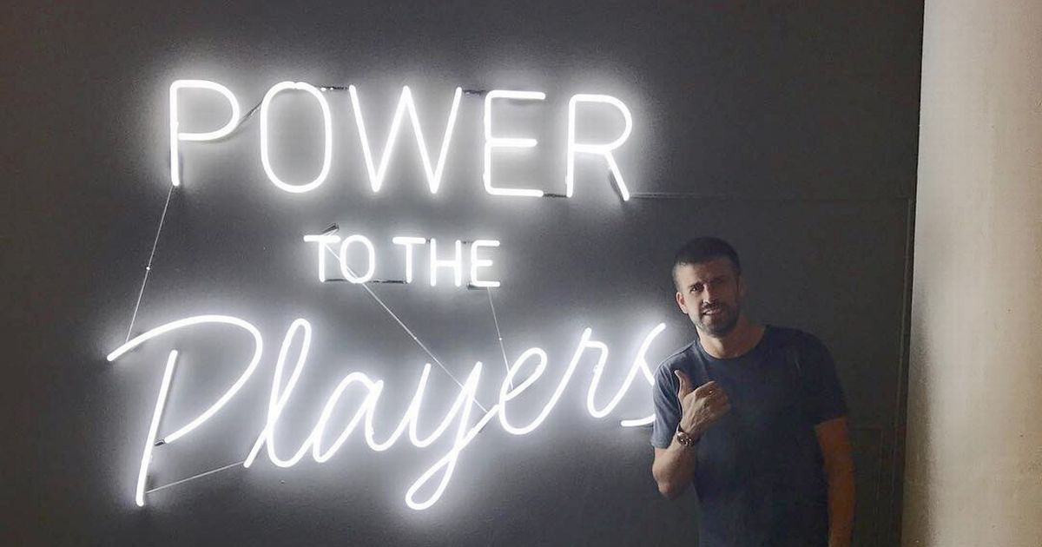

Slide 24
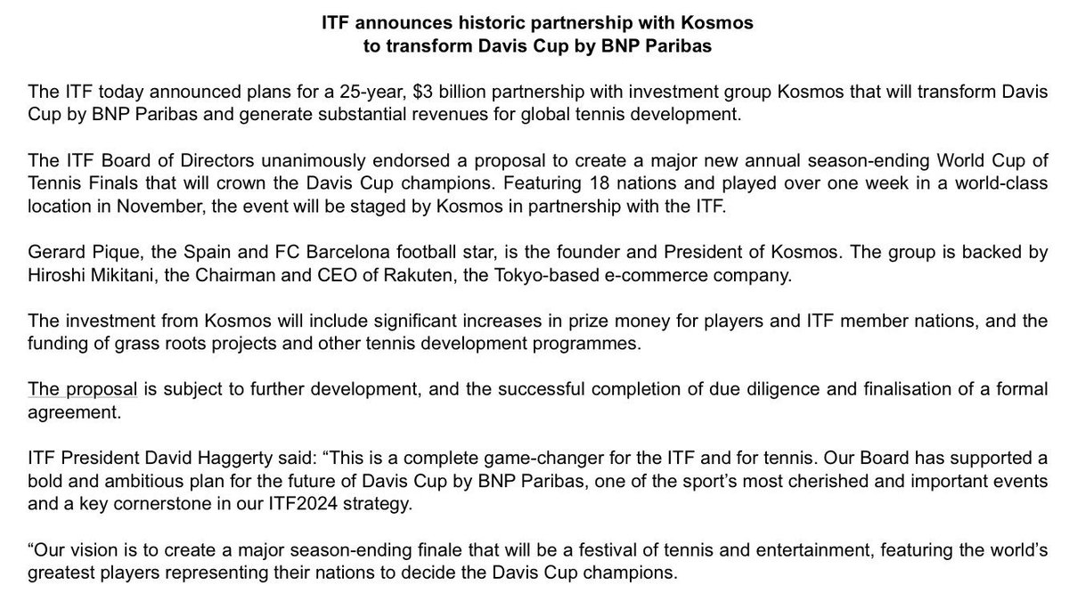

Slide 25

Sport Marketing Digest : Communication - Networks – Experiences – Brand
Relational Marketing
CRM – Ticketing – RP – Social Capital
« The Place to be »
Experiential Marketing
Entertainment BtC BtB CtC
« The Place to show the show »
Brand Management
Merchandising – branding
« The Place to express your brand »
Event Communication – Commercial Sponsorship
« The Place to leverage and activate »

Slide 26
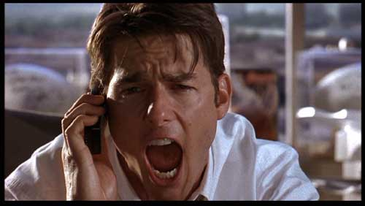

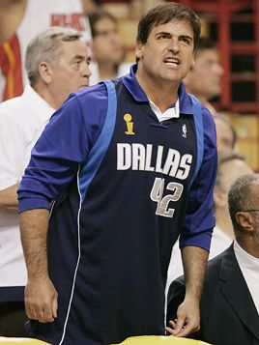
To be a value-added in sport business
Or american dream !
Business Marketing capabilities !

Slide 27
Competencie ?
Success comes from knowing that you did your best to become the best that you are capable of becoming. John Wooden
EXPERIENCE
Knowledge
EXPERTISE
Know-How
TEAM
Being
(know how to be)

Slide 28
Sport business market competencies
SALES : Ticketing, PR, Activations, Rights, Sponsorship, Negociation, Merchandising, Licencing, CRM (FRM), Place Management…
COMMUNICATON : Branding, Digital, Medias, PR
EVENT MANAGEMENT : Coordination, Project management, Suppliers management, Recruitment, Human organisation…

Slide 29
Program
/
Introduction : Sport Business Markets and Case Studies
1
Sponsorship Activation
2
Cause Related Marketing & Sponsorship Activation
3
Workshop / Coaching : Activation
4
Group Presentation
5

Slide 30

CASE STUDY 1
2006 - 2011
2011 - 2016
FUTURE ?

Slide 31
TICKETING
100 000
spectators
REPUTATION
SPORTAINMENT
FAN EXPERIENCE
GOALS
N1
INDOOR TOURNAMENT

Slide 32
Positioning
Servicing
Hospitality
General Public
Product*
Best Draw / Players
Experience
Entertainment
Fan Experience

Slide 33
ACTION
Tennis – Indoor
Number and games
time
Attraction
Stars
&
Show
“VOLUME”
Journey session
“DIFFERENCIATION”
Night session
Danger* !

Slide 34
Rentability
100K€ → 125K€
Innovation
Sportainment reference
Goals 2011-2016
Sponsorship ACTIVATIONS

Slide 35
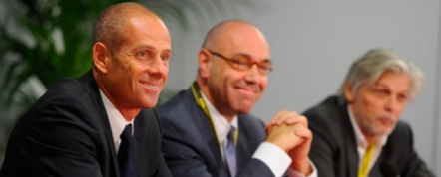
Competencies…

Slide 36
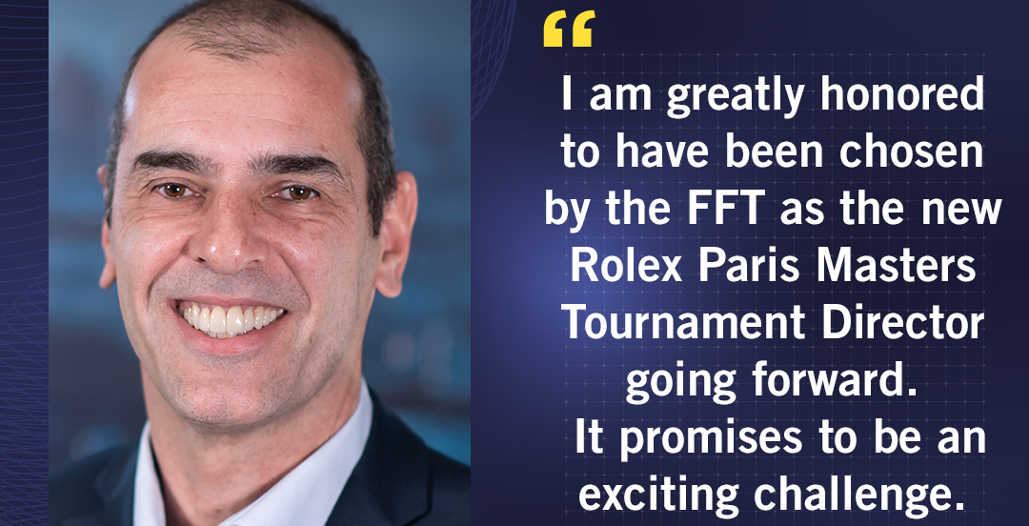

Slide 37
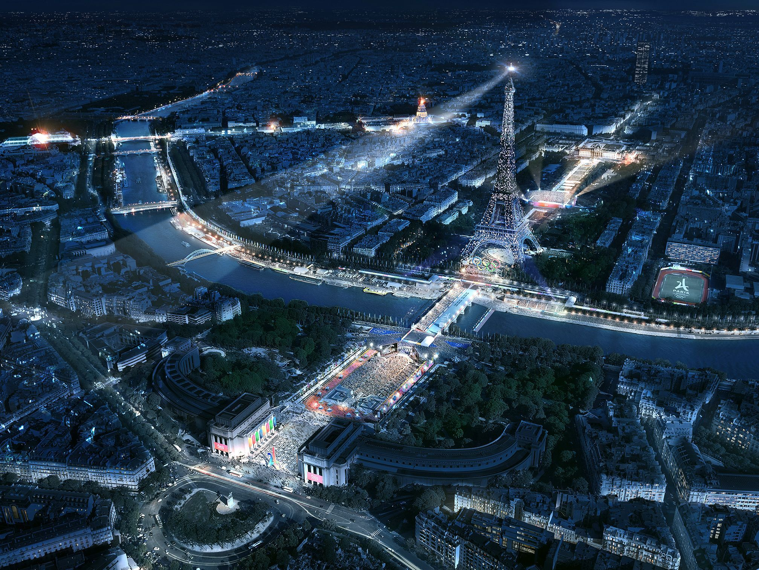



Slide 38


Slide 39

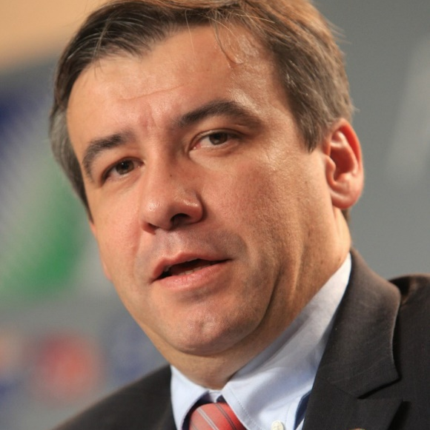
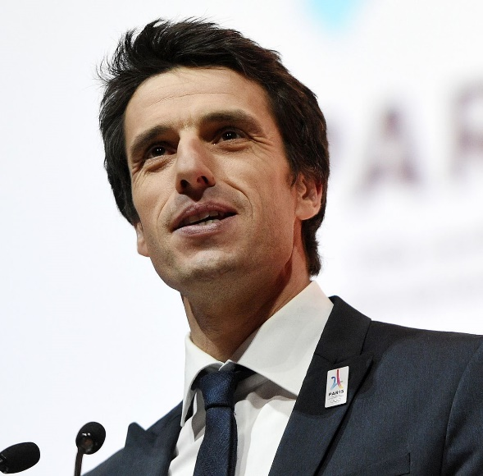
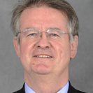
EtienneThobois
Tony Estanguet
Bernard Lapasset

Slide 40
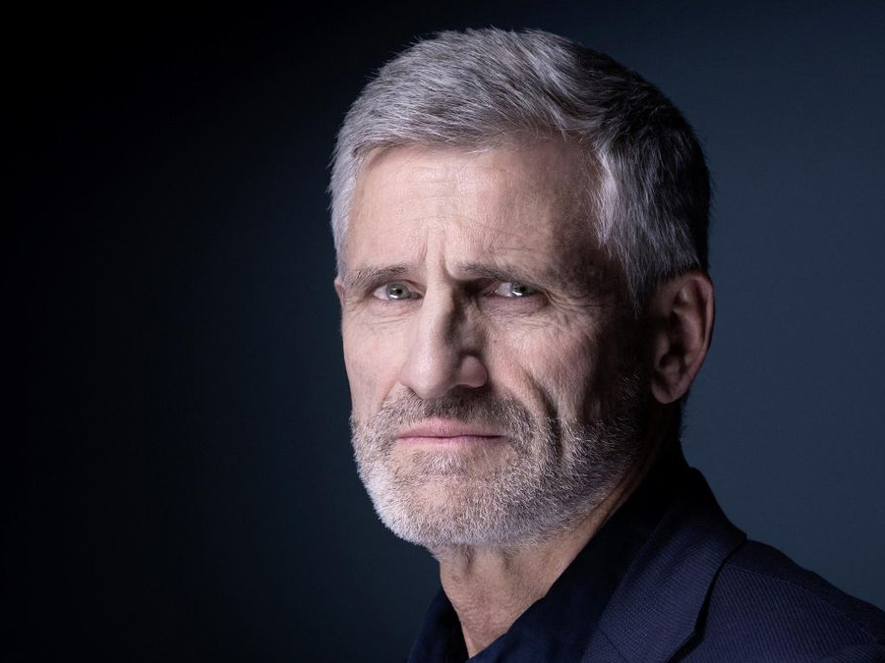
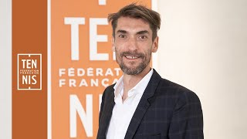
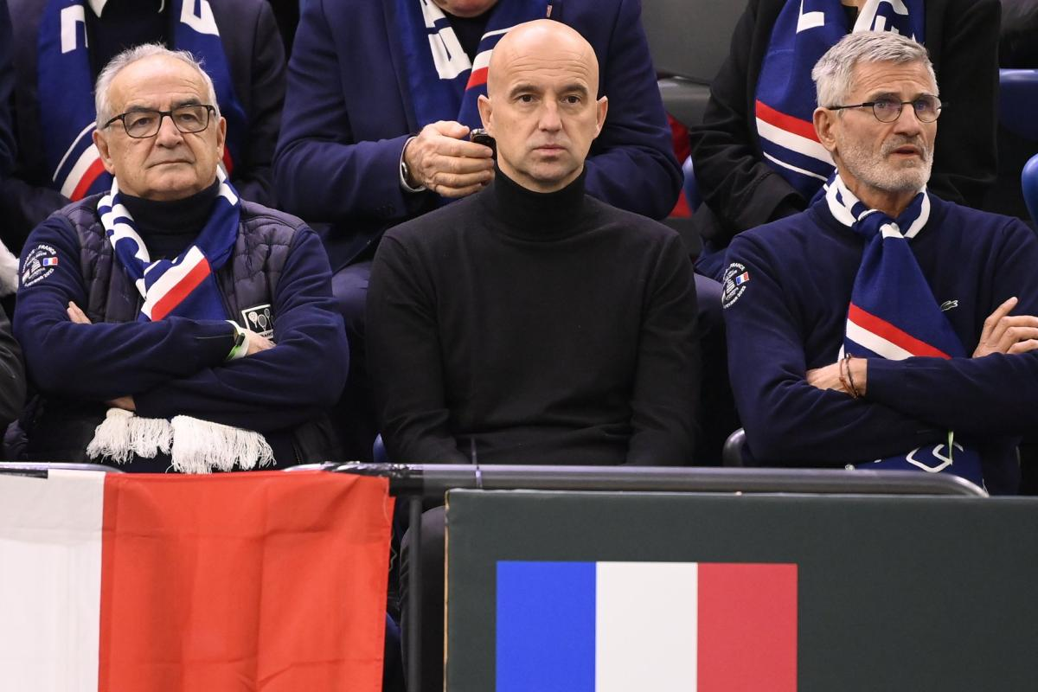
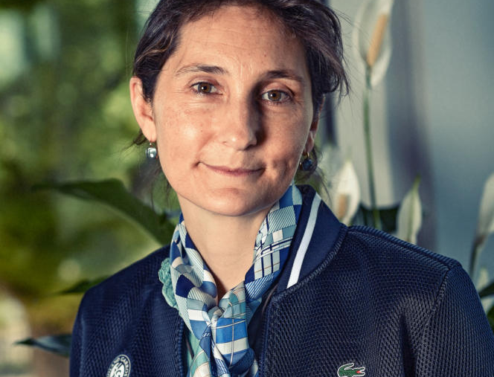
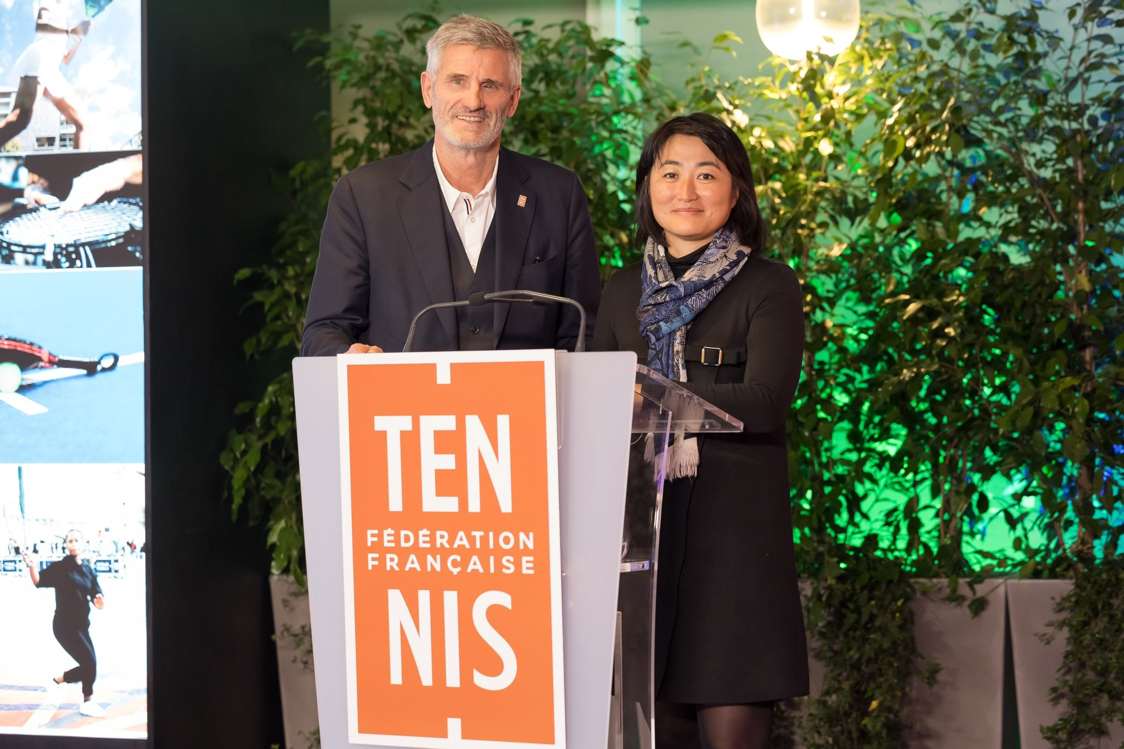

Slide 41
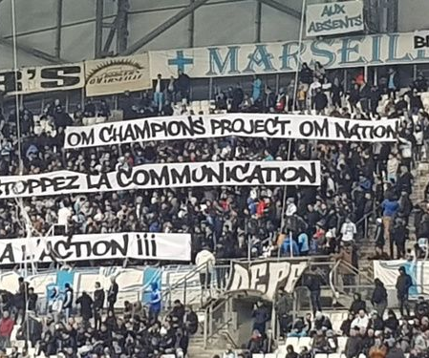

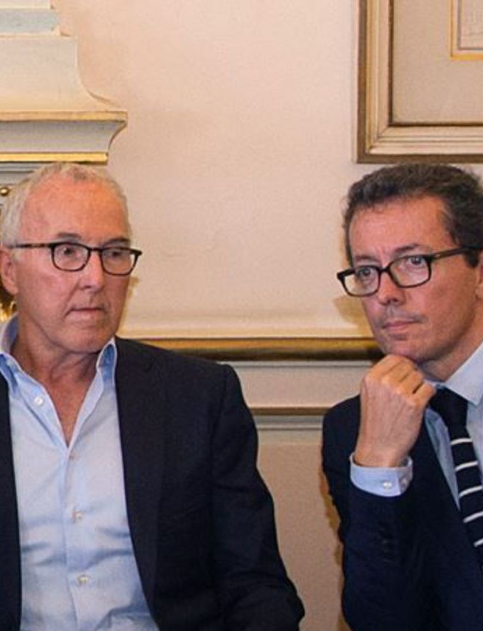
OM « Champion Project » ?

Slide 42
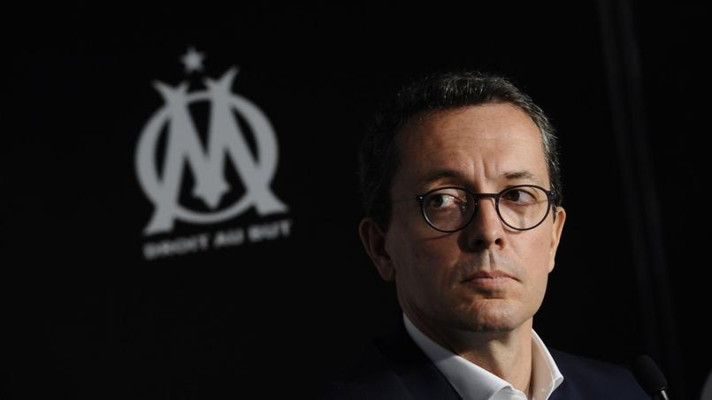
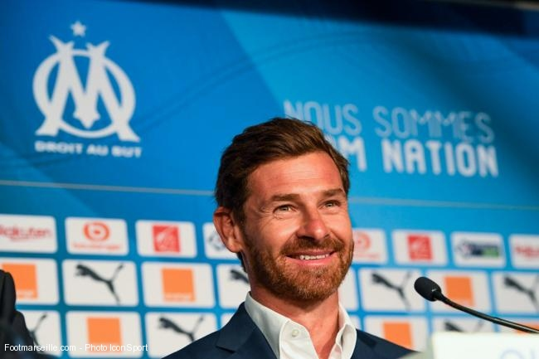
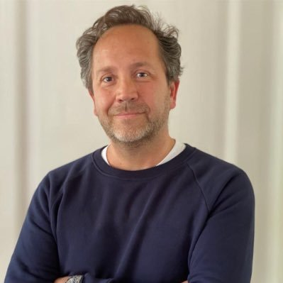
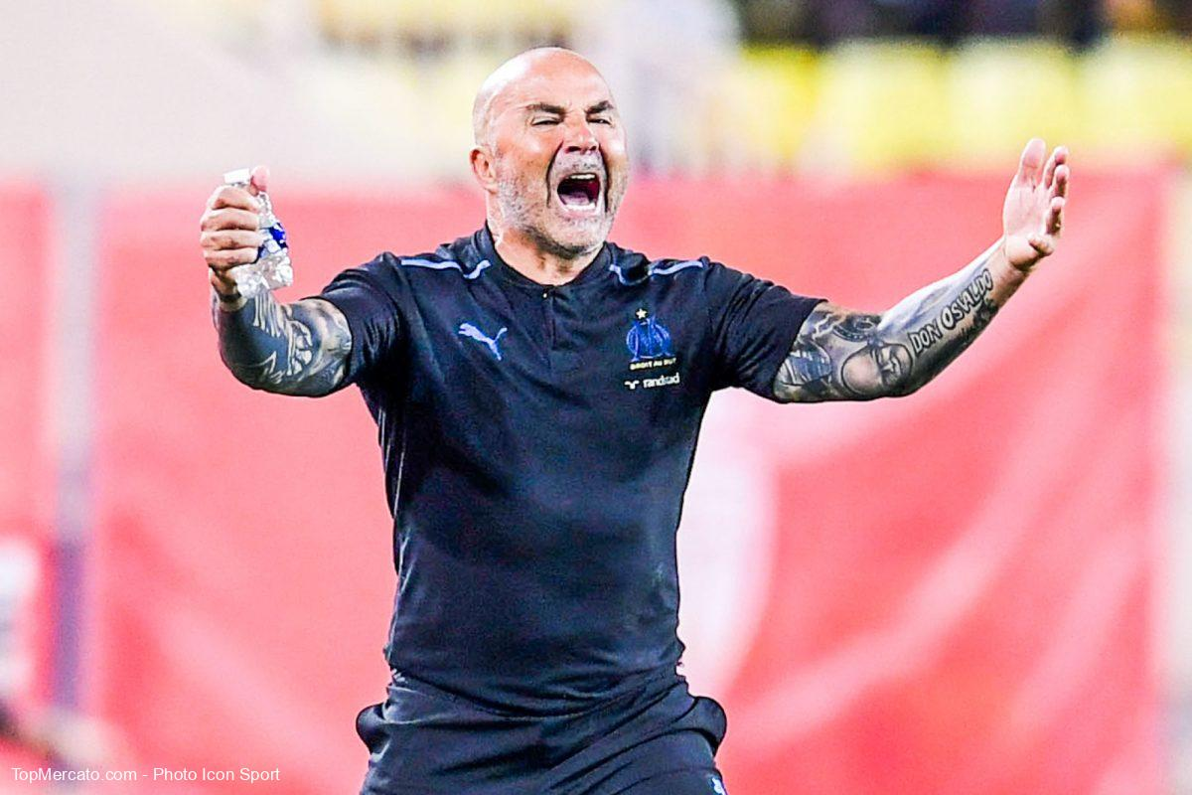
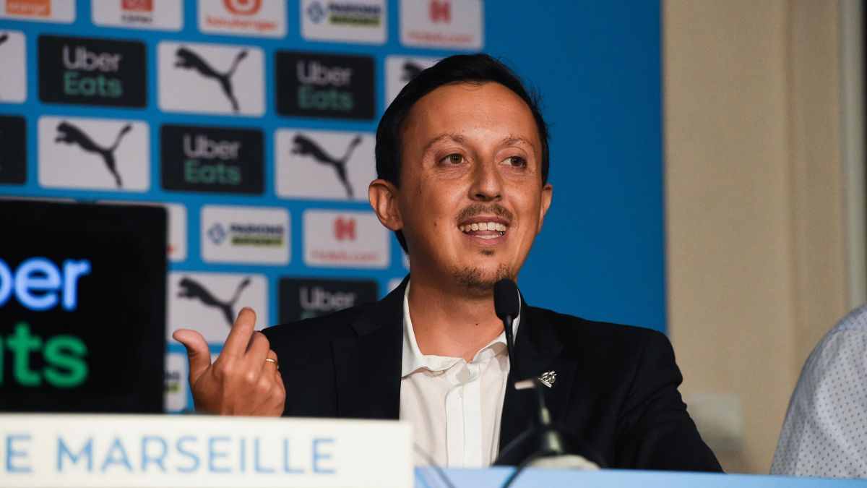
B
P
S
Pablo Longoria
Hugues Ouvrard

Slide 43
Business & Marketing Organisation
TICKETING
MS
FAN
GMS
BRAND
SV
SPONSORSHIP
HOSPITALITY
BK
BTB
SERVICING
AM
$
Tickets – Match Day Revenue
$
Sponsorship
Hospitality Events
$
Merchandising
Products

Slide 45


Slide 46



Slide 47
HOW DOES SPORT COMPARE TO OTHER INTERESTS?
– % of those ‘Passionate’ for each interest
% with Passionate in interests

Slide 49
Challenge
Introduction
Activation
Closing
Less « sponsorship as adverstising » and more « sponsorship-linked marketing » as authentic engagement
(Bettina Cornwell, 2019).
One of the key changes in the evolution of sponsorship has been the transition from “badging” (by sponsors) to “building”
(brand engagement and relationships) as the raison d’etre for sponsorship involvement
(Tony Meenaghan, Damien McLoughlin, and Alan McCormack, 2013).

Slide 50



