Slide 1
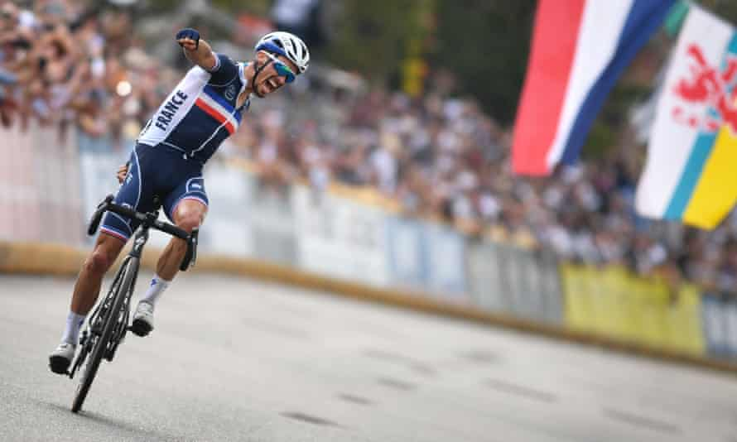
Commercial Business Strategies in Sport Organisations lionelmaltese.fr
@lionelmaltese
Lecture 2
Lionel Maltese
Maître de Conférences Aix Marseille University – CERGAM IAE Aix-en-Provence - #OIMS Laval University Canada
Associate Professor Sport Business Management Kedge Business School
Senior consulting sport business management
Twitter : @lionelmaltese

Slide 2
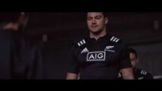

Slide 3
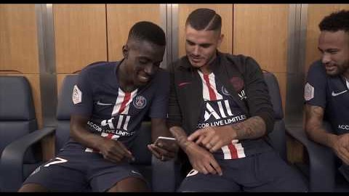
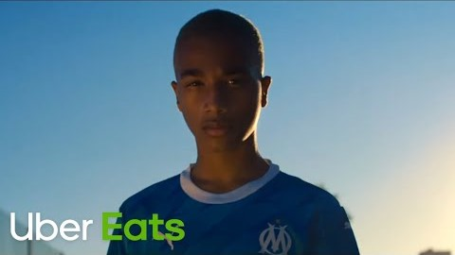
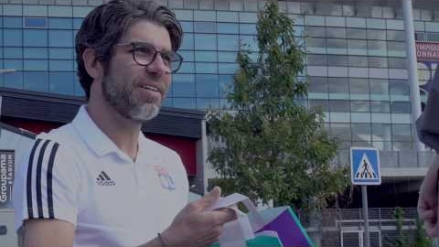
Competitive Advantage !
VS

Slide 5
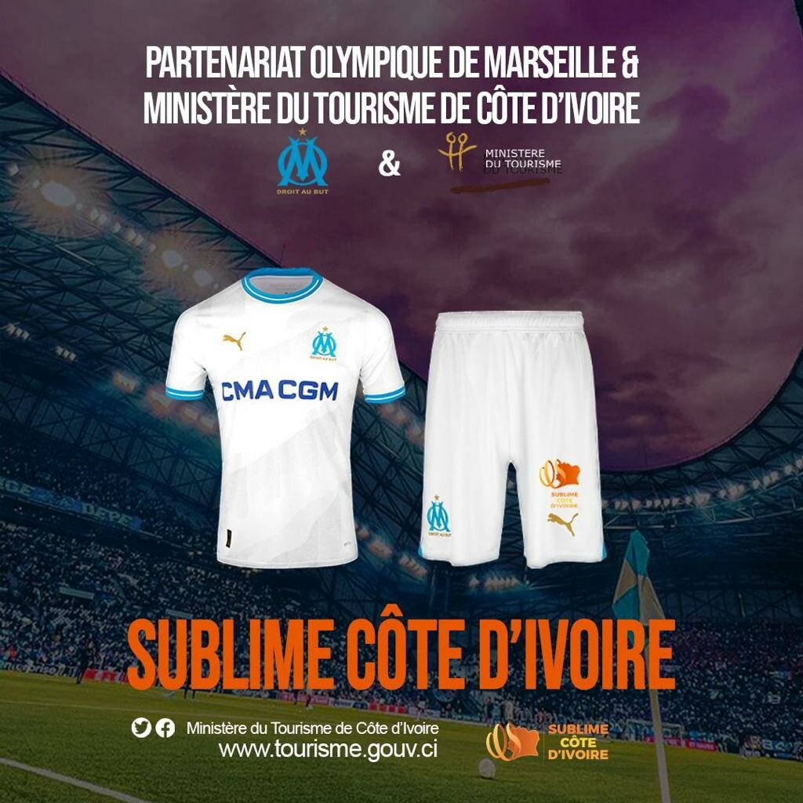



Slide 6
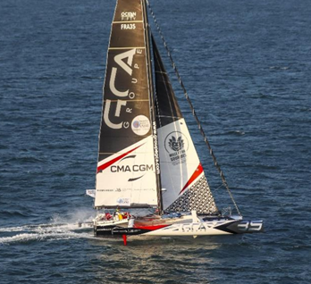
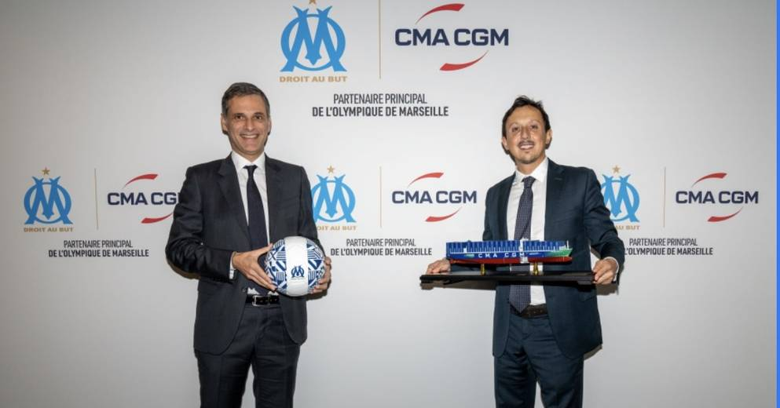


Slide 7
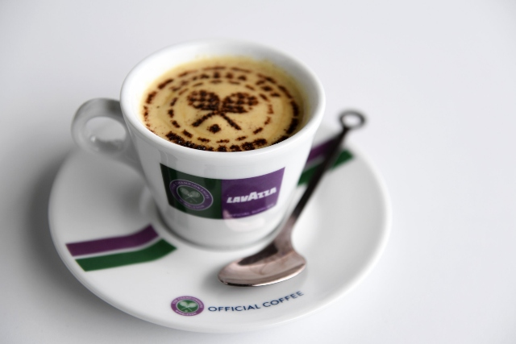
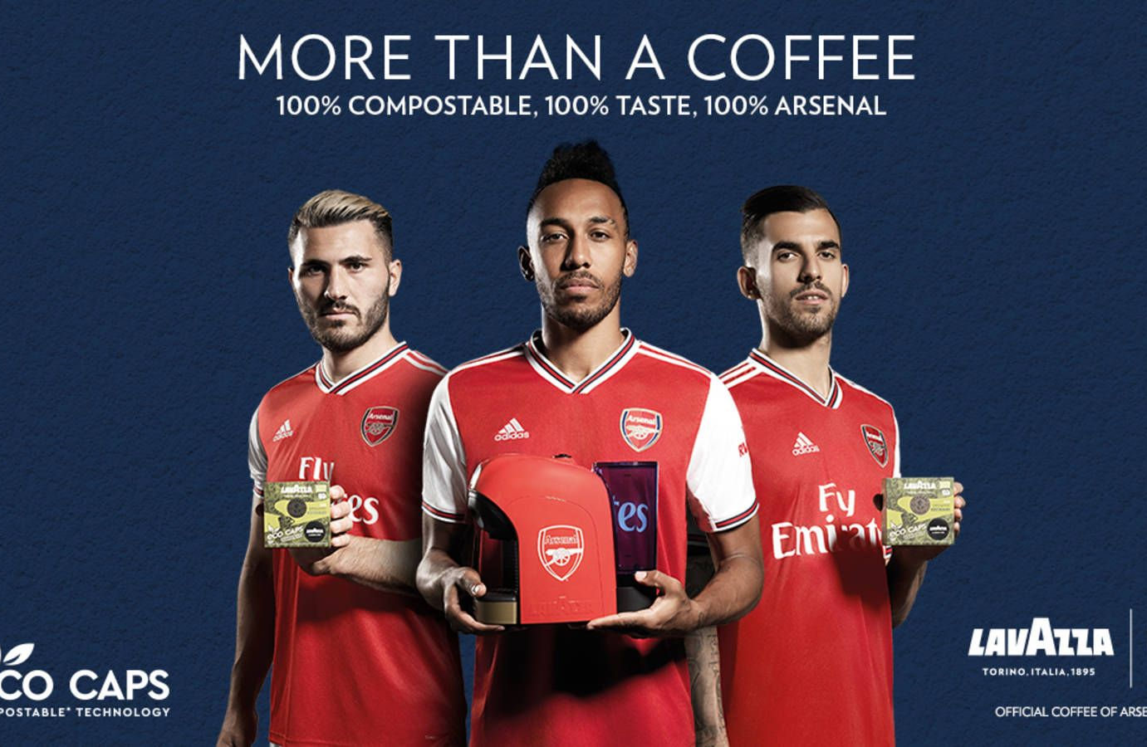

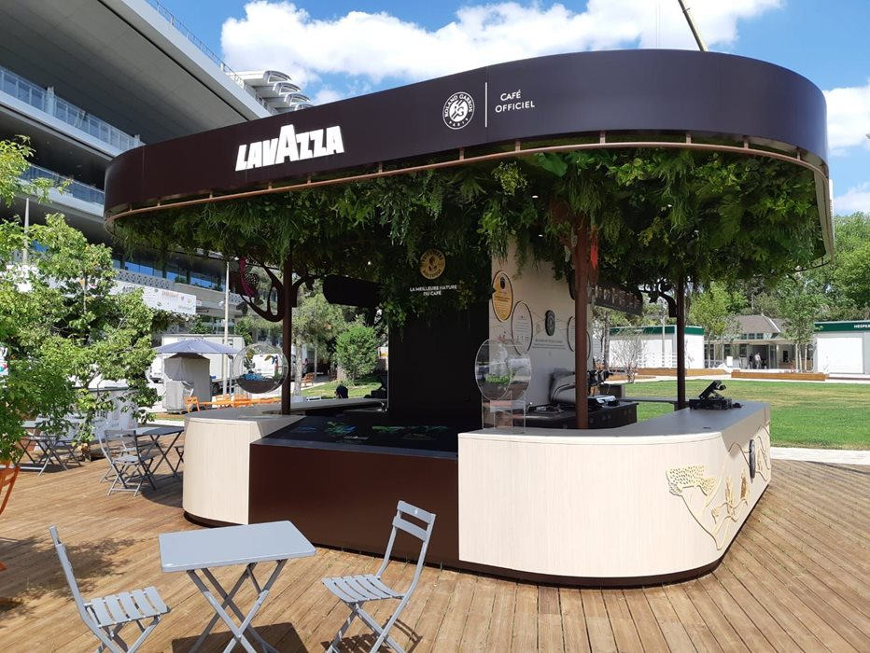
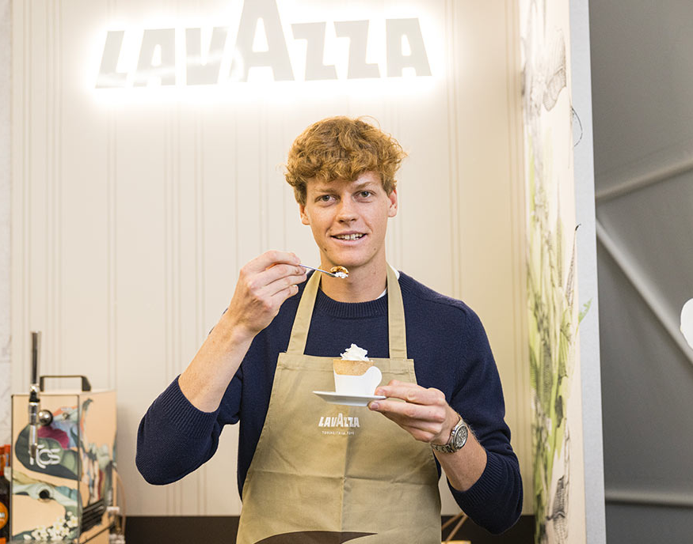

Slide 8
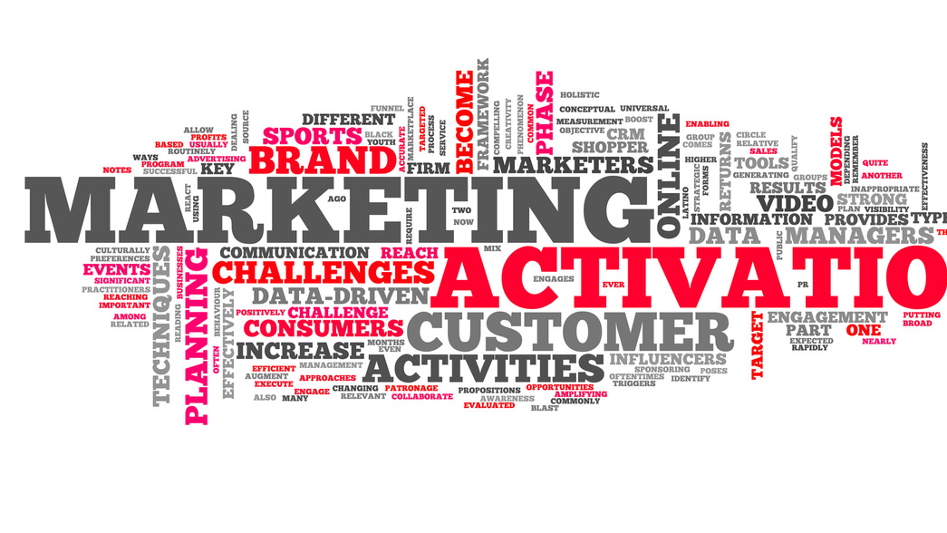
Our goals
As event or club manager : analyzing and producing a sponsorship activation programs
Operational approach :
  How to prospect for a new sponsor ?
  How to customize your sponsorsorship offer ?

Slide 9
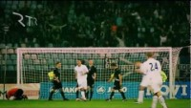

Slide 10
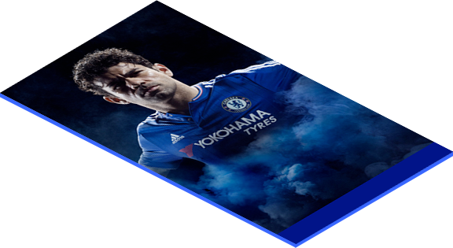
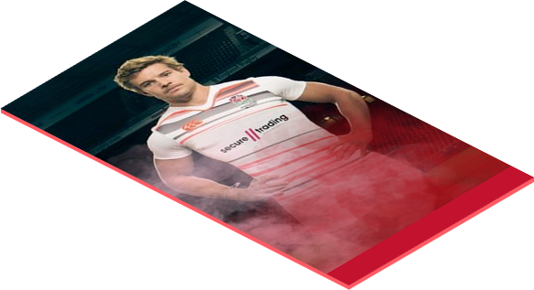

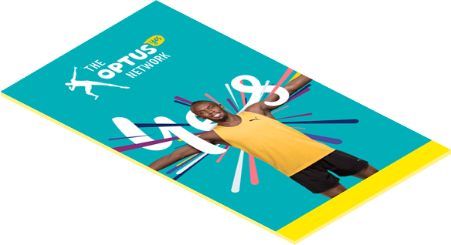
BE AN INSIDE

Slide 11
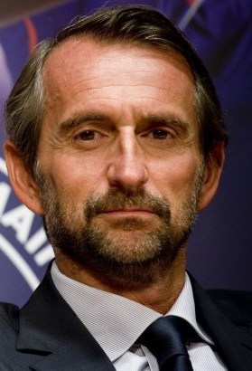
PSG’s commercial strategy Jean Claude Blanc
HOW DO YOU CHOOSE YOUR PARTNERS?
“Each club has its own commercial strategy, we have chosen to reduce the number of brands to increase their value and give them very strong exclusives. It is about visibility outside of field, the use of the players’ image, and access to the club’s digital platform or hospitality services developed year-round. We are looking for active partners, developing and aligned with our values. We are premium in terms of cost because of the fact that there are very few places to join PSG.

Slide 12

NOW TRENDING IN THE SPONSORSHIP WORLD
1
THE MARKETPLACE (AND RIGHTS FEES) CONTINUE TO GROW
2
SPONSORS HAVE A BIGGER VOICE (AND RESPONSIBILITY?) THAN EVER
3
BRANDS REQUIRE PROOF OF IMPACT – BEYOND EXPOSURE
4
COMMUNITY / ACTIVATION / ENGAGEMENT PLAY A CRITICAL ROLE
5
DIGITAL HAS CHANGED THE GAME
6
E-SPORTS AND OTHERS ARE CHANGING IT FURTHER
7
SPONSORSHIP IS MORE STRATEGIC THAN EVER
… BUT YOU ALREADY KNEW THAT

Slide 13
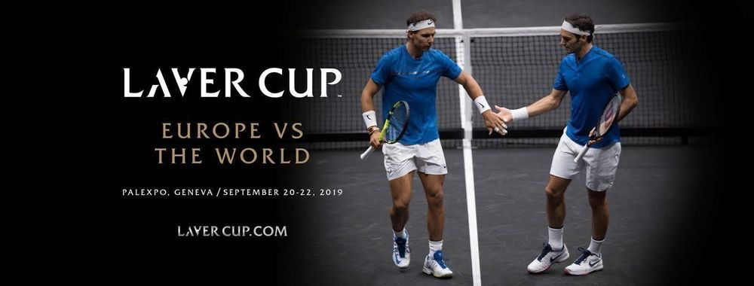
Storytelling / storyliving ? Endorsement & Sponsorship

Slide 14
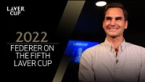

Slide 15
THE FUTURE OF DIGITAL SPORTS CONSUMPTION
– % of sports content via PC/Laptop or Mobile/Tablet

Slide 17

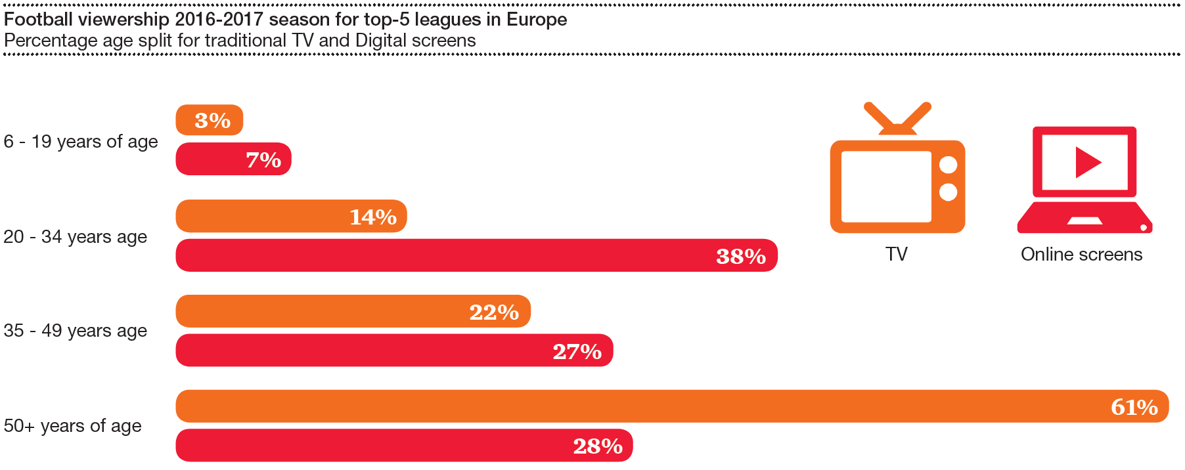
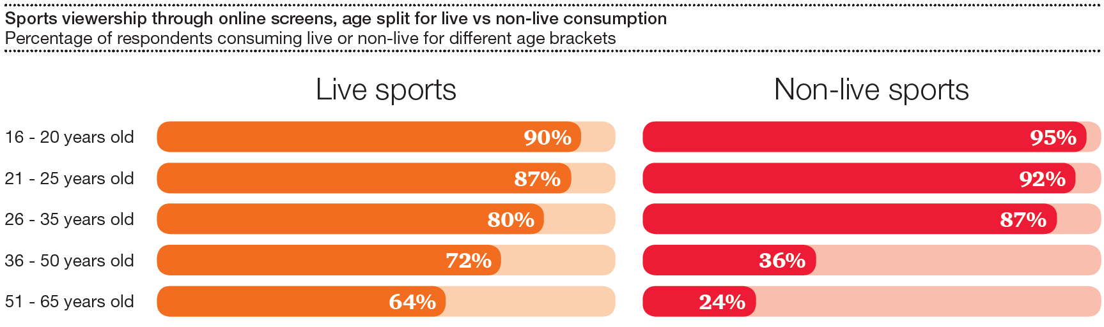
Is live dying of a slow death…?
Media
Data provided by:
IRIS - Intelligent Research in Sponsoring
0.1 Introduction: why are we here?
Contents
Sports Viewership through online screens, age split for live vs non-live consumption
Mobile, Tablet, Laptop, Desktop
Sports industry: lost in transition?
10
Notes:
The answer is clearly NO- it is not only about the channel
What you see here is sports viewership on online screens, split by type of content and age
Good news: live is still relevant ! 90% of 16-20 watch live sports on online screens !
64% of 50+ also do so… which sounds like all positive: even older generation is changing
BUT HOLD ON: When you look at non-live, the message comes with a TWIST…
50+ don’t really watch non-live on online… seems they replicate online what they used to do on traditional TV: tune-in, watch, then tune out after 90mins
<20 is different: they tune in to watch live, but still consume a ton of non-live sports… what does this tell us?
1. there is as much media value in live as there is in non-live sports (at a minimum)
2. HOWEVER, younger generation do not consume with the same degree of concentration, hence their need for non-live…
As reminder.
74% of 2nd screen content they is unrelated to what they are watching on TV
So, during half-time or any boring moment of the match, they will tune out…
What des this tell us?
If you wanna be a winner in the race for live spectators
innovate on and off the pitch
integrate the variety and personalisation of on-demand within a context of live consumption, all while
ensuring a seamless transition into the conversations taking place on social media
FOCUSSED Vs. DISTRACTED
Older generations still consuming live online, but not the case for non-live (similar to traditional channels: tune in to watch entire broadcast → satiated by live)
Younger generations: picture very different (more non-live than live online: engaging with sports content differently: YouTube, social media platforms, etc.)
E.g. TV viewers in US: 70%+ use 2nd screen while watching (91%+ using smartphones, 74% of 2nd screen content they is unrelated to what they are watching on TV.
U-35: watch live in a more distracted manner, and for shorter durations than O-35, or only tune in for most premium, socially engaging, must-see content (threshold up)
Display IRIS graph of live Vs. non-live: key messages = not clear if shift is in type of content consumed or through which channel; 64 per cent of people above 50 watch live sports through online screens, demonstrating that the older generation is adapting to new ways of consuming live. As for non-live content, however, only under a quarter of those above 50 consume them online; so older people consuming sport in a similar way offline as online (take time to watch full broadcast live); our view is that going forward, the winners in the race for live spectators will be the ones innovating the most on and off the pitch, integrating the variety and personalisation of on-demand within a context of live consumption, all while ensuring a seamless transition into the conversations taking place on social media

Slide 18
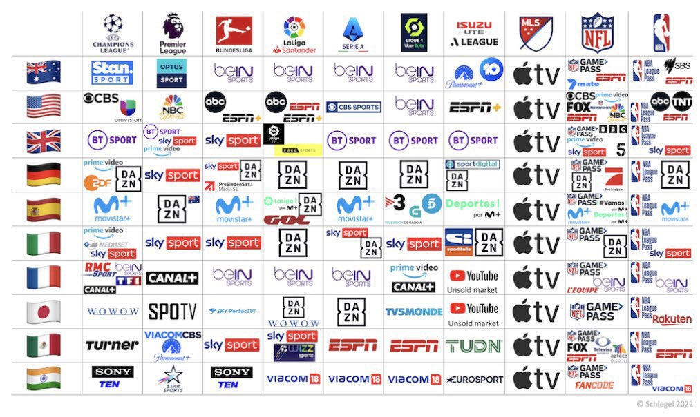

Slide 19
Key trends: what is the market telling us?
Overall state of the industry: key threats
Type of content
Consumption channel
0.1 Introduction: why are we here?
Contents
Media
Expected growth of content and channel going forward
Sports industry: lost in transition?
11
Notes:
We also brought this dichotomy of type of content vs channel of consumption to our respondents
We’ve asked to tell us how they expected consumption of content to grow going forward
Highlights or other type of “on demand” came up on top
→ the best format for mobile, online and short-form
→ makes it clear how important to produce appealing content for before and after (not only during)
The bedrock of sports media (Live) comes in second
UGC 3rd and 4th: teams and fans… AUTHENTICIY front and center… so more to see from the likes of COPA90
In regards to channels
Digital on top –headed by Tech
→ Significant noise they have been making the rights market
→ Seems to confirm the industry sees them as the ones that will potentially replace traditional pay and FTA
because of their ability to use sports as a way to keep a growing user based loyal and engaged….
We’ve now looked at Media… but what about sponsorship?

Slide 20
Annual growth rate by revenue stream in next 3-5 years
Growth & threats
0.1 Introduction: why are we here?
Contents
Digital media rights
Sponsorship & advertising
Licensing & merchandising
Participation fees
Ticketing & hospitality
Traditional TV rights
16.6%
11.5%
10.1%
Overall
8.8%
9.2%
8.5%
7.8%
7.0%
5.5%
6.3%
4.8%
4.4%
3.8%
3.2%
0.9%
0.9%
0.3%
-0.1%
o%
-2.7%
Sports industry: lost in transition?
6
Notes:
We also looked at growth in terms of revenue streams-
To cater for transition from traditional to digital, we have split DIGITAL from TRADITIONAL TBV rights…
respondents expect
11.5% for Digital media rights
Over 3.5 times higher than traditional TV rights
Note that many people expected traditional TV rights to decrease, hence the range starts in the negative zone…
Sponsorship at 5.5%
Interestingly enough, if you consider overall expectations at 7%... Seems most people expect that growth is over-proportionally coming from to Digital Media

Slide 21
SPONSORSHIP SALES
– Sector stabilisation returns
1
FINANCIAL SERVICES most volatile, but stabilising
2
BEVERAGE SECTOR on the rise
3
AUTOMOTIVES slight decline, still top 3
4
TELECOMS steady decline since crisis
Trend analysis by sector

Slide 22
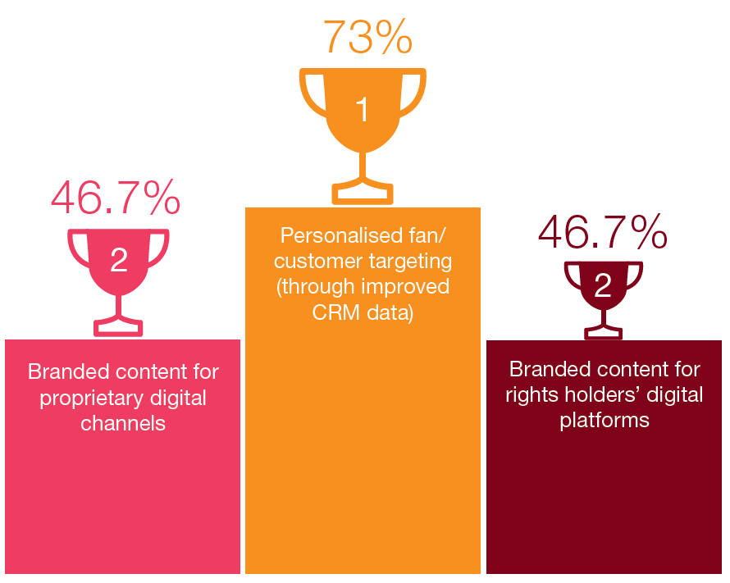
Key trends: what is the market telling us?
Overall state of the industry: key threats
0.1 Introduction: why are we here?
Contents
Sponsorship
Top 3 areas of focus for sponsors to drive ROI
Sports industry: lost in transition?
13
Notes:
We’s asked responds to tell us what is top priority going forward to generate value from sponsorship:
It’s all about personalisation of content and knowing your fans:
The end game is to integrate data from multiple touchpoints (social media usage, ticketing, merchandising, etc.) in order to build fan profiles which will facilitate real-time targeting;
branded content’s comes in twice here: and exactly with same results: branded content for own platforms and for that on rights holders
What does this mean?
Creativity and authenticity are the way…
The importance for sponsors to access athletes’ and teams’ personalities, their stories and their values, and, last but not least, their fans !
What does this tell us about the very structure of sponsorship?
I think, we will be experiencing a “split” within sponsorship as we know it today… today’s sponsors, will either become “partners”… or “advertisers”…
Partners will place their focus on these items: personalisation, branded content – all about engagement
Advertisers will use sports as a way to get their brand outs… and Virtual Advertisement will make that possible

Slide 23
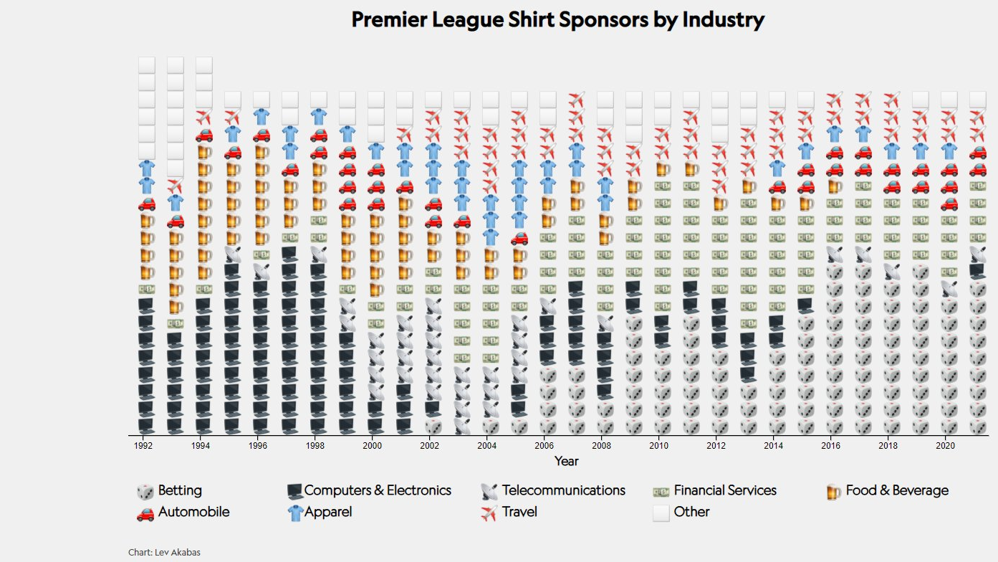

Slide 27

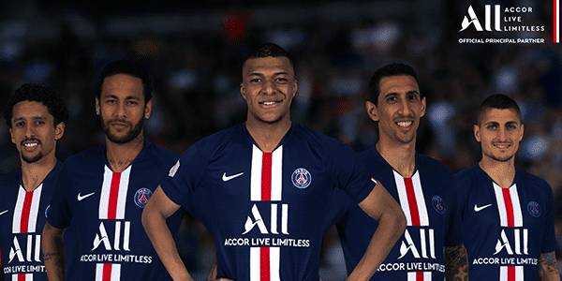
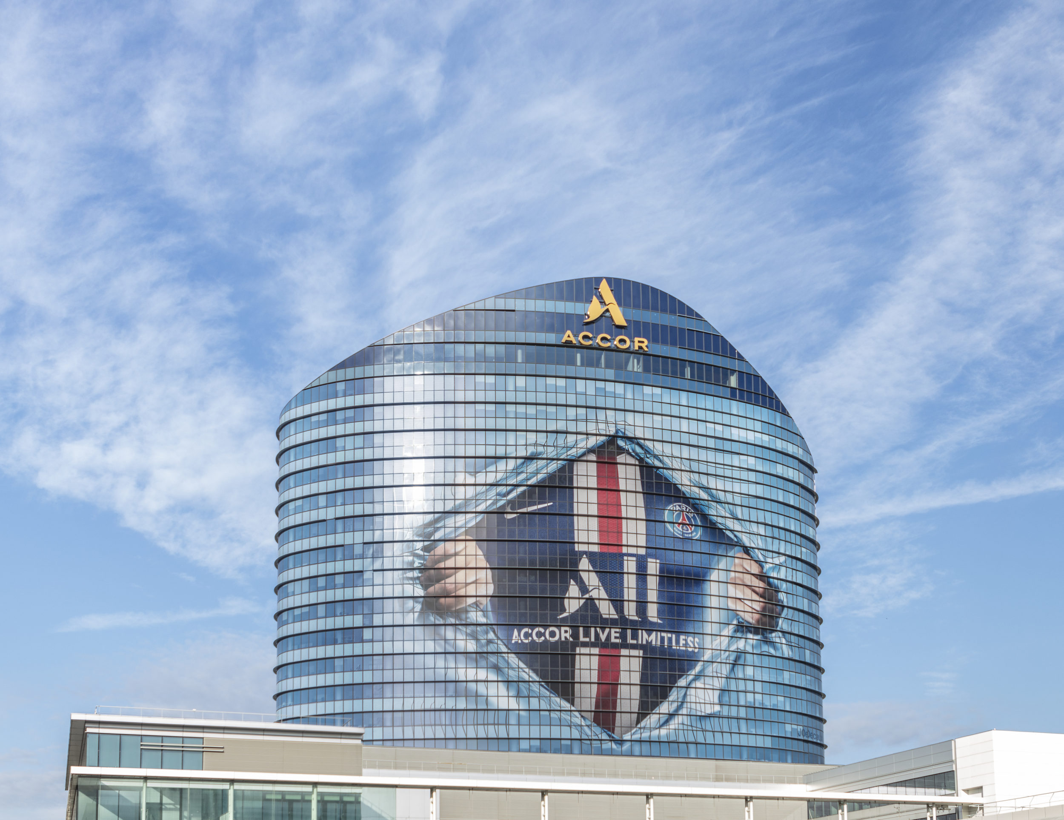
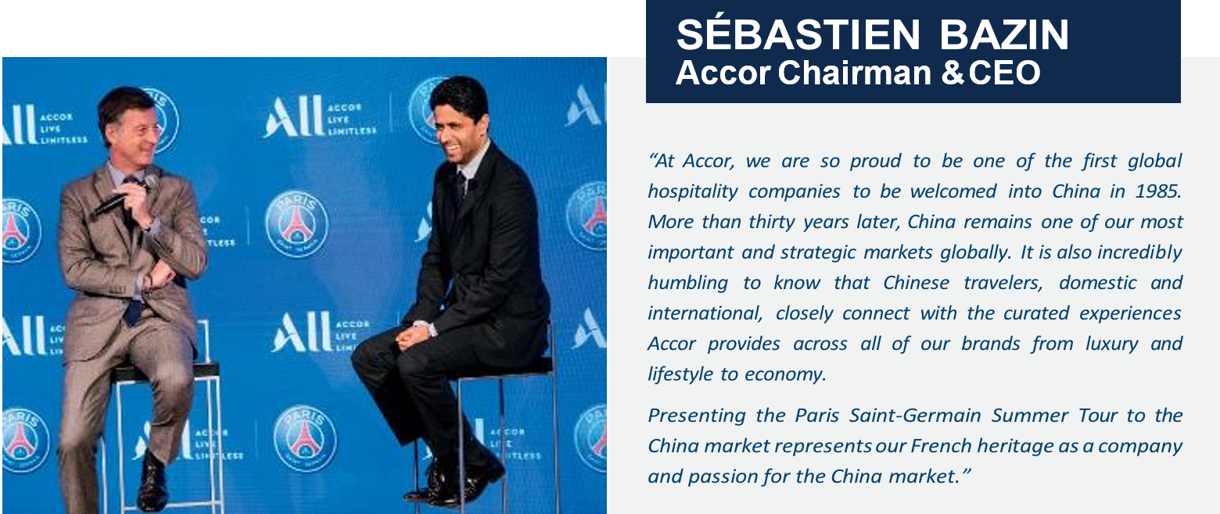
PSG = 395 M Followers + ACCOR = 265 M Customers

Slide 28
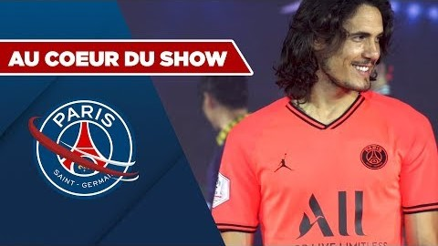
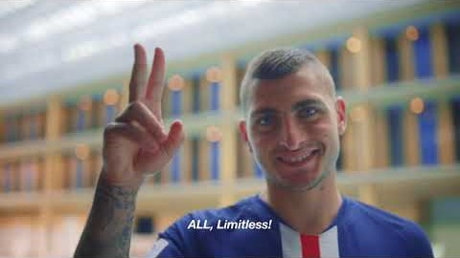
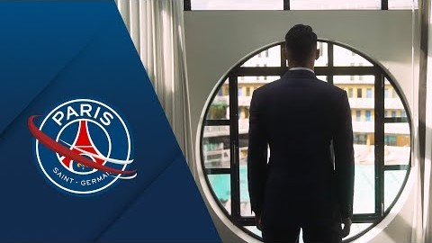

Slide 29
Sponsors goals
WHY
Top of mind (notoriety), image, reputation !
Increase sales / product ou service placement
CRM, Prospection
Internal communication
Connect the fans to the brands
HOW
Media – Social Media – PR
On site marketing operations
PR (BtB & BtC)
PR
Activations

Slide 30
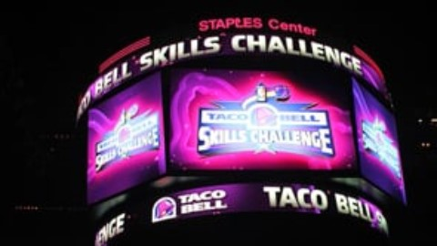

Slide 31
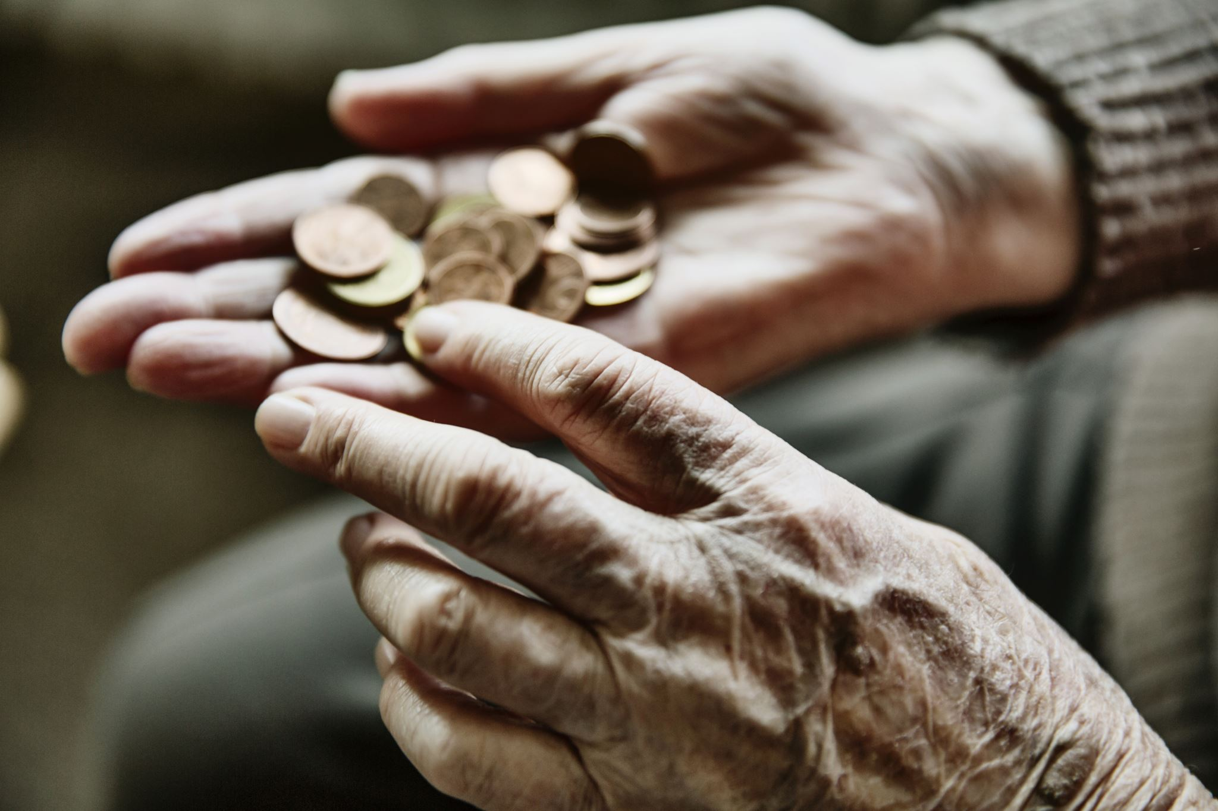
Definition
Provision of assistance either financial or in kind to an activity by a commercial organization for the purpose of achieving commercial objective (Meenaghan, 1983)
Sponsorship involves two main activities (Cornwell and Maignan, 1998) :
  Exchange between a sponsor and a sponsoree whereby the latter receives a remuneration (cash or in-kind contribution) and the former obtains the right to associate itself with the activity sponsored
  Marketing of the association by the sponsor

Slide 32
Sponsor support : financial or not
SPONSOR
Firm, non profit organization, institution…
SPONSORED
Entity : individual, group, oragnization, event…
Area : sports, arts, environment..
Benefits for the sponsor : achieve communication objectives
Media
Sponsor
target
Sponsored
Target
PUBLIC

Slide 33
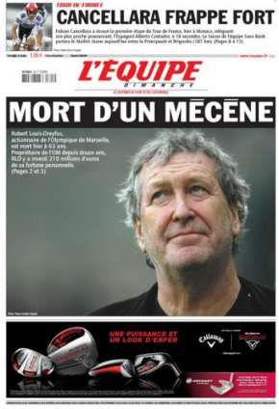
Sponsorship strategic approaches
Passion : executive passion for sport (« President dancer ») : RLD, Kampf, Weber, Lagardere…
Opportunism : business project using sponsorphip potential : Sodexo, Veolia, Vinci, Eiffage, Bouygues, Thomson & PSG…
Strategic : sponsorshsip integration into a global brand strategy : We all speak football, We are tennis…

Slide 34
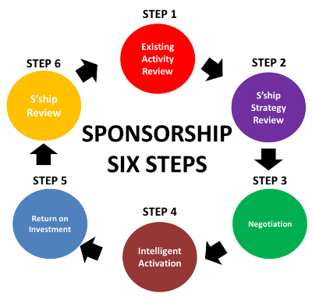

Slide 35

In the real world
→ 75 % : Executive meeting and individual introducing
2 personalities
Actor games
Serendipity capability
→ 25 % strategic process / brand strategic management

Slide 36
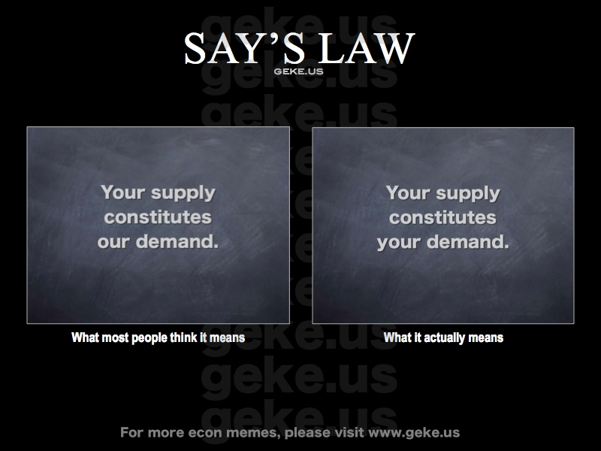

Slide 37

Mega event & the rest
Demand > Supply
Best clubs and events
Sponsor selection
Financial optimization
Open call - closing
Demand < Supply
Others clubs and events
Customization
Prospect
Introducing + closing

Slide 38











Make the difference
Competitive advantage
Not only visibility !
Reputation !
Visibility
+
Sensemaking activation to create a difference

Slide 39

The Place to leverage and activate
Sponsorship leverage can be defined as “the act of using collateral marketing communications to exploit the commercial potential of the association between a sponsee and sponsor.”
Activational communications (or activation) can be described as “communications that promote the engagement, involvement, or participation of the sponsorship audience with the sponsor”
(Weeks, Cornwell & Drennan, Psychology & Marketing, 2008)

Slide 40


Slide 41
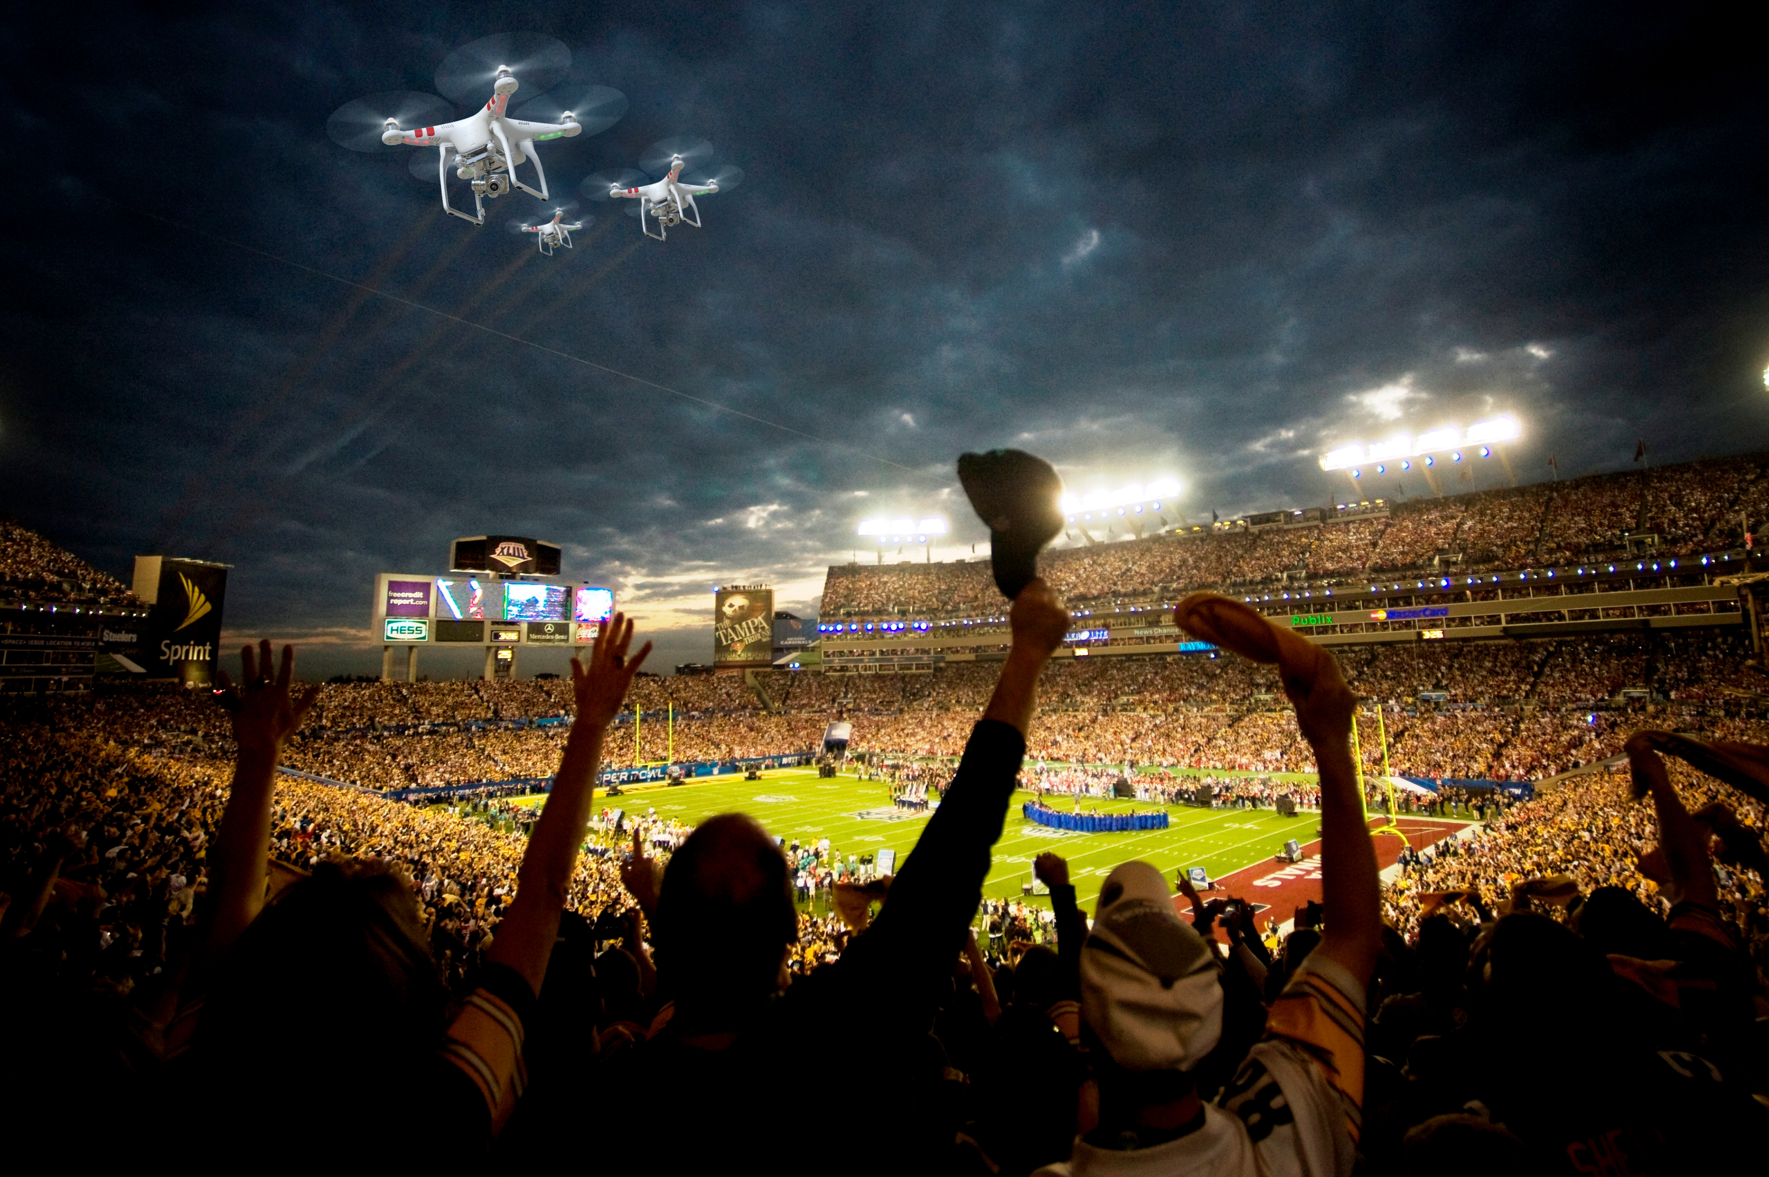
ACTIVATION
« Connect the fans to the brands »

Slide 42
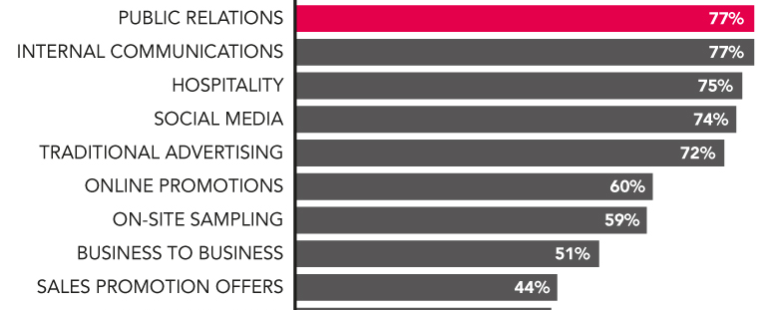
Which of the following marketing communications channels do you use to leverage your sponsorship programs ?

Slide 43
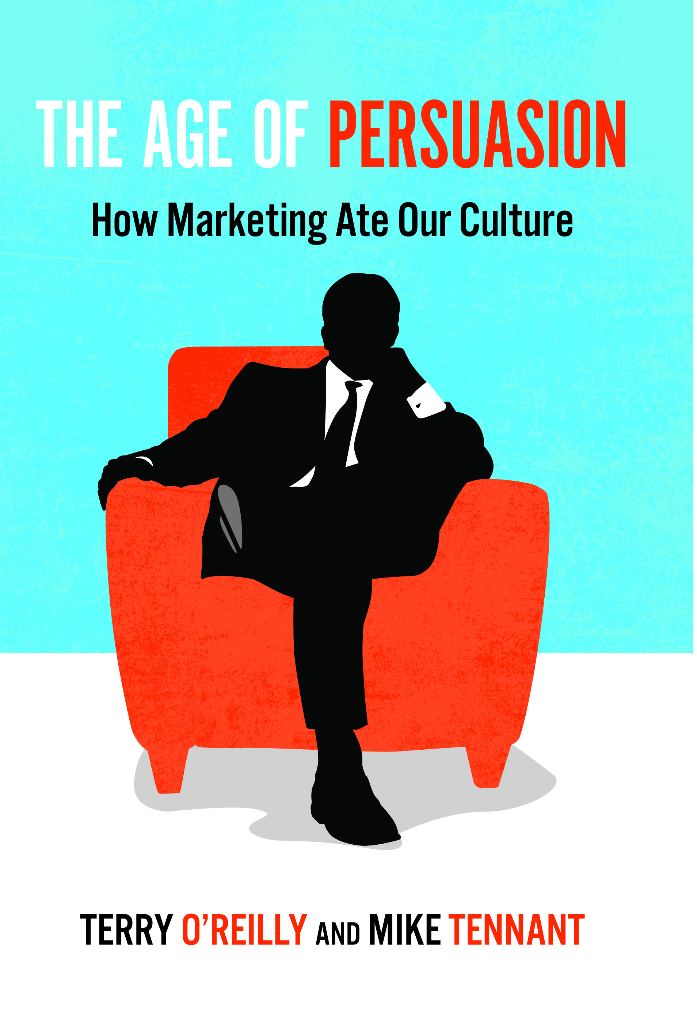
Promotional strategy
Any form of communication used to inform, persuade or remind about company products and services (Keller)

Slide 44
Activation axis
Sponsorship –
Event Communication
Visibility
Relational
Hospitality
Entertainment
Experiential
classical
CRM
Services Marketing
Experiential Marketing
innovationt

Slide 45
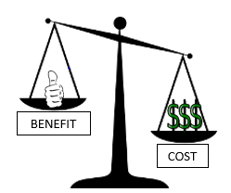
Activation tools
Billboards
Printed
supports
Cause Related
Marketing
Scoring
Referees
PR
Media
Supports
Web Marketing
Web 2.0
Fans
Objects
Special Events
Human
Supports
Mobile
Maketing
Stands
Naming
Seminars
Conferences
Games
Official
Supplier
Branding
Visibility
Relations
Experience
Engagement

Slide 46
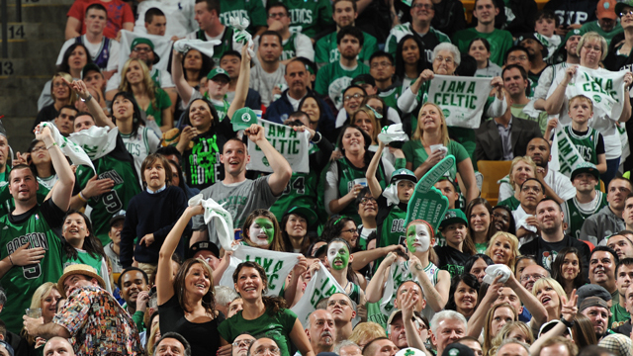
SPORSORSHIP ACTIVATIONS MODEL
V R E E
VISIBILITY
ROI
RELATIONS
ROO
EXPERIENCE
ROO
ENGAGEMENT
ROI ?

Slide 47
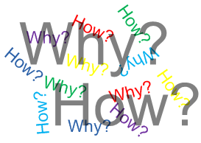
So what ? How to Implement ?
Back to the basics :
WHY ? : targets, visibility, value, internal communication,… [needs + sponsors goals]
HOW ? : activation tools panel [answer needs + objectifs]
= your JOB !

Slide 48
Agencies… or not !
Sport Marketing
Agencies
Club / Event
Sponsors
Need
For
Competencies
Commercial
Sponsorship
Direction

Slide 49
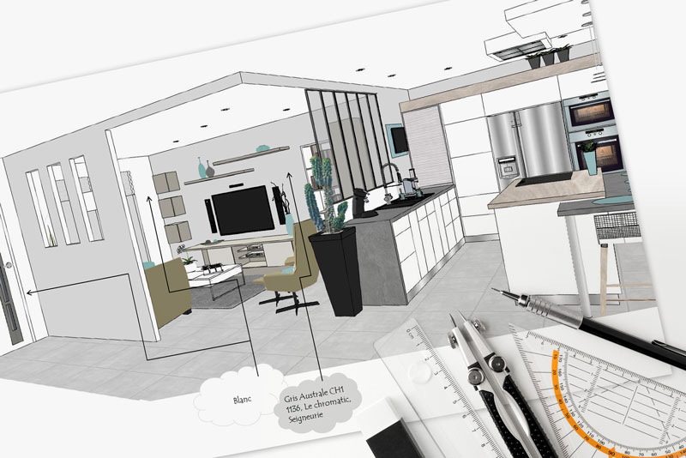




Slide 50
Activation program process
4. Evaluation ROO or ROI
3. Activation - Action
You are on the field
5. Evolution –
Dynamic program
Loyalty
2. Customize your offer
Sensemaking proporsals
You are not a prof !
Using 3 packs (light – medium – gold)
1. Prospecting – Analyzing - Spying
For a new sponsor
Special individual access and information
by your top management or owner

Slide 51

Value Proposition and Activation Platform
Interactional Typology
ACTIVATIONS
Visual
Interactions
Relational
Interactions
Experiential
Interactions
Engaging
Interactions
AUDIENCES
VISUAL CONTENTS
Optimize your media/digital/in stadia exposition
Visual Dilution
HUMAN CONTENTS
« PR » / ex Champions / Premium
Relationship Volume
FESTIVE CONTENT
Specific animations/ Enlargement & reinforcement
Experiential Imbalance
EMOTIONAL CONTENTS
Common brand content/sport authenticity
Forced Wedding

Slide 52
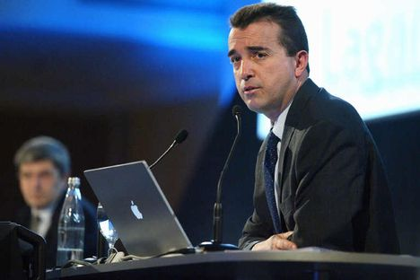




CEO personnality « passion » activation

Slide 53

Basketball competition and free practice
Open area for a general public
Elite championship 5*5
8 cities in Europe : Lyon, Paris, Cologne, Munich, Madrid, Barcelona, Milan, Roma

Slide 54

Visibility activations :
  Street marketing , flyers, printed supports, TS staff.
  Staff + presents for players
  Court: 16 m billboards, wall ITW, tents.
Sensemaking activations »:
  Champion of the Court : 1 vs 1 (300 - 350 players per day)
  2 targets : elite – teens (streetware)

Slide 55

Visibility activations :
  Printed supports logo
  Staff with Nike (shoes) – Winners (shoes)
  Court : 10 m billboards
Sensemaking activations »:
  Nike – 3 point shootout
  Stand for shoes
  Jordan Camps recruitment : buzz

Slide 56

Visibility activations :
  Printed supports logo
  Referees / Foot Locker clothes
  Court : 10 m billboards
Sensemaking activations :
  Flyers + website NBA jam 06 : Foot Locker shop to get your ticket to play
  Game « Foot Locker 10 000€ » : shoot from the center of the court.
  Promotional coupons for players and winners

Slide 57

Visibility activations:
  Printed supports logo
  EA Sports Lounge area
  Court n°2 : EA Sports 10 m billboards
Sensemaking activations
  NBA Live 07 video game promotion with stands
  Virtual tournament : European finals (finalists : match Suns / Sixers – Winners : All star Game invitation in Las Vegas 07)

Slide 58

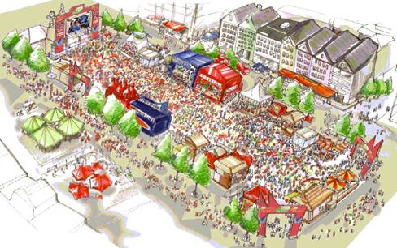
Fan Fest

Slide 59

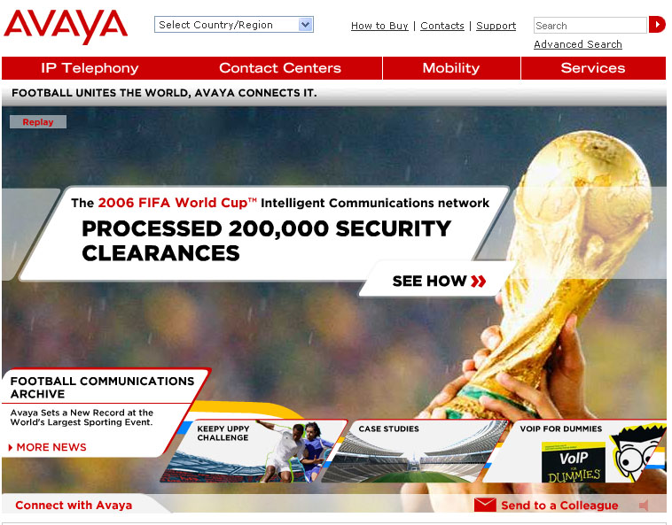
Communication services supplier
Visibility activation:
  Field : 2-4 billboards 8*6.50 m
Sensemaking activations
  Website : official facts – news – products
  Promotion services Voice over IP : press, media…

Slide 60

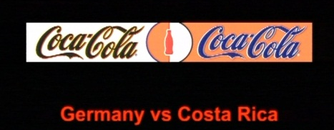
Powerade official supplier ‘energy drink’
Bonaqa official supplier « water »
« We all speak Football » campaign
Visibility activations :
  2 à 4 billboards
  Visibility using teams colors
Sensemaking activations
  FIFA World Cup ™ Trophy Tour :
  Official balls
  Coca-Cola Football Camp
  Panini Virtual Football Stickers
  Children / 6 villages SOS FIFA

Slide 61
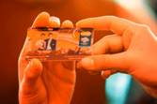

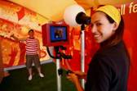
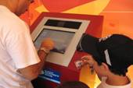
+ 20 years with FIFA → Brand Visibility / N1 International soccer / Relations users + banks
Visibility activations :
  2 – 4 billboards
  90 min TV broadcast : 10-13 min brand visibility
Sensemaking activations
  Hospitality
  Master Card « Priceless Photo » : (Pelé – Klinsmann) / credit card souvenir
  Cities soccer championship by Master Card

Slide 62

Visibility activation :
  2 – 4 billboards
Sensemaking activations »:
  McDonald’s Player Escort Program : 1048 children (6-10 years)
  Special promotions :
    Germany : Goleo / Celebrity endorsment / Tickets
    Brazil : Countries Burgers
    China : TV adverstersing and goodies
    USA : Limited goodies FIFA World Cup
    India : coccer table games Mcdonald’s
    Japan : Mini balls and mino Goleo
    Mexico : packaging
    UK : mobile games« A tex to Win » with Georges Hurst (CDM 1966)
  Exclusivity : FIFA Fantasy football
  Salads, fruits… McCofee…
SALES PROMOTION + SOCCER ENGAGEMENT

Slide 63



Slide 64



Slide 65

Françoise Bresson (Sponsoring Director Nestlé Waters - Vittel) : « Link with the public with « La caravane », TDF platform is complete and we can meet our consumers… »
Program
  14 cars et 500 000 products for the spectators
  Eauficiel : 30 000 for free for spectators
  PR
  Sales activation with 3 Millions (Packs TDF)
  Last 25 km Vittel Red « arches »
  Focus on Vittel origign (les Vosges) with the vacation

Slide 66

Antoine Willaume (Communication & Marketing Director Antargaz) : « Our customers are in rural areas. TDF is a perfect way to meet them ».
Program : Village, caravane, inter-station & VIP
  PR & Hospitality inter-station 50 Km from the arrival (exclusivity : 200 m²)
  Trophy « Flamme Gaz Naturel » with the Major of the City
  Mascot
  200 000 Tap tap & 250 000 magnets

Slide 67

Eric Marchyllie (Sponsoring Director Carrefour) : « Our partnership with TDF and the soccer is focused on proximity. We want to promote our product and our diffrence with our quality made in France and explain our positionning ».
Actions :
  Games in shops
  Website : C-letour.fr with practicers and fans
  Cars & Caravane
  Jersey for the best climber

Slide 68
Key points to analyse your future sponsor
Target : identity, image, brand strategy
Goals : Direction : strategy, competitive advantage, needs anticipation
Communication channels
Financial potential : Turnover, assets…
Sponsorship existing actions
Who is the BOSS inside the company :
Access
Working on his personnality and the link the your sport (fan, practice, networks…)

Slide 69

Sponsorship 3.0 : BNP Paribas

Slide 70


Slide 71



Slide 72

Activation Plan / Program to create your offer
Teasing « who you are » / your difference / Brand Values → YOUR VALUE PROPOSITIONS (video is usefull)
Business Target : Industry/Common Values/Sensemaking reason to activate→ personnal relationnal INTRODUCTION (who/how/when…)
Activations program : VREE / Justify your fit with your sponsors needs/Cost-Benefit→ VALUE PROPOSITIONS FOR yOUR CLIENT
VALUE CREATION : How to measure ROO or ROI ?
Packs and Pricing

Slide 73


Slide 74

EMOTION ²

Slide 75



Slide 76


Slide 77







Slide 82

Opportunism or
Pragmatism ?

Slide 83


Slide 84

CAUSE RELATED MARKETING
Cause marketing or cause-related marketing refers to a type of marketing involving the cooperative efforts of a "for profit" business and a non-profit organization for mutual benefit. The term is sometimes used more broadly and generally to refer to any type of marketing effort for social and other charitable causes, including in-house marketing efforts by non-profit organizations.
Cause marketing differs from corporate giving (philanthropy) as the latter generally involves a specific donation that is tax deductible, while cause marketing is a marketing relationship not necessarily based on a donation.

Slide 85


Ethical Corporate Responsibility (Babiak & Wolfe, 2006)

Slide 86

Discretionary Corporate Responsibility (Babiak & Wolfe, 2006)

Slide 87




Slide 88




Slide 89


Slide 90



Slide 91


Slide 92


Slide 93
Event Stakeholders
Communication platform
Stakeholders with legitimacy
OGN - Association
Financial
Stakeholders Private or plublic organizations
Classical
Commercial
Sponsorship
Donation
CAUSE
Donation

Slide 94
Process
Cause identification : local aspects, fit with your main sponsors or cities…
Legitimacy with your OGN or association
Activation program
ROI or ROO for :
Sponsors
ONG
Event

Slide 95

The core objective : create sponsors network = cross partnership
HOW ?

Slide 96








CSR : ressources arrangement and synergies

Slide 97

Solutions :
Corporate Social Responsability and Cause marketing
Cross businesses (not easy…) using public – private networks…
Danger : impossible to put the offer or attractiveness on your website or business presentations…
Destination marketing : public sponsorship strategy

Slide 98








Slide 99



Slide 100



Slide 101


Slide 102


Slide 103


