Slide 1

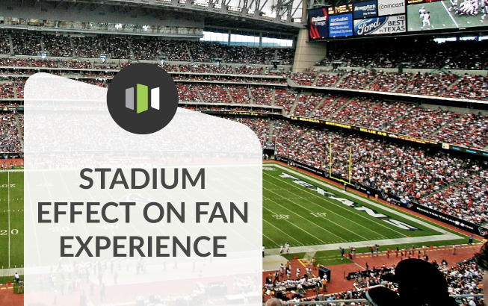
Commercial Business Strategies in Sport Organisations lionelmaltese.fr
Lecture 3
Lionel Maltese
Maître de Conférences Aix Marseille University – CERGAM IAE Aix-en-Provence - #OIMS Laval University Canada
Associate Professor Sport Business Management Kedge Business School
Senior consulting sport business management
Twitter : @lionelmaltese

Slide 2
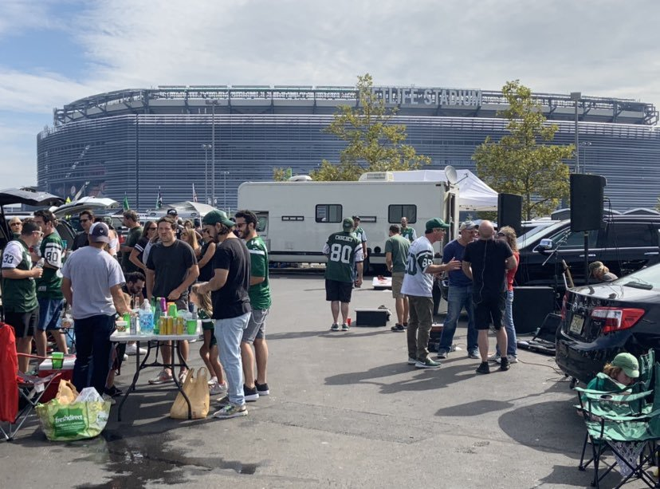
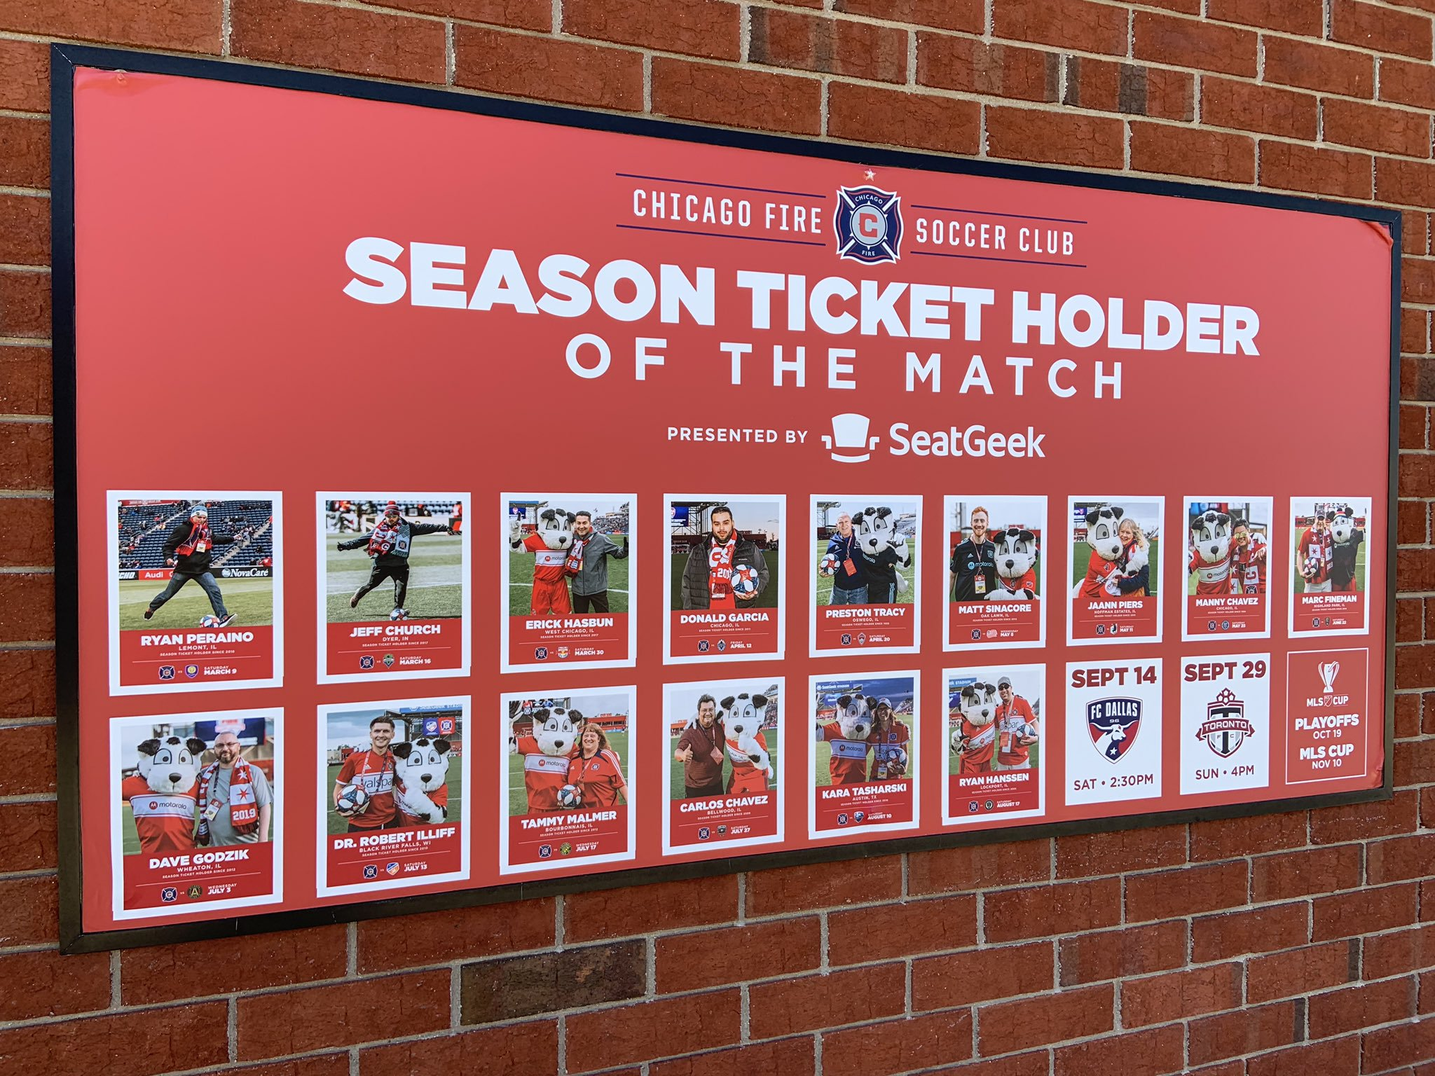
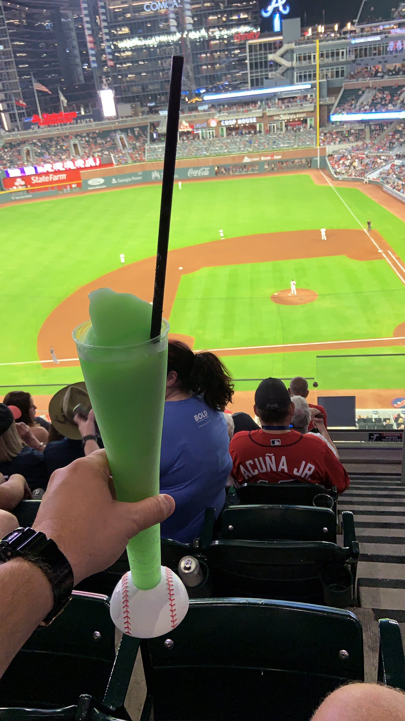
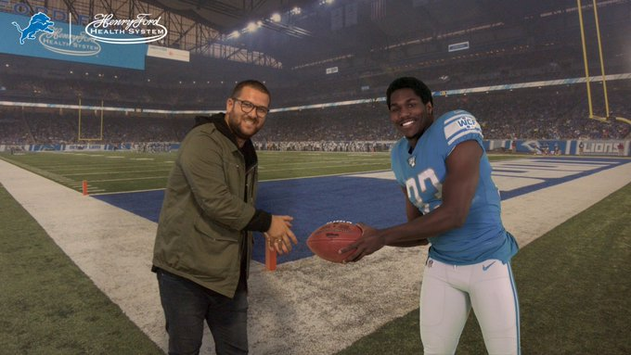
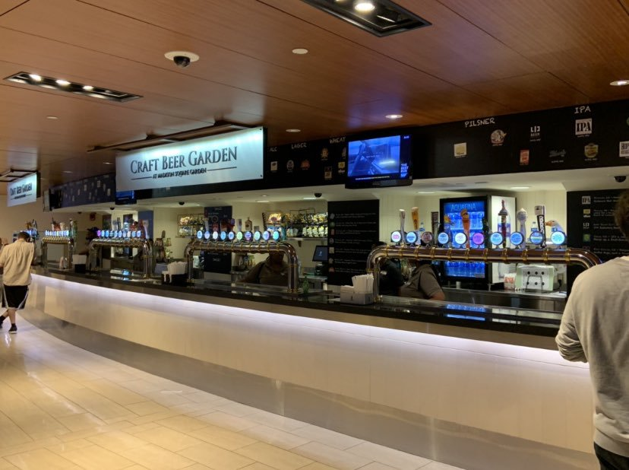
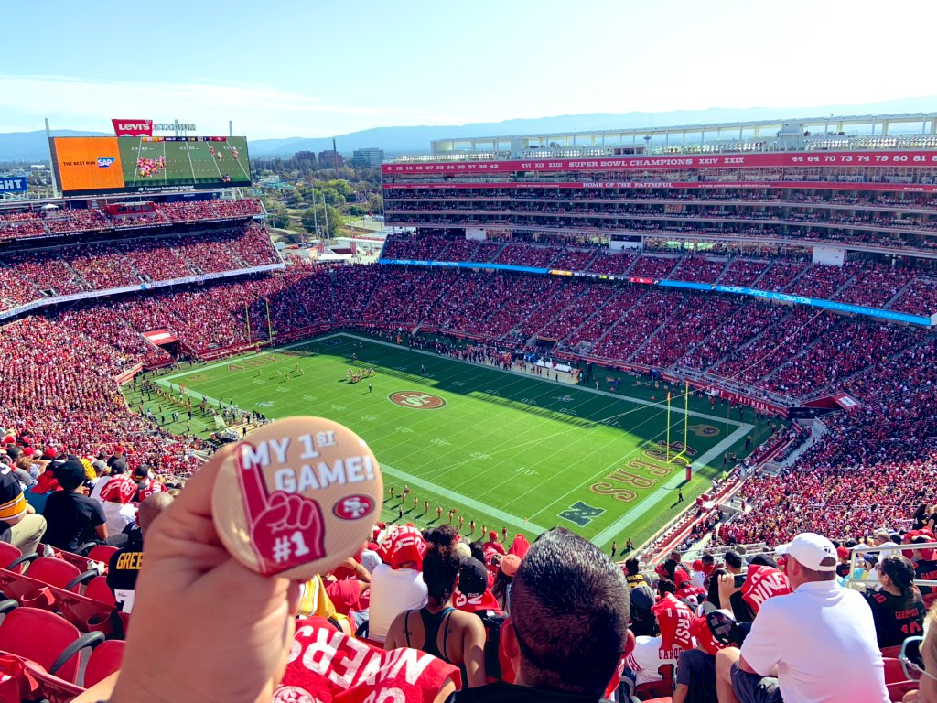
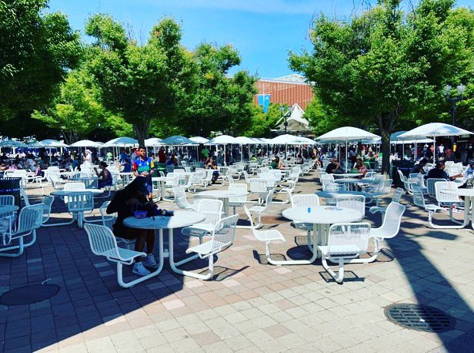

Slide 3
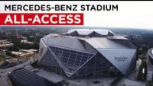

Slide 4
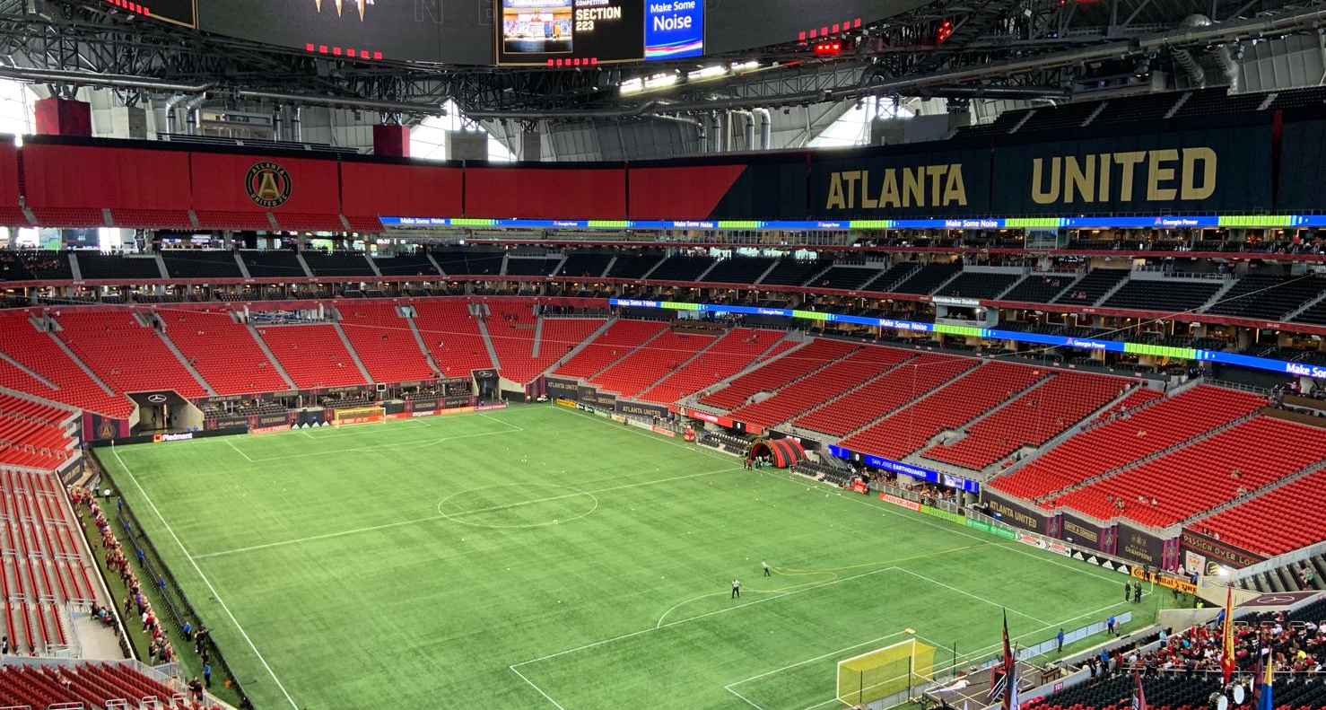
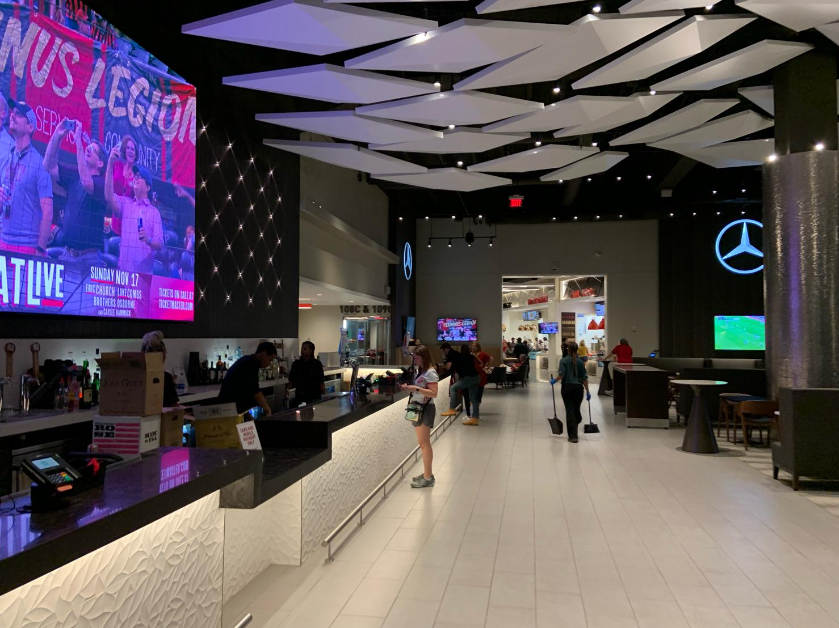
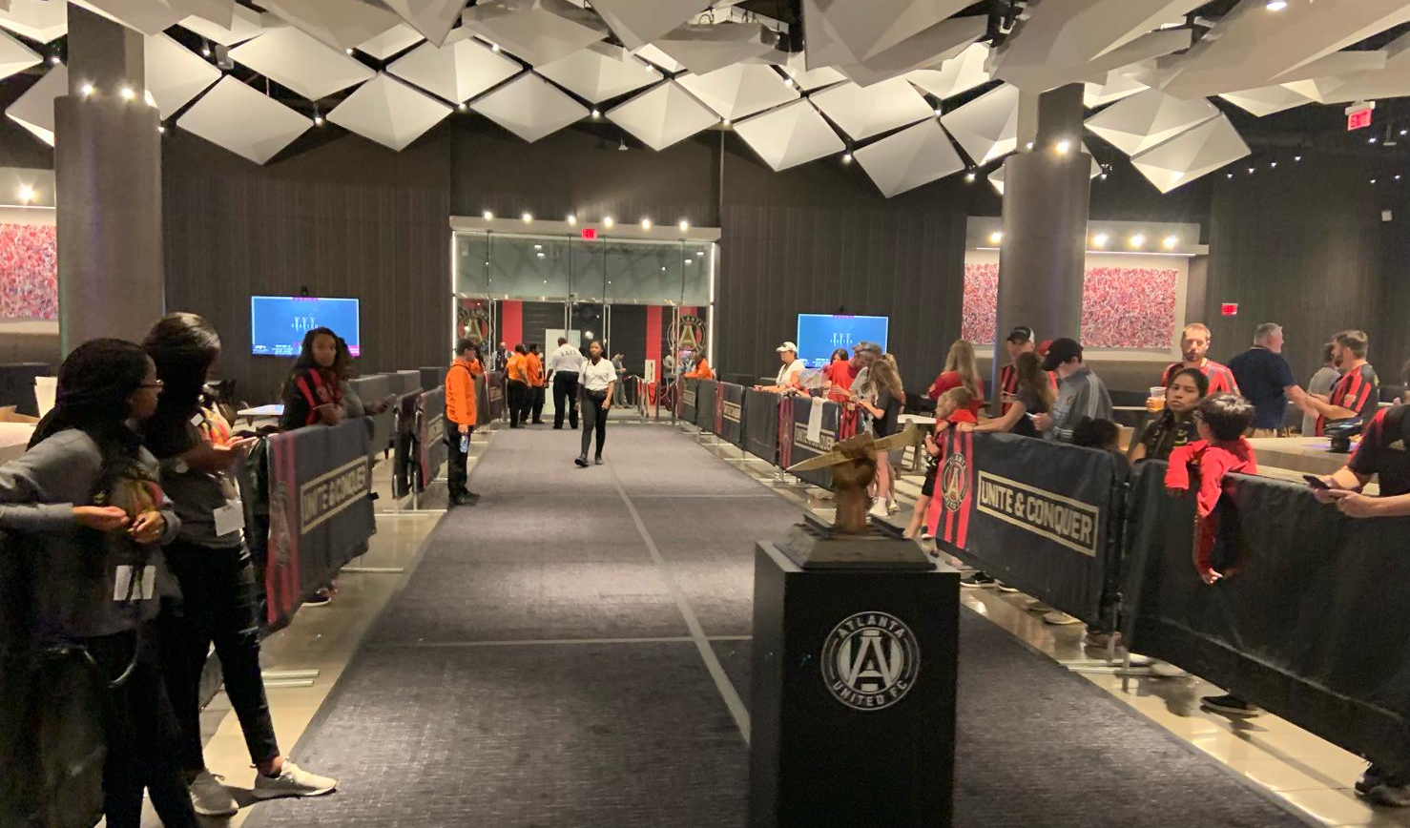
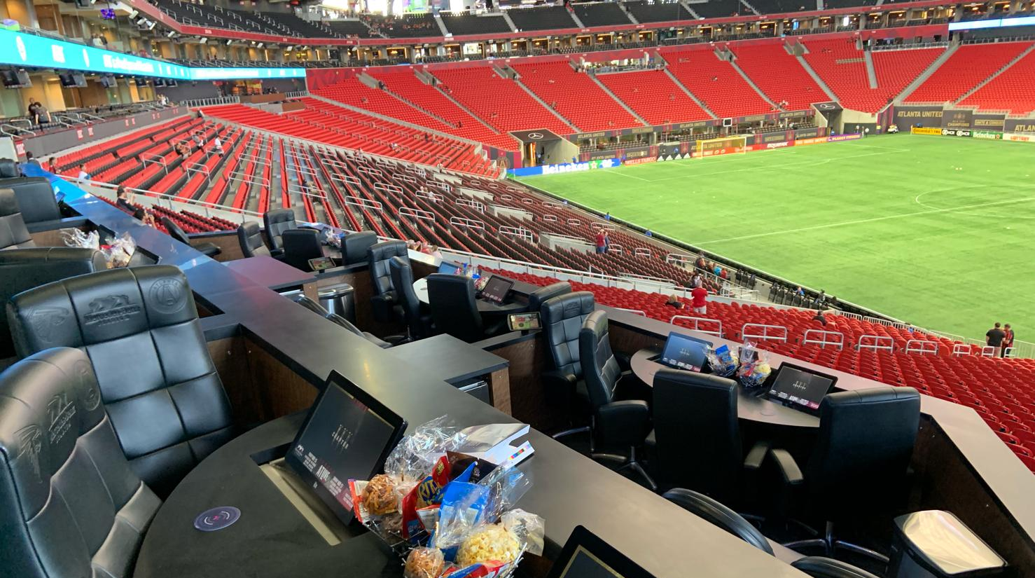

Slide 5
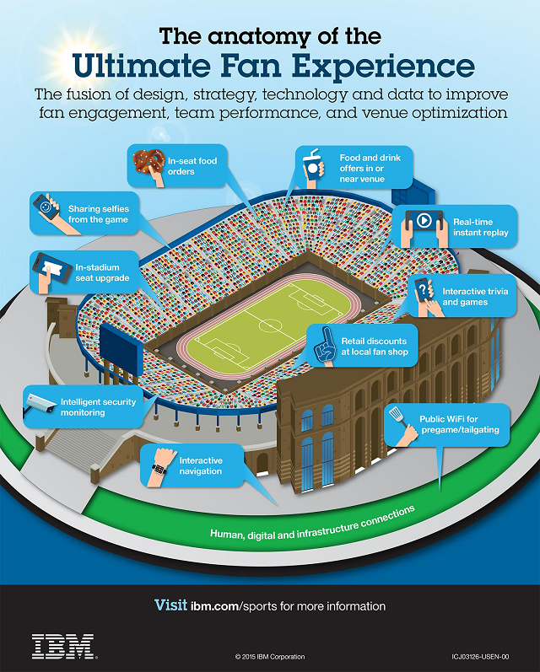
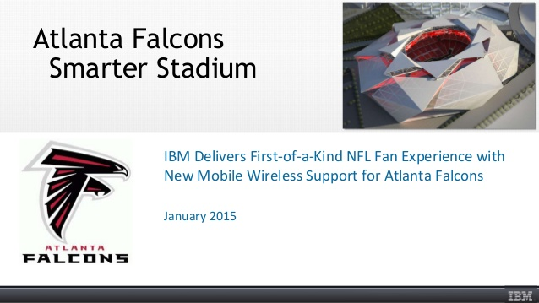
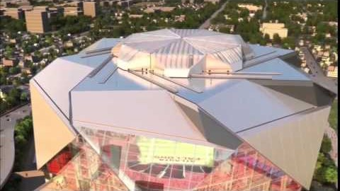

Slide 6
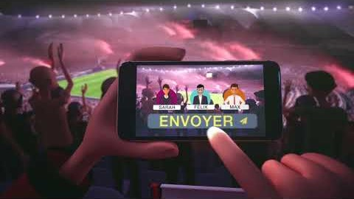

Slide 7
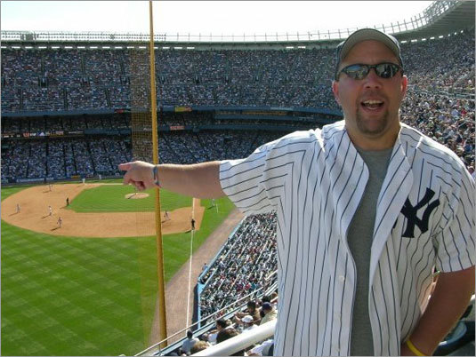
KEY = THE FAN

Slide 8
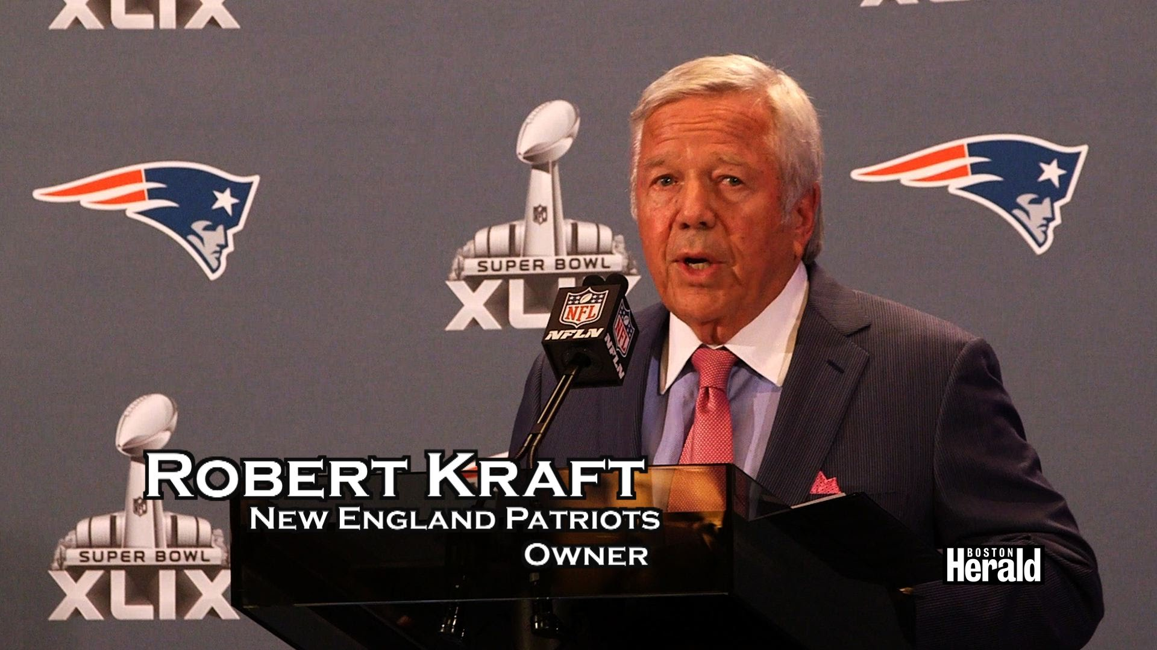
KEY = THE FAN

Slide 9
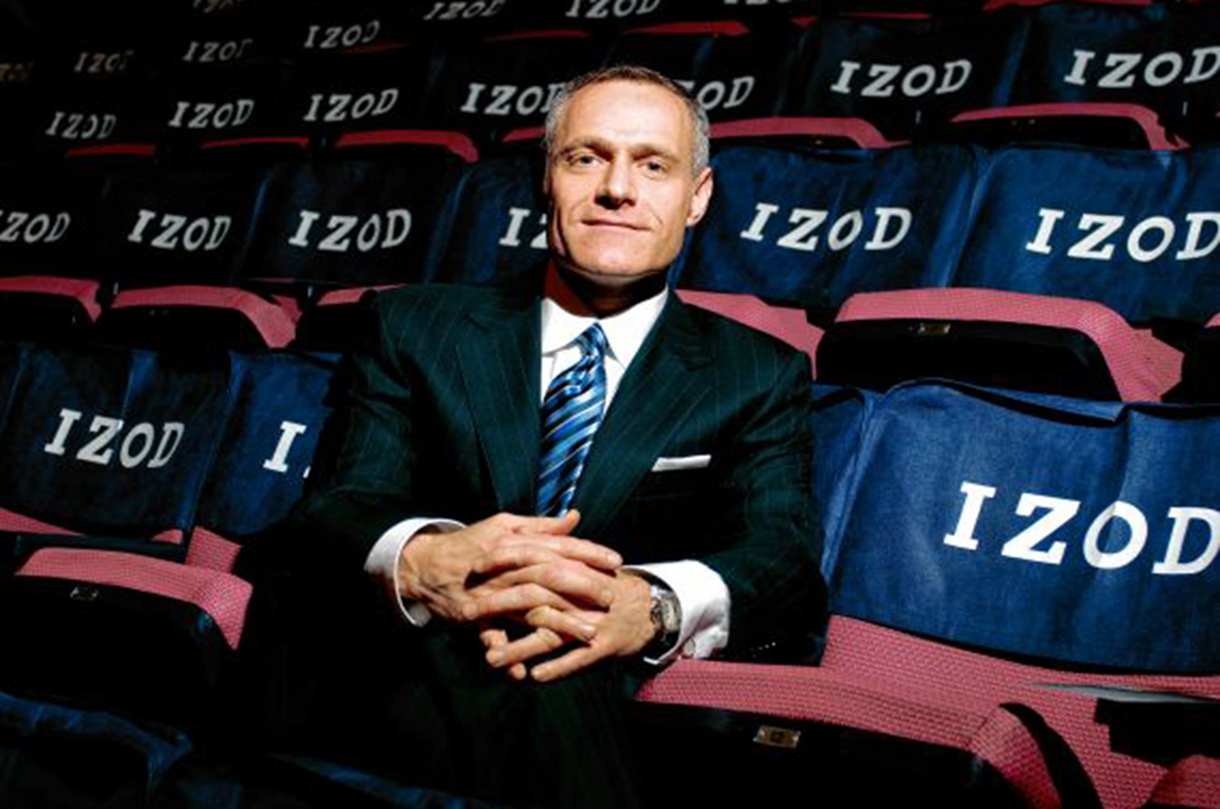
KEY = THE FAN

Slide 10
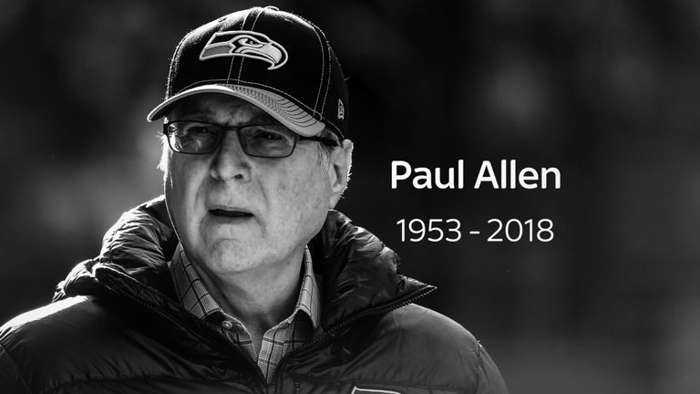
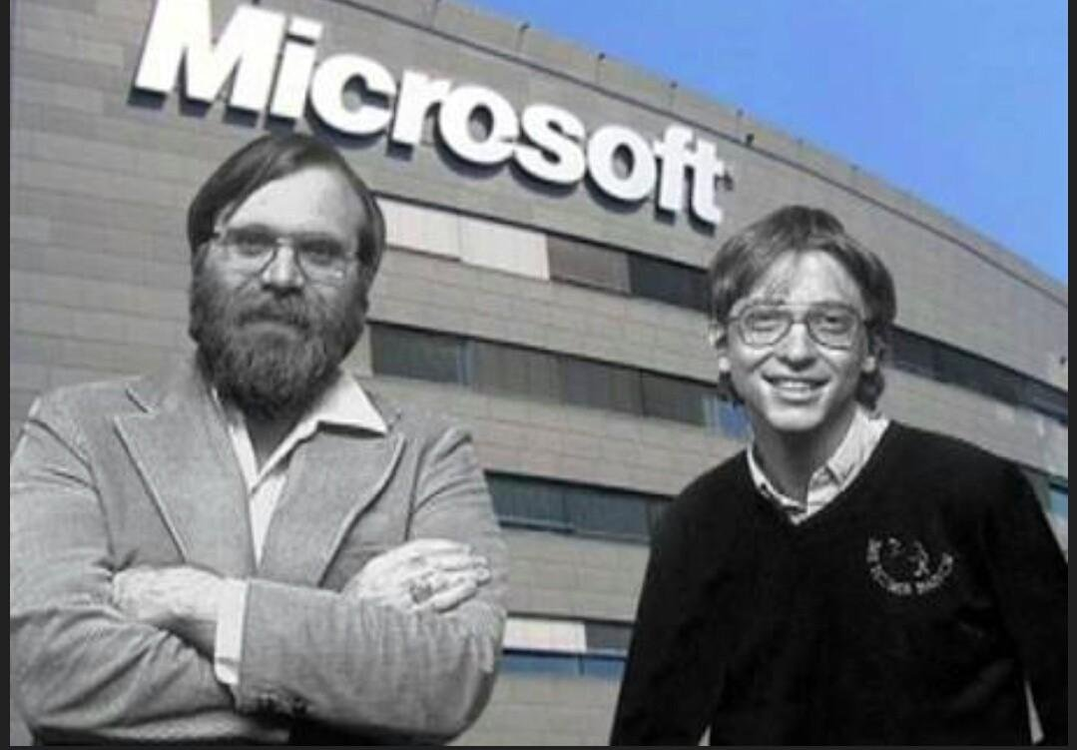
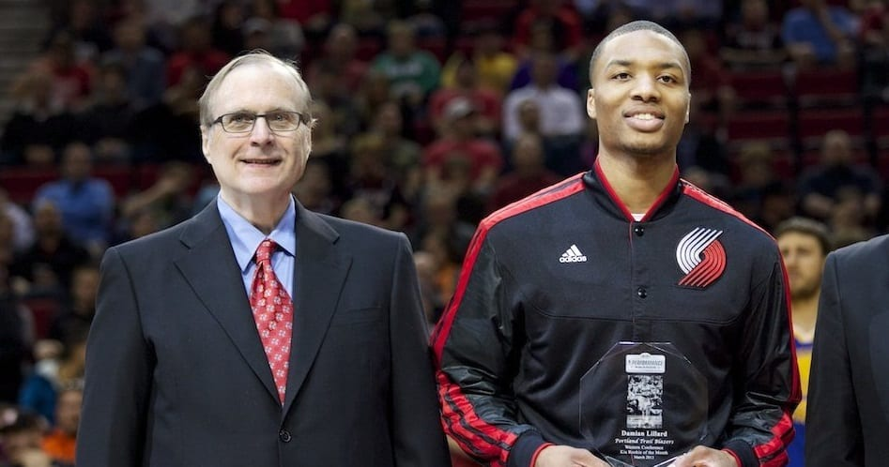
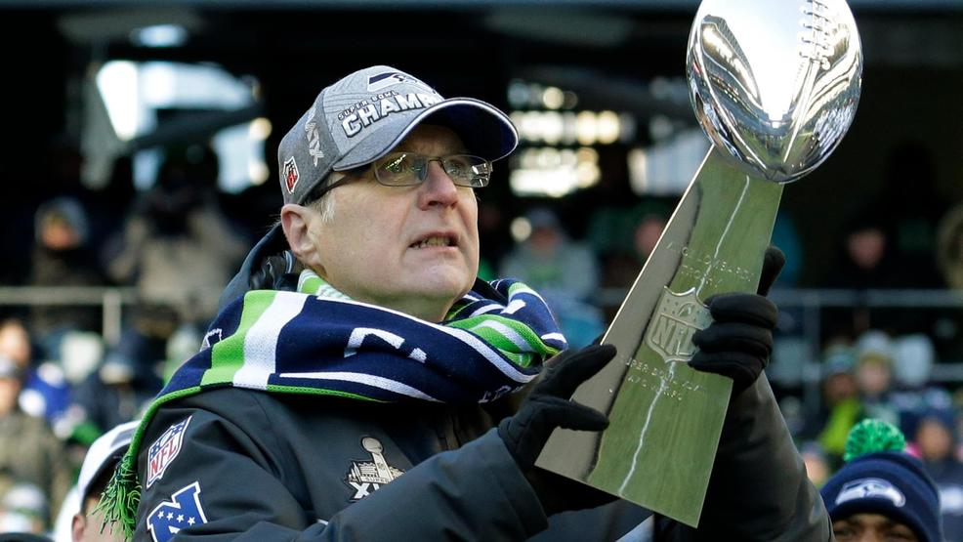
KEY = THE FAN

Slide 11
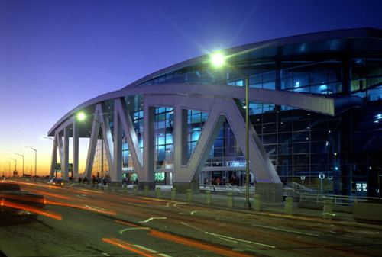
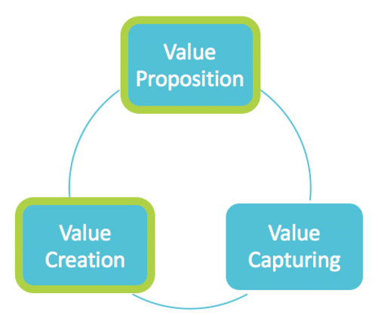
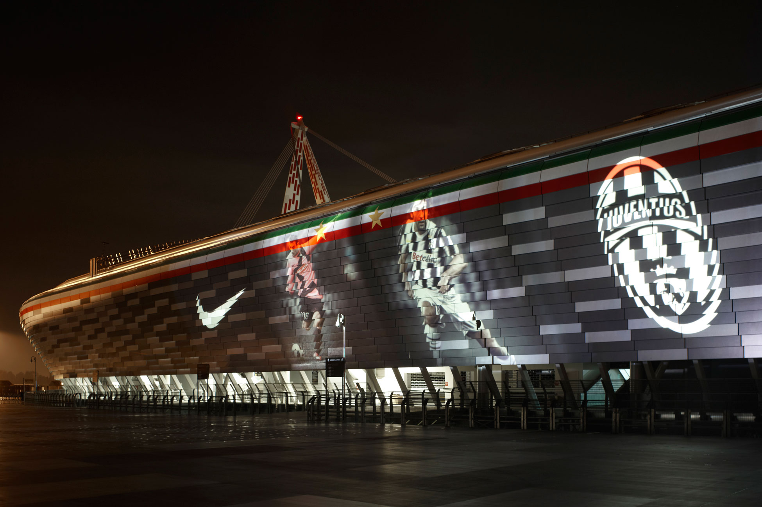

Slide 12
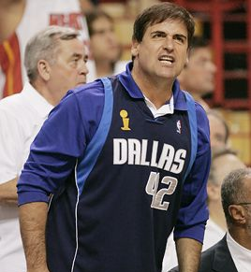
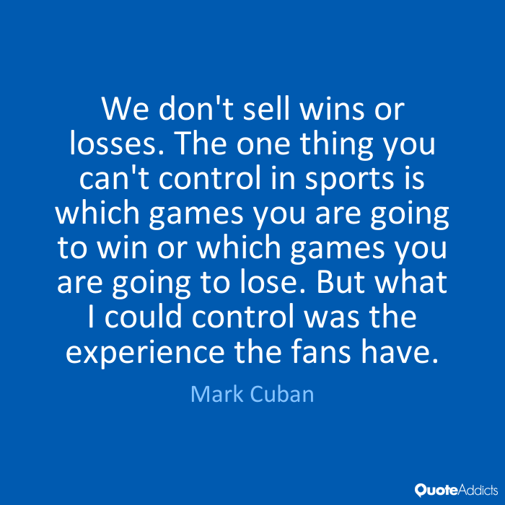

Slide 13
Event offer and specificities
Core event’s offer
ACTIVATION
ENTERTAINMENT
Customization
B to B
B to C
Sponsorship
Ticketing
Customers

Slide 14

B to B : The Key !
« Connect the fans to the brand »

Slide 15

B to C : The Key !
CRM + ENTERTAINMENT = FAN RELATIONSHIP MANAGEMENT

Slide 16
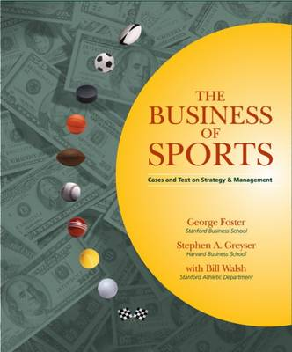
Fans support for the system : the business of sports – a perspective from Harvard (Stephen A. Greyser)
« Fans are the fundation of the business of sports world. They support the entire apparatus : with thier bodies at games ; with their eyeballs wathing on TV ; and with their wallets for tickets, for cable and pay-per-view fees, and for merchandise, publications, videos, fantasy leagues fees, and equipement, as well as the sponsors’ products and services ».

Slide 17
Relationship Marketing keys
Relationship Strategy
Communication
Customer Knowledge
Offer customization

Slide 18
Attracting – Seducing – Conquering your fans!
Attract your fans
→ products
Communication
Supports – Managers
Coaches
Attracting
Push your fans
→ products
Promotion
Activation – Special
offers
Seducing
Establish a direct
Contact with your
fans
CRM (FRM)
Social
Networks – Engagement
Conquering

Slide 19
CRM Steps | Sports events ecosystem assets | Sports events ecosystem limitations | Recommendations
KNOWING | Core targets : practicers (clubs / federation) + sport goods consumers including media and social media | Invitations : public sponsors with free distribution contacting your targets ! | Limitation of the invitations or tracking (or influencing) your sponsors for their invitations - distribution & selection
SELECTING | Motivational segmentation using your data basis | External ticketing distribution (digitick example) / needs for creating and managing your CRM -→ FRM | Customers Information are not Customers Knowledge ! You have to work on your data creation and knowledge based assets…
CONQUERING | Using stakeholders communication channels (media, sponsors, « smart » cities, players !…) | Without IT strategy no interaction ! | Coupling with servicing : parking, food, products, sponsors goods….
LOYALTY | Loyalty programs | Limitation of a one shot event / no external fans cards (ex : OM with fans associations) | Mobile strategy using your partner competencies (Cisco, IBM, Oracle, Apple, Orange….)

Slide 20

Fan Relationship Management ?
« In sport lack of relationships between fans and their clubs/events has led to empty stadiums, low merchandising, no sponsorship and no growth. Events adans clubs need to smell the coffee, change and benefit from their fans. They have to institute a Fan Relationship Management (FRM) program »

Slide 21
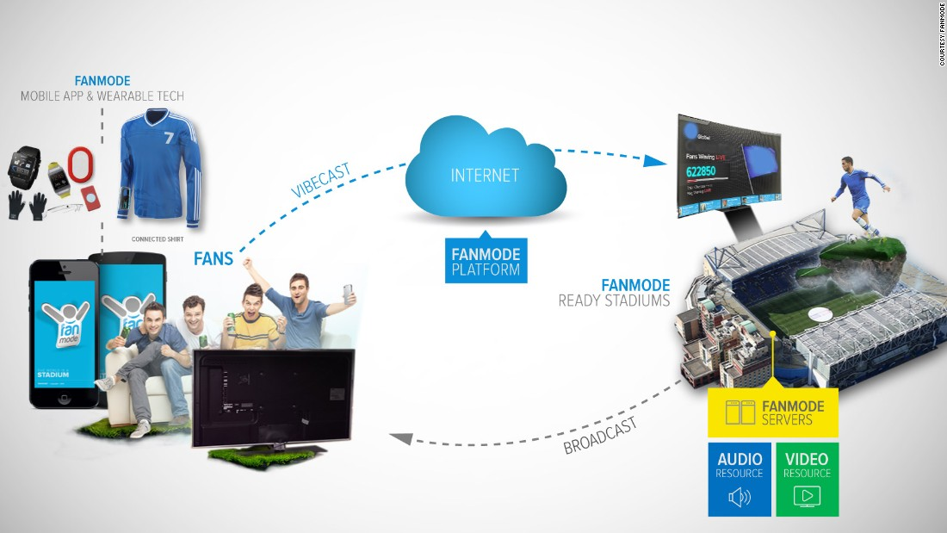
Fan Relationship Program
Fans identification using experience (Entertainment)
Fans Marketing Intelligence : from data to knowledge
Offer diversification
Fan Engagement
Customization and Yield management
Relational dynamics with fans using Loyalty programs
→ IT = FIRST FRM SUPPORT

Slide 22
Tactics used by sports organizations in the
United States to increase ticket sales
$12 billion / year spent on the purchase of tickets to than doubled over the past decade
Tickets prices have more than doubled over the past decade (US)
Hornets : « When no one is in that seat, not only do we lose the value of the ticket, we lose concession money, merchandising money, and program money »
Ticketing strategy : equilibrium between rentability and fill rate

Slide 23
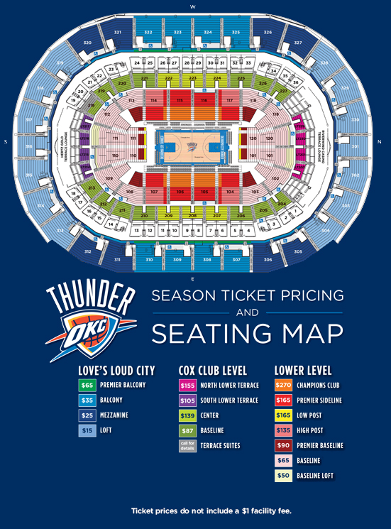
Flexible Ticket Pricing
Quality of the opposing team
Time : prices vary by different times of day, week, or season of the year or first round versus championship game or match
Place : prices vary by different seating locations

Slide 24

Money-Back Guarantees
Loyalty programs
Mini packs / fans groups (Sportainment)
Using top games to sell « garbage »

Slide 25
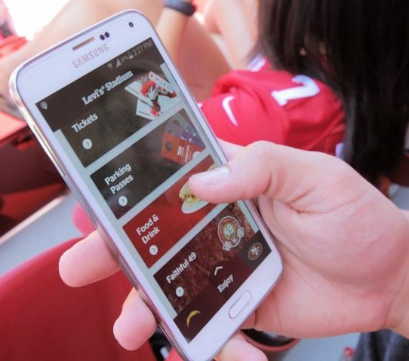
Web-based ticketing & servicing
E-commerce Tickets
Benchmark : US Major ski areas
Improving mobile tickets using IT scanning in your stadium
Connected arena & stadium

Slide 26
Possible fans segmentations (classical)
Demographic variables :
  Age : some categories by generation rather than random age bands
  Gender : male or female
  Ethnicity / culture
  Family status : familiy size or family life cycle
  Working status : income, occupation & education
Geographic variables :
  Location : where does the customer live ?
  Population : What is the size of population where the customer lives ?
  Density
  Climate
Psychographic variables :
  Lifestyle : what type of lifestyle does the customer lead ?
  Personality
Behavioural variables ?
  Occasion : when does fan attend games ?
  Benefits : what are they seeking from the event – a winning team or entertainment ?
  User status : current, lapsed, prospective or non uers
  Usage rate : frequency of attendance
  Loyalty status : how loyal are they towards the team ?
  Attitude : posititive or negative ?

Slide 27
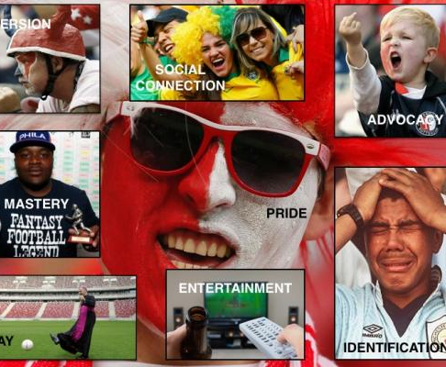
Other fans classification
(Hunt, Bristol and Bashaw)
Fanatical fan : always fans wearing jersey, enhancing atmosphere of the live event, added value for other fans.
Devoted fan : at the games but also watch via media, general sports fans, they are willing recipients of exclusive content such as insider news or behind the scenes stories
Local fan : local affiliation, city identification
Temporary fan : seek unique « once-in-a-lifetime » and « money can’t buy » experiences and will be attrcated by big events, big names and star players.

Slide 28
« Phygital » strategy : Fans & Members Relationship Management
FFT Case Study
MEMBER
Level of ENGAGEMENT
Fan
Tool
Practicer
FFT Context
AWARENESS
I KNOW about tennis Events (RG)
FFT
TV
I KNOW about tennis
Tennis for Leisure
Volume
Poor Knowledge by FFT
ATTRACTION
I LIKE tennis events (RG)
FFT
TV
I LIKE to play tennis
Tennis for leisure
Volume
Leisure Community inside clubs
ATTACHMENT
I AM a RG fan
FFT
TV
CLUB
I AM a tennis player
Tennis Competition
Differenciation
Competition Community
ALLEGIANCE
I LIVE for tennis events (RG)
CLUB
RG
I LIVE to play tennis
Tennis addiction
Niche
Close Community

Slide 29
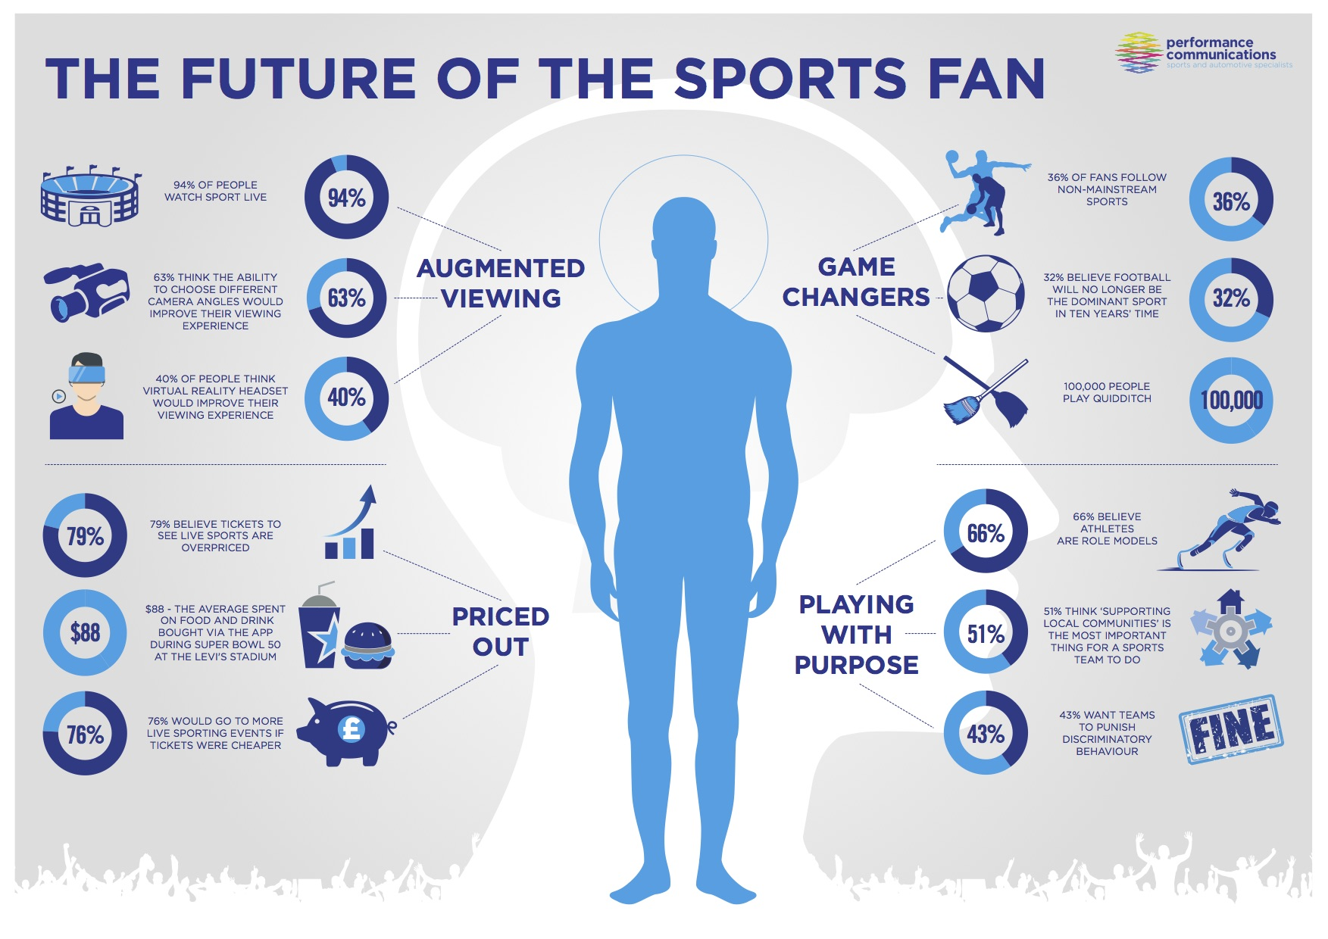

Slide 30

Ticketing effeciency : Reputation – Rentability - Responsibility
EVENT
RENT
EVENT
RESP
EVENT
REP
Seat-occupancy rate
Rentabilility

Slide 31
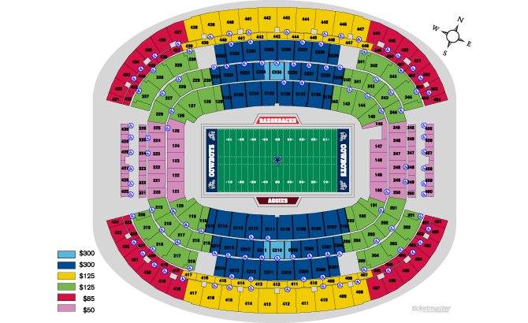

Slide 32

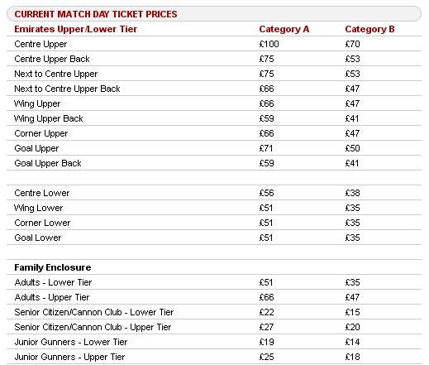
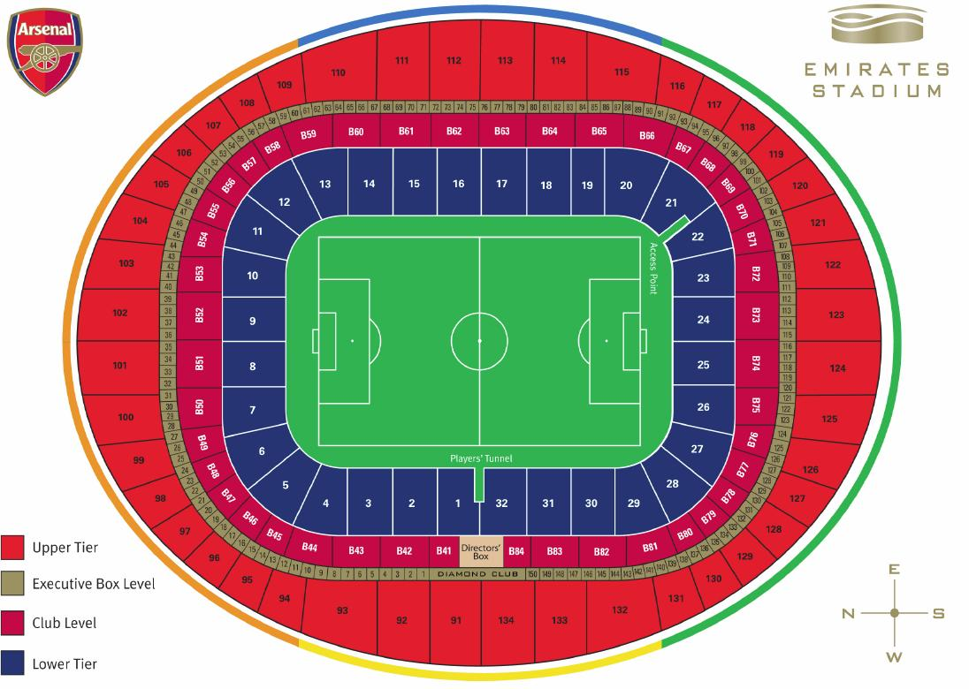

Slide 33
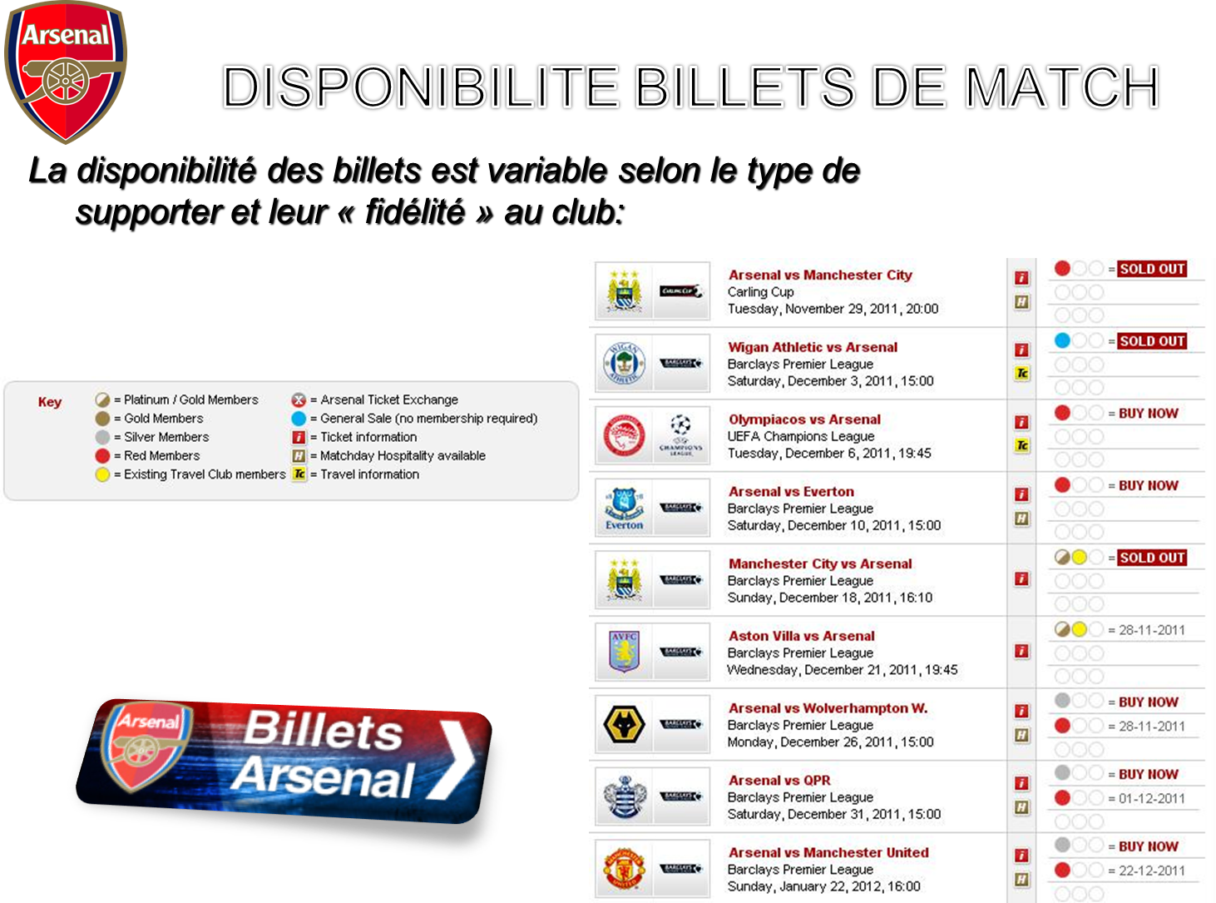

Slide 34

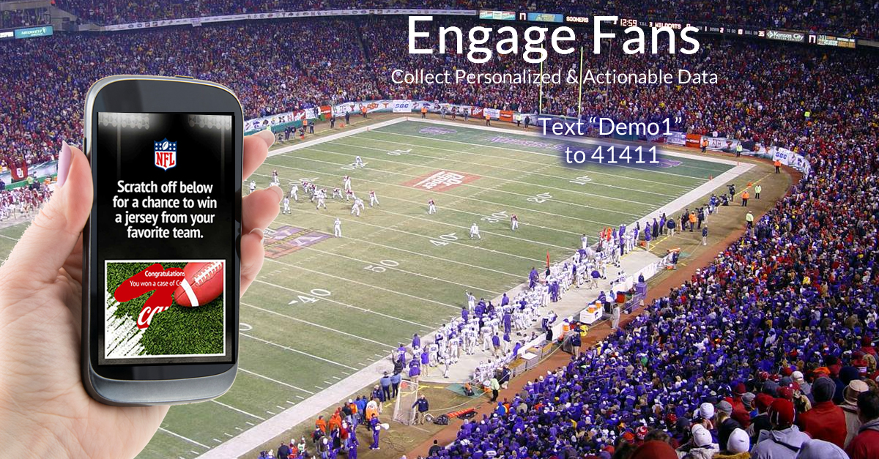
How to create your fan base ?
On line tickets and product or services
Games
Social media
Sponsors common customers and database
Marketing surveys

Slide 35
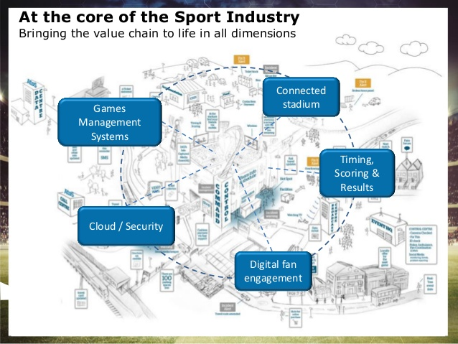

Slide 36
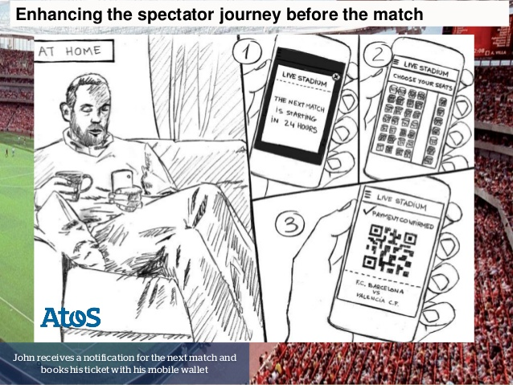

Slide 37
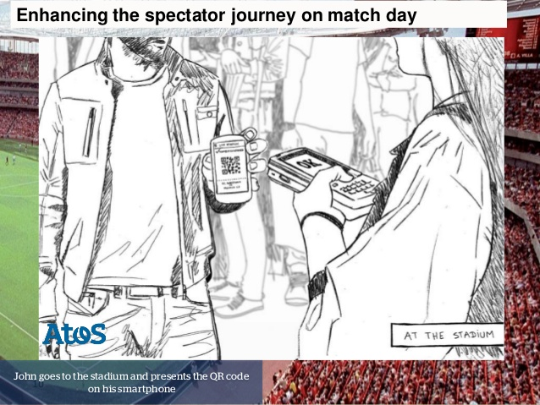

Slide 38
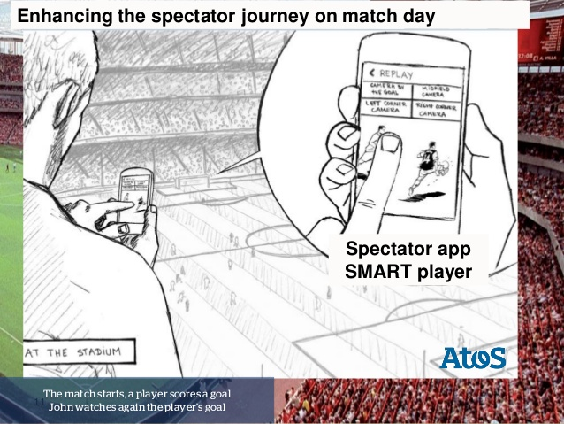

Slide 39
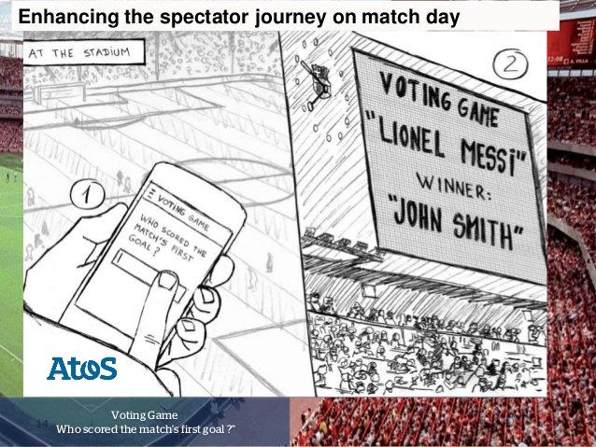

Slide 40
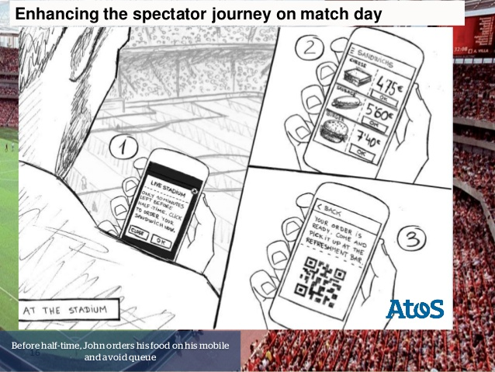

Slide 41
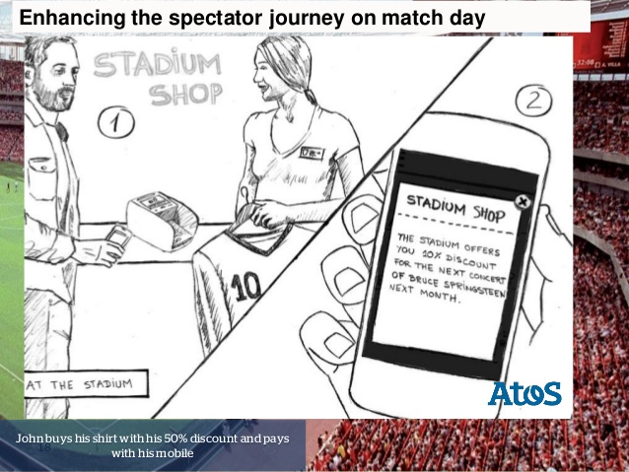

Slide 42
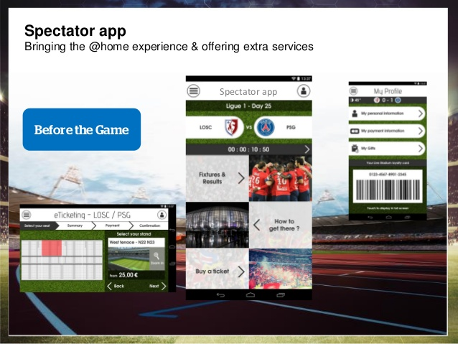
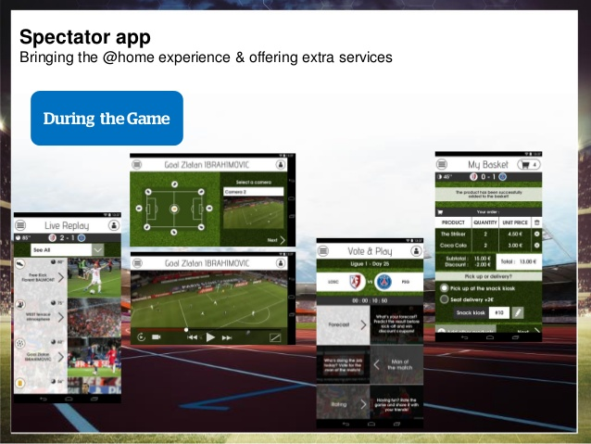
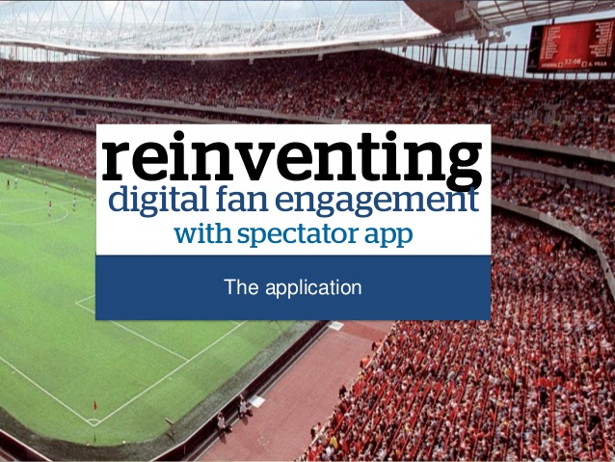


Slide 43


Slide 44

Example : fan adoption process
Fan adoption stage | Marketing strategy objective | Specific strategies implemented
Awareness | Communicate the availability of the sport | Press conference Name selection strategy Team media guide Entertaining promotions Entrenchment campaign
Interest | Communicate benefits, attributes, and attitudes associated with the sport to gain potential fan interest | Hockey 101 Hockey clinics Promoting superstars of visiting teams
Evaluation | Emphasise the advantages of the sport over alternative entertainment options | Cross-promotions with NASCAR Experiential promotion
Trial | Motivate potential fans to try a new sport | Price promotions Giveaways
Adoption | Make sure fans are satisfied with their « sporting experience » | Advanced entrechment campaign List of « firsts » Relational strategies

Slide 45



Servicing – Experience - Engagement

Slide 46

FRM : From Experience to Engagement
Time
→Waiting time before, During, After
Information
→Game/Players/performance…
Social
→ Community/Groups/Food and Beverage,,,
Entertainment
→ Presenting/Players Entrance/Celebration/Animations

Slide 47


Value Proposition / Creation / Capturing

Slide 48


Slide 49


Slide 50

One strategic solution : B to B to C !!!!!

Slide 51




Slide 52



Slide 53



Slide 54



Slide 55



Slide 56





Movies and teasing…

Slide 57









Slide 58


Slide 59



Slide 60



Slide 61


Slide 62


Slide 63


Slide 64





Slide 65

Multiple markets:
Customers - Stakeholders
Multiple offers
B to B & B to C
WHO?
EVENT
CLUB
Global Communication
Your stakeholders
support you !
HOW ?

Slide 66



Slide 67


Dosing communication for sporting events
Sponsors – Institutions
General public
Ticketing
PR
Mass
Communication
One to One
+
Reputation
Buzz
Reputation
Direct Marketing
FRM

Slide 68




Slide 69


Slide 70

Reputation platform (Van Riel & Fombrun, 2007)
A reputation platform describes the root positioning that a company adopts when it presents itself to internal and external observers.
Express the company’s history, strategy, identity and reputation that rings true to internal and external observers.
The quality of a reputation the platform can be test on 3 key criteria :
  Is the reputation platform relevant ? Building your reputation around your key assets
    On line trading for e-Bay or network computing for Sun Microsystems
  Is the reputation platform realistic ? Expecting benefits from stakeholders
    Dell cuts your costs or Disney makes you happy
  Is the reputation platform appealing ? Emotional theme to inspire your support
    Amazon on «¨Personal service » or Johnson&Johnson on « motherhood »

Slide 71
Creating a corporate story (Van Riel, 2001) : Teasing your event
1. Positioning the event
2. Linking the story to the
event’s identity
3. Linking the story to the
Event’s reputation
4. Plotting the corporate
story : Buzz
5. Implementing the
corporate story
6. Monitoring the
story’s effectiveness

Slide 72
A seven-step model for implementing a corporate story
1. Test corporate story
2. Prioritize stakeholders
7. Pretest campaign
3. Identify communication goals
6. Choose media
4. Create a brief story
5. Develop creative concept

Slide 73

1. Test corporate story
10 % budget for communicat ? No you have to fit with your needs :
Internal brainstorming on you reputation feeling :
Identity problem ?
Reputation pilars :
  Products, services, experience = PLACE (Stadium, Arena, Natural place…)
  Emmotional appeal = FANS - PLAYERS
  Vision & leadership = MANAGERS
  Performance = MANAGERS
  Workplace environment = PLAYERS – EMPLOYEES
  Social Responsibility = OGN – INSTITUTIONS - CITIZENS

Slide 74
2. Prioritize your stakeholders
LEGITIMACY
POWER
Discretionary
Dormant
Dominant
Definitive
Dangerous
Dependent
Demanding
Nonstakeholder
URGENCY

Slide 75

3. Identify communication objectives
Generate change in a particular stakeholder’s :
Knowledge : informational content of the message
Attitude : react favoraly to the content
Behavior : change a specific supportive behavior such as purshasing or investing

Slide 76

4. Create a brief
Description of your market : compitors and customers
Core mission :
Why does the event exist ?
What are the value of the event ?
What are the event’s key source of distinctive competence ?
Core Message :
Promise : program, top games, experience
Proof : ROO, ROI
Tone : Agressive, humorous, provocative

Slide 77

5. Develop a robust creative concept
Designers, agencies role
Explain your identity, strategy and history
External isolation = danger

Slide 78
6. Select the media
REACH
Number of target audience individuals exposed to the adverstising, in a purchase cycle
BUDGET
FREQUENCY
Number of exposures per individual target audience member, in a purchase cycle
CONTINUITY
Distribution of exposures over successive purchase cycles, for the average target audience member, for the planning period (1 year)

Slide 79
7. Pre-test the IMPACT of a campaign
4a. Improve
corporate
communication
campaign
1. DRAFT
Corporate
Communication
campaign
4b. Implement
corporate
communication
campaign
2. Test corporate
campaign
Creativity
Professionalism
Consistency
3. Predict success of corporate
Communication campaign :
Improves knowledge (K)
Improves attitude (A)
Improves behaviour (B)
Sucess = sum of changes in K, A, B
Not successful
Sucessful

Slide 80


  « There is no separation between sports
  and entertainment… merge them together
  and create something unique ».
  Robert Johnson (Onwner Charlotte Bobcats)

Slide 81











Buzz « Entertainment »
Fan Experience
strengthening
Enlargement
Entertainment
Fan Engagement
Meta information - NTIC
Fan expert – Superfan
Party-time - Gaming
Exiting – Ambiance
Experiential Fan

Slide 82





Slide 83


Motivational Marketing Study for PSG Fans
by Frank Pons & Lionel Maltese (2015-2017)

Slide 84

Piste : cartographie motivationnelle / « fan expérience »
Enlarge +
Super
Fan
Experiential
Fan
Social
Fan
Reinforce -
Reinforce +
Dysfunctional
Fan
Enlarge -

Slide 85
Un déficit expérientiel socialisant ?
Fan type
Goals
Actions
Enlargement
Gaming – Digital Social media – Apps
Social Fan
Strengthening
Physical social support
Snacking – bars - Groups

Slide 86
Une expérience à optimiser de manière sélective ?
Fan type
Goals
Actions
Enlargement
Music – Song – Videos Tifo… Gameday
Experiential
Fan
Strengthening
Datatainment

Slide 87





Slide 88


Slide 89


Slide 90


Slide 91


Slide 92


