Slide 1
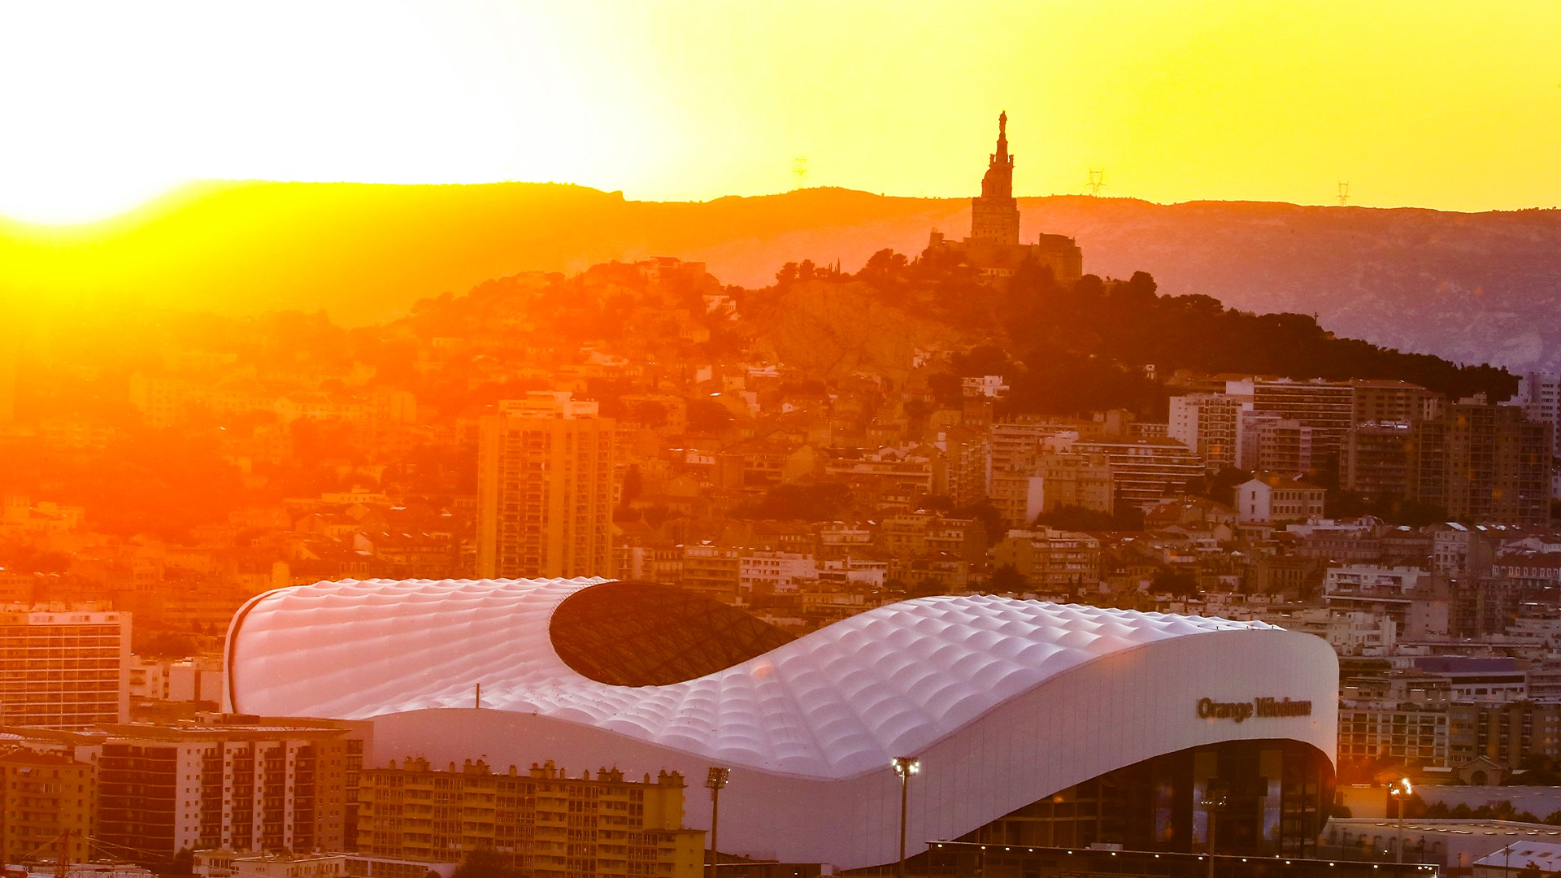
Lionel Maltese
Maître de Conférences Aix Marseille University – CERGAM Laboratory- #OIMS Laval University Canada
Associate Professor Sport Business Management Kedge Business School
Senior consulting sport business management ATP Marseille – Lyon – Metz – Montpellier – FIBA 3*3 World Tour Marseille
Twitter : @lionelmaltese
Msc International Sport & Event Management
2023-2024 - Season N°31 [1993-2022]

Slide 2
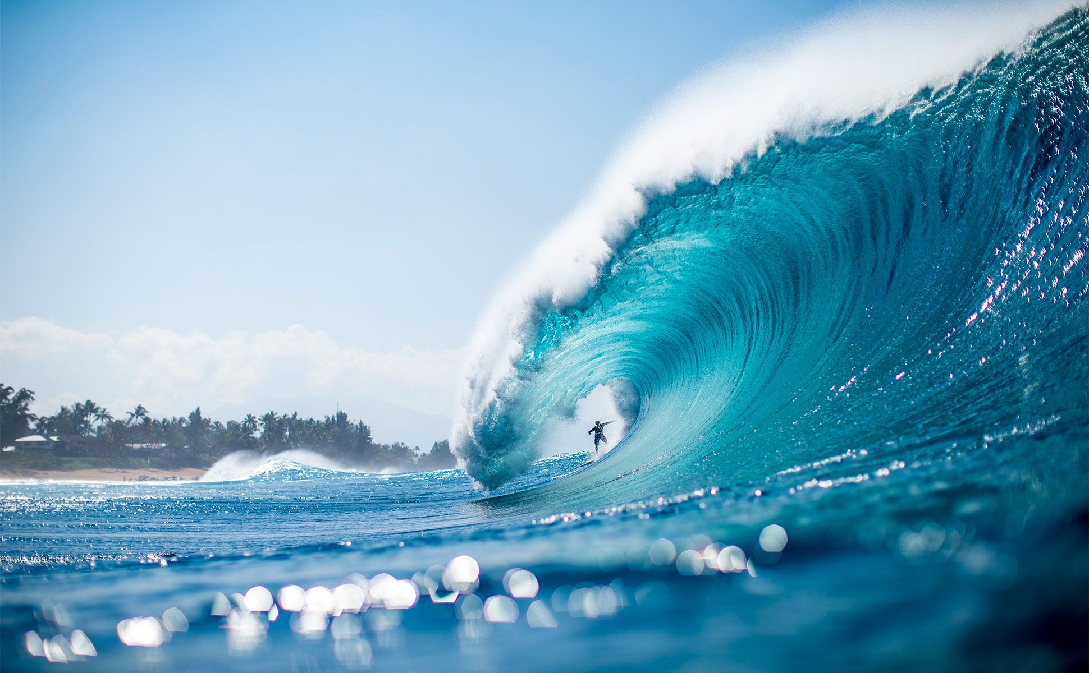
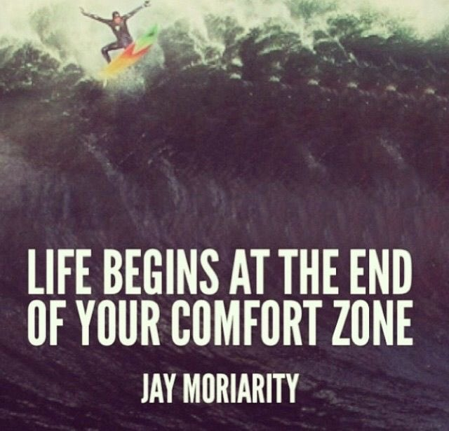
Learn – Prepare & Manage your « grit » and your « weak ties »
This is ISEM !

Slide 3
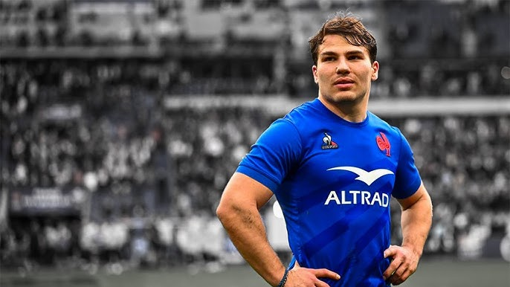
Resources & Competencies to make a sustainable brand
Unique staff key expertise : academic / teaching / profesionnal actors
Collective teaching experience in Msc ISEM : more than 10 or 15 years
International and profesional diversity (US, Canada, Australia, UK, Italy, France…)
Strategic action to improve your sport business labor market penetration : brand activations & business marketing culture

Slide 4
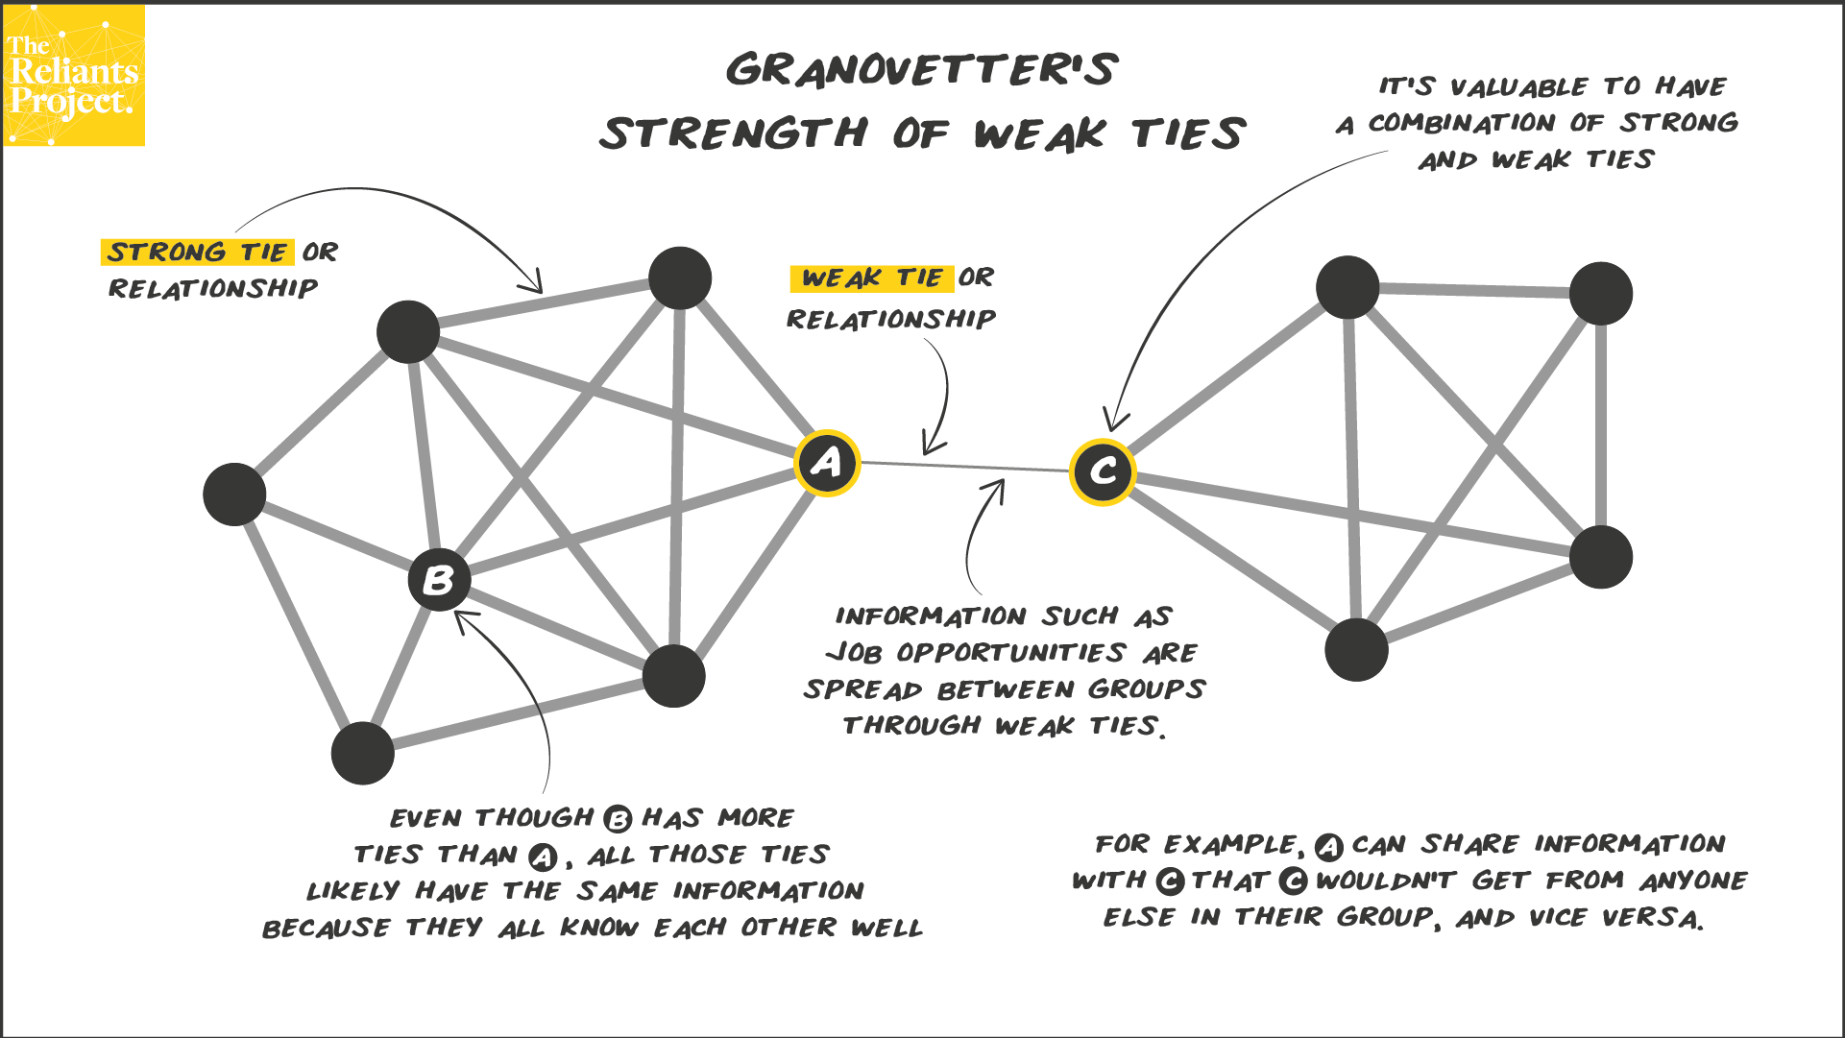

Slide 5
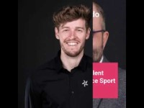

Slide 6
ISEM “TRAINING” TEAM
ISEM “TRAINING” TEAM & CONTENTS
 | SEMINARS | FULL INTERNATIONAL | MIX INTERNATIONAL FRENCH
S1 | Commercial business strategy in sport organisations | BOUVRANDE Thomas 6H / WEISZ Michael 9H / MALTESE Lionel 15H | BOUVRANDE Thomas 6H / WEISZ Michael 9H / MALTESE Lionel 15H
 | Commercial & social Sponsorship and Operational Activations | DANGLADE Jean-Philippe15H / AL NIMER Mohammad 15H | CARILLAT François 15H / GUILLET Marie-Amélie 9HH / CHANTREAU Alizée (6H)
 | Sport Media Consulting and Event Communication Operational Strategy | ROUGER David / FERSING Aurélie 15H | ROUGER David (15H) / FERSING Aurélie 15H
 | Event, Experiential, Social and Cultural Marketing for sport & e-port | VACHIER Sylvain & Romain SOMBRET 15H / FUSCHILLO Gregorio 15H | VACHIER Sylvain & Romain SOMBRET 15H / FUSCHILLO Gregorio 15H
 | Sport Career Services and labor market opportunities | Damien INNOCENTI 30H | GHIBAUDO Alain 30H
 | Sport business consulting projects | MALTESE Lionel 15 / VIGNAIS Lucas 15H
 | Droit des compétitions Sportives et de ses acteurs |  | RIZZO Fabrice 30H
S2 | Strategic Management and sales & Digital marketing in Sports Organizations | MALTESE Lionel 15H / LADIK Daniel 15H | MALTESE Lionel 15H / LADIK Daniel 15H
 | Economics and Finance of professional team sports | SIMMONS Rob 30H | DURAND Christophe 30H
 | Fan experience & stadium strategic management | REQUENA Alejandro 9H/ KUDAWOO Joakim 9H /LEPRON Julien 12H | REQUENA Alejandro 9H/ KUDAWOO Joakim /LEPRON Julien 12H
 | Brand Management in sports organizations | PONS Frank 12H / Marina CAIAZZO 9H / Charlotte VEYRON-Tea TEFANI (9H) | PONS Frank 12H / Marina CAIAZZO 9H / Charlotte VEYRON-Tea STEFANI (9H)
 | Corporate social responsibility in sports and Destination Marketing | KUNKEL Thilo 15H / BEE Colleen 15H | FRANCOIS Aurélien 15H / Julien BERENGER 9H / LLORENS Emilie 6H
 | Celebrity & Talent Marketing Management | DANGLADE Jean-Philippe 18H / GEOFFROY Kevin 12H
 | Organisation contractuelle du spectacle sportif |  | MARMAYOU Jean-Michel 30H
Conferences/ Challenge : OM / DELTATRE (NBA-NFL-MLS-JUVE-ATP…) / PARIS 2024 …

Slide 7
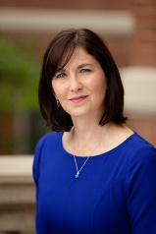
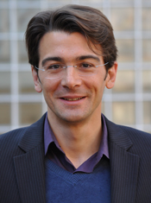
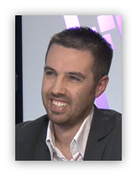
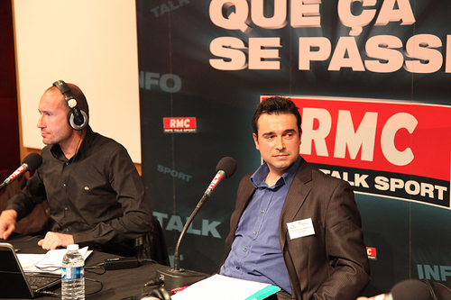
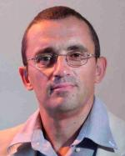
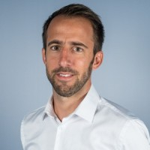
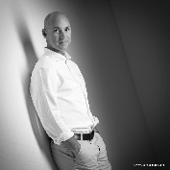
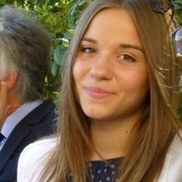
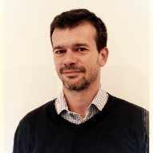
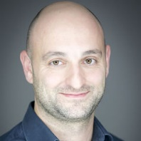
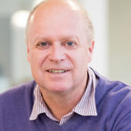
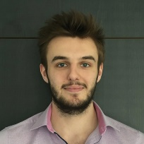
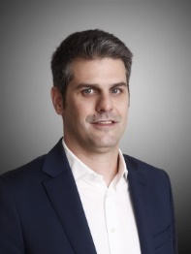
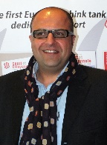
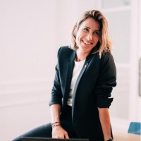
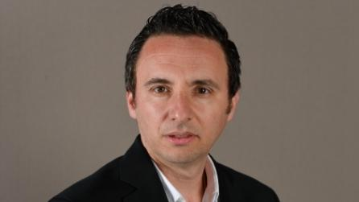
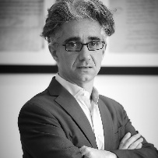
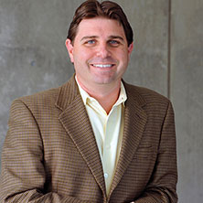
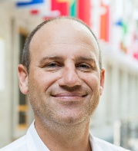
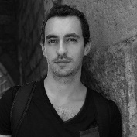
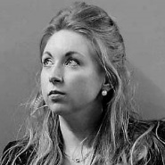
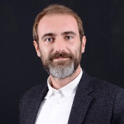
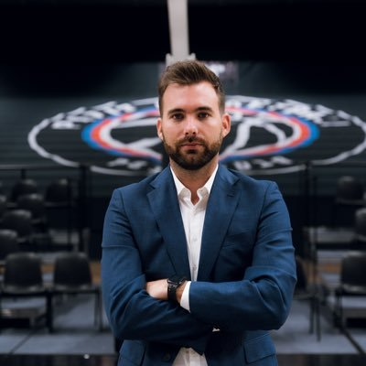
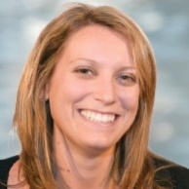
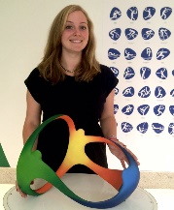
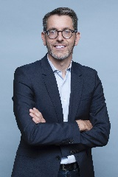
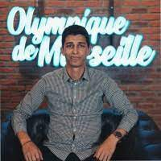
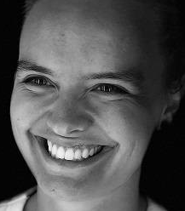
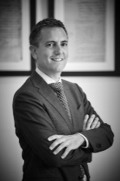
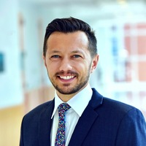
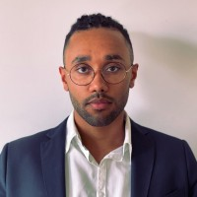
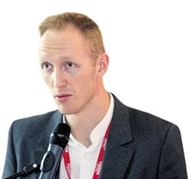
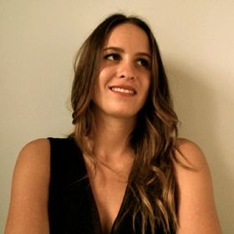
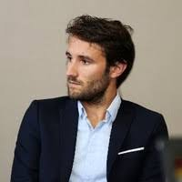
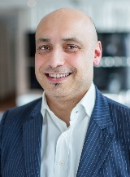
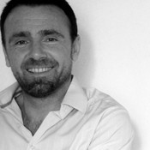
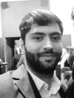
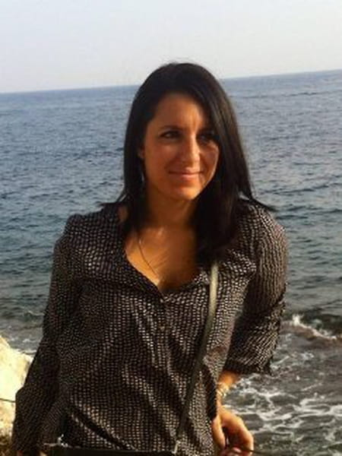
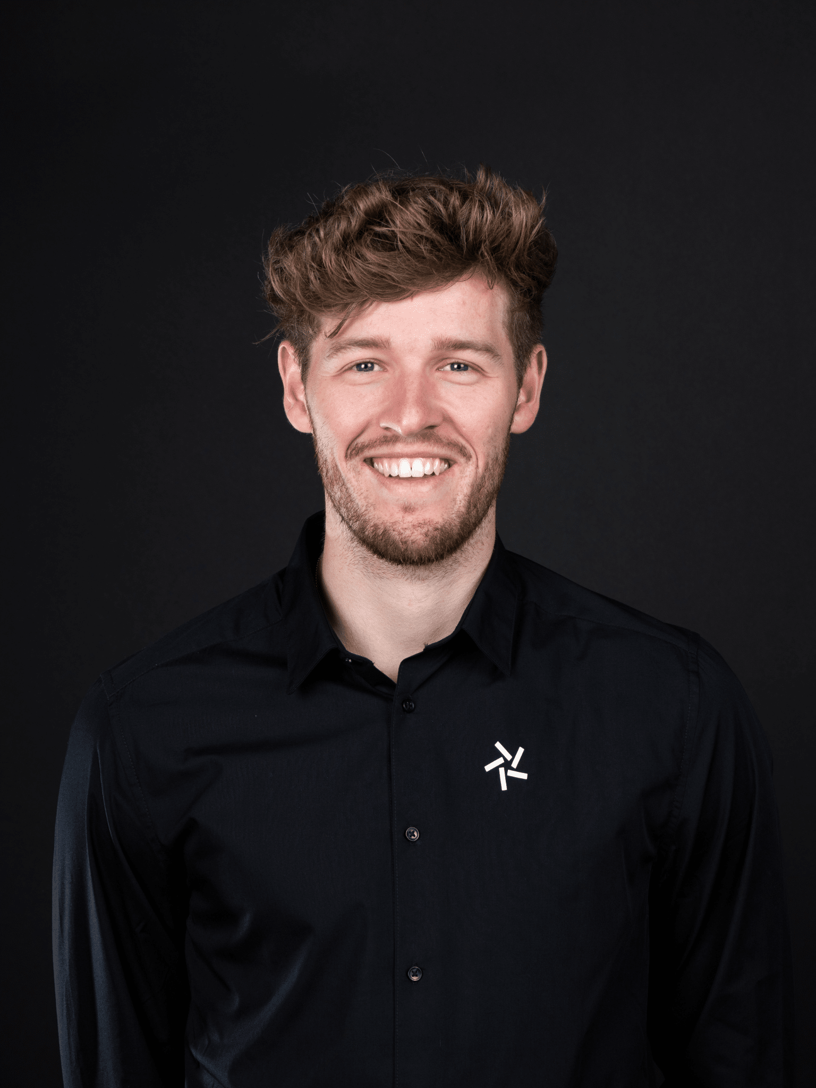
Academics (7)
Professionals (8)
Academic + Professional + Alumni
Colleen
Bee
François Carrillat
Aurélien
François
Christophe Durand
Sylvain
Vachier
Thomas Bouvrande
Marie-Amélie Guillet
David Rouger
Jean-Philippe Danglade
Academic + professional (consulting+executive)
39 weak ties
Gregorio Fuschillo
Robert
Simmons
Werner Boucher
Julien Berenger
Alain
Ghibaudo
Marina Caiazzo
Academics + Professionals (5)
Professionals + Alumni (19) → 49 % in 2023-24
Lionel Maltese
Fabrice
Rizzo
Daniel
Ladik
Frank
Pons
Michael Weisz
Aurélie Fersing
Damien Innocenti
Alejandro Requena
Emilie
Llorens
Amélie
Bouan
Benjamine Causse
Ilyes Chaibdra
Tea
Stefani
Thilo
Kunkel
Joakim
Kudawoo
Julien
Lepron
Alizée
Chantreau
Kevin
Geoffroy
Vincent Chaudel
Romain Sombret
Jean-Michel
Marmayou
Mohammad
Al Nimer
Charlotte Veyron
Lucas
Vignais

Slide 8
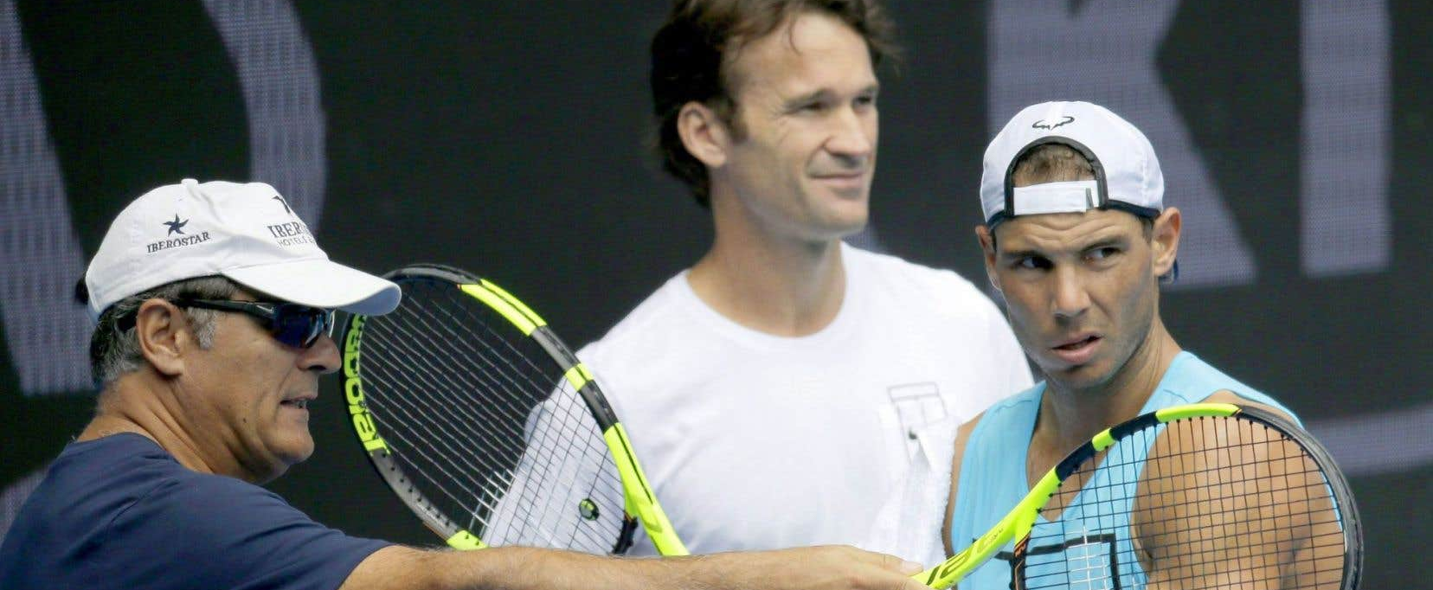
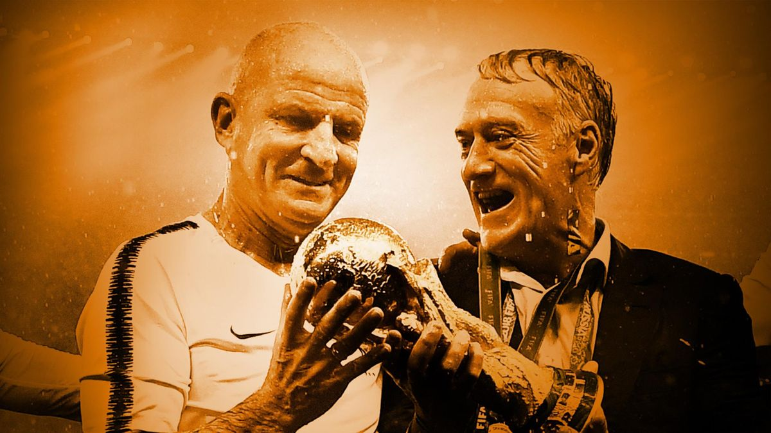
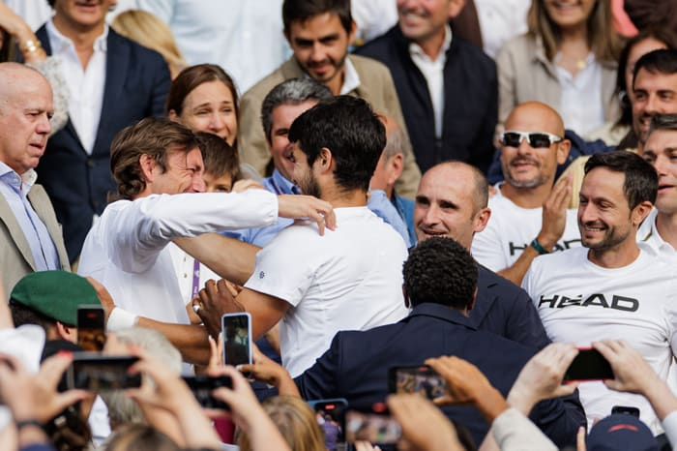
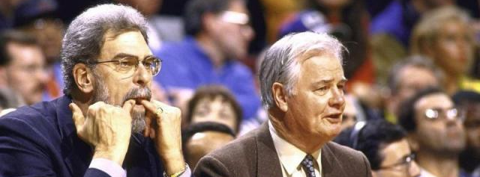

Slide 9
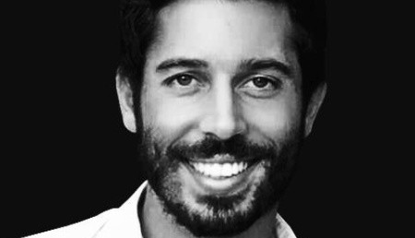






Slide 10





We teach what we are doing in sport business

Slide 11

We are « hardworkers »

Slide 12



We will try to make « grit students » to become « grit & great » sport business women and men

Slide 13


Slide 14





Slide 15



PASSION
WEAK TIES MANAGEMENT

Slide 16







Slide 17






