Slide 1
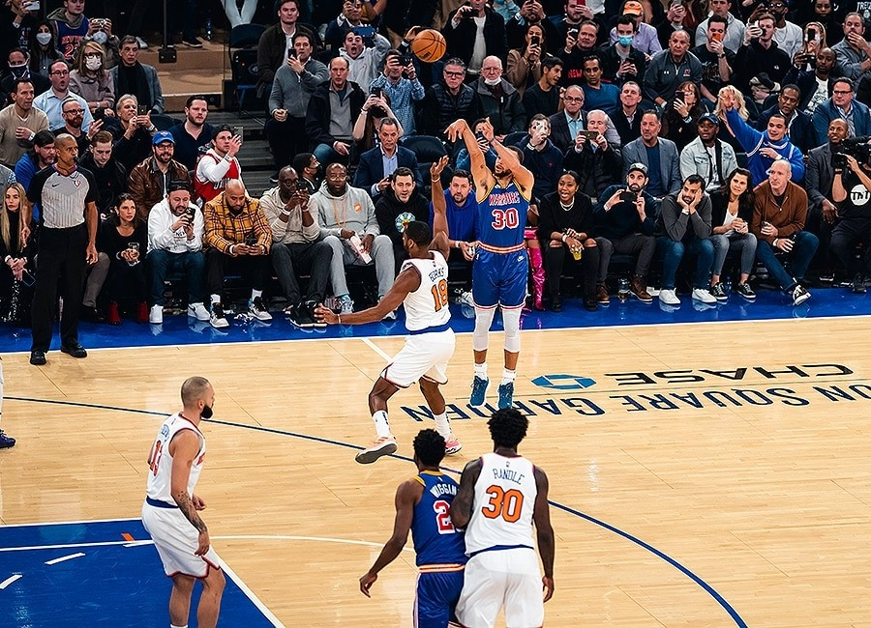
Strategic Sport Business Management
Lecture 1
Lionel Maltese
Maître de Conférences Aix Marseille University – CERGAM IAE Aix-en-Provence - #OIMS Laval University Canada
Associate Professor Sport Business Management Kedge Business School
Senior consulting sport business management
Twitter : @lionelmaltese

Slide 2
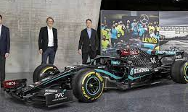
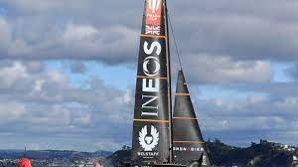

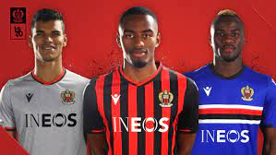
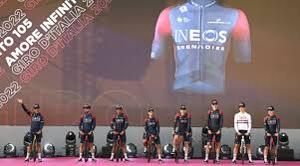
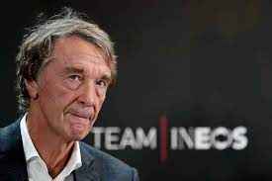
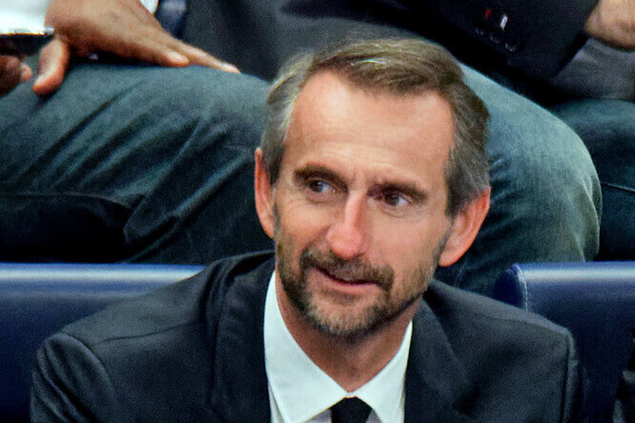
Sir Jim Ratcliffe, Chairman of INEOS said, “I am delighted to welcome Jean Claude as CEO of INEOS Sport with his many years of experience across different sports. We have high ambitions for all our sports teams with a particular ambition to raise our standards in football and Jean Claude will bring an entrepreneurial and innovative flair to all our teams.”

Slide 3
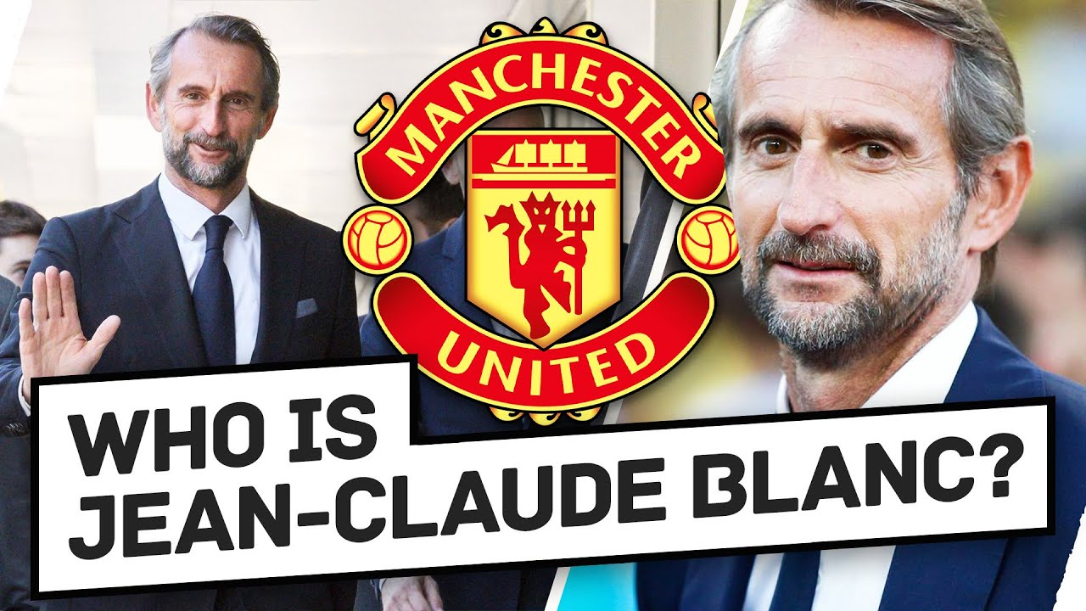
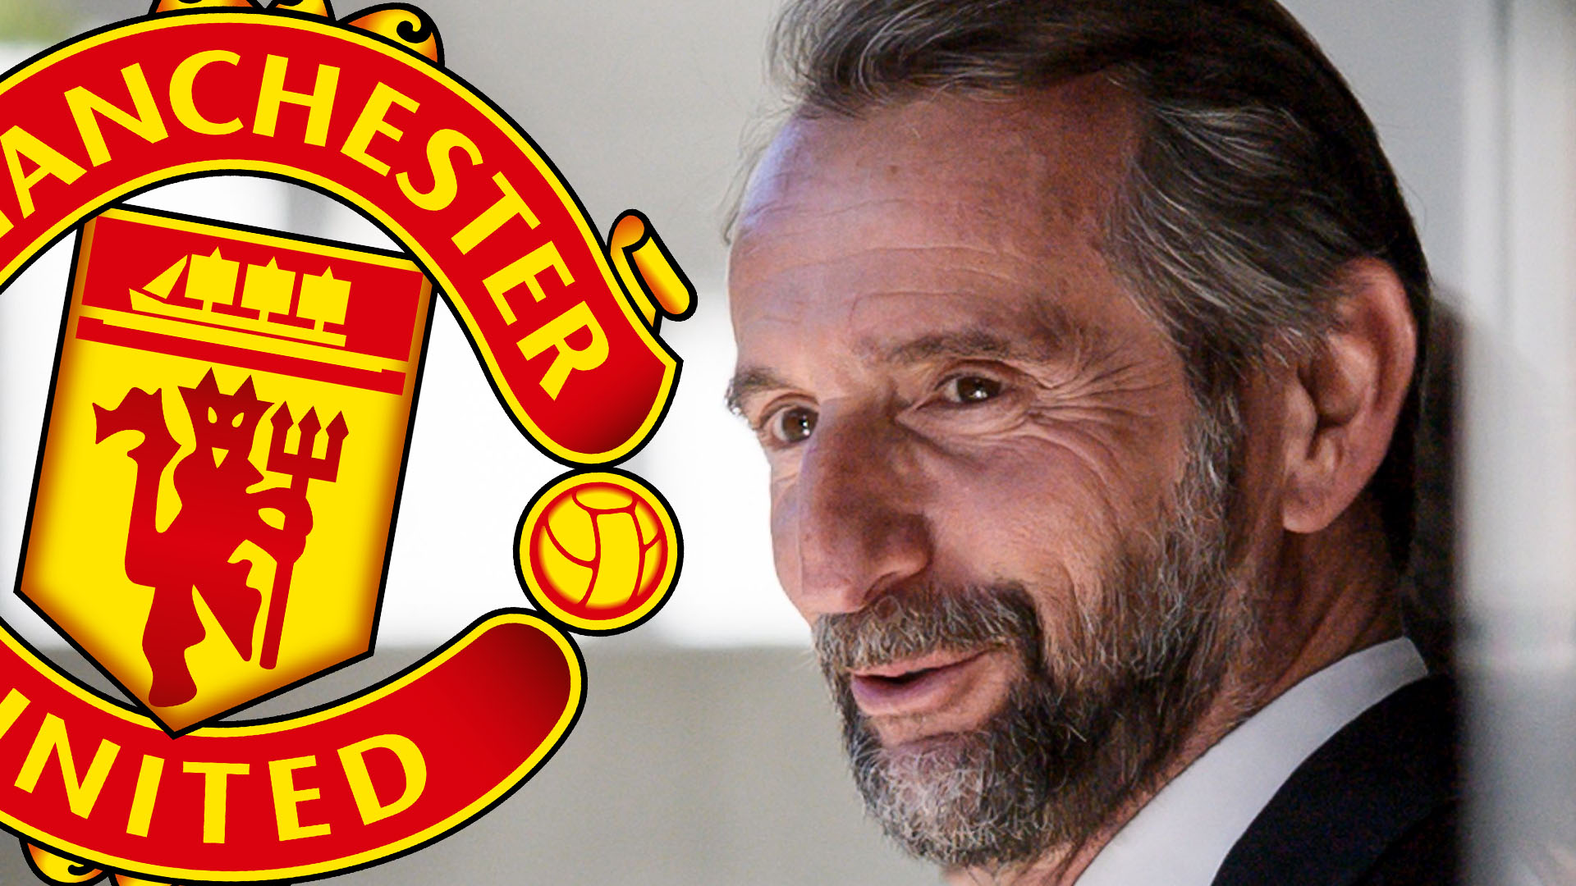
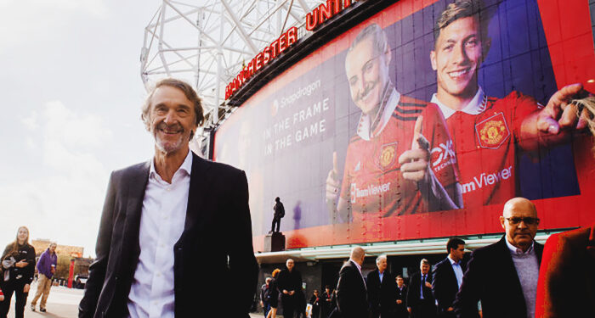
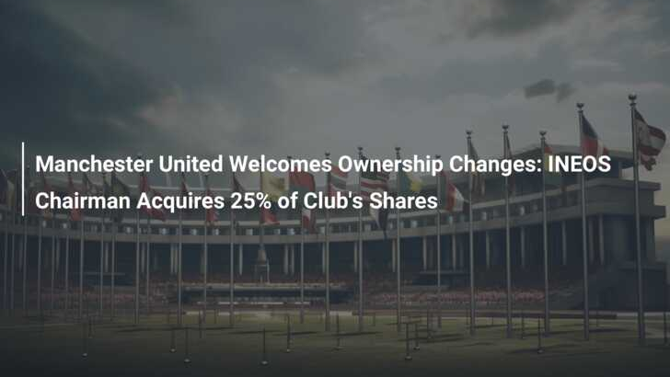

Slide 4
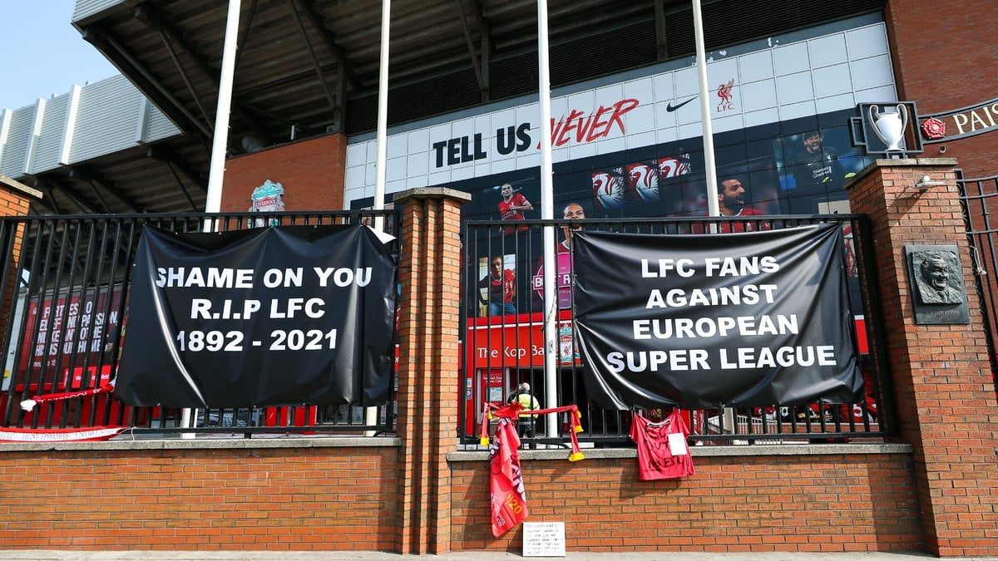
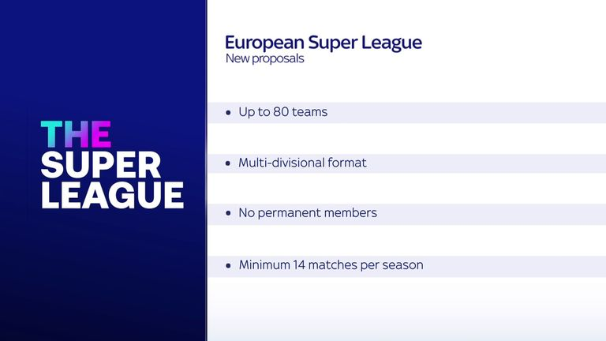



Slide 5


Slide 6
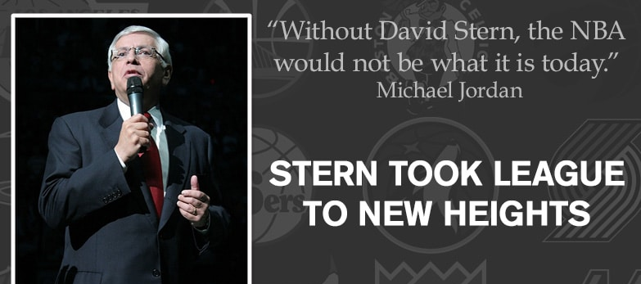
TIME IS A RESOURCE – TIMING IS A COMPETENCY

Slide 7
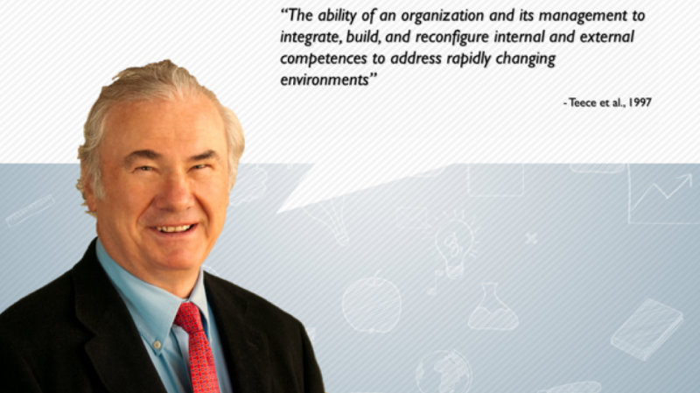

Slide 8
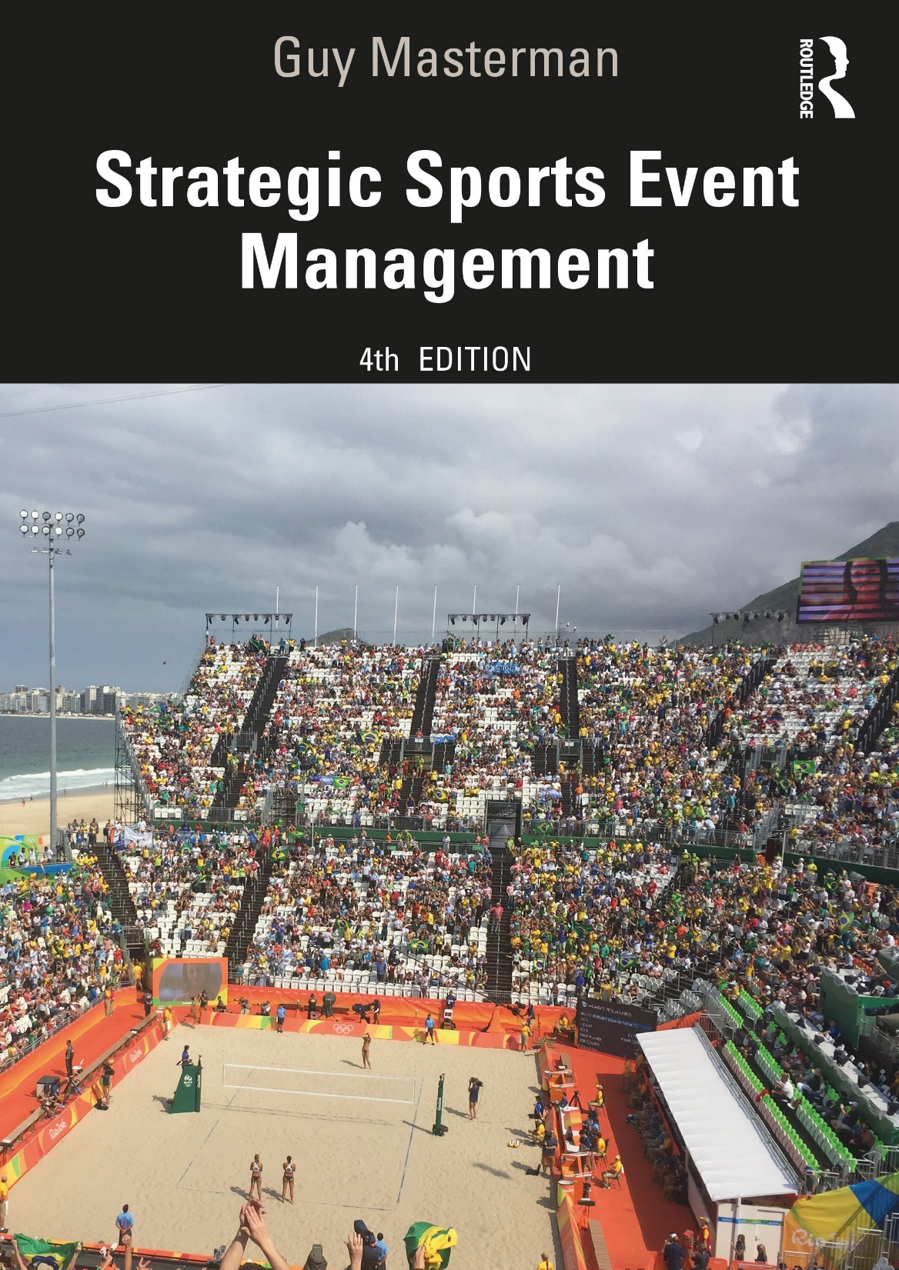

?

Slide 9
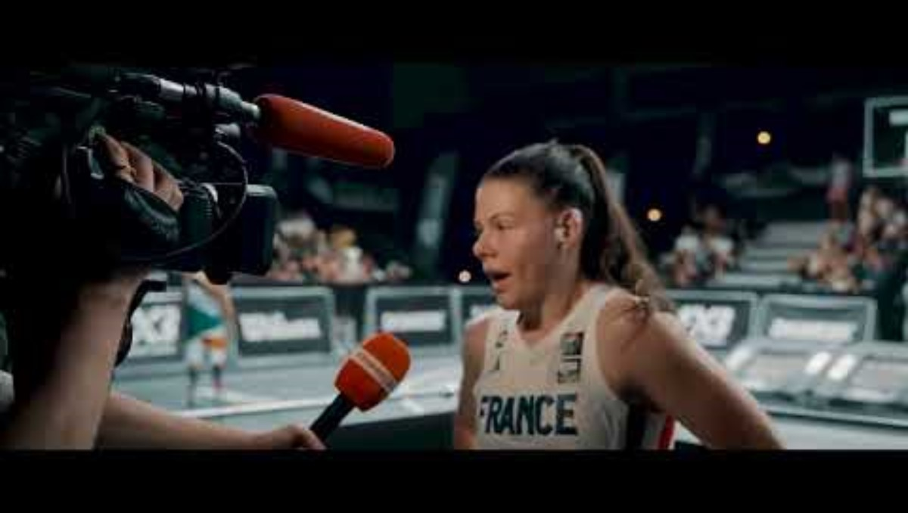

Slide 10
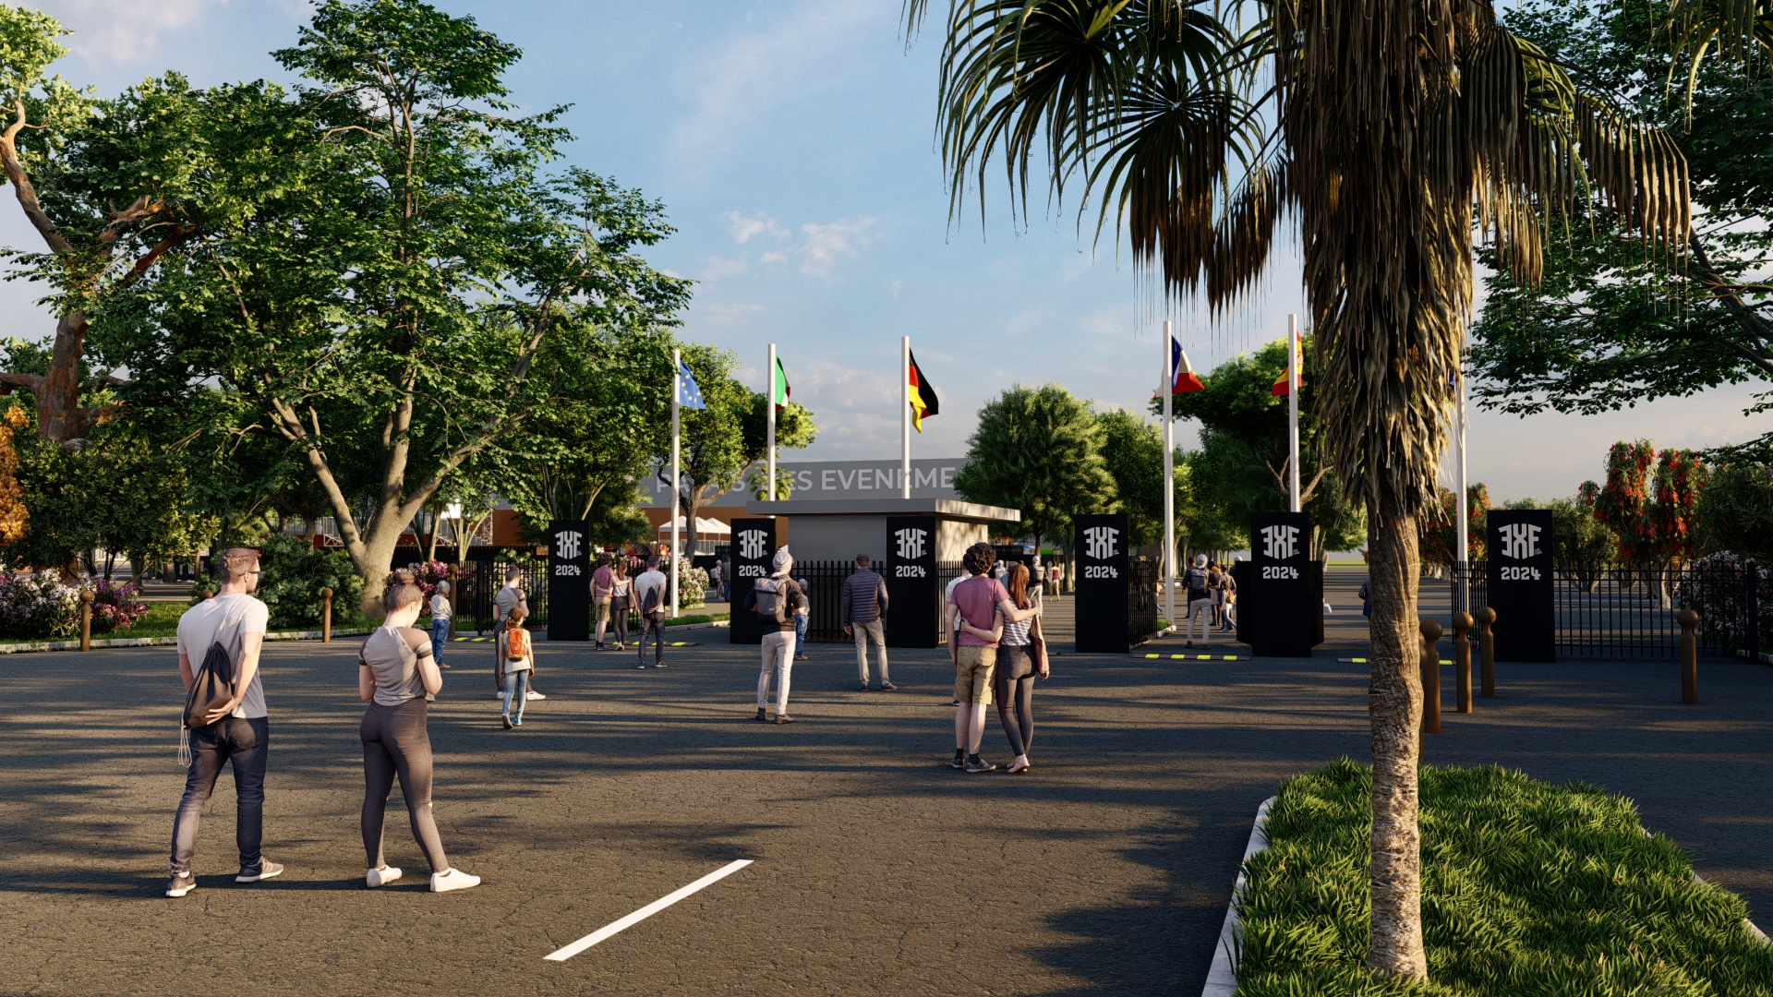

Slide 11
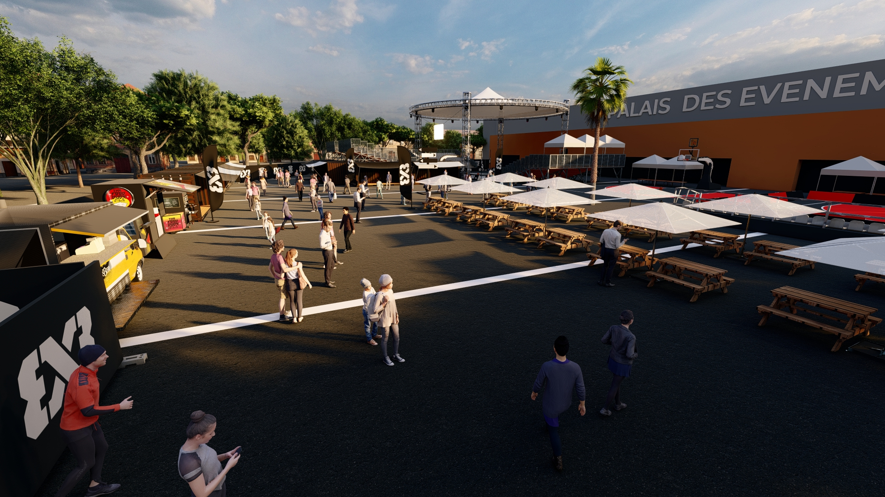

Slide 12
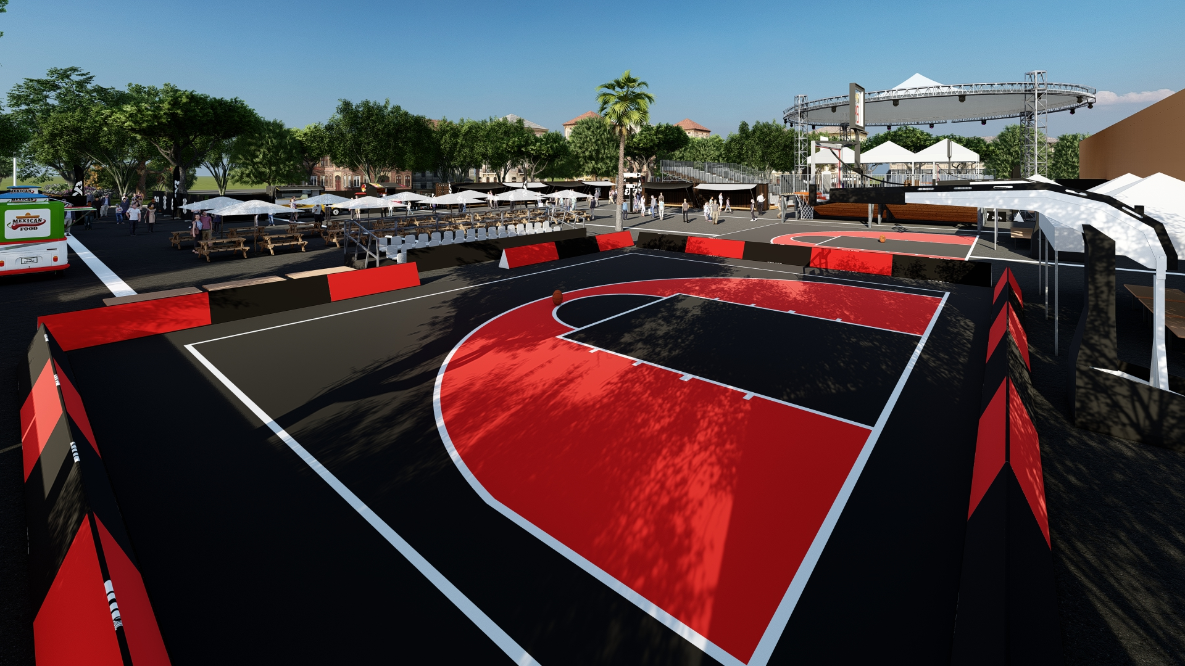

Slide 13
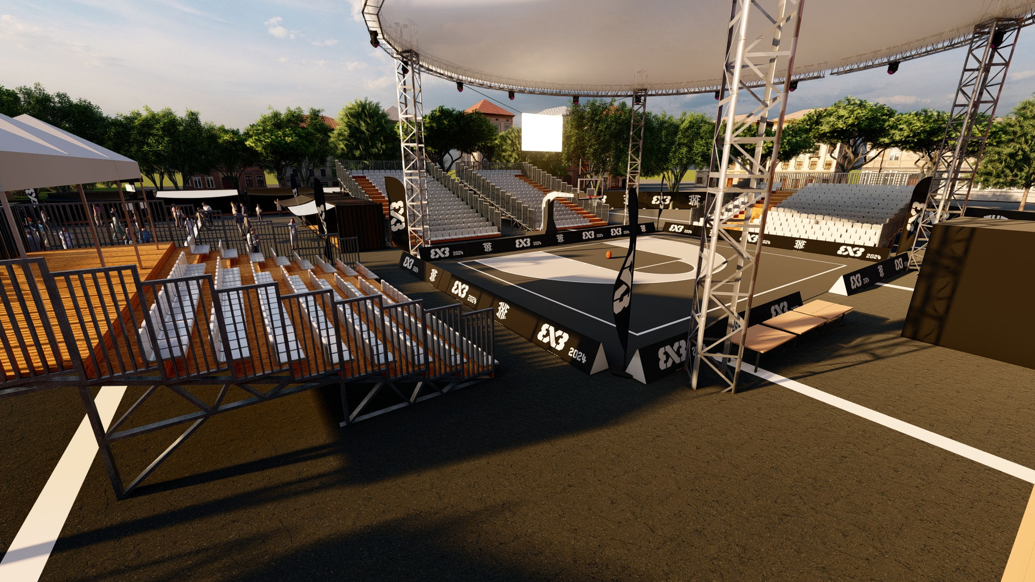

Slide 14
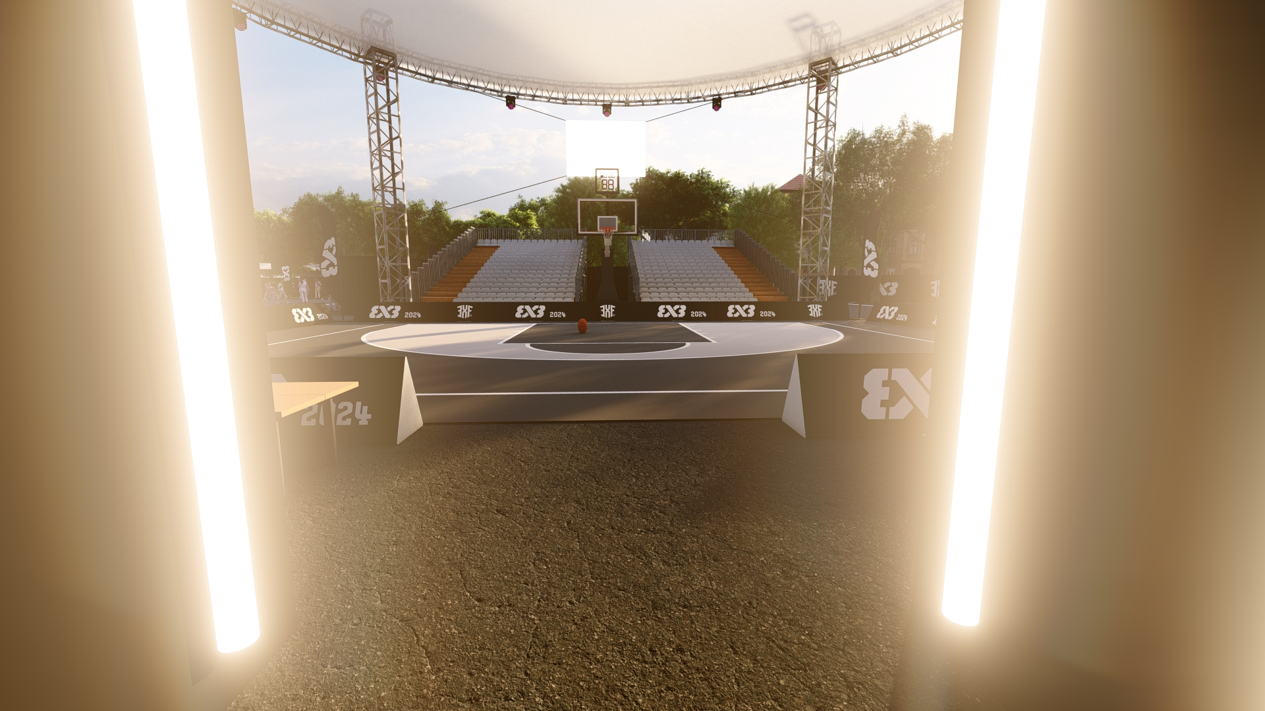

Slide 15
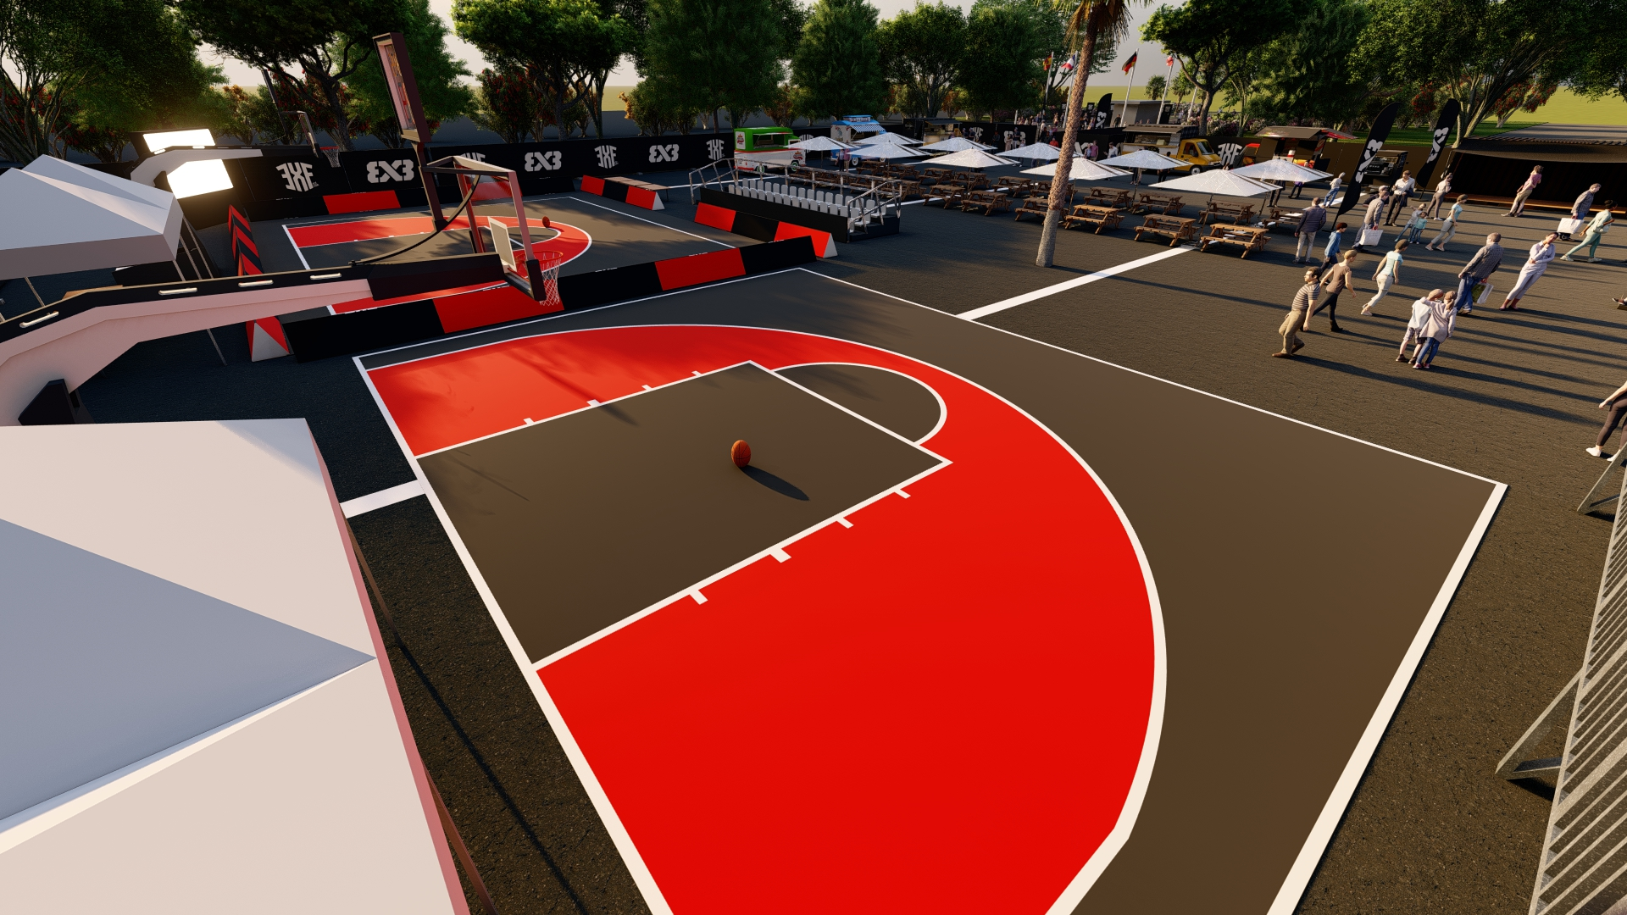

Slide 16
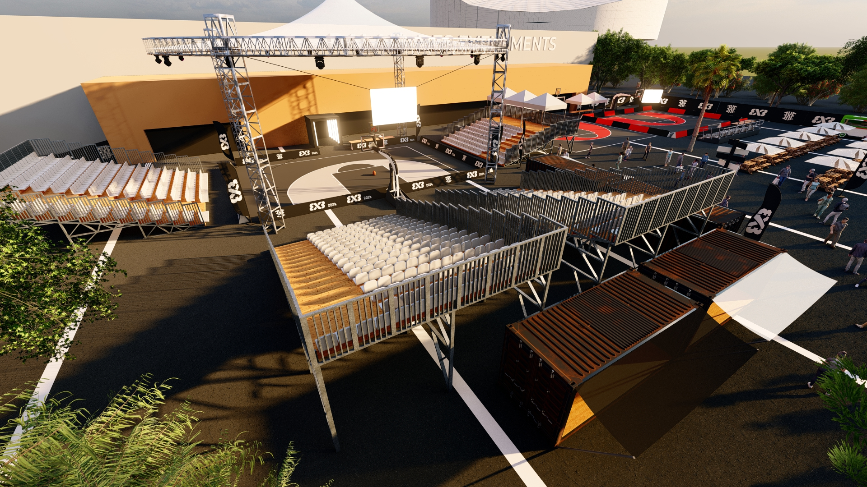

Slide 17
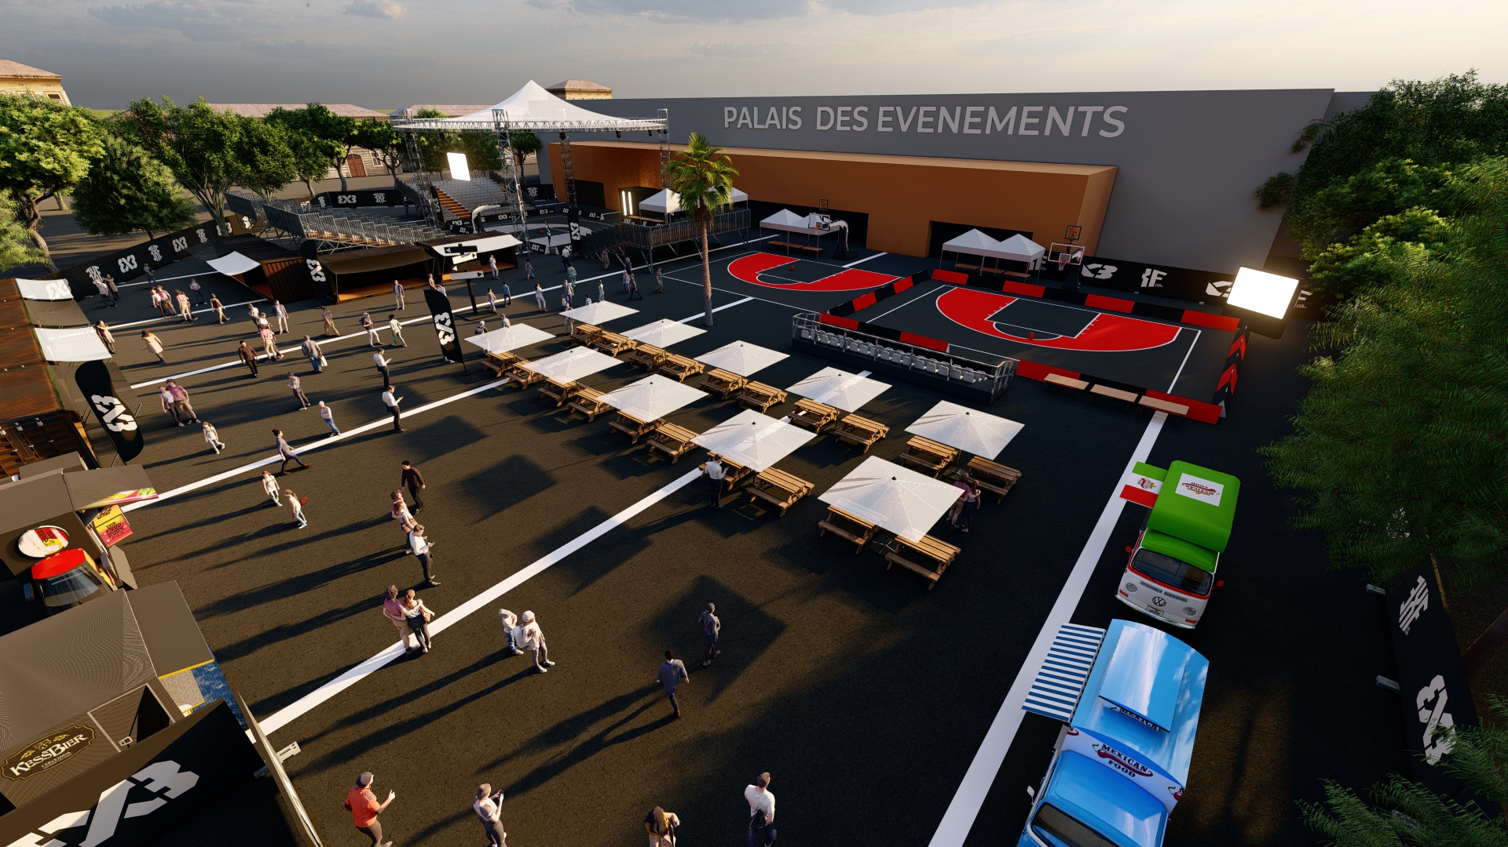

Slide 18
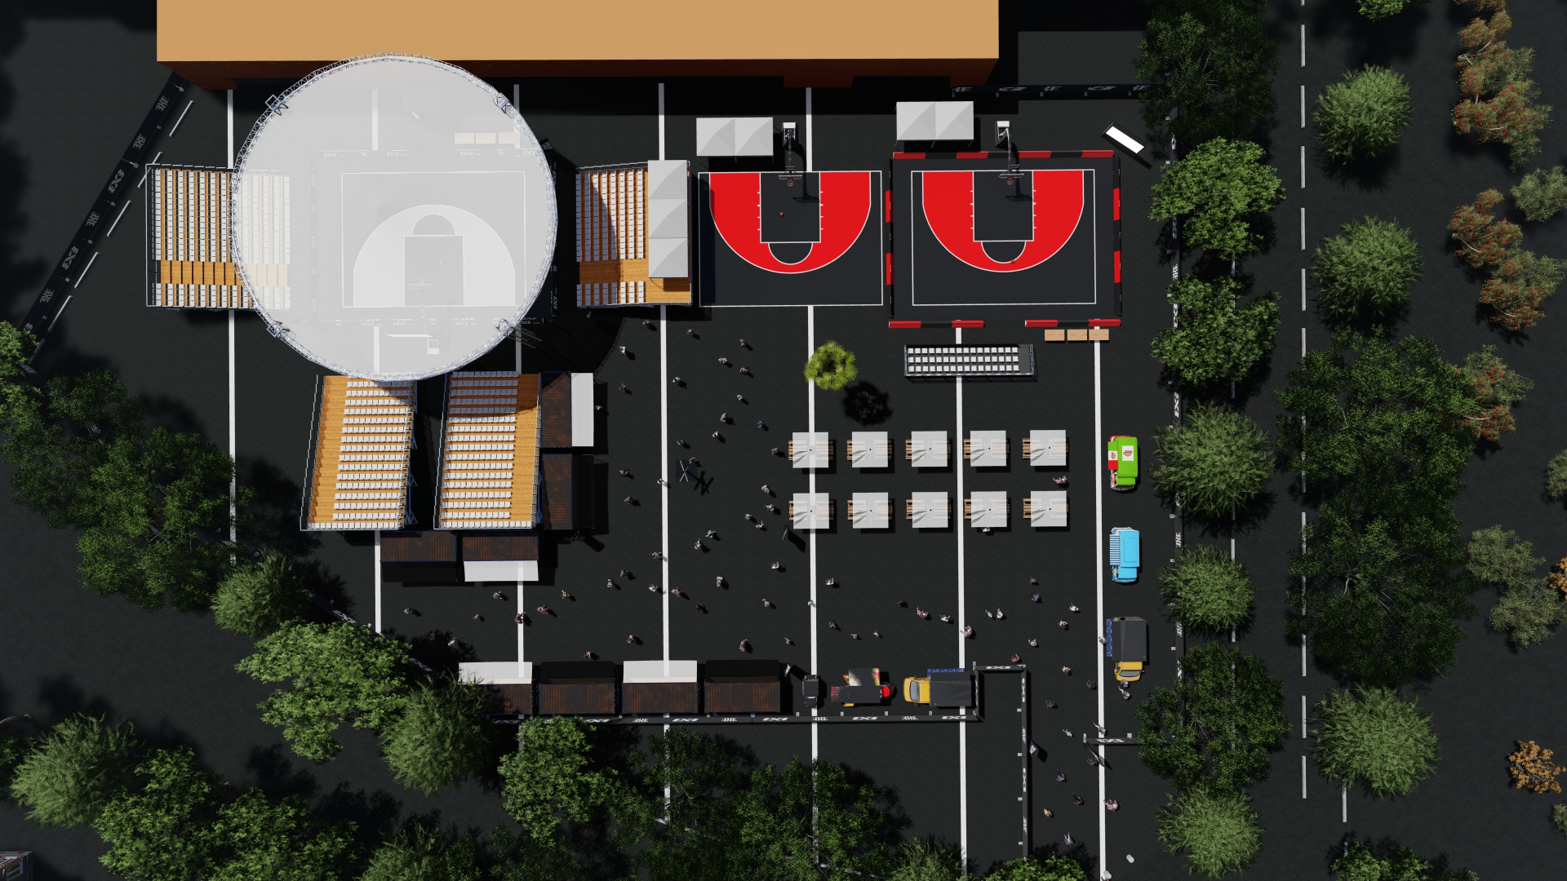

Slide 19
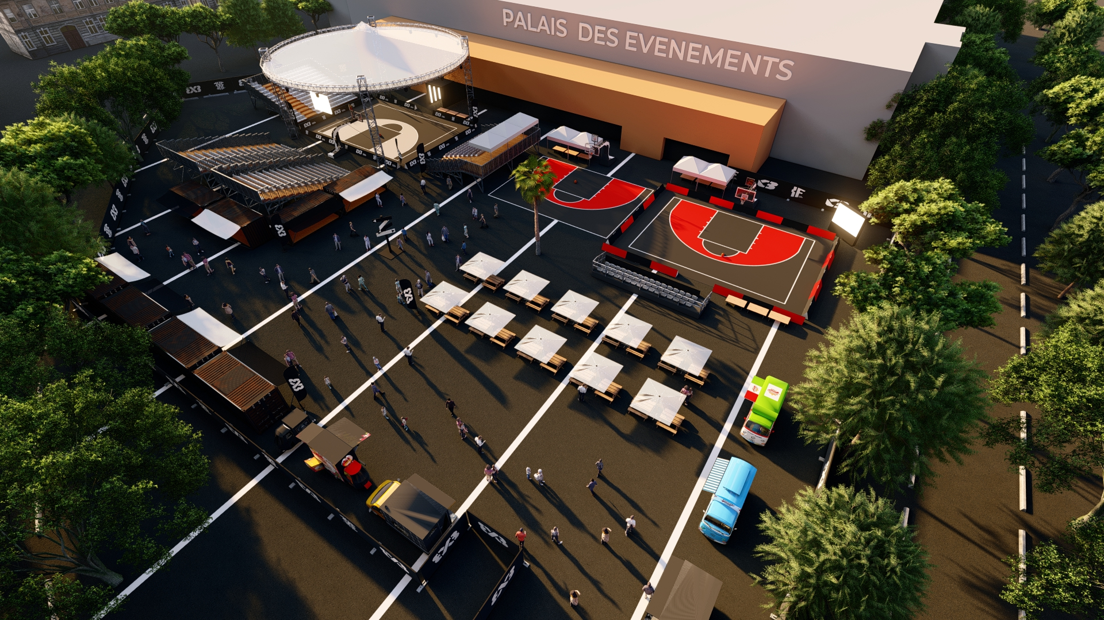

Slide 20
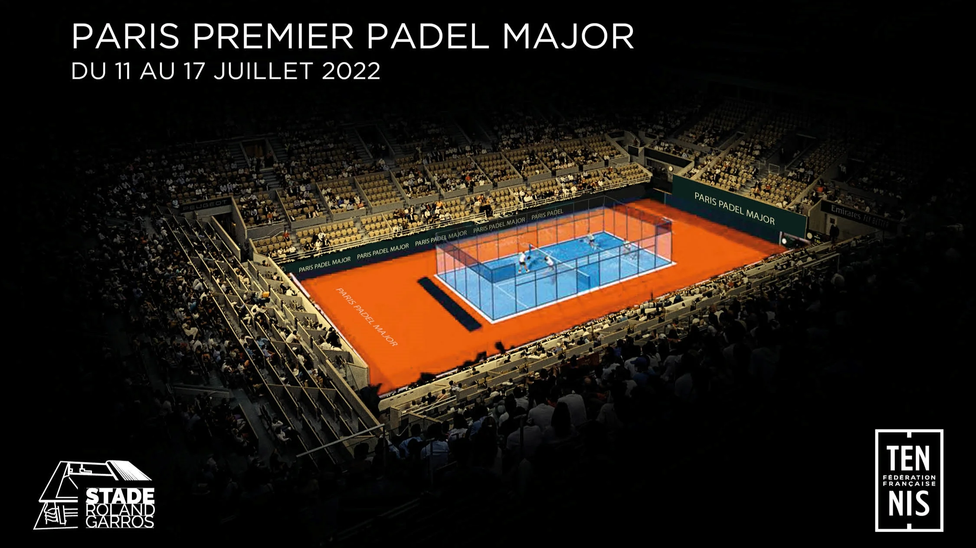

Slide 21


Slide 22
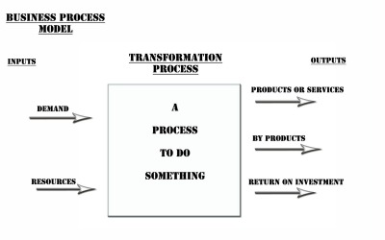

Slide 23
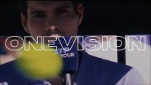

Slide 24
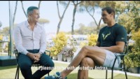

Slide 25
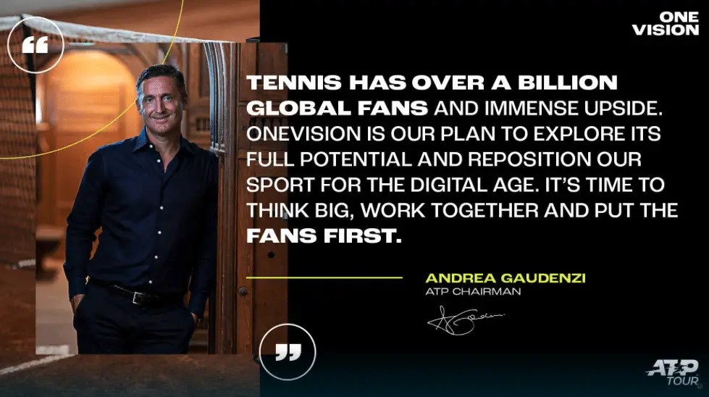

Slide 26
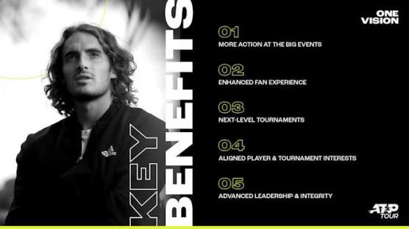

Slide 27
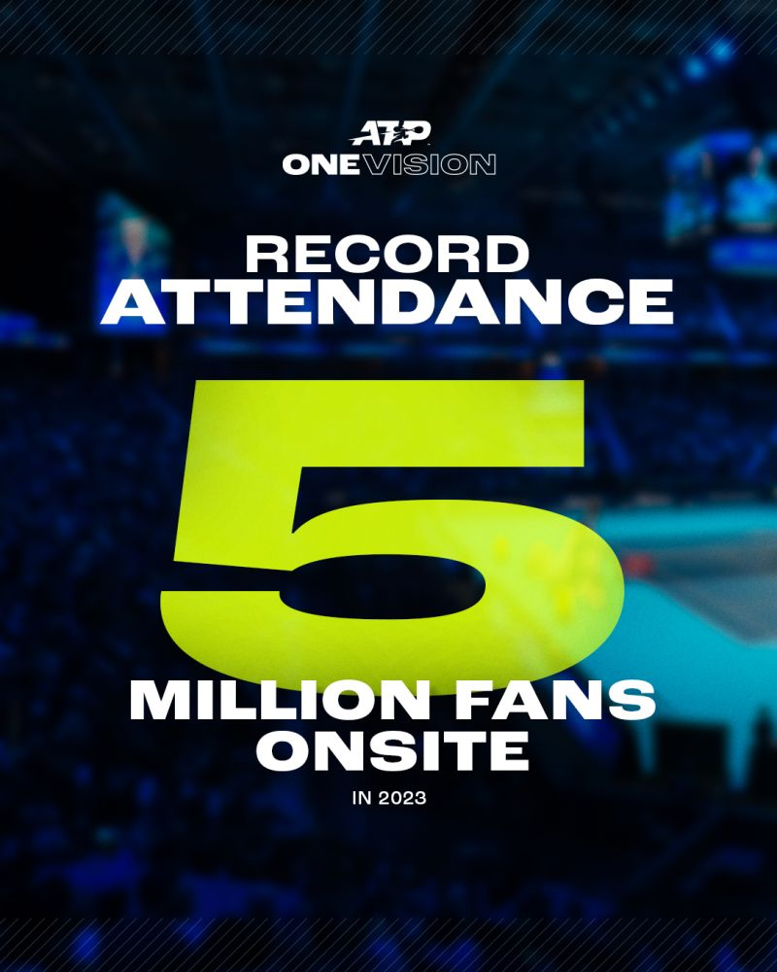
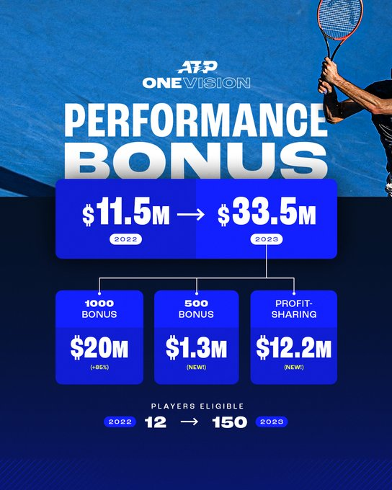

Slide 28
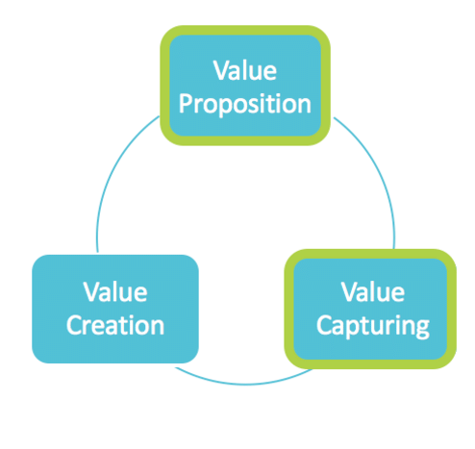
Seminar DNA

Slide 29
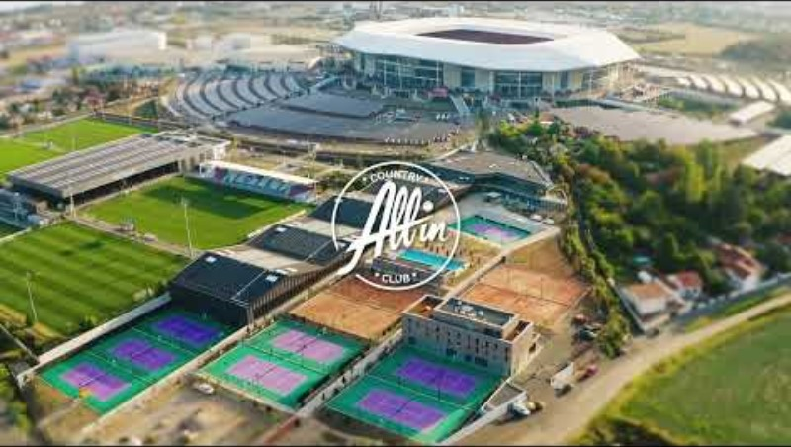

Slide 30
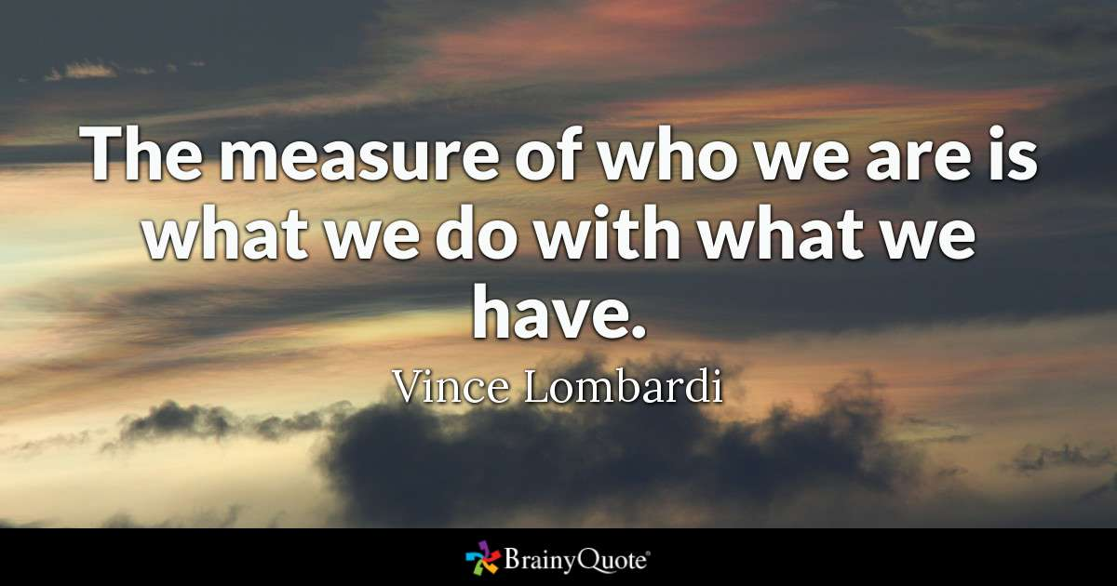

Slide 31


Slide 32
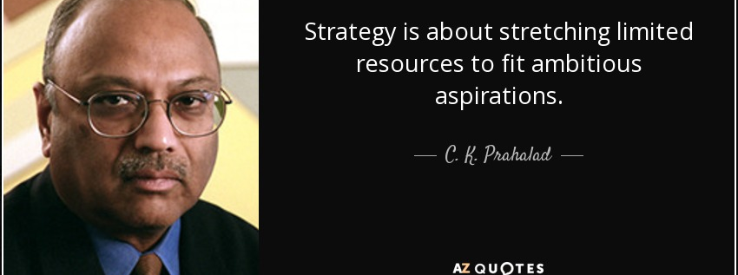
What is strategy ?
"Strategy is the direction and scope of an organisation over the long-term: which achieves advantage for the organisation through its configuration of resources within a challenging environment, to meet the needs of markets and to fulfil stakeholder expectations".

Slide 33
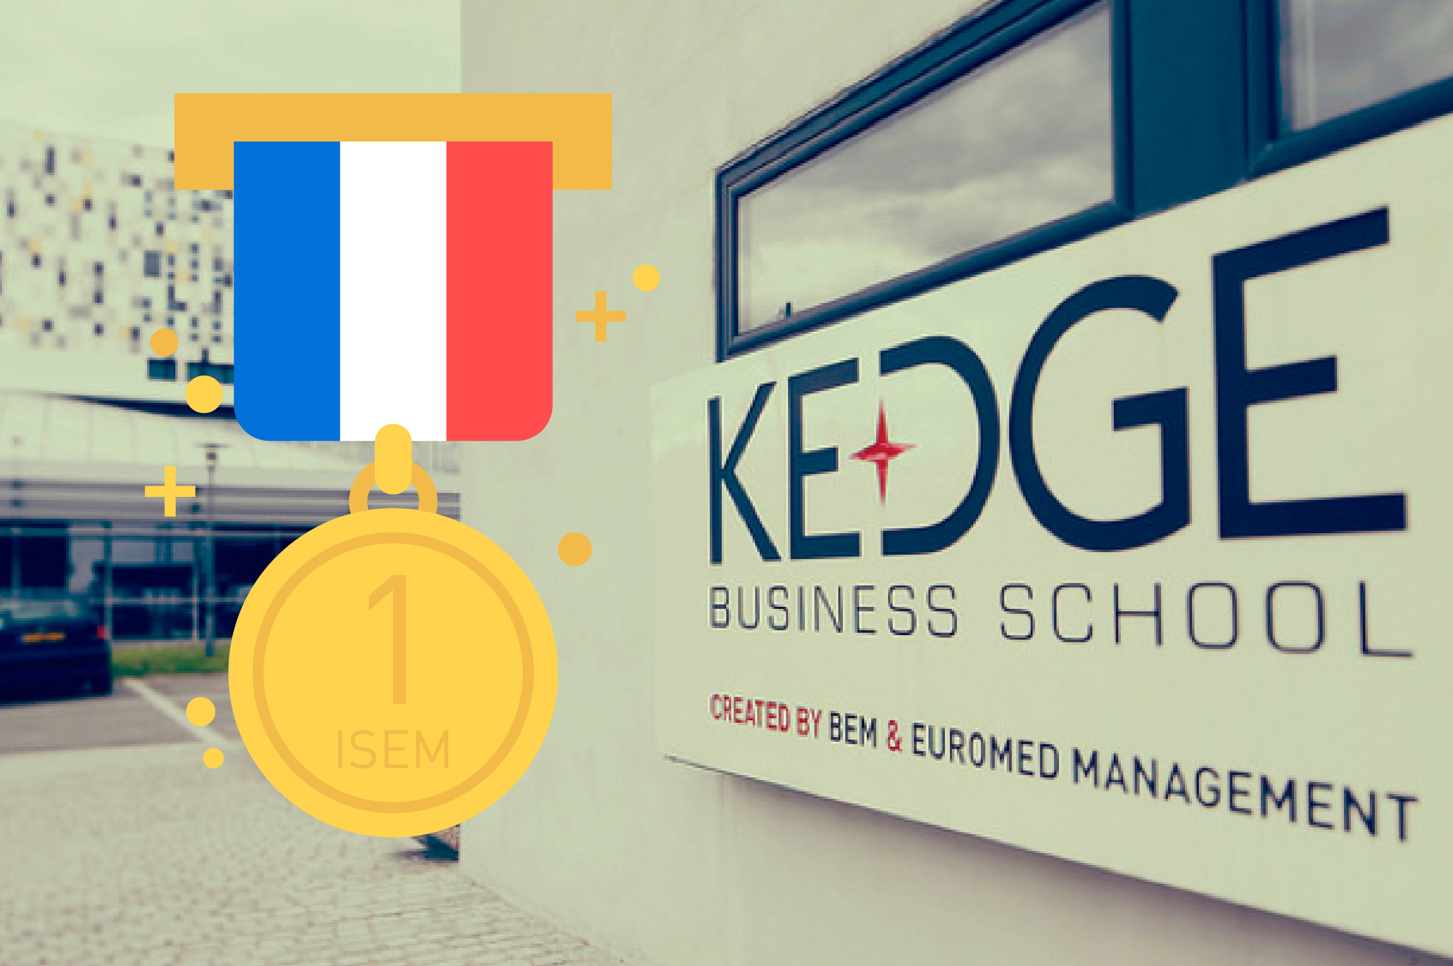

Slide 34
Kedge Business School & Sport Business : strategy ?
Resources & Competencies ?
JPD
LM
JMM
FR
+
Network
Alumni
Ms ISEM
(N1 France
Top 10 World)
Msc Marketing
Summer School
PGE (ESC)
Research
N1 Europe
Networks
Alumni
Companies
Institutions
Academic
(Project)
Communication
Media
N1 (School)
Business Model ?

Slide 35
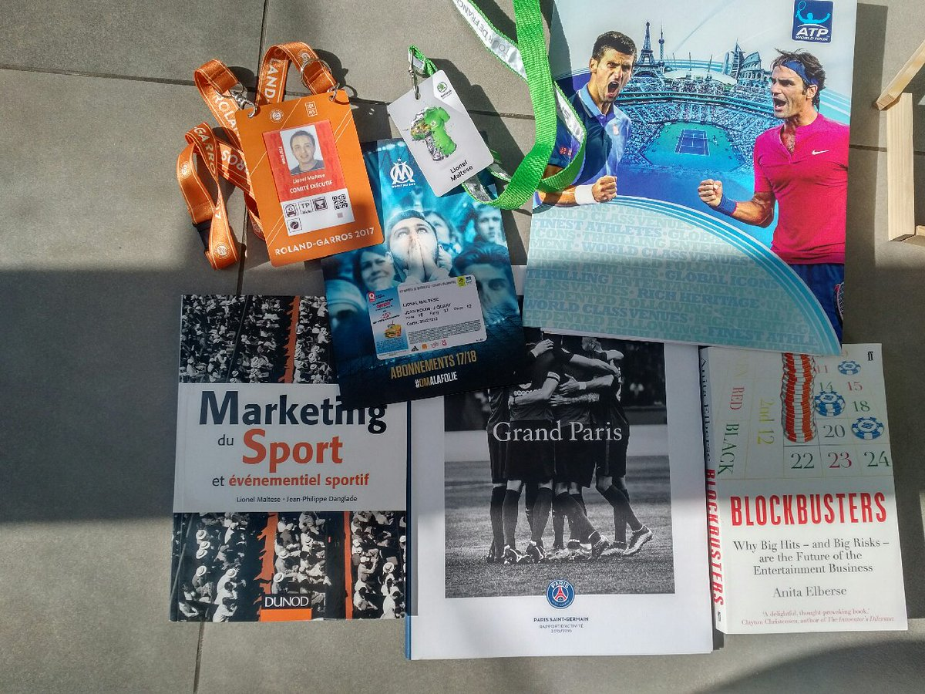
My job for you
Resources & Competencies = Assets?
Be reputational to promote you ! Professional & academic publications – business – networks - alumni
Be relational : Attract experts both academics and professionals including alumni to tranfert knowledge and competencies
Be strategic : Students help for selection
Be Efficient : ?

Slide 36
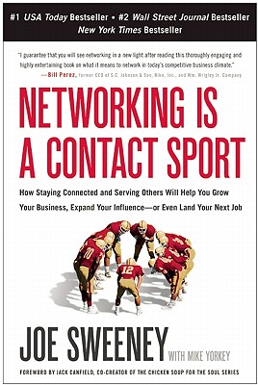

Resources & Competencies :
Value Proposition ?
Value Creation ?
Value Capturing ?

Slide 37
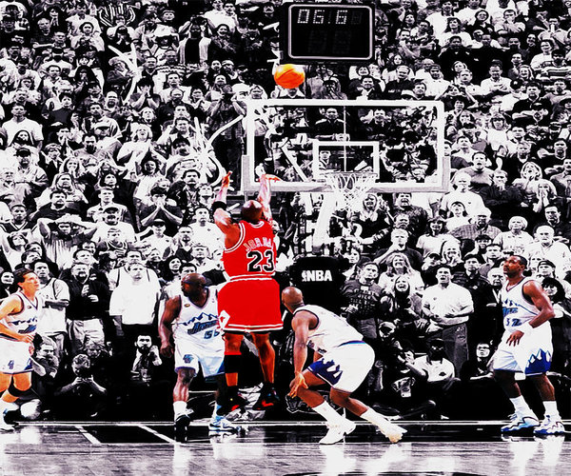
SPORTAIMENT BUSINESS
AUDIENCIES
PLACE
&
MOMENT
FOR
FANS
Resources & Competencies ?

Slide 38
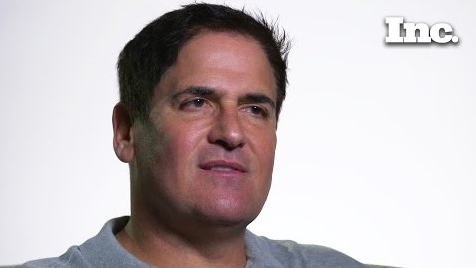

Slide 39
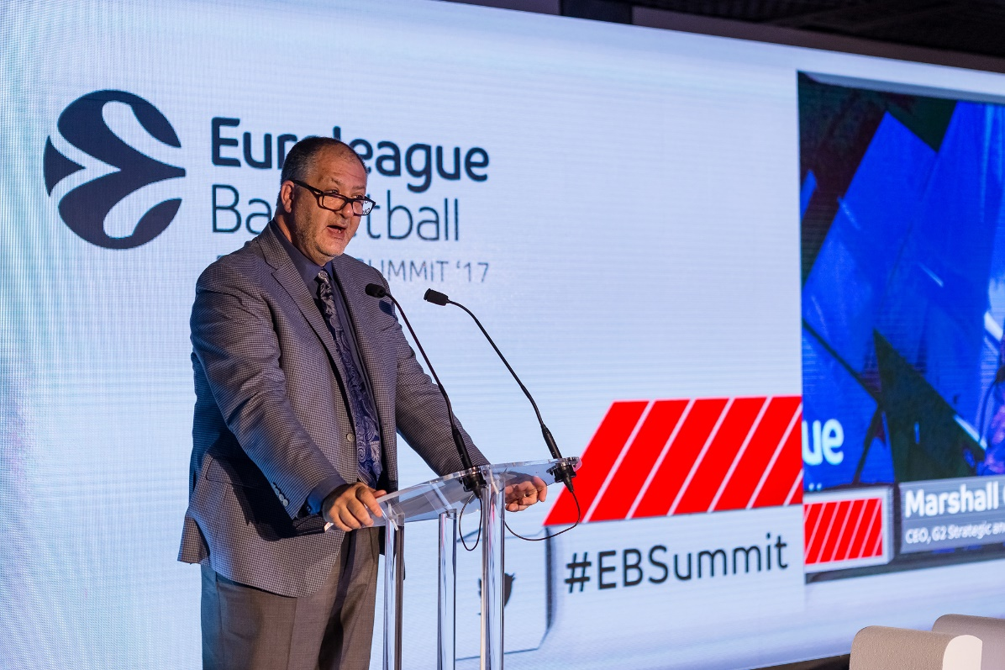
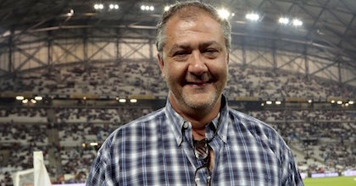
Marshall Glickman
CEO EUROLEAGUE , former president of the NBA’s Portland Trail Blazers
Over the last four decades, sports in North America has evolved from pure competition to business…from game to entertainment. Although the quality of competition has remained the centerpiece, North American sports culture is primarily motivated by money.
In France, as in most European countries, the sports culture has historically been driven by the competitions themselves, so consumption trends are not comparable. That said, there is no question that economic reality is driving French sports organizations to become more professional and oriented to business and profits.
From the perspective of an American who has extensive experience working with European and French sports organizations, finding the right balance between economics and culture is precisely the right recipe for success.

Slide 40

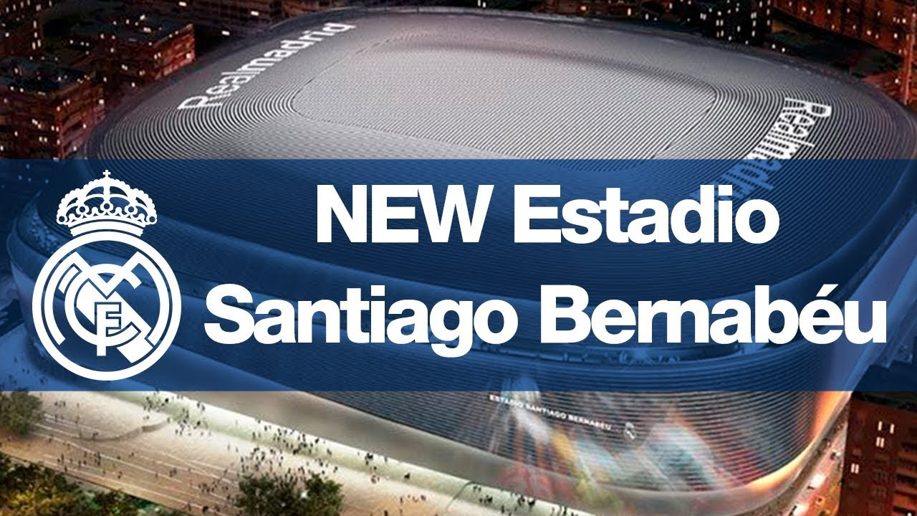
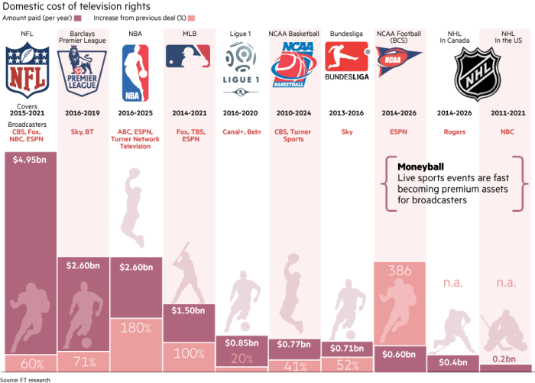
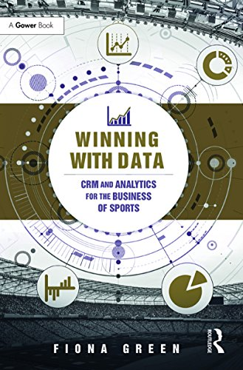
New Sport Business model ?

Slide 41
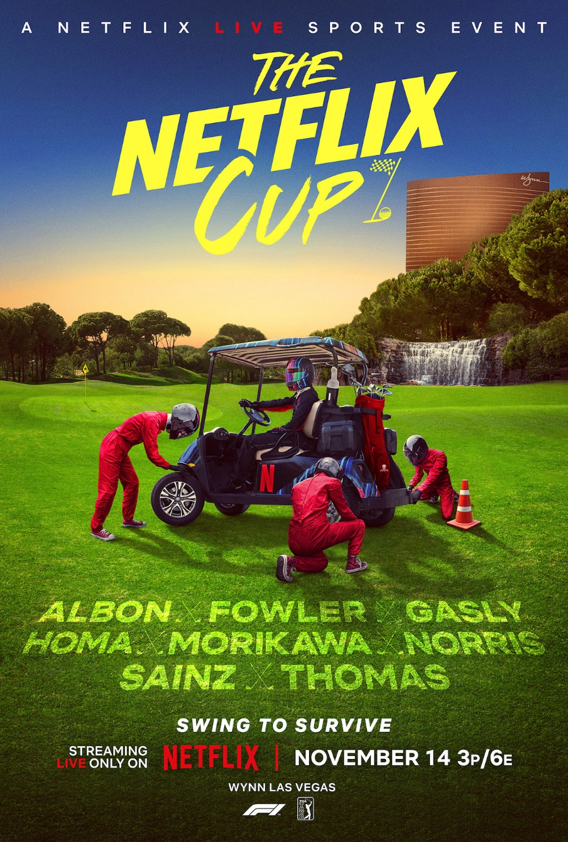


Slide 42



Slide 43


Slide 44


Slide 45


Slide 46



Slide 47

Assets Manager : the « road » for EFFICIENCY ?

Slide 48






The right effort allocation
Reducing costs of inputs
To achieve the goals

Slide 49






Slide 50

Key questions
Goals ?
Strategic vision ?
Efficiency ?
Actors ?
Resource or asset ?
Mission ?
FFT action for key stakeholders ?
Clients and Suppliers ?
Value proposition from FFT ?

Slide 51
Strategic triangle model
Competencies for non profit organizations
Clubs
Resource
2. reservoir
1 $ + Reputation
Sport Competencies
Business Competencies
Professional
Tennis
Players
Resource
4 Reputation
5 Community
Events
Asset
1 $
3 Reputation
Professional Competencies

Slide 52

Competencie ?
Success comes from knowing that you did your best to become the best that you are capable of becoming. John Wooden
EXPERIENCE
Knowledge
EXPERTISE
Know-How
TEAM
Being
(know how to be)

Slide 53



My strategy : creating my ecosystem !
Teaching
Media
Communication
Students
Alumni
Customers
Applied Research
Business
Consulting

Slide 54


Slide 55


Slide 56
Key words
Strategy
Sport
Events / Clubs
Ecosystem
Assets
Business Model
Efficiency
Relations
Reputation
Fans
Culture

Slide 57

Personal reflexions…
Sport Business = SME Market
Business comes from Media for mega event and championships
Stock of resources are often important but competencies not…
Sport = unique communication platform but we can define it as a moment and a place
Unicity in sports = Emotion as a marketing tool to attract customers and stakeholders
Your Job : understand the offer and help to sell or market sport event products then be a sport manager

Slide 58

Business Ecosystem (Moore, 1993)
“An economic community supported by a foundation of interacting organizations and individuals—the organisms of the business world. The economic community produces goods and services of value to customers, who are themselves members of the ecosystem. The member organisms also include suppliers, lead producers, competitors, and other stakeholders. Over time, they coevolve their capabilities and roles, and tend to align themselves with the directions set by one or more central companies”.

Slide 59



Club (or franchise) VS sport event
Clubs and Franchises :
Contracts : transactions and salary
Motivation : training, selection, financial premiums
→ Athlete = “asset” for the managers
Events :
Fees (ATP, PGA for instance)
No control of sport performance by the managers
→ Dependency of the athletes (calendar for instance) and their professional associations (ATP, PGA, UCI…)
Professional athletes management and control

Slide 60

Main “goals” for this seminar !
Sports organizations [professional Events & Clubs] = management “stake” ?
Proposition of a new Strategic Management and Business Model for these organizations !
Understand & manage key factors of success (or failure) : sponsoring, public relations, reputation, physical (stadium) & local factors, managerial skills…
Develop your professional skills on : strategic analysis & formulate Sport Organizations Business Plan (ROADMAP) : STRATEGIC PLANNER for sport organizations
PROJECT TO STRATEGIC ACTIONS !

Slide 61

Focus on “Event Concept”
In sports context, “event” is everywhere :
National Championships (every week ! : NBA, MLB, NFL, NHL, LNF, Top 14, Premier League…)
National and International Competitions (JO, World Cups…)
One shot events (every year) : Roland Garros, Tour de France, ATP, PGA, Superbowl, Formula 1… exhibitions…
…

Slide 62


Slide 63



Slide 64








?

Slide 65


Slide 66

But… we need definitions (Covell and al., 2007)
Organization : « Any group of people working together to achieve a common pupose or goals thant could not be attained by individuals working separately »
Management :
  The coordination of human, material, technological, and financial resources needed for the organization ti achieve its goals.
  Responsibility for performance

Slide 67

But : what is performance for sports organizations ?
Performance indicators (Pis) give us an evaluation process that can provide objective and meaningful performance feedback to aid future decision making.
The methods of evaluation are both quantitative and qualitative but all the final results depend upon one or more manager’ interpretation (judgement)
The key for sport organizations : your stakeholders analysis.

Slide 68

Sport organizations – performance and stakeholders
You can evaluate returns for :
Media
Athletes
Sponsors
Institutions
Spectators
Cities
Suppliers
Owner
….
→ Various PIs for different objectives and muliple stakeholders…

Slide 69
Categorization of events
Scale of impacts (attendance, media, profile, infrastructure, costs, benefits)
High
Low
LOCAL
MAJOR
HALLMARK
MEGA-EVENT
Category of event

Slide 70

Categorization of events
Local or community events : Local consumers (Beach events, Corrida, Snowboard & Surf contest, ATP International Series Tournaments, National Events…)
Major events : Media interest (coverage & benefits) and capability of attracting significant visitor numbers (Formula 1, Master Series ATP, PGA…)

Slide 71

Categorization of events
Hallmark events : identified with the spirit or ethos of a town, city or region (synonymous with the name of the place) & very traditional (Wimbledon is the best example, 24H du Man, Paris Dakar, Masters Evian…)
Mega events : so large that they affect whole economics and reverberate in the global media (Olympic Games, FIFA World Cup, IAAF World Championships, Superbowl, March Madness, NBA, MLB, NHL Finals…)

Slide 72
Managing stakeholders into sport organizations ecosystem
Private sponsors
Public sponsors
Sport institutions
Event / Club
Organisation
Athletes
Suppliers
Spectators
Media

Slide 73

How to control external environment (stakeholders) and how to be independent to perform, to develop and maintain ?
Now before studying strategic analytic tools :
What is Strategy ?
What are the more “sensemaking” approaches to analyze a sports organizations and their stakeholders ?

Slide 74


Main Strategic Approaches
(Saias & Métais, 2001)
POSITIONING
MOVEMENT
S.W.O.T
5 Forces
Resource-Based View RBV
Permanent Transformation
Competitive
Advantage
STRATEGIC « FIT »
STRATEGIC
« INTENT »
Michael Porter & Co
Gary Hamel and C. K Prahalad & Co

Slide 75

FIT
What business are we in ?
S-C-P : Structure Conduct Performance
  The structure of the industry will dictate the conduct of firms and thereby their performance (most popular : SWOT or “five-forces” model (Porter, 1979)).
The big illustration is the 5 Forces Model (Porter, 1979).

Slide 76


Slide 77

INTENT
What are we able to make with what we have ?
RBV (Resource-Based-View, Wernerfelt, 1984, Barney, 1991, Grant, 1991) : certain assets (resources and capabilities) with certain characteristics will lead to sustainable competitive advantage.
Strategy dictated by unique resources and capabilities of the firm (what can the firm do best?)

Slide 78

Concepts definitions
Resources : stocks of available factors that are owned or controlled by the firm (Amit and Schoemaker, 1993)
Capabilities : a firm’s capacity to deploy resources, usually in combination, using organizational processes, to effect a desired end” (Amit and Schoemaker, 1993)
Dynamic capabilities : the firm’s ability to integrate, build, and reconfigure internal and external competences to address rapidly changing environments” (David J. Teece, Gary Pisano, and Amy Shuen).
Dynamic capabilities can be distinguished from operational capabilities, which pertain to the current operations of an organization. Dynamic capabilities, by contrast, refer to “the capacity of an organization to purposefully create, extend, or modify its resource base” (Helfat et al., 2007). The basic assumption of the dynamic capabilities framework is that core competencies should be used to modify short-term competitive positions that can be used to build longer-term competitive advantage.
Asset = resource + capability

Slide 79

ASSET ORCHESTRATION
If capabilities are dependent on co-specialized assets, it makes the coordination task of management particularly difficult.
Managerial decisions should take the optimal configuration of assets into account.
Asset orchestration refers to the managerial search, selection, and configuration of resources and capabilities.
The term intends to convey that, in an optimal configuration of assets, the whole is more valuable than the sum of the parts.

Slide 80
Resource Based-View : VRIO model (Barney, 1991)
Value
Rareness
Resources & capacities
Lead to
Sustained Competitive
Advantage
Organization
Inimitability
Non-Substitutability

Slide 81


Slide 82

Criteria for Sustainable Competitive Advantage and Strategic Implications

Slide 83



The strategy (tactical) is a function of the external environment (rival teams : opportunities - threats).
The trainer has a tactic adapted to the adversary and the players (resources) adapt to this positioning (diagram of play).
FIT : Soccer metaphor

Slide 84





The head coach "visionary" (or manager) has resources (players) and sets up a strategy (tactical) starting from these forces and weaknesses (resources), in order to face to certain opportunities or threats of the environment (air play, speed, physical engagement)
Intent : Soccer metaphor

Slide 85

So What ?
How can we “implement” that ? It’s very theoretical !
Your and my job : to be able to construct a business plan (development) with a “specific RBV analysis” (your “sensemaking background”), and furthermore :
Persuade and control our stakeholders
Maintain our performance
To be “ready” for new opportunities and threats because of very instable sports environment…
Managing resources & capabilities = core competency of a “modern” CEO in sport organizations

Slide 86

Categorizing resources
Barney (1991) : 3
Physical capital : technology, plants, equipment, geographical localization…
Human capital : formation, experience, networks - relationships…
Organizational capital : formal structure, control, routines, process, coordination systems…
Grant (1991) : 6
financial, physical, human, technological, organizational, reputation.
Wernerfelt (1989) : 3
Fixed assets : plants, equipment…
“Blueprints” : patent, brand, reputation
Teamwork “effects” : routines, habits, experience…

Slide 87
Sport events & clubs : assets identification
Sport Event & Clubs
Financial resources « Profit centres » | Ticketting
 | Contracts (sponsoring, Public Relations) & Players (clubs only)
 | TV rights
 | Merchandising
 | Institutions (public subsidies)
Renown | History
 | Sport performance
 | Affluence, audience
Assets
Players & coach (clubs only) Partnership (sponsoring, partners) Reputation (event, sport, players) Relational (Social capital, relational networks, Public Relations) Physical (infrastructures, stadium, territory) Organizational Capabilities (Core competences, event driven know how, project management))

Slide 88


Sponsoring : brand image, image transfer, notoriety, visibility, target specificity, TV…
  Examples : BNP Paribas, Louis Vuitton, Rollex, Peugeot, Indesit, Adidas, Nike, Fedex, Coca-Cola, Philips, Renault, Mercedes…
Leverage and activate !
Partnership (sponsorship) resources
$ = Commercial Sponsorship Contracts

Slide 89


Event Manager’s Social Capital
Relational and business networks !
Relational Resources
$ = Public Relations

Slide 90


Event legend and history : JO, America’s Cup, Le Tour de France, Roland Garros, Wimbledon…
Corporate Reputation
Reputational Resources
$ = Media Rights & commercial brands

Slide 91


Stadium : Wimbledon, Roland Garros, Madison Square Garden…
Territory : Tour de France, F1, Rally & Tennis (Monte Carlo), 24 H Le Mans, Stade Toulousain….
Facilities : training camps and conditions…
Physical (territorial) Resources
$ = Ticketing and merchandising

Slide 92

Dynamic Capabilities and Organization
Dynamic Capabilities : “processes to integrate, reconfigure, gain and release resources – to match and even create market change”
Organizational capabilities : Project Management
Most “organizational event” : Tour de France !

Slide 93
Concepts
RBV first model for a sport organization
Partnership Resources
Reputational
Resources
Resources
portfolio
PROPERTIES
?
Players
Coach (club only)
Relational Resources
Physical Resources
Core
Competencies,
Capabilities
Organizational team,
Managers
Performance, Sucess
Sport Success
Financial Sucess
Public Sucess
Long Term

Slide 94
Athletes as suppliers for the « show content »
Key synergistic resources « Heart »
Deployment resources « Lung »
Market-based resources
❹
❶
❷
❸
Partnership –
Sponsorship
Privates - Public – Media
Sport
Management
Communication
Hospitality
management
CRM
Activation
CRM
Negociation
Sport
Performances
Reputation
Stadium
Ticketing
Commercial Brand
Merchandising
Hedonism
Brand
Management
Co-branding
Social networks &
capital
Public Relations
Resources
Intangible Resources « Event expressiveness »
CRM
BtoB Networks
Competencies
Commercial resources linked to products & services and profit centers

Slide 95


Slide 96


Slide 97

Seminar Program
Lecture 1 : Sport Business Ecosystem
Lecture 2 : Sport Business Models
Lecture 3 : Relational Business Model
Lecture 4 : Reputational Business Model
Lecture 5 : Individual Exam

