Slide 1
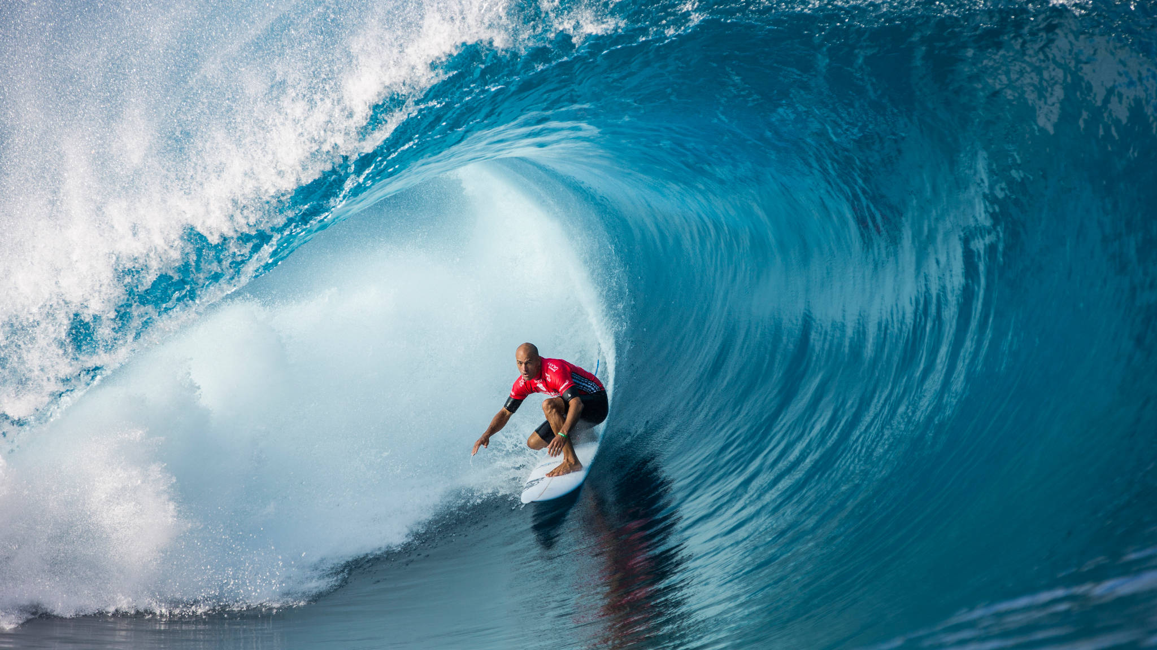
Lecture 2
Strategic Sport Business Management
Lionel Maltese
Maître de Conférences Aix Marseille University – CERGAM IAE Aix-en-Provence - #OIMS Laval University Canada
Associate Professor Sport Business Management Kedge Business School
Senior consulting sport business management
Twitter : @lionelmaltese

Slide 2
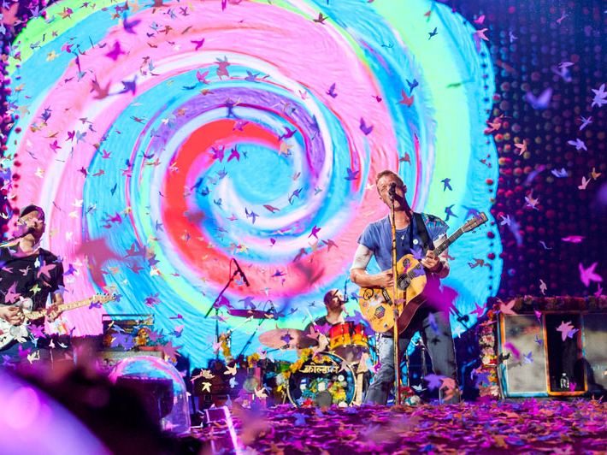
Business Model

Slide 3


Slide 4
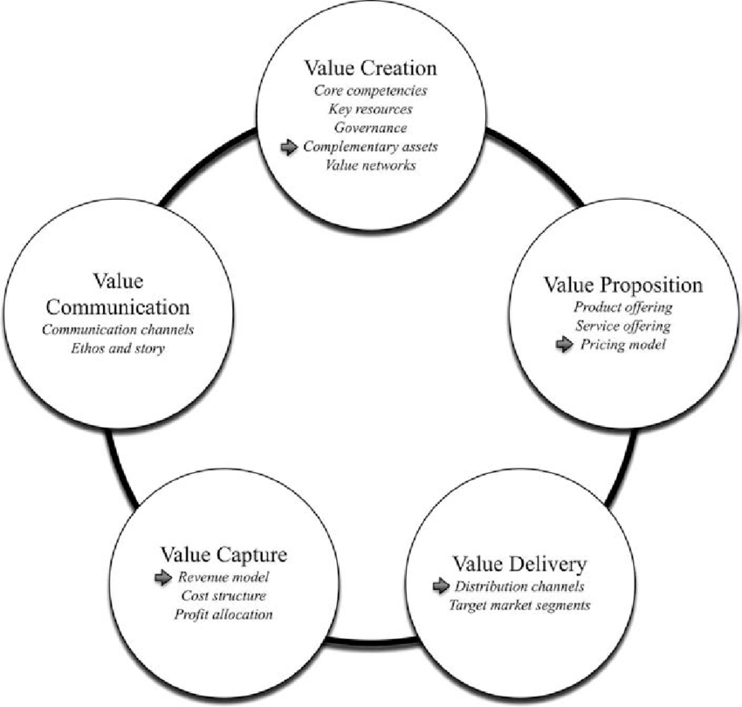

Slide 5
Strategic management of Stakeholders in sport organizations ecosystem
Private sponsors
Public sponsors
Sport institutions
Event / Club
Organisation
Athletes
Suppliers
Spectators
Media

Slide 6
Identifying key stakeholders (Mitchell et al., 1997)
LEGITIMACY
POWER
Discretionary
Dormant
Dominant
Definitive
Dangerous
Dependent
Demanding
Non stakeholder
URGENCY

Slide 7
Sport events & clubs : assets identification
Sport Event & Clubs
Financial resources « Profit centres » | Ticketting / Match Day
 | Contracts (sponsoring, Public Relations) & Players (clubs only)
 | TV rights
 | Merchandising
 | Institutions (public subsidies)
Renown | History
 | Sport performance
 | Affluence, audience
Assets
Players & coach (clubs only) Partnership (sponsoring, partners) Reputation (event, sport, players) Relational (Social capital, relational networks, Public Relations) Physical (infrastructures, stadium, territory) Organizational Capabilities (Core competences, event driven know how, project management))

Slide 8
Concepts
RBV first model for a sport organization
Partnership Resources
Reputational
Resources
Resources
portfolio
PROPERTIES
?
Players
Coach (club only)
Relational Resources
Physical Resources
Core
Competencies,
Capabilities
Organizational team,
Managers
Performance, Sucess
Sport Success
Financial Sucess
Public Sucess
Long Term

Slide 9
Learning by failures on resources
Sectoral factors understood
Handicap of Inexperience
Survival = Capacity to develop new assets because of « ossification » of the starting ones
Organizational Rents
Strategic assets lead to development
B
C
R & C
Low Value
R & C
High Value
Low probability of survival without important starting assets to support learning about sectoral factors and the acquisition of valuable R & C
Handicap of Ignorance
A
D
The risk of failure increases because of the gap and its evolution between R & C and the competitive requirements of the environment
Handicap of obsolescence
Sector factors not understood

Slide 10
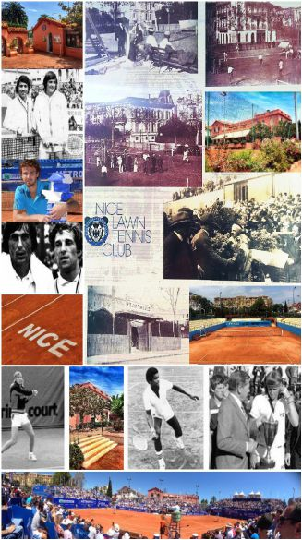
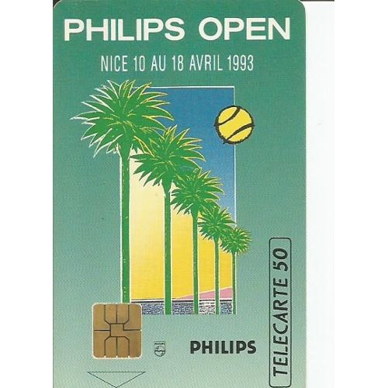
Failure Case Study
ATP Tennis Tournament
Philips Open of Nice (1995)
“Honeymoon illusion”

Slide 11
History : Philips Open of Nice
Date : April – Outdoor (clay)
Tournament direction : ex ATP french players (Pascal Portes and Dominique Bedel)
Ambush with Monte Carlo Tournament (TMS) : important sport success (Sampras, Courrier, Bruguera…)
Creation of this event for Philips
Resources allocations → Focus on Philips demand
Long term Vision ?

Slide 12
Understanding the failure
Philipe Open of Nice
Handicap of inexperience
« Honeymoon illusion » with Philips
Handicap of obsolescence :
Resources isolation
Failure of « axes » resources
&
Capabilities on survival sectors
Weakening of the stock of resources
&
Dynamism (mechanism) broken
Event failure

Slide 13

Partnership Resources
« Axes »
Learning
Organizational
Capabilities
Survival
Relational
Resources
Reputational
Resources
Survival
Physical
Resources
Dynamic capabilties
Stock of resources

Slide 14
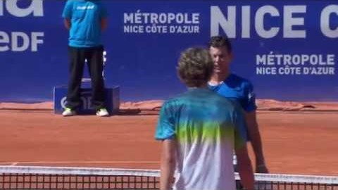

Slide 15

Open Nice Côte d’Azur - Positioning
Historical tournament and club of the french sporting inheritance
Favorable site towards player / fan proximity
High quality Public Relations
Customization of the offers and flexibility of the organization
Roland Garros ambushing
Last preparation for the French Open in the heat of the clay season
Last stop before a Grand Slam which entails broad international media coverage
Jean-François Caujolle, co-director
Melting pot between top french players and top 15 members of the ATP world tour

Slide 16










Dangers
TITLE SPONOR
No stadium
No TV Rigths
Public sponsors dependency
Relational Model = short term?
OFFICIAL SPONSORS
SPONSORS

Slide 17

How to be sustainable ?
With a relational model !

Slide 18

One solution for this case !
Creative Artists Agency (CAA) is a prominent entertainment and sports agency headquartered in Los Angeles. CAA represents A-list and emerging stars in movies, television, music, and sports. It is often cited as the leading talent agency and its clients include Meryl Streep, Brad Pitt, George Clooney, Sandra Bullock, Oprah Winfrey, Julia Roberts, Steven Spielberg, and David Letterman.
CAA Sports represents more than 650 of the world's best athletes in baseball, football, hockey, basketball, soccer, tennis, and golf,
Licensing, endorsements, speaking, philanthropy, video games, and the Internet.
broadcast rights, corporate marketing initiatives, and sports properties for sales/sponsorship opportunities.

Slide 19
CAA Football : Drew Brees, Peyton Manning, Eli Manning, Tony Romo, LaDainian Tomlinson, and Adrian Peterson, among many others.
CAA Basketball LeBron James, Chris Bosh, and Dwyane Wade, plus Carmelo Anthony, Tony Parker, Chris Paul, and many other stars.
CAA Baseball negotiated $400 million in new guaranteed contracts within the past year ($135 million more than the next closest agency), including three of the six largest contracts in the league (based on an average annual value.) Clients include Derek Jeter, Ryan Howard, Roy Halladay, Ryan Braun, and Ryan Zimmerman.
CAA Hockey Sidney Crosby, Henrik Sedin, Evgeni Malkin, Jonathan Toews, Daniel Briere, Patrick Kane, John Tavares, and Daniel Sedin, among many others.
CAA Tennis 3 Novak Djokovic and #4 Andy Murray, plus tennis legends Andre Agassi and Stefanie Graf.
Cristiano Ronaldo, renowned manager of Real Madrid José Mourinho, Chelsea FC’s Deco, Manchester United stars Nani and Anderson, and along with CAA client Simon Fuller, represents David Beckham, for whom it orchestrated the landmark deal that brought him to Major League Soccer’s Los Angeles Galaxy.
In 2009, CAA was the organizer of the World Football Challenge, a six-city round robin tournament which brought Chelsea FC, AC Milan, FC Internazionale Milano, and Club America to compete in the United States, and became the most watched international soccer exhibition matches to air on Spanish-language cable all year.
CAA Golf represents Sports Illustrated’s “Individual Male Athlete of the Century” Jack Nicklaus and legendary champion Greg Norman, who spent seven years atop the world rankings and now heads a global enterprise.
The agency represents such superstar athletes as action sports icons Tony Hawk and Shaun White and four-time reigning NASCAR champion Jimmie Johnson.
CAA Sports won the highly-coveted assignments to sell major corporate partnerships for the new Yankee Stadium and the soon-to-be renovated Madison Square Garden, and has since closed nearly 20 deals.
Corporate clients also include FC Barcelona, Chelsea FC, Juventus FC, and StubHub, among many others.

Slide 20
Assets Construction !
Be efficient !

Slide 21
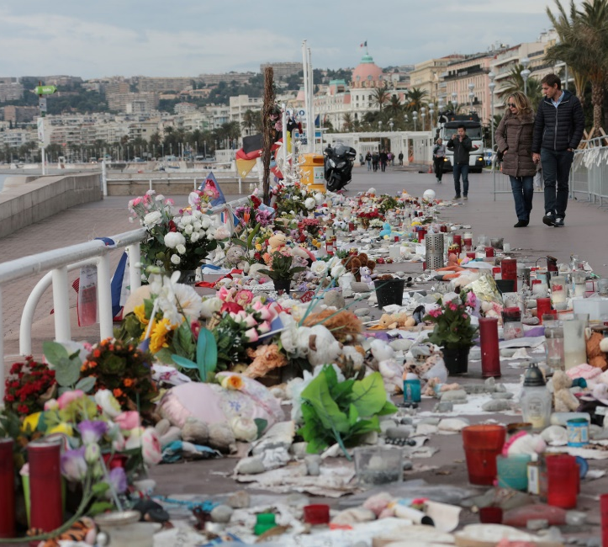
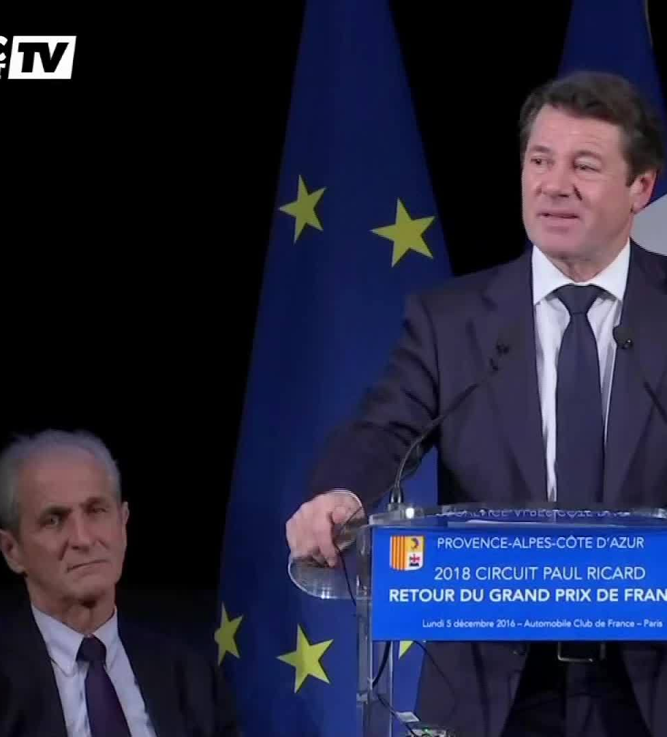
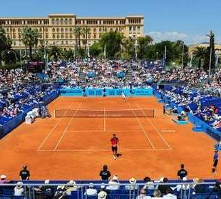

Slide 22
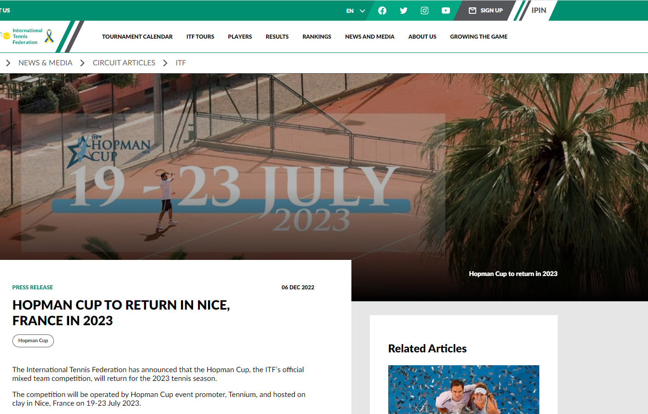

Slide 23
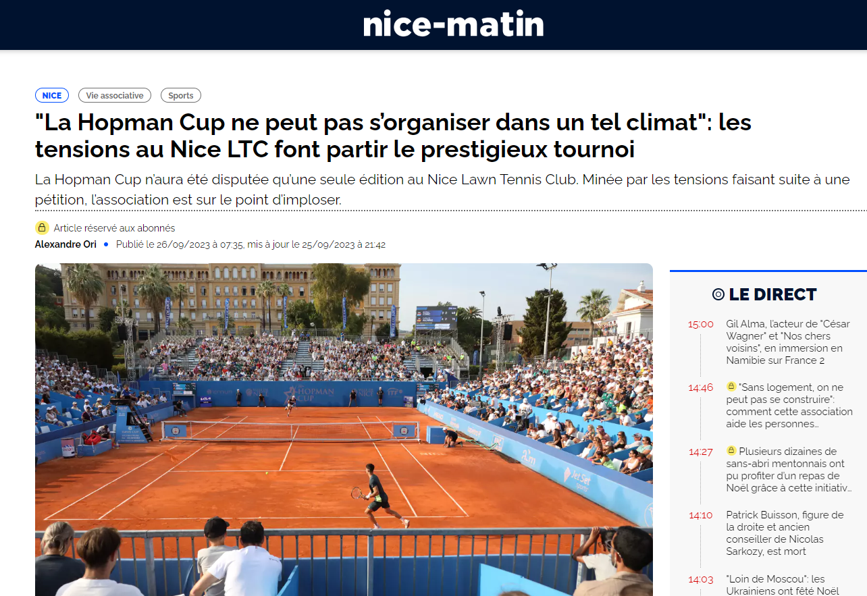

Slide 24
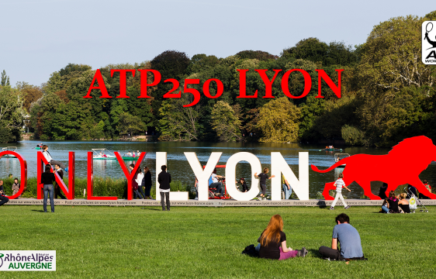

Slide 25
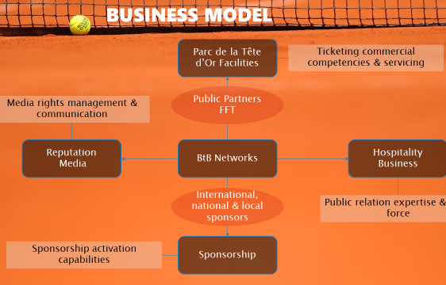

Slide 26
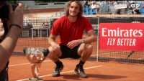

Slide 27

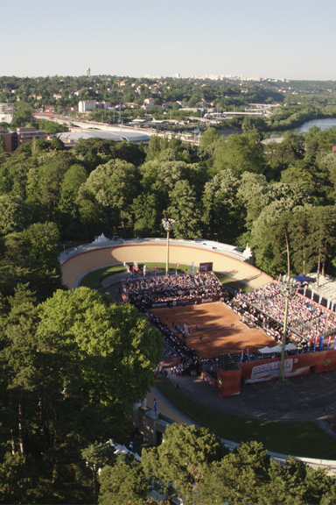
NEXT Session Challenge

Slide 28
Business Strategy &
Model
From theory to practice !

Slide 29
Business Plan
Roadmap
A Business Plan is a document that summarizes the operational and financial objectives of a business and contains the detailed plans and budgets showing how the objectives are to be realized.
A Business Plan includes :
Strategy formulation and complete description
Financial aspects linking to the project
Core Model (Business Model) to resume the link between strategy and financial returns

Slide 30
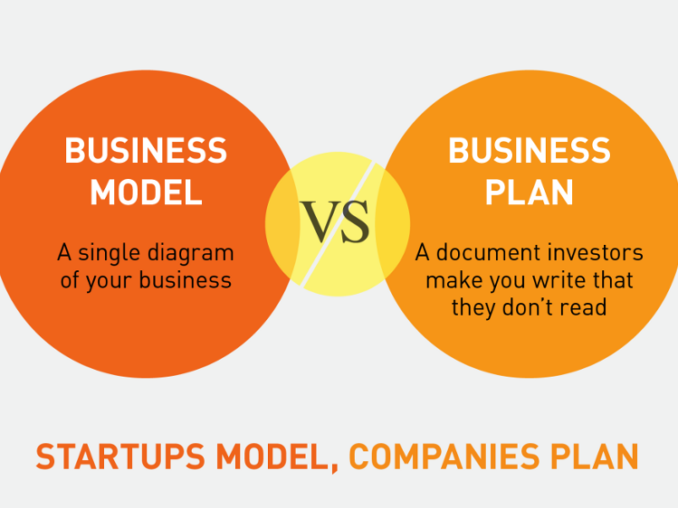

Slide 31
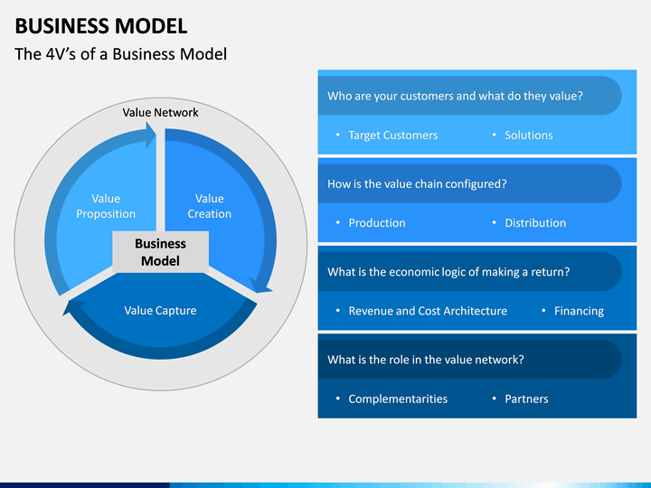

Slide 32
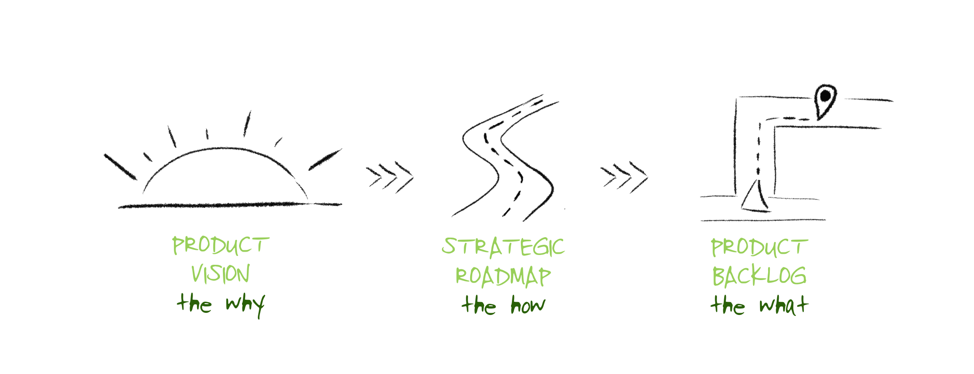

Slide 33

Preamble
FIX YOUR GOALS 3-5 YEARS

Slide 34

Business ROADMAP
For sport organizations → specific “hybrid” approach : RBV development at first and environment analysis as a kind support in a generic (classical) “background”
3 levels (chapters) :
Evaluation
Organization
Restitution

Slide 35
Evaluation step
1. Assets (resources & capabilities) identification linking to the main profit centers and key stakeholders
2. Potential and rent evaluation of each asset (V.R.I.O)
3. Description of the main characteristics of the “macro” environment :
Economical
Political
Sociological & cultural
Legal aspects

Slide 36
Evaluation step
4. Description of the main characteristic of the “micro” environment ( “5 forces model”) :
Identification of your stakeholders linking to resources access and sharing : analyze your control and negotiating power !
Customers (marketing segmentation) : analyze your control and negotiating power !
Competitors (direct - substitutes – new entrants) analyze the threats
5. First summary :
Financial needs : budget necessary to implement
Human needs : competencies ? Recruitment ? Formation ? Placements ? Consulting agencies ?
Global profitability of the development project
First prices fixation : ticketing – Public Relations – Communication supports - Merchandising…

Slide 37
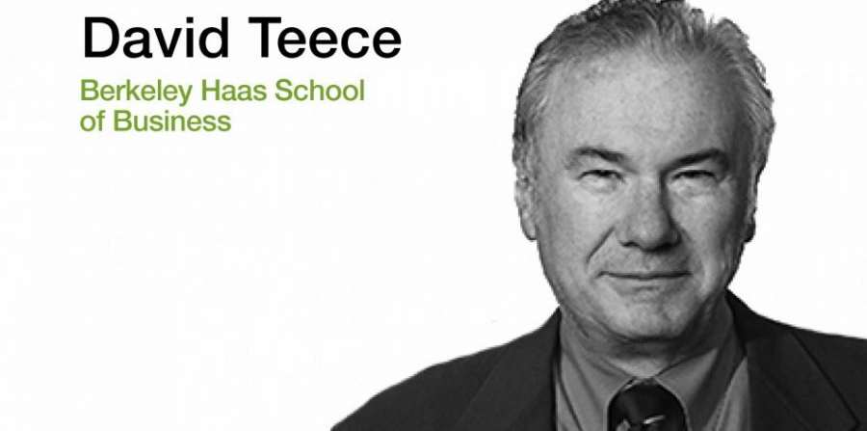
“The whole is more valuable than the sum of the parts”.
Asset orchestration
If capabilities are dependent on co-specialized assets, it makes the coordination task of management particularly difficult. Managerial decisions should take the optimal configuration of assets into account. Asset orchestration refers to the managerial search, selection, and configuration of resources and capabilities. The term intends to convey that, in an optimal configuration of assets, the whole is more valuable than the sum of the parts.

Slide 38
Organizational step
Value Creation
Assets Orchestration
1. Articulation and orchestration of resources with your capabilities : exploration and exploitation to optimize the whole potential of assets portofolio ?
2.Interactions between resources : analyze the links and the creation of a system ?
3.Renew or reject your assets ?

Slide 39
Resume
“BUSINESS MODEL”
Definition : a sort of diagram which explain how you can generate profits (more precisely your turnover)

Slide 40
Business Model ?
« The essence of the idea is ‘how you get paid’, or ‘how you make money’ with a taxonomy of alternative mechanisms ». (Chesbrough et Rosembloom, 2002)
« Business model refers to the core architecture of a firm, specifically how it deploys all relevant resources ». (Tapscott, 2001)

Slide 41
5 “keys” to explain for your Business Model
Trade ?
Business
Model
Positioning ?
Singularity ?
Core human compenetencies ?
Description of the demand in your market?

Slide 42
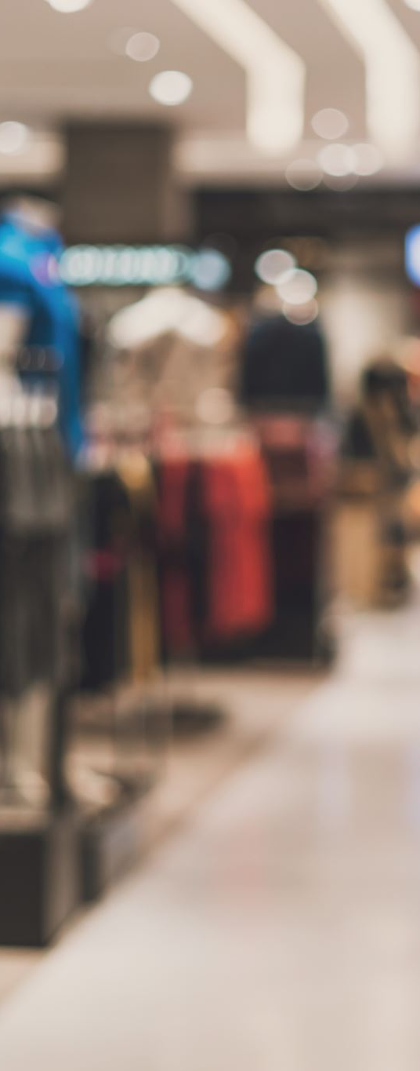
Example of Business Model : ZARA case
Creation (imitation in fact !), production (plants), distribution (ZARA shops) of fashion products with a large diffusion
Positioning in selling fashion products with relative low prices
Singularity : imitation of fashion actuality (most creative dressmakers) & new models in the shops every week !
Core competencies : control of all the process of the supply chain management (creation – production – logistic) → a just in time strategy very difficult to implement in this industry !
The demand is very high for this kind of “fashion” products with relative low prices…

Slide 43
Pampelonne
Organisation
Business Model
Trade : Public Relations expert → implementation & activation
Positioning : High level services coupling to rare sport experiences with the most prestigious events
Core competences : relational networks exploitation – anticipation due to personal informations and “special” access to key actors…
Singularity : contracts & agreement (Roland Garros – Stade de France…) – possession of an event (Open13) and direction of BNP Paribas Masters in Paris.
The demand ? : Large firms communication (Public Relations) strategy (Total, Sodexho, BNP Paribas…) and important demand due to exceptional event (Rugby World Cup for instance…)

Slide 44
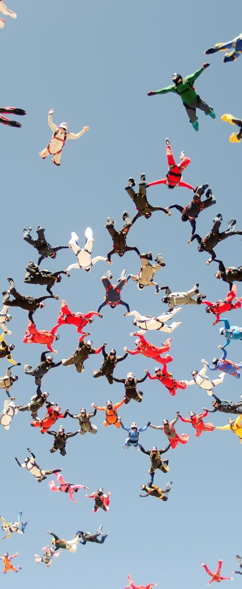
Restitution step
Business and marketing actions :
  Stadia / Arena management (“Model based on Fans”) :
    hospitality
    CRM (Ticketing)
    Merge sport and Entertainment
  Sponsorship Activations
  CSR Strategy
  Reputation and Brand Management
  Sport area development : training – coaches – scout… : sport performance !

Slide 45

Final Restitution step
  Proposition of development axes and Marketing activities :
  Public Relations – Social Capital
  Partnership - Sponsorship Activation
  Communication
  Brand Management
  Merchandising
  Ticketing – CRM
  Stadia Management :
    Experiential View B to B
    Experiential View B to C
  …

Slide 46

Be careful !
Be sensemaking in linking your final propositions (development axes and marketing activities) to your strategic analysis (evaluation + organization)

Slide 47

+ You have to be “sensemaking” and on the implementation of :
Characterization of interconnections between resources (and not only VRIO) and their interaction with the environment indicates that the managerial aptitudes to manipulate assets within a single system are essential !
The objective is to create an unique combination of assets to exploit opportunities, face to threats and to develop sustainable performance.

Slide 48

Success case
Open13 1993---2024 next ?
www.open13.fr
“Familial professional “bricolage” from Marseille”

Slide 49
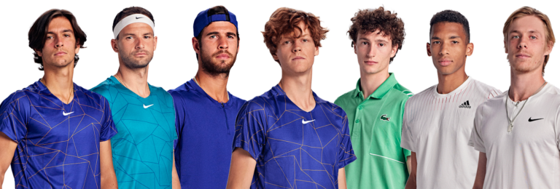
2024

Slide 50
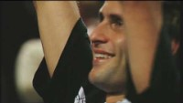

Slide 51
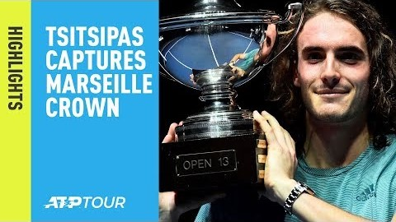

Slide 52
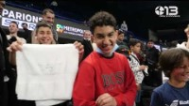

Slide 53
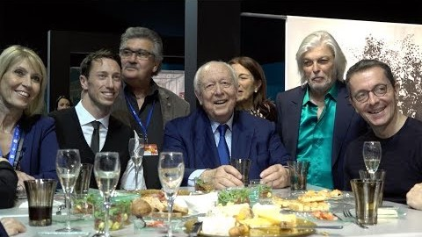

Slide 54

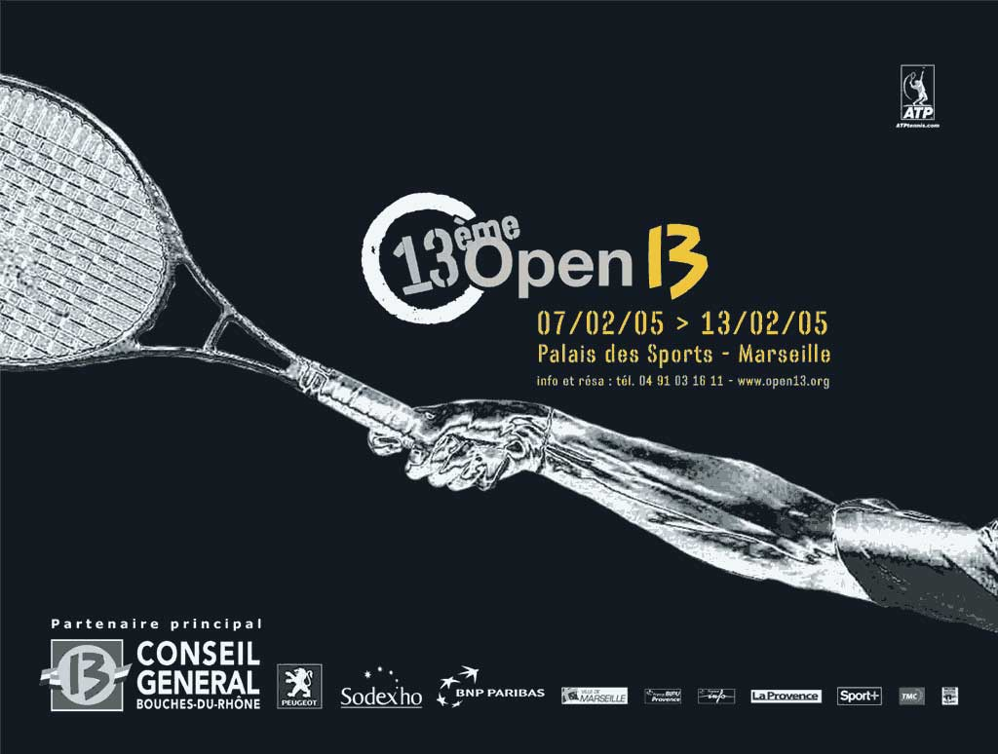
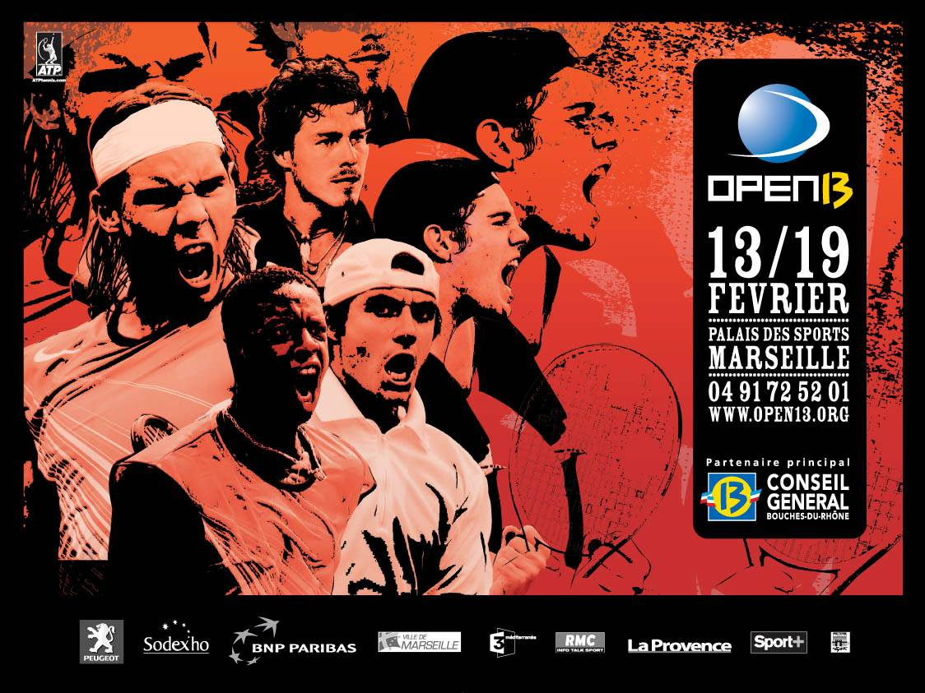
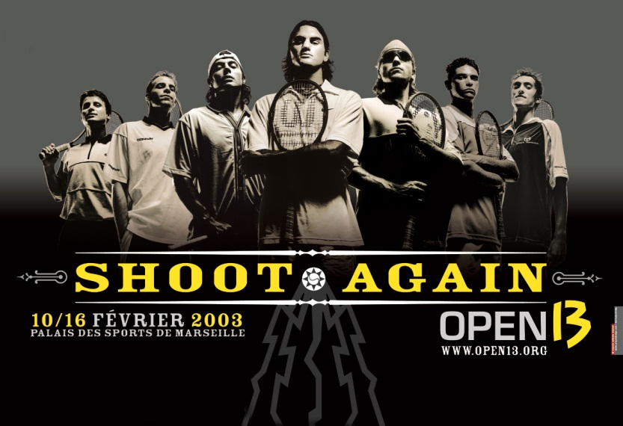
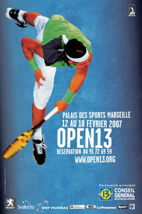


Slide 55
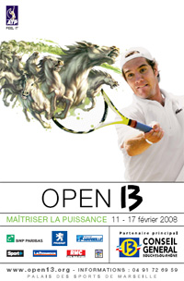
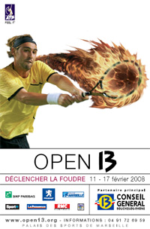

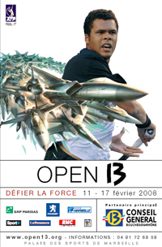
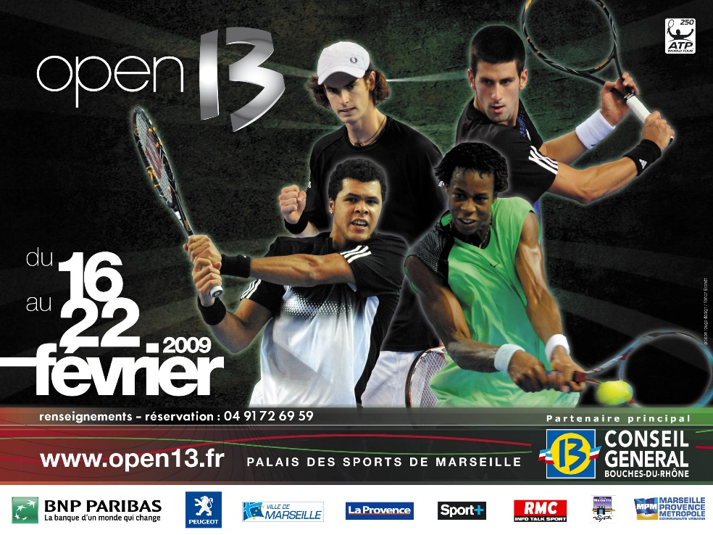
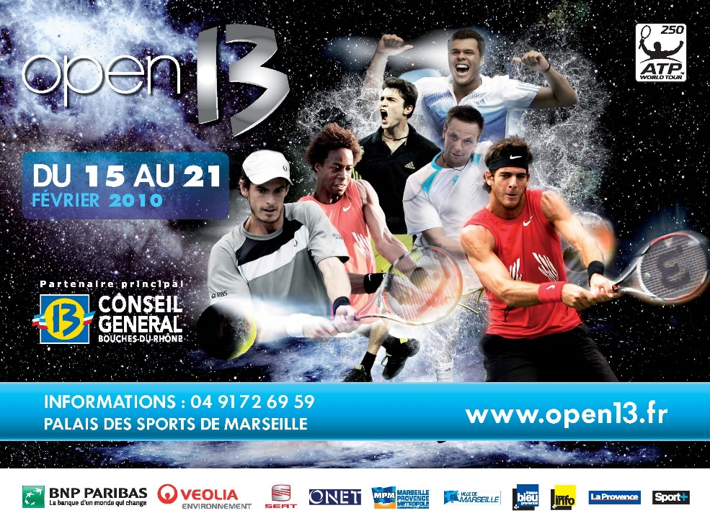

Slide 57


Slide 59


Slide 67

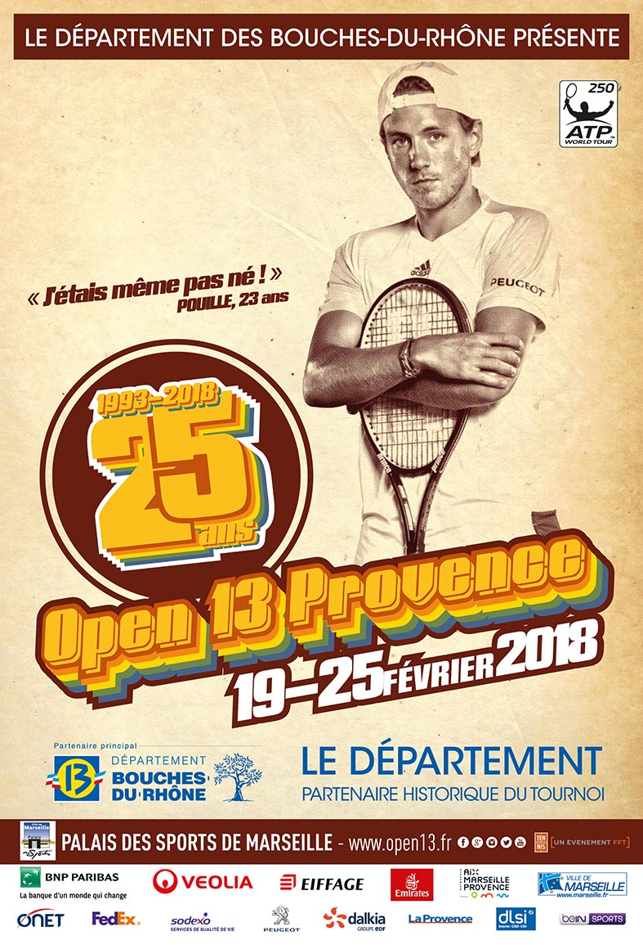

Slide 68
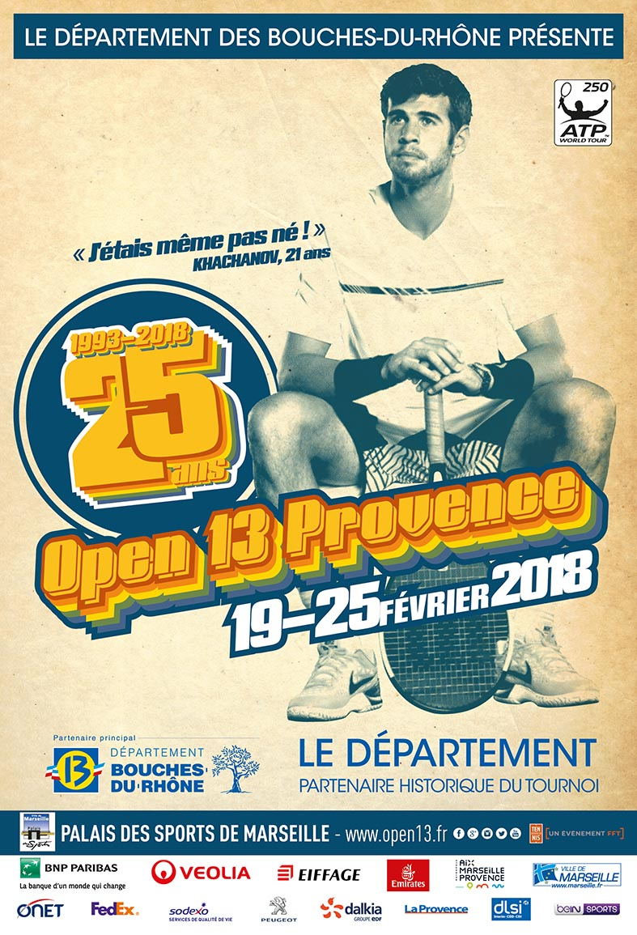
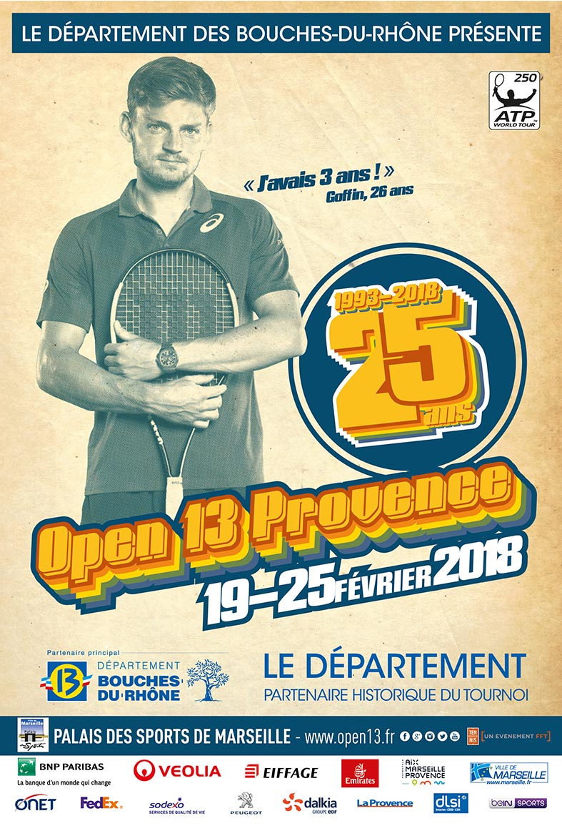

Slide 69
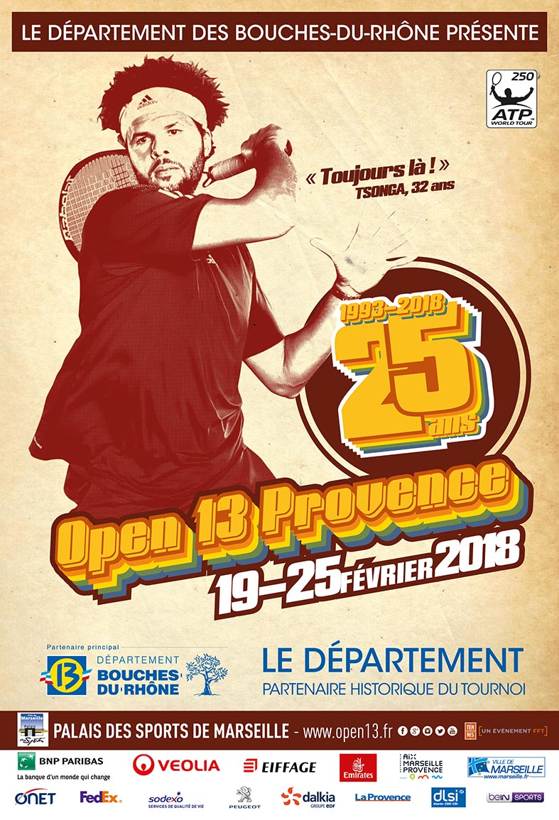


Slide 70
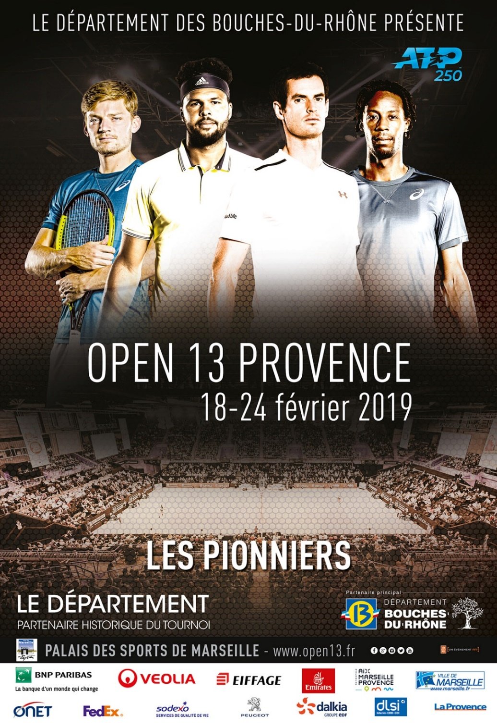
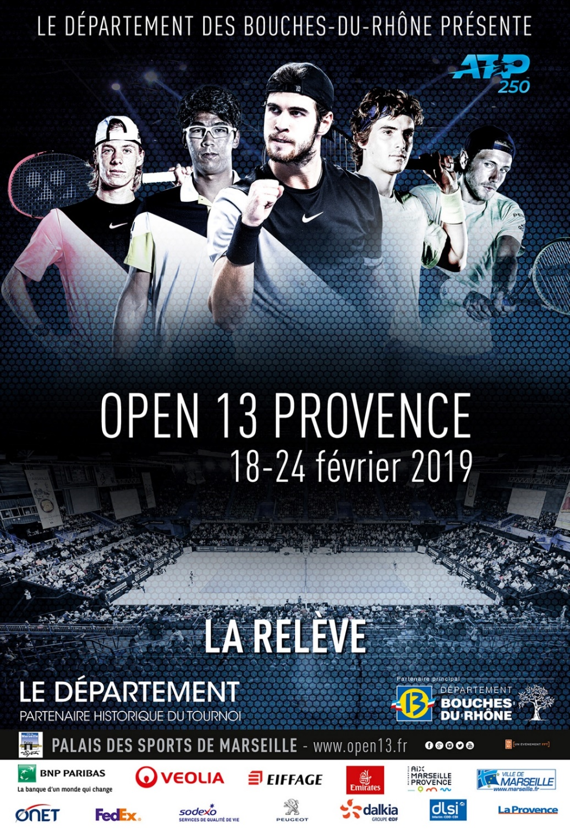

Slide 75
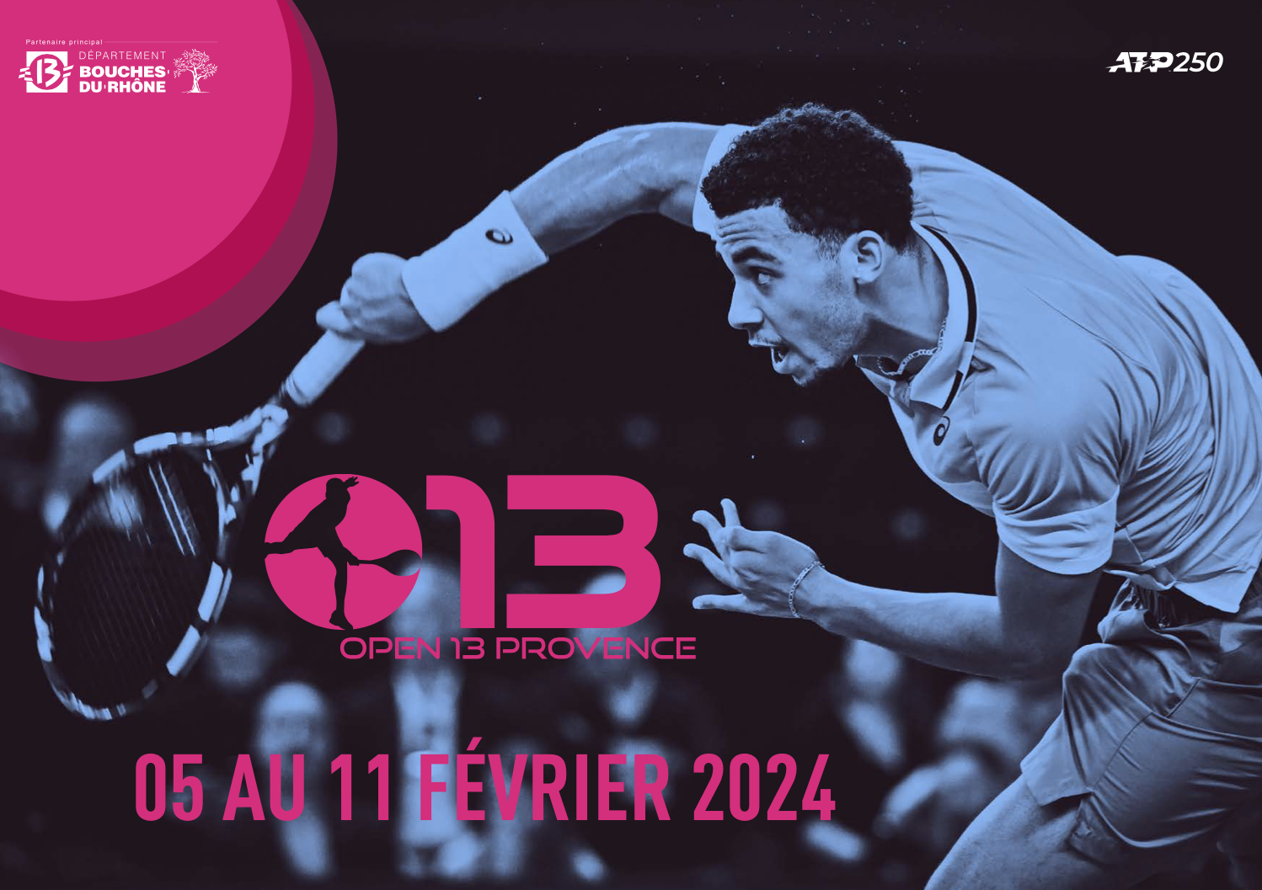

Slide 76
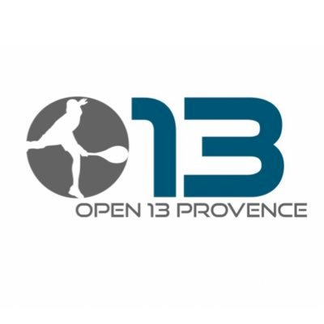

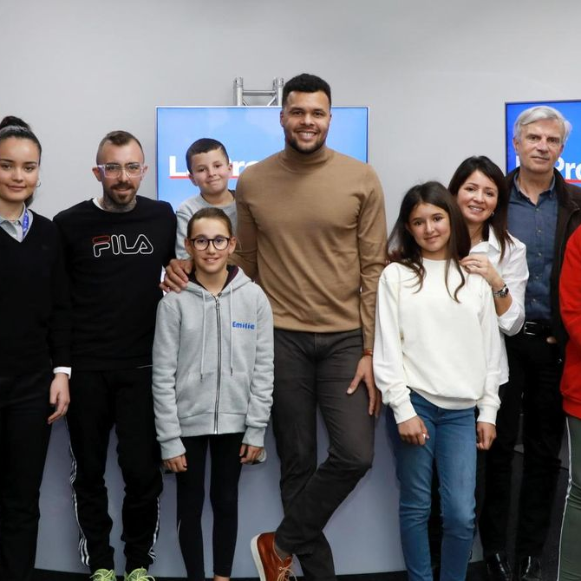
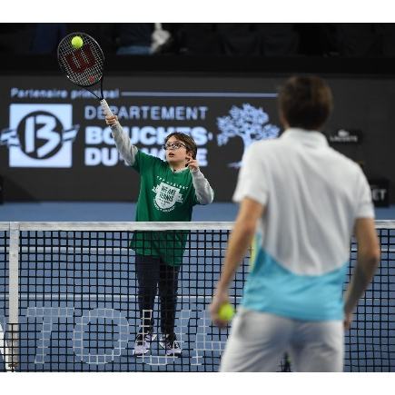
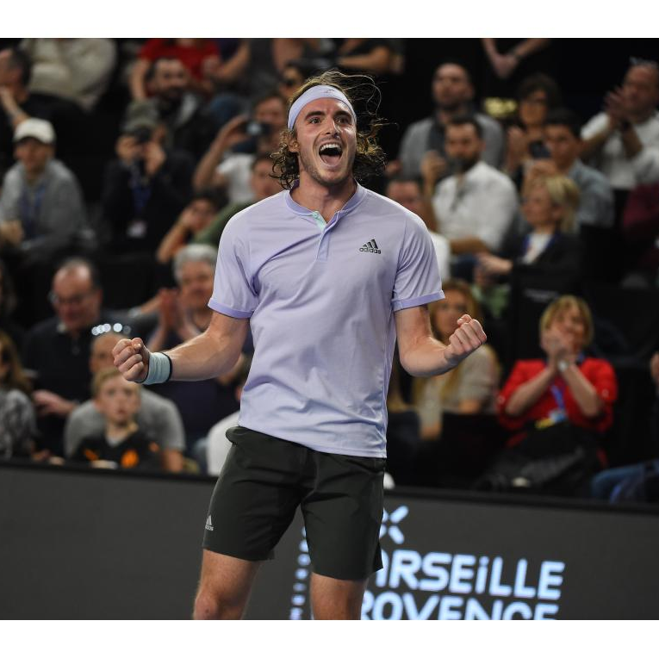
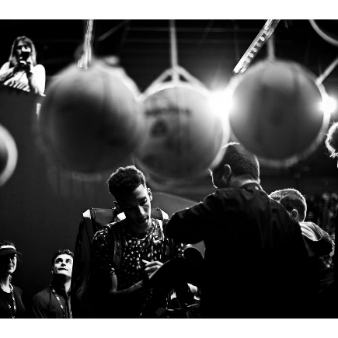
Meeting
Sharing
Hedonism
Discovering
Distinction
Values
« Raison d’être »
Ambition

Slide 77
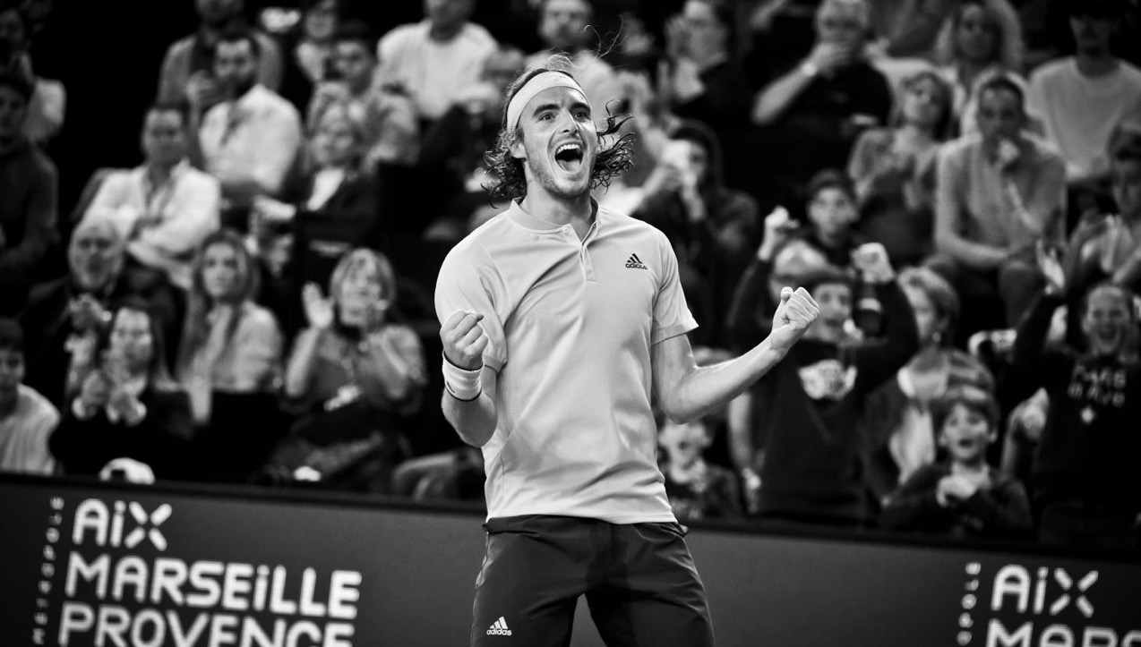

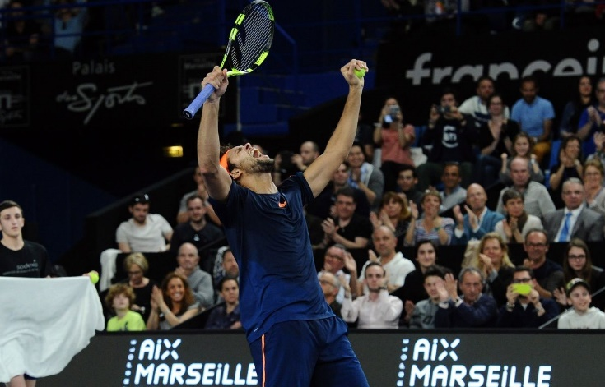
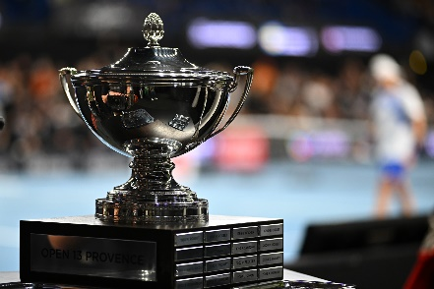


A singular event
Worldwide
Reference
ATP250
Sport quality
Reputational VIP experience

Slide 78

A SINGULAR EVENT
Only 4 « ATP250 » in France on 38 in the world
Prize Money : more than 650K€ .
250 ATP points ATP for the winner
More than 40 hours TV broadcasting in more than 70 countries
A global media coverage
15 domestic media

Slide 79


Sport heritage
Records
13 ex n°1 ATP played the tournament : Djokovic, Nadal, Federer, Murray, Ferrero, Hewitt, Kuerten, Safin, Kafelnikov, Moya, Rios, Becker, Lendl
Worldclass winners : Becker, Forget, Kafelnikov, Federer, Murray, Tsonga, Del Potro, Kyrgios, Medvedev, Tsitsipas, Rublev…
Talents revealer
New generation ATPNEXTGEN : Tsitsipas, Auger-Aliassime, Shapovalov, Humbert, Sinner, Rune, Fils
New champions in Marseille : Federer, Soderling, Murray, Tsonga, Kyrgios, Khachanov, Tsitsipas, Rublev
Best french players in Marseille : Noah, Forget, Leconte, Pioline, Santoro, Grosjean, Clément, Tsonga, Monfils, Gasquet, Simon, Pouille…

Slide 80




« Cultural » Public Relations and Hospitality
More than 32 years in Marseille as « the place to be » and the « place to meet », Open13 Provence is one the the main actor in France for its VIP servicing and experience
Espace VIP
More than 6000m2 of hospitality for around 20 000 VIP during the week every year
More than 30 VIP suits
3 Restaurants with 3 experience stages
More than 25 000 lunches and dinners during the week
1 historical lounge bar with musical atmosphere
More than 2000 VIP tickets in boxes in the center court

Slide 81












GLOBAL MEDIA COVERAGE
+ than 23 live tennis game
Worldwide Broadcasting
More than 40 hours on TV in 70 countries
National radios
15 domestic media
Press and Web

Slide 82

MEDIA IMPACTS *
CD13 :
2 808 605 € advertising equivalent*
64 213 422 contacts touchés
143 impacts from Open13 Provence
105 TV impacts
42H 48Min
TV coverage
France
5 511 046 €
advertising equivalent
288
Press impacts
2 251 751 €
advertising equivalent
1005
Internet impacts
7 414 495 €
advertising equivalent
TOTAL
289 186 881
Contacts
15 334 071 €
advertising equivalent
75 982 750 contacts
95 862 709 contacts
82 351 198 contacts
160
Radio impacts
156 779 €
advertising equivalent
34 990 224 contacts
* Annual study from VERTIGO BIS Media & données Médiamétrie

Slide 83


CITIZENSHIP POSIONNING
During 32 years, the Open13 Provence is becoming a singular social moment and place for sport, economy and public actors from Marseille Provence destination.
With a high quality of the worldclass tennis competition and its hospitality for sponsors and executives, the Open13 Provence DNA is to focus on the HUMAN RELATIONS as an asset.
With more than 40 international media, its local action is a one week meeting with all the Marseille Provence actors mixing sport and relations.
The citizen aim of Open13 Provence is to be a reputational asset for the Marseille Provence destination in order to promote its brand and attractivity .

Slide 84






Slide 85
EXPENSES : 4,771 K€
Fees = Adjsutment Variable
Facilities = strong limit (worst on 61 ATP Events)
PO Employees / CEO : important cost

Slide 86
INCOMES : 5.163 K€
Strong CD13 dependency for Ticketting
Organum (Veolia, Eiffage, Suez, Dalkia, Nexity…) Dependency
Interntional TV Rights > Domestic TV Rights

Slide 87
Cascade of assets
Relational
Resources
« Axes »
Learning
Organizational
Capabilities
Partnership
Resources
Reputational
Resources
Physical resources
Stock of resources
Dynamic Capabilities
« Bricolage »

Slide 88
Business Model / RBV Open13
CRM
Activation
B to B
Partnerships
Reputation
Social Capital
Social
Networking
Physical Resources (stadium)
PR Facilities one shot Management
Resources Basis
Direct impact
Deployment
Indirect impact
Core Competences

Slide 89
New investor from India…

Slide 90





Futur ?

Slide 91













Slide 92
Strategic vision for an unique tennis ecosystem
Sport business companies are not industrial, we have to create a new « crafting human strategy »
Sport performance is the first goal : we have to create and maintain sport reliability and credibility
Strategic assets combination and synergy will create a powerfull brand with a singular value chain for our future tennis factory.

Slide 93
Strategic vision ?
Relational
BM
Reputational
BM
Cultural
BM

Slide 94





Slide 95





Slide 96


Slide 97












Slide 98





Slide 99




Slide 100
90 % of sports organizations
Relational Business Model because :
With a large part of the turnover linking to public and private sponsors
Without huge TV Rights
Without Stadium or Arena to implement a strong brand strategy based on fans consuming

Slide 101
Finance
PM + EM (Supplier)
Technical Manager
MG (Supplier)
Directeur
Commercial Senior
JFC
Strategic Management - IT
LM (Supplier)
Commercial Senior
PC (Full Time)
Ticketing
BC (Full Time)
Communication
YF (Full Time)
Marketing
Key Account Manager
AF (Full Time)
Administration
KC (Full Time)
Community Manager
MC (Full Time)

Slide 102







Slide 103


Slide 104


Strategic Management : From 2007 to 2011 with JF Caujolle

Slide 105


Slide 106


Slide 107


Slide 108


Slide 109


Slide 110


Slide 111


Slide 113


Slide 114


Slide 115


Slide 116


Slide 117


Slide 118


Slide 119


Slide 120
© Illustrasport – juin 2010

Slide 135



Slide 136


Slide 137


Slide 138


Slide 139


Slide 140
Business Model / RBV BNPPM-RPM
CRM
Activation
B to B
Athletes
Management
Parnerships
Reputation
Physical Resources (Stadium)
Entertainment Production
Ticketing & CRM
Social Capital
PR infrastructure development
Resources Basis
Direct impact
Deployment
Indirect impact
Core Competences

Slide 142




Slide 143



Slide 144


Slide 145


Slide 146


Slide 147
10 % of sports organizations
Reputational business model based on brand management and where fans are the HEART of the entire Model
With a modern stadium or arena
With TV Rights
With a better control of key assets : reputation-brand and stadium-arena

Slide 148


3 Business Models in sport Business area
Hospitality / PR
Relational
Centric
Club or Event BRAND
Cultural (fan)
Centric
Reputational
Centric
Media / WOM
Communication
FRM
Brand Management

