Slide 1
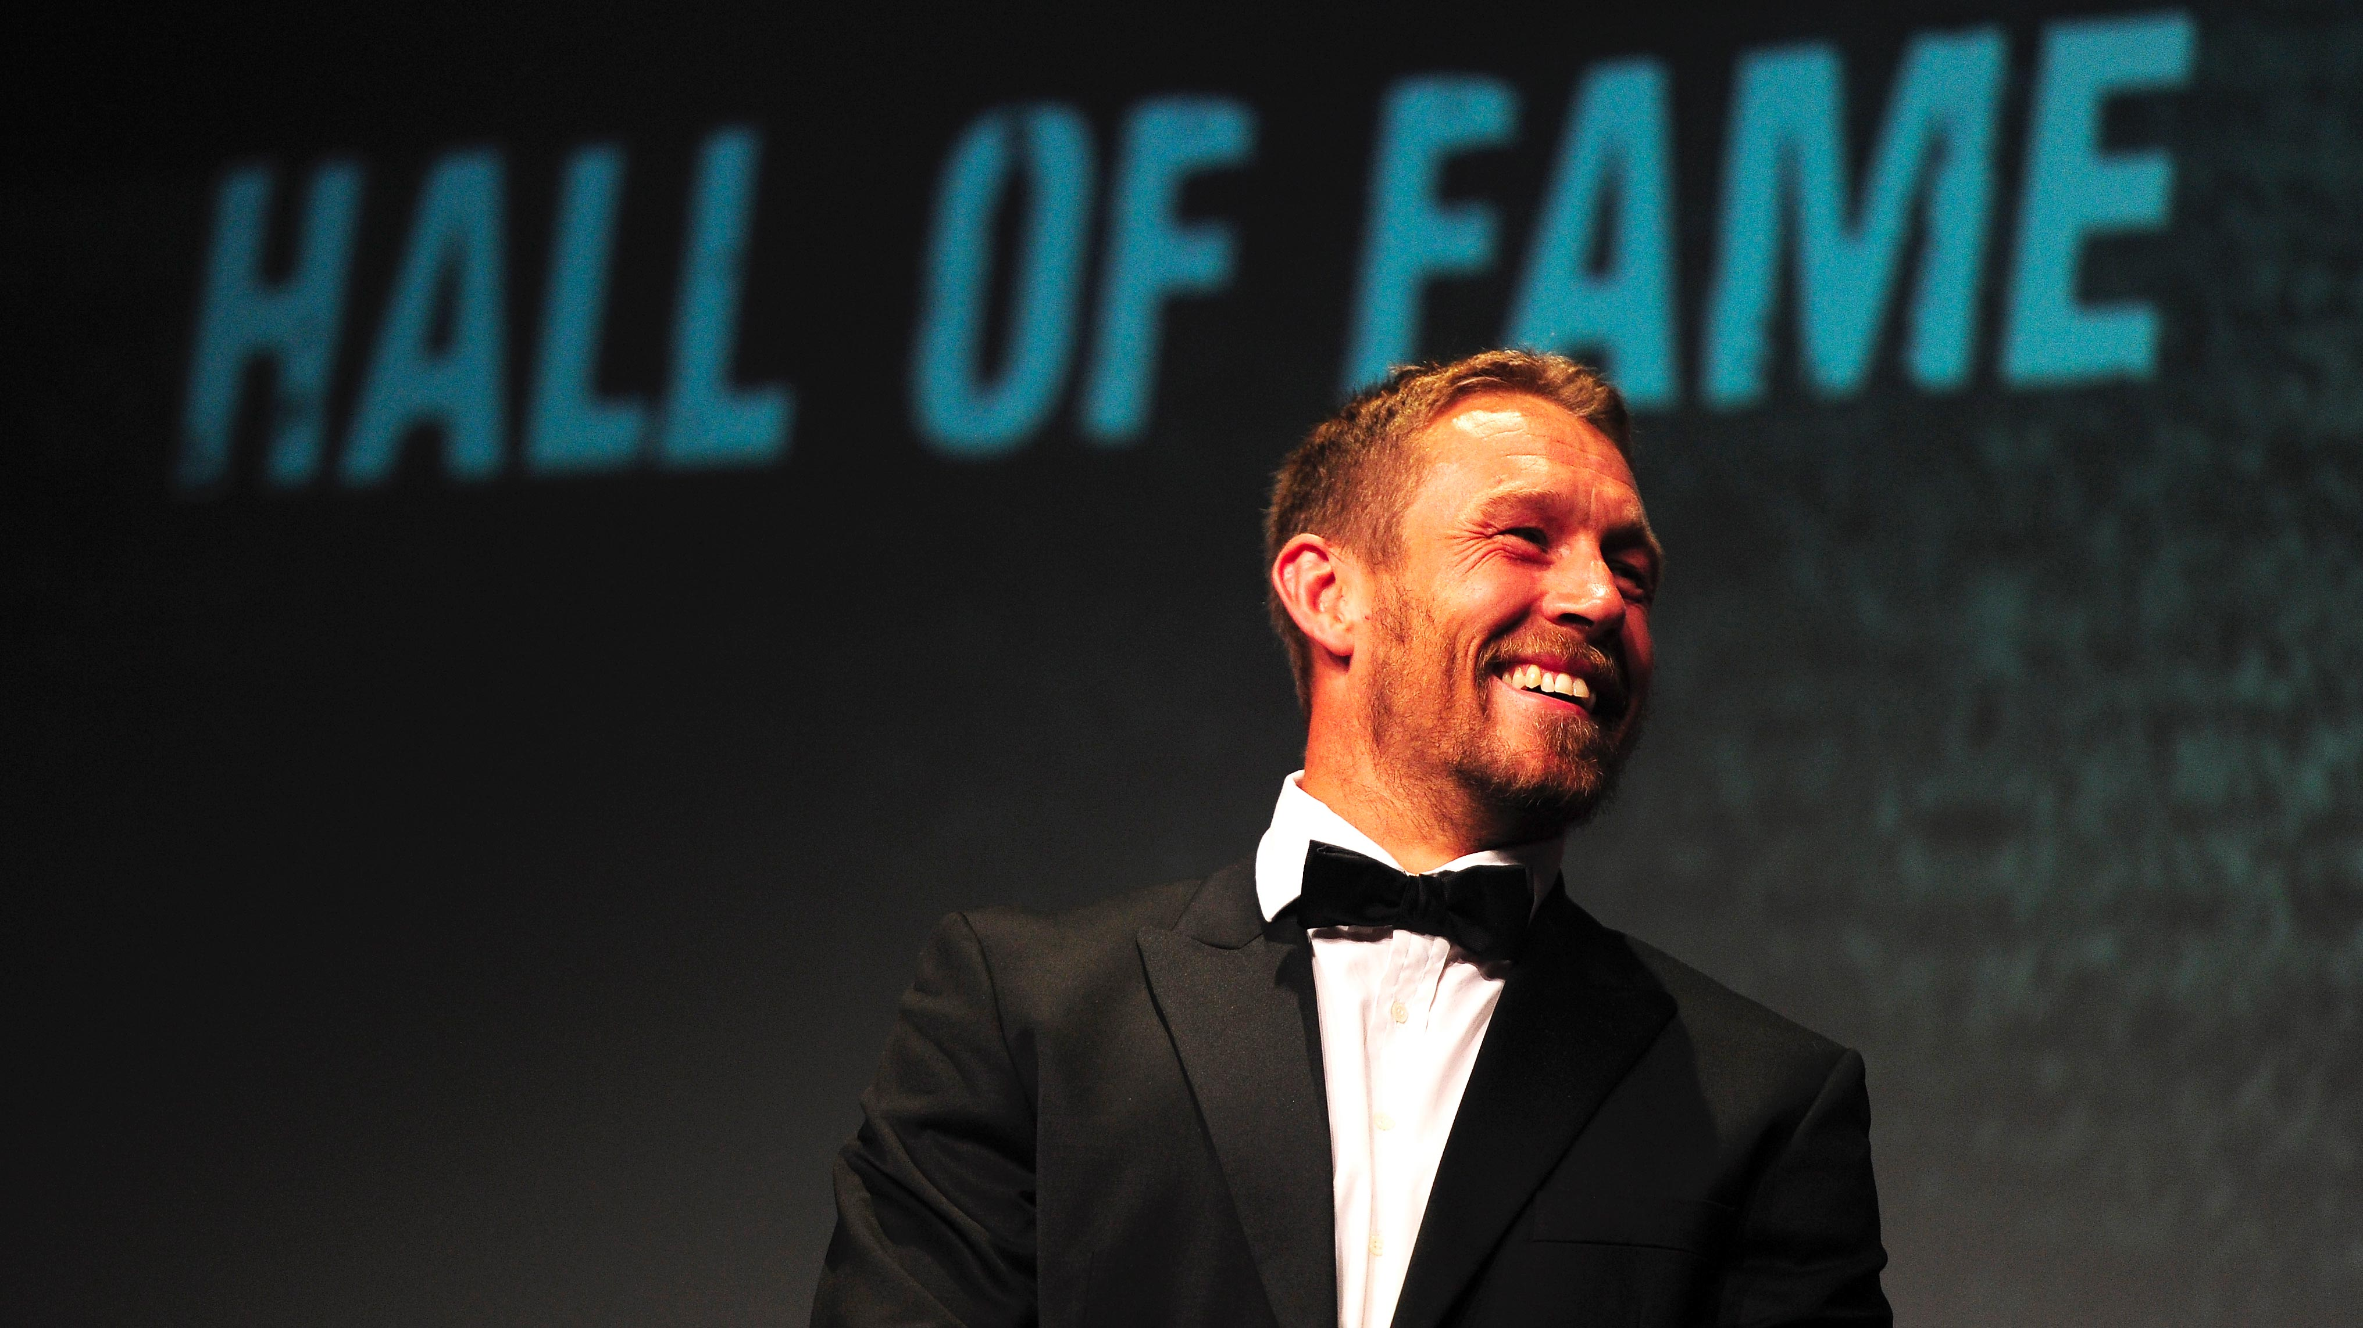
Strategic Management and Advanced for sports organizations
Summer School
SPORT EVENT MANAGEMENT
Lecture 4
Lionel Maltese
Maître de Conférences Aix Marseille University – CERGAM IAE Aix-en-Provence - #OIMS Laval University Canada
Associate Professor Sport Business Management Kedge Business School
Senior consulting sport business management
Twitter : @lionelmaltese
Notes:
Est-ce que les couleurs de votre classe différentes que vous voyez dans ce modèle ? C’est OK ! Cliquez sur Création -> variantes (la flèche vers le bas) -> sélectionnez le modèle de couleurs qui vous convient!
N’hésitez pas à modifier les instructions «vous serez... » et « Je vais... » pour vous assurer qu’elles correspondent aux procédures et règles de votre classe!

Slide 2
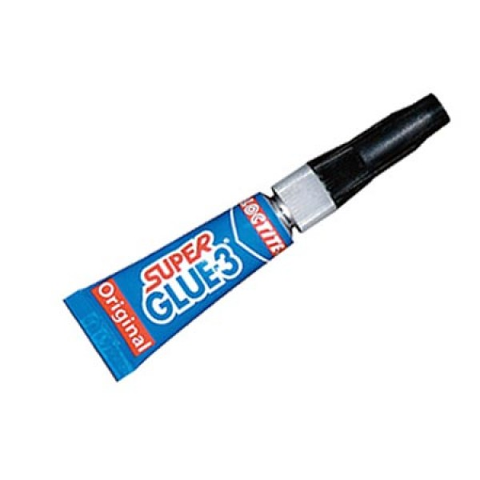
Assets strategic management
Capabilities : Explore – Exploit - Combine
Resources
Partnerships
Relational
Physical
Reputation
« The Place to express your brand »
« The Place to leverage and activate »
The Place to Be
« The Place to show the show »
Event (game day)
Brand
Sponsors
Brands
Network
Brand
Stadium
Brand

Slide 3
Athletes
Performance
Understanding the Meaning of Performance ?
Shareholders performance
Brand
Exploitation ?
Event
Internal Measure
P.A.P.E.R
Test
Event
Reputation
⇨
Performance
FAN
Experience
PR Efficiency
(Partners)
Sponsoring
Efficiency
(Partners)
Institutional
Performance
Media
Performance
Stakeholders Performance

Slide 4
Reputational Business Model
Activation
CRM
SPONSORSHIP
7
Sport
Management
Offer attractivity
Media Rights
Ticketing
Sponsorship
  Visibility
  PR
  CSR
Commercial
Brand
2
FACILITIES
STADIUM
ARENA
REPUTATION
BRAND
1
6
5
4
3
Ticketing
Entertainment
Brand
Management
SOCIAL
CAPITAL
8
Negociation
Hospitality
resources
competencies

Slide 5
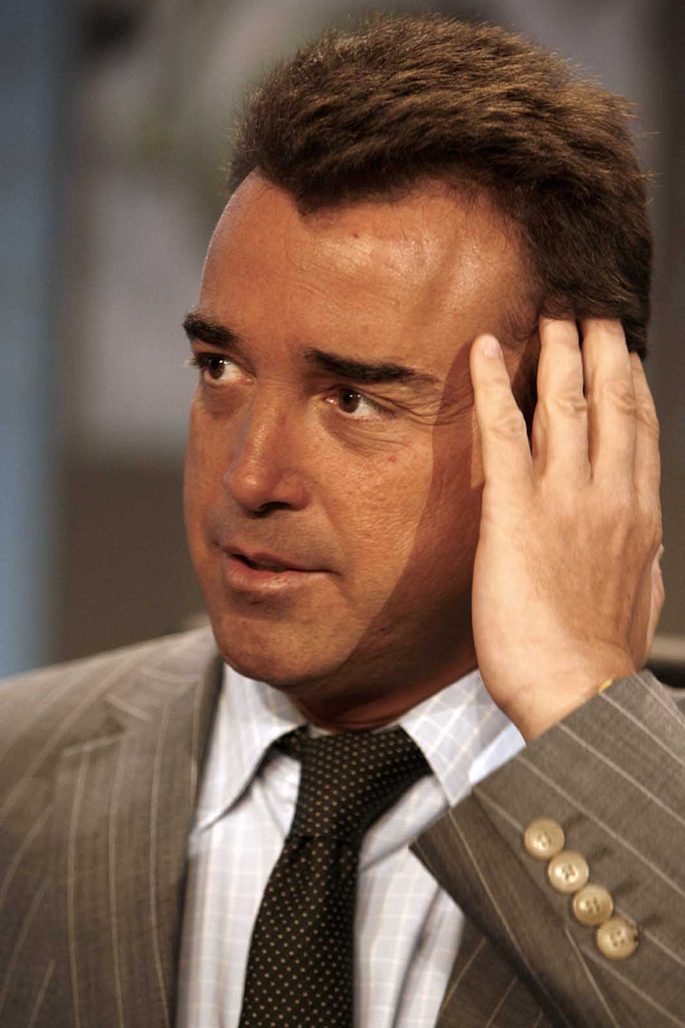
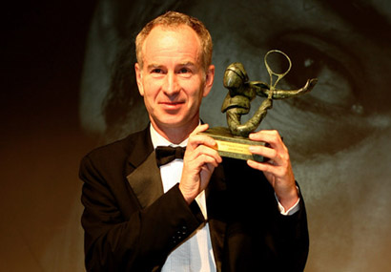
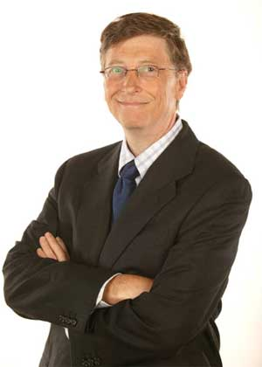
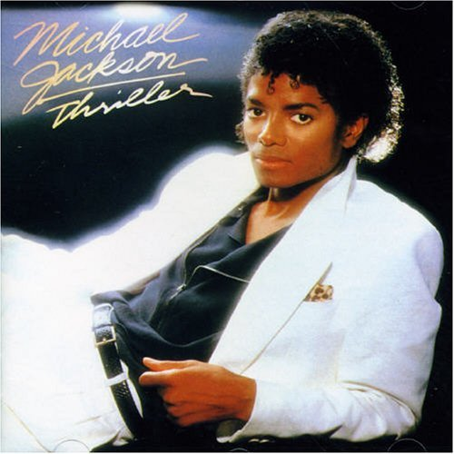
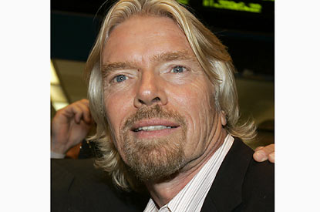
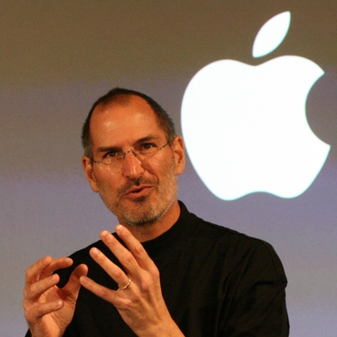



Réputation ?

Slide 6
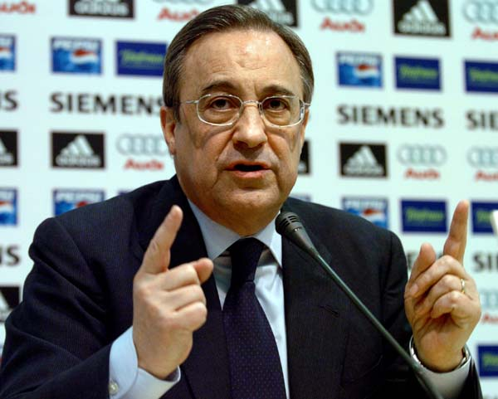
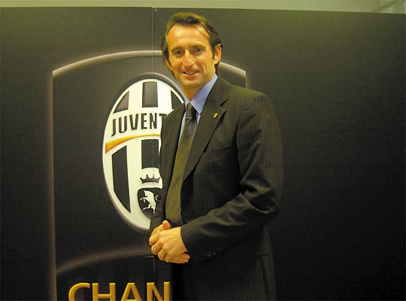
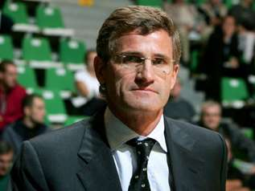
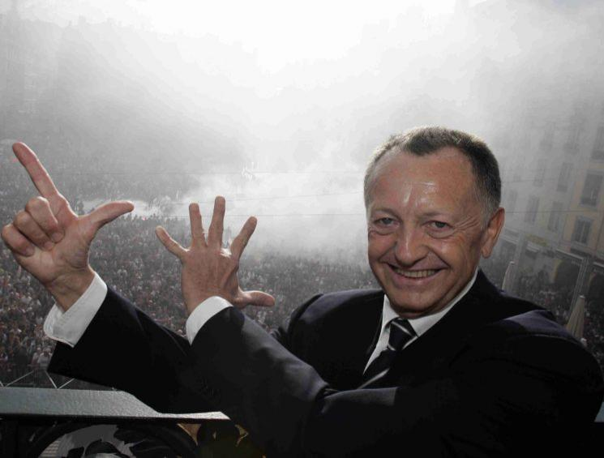
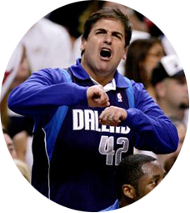
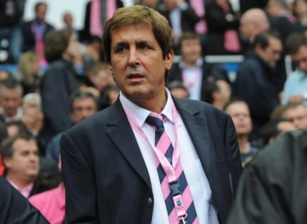
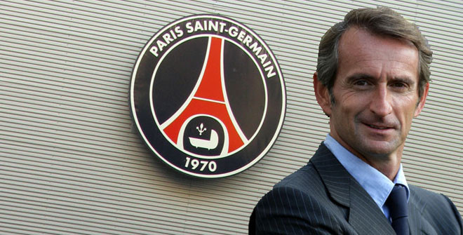
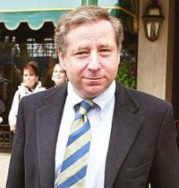

Slide 7
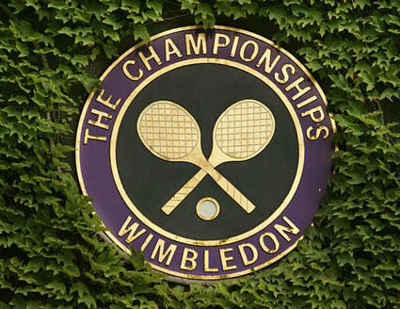
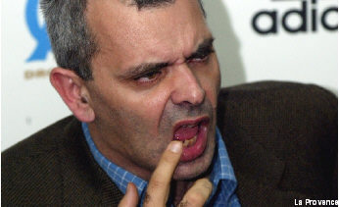
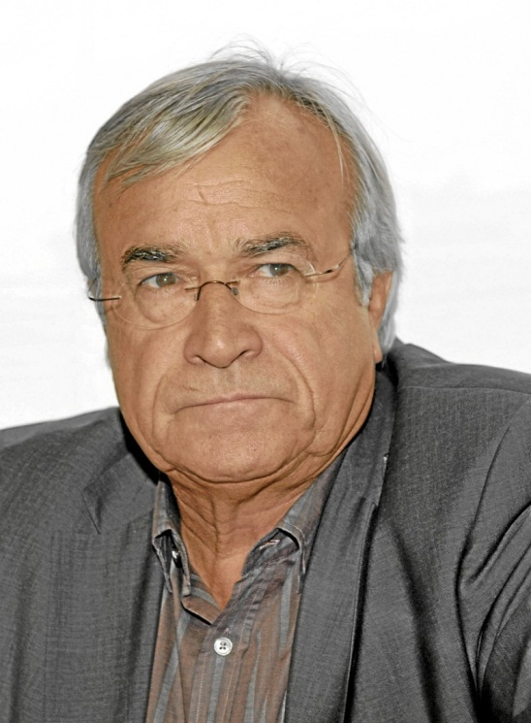



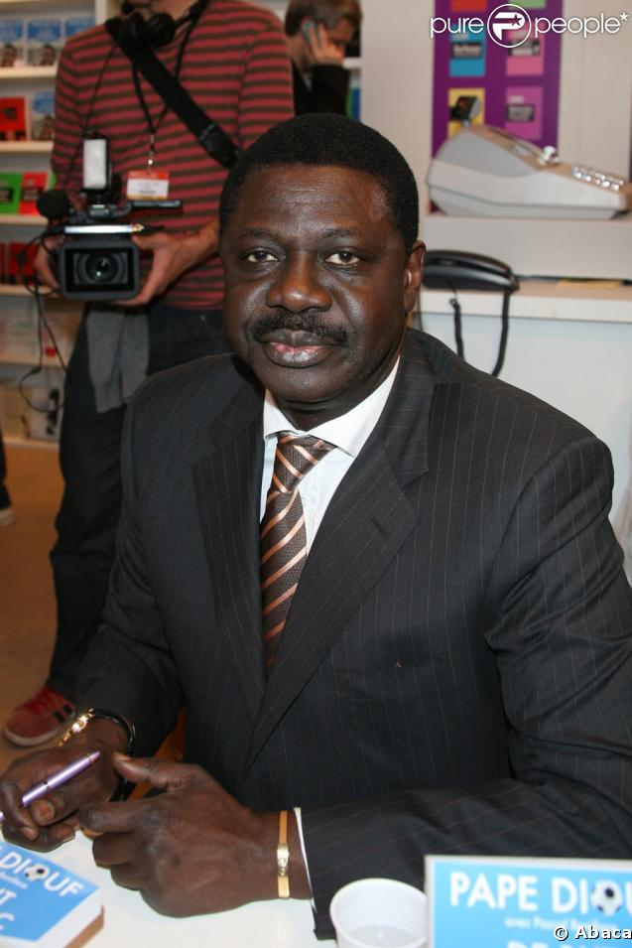
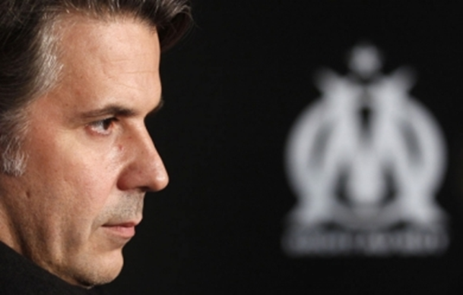

Slide 8

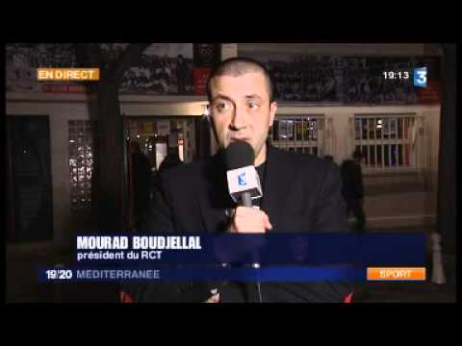
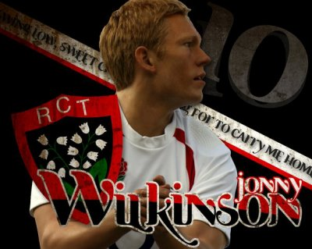

Slide 9
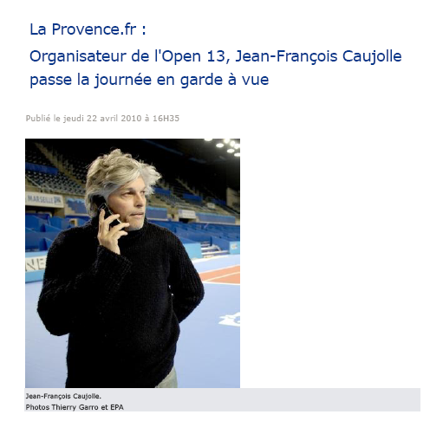

Slide 10
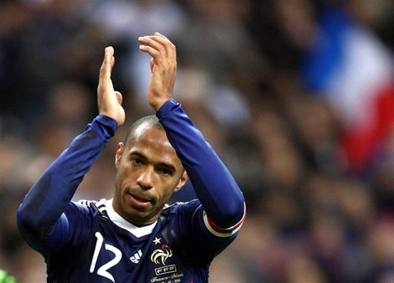
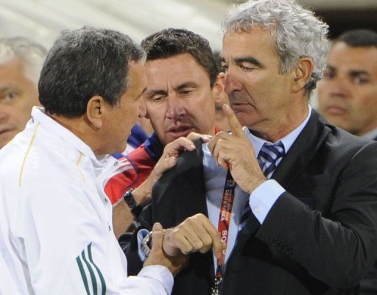
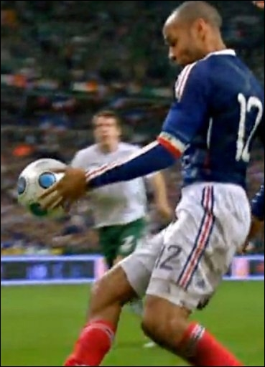
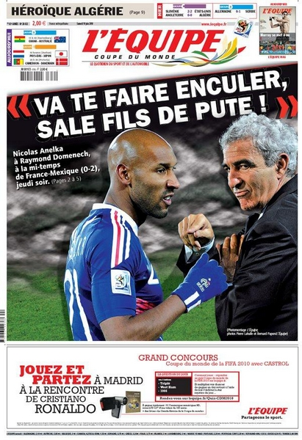
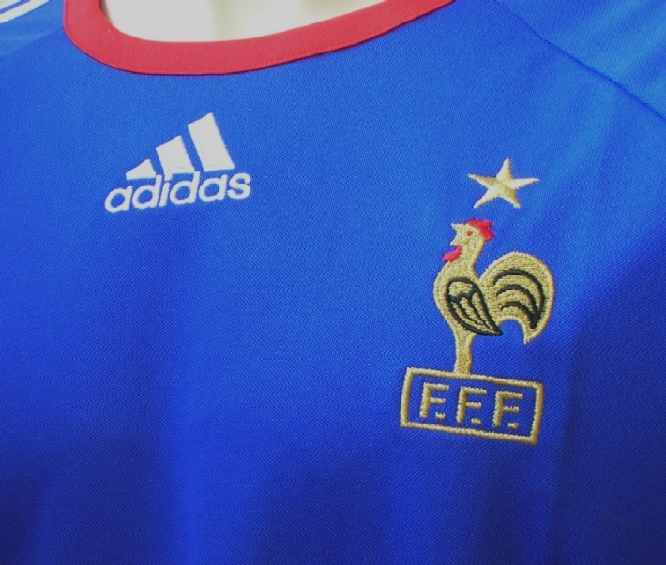
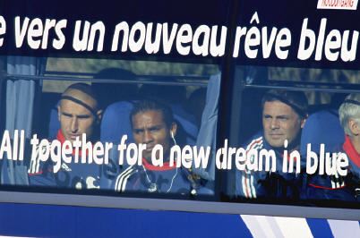
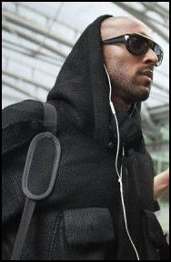


Slide 11
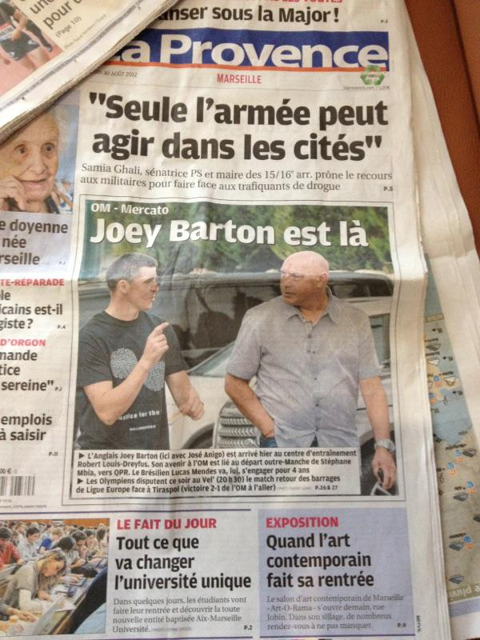
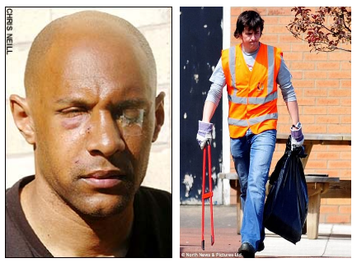
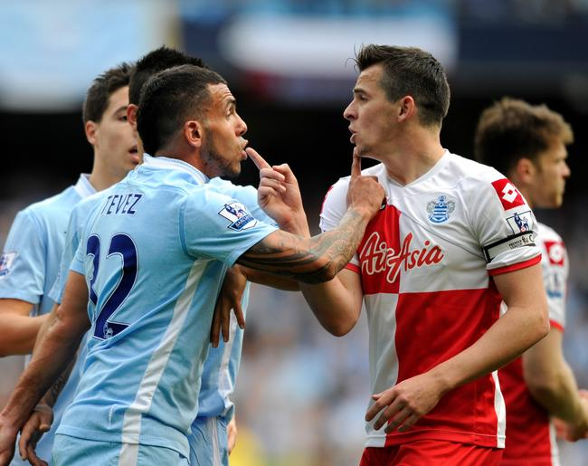

Slide 12
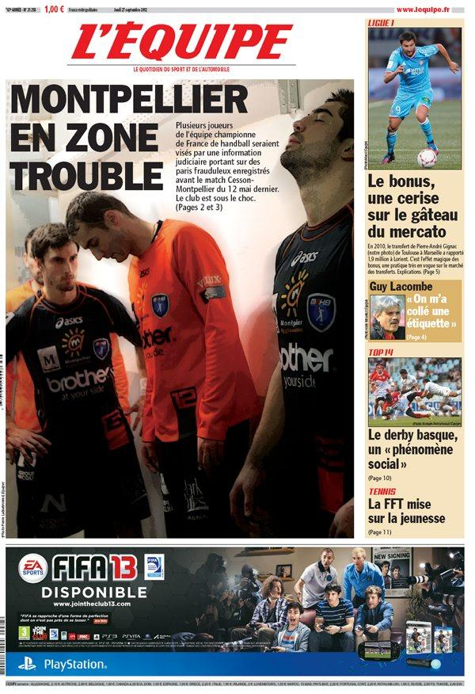
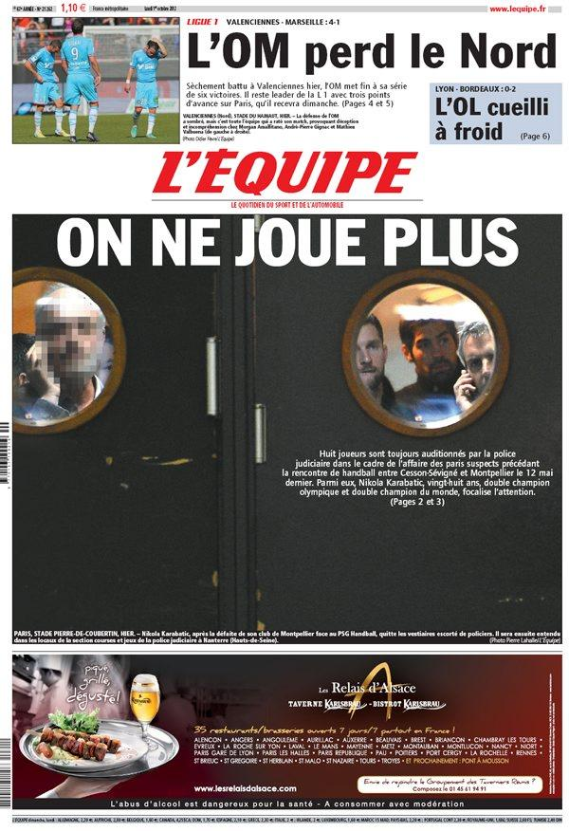

Slide 13
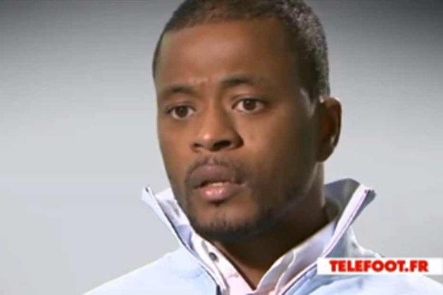

Slide 14
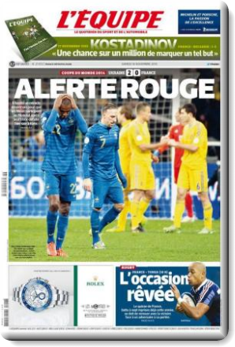
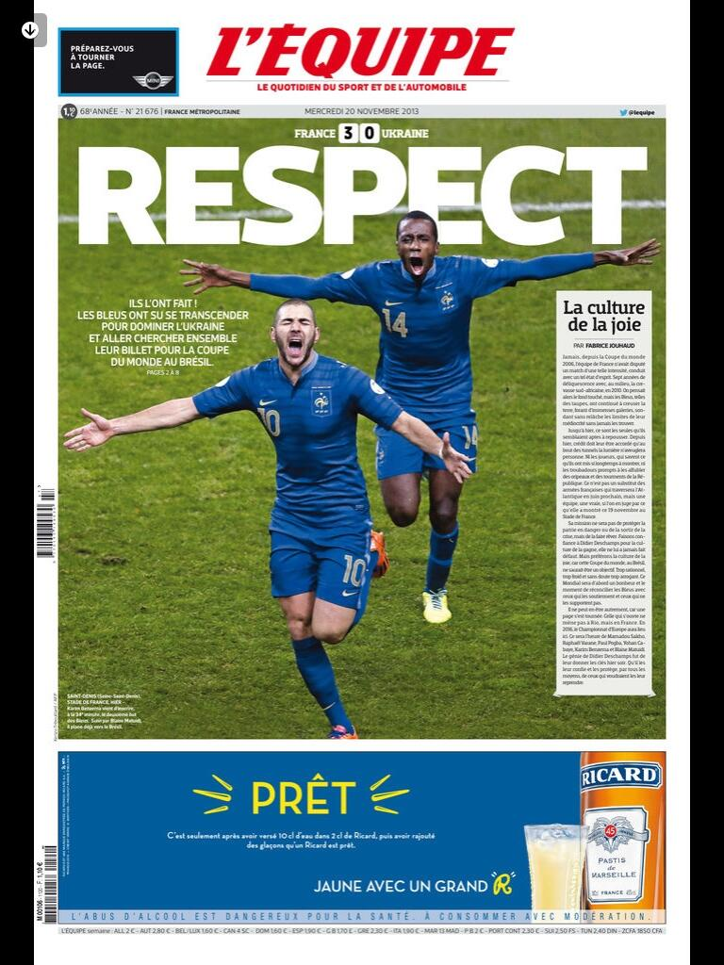

Slide 15
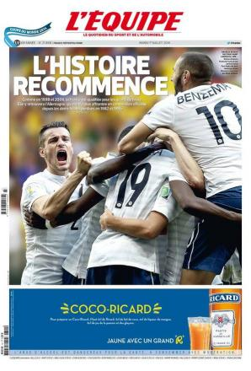
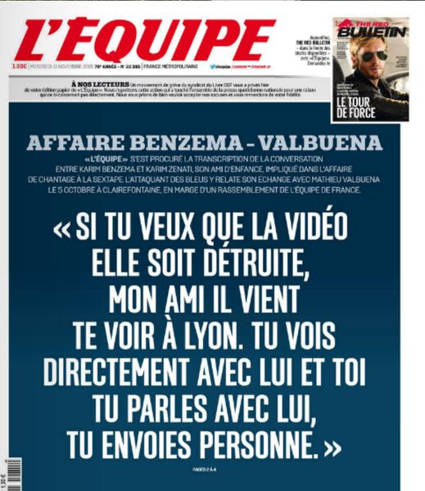

Slide 16
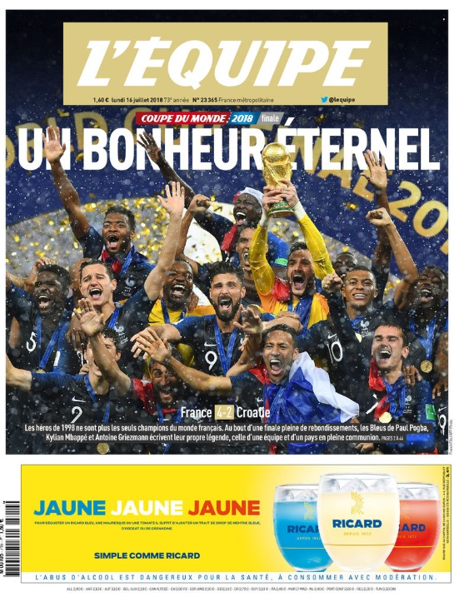

Slide 17
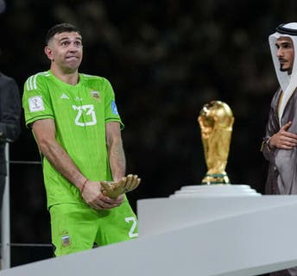
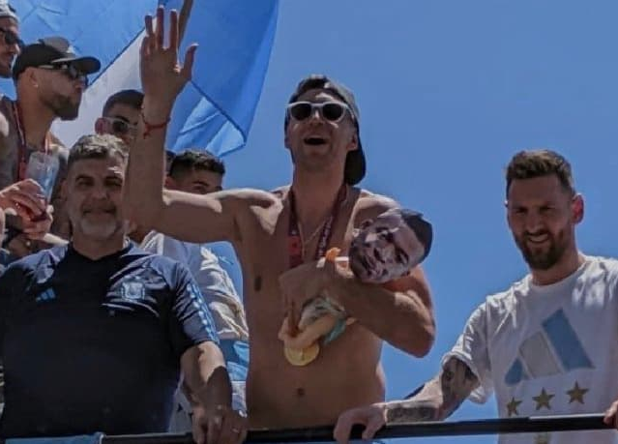
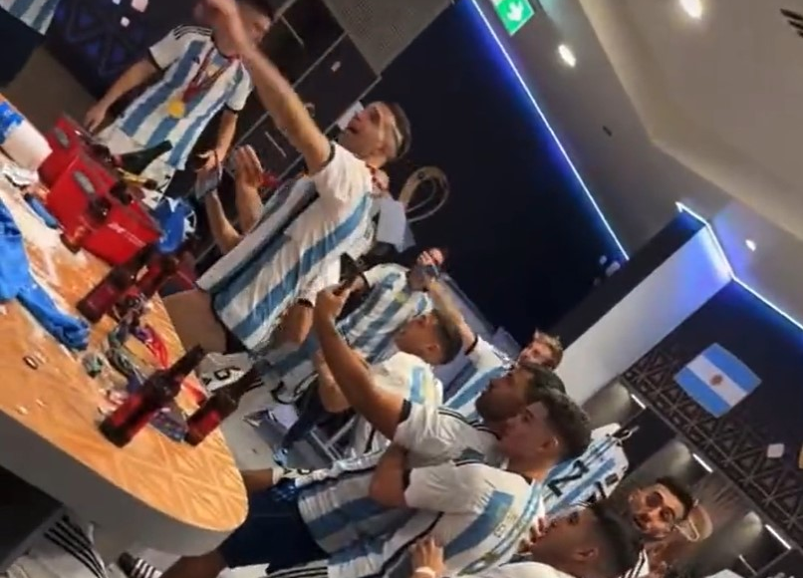

Slide 18
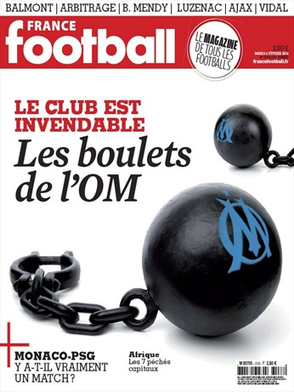
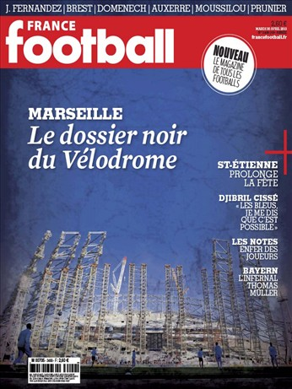
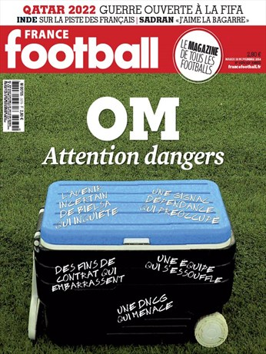
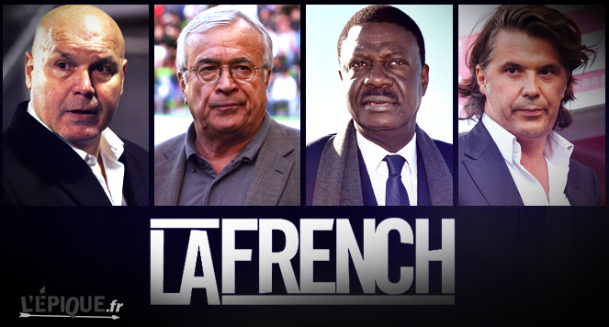
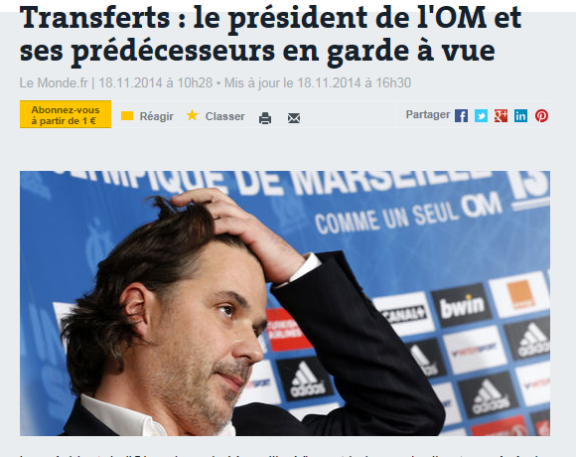

Slide 19





Slide 20





Slide 21




Slide 22


Slide 23





Slide 24




Slide 25



Slide 26





Slide 27


Slide 28


Slide 29


Slide 30





Slide 31



Slide 32





Slide 33




Slide 34





Slide 35






Slide 45
Reputation = key resource ?
Value
Rareness
REPUTATION =>
Sustained Competitive
Advantage
Organization
Inimitability
Non-Substitutability

Slide 46

Reputation = key asset but difficult to control
Media exposition
Being Good or Being Known (Business School cases !)
Notoriety / Reputation
Actors Reputation (athletes, coach, Managers) : differences between local & major / hallmark & mega events

Slide 47
Expressive organizations ?
Services
Hospitality : B to C – B to B
In the context of Entertainment and sport : organizations (clubs & events) are expressive
Sports organizations compete based on their ability to express who they are and what they stand for.
Emotional and symbolic expressiveness is becoming part of the experience of doing business…
Expressiveness : strategy must serve all stakeholders and that means employees as well as customers, shareholders, creditors, suppliers, local or special communities, and the media.
Product
Sport competition
Experience
Entertainment
Expressiveness implementation :
Very difficult !

Slide 48
Linking Identity, Reputation and Expressive Organization (club or event) Brand

Slide 49
Identity (Fombrun, 1996)
Corporate identity describes the set of values and principles employees (and players) managers associate with a company.
Corporate identity derives from a company’s experiences since its founding, its cumulative record of successes and failures : very important for sports organizations !

Slide 50
Corporate image (Fombrun, 1996)
A corporate image accurately mirrors the company’s identity
The image is often distorted :
  i) as the company tries to manipulate its public through advertising and other forms of self-presentation
or
  ii) rumors develop from the unofficial statements of employees to peers, analysts, and reporters.

Slide 51

Reputation (Fombrun, 1996)
“Reputation” is the general estimation in which one is held by the public (American Heritage Dictionary’s)
A corporate reputation represents the “net” affective or emotional reaction – good or bad, weak or strong – of customers, investors, employees, and the general public to the company’s name.

Slide 53

What’s in a name ?
Sports organizations names are very strategic :
  Cities
  Objects, animals, groups, symbols, features : Colts – Bulls – Celtics – Patriots - Indians…
  Sponsors : BNP Paribas, H Cup , Evian Masters, Andros Trophy…
Moreover : in a market society like ours, it’s clear that names – and the reputations we associate with them – have economic value :
  Michael Jordan : continued to bring in top endorsement income from companies like Nike, Hanes, General Mills and Quaker Oaks (estimated $ 13 million a year)
  Jack Nicklaus, Arnold palmer (golf), Joe Montana, Wayne Gretzky, Andre Agassi, Zinedine Zidane…

Slide 54

Reputation and media
Difficulty to control inside de Communication Mix (TV, Radio, Internet, Press, posting) !
For sports organizations : you can develop your own information for the public : official website (very important !) and sometimes own press (production) or TV

Slide 55
Linking Identity – Name – Image – Reputation (Fombrun, 1996)
Corporate Identity
Names
Self-Presentations
Customer
Image
Community
Image
Investor
Image
Employee
Image
Corporate Reputation

Slide 56

Branding !
A brand is a name, term, sign, symbol, or design or combination of them which is intended to identify the goods and services of one seller or group of sellers and to differentiate them from those of competitors (Kotler, 1991).
Branding → Differentiation
But for a sport organization :
  Intangible good (except the ticket)
  Athlete brand VS team or event brand = your product is difficult to control in the long term !
  Identity ?
  Tangible element = stadium !

Slide 57

6 classical elements to define a Brand
Attributes : proper characteristics linking to the brand (seller promises…)
  Mercedes : solidity, expensive, durability… “Unlike any other Mercedes-Benz. The Future of the Automobile
  Engineered to move the human spirit”
  Difficult for a club or an event !
Customers benefits : emotional, functional advantages associated to the brand.
  Mercedes : durability (I can use my car for a long time) – Solidity (I am in safety in my car)
  Difficult for a club or an event !

Slide 58

6 classical elements to define a Brand
Values : the brand express the firm culture and its history.
  Mercedes : performance, prestige, tradition…
  OK for a club or an event
Culture : the brand express a cultural linkage
  Mercedes is German (as Bosh, Miel…) Fiat from Italia, Renault from France…
  OK for a club or an event

Slide 59

6 classical elements to define a Brand
Personality : A brand is a person ? An animal (Mascot role in US) ? An object (stadium, trophy (Stanley cup) ?)
  Mercedes is more a CEO, a lion or a prestigious palace…
  It’s possible to construct that for a club or an event (US franchises marketing strategy)
Core targets
  Mercedes : CEO (50 years)
  Difficult but tribal or fans segmentation are useful…

Slide 60

Brand image
Brand image is defined as perceptions about a brand as reflected by the brand associations held in consumer memory (Keller, 1993)
In marketing domain : reputation ⬄ brand image
But club or event = brand ?

Slide 61


Brand construction and control in a very expressive organization…
Place, City, Country
Club or Event
Brand
Public, Fans, Communities
Athletes brand
Sponsors brand

Slide 62

What are 'reputations'?
Reputations are perceptions people have of an individual or organization, be it a company, a city, or a country. These perceptions form as a result of the personal experiences that people have, the messaging they see and hear, and the third party conversations they are exposed to.

Slide 64
What's the difference between 'brand' and 'reputation'?
A brand is a promise. Making a relevant and distinctive promise helps to build a brand.
A corporate reputation is built by fulfilling that promise to stakeholders. A company therefore owns its brand, but stakeholders own its reputation.

Slide 65
Brand construction is difficult in this context…
But :
Reputation construction and control can stimulate and develop your commercial brand !

Slide 66
Rethinking your communication !
COMMUNICATION
STRATEGY
REPUTATION
BRAND
WHY ?
HOW ?

Slide 67
Corporate Reputations can be measured and managed
Reputation management
The Reputation Quotient

Slide 68
Reputation management
(Fombrun, 1996)
Visibility
REPUTATION
Authenticity
Transparency
Consistency
Distinctiveness

Slide 69




Slide 70








Slide 71


Slide 72
Communicates Appropriately with Everyone…
Carries out Visible Stakeholder Initiatives…
Participates in Worthy Social Initiatives…
Visible
Is Recognizably Different...
Makes a Distinctive Promise…
Stands out…
Distinctive
Walks the Talk…
Is Identifiable in its Communications…
Conveys a Consistent Message…
Expressiveness
Quotient
Consistent
States Its Beliefs Openly…
Discloses Information in a Timely Fashion…
Shows Responsiveness to all Stakeholders…
Transparent
Is Credible and Sincere in Its Communications…
Is Honest…
Is Appealing to deal with…
Authentic
The expressiveness quotient (Fombrun and Van Riel, 2004)

Slide 73
5 principles Reputation Management | Roger Federer 1st Intemporal brand | Rafael Nadal 2nd Intemporal player | Novak Djokovic 3th Intemporal winner
Be visible | Titles, Sport & Business Centric, Sponsorship, sustainability | Titles, Sport centric, Sponsorship, sustainability | Titles, sport & politic centric, sustainability
Be authentic | Staff, Coach, Nadal Rivalry & Friendship, Fundation | Family, Coach, Spain Hardworking, Federer Rivalry & Friendship | Serbia, Family, Staff, Hardworking, Fundation
Be consistent | Be offensive based on talent becoming skills | Be dominant physically using his left-hand | Be a total player able to be a « destructive creator » for all players skills and surfaces
Be distinctive | Style, 8 Wimbledon, global fan oriented | Fighting Spirit, 14 Roland Garros, global fan oriented | 23 slams, 10 Australian Open, Mentalist & total player, brand communities oriented
Be transparent | Clear on his carreer evolution and choices to create the best personal brand ever in tennis and in sport | On his carreer and his preparation to be ready to win. On his academy and future | Not on tennis & politics choices – not on his lack of brand power versus nadal & federer

Slide 74




Reputation management in action !
You have to
  Create
  Protect
  Repair
your reputation
Indeed bad reputation can affect brand development… (OM)

Slide 75


But don’t forget your resources reputation !
Sponsors Brand
PR and CEO celebrity
Local or cultural identity
Hospitality (stadium)
Your history !
“Being Known” => not always “Being Good”
(Stade Français or NY Knicks cases…)

Slide 76
Reputations are magnets : they help a company attract resources
(Fombrun and Van Riel, 2004)
Employees
Make jobs more attractive
& motivate hard work
Customers
Encourages repeat purchase
& builds market share
REPUTATION
Investors
Lowers capital costs
& attracts next investment
Media Journalists
Generates more favorable
Press coverage
Financial Analysts
Affects content of coverage
And recommendations

Slide 77
Measure : reputation Quotient (6 dimensions and 20 attributes)
(Fombrun and Van Riel, 2004)
7-pt scale
7 = describes very well
1=oes not describe well
Social Responsibility
Supports Good Causes
Environmental Responsibility
Community Responsibility
Emotional Appeal
Feel good about
Admire and Respect
Trust
Vision & Leadership
Market Opportunities
Excellent Leadership
Clear Vision for the future
Products & Services
High Quality
Innovative
Value for money
Stands Behind
REPUTATION
Financial Performance
Record of profitability
Low Risk investment
Growth Prospects
Outperforms Competitors
Workplace Environment
Good Place to work
Good employees
Rewards Employees Fairly

Slide 81


Slide 82
Transfer in the context of sports organizations
7-pt scale
7 = describes very well
1=oes not describe well
Social Responsibility
Supports Good Causes (Ethic)
Environmental Responsibility
Community Responsibility
(fans)
Emotional Appeal
Admire and Respect sport
& athletes
Passion & hedonism
Comsumer
experience
Vision & Leadership
Market Opportunities
Excellent Leadership
Clear Vision for the future
CEO celebrity
Products & Services
High Quality of sport show
& experience
Innovative
Value for money (tickets)
Hospitality
REPUTATION
Financial Performance
Record of profitability
Low Risk investment
Growth Prospects
Outperforms Competitors
Media returns - affluence Stakeholders performance
Workplace Environment
Good Place to work
Good employees
Volunteers management

Slide 83






Slide 84


Slide 85



Slide 86



Slide 87


Slide 88


Slide 89


Slide 90



Slide 91


Slide 92


Slide 93


Slide 94



Slide 95


Slide 96
Remarks…
Communication : fit with the actuality ?
Merchandising and memory ?
Identity and Reputation : places – french inheritance
The athlete is known because of the event
Difficulty to target : popular event
“Caravane” : sponsoring unicity
Event director : charisma and celebrity : Jean-Marie Leblanc → Christian Prudhomme

Slide 97
Questions ?
How do you manage an exceptional (mega) event ?
Development ? Innovation ?
Culture ?
Answers ?
You have to maintain your level !
Reputation management (creation – protection (doping) – repair) : pivotal resource !
If you can : transform your event reputation into a brand
+
External control (sponsors – media – institutions – communities…)

Slide 98





Slide 99





Reputation ⇨ Brand
Roland Garros

Slide 100



Slide 101



Slide 102



Slide 103



Slide 104



Slide 105



Slide 106



Slide 107


Slide 108


Slide 109


Slide 110


Slide 111







Top positioning among sport events
The yearly survey led by the IFOP demonstrates the outstanding popularity and extremely positive perception of Roland-Garros
84%
TOP VALUES
4TH
Of awareness among tennis fans**
Associated with Roland-Garros*
Most famous sport event***
INTERNATIONAL
84
PRESTIGIOUS
47
35
81
76
62
HIGH-LEVEL
17
14

Slide 112




















First in class global TV coverage
Europe
France
until 2020*
*France
as of 2021
FTA
USA - Canada
Middle East
China
Japan
Latin America
Africa
India
SE Asia
Brazil
Australia & NZ
WW - betting

Slide 113
5 principles Reputation Management | For Roland Garros
Be visible | Media choice (France TV?) Stadium evolution
Be authentic | Traditional identity History respect (museum)
Etre consistent | Sport advantage Sponsors control (colors on the court)
Etre distinctive | Sport exception : Grand Slam Clay courts Physical impacts
Etre transparent | Communication (ex players) FFT is an association Politic ?

Slide 114
Physical
Resources
Partner
Resources
Relational
Resources
Corporate
Reputation
Reputational
Resources
Sport
Reputation
Protection
Exploitation
Learning
Forecasting
Organisational
Capabilities

Slide 115

Cascade of assets
Reputational
Resources
« axes »
Learning
Organizational
Capabilities
Partnership
Resources
Physical
Resources
Relational
Resources
Stock of resources
Dynamic Capabilities
« Bricolage »

Slide 116
Jean-Claude Blanc : resources management strategist…
TV Rights
€32 million
Public Relations
€31 million
Sponoring
€25.5 million
Ticketing
€21 million
Equilibrium « Resource-Based » (2001-2006)
No Resources Dependency
+
External control of the environment
= rents optimization (most important in France)

Slide 118



And Now ?

Slide 119
Reputational business model and external control of your stakeholders sharing resources
Connexion with Fans = medias
Private Sponsors
Public sponors
Sports Institutions
Reputation
Club / event
Organization
Athletes
Management
Reputational Business Model
Suppliers
Fans
Media
Media plat-form = Entertainement
Services for fans

Slide 120
Reputational → Cultural FRM Business Model
CRM
Activation
B to B
Athletes
Management
Parnerships
BRAND
Physical Resources (Stadium)
Reputation
FANS
Entertainment Production
Ticketing & CRM
Social Capital
PR infrastructure development
Resources Basis
Direct impact
Deployment
Indirect impact
Core Competences

Slide 122





Slide 123
How to protect their reputation ?
With reputation of top management affected !

Slide 125

Sustaibable Assets strategic management
Capabilities : Explore – Exploit - Combine
Resources
Partnerships
BRAND
Relational
Reputational
Physical
« The Place to express your brand »
« The Place to leverage and activate »
The Place to Be
« The Place to show the show »
Event (game day)
Brand
Sponsors
Brands
Network
Brand
Stadium
Brand

Slide 126
« Relational » Business Model
CRM
Negociation
resources
SPONSORSHIP
competencies
Offer attractivity
SPONSORSHIP
  PR
  Visibility
  CSR
Media rights
Ticketing
2
1
REPUTATION
SOCIAL
CAPITAL
BRAND
4
7
8
5
3
Sport
Management
Interpersonnal
Networking
PHYSICAL
SUPPORT
6
Hospitality
Management

Slide 127
« Reputational » Business Model
Activation
CRM
resources
SPONSORSHIP
competencies
7
Sport
Management
Offer attractivity
Media Rights
Sponsorship
  Visibility
  PR
  CSR
Ticketing
Commercial
Brand
2
FACILITIES
STADIUM
ARENA
REPUTATION
BRAND
1
6
5
4
3
Ticketing
Entertainment
Brand
Management
SOCIAL
CAPITAL
8
Negociation
Hospitality

Slide 128
Cultural Business Model
Activation
CRM
SPONSORSHIP
Sport
Management
7
Ticketing
Servicing
Offer attractivity
Ticketing & Services
Sponsorship
  CSR
  PR
  Visibility
Media Rights
Commercial brand
3
REPUTATION
FALICITIES
Stadium/Arena
BRAND
2
6
5
1
4
Brand
Management
Fan Relationship
Management
SOCIAL
CAPITAL
resources
8
+
= ASSETS
Hospitality
Negociation
competencies

Slide 129






Sport business life cycle to build a sustainable brand
Relational
Business
Model
+
Reputational
Business
Model
=
Cultural
Business
Model
1.0
2.0
3.0

Slide 130


Asset orchestration refers to the managerial search, selection, and configuration of resources and capabilities.
The term intends to convey that, in an optimal configuration of assets, the whole is more valuable than the sum of the parts.

Slide 131


Managing your « glue resources » to build your social sport brand

Slide 132



Slide 133

Your strategic GOAL !
Building and managing
your global sport ecosystem
where all shareholders and stakeholders
will become your FANS
to create your « CULTURE »
focusing on efficient « glue » assets strategic management

Slide 134


